Slide 1
ECE 445: Brainstorming and Ideation
Nicholas Ratajczyk
Notes:
ECE Main Slide

Slide 2
Overview
What makes a good project?
Brainstorming Techniques
Idea Tree
Post-It Notes
Reverse brainstorming
Activity!

Slide 3
What makes a good engineering project?
A CLEARLY DEFINED PROBLEM
What is the problem?
Who does it affect?
When does it happen?
Where does it happen?
Why does it need to be fixed?

Slide 4
Principles of Brainstorming
Clearly identify your goal
Find a problem
Find a solution to a problem
Write everything down
Maximize quantity
Elaborate
No idea is a bad idea
You never know where something might lead

Slide 5
The Idea Tree
Specific Solution
Specific Solution
Specific Solution
Specific Problem
Specific Problem
Specific Problem
Problem Space

Slide 6
Sticky Note Technique
Specific Solution
Specific Solution
Modify
Modify
Issue/ Challenge
Modify
Issue/ Challenge
Modify
Issue/ Challenge
Modify

Slide 7
Reverse Brainstorming
Make something worse
What would make an existing solution worse?
Work backward to improve the idea
Why does this make the solution worse?
What problems this reverse-solution identify?
Alternatively:
Find a way to break something.
How could you prevent that?

Slide 8
Activity!
Get together in groups according to your number
Grab an easel and some post-it notes
Brainstorm using your favorite techniques
Share with the class:
What is your team’s favorite problem?
What is your team’s favorite solution?
Remember the Cardinal Rule of Brainstorming:
There is no such thing as a bad idea

Slide 9
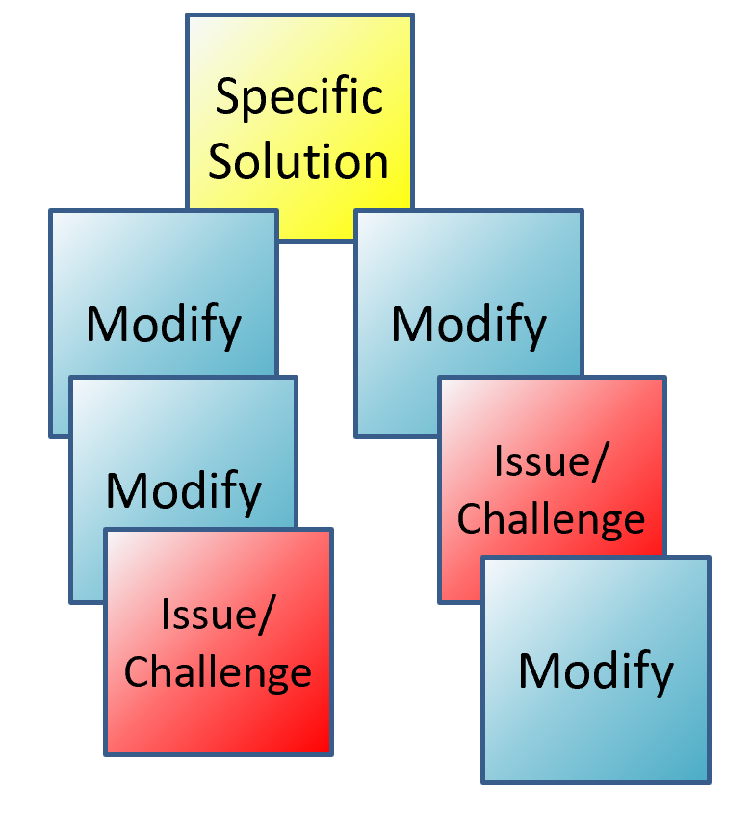
Example Problem Spaces
Assist people with disabilities
Green energy
Music/speaker improvements
Home/kitchen appliances
Sport safety; sport training improvement
Machine safety
Automate daily activities
Improve public spaces
Instrument enhancement, creation?
Pets
Restaurants
Personal hygiene
School/classroom improvements

Slide 10
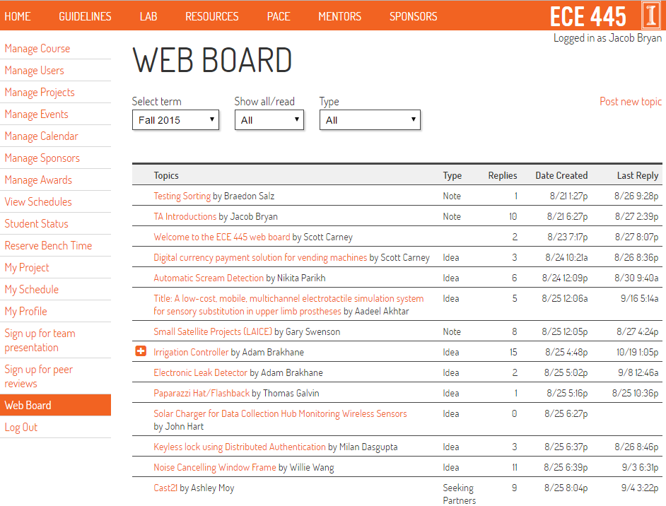
Homework
Post to the Web Board by Thursday (Jan 17th)

