Slide 1
ECE 445: Block Diagram Development
Nicholas Ratajczyk
Notes:
ECE Main Slide

Slide 2
What is a Block Diagram?
A visual representation of the main components of your project
The goal is to outline the construction of your system and show the dependencies between subsystems
Break your system into the main subsystems/modules
Break each subsystem into blocks
Show the connections between components, not subsystems

Slide 3
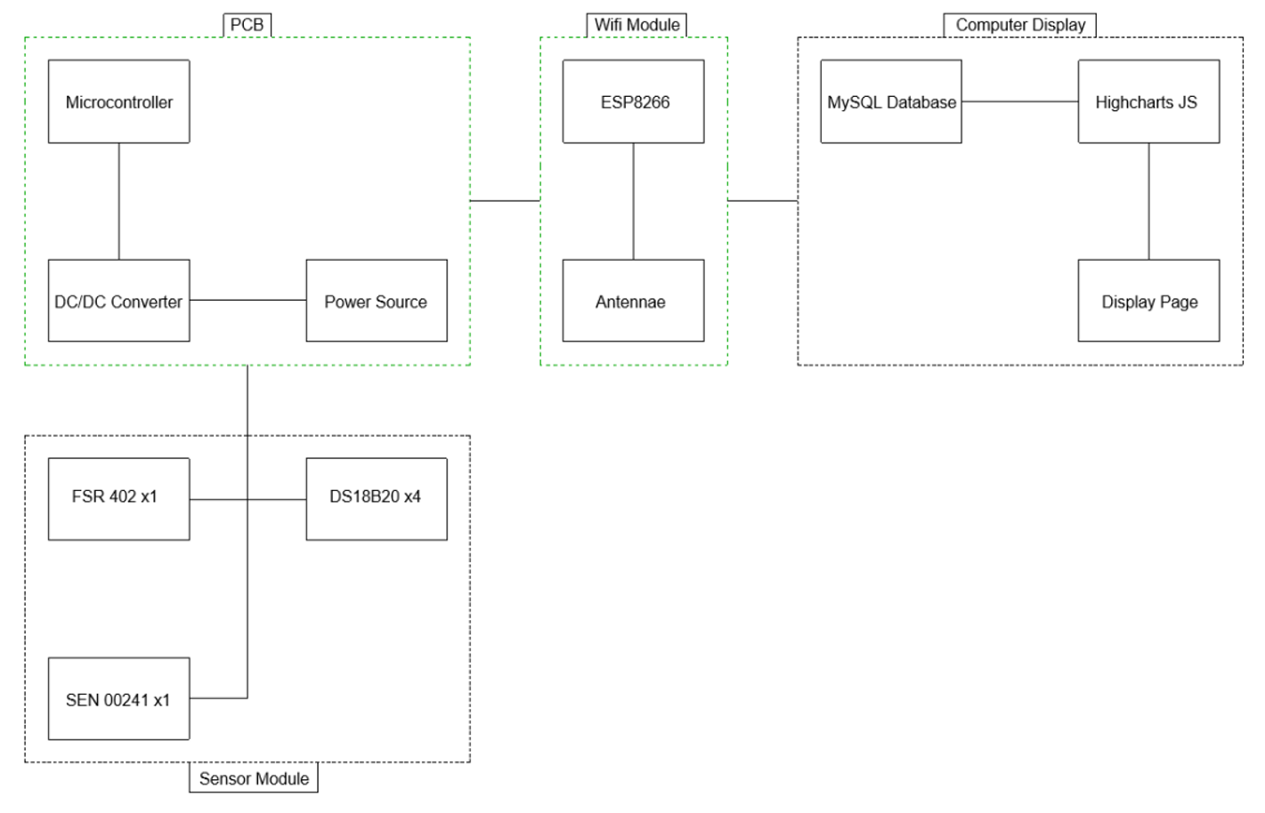
Bad Block Diagram

Slide 4
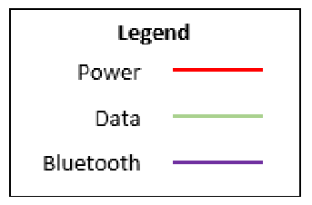
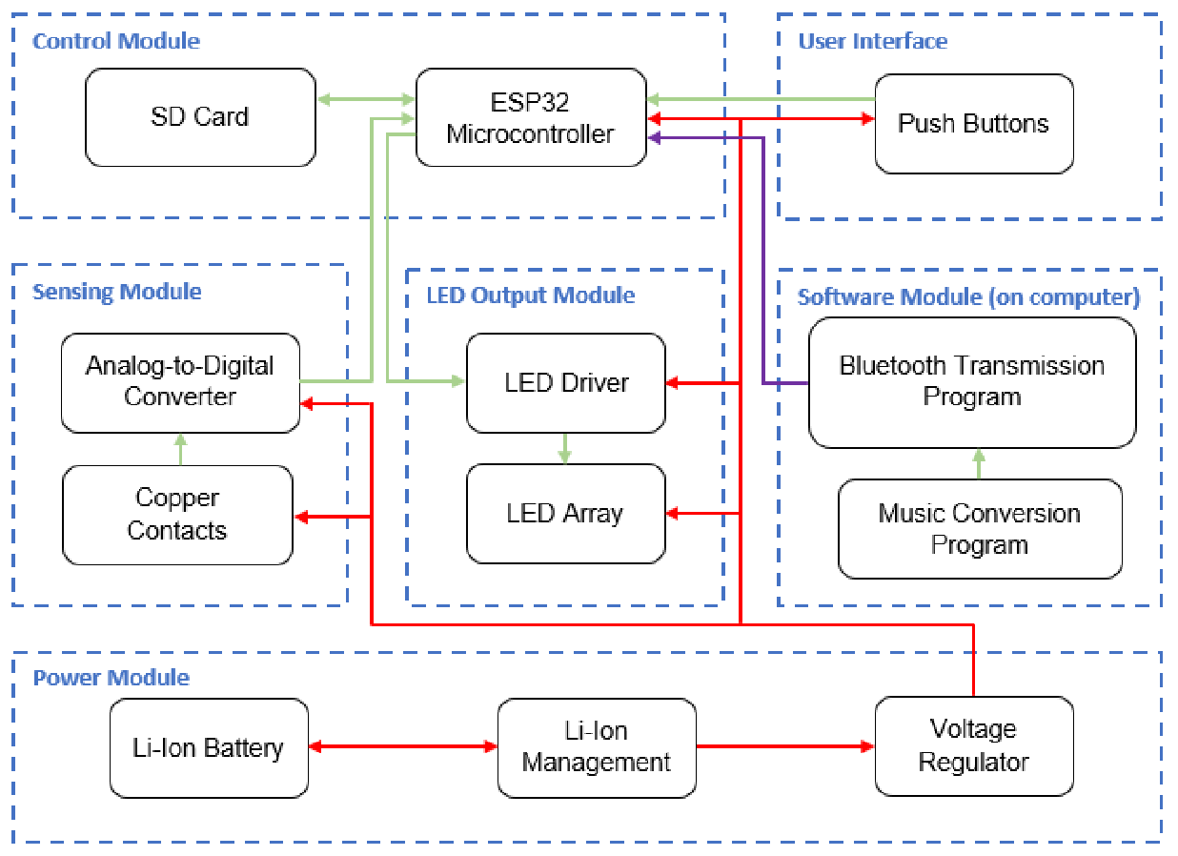
Good Block Diagram

Slide 5
Activity!
Get into groups according to your number
Go to an easel and grab a marker

Slide 6
Problem Statement
In order to maintain a safe environment when working with power tools in a machine shop, only 1 person is allowed to be within a certain area in front of a power tool. Design a system that enforces this rule in order to provide worker safety.
Engineer a solution to
solve this problem
Table with power tool
Safety Zone
Notes:
How would you know how many people are in the zone?
What could you use to count them?
How do you control the machine?
Any interaction with the worker?

Slide 7
Proposed Solution
Ultrasonic and Passive IR sensors to count the number of people in the zone
Relays to control the power to the machine
Current sensor to sense whether the machine is currently on or off.
Lights to indicate the status of the system
Break this solution up into logical subsystems for a block diagram
Notes:
… solution chosen is this
Think about the list of components (not comprehensive)
Functionality, purpose, or proximity
e.g. Power subsystem, WiFi, user interface

Slide 8
System Breakdown
Power Module
Control Module
Sensor Module
Now add individual components/blocks to their logical modules
Notes:
Could have had different names
Take only a couple minutes
Remember, think a combo of funct/proximity

Slide 9
Subsystem Breakdown
Power Module
Tool
Current Sensor
Relays
AC Power
AC-DC Converter
Control Module
Sensor Module
Geometrical Array of PIR Sensors
Microcontroller
Status Lights
Ultrasonic Sensors
Finally, include the interconnections to show how the system works together
Notes:
The most basic breakdown of important components
No resistors or capacitors, no part numbers
Current sensor in power module
Last two steps are usually done at the same time
Don’t forget a legend!

Slide 10
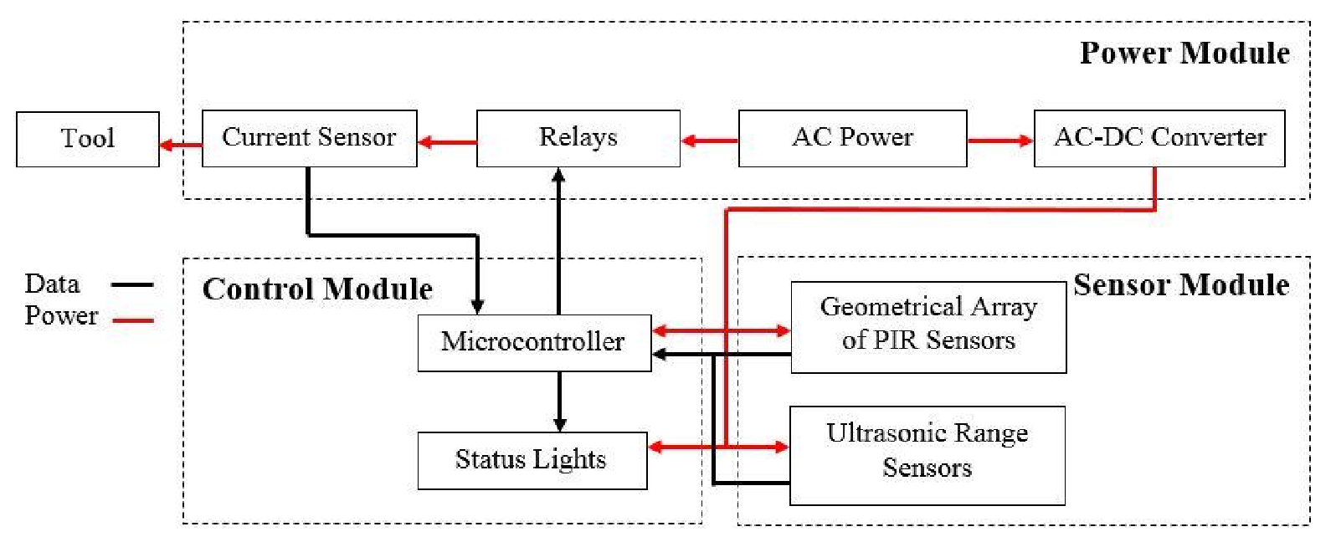
Final Diagram
Notes:
Very modular design
Clear interconnections
Prob statement + block diag = clarity
Lecture in 1002 next 2 weeks

