Slide 1
ECE 445 Project Resources
01/22/2018
Notes:
ECE Main Slide
I less than two weeks your RFAs will be in, your project proposals will be in, and you’ll be diving head first into your design and implementation. At this point you probably feel 1 of 3 things if not all of them: How many people feel a little worried? How many people feel excited? That’s good, we want that one. Lastly, how many people feel alert, ready to go? We are glad you are excited. We are glad you are alert. Here we are in week 3, the last day of the first month. It came quick didn’t it. The semester goes by even faster. So you definitely need to be alert and ready to go. But you shouldn’t be worried. You shouldn’t be worried because you have help. So in the next 15 mins Ill talk about all the help you have.

Slide 2
If you take away only one thing from this…
There are a lot of resources available to help you design and build a successful senior design project.
If you need something and you’re not sure where to find it, ask your TA for help!
Notes:
The number one thing you should take away from this presentation……is that the TAs are your best and first resource for everything. That’s why there’s so many of us and each of has our own expertise, skill set, and perspective that you can take advantage of. Start with your project TA assigned to you, and one of two things will happen…we’ll point you towards where you can find the answer to your question or if we can’t do that we will find someone who can. And when we say use your TA, again start with your project TA, but we are all your Tas, we are all here to help you, and you are welcome to come to any of the TA office hours for help.

Slide 3
Outline
Funding your project
Hardware for your project
Acquiring components
Ordering PCBs
Mechanical elements
Knowledge Resources
Notes:
Here are the three aspects of your project where we can help you. Number 1, I’ll talk about options you have to help you out with funding your project if you’re really looking to take it to market or really interested in going above and beyond with your design and you make a strong application for it. Number 2, we have a number of resources that will allow you to get most of the hardware you need in most cases FOR FREE or NOT THAT MUCH MONEY at all. And finally, number 3, between all of the Tas, the faculty, and the course website we have an endless wealth of knowledge that we can and will share with you if you just ask.

Slide 4
Funding your project
Leung Fund
Up to $2,000 for materials and services
Venturewell E-Team Program
For developing your project beyond this course
www.venturewell.org
Entrepreneurial Resources are on the course website
Notes:
Leung Fund is a grant that either one of you or your entire team can apply for which provides up to $2,000. This will require a little bit of effort as you have to put together documentation for an application most of which you should probably be doing anyway for the course. It’s an email application and there’s more information on the website if you check there.
E-Team or Entreprenuer Team grant. This will provide resources in terms of funding, information, and mentorship for you to take your idea to market after the course. I eblieve it said the deadline for this is May 3rd. This also has a bit of an application process and a very good website which is listed right there and you can visit if you are interested.
IN addition to those two funding sources, there are additional resources in terms of legal resources, as well as connecting you with the MBA program and external companies which are all listed on the website.

Slide 5
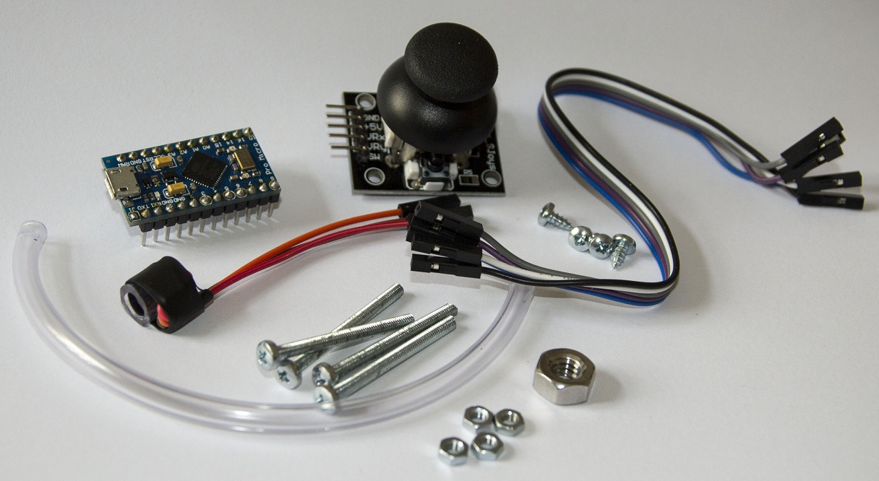
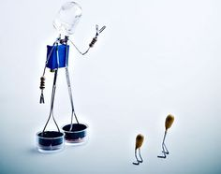
Hardware for your project
Notes:
The main purpose of this course is to build something. Wait no, the main purpose is to build something that works. The majority of the items you will need, we have or can get to you with relative ease.

Slide 6
Getting Parts
There’s a lot available in the lab
Most common resistors, capacitors, etc. (free, no cost) can be found on desk closest to the hallway
Microcontrollers, sensors, dev kits and more can be checked out, must be returned at the end of the semester
Request components in the services shop
Discuss with your TA first if you need anything from service shop
Order Parts through MY.ECE (or the supply center)
Email TA for approval, upper limit of $40 per team
Turn-around time ~1week, don’t wait till last minutes to place orders, as early as possible
Buy your own
Call it the “textbook” cost of the course, or if you need anything urgent/ fast-shipped
Free Samples
Don’t bet your grade on it though…
Notes:
The lab should be your first stop. Casey talked about all of the instruments in the lab, but in addition to that we have a number of parts that you can check out including a number of different sensors, a variety of microcontrollers, development kits, and a whole bunch of stuff that we probably don’t know is in there. If what you need isn’t in lab, the next place to look is the ECE services shop in room 1041. These parts are free to you. If you can’t find what you want in lab and the ECE shop doesn’t have it (which in most cases you probably won’t make it this far) you can order parts through My.ECE store. You have a limit of $40 to spend on parts and you have to go through your project TA to do this. If all else fails, by your own or borrow it from a friend. Finally, free samples? Maybe but good luck with that. Take away here is the majority of what you will need is somewhere in this building, and if you can’t find it you can order it.

Slide 7
What’s available in the lab?
Development boards
MSP430 LaunchPad, Arduino dev, PSoC devkit
ARM eXpress
Software IDE
Energia + CCS for MSP430 (and DSPs)
MPLAB for PICs
PSoC Designer for Cypress PSoC
Notes:
More specifically in the lab we have plenty of development kits and boards including launchpad, arduino, ARM, and cypress boards
We also have a few different options for prototyping sofrware that you can use with these boards and dev kits.

Slide 8
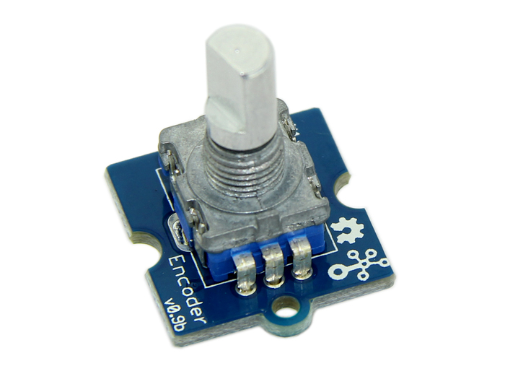
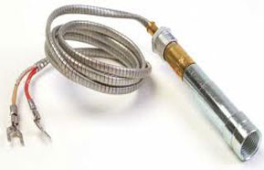
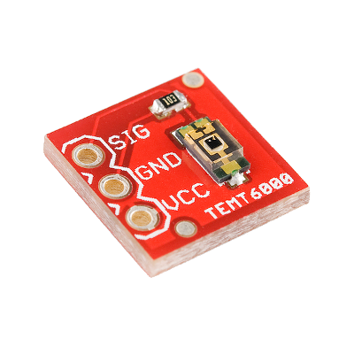
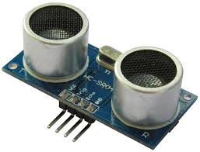
What’s available in the lab?
IR Sensors
RFID + Tags
Camera
FLiR Camera
GPS
Accelerometer/Gyroscope
Fingerprint Scanner
Compass
LIDAR Module
SD Card Reader
Peltier Devices
Body Pulse (heartbeat)
Pressure
Temperature
Altitude
Flow Meter
Microphones
UV/IR/Visible Light
Notes:
What else do we have in lab? This is a small list that includes a number of different sensors including Infared, UV, pressure, temperature. We have accle/gyros, micophones, SD card readers. In short, if you need something there’s a good chance you can find it here or we can find it for you. These slides and this list will be up on the site.

Slide 9
Some advice on choosing parts
Don’t pick your part based on what “some guy said online”
Or because “your friend used this one”
Research what is available and make an informed decision
Power consumption
Sensitivity, resolution, sample rate for sensors
Processor speed, GPIO,
No preference or background?
Consider which series your TA is most familiar with
Notes:
Now just some quick advice when you do go to pickup or buy parts. Start with your own research, from the specs, the manufacturer, and the website. This is your design, you should have a good idea what you need and what your hardware can do from your own research. Online forums are a good resrouce, but being a data guy signal-to-noise ratio is an important concept to me. On those forums you have no idea what’s signal and what’s noise. Be careful with that or advice from a buddy. The bottom line is….do your homework before buying and consider specific power requirements, sensor performance, micro performance, sample rates, the right number and type of pins all these kind of things. Use the data sheets and make sense of them. Ultimately, if you aren’t sure between two choices that seem the same, it can only help us help you better if you do end up using something we have previous experience with.

Slide 10
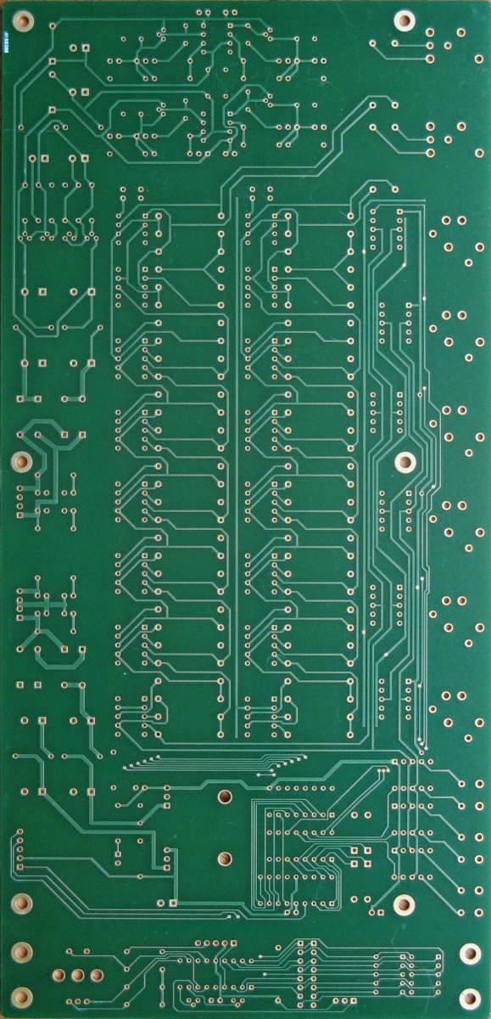
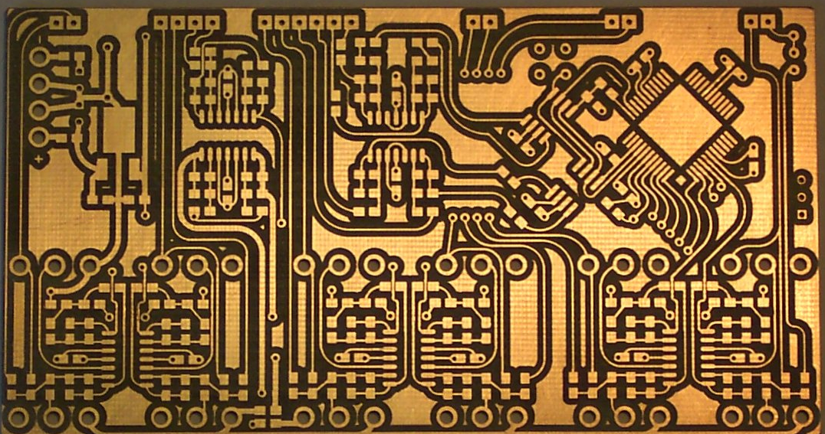
Printed Circuit Boards
Course Order Through PCBway
Read instructions
Costumed 2 layer
Submit to TA, follow the 2 deadlines
Pass the DRC/Audit first!
Batch ordering means no delay tolerated!
Electronic Services Shop
Bare copper, no solder mask, 2-layer
Read the instructions before you order
External vendors
You cover the cost
More advanced board designs (multilayer, silk screening, stencils…)
http://pcbshopper.com/, www.pcbway.com/free
Notes:
Okay, PCBs, printed circuit boards. These can make or break a project and a demonstration so it’s worth your time and effort to pay attenton with these. You can get them done here, there are two deadlines that you have to meet to get them done here for free. The sop can do up to two layers for a PCB and they do not do solder masking for you. If you’re going to use the shop pay attention to two things and make sure you take a look way in advance: know what dates you need to get your designs in by and understand the design rules that you must follow with your PCB. If you violate these layout rules, the shop will not print your board. Also, don’t wait until the last minute.
In addition to the shop, you are free to use outside vendors but you have to pay for it. If you need more advanced services this might be the way to go.
Something that worked well last semester, there is a website PCBway.com that will give you free boards. They have a relatively quick turnaround time, but again if you want to use the shop. It’s here, it’s free, just put in a little effort ahead of time to make sure you can do that effectively.

Slide 11
Electronic CAD Software
Available on the computers in the lab
Schematic entry and PCB design
We have licenses for EAGLE and Cadence
Student version of eagle is free
Get familiar: training workshop by IEEE
Notes:
In terms of designing your PCB, we have Eagle and Cadence on the computers in the lab. You can also download a version of Eagle for free to your own computers. There is an assignment where you will need to use eagle so it might be a good idea to get a jump on this an get eagle going. It should be quick and straightforward. I’ve been asked about other software, if you want to use that with an outside vendor and they accept it go ahead, but remember….the ECE print shop has certain expectations for your PCB design and layout so I would recommend using what they’r expecting if you’re going to go that way.

Slide 12
Mechanical Components
The Machine Shop
Talk to them early if you might need their services
Deadline is in less than 3 weeks
Notes:
Many of you will in fact need housing and given some of the mechanical tolerances we’ve seen in the past you will certainly need the expertise of the machine shop. They are very nice, very knowldgeable machinists (especially if you talk to them early) and early means very soon with the deadline being two weeks from Saturday. If you think your project will need some machining for the housing, please go and talk to them early on. You just need to have a first conversation to give them an idea of what you’ll need. Again, just like the PCBs do not wait until the last minute. 3D printing is good for rapid prototyping, but might not always be the best and cleanest option. If you have questions about where to find the machinist, ask your TAs and we can introduce you.

Slide 13
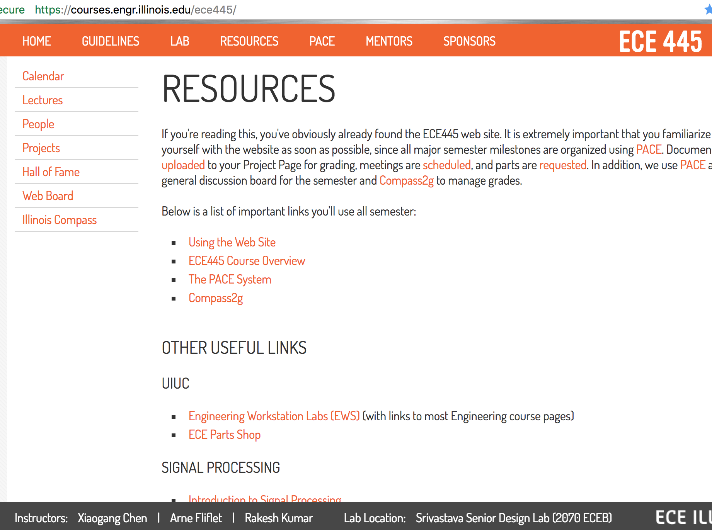
Knowledge Resources
The course website
Has your question been asked before?
Then it’s probably on the site…
Calendar has all the due dates
Notes:
Last but not least, probaly most important….is the extensive knowledge base you have here. In lieue of your TA, if you have a question chances are it’s somewhere on the website. The website probably even know’s things that we don’t including the date and time of the due date of every assignment in the course. Check this regularly and spend some time getting familiar with it. Most likely the question you have, someone in a previous semester had. If that’s true, then it is somewhere on the website. The Tas have been through the website and can help point you to where you need to look for something if you’re lost. So again, still beating the horse, use your TA and use the website and you’ll have just about everything you need. There’s also a number of technical references on the site.

Slide 14
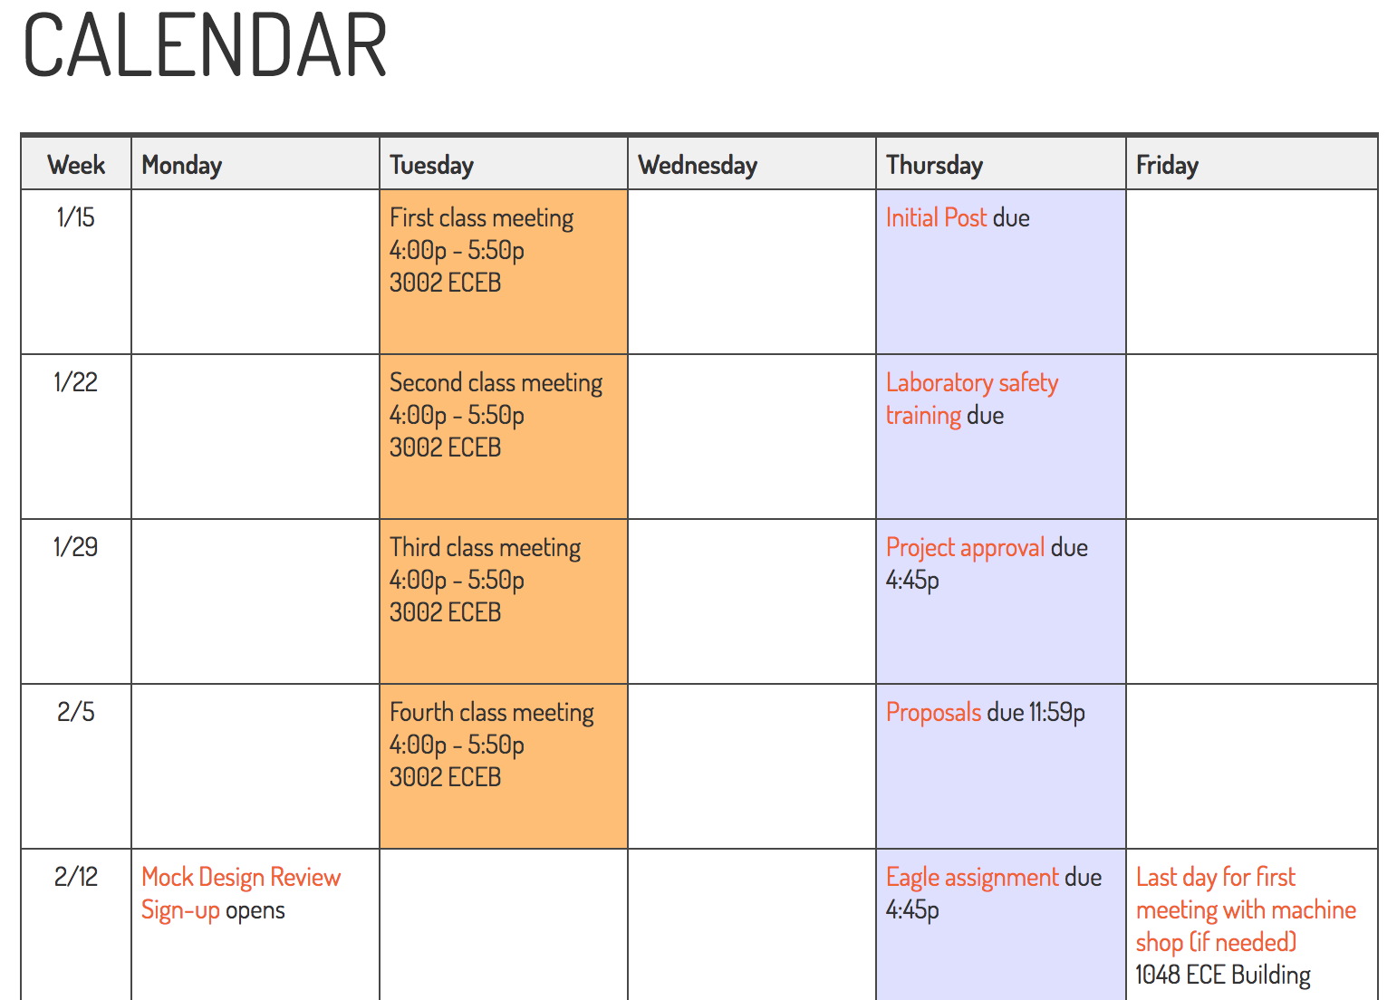
Knowledge Resources
The course website
Has your question been asked before?
Then it’s probably on the site…
Calendar has all the due dates
Notes:
Again, I can’t reiterate this enough. Take a look at the calendar. Get a feel for what’s coming up and whn it’s coming. This semester goes by quicker than you expect and before you know it it is going to be demo day. Check the calendar, it is your second best friend your TA being your first.

Slide 15
Knowledge Resources
The ECE 445 course staff
The TA assigned to your project is your most important resource
A lot of technical breadth between all of us
We’ll help you find who to talk to
Around the department*
Faculty: specific area knowledge
The Electronics Services Shop: help with hardware issues
The Machine Shop: help with mechanical design
* Please talk to your TA first, there are a lot of you
Notes:
In terms of technical content, in addition to documentation, you can just ask us. We all have different areas of knowledge, expertise, and different kinds of experience. If you have a problem, whether it’s technical or not, come see any of us. It’ll probably be to your benefit to start with the TA for your team and if your TA does not know the answer chances are one of the other Tas will and your TA will know which one. You can go to other areas of campus for assistance, but really you should rely on what’s here including starting with your Tas for most questions, seeing the service shop for hardware issues, and seeing the machine shop for any mechanical design questions. If there’s a faculty member here who you’d like to talk to. Just run it by your TA first to get guidance in how to approach or who to speak with.

Slide 16
What should you take away from all this?
Notes:
Last time I promise, if you have been looking out the window at the beautiful day the entire time please listen to this and remember it. This is what you should take away from this lecture……

Slide 17
What should you take away from all this?
There are a lot of resources available to help you design and build a successful senior design project.
If you need something and you’re not sure where to find it, ask your TA for help!
Notes:
This is your portfolio course, we all want you to not just succeed but do incredible things, and the only reason we are here is to help you. Please take advantage of all of these resources. I’m going to add one more takeaway here…..we are not mindreaders either. If you need something, you have to ask us.

Slide 18
Let’s practice…..
ANY QUESTIONS:
Please ask us
Notes:
SO let’s practice asking your Tas for help…..ARE THERE ANY QUESTIONS?

