Slide 1
Project Management Tools
Channing Philbrick (phlbrck2@illinois.edu)
Notes:
ECE Main Slide

Slide 2
What is the most common reason for project failure?

Slide 3
What is the most common reason for project failure?
Bad planning!

Slide 4
Motivation
Things take time
Some tasks depend on other tasks
Fair workload between team members
Engineering projects rely on many external factors
Parts procurement
Lab equipment availability
Scheduling conflicts (midterms, classes, etc.)

Slide 5
In this course…
We require a basic schedule only
However, we suggest using additional management tools
https://courses.engr.illinois.edu/ece445/documents/examples/ExampleDD.pdf

Slide 6
Common Management Tools
Winging it
Stoplight charts
Risk matrices
Gantt charts
Increasing Complexity

Slide 7
Stoplight Charts
Red: A problem exists that cannot be fixed
Critical system design failure
Significant delay in parts procurement
Yellow: A problem exists that can be fixed
Schedule change
Potential design issue
Green: Task is on track
http://clipartbarn.com/stoplight-clipart_20273/

Slide 8
Stoplight Charts
Week | Task | Owner | Notes
2/12/18 | Receive and characterize sensors | Bert | Unexpected manufacturer delay: +4 weeks
2/12/18 | Circuit board population and testing | Ernie | Accidentally shorted power lines during testing – multiple components burnt. Can repopulate with spare parts
2/12/18 | Code debugging | Bert | No debugging necessary; magically worked the first time

Slide 9
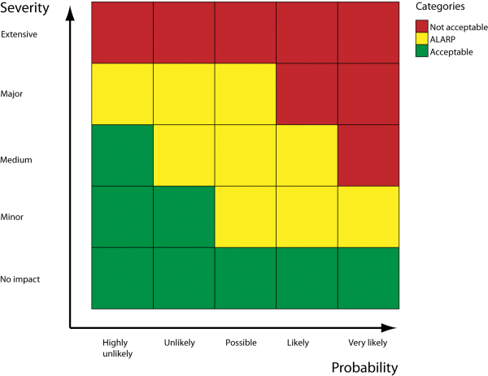
Risk Matrices
Assess impact of potential project failures
Minimize number of high-impact items
Base timeline and major project decisions off of matrix
(ALARP = as low as reasonably practical)
https://www.cgerisk.com/knowledgebase/Risk_matrices

Slide 10
Risk Matrices
Systems integration failure
3
Sensor does not meet specification
Subsystem failure
Severity
2
Capacitor out of tolerance
PCB design flaw
1
1
2
3
Probability

Slide 11
Gantt Charts
Used for developing complex timelines
Based on key inputs
Project milestones
Duration of task
Dependencies on prior tasks
Availability of resources
Availability of personnel
Free software
MS Projects (UIUC Web Store)
Gantter (Google Drive plugin)

Slide 12
Gantt Charts

Slide 13
Gantt Charts
Milestones are fixed dates used to guide project planning
Typically indicate major project deadlines
Help define what needs to happen by when

Slide 14
Gantt Charts
Duration is based on estimation
Estimation of how long a task will take based on available knowledge
It is important to revise estimations as information comes to light
Accurate estimation is best, but when in doubt, air on the side of over-estimation

Slide 15
Gantt Charts
Categories help organize tasks
Break down tasks by subsystem or top-level category
Denoted by brackets on timeline

Slide 16
Gantt Charts
Dependencies define order
Certain tasks cannot occur until other tasks have been completed
Denoted by arrows on chart

Slide 17
Gantt Charts
Resources may also act as dependencies
Individual workers often cannot work on multiple tasks at once
Equipment availability determines if a task can be worked on

Slide 18
Lessons I’ve learned the hard way
Systems integration always takes longer than expected
Build in slip to any schedule – you’ll need it
Do your research – inaccurate time/resource estimation can ruin a project
Nothing is worse than finding out your project won’t work halfway through the semester

Slide 19
Quick Lesson: Bad Research
Goal: Measure altitude-dependent atmospheric density
Implementation
High-altitude balloon
Elastic Backscatter Lidar (uses a laser)
Timeline: 6 weeks
What we missed: FAA licensing for lasers
The problem: Not enough remaining time to get a license
Effects
Could not legally operate payload
Had to re-scope project during Week 4

Slide 20
The Bottom Line – Work as a team
Time and task management is useless without a functional team
Understand how your partners are doing – what is their progress?
Support your teammates emotionally and professionally
Hold yourself accountable
Communicate! If there’s a problem, address it
If you’re struggling, don’t be afraid to ask for help

