Slide 1

Intellectual Property
Michelle Chitambar, PhD
Technology Manager
8 SeptemberFebruary 2020
1002 ECEB
otm.illinois.edu

Slide 2

Intellectual Property (IP)
Intangible “creations of the mind”:
inventions, written works, art, designs, etc.
IP protection is a tool to help extract this value
Patents
Trademark
Trade Secret
Copyright
Mask Works
Know-How
Notes:
Core philosophy underlying IP
We’re used to the concept of things having value that attaches to an individual or company—you can’t just steal my phone or walk out with the desk you’re sitting at. Intellectual property is a related concept for works of the mind—if I write a book and you buy a copy, you can’t just make thousands of copies to sell without my permission. If I design and patent a new type of computer memory, IBM can’t just incorporate my design into their products unless I give them the right to do so.

Slide 3
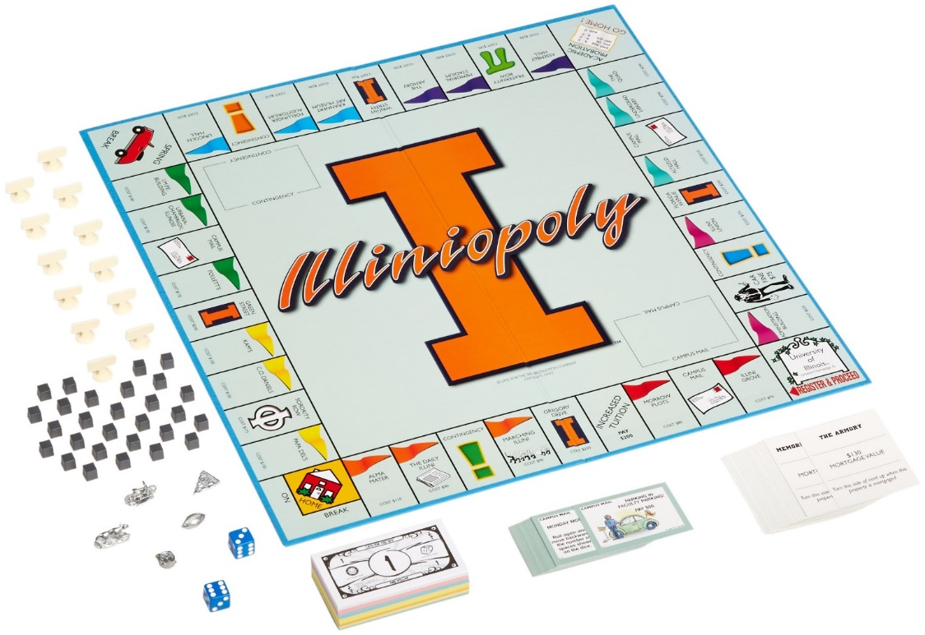
Why “Protect” IP?
Obtain a limited monopoly for IP owners to commercialize their idea
HOWEVER,
IP owners, not governments, enforce IP
Sue infringers
Notes:
Limited in time, geographic region, scope

Slide 4
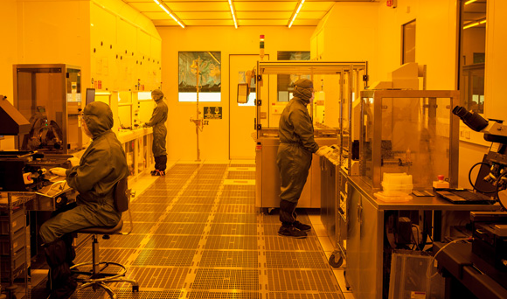
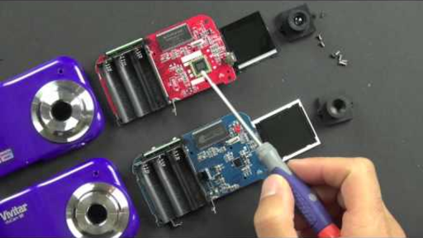
IP Protection as a Public Good
R&D is expensive …copying is not
Without IP protection, many innovations would never be developed
Notes:
Without IP, innovators can’t compete with copycats that have no development expenses. Others, including BigCos with endless access to capital, supply chains, reputation, customers, etc. can just replicate successful products and drive originators out of business.
Avg. cost to develop new drug $2.6B in 2014

Slide 5
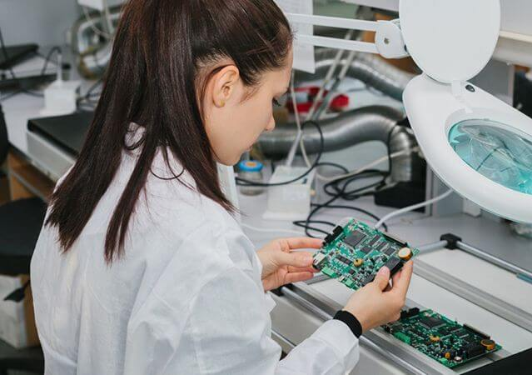
Who Owns IP?
DEFAULT:
Inventors/creators own their own intellectual property
REALITY CHECK:
Most of us sign our IP rights over to employers
UIUC generally only asserts ownership over student work if it was developed using significant university resources.
Ask OTM for determination if unsure
HOWEVER, project sponsors/clients may own IP for projects they offer.
Notes:
As personnel, you will be one of your employers’ largest R&D expenses. Your work may have minimal value if a competitor can freely copy it.
IP is critical for most start-up companies—you don’t have the economy of scale, personnel, relationships, brand recognition, sales channels, etc. of established companies.
Patent agents, tech transfer, law firms, private practice, within large companies…

Slide 6
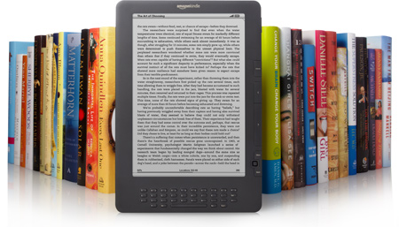
Types of IP: Copyright
Copyright attaches automatically and instantaneously to “expressed form”
  Words, photos, artwork, software code, music, video…
Good practice to include copyright mark to avoid damage limitations
  Copyright 2019 Board of Trustees of the University of Illinois
  © 2019 Michelle Chitambar
Generally expires 70 years after author’s death
  Fair use exceptions
University usually doesn’t own traditional academic works

Slide 7

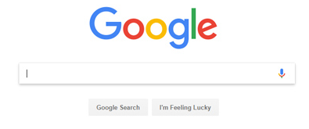
Types of IP: Trade Secrets & Know-How
Keep information out of public domain
“Protect” via confidentiality agreements, etc.
Lasts until is disclosed, reverse-engineered or independently discovered
Notes:
Examples: Coke recipe and Google’s search algorithm

Slide 8
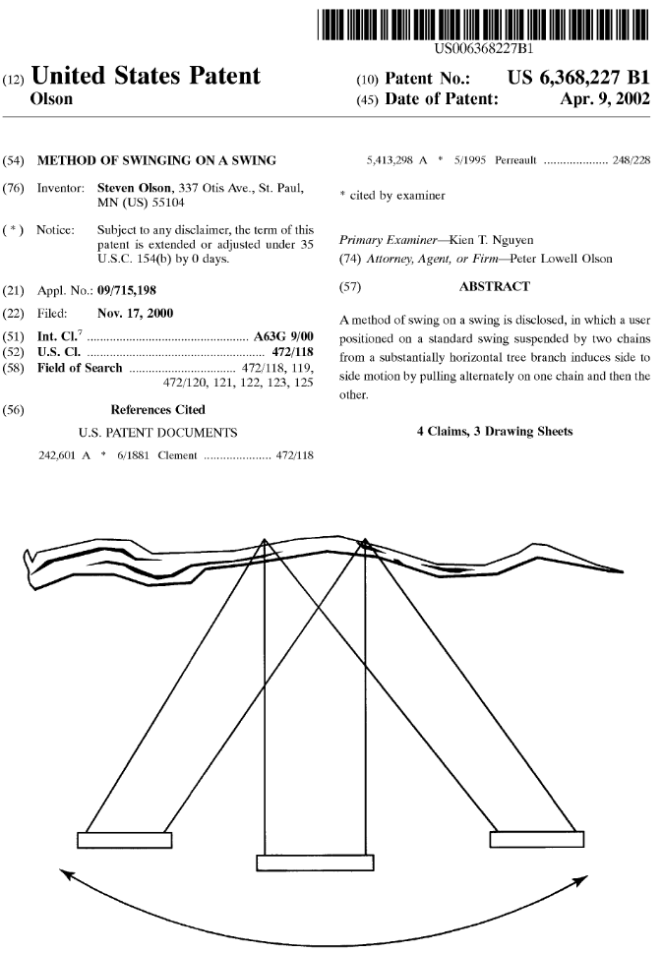
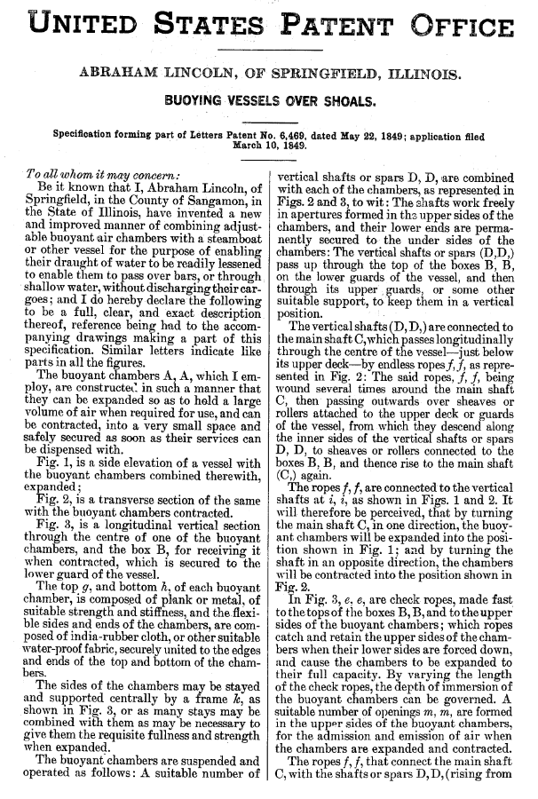
Types of IP: Patents
Last ~20 years
Requirements for patentability:
  Novel
  Non-obvious
Usually cost $25-$35k each
A patent does not mean the invention has academic merit, is valuable, or is even a good idea… just that it’s patentable.

Slide 9
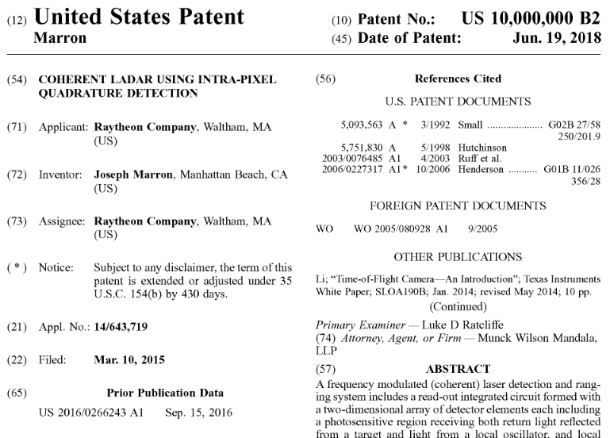
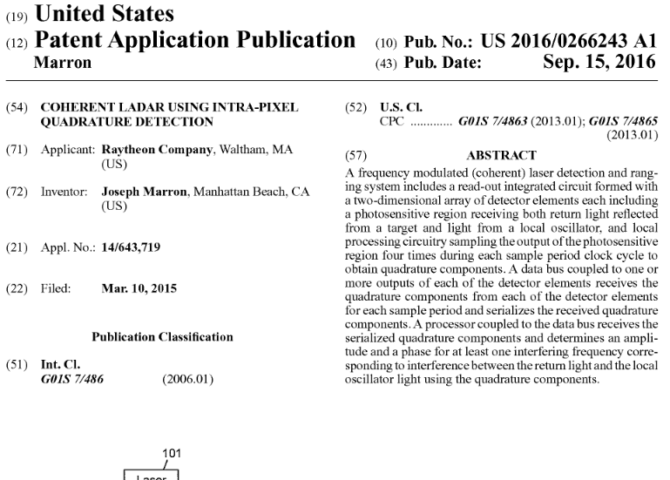
Patent Infringement
To infringe, must meet every limitation of issued claim in patent territory and be using for commercial purposes
  If you aren’t selling, offering as a service, using for commercial purpose, you likely aren’t infringing*
  To infringe on a Country X patent, must make, use, sell, etc. in Country X
  Can’t infringe on a patent application, only an issued patent
  If “A widget comprising A, B, and C” is patented, you have to do A, B, and C to infringe
    Doing A, B, C, and D still infringes; doing A and B doesn’t; doing A, C, and D doesn’t
Notes:
*Madey v. Duke and other cases really narrowed the “research use exception” for patent infringement. If a company or even a university (provided that part of the university’s “business” is research) is making/using a patent as part of their R&D, testing, etc. they are likely infringing even if they never sell or commercialize any product/service that would itself infringe on the patent. For individuals tinkering or satisfying idle curiosity, the research use exception still applies. In practice, it would be very atypical for a patent holder to sue an individual for patent use that wasn’t commercial since lawsuits are expensive, damages would likely be minimal, and the individual likely wouldn’t be able to pay damages anyway (plus, likely would be terrible PR).

Slide 10
Questions?
Michelle Chitambar: mchitamb@illinois.edu
otm@illinois.edu
www.otm.illinois.edu
otm.illinois.edu

Slide 11
Fast Facts
Patents go to first inventor to file
Everything known to public before filing date is “prior art”
Can only protect what you disclose… and can’t add new matter
All patents not made equal—quality matters
  Invest in a good patent agent/attorney
  Patents can be overturned in whole or part
Provisional filings can be a cheap one-year placeholder
Notes:
Many strategies and considerations, so each person, company, or university’s analysis may be different. Nearly all will depend on context.

Slide 12


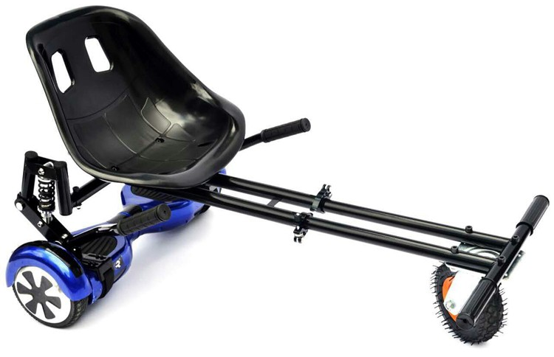
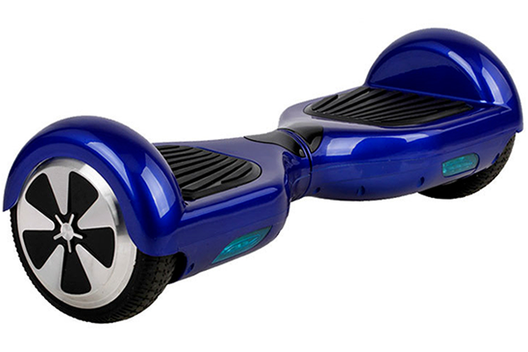
Freedom to Operate
IP rights don’t give you the right to make/use/sell an invention… just the right to exclude others
I need to license Bill Nye’s IP to legally make/use/sell my HoverTrike

Slide 13
When Should You Patent?
It depends
  Is the technology marketable?
  How strong/defensible will claims be (design-arounds)?
  Is 20 years enough time to commercialize a product?
  Is there current interest to license or start a company?
  Do we already have blocking rights? Does someone else?
  How long are technology/market cycles?
Notes:
Many strategies and considerations, so each person, company, or university’s analysis may be different. Nearly all will depend on context.

