Slide 1
Smart Interface Box for Solar Panels
Arijit Banerjee
Date: May 3, 2019

Slide 2
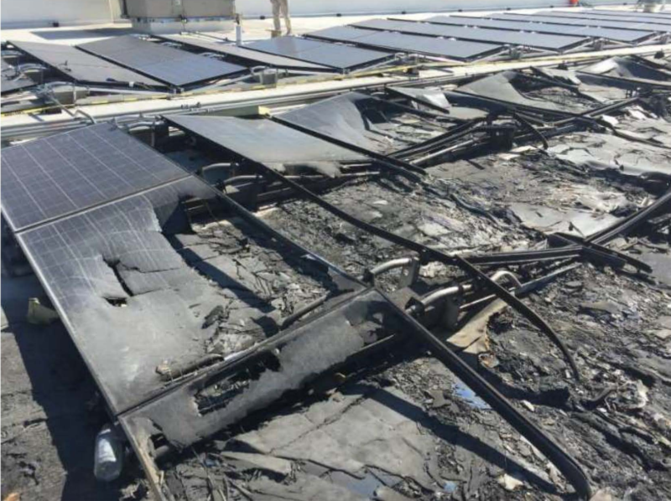
Safety is the number priority
After seven roof fires, Walmart sues Tesla over solar panel flaws
https://arstechnica.com/tech-policy/2019/08/after-seven-roof-fires-walmart-sues-tesla-over-solar-panel-flaws/

Slide 3
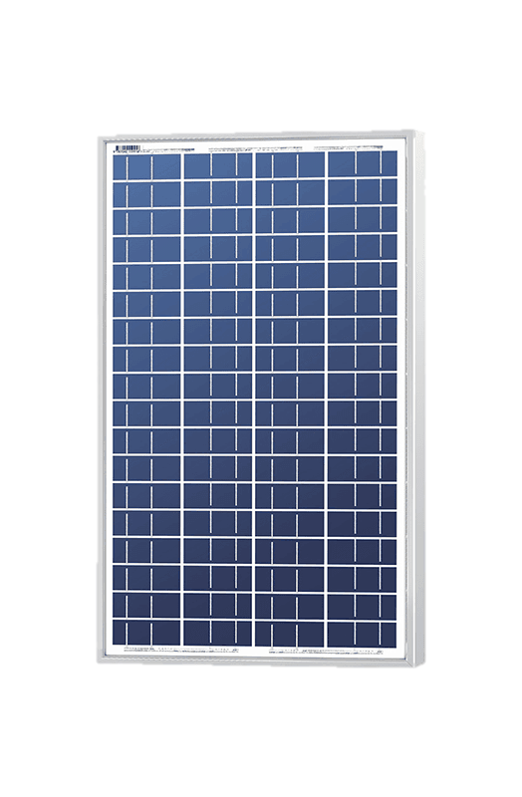
Objective: Design a Smart Interface Box for ECE’s Research Solar Panels
Smart Interface Box
Solar Panel
A
Key Features (combined hardware/software):
Reconfigurable tapping: either DC, CB, or DA gets connected to EF
Protects terminal EF from overvoltage and overcurrent
In-built microprocessor communicates for configuration/measurement over ethernet
The box power is isolated from the 12 V supply
LED Status display
Possibility of manual configuration
Weather-proof enclosure and cable jacks
Option to integrate thermocouples
Shutting down 12 V shuts off the entire operation
E
+
To Distribution Box
32 Cells
B
-
F
64 Cells
Ethernet Communication
C
-
32 Cells
+
From a
12 V power supply
D
-

