Slide 1
ECE 445: Brainstorming and Ideation
David Null
Notes:
ECE Main Slide

Slide 2
Goal – Generate Ideas to Define your Project
What makes a good project?
Brainstorming Techniques
Ideation Activity!

Slide 3
The Core of a Good Engineering Project
A CLEARLY DEFINED IDEA

Slide 4
The Core of a Good Engineering Project
A CLEARLY DEFINED IDEA
What is the problem that you are solving?
What is the problem?
Who does it affect?
When does it happen?
Where does it happen?
Why does it need to be fixed?

Slide 5
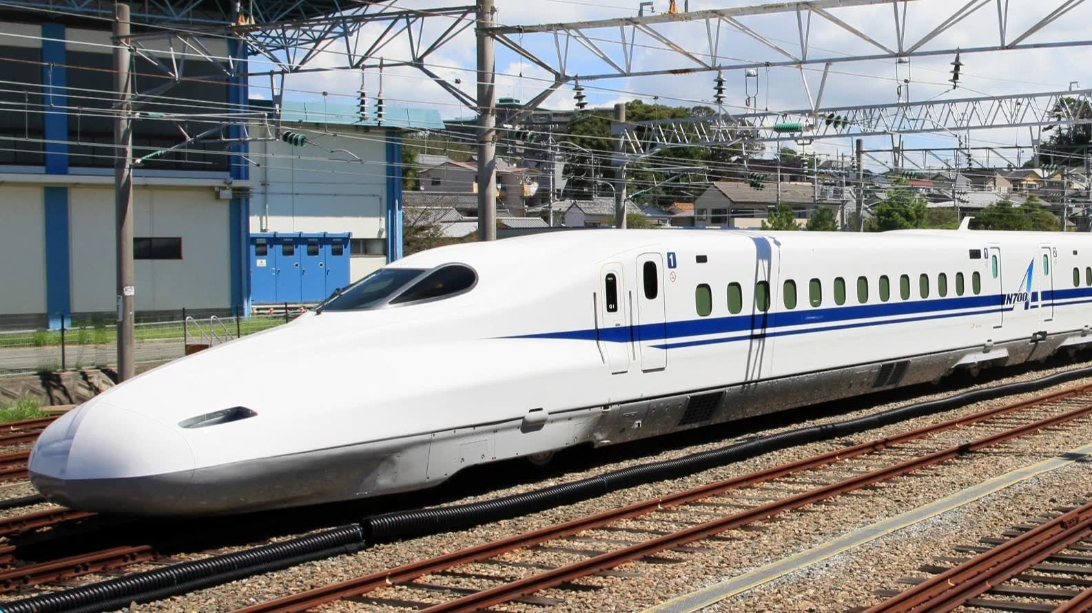
The Core of a Good Engineering Project
A CLEARLY DEFINED IDEA
What is the problem that you are solving?
Freight Train
Bullet Train

Slide 6
The Idea Tree
Specific Solution
Specific Solution
Specific Solution
Specific Problem
Specific Problem
Specific Problem
Problem Space

Slide 7
The Idea Tree
Pick up truck
Freight Train
Bullet train
Carrying heavy things is hard
Takes too long
Uses too much energy
Transportation

Slide 8
Sticky Note Technique
Specific Solution
Specific Solution
Modify
Modify
Issue/ Challenge
Modify
Issue/ Challenge
Modify
Issue/ Challenge
Modify
Problem Space/Specific Problem

Slide 9
Ideation Activity

Slide 10
Room 3002

Slide 11
Groups of 7
Room 3002

Slide 12
Activity!
Get together in groups
Grab an easel and some post-it notes
There is no such thing as a bad idea
Why? Because you never know where it might lead

Slide 13
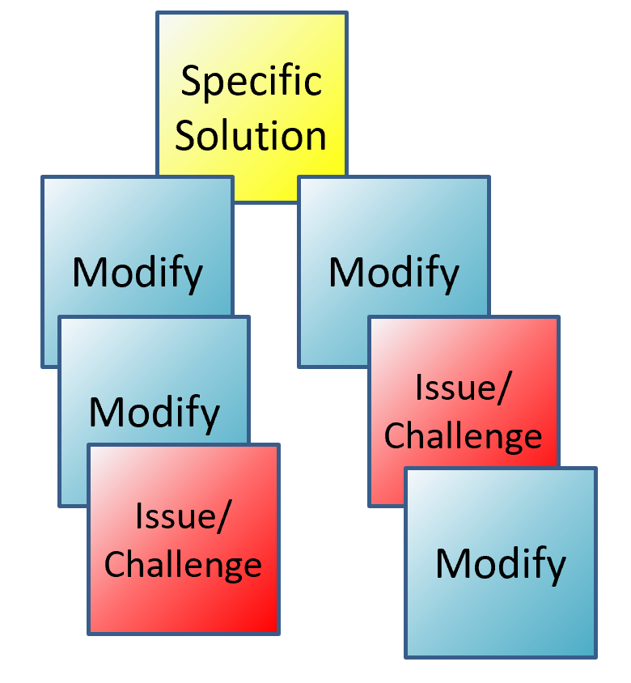
Example Problem Spaces
Assist people with disabilities
Green energy
Music/speaker improvements
Home/kitchen appliances
Sport safety; sport training improvement
Machine safety
Automate daily activities
Improve public spaces
Instrument enhancement, creation?
Pets
Restaurants
Personal hygiene
School/classroom improvements

Slide 14
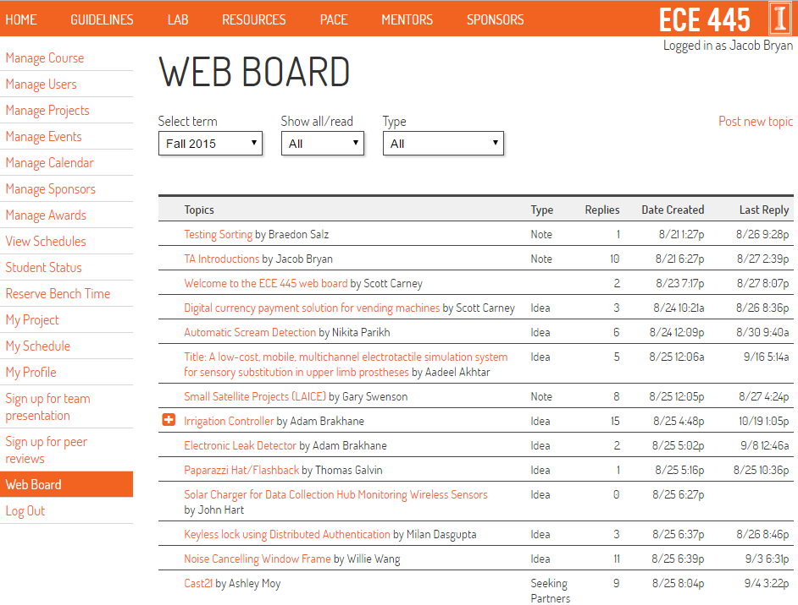
Homework
Post to the Web Board by Thursday (Aug 29th)
https://courses.engr.illinois.edu/ece445/

Slide 15
Web-board Idea Post
Problem: Clearly defined problem statement
Solution: general solution, and 3 requirements of solution

