Slide 1
Communicating Technical Information as a Team
Katie bruner
EngineerSPEAK
http://speak.engineering.illinois.edu/index.html

Slide 2
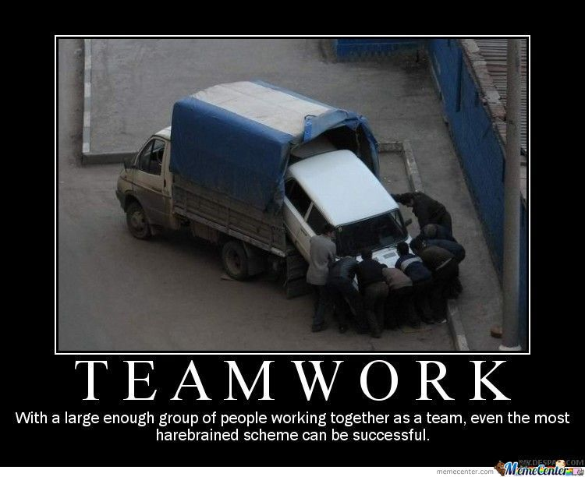

Slide 3
Timeline
Project Proposals – start weekly meetings!
Design Review
Demo and Presentation
Notes:
Focusing on communicating as a team because the work you do this semester will be the foundation for your final presentation, when you’ll see me (and other CMN TAs) again.
Some important dates that you should already be aware of, but want to make sure you see them in this context: project proposals signal the formal start of your team, but the work you put into the proposal starts to set some norms among your team members. This could be a good time to check in with your team and set expectations for how you will work together this semester.
Design Review is the first time you’ll get up in front of faculty and explain your progress and ideas. This isn’t a presentation, but you will need to be able to talk about your project as a group to people unfamiliar with the detailed work you’ve been doing, and where you plan on going.
Final Demo is the biggest opportunity you have to show what you’ve been doing all semester – this includes both technical work and team work, as your group dynamic can make or break your experience getting to this point. During Mock Presentations we’ll meet again and talk specifics about presentation skills, but today I want to focus on setting a good foundation for your team.

Slide 4
Working With Your Group
Remember that working with others takes time
Set clear guidelines and goals
Discuss preferences
Importance of in-person meetings
Talk to your TA!!
Notes:
This semester you’re really doing two things: working on a project, and working within a group. It’s easy to forget that working with other people takes time and energy too!
Although it can be awkward, sitting down and talking about team goals and guidelines can help clarify any potential misunderstandings before they start. Don’t make assumptions about your team members – they may want an A, they may want a C, they may have good enthusiasm but are taking several other classes, they have different technical strengths and weaknesses. Knowing this ahead of time can help figure out how you will work together towards a common goal by drawing on everyone’s strengths.
It can also be easy to make assumptions about working with other people: you may prefer texting, or GroupMe, or Google Docs, but that doesn’t mean your group members feel the same way. I’ve seen lots of groups struggle because one member never responds to the GroupMe, or never checks their email. A simple conversation could have prevented that mismatch, so I encourage you to think about how you’ll work together this semester. What is everyone’s schedules? When are people generally available? How much time does everyone have to dedicate to this class? What’s the easiest way to get in contact with each other?
It can also be easy to fall into the technology trap – communicating only by text, or by updating a Google Doc, or not checking in at all throughout the week. I also encourage you to not underestimate the importance of in-person meetings, or even a quick Google Hangout check in when things get really busy. Something that might take several hours back and forth to figure out could be a 5 minute conversation, and it’s a good idea to stay in touch with what your group members are working on, what they’ve accomplished, and where they’re stuck. This will help you work together: the final project is a reflection of all of your work, so celebrating progress and offering support when things are stressful can be really helpful.
Be sure to stay in constant communication with your TA – they can help you individually if you start to struggle this semester, as a group if you start to experience conflict (which every group does at some point), and they really do like celebrating your progress. Their role here is to help – not do your project for you – but they have experience, contacts, and connections that you’ll likely need at some point.

Slide 5
Communicating Technical Information…
Start with organization
Verbally transition (“now that I have discussed X, my partner Katie will explain Y…”)
Use visual aids [block diagram]
Be concise
Tell a story – what were you trying to do, and how did it go?
Not all information is equally relevant/important
They can always ask questions
Notes:
When preparing to communicate technical information, like for the Design Review, some suggestions to think about include persuasion, organization, and being concise.
When I say think of persuasion I mean think about the purpose of each assignment and your audience. The Design Review is not just about telling faculty what you’re going to do, but justifying why your design is good. From their perspective, the point of the Design Review is to make sure that your plan for the rest of the semester makes sense: is it safe? Is it feasible? Will it lead to the outcomes the project intends? Is this the best way to achieve your goals? What are your goals? So you need to be ready to explain your thought process – walk them through your engineering design process.
A key part of this is organization. It’s really easy to lose someone when talking about technical details. There’s a tendency to dive right into the specific knowledge you have, but starting with a fancy equation or circuit schematics doesn’t tell them your design process. Think about the process you went through to get to your design, and make sure you convey that process to your audience. That means starting from the big picture – what’s the problem, purpose, goal? What’s the first decision you had to make? How did that lead to the next decision? How does that connect back to the overarching goal? You need to lead your audience through this process with you, rather than starting at the end. One way to do this is using visual aids – there’s a reason you start with a block diagram! You’ve done that work already – use it. If your Grandma saw your block diagram and asked you what it was, you wouldn’t start with some detailed circuit schematic – you would start by explaining the project as a whole, what the diagram represents, what the different pieces are, how they fit together. That explanation is much more effective than jumping from one concept to another without context.
Lastly, be concise. When you think about what you’re going to talk about, ask yourself “so what?” – why does your audience need to know this? If it doesn’t help explain your goals, offer support for your decisions, or connect concepts together, you probably don’t need to say it. Your audience can always ask more detailed questions, but if you go down that rabbit hole of explaining every single detail, you’re going to lose them.

Slide 6
…As A Team
What’s different?
Special considerations:
Goal: Cohesive final product
Importance of transitions
Where does everyone stand?
What do you do when you aren’t speaking?
Have a plan!
Notes:
Finally, an important component of this class is working as a team. A lot of school is “doing your own work” and being individually graded, and we take that with us into group projects. The tendency is to divide up the work and smash it all together at the end and call it a group presentation. That’s not really a group presentation – that’s a Frankenstein presentation. Even if you all work from the same Google Slides template, your team members have different ways of speaking, different ways of writing, and those differences come through.
When working as a group, then, remember that whenever you’re communicating your project as a team, your communication should be cohesive. This goes beyond presenting skills – how you talk about your project can indicate a lot about your group dynamics. I’ve gone to several mock presentations where, having never seen the group before, can pick out who the official leader is, who has burnt out, who doesn’t get along with the rest of the group, or which groups are clearly friends outside of class. Developing a positive group dynamic can help with that, and remembering little details such as transitions, both from topic to topic but also from group member to group member, where everyone sits or stands, who is going to introduce the group and offer a conclusion in addition to everyone talking about their specific piece, what you do when you aren’t speaking (staring at the wall, checking your phone, laughing at your teammates bad joke, showing the audience how excited you are about what your teammate is saying), all indicate how well you’re working together. Basically, any time you need to communicate as a team, have a plan!

Slide 7
Work to make your group members a source of support, not stress!
Notes:
Basically, your group can be a source of support or stress this semester. Putting in a little extra effort up front can help make your group a source of support; people to pick up slack when you have 4 midterms in 3 days, people who are excited when you make cool progress, people who can help your ideas become better. I’m not saying you need to be best friends with your group members, but having a basic level of courtesy and empathy can go a long way in developing a professional, equitable team.

