Slide 1
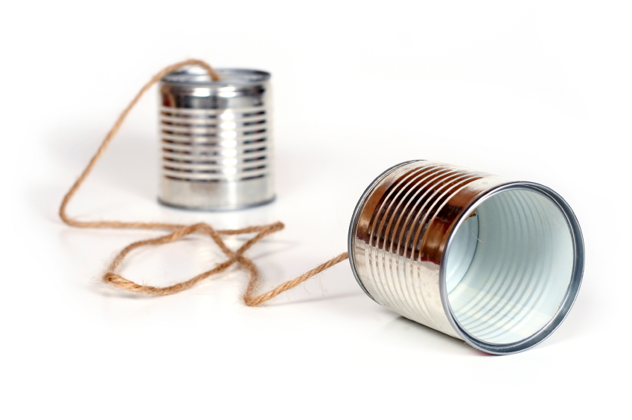
Tin Can Telephone upgrade for the digital age
Jacob Bryan jdbryan2@illinois.edu

Slide 2
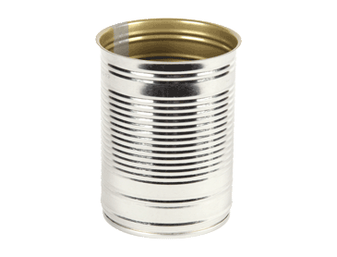
Easy Mode: One Way Communication
TX
RX
Must transmit and receive using vibrations in the string

Slide 3
Hard Mode: Two Way Communication
TX
RX
RX
TX
Must transmit and receive using vibrations in the string

Slide 4
Bonus: Going the distance
Reliably communicate over long distance
Must transmit and receive using vibrations in the string

Slide 5
Some Suggestions and Advice
Reliability is more important than latency
Use digital a communication scheme
Measure the tension in the string (in real time)
Consider your materials selection carefully

