Slide 1
Group Number 42:
Monitoring System for Rotating Turbines
Alaa Qarooni, Asm Khandker

Slide 2
Introduction
This device provides a modular RPM detection design for fans and turbines using a non-contact, photonic integrated system
Can be implemented in a wide range of systems that feature no built in sensors (like rotary encoders) and require an external means of calculating fan speed
Does not require tampering or modification of the actual fan motor (ideal for brushless fans)
Features a backup power option, provided by the user
Backup supply kicks in when the motor starts to lose power from the main supply unit.

Slide 3
Features
User-provided Main and Secondary Power Supply Inputs
Integrated RPM Display
Efficient design and low power-consumption

Slide 4
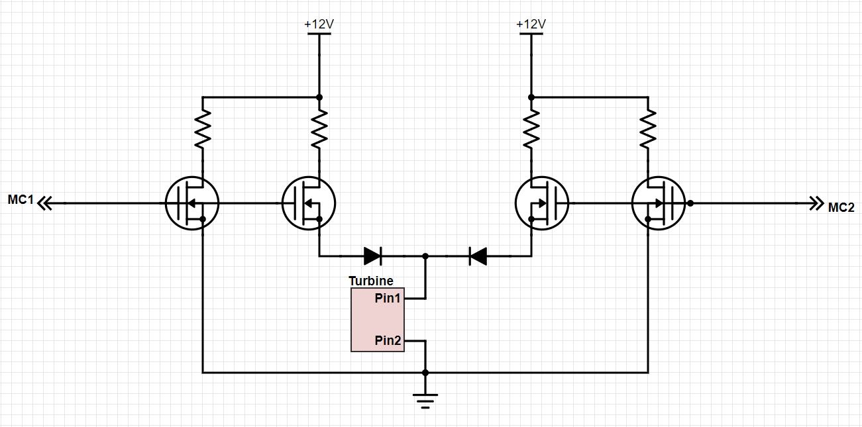
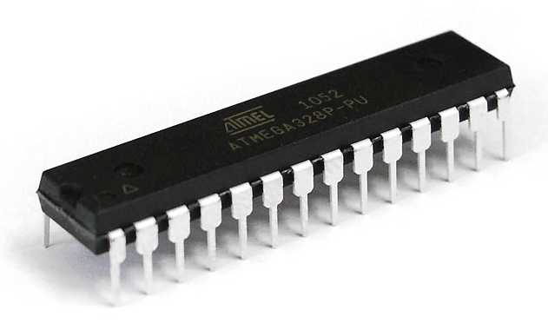
Objective
Pulse Train
RPM Calculation
Power Switching
1
2
3
¹
¹ https://ktechnics.com/wp-content/uploads/2015/12/atmega328p-pu.png

Slide 5
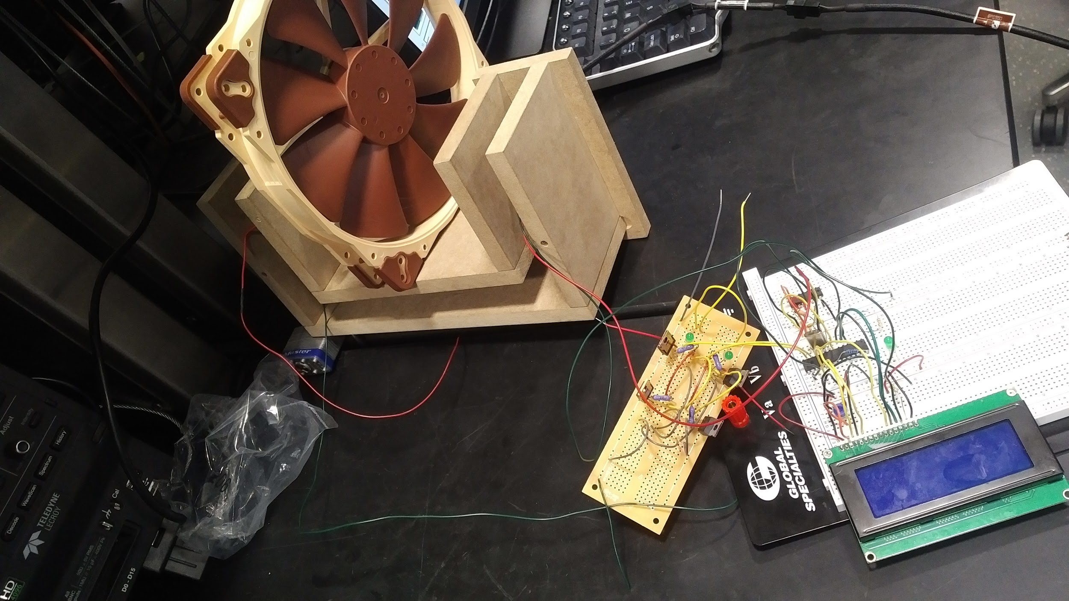
Our Design

Slide 6
System Overview
Hardware | Software
Sensor module for pulsed laser detection Microcontroller module for overall system integration LCD Screen for RPM Display Power Switching module | RPM Calculation from sensor module input signal Sending LCD display commands Sending signals to power switching module

Slide 7
System Overview
Data Path
Power Path
Turbine
LCD Display
Microcontroller Module
Sensor Module
Main
Secondary
Power Switching Module
To Turbine

Slide 8
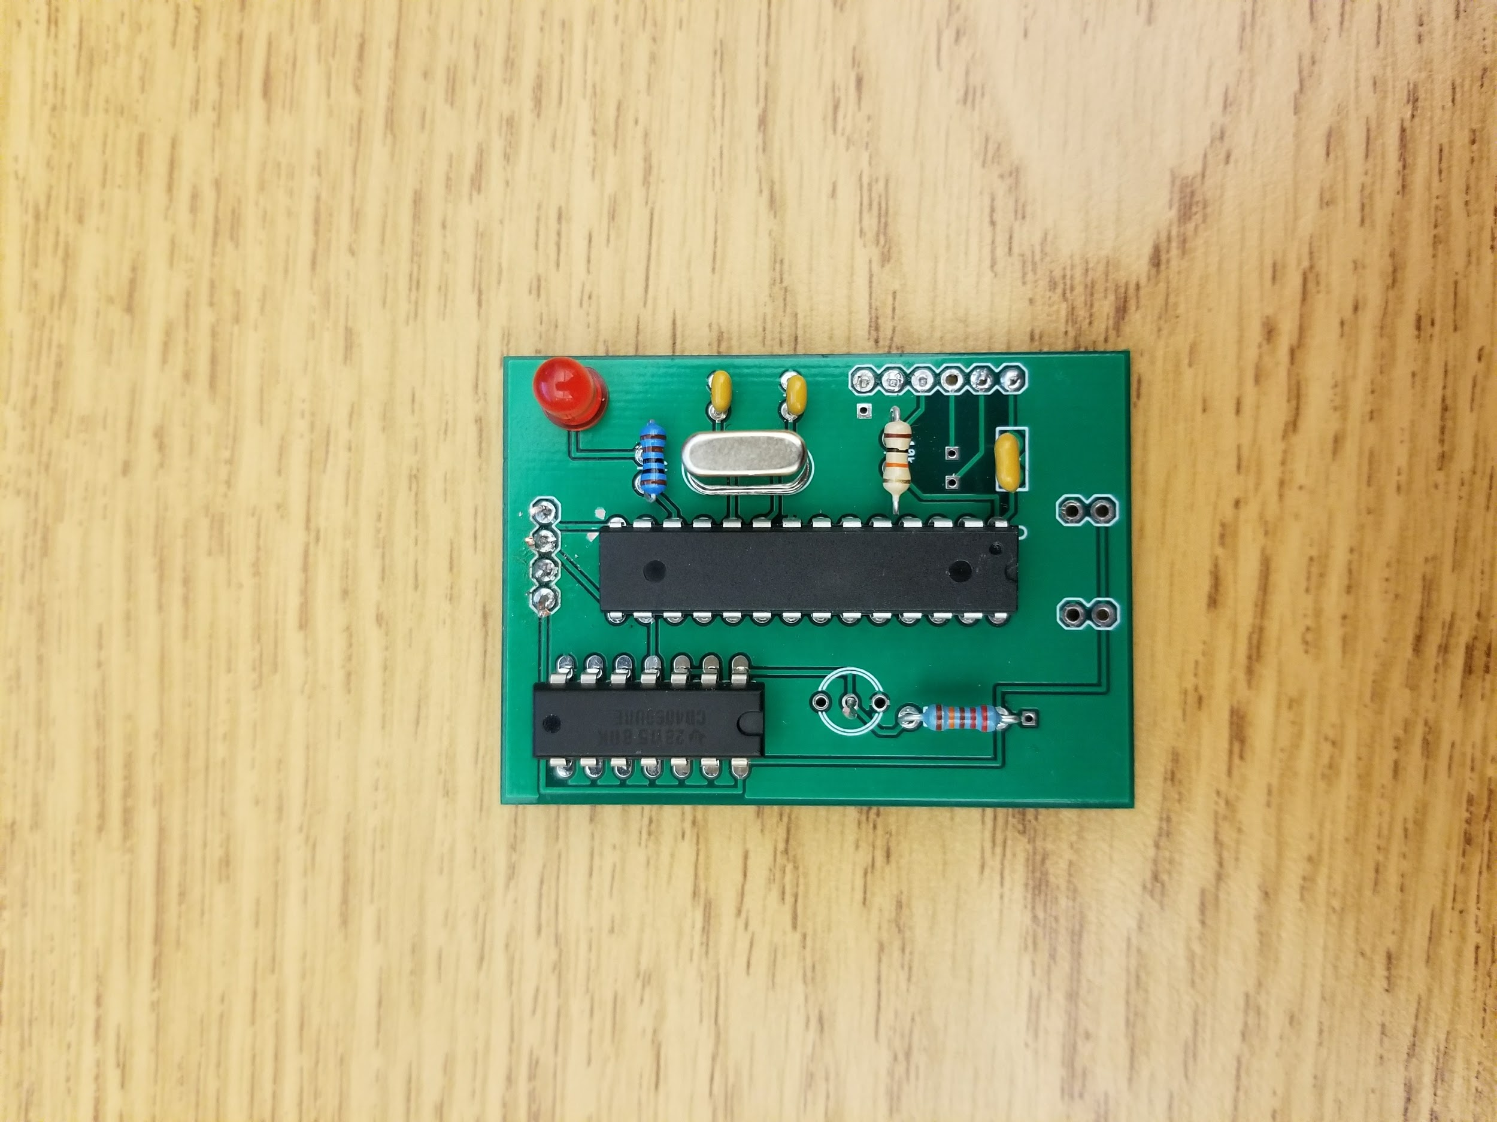
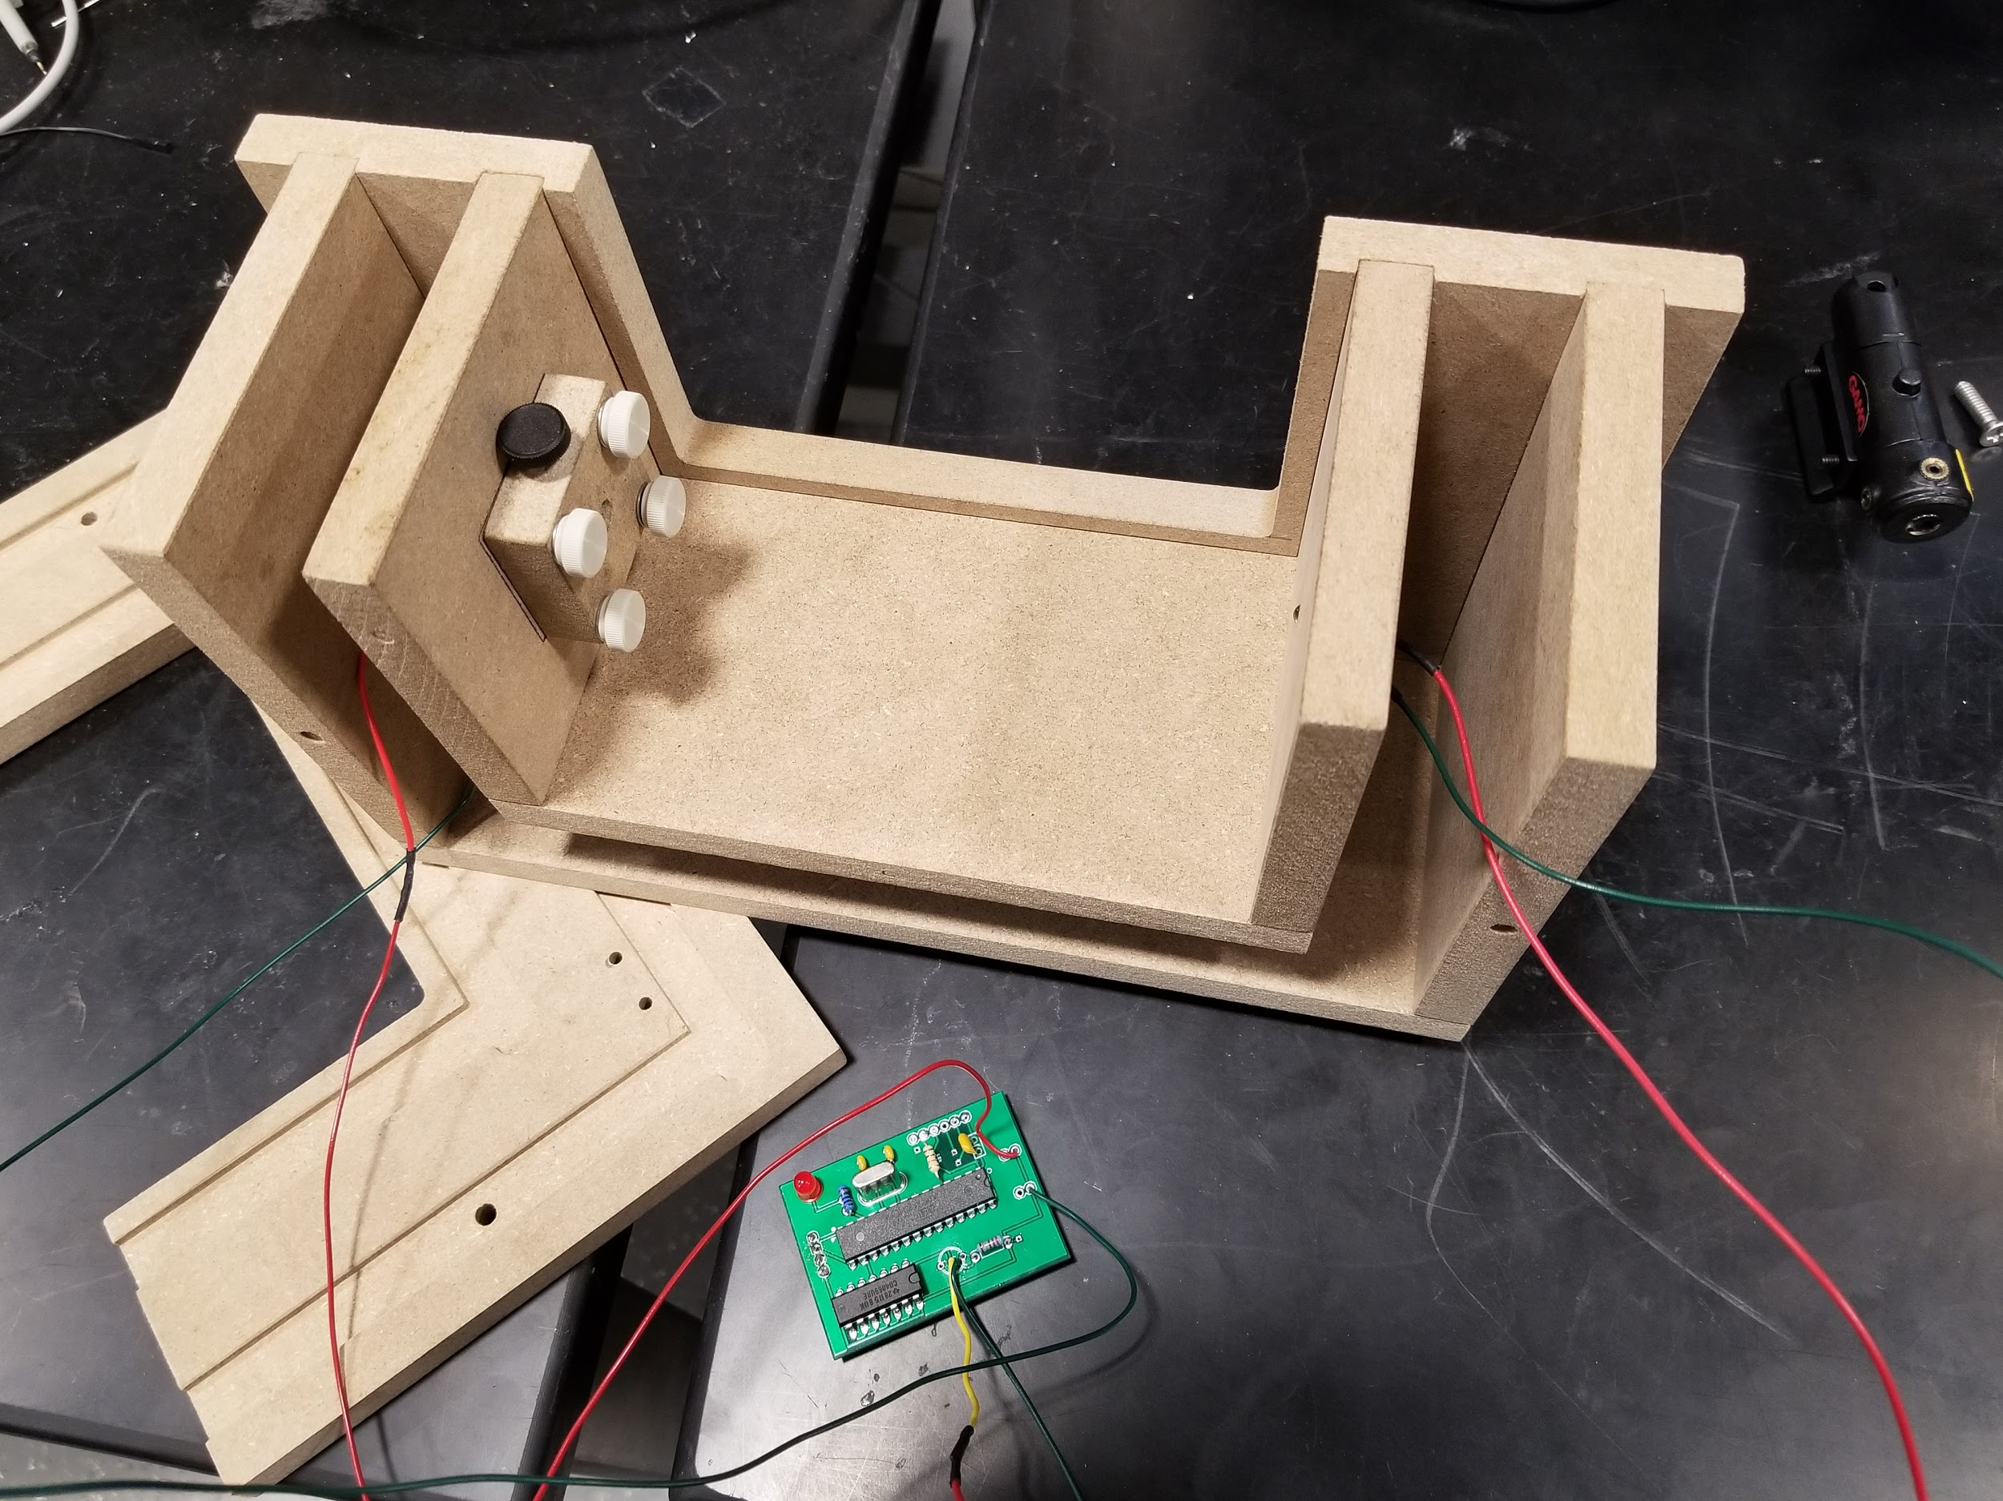
Sensor Module

Slide 9
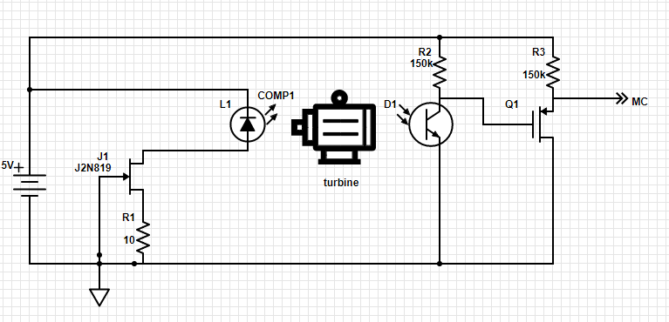
Sensor Module - Circuit

Slide 10
Sensor Module - Functional Overview
Correctly matched Vertical Cavity Surface Emitting Laser and phototransistor (photo-BJT) pair
The laser feeds a continuous signal into the base region of BJT, resulting in continuous electron-hole pair generation
The turbine pulses the laser, and current density in the BJT is reduced to zero every time a blade interferes with the laser.
This produces a series of high and low signals to be fed into the microcontroller

Slide 11
Sensor Module - Hardware Specifications
Vertical Cavity Laser (VCSEL)
Low drive current (10 ~ 50mA)
Low optical power output (<5mW)
Output power is only a function of current (Voltage is clamped at population inversion)
Fixed 5V supply (drive current is controlled by additional circuitry)

Slide 12
Sensor Module - Hardware Specifications
The laser output only depends on the drive current as follows:
Our operating point for the detector to saturate is 2mW.
The laser outputs a maximum 10mW at 50mA drive current. So to output 2mW we need to drive the laser at 10mA.
Our supply voltage to the laser is 5V. We convert this to a 10mA voltage controlled current source using the JFET J2N819.

Slide 13
Sensor Module - Hardware Specifications
VCSEL (additional requirements)
High beam quality
High coupling efficiency with phototransistor
Collimating lens ensures high enough intensity even at low power

Slide 14
Sensor Module - Hardware Specifications
Detector
NPN transistor in common emitter configuration with high pull up resistor (150k)
Fast switching (higher than the microcontroller sampling frequency)
Saturation at 2~3mW optical power from the laser (saturation shorts the ground to output and sends “LOW” signal to microcontroller)
Diameter of collecting lens over base region should match the beam width
PMOS discriminator gets rid of negative voltages - sets ‘HIGH’ to 4.5-5V and ‘LOW’ to 0-300mV

Slide 15
Microcontroller Module - ATmega328P Connections
To 150kΩ pull-up resistor
LCD Display Module connections
Sensor Module connections
To LCD PIN 14
Power Switching Module connections
To LCD PIN 13
To LCD PIN 12
To 5V
To GND
22pF
22pF
16MHz Crystal Oscillator
To LED Circuit
To LCD PIN 11
To LCD PIN 4
To gate pins of ¹M3 and M4
To LCD PIN 3
To gate pins of M1 and M2
Input from Sensor Module
¹See “Power Switching Module - Circuit” slide

Slide 16
Microcontroller Module - Sensor Module Connections and RPM calculation
Sensor Module output acts as a digital input to PIN 16 of the ATmega328P
PIN 16 = Arduino Digital Pin 10
Step 1
Step 2
Step 3
Step 4
Digital Pin 10 = LOW
prevTime = current time in milliseconds
Digital Pin 10 = HIGH
Do nothing
Digital Pin 10 = LOW
&& prevIsHigh
curTime = current time in milliseconds
timePerBlade = curTime - prevTime
totalTime = numBlades * timePerBlade
rpm = 60*1000/totalTime

Slide 17
Microcontroller Module - Power Switching Module Connections and Code
PINs 12 and 13 provide digital HIGH (5V) and LOW (0V) output signals to gate pins of M3, M4 and M1, M2, respectively
PIN 12 = Arduino Digital Pin 6, PIN 13 = Arduino Digital Pin 7
Conditions
Power Switching
Secondary Supply only
Pin 6 = LOW and pin 7 = HIGH
Main supply is ON and secondary supply is OFF
Pin 6 = HIGH and pin 7 = LOW
Main supply is OFF and secondary supply is ON
RPM > threshold
pin 6 = LOW, pin 7 = HIGH
RPM < threshold
pin 6 = HIGH, pin 7 = LOW
Once RPM<threshold, keep pin 6 HIGH and pin 7 LOW, even if RPM becomes > threshold again
Main Supply malfunctioned and we do not want to use it anymore

Slide 18
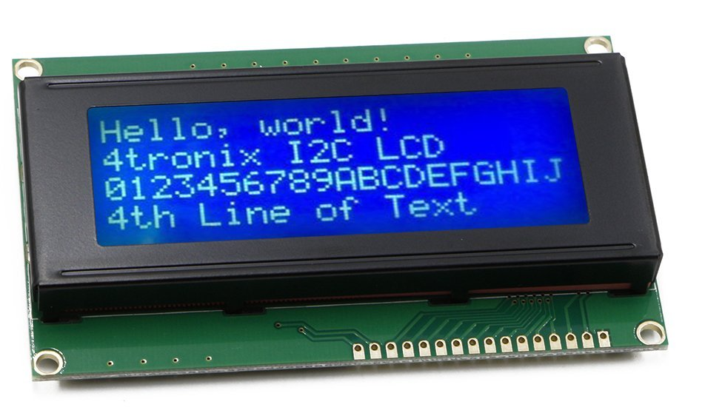
LCD Display Module
HD44780 Compatible
16 15 14 13
12 11 10 9 8 7 6 5 4 3 2 1

Slide 19
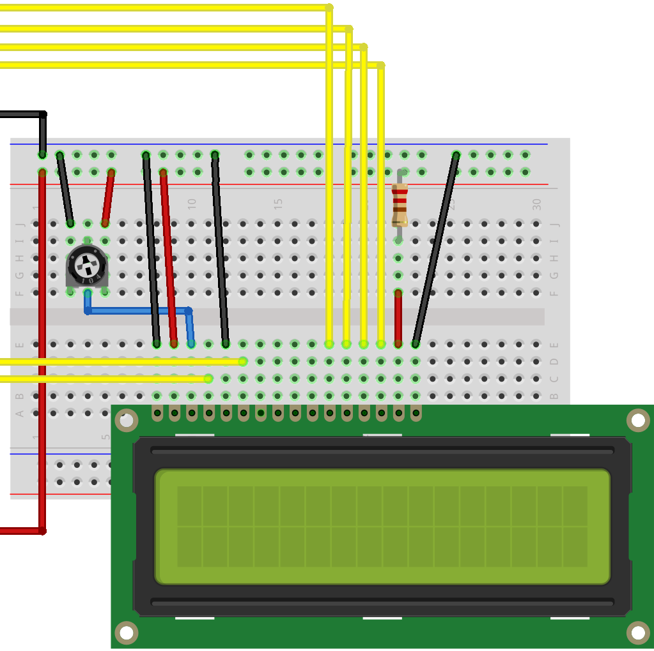
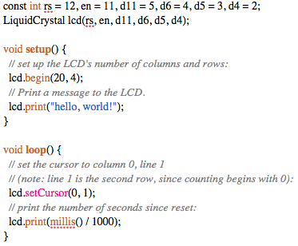
LCD Display Module Connections and Code
MC PIN 11
MC PIN 6
MC PIN 5
MC PIN 4
GND
MC PIN 17
MC PIN 18
+5V

Slide 20
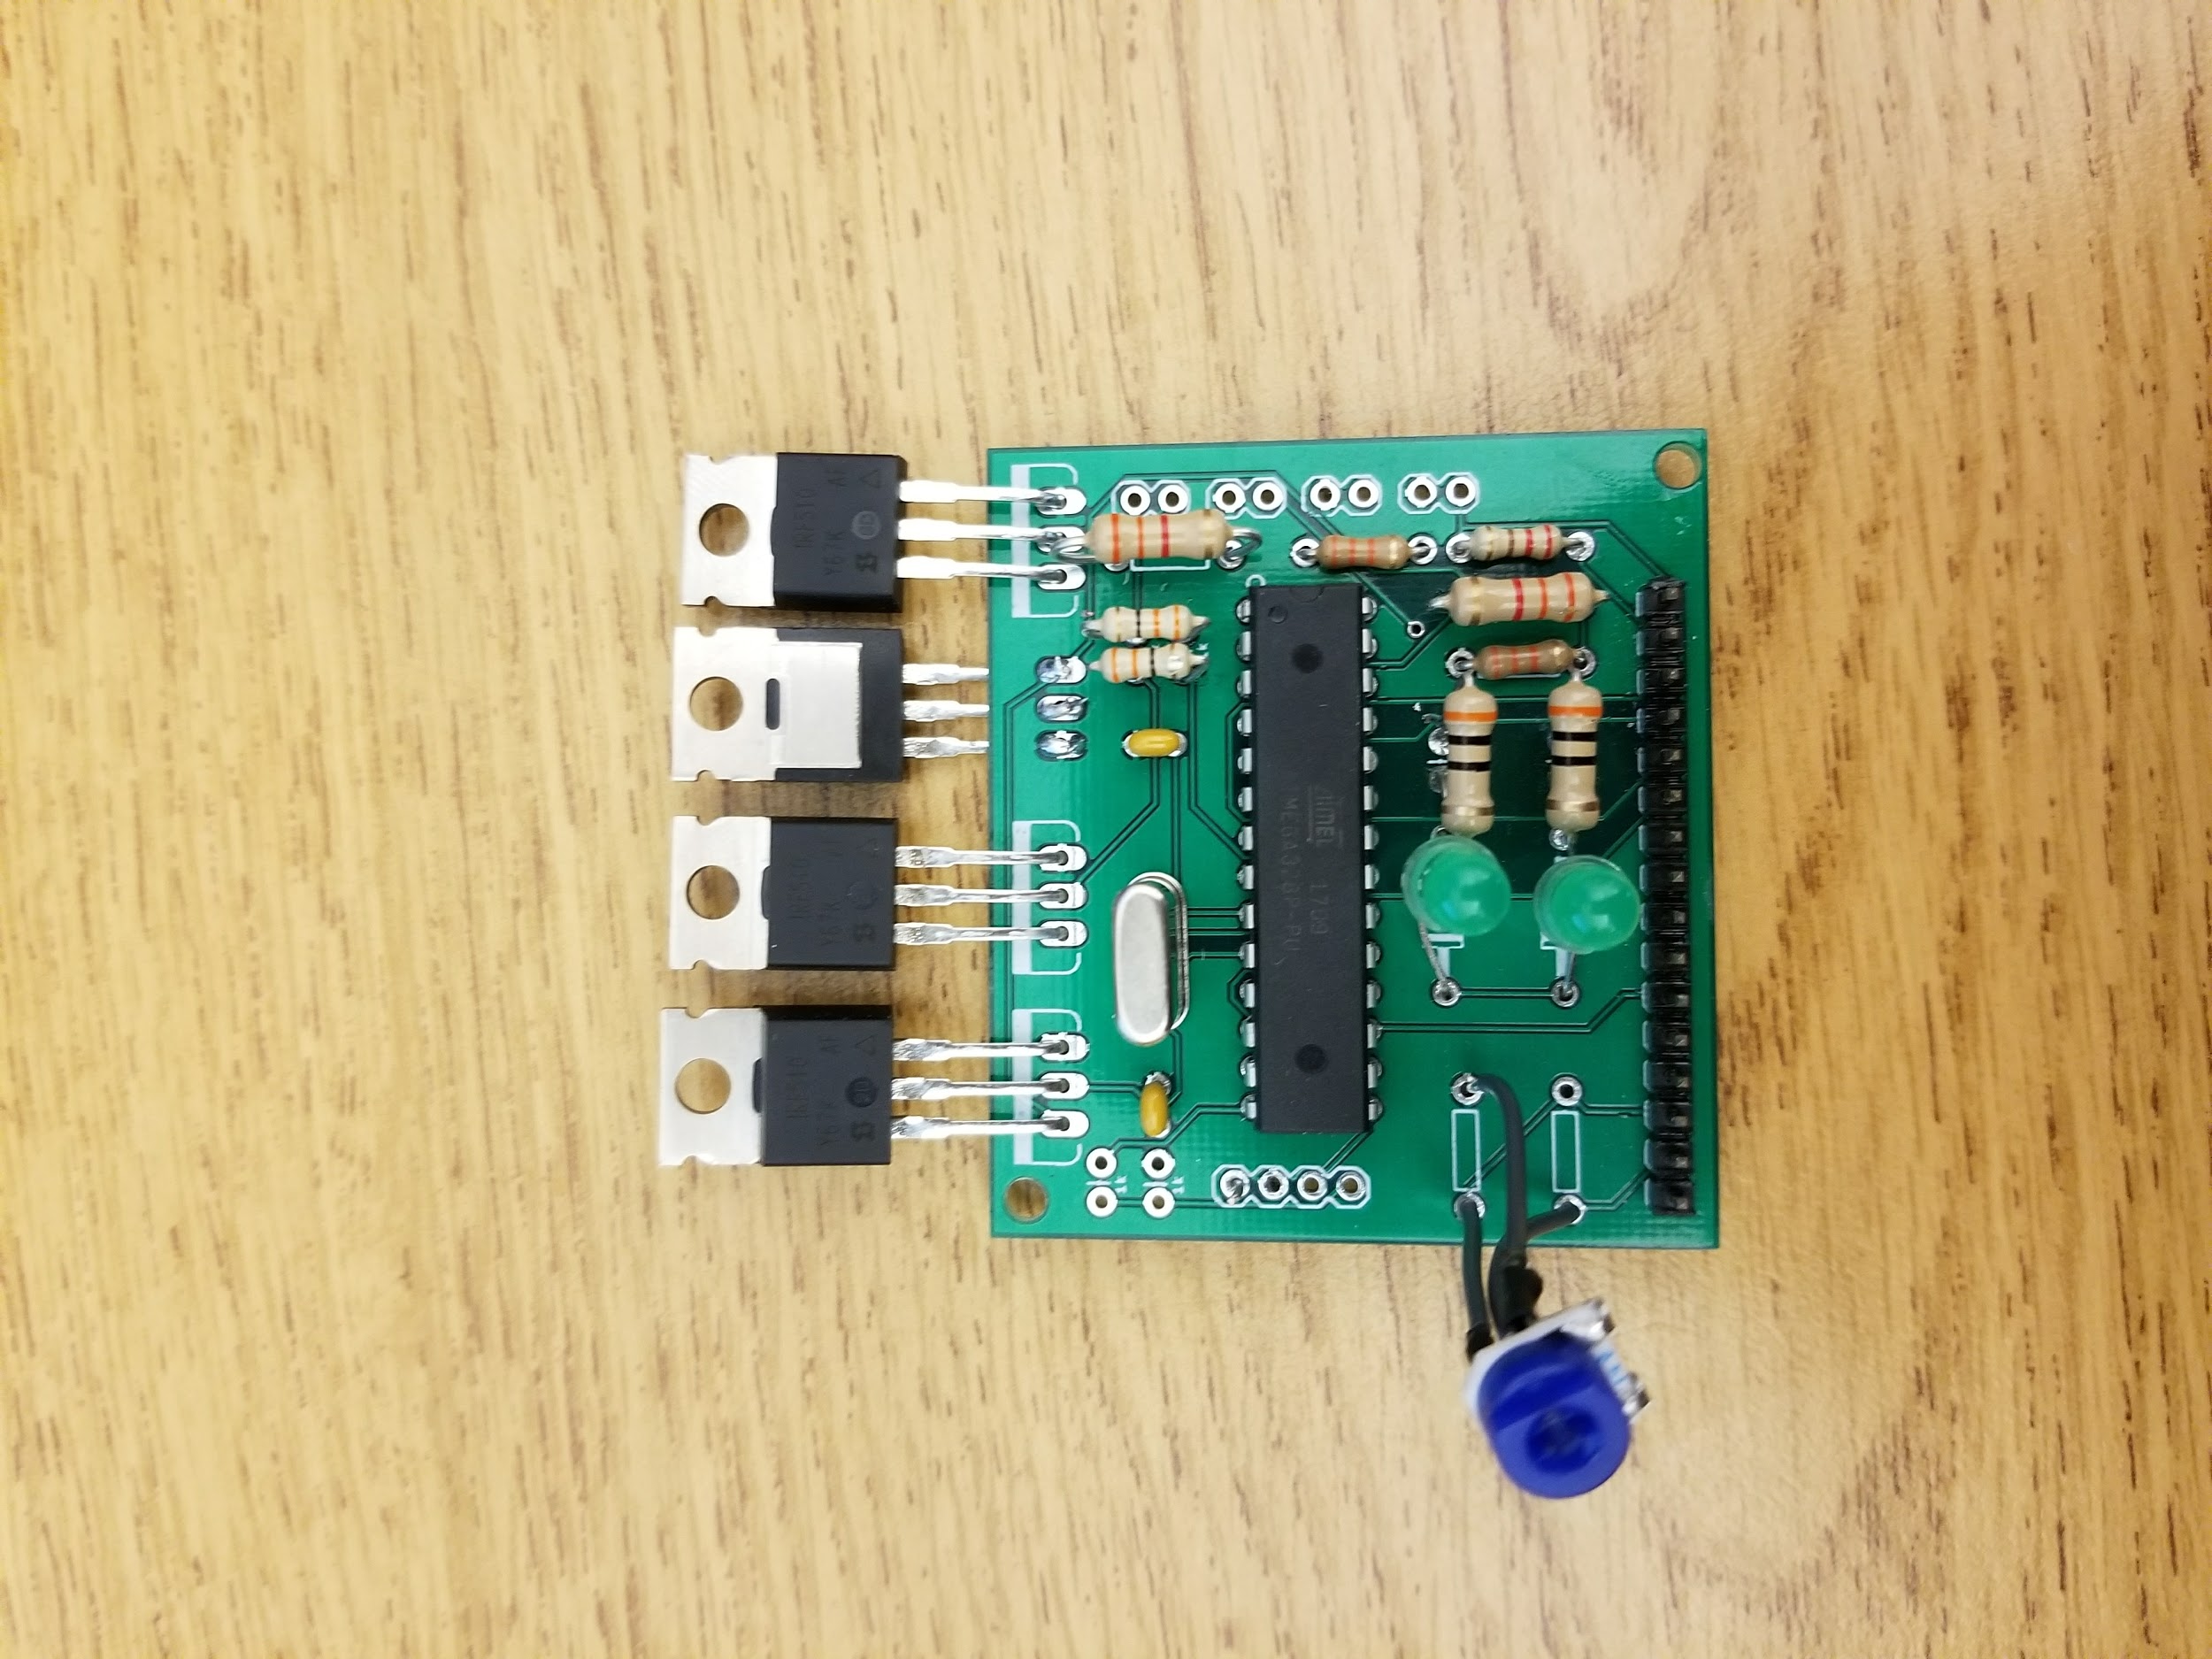
Power Switching Module

Slide 21
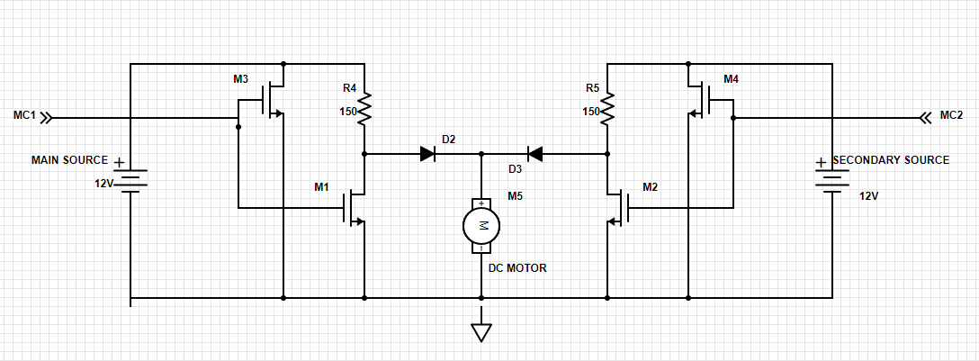
Power Switching Module - Circuit

Slide 22
Power Switching Module - Overview
Symmetrical design
The Main Power and Secondary Power are both connected to the motor parallely
If both supplies are simultaneously “ON”, the motor only ever receives the required 12V
MC configured so that only one supply is “ON” at any given time
If M1 and M3 receive “high” signal, M2 and M4 receive “low” [this means that MAIN SUPPLY is “ON”]
The opposite case is true when we switch to SECONDARY

Slide 23
Power Switching Module - Overview (Cont.)
Power Switching Operation is active low, i.e. when the gate signal (from MC) is high, the FETS M1 and M3 short out the Turbine from the Main Power
When the gate signals are low, M1 and M3 are “open” and current is allowed to flow through the pull up resistors to the turbine from the Main Power
The diode D3 now prevents the secondary network from shorting out the motor

Slide 24
Power Switching Module - Hardware Specifications
MOSFETs for bottlenecking power - IRF510 Power FETs
Power FETs provide fast switching at low gate voltages (logic controlled)
Allow for large V_{ds} (well above 12V)
I_{d} in saturation is kept strictly below 800mA at carefully selected logic level gate voltages
Zero current in channel when gate voltage is zero (MOSFET becomes open circuit between drain and source)

Slide 25
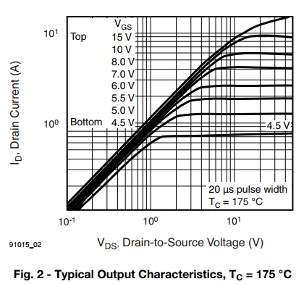
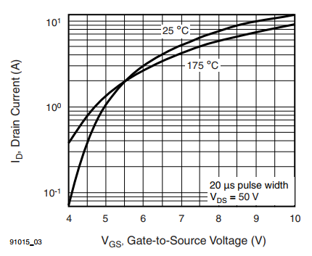
Power Switching Module - Hardware Specifications
The following graphs show the current-voltage characteristics of the IRF510 FETS; they are also used to select the correct operating point for the gate voltage.

Slide 26
Power Switching Module - Hardware Specifications
Additional features
Operate optimally at higher temperatures
Diodes at output have very low turn on voltage to allow maximum power to be drawn by motor.
Pull-up resistor values chosen to be small to also allow maximum power to be drawn by motor

Slide 27
Overview of Strengths
User-provided Main and Secondary Power Supply Inputs
Integrated RPM Display
Efficient design and low power-consumption

Slide 28
Overview of Limitations
Slight loss of modularity because of requirement to insert main supply and secondary supply into device
No way to remotely monitor turbine and perform power switching because of design choices - possible safety hazard

Slide 29
Difficulties
Malfunctioning products
Impulsive design choices - Incorrect Power FET choice lead to too much drain current, heating up and burning some components
Stolen parts!

