Slide 1
Inductive Charging Case
Team 66
Brian Slavin, Anshil Bhansali, Jose Javier Rueda

Slide 2
Introduction
Problem
We speculate USB type C becoming more common in smartphones. It becomes a problem when we want to listen to music/transfer data while charging the phone as the USB port is occupied.
Solution
A way to charge a phone without occupying the USB port (wirelessly).
Allows for phones without AUX jacks to use the USB port and charge.
Wrap it up into a phone case that wirelessly charges your phone.

Slide 3
Objective
Charge a phone without using the USB port.
Create a device that could fit in a pocket.
Slim design to allow a portable rechargeable battery.
Incorporate FOD detection to save power
Foreign Object Detection
Design a software application around device
Display a scatter plot of battery level vs time.
Inform user when wireless charging starts/stops.
Alert user in case of danger.

Slide 4
System Overview
Hardware
Lithium ion polymer battery, LM2621 step up DC-DC switch regulator.
Micro-controller BQ 500511, Analog Front End BQ 50002a.
A11 type transmitting copper coil.
Software
Android application (using Android Studio)

Slide 5
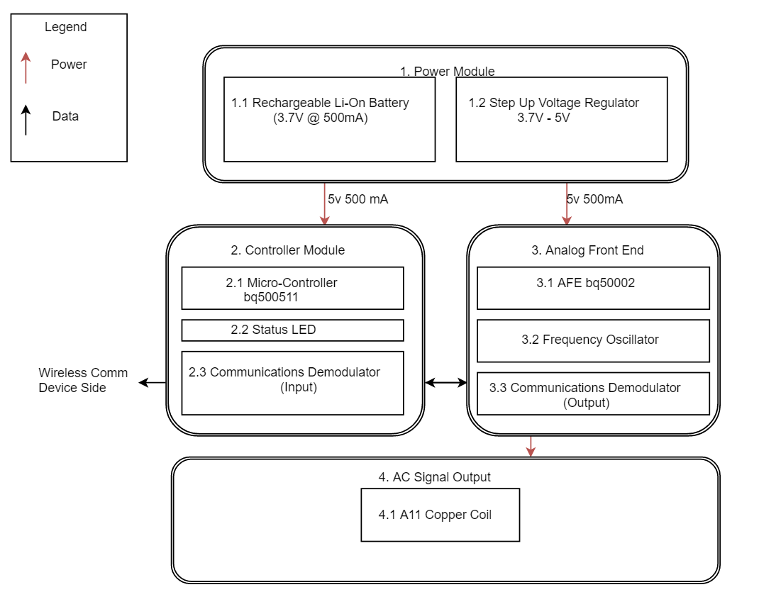
Block diagram

Slide 6
DC-DC step up voltage regulator

Slide 7
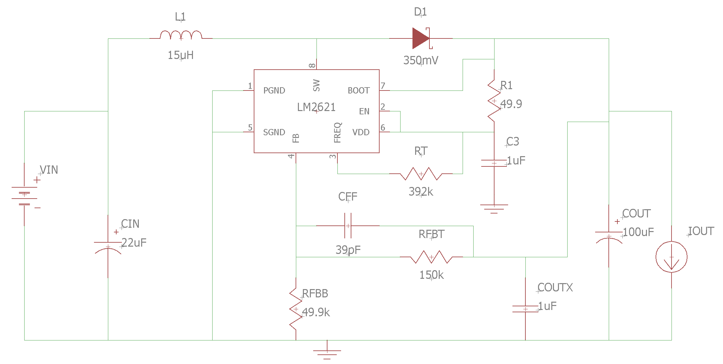
DC-DC step up voltage regulator
Input voltage: 3 V
Output voltage: 5 V
Output current: 0.5 A

Slide 8
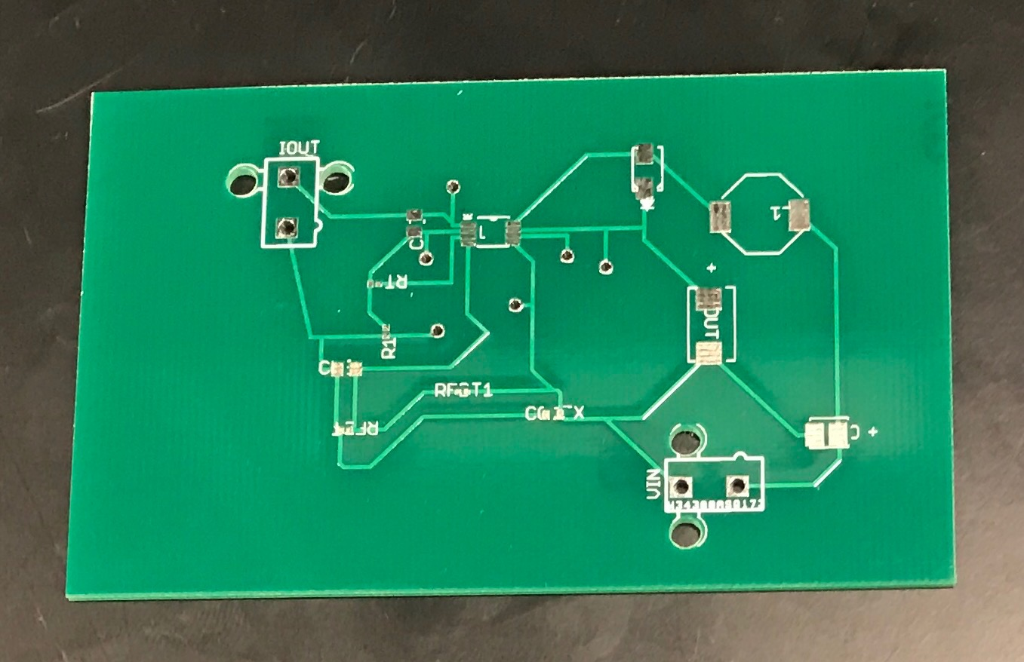
DC-DC step up voltage regulator
PCB without components

Slide 9
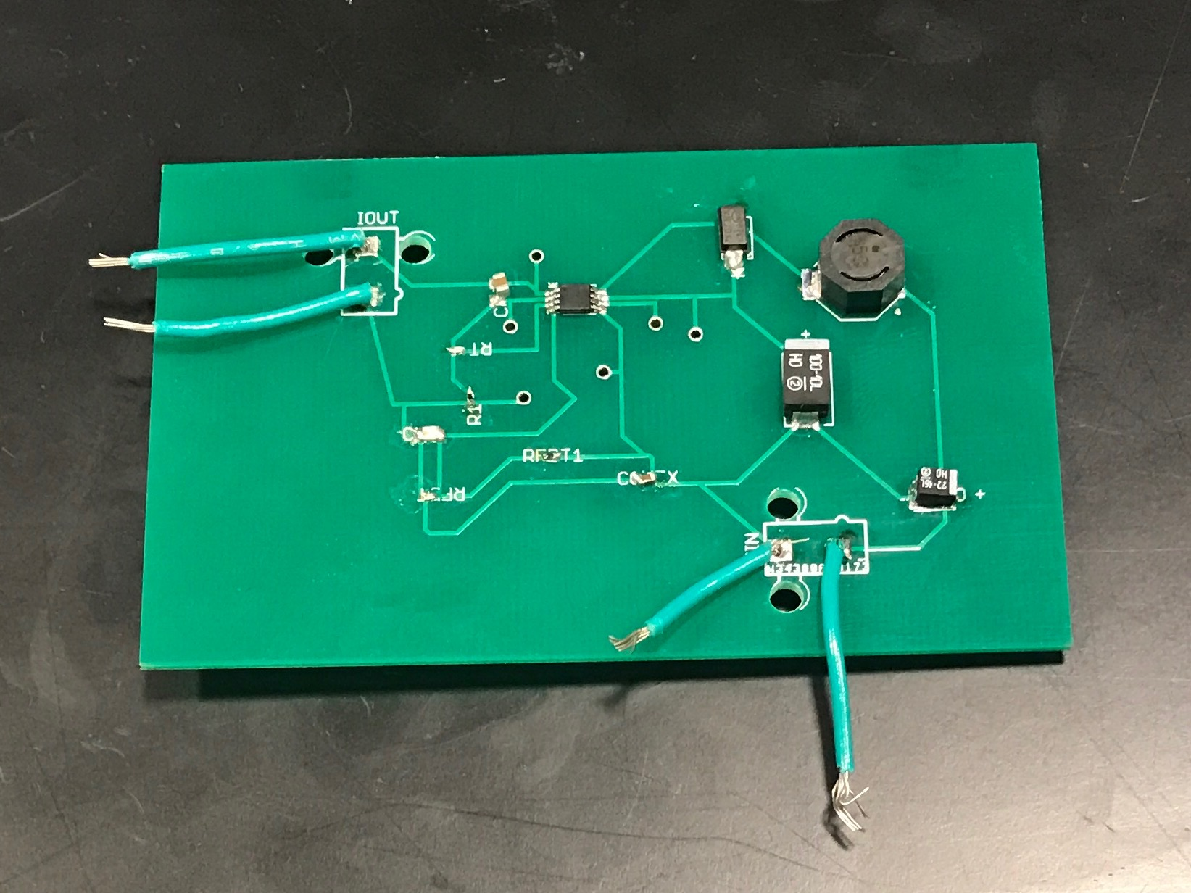
DC-DC step up voltage regulator
PCB with components

Slide 10
DC-DC step up voltage regulator
Requirements:
1)
The output must be 5V ± 0.25V for load currents of 0.5A - 2.85A and Vin: 3.0V - 4.0V.

Slide 11
DC-DC step up voltage regulator
It worked as expected for the nominal load current: 0.5 A.
It stopped working for load currents of 2.8 A.
Problems: design of the circuit and IC current limit lower as given.
Solution: run simulations for limit load currents.

Slide 12
DC-AC circuit

Slide 13
DC-AC circuit
Input voltage: 5 V
Output voltage: 4.5 V
Output frequency: 110 - 205 kHz (Qi Frequency)
Features
Foreign Object Detection
LED indicator

Slide 14
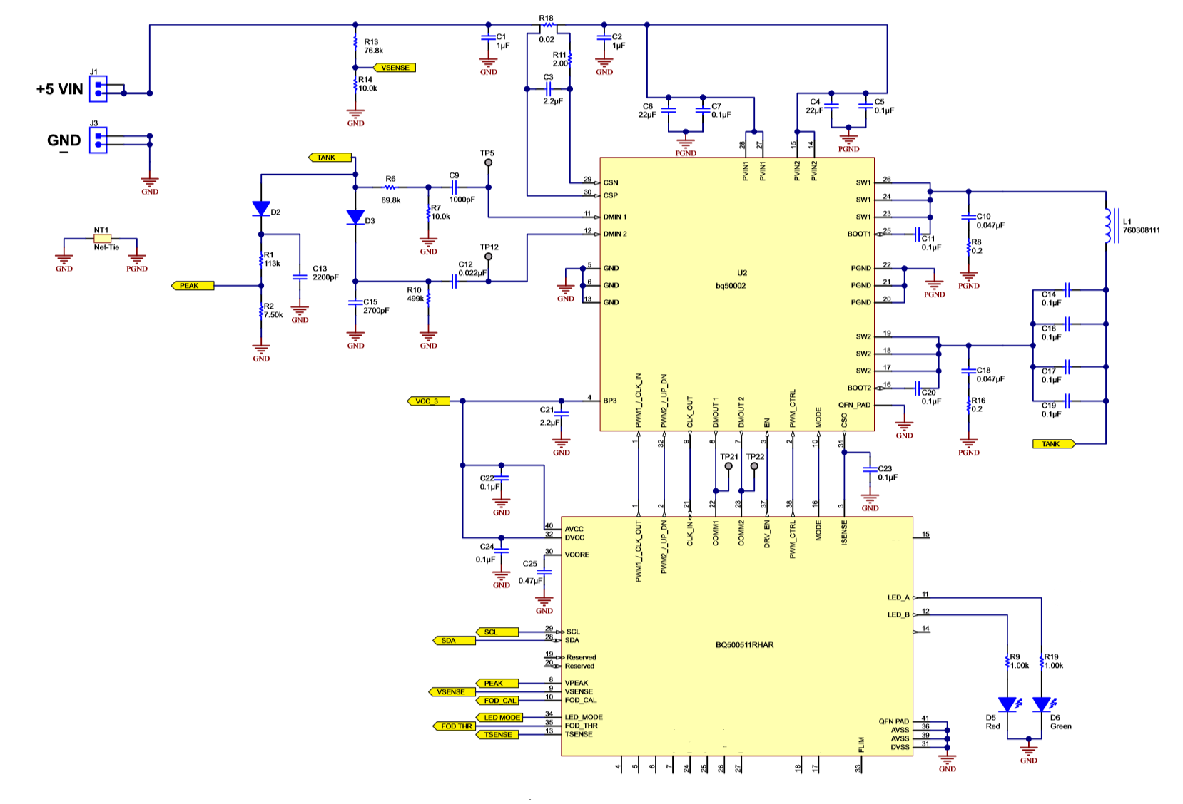
DC-AC Schematic

Slide 15
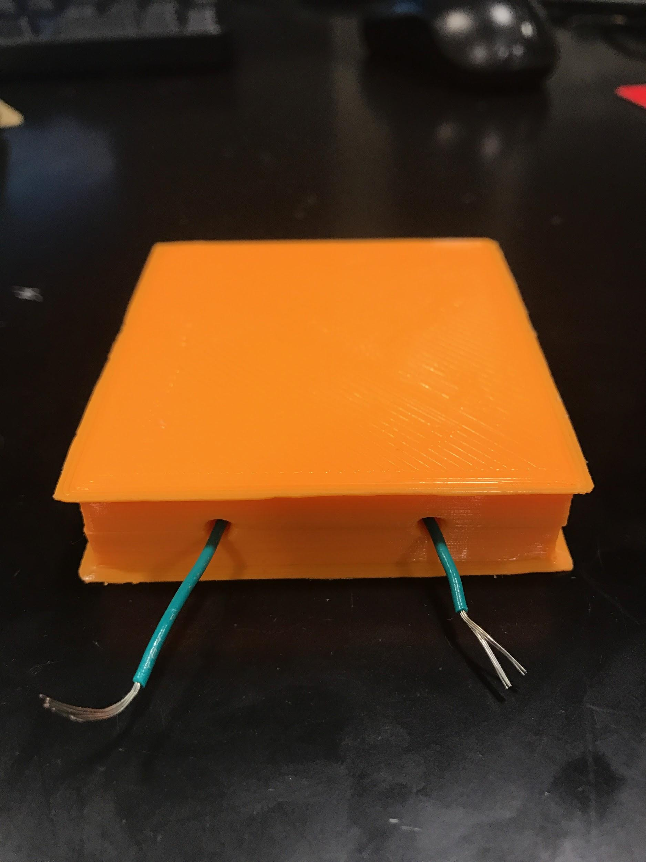
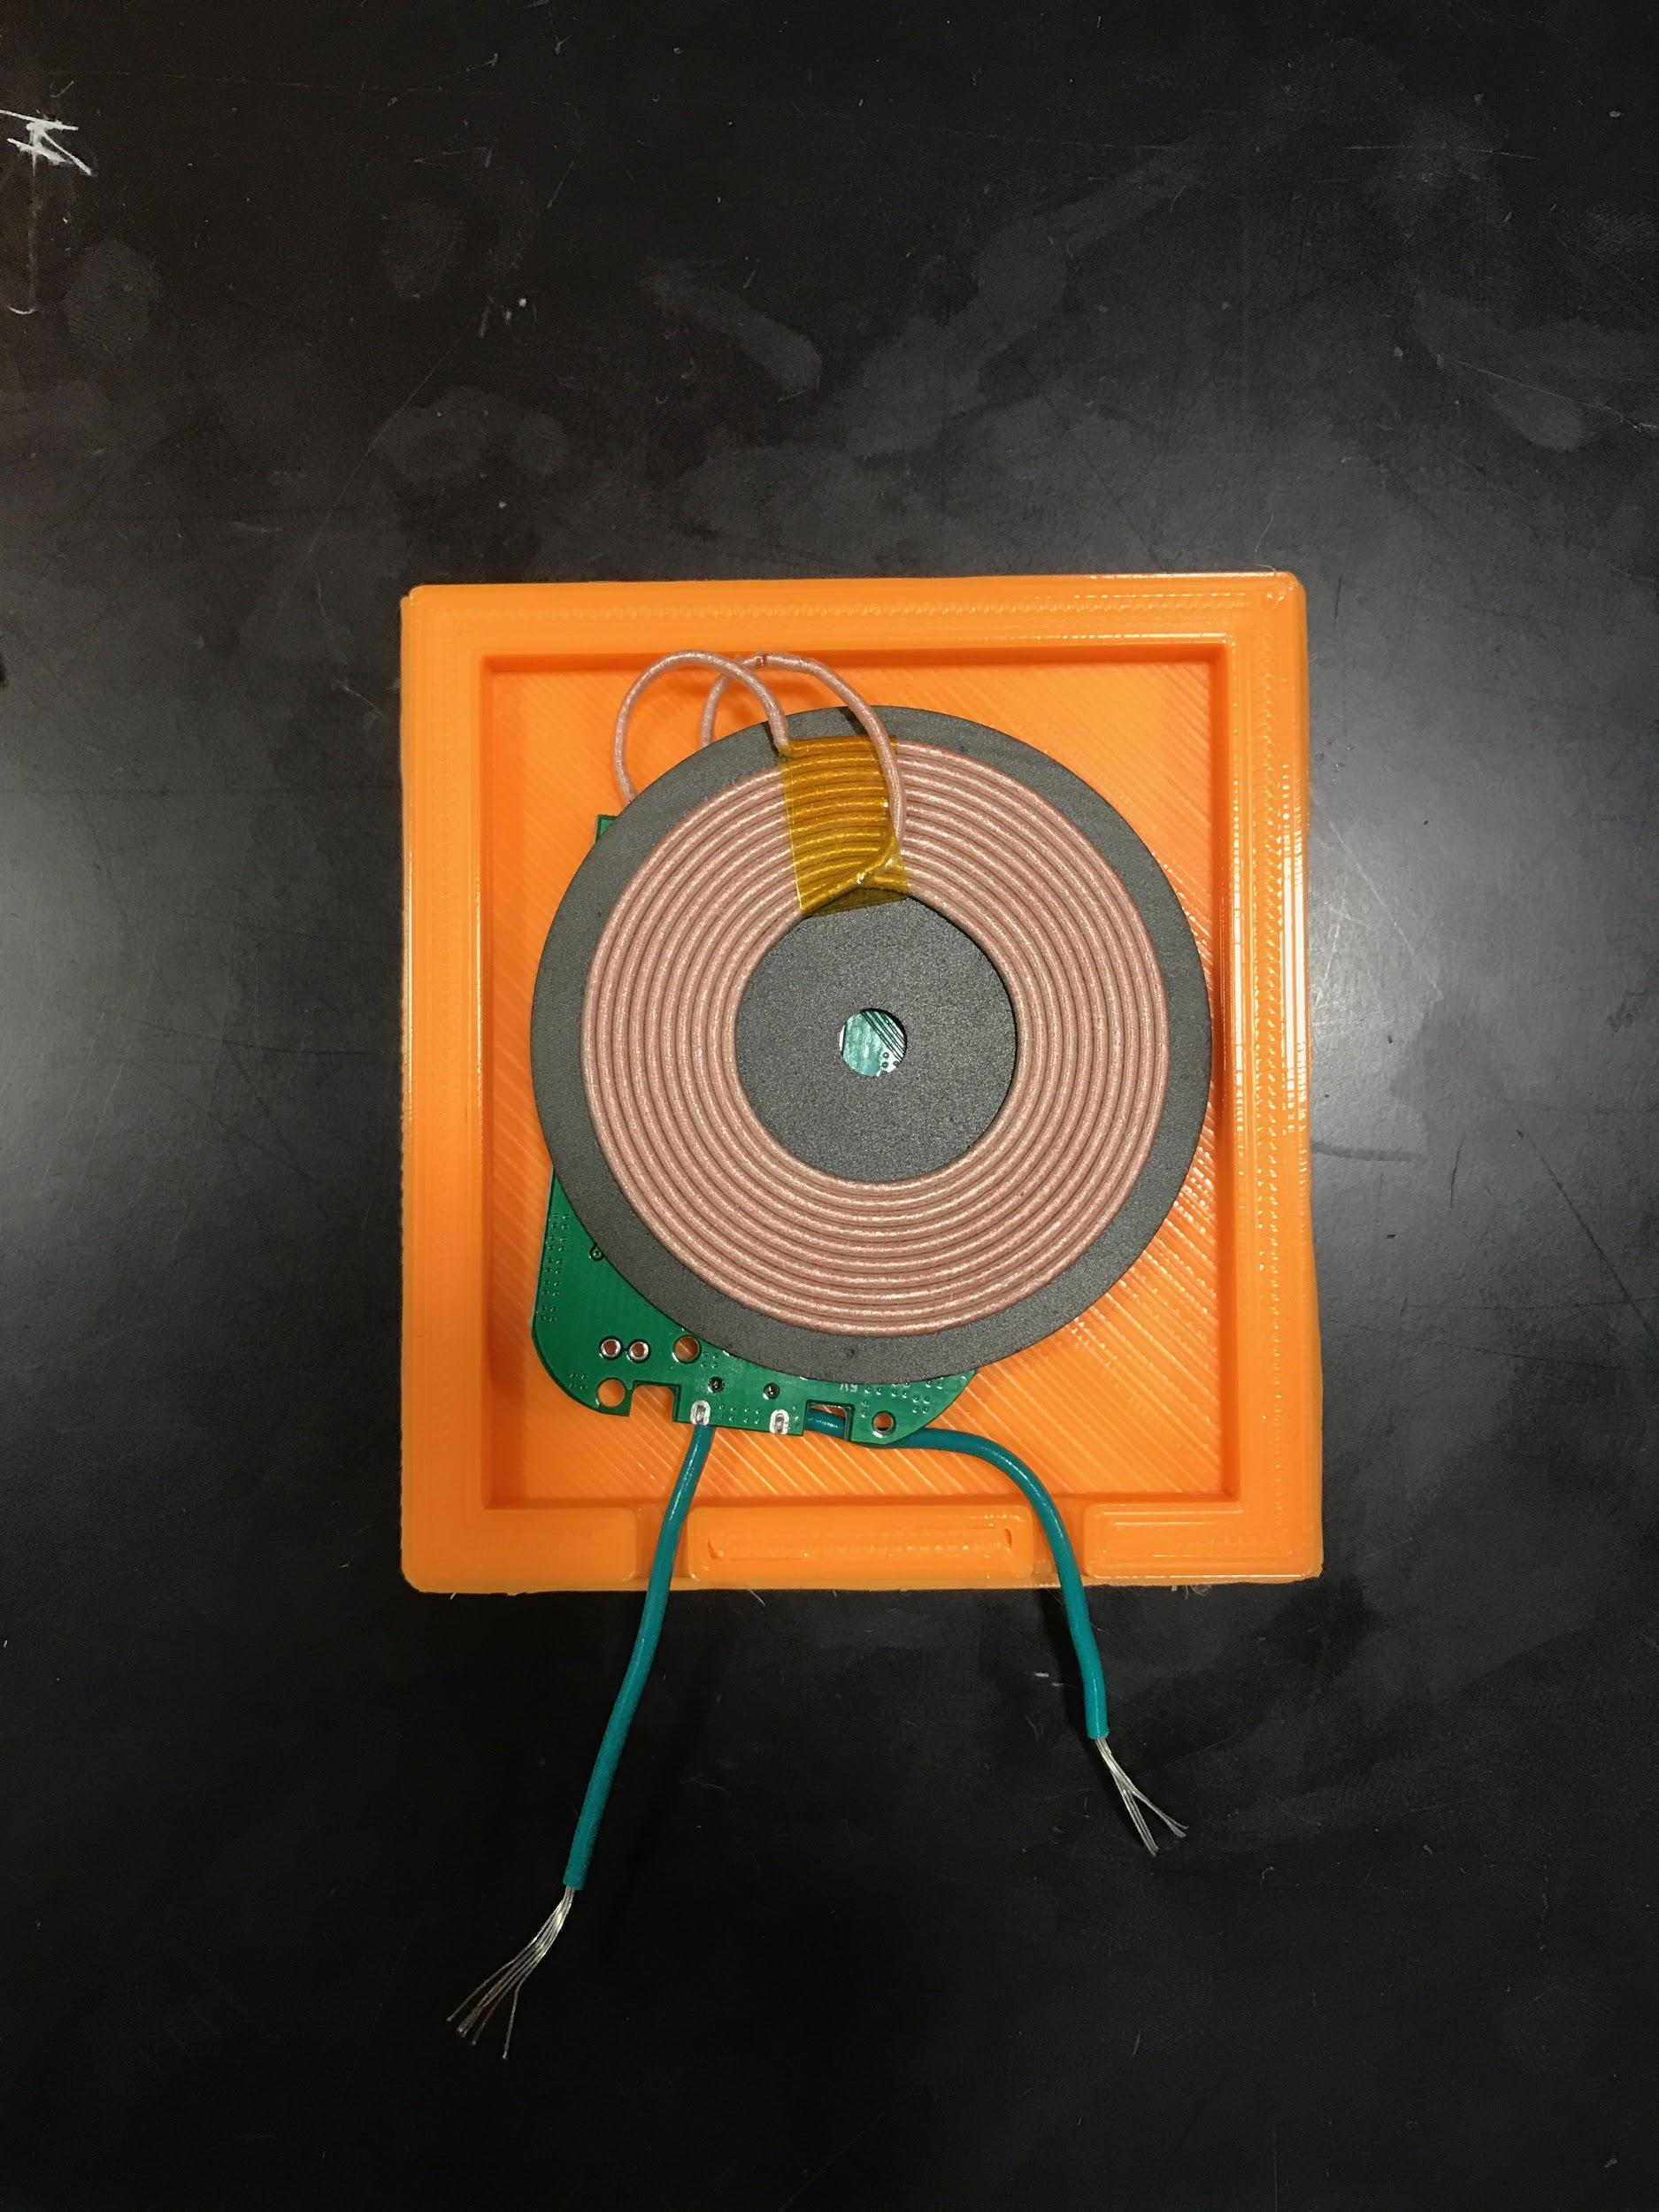
DC-AC circuit

Slide 16
DC-AC circuit
Requirements:
1)
The AC signal frequency must be within the Qi range.
2)
The coil temperature should not exceed 120ºC.
3)
Microcontroller can detect Qi receiver circuit within a range of 5 mm.

Slide 17
DC-AC circuit (video)

Slide 18
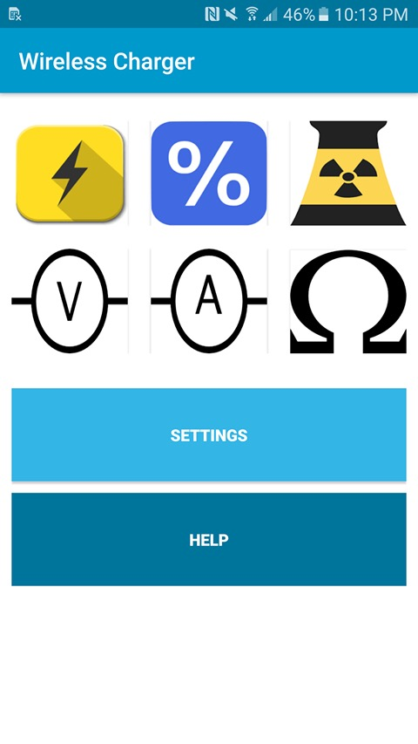
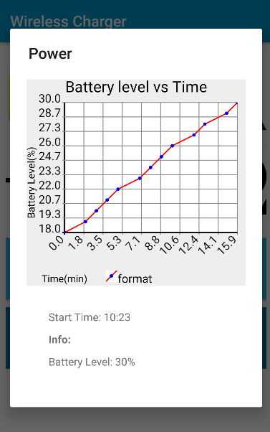
Software
Display a graph of battery level(%) vs time(min).
The graph dynamically changes as the battery level increases.
User can extract important information such as the rate of charging.
Alert user if battery overheats or battery voltage is too high

Slide 19
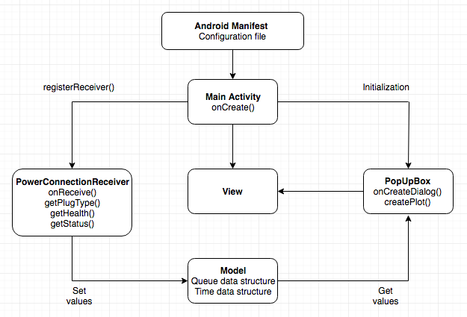
Software Block Diagram

Slide 20
SWOT analysis
(Strength, Weakness, Opportunity, Threat)
Strengths
Cost efficient ($12-$17) & portable
Weakness
Slower charging time when compared to wall charger
Opportunity
Market trending towards removing aux ports
Threat
Apple may not follow Qi standard

Slide 21
Further work
We have a basic functional circuit that charges the phone wirelessly, and a software application to accompany it. For future plans:
We plan to design the phone case to incorporate a rechargeable battery.
We also plan to improve the functionality of the software application such that it can communicate with the circuit directly, and not limited to the Android OS. This can add more functionality such as user control for charging.
Develop a similar iOS application.
Market our product, and gain user feedback.

Slide 22
Conclusion
We would like to thank Prof. Scott Carney, Prof. Arne Fliflet, Prof. Seth Hutchinson, Prof. Michael Oelze, Prof. Karl Reinhard, and our fantastic TA, Jackson Lenz for guiding us through this course, and giving us the opportunity to experience, learn and transition to industry level product development.

