Slide 1
Power Tool Safety Zone Enforcer
Kristina Chu | Channing Philbrick | Nick Ratajczyk
ECE 445 | Spring 2017 | Group 11
May 2, 2016

Slide 2
Motivation
79,500 table/bench saw entries medically treated in 2007-2008 [1]
Location/distance checks and accidental startup prevention are important safeguarding methods [2]
Goal: Reduce injuries caused by human interference
Source:
https://studentshop.pratt.duke.edu/lab%20space
Notes:
Channing

Slide 3
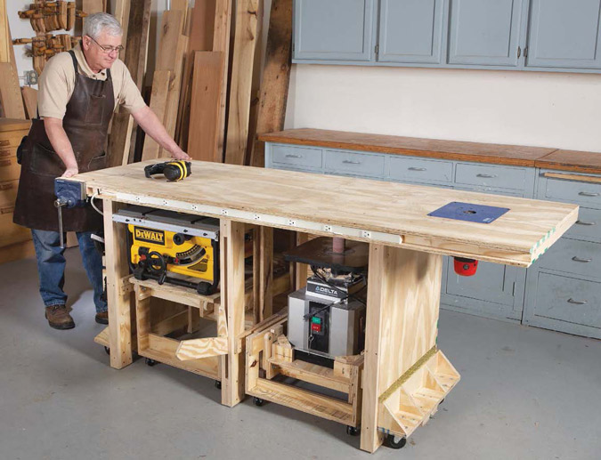
Objective
A non-invasive way to improve machine shop safety
Little hassle for workers
Quick response time to detection of hazards
Source: http://www.popularwoodworking.com/woodworking-blogs/power-tool-friendly-bench-richard-tendick
Notes:
Channing

Slide 4
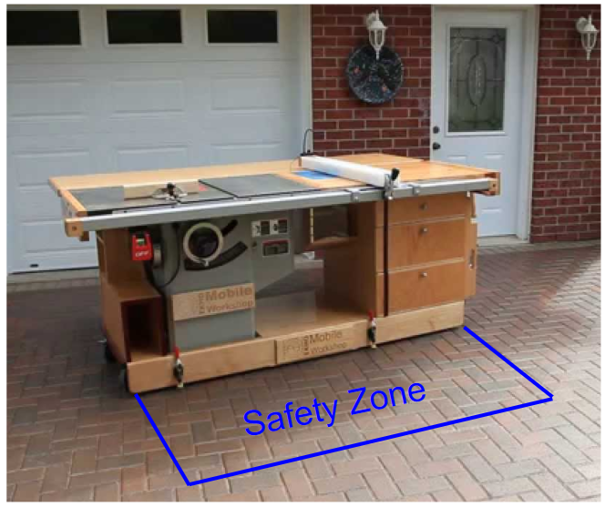
Features
Monitor human activity within a 1.2m x 1.8m zone in front of a power tool
If there are too many people in the zone, the tool will not be able to be operated
Display safety status of tool to worker
Source: https://i.ytimg.com/vi/sIZ2hrmJCmY/maxresdefault.jpg
Notes:
Nick

Slide 5
Ethics and Safety
IEEE Code of Ethics
#1 - “...promptly [disclose] factors that might endanger the public or the environment” [3]
Product designed to identify worker hazards
Provide immediate feedback to the user of potential danger
OSHA: Occupational Safety and Health Administration
Current regulations account for operator’s whereabouts but not passerby’s
Zone of safety as a workplace-level regulation
Despite the added safety, power tools are still dangerous
Notes:
Nick

Slide 6
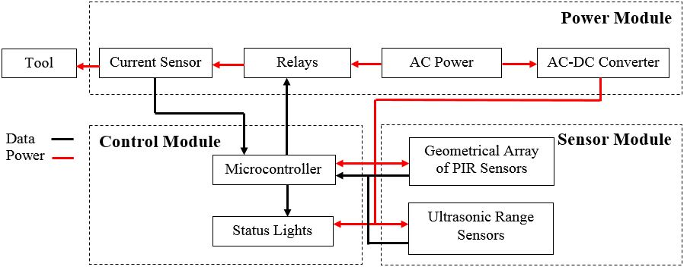
Block Diagram
Notes:
Kristina

Slide 7
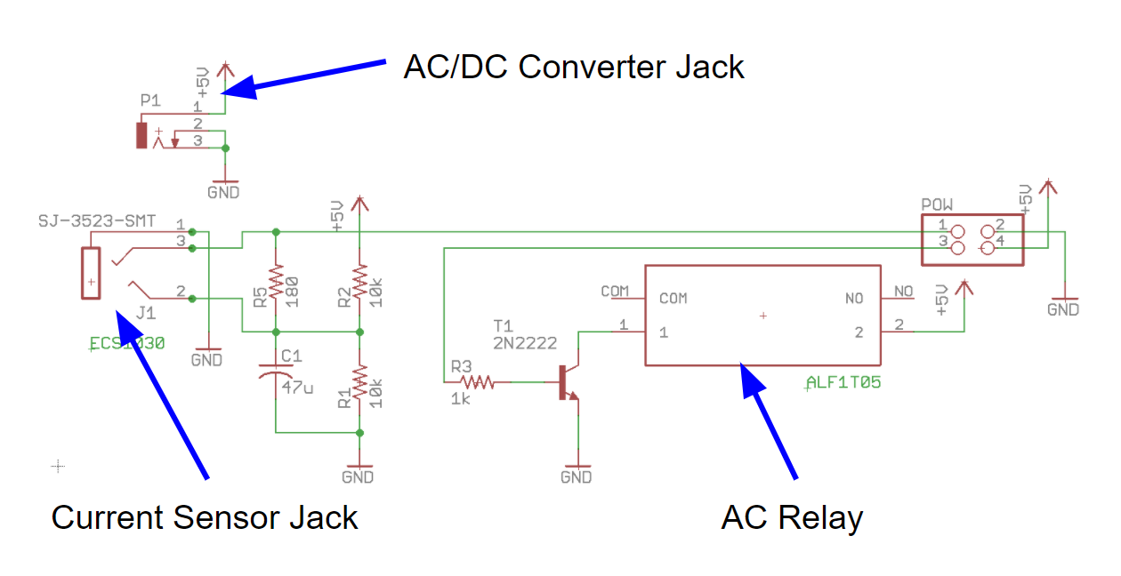
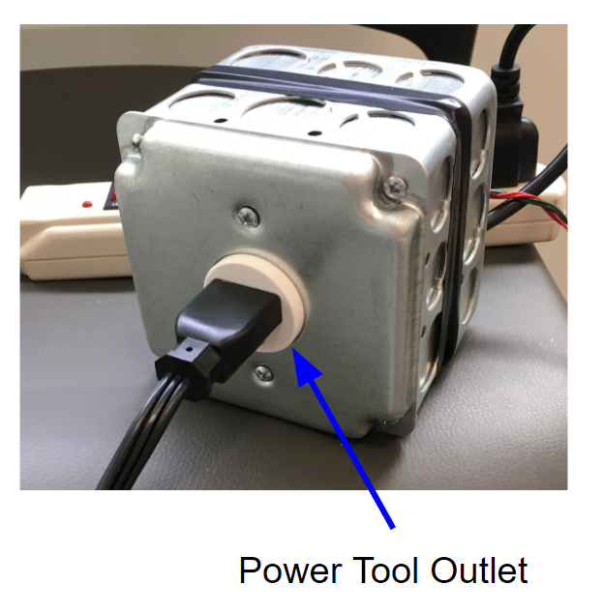
Power Module
Overview
Notes:
Channing

Slide 8
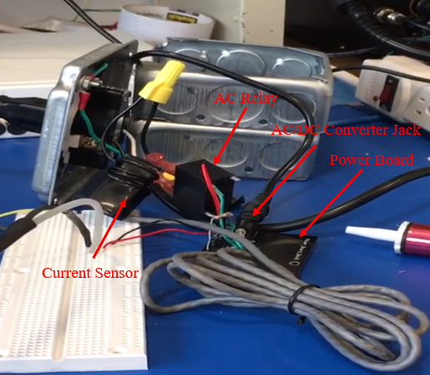
Power Module
Verification
Unit testing of individual components
Current sensor I-V relation for 180Ω load
Impedance checks on AC relay contacts
AC/DC converter output ripple
Notes:
Channing

Slide 9
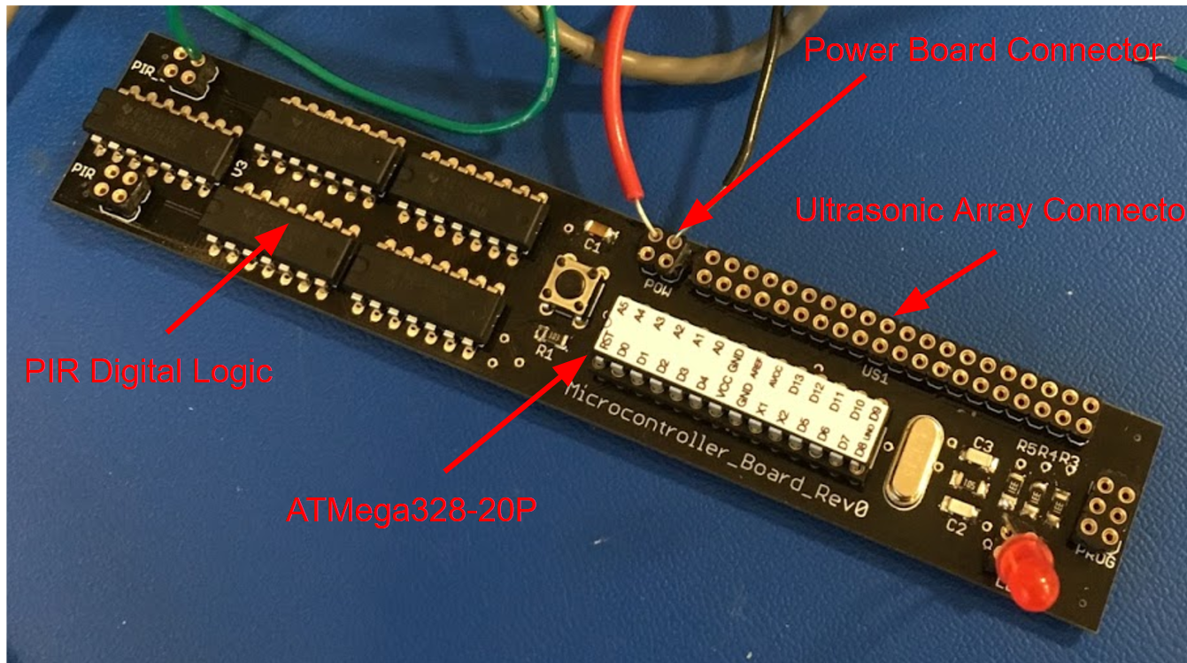
Microcontroller
Notes:
Channing

Slide 10
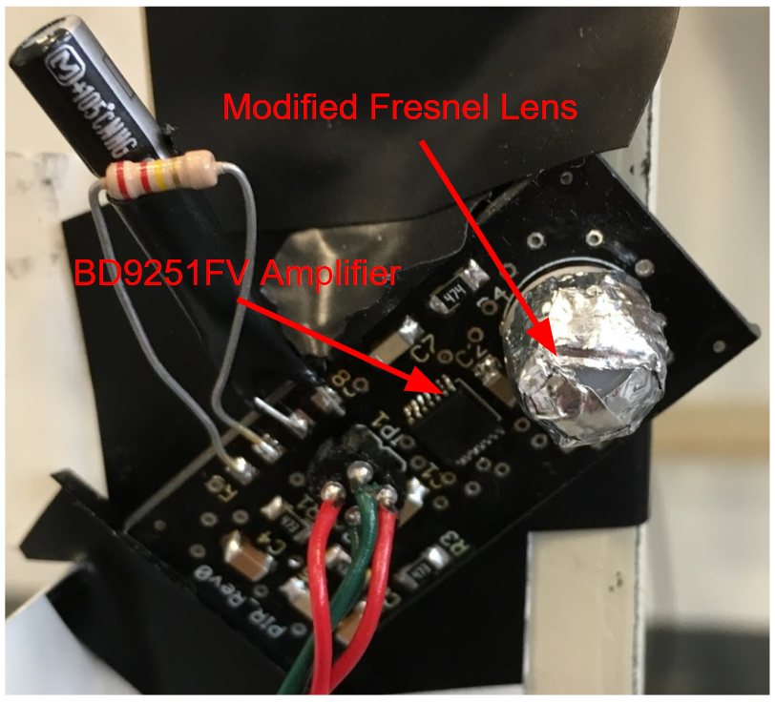
Passive Infrared (PIR) Sensors
Overview
PIR Sensor
Passive sensor
Detects infrared (IR) signatures moving orthogonal to the sensor
BD9251FV Filter-Amplifier
Amplifies and filters PIR signal
D_OUT signal indicates activity
T_OUT signal indicates direction
Modified Fresnel Lens
Splits sensor field of view (FOV) into narrow beams
Modification blocks all but one beam
Notes:
Nick

Slide 11
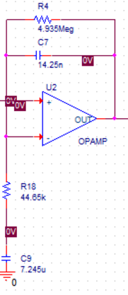
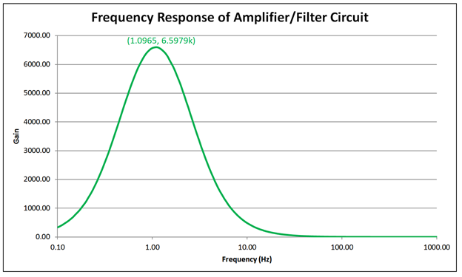
PIR Sensors
Amplifier Design
Gain Calculation
Cutoff Frequency Calculation
Notes:
Nick

Slide 12
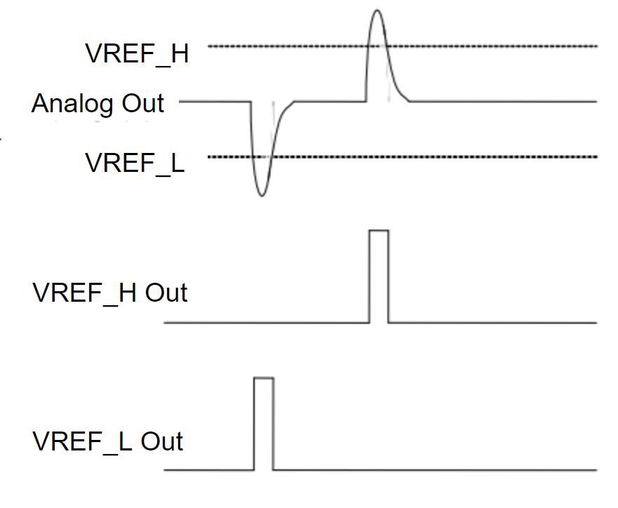
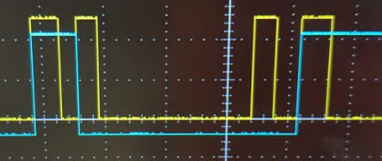
PIR Sensors
Output
Comparator turns analog output of amplifier into digital signal D_OUT
Directional output T_OUT is the directional output and is the output of an SR latch
5V
Source: http://rohmfs.rohm.com/en/products/databook/datasheet/ic/sensor/human_body_detector/bd9251fv-e.pdf
Notes:
Nick

Slide 13
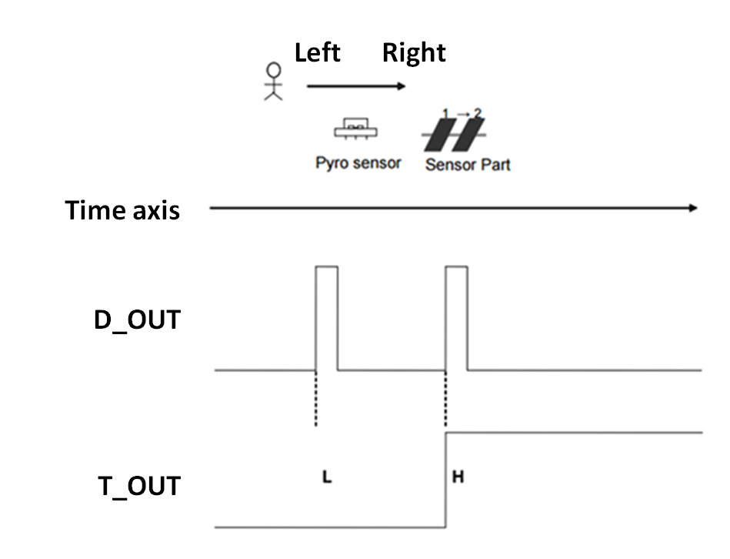
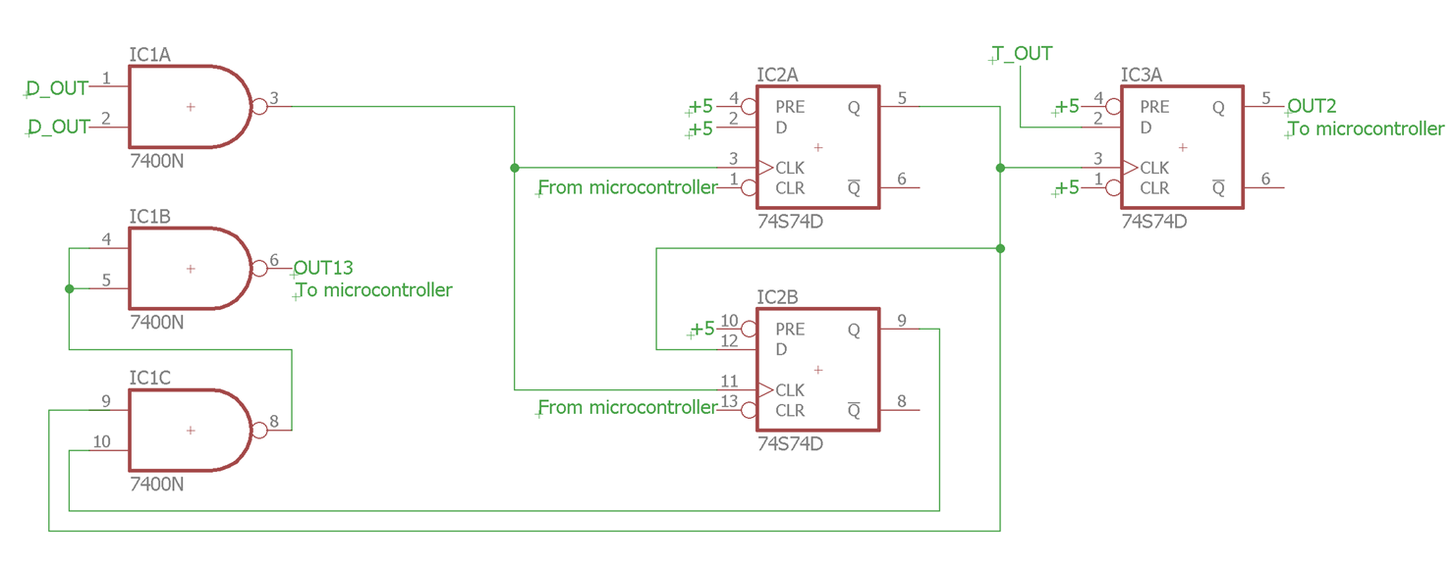
PIR Sensors
Digital Logic
Purpose: Maintain information from asynchronously triggered PIR sensors
Holds D_OUT and T_OUT
Reset when microcontroller reads data
Source: http://rohmfs.rohm.com/en/products/databook/datasheet/ic/sensor/human_body_detector/bd9251fv-e.pdf
Notes:
Kristina

Slide 14
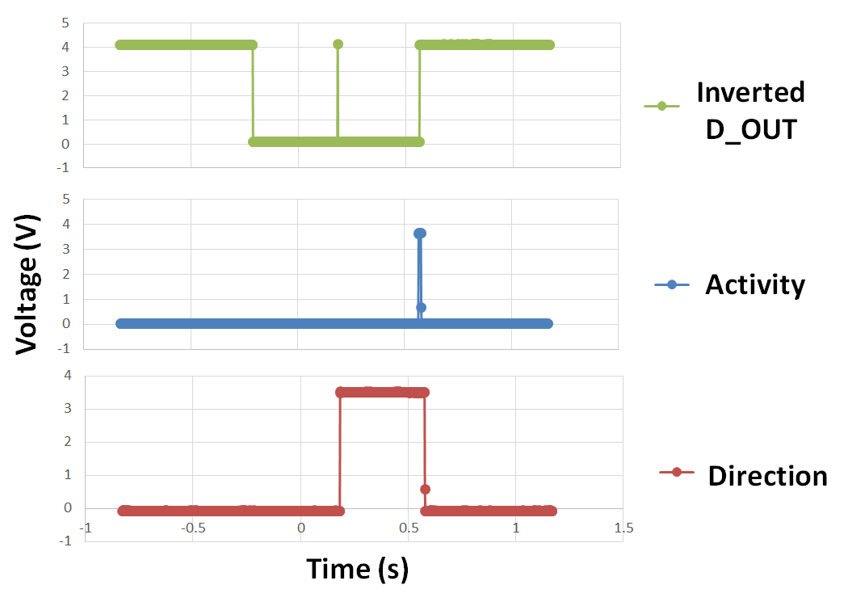
PIR Sensors
Verification
Tested using microcontroller for reset
Verified in software and on oscilloscope
Notes:
Kristina

Slide 15
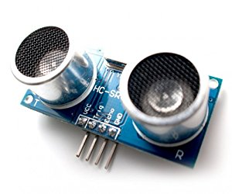
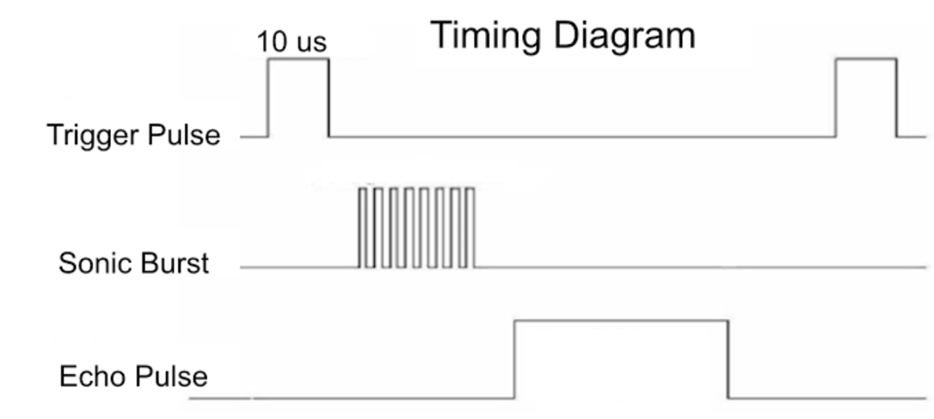
Ultrasonic Sensors
Overview
Operating range of 2 - 400 cm
Chosen because of ease of interface with microcontroller
Good for detecting motion along its field of view
Notes:
Channing

Slide 16
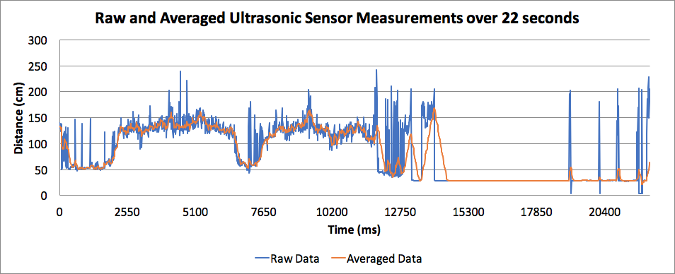
Ultrasonic Sensors
Use of simple averaging filter to lessen impact of spurious readings
Notes:
Channing

Slide 17
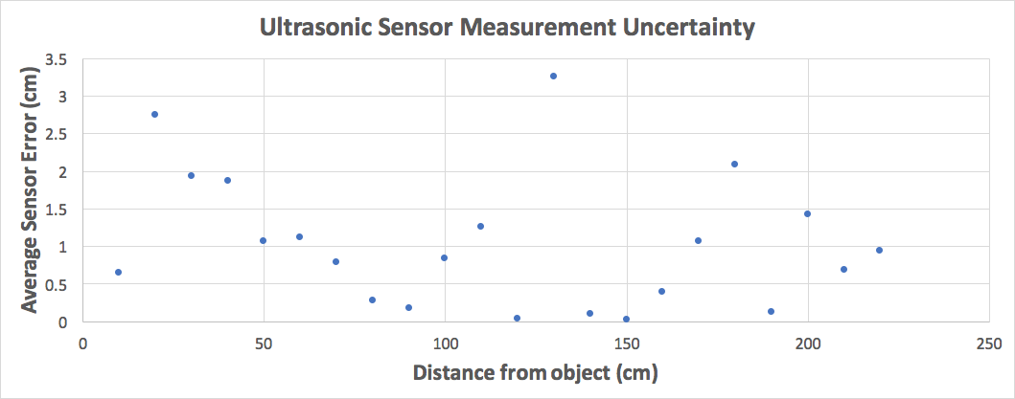
Ultrasonic Sensors
Verification
Distance measurements in 10 cm increments
Stationary object with flat surface
Filtering algorithm required to accurately detect human activity
Notes:
Channing

Slide 18
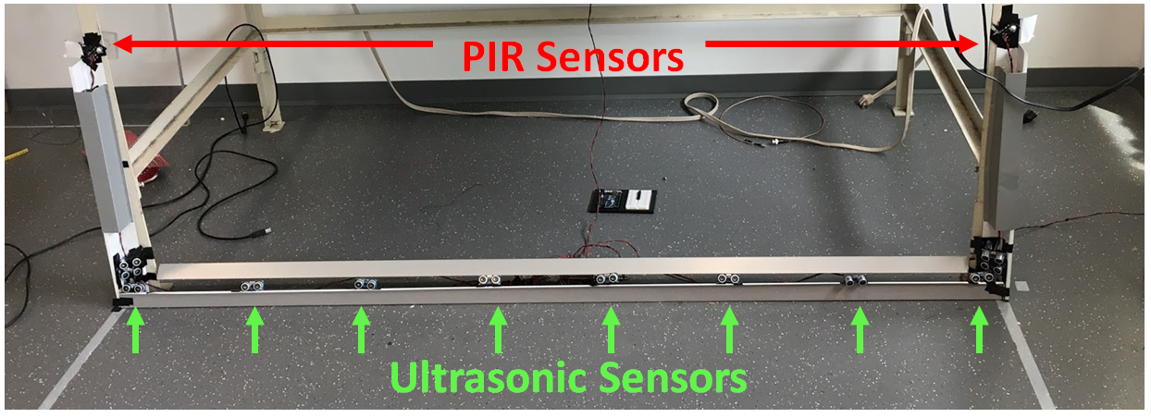
Sensor Array Layout
Overview
Goals
Detect entries and exits
Both single person and multiple people at a time
Account for obstructed sensor view
Limitations
Ultrasonic field of view fixed width
PIR does not give steady state values
Notes:
Kristina

Slide 19
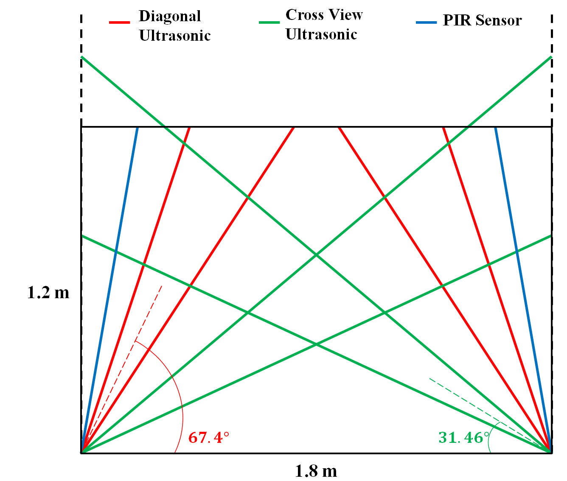
Sensor Array Layout
Side Entry/Exit and Obstructed Back Entry/Exit
Notes:
Kristina

Slide 20
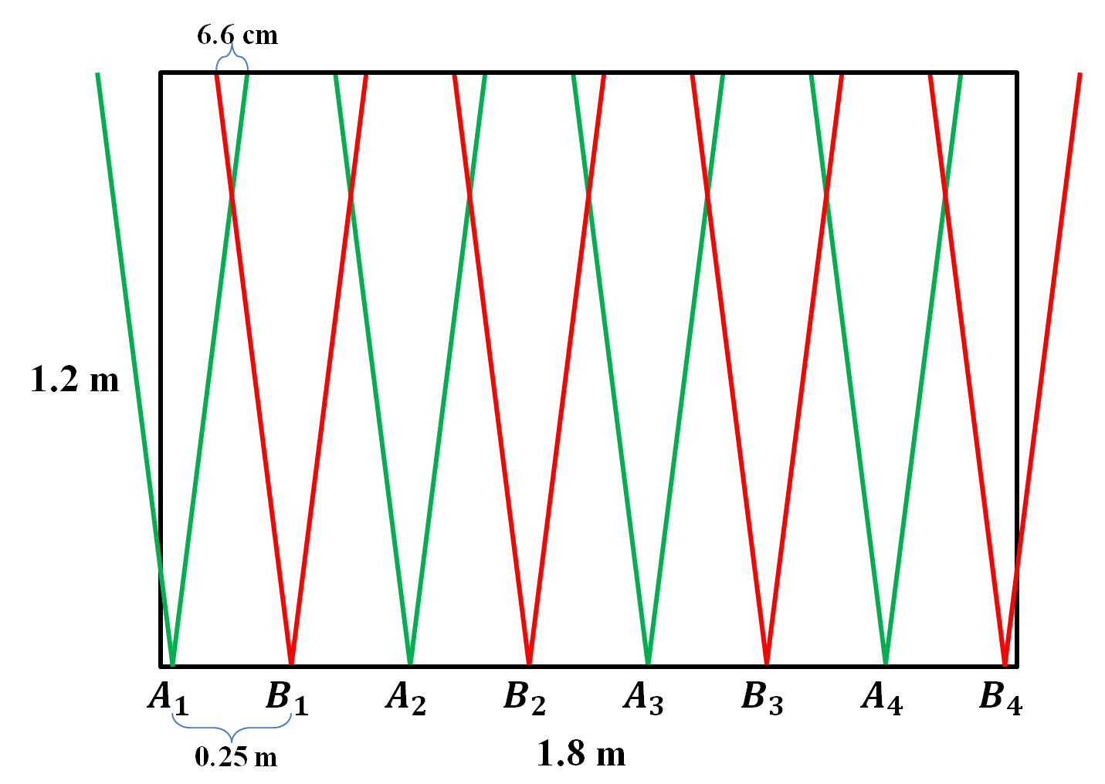
Sensor Array Layout
Back Entry
Notes:
Kristina

Slide 21
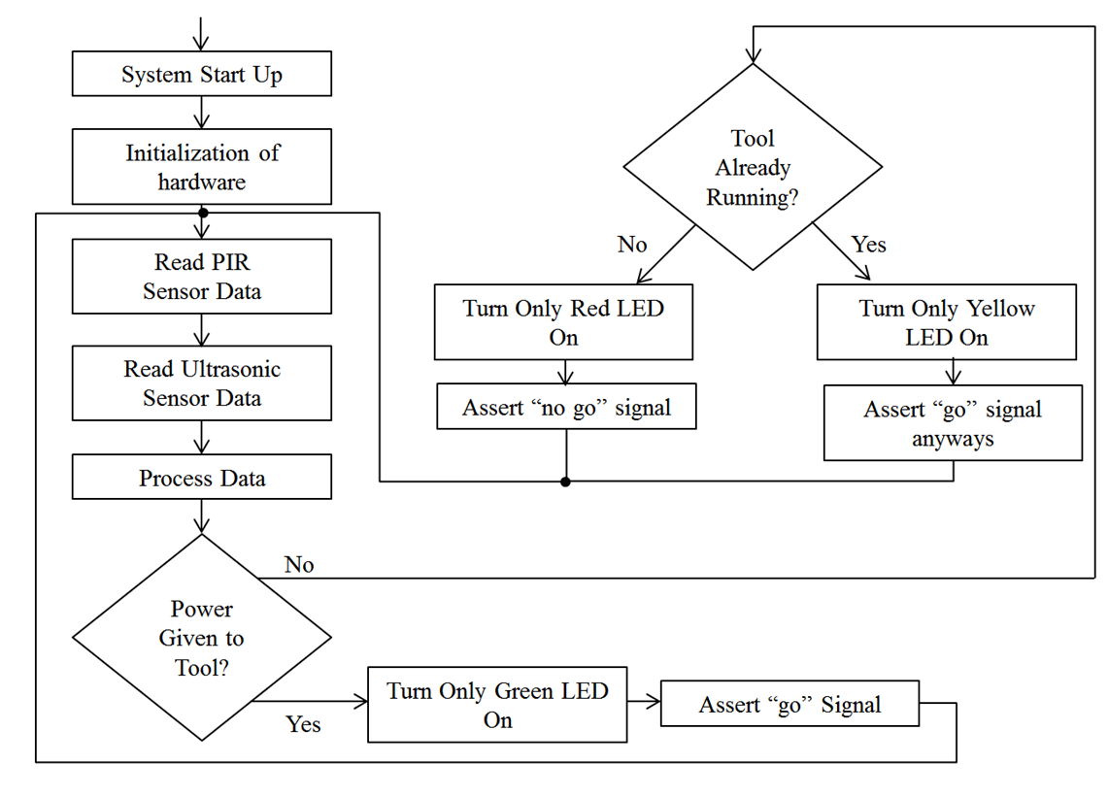
Software Algorithms
Main Control Loop
Reads Sensor Data
Calls ProcessData()
Controls Relay and LEDs
Notes:
Kristina

Slide 22
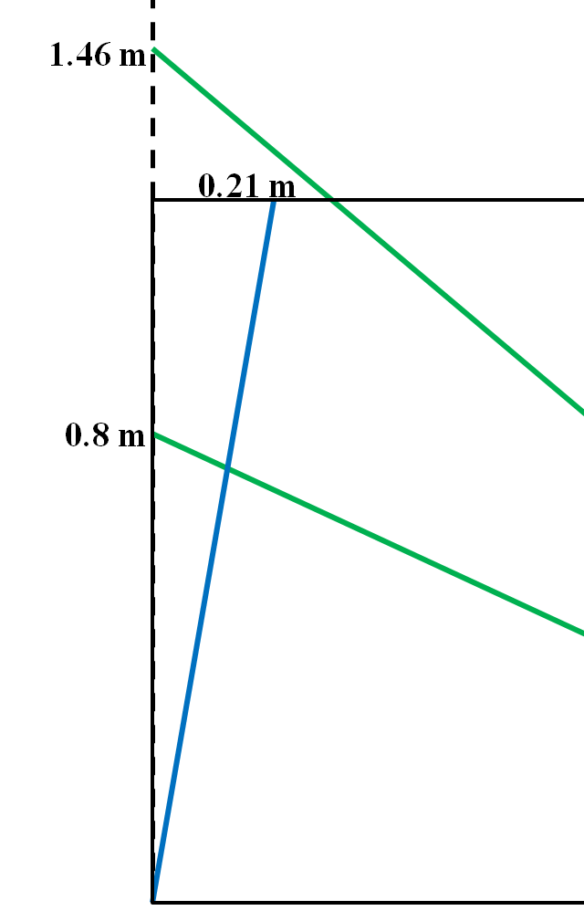
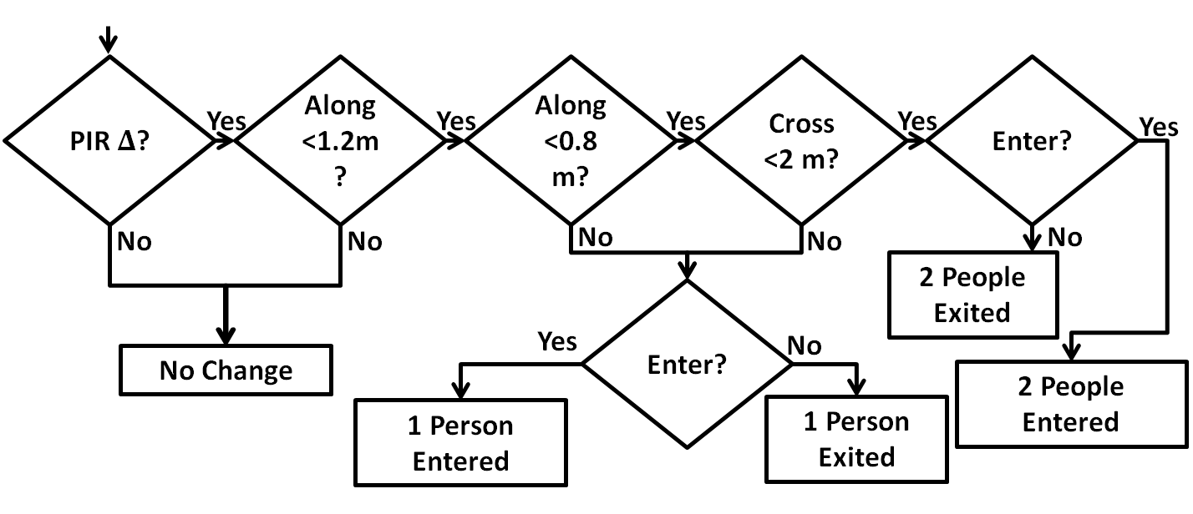
Software Algorithms
Process Data Side Entry/Exit
Uses PIR and Cross Ultrasonic
Detect one or two people entering at a time
Notes:
Kristina

Slide 23
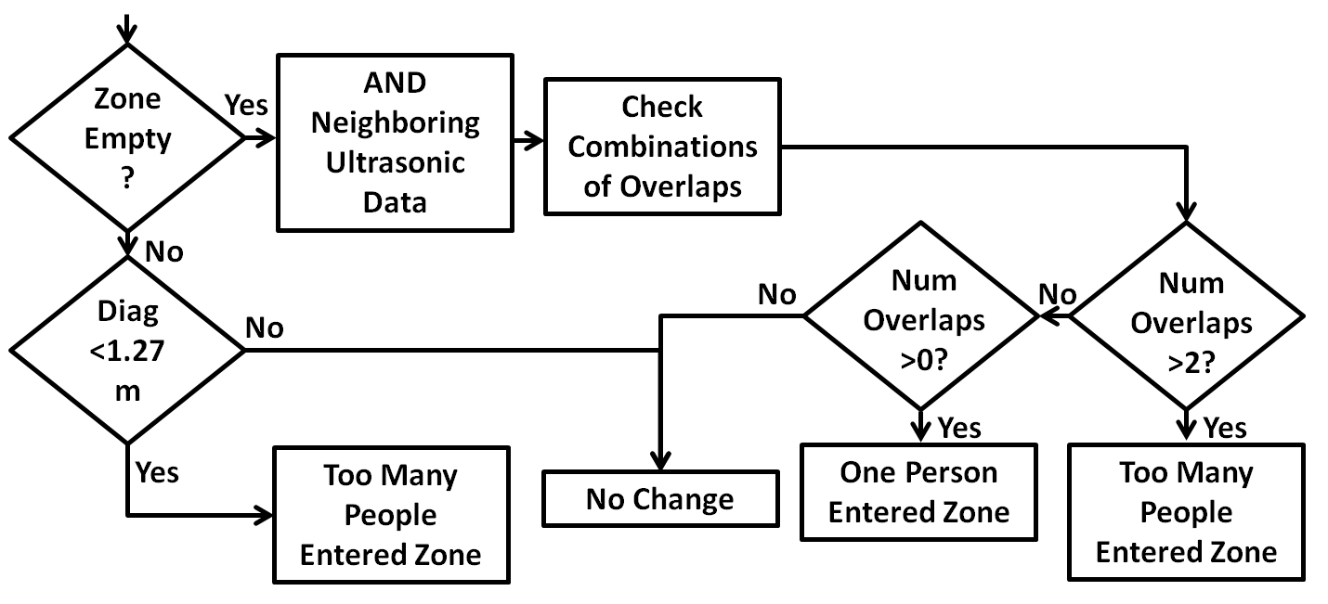
Software Algorithms
Process Data Back Entry
Series of Ultrasonic Sensors
Uses field of view overlap
Notes:
Kristina

Slide 24
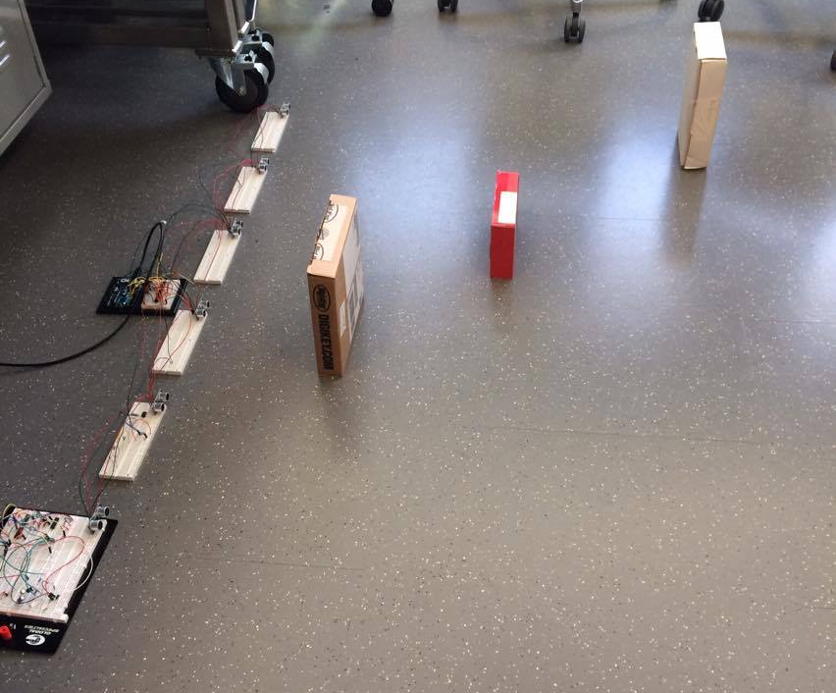
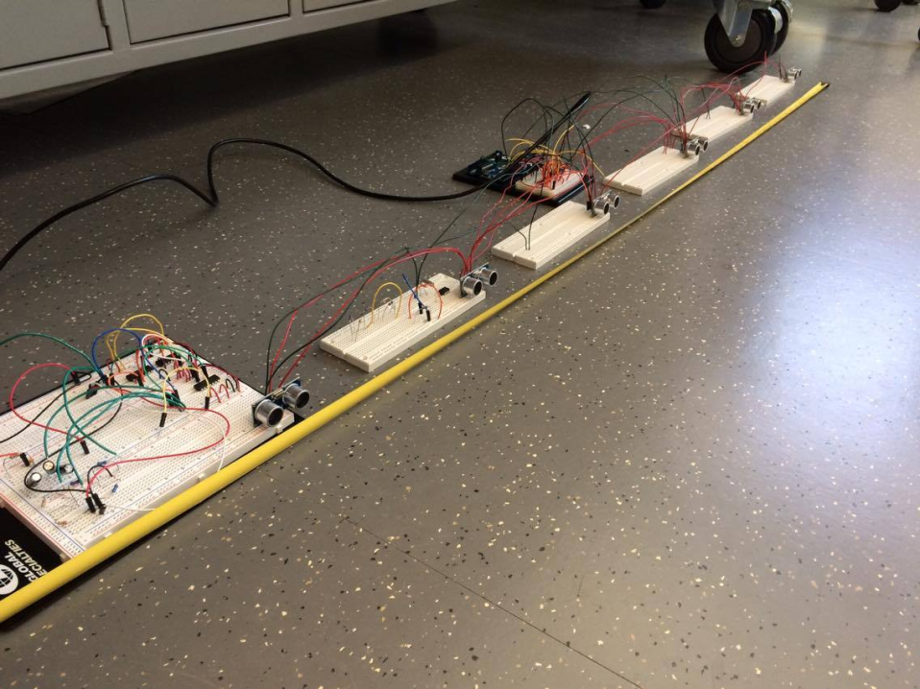
Software Algorithms
Verification
All parts function correctly
Main Control Loop
Read sensor data for PIR and Ultrasonic
Process Data with Idealized Data
Notes:
Kristina

Slide 25
Challenges Encountered
Sensor Algorithm
Unable to read current sensor output consistently
Ultrasonic Sensors
Inconsistent readings
Intrinsic manufacturer design flaws
Intermittent sensor lockup
PIR Consistency
Two-pulse response problem for the full depth of the zone
Notes:
Channing

Slide 26
Successes
System able to count single side entries and exits using PIR sensors
Power module fully functional
Software algorithm works for idealized test data
Ultrasonic sensors individually function correctly when an object is present
Notes:
Channing

Slide 27
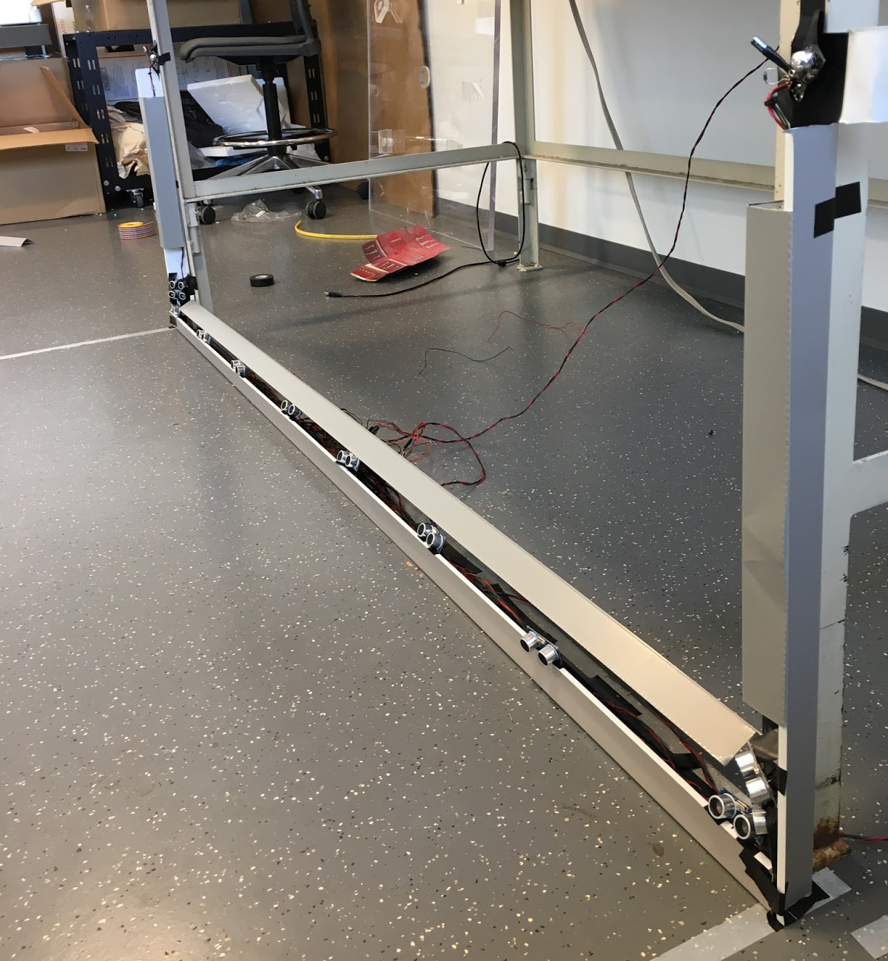
Conclusion
Viable solution to unsolved problem
Cost effective
Eliminates human error in self-monitoring a zone
Notes:
Nick

Slide 28
Future Work
Adding accuracy to more precisely define the zone
More robust mounting system
Custom-designed power supply
Only requires one outlet versus two
Reduction in module size
Notes:
Nick

Slide 29
Acknowledgements
Professor Oelze - Assistance with project planning
TA Eric Clark - Guidance throughout
Professor Swenson - Use of lab space
Other ECE 445 Course Staff
Notes:
Nick

Slide 30
Questions?

Slide 31
References
[1] S. R. Chowdhurry. (2009). Survey of Injuries Involving Stationary Saws [online]. Available: https://www.cpsc.gov/PageFiles/108980/statsaws.pdf
[2] Occupational Safety and Health Administration. (1999). Guide for Protecting Workers from Woodworking Hazards [online]. Available: https://www.osha.gov/Publications/woodworking_hazards/osha3157.html

