Slide 1
RFI Detector
Group 13:
Jamie Brunskill
Tyler Shaw
Kyle Stevens

Slide 2
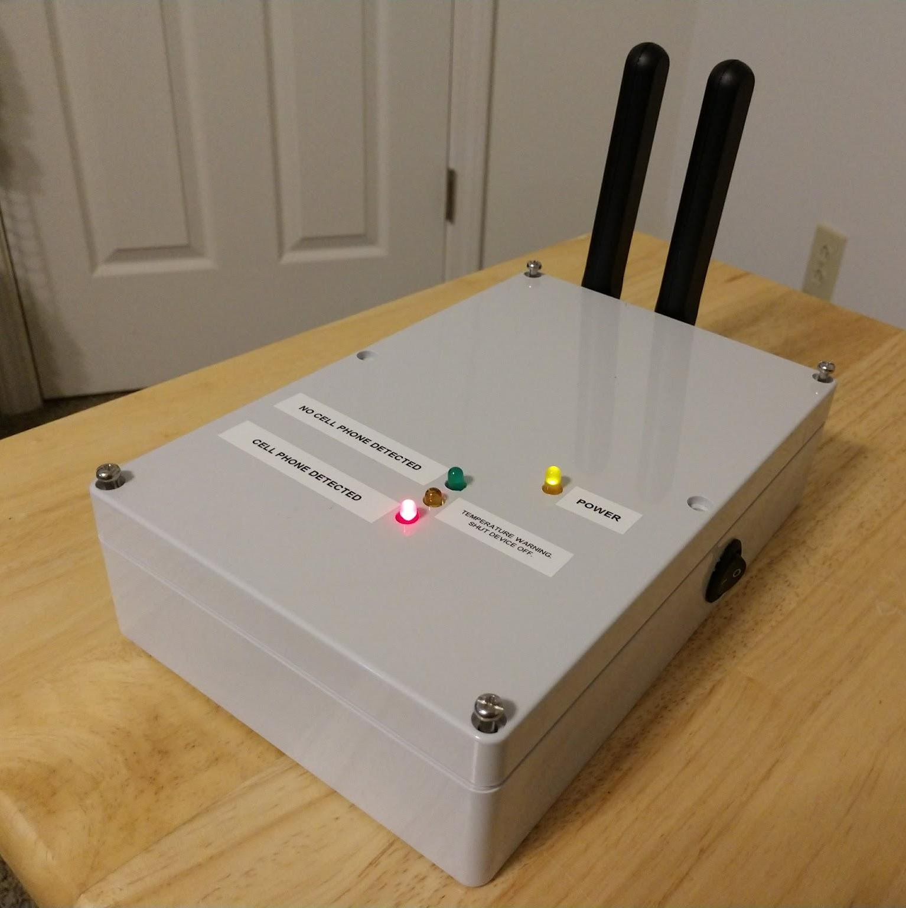
Introduction
Radio Frequency Interference (RFI)
Passive element filters detect phone RF
User knows if nearby phone is active

Slide 3
Objective
Arecibo Observatory
Measurements susceptible to interference
Phones radiate RF signals under normal operation
Can affect data
Easy for visitors to forget and/or ignore
Create handheld device to detect active cell phones

Slide 4
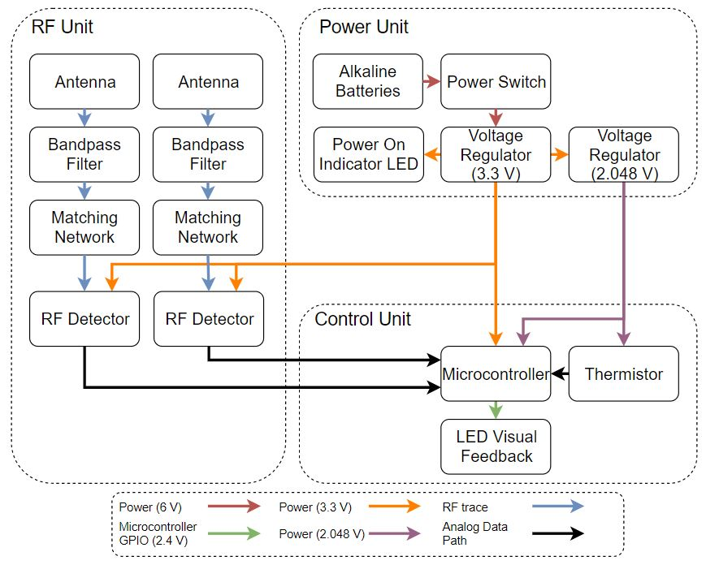
Design

Slide 5
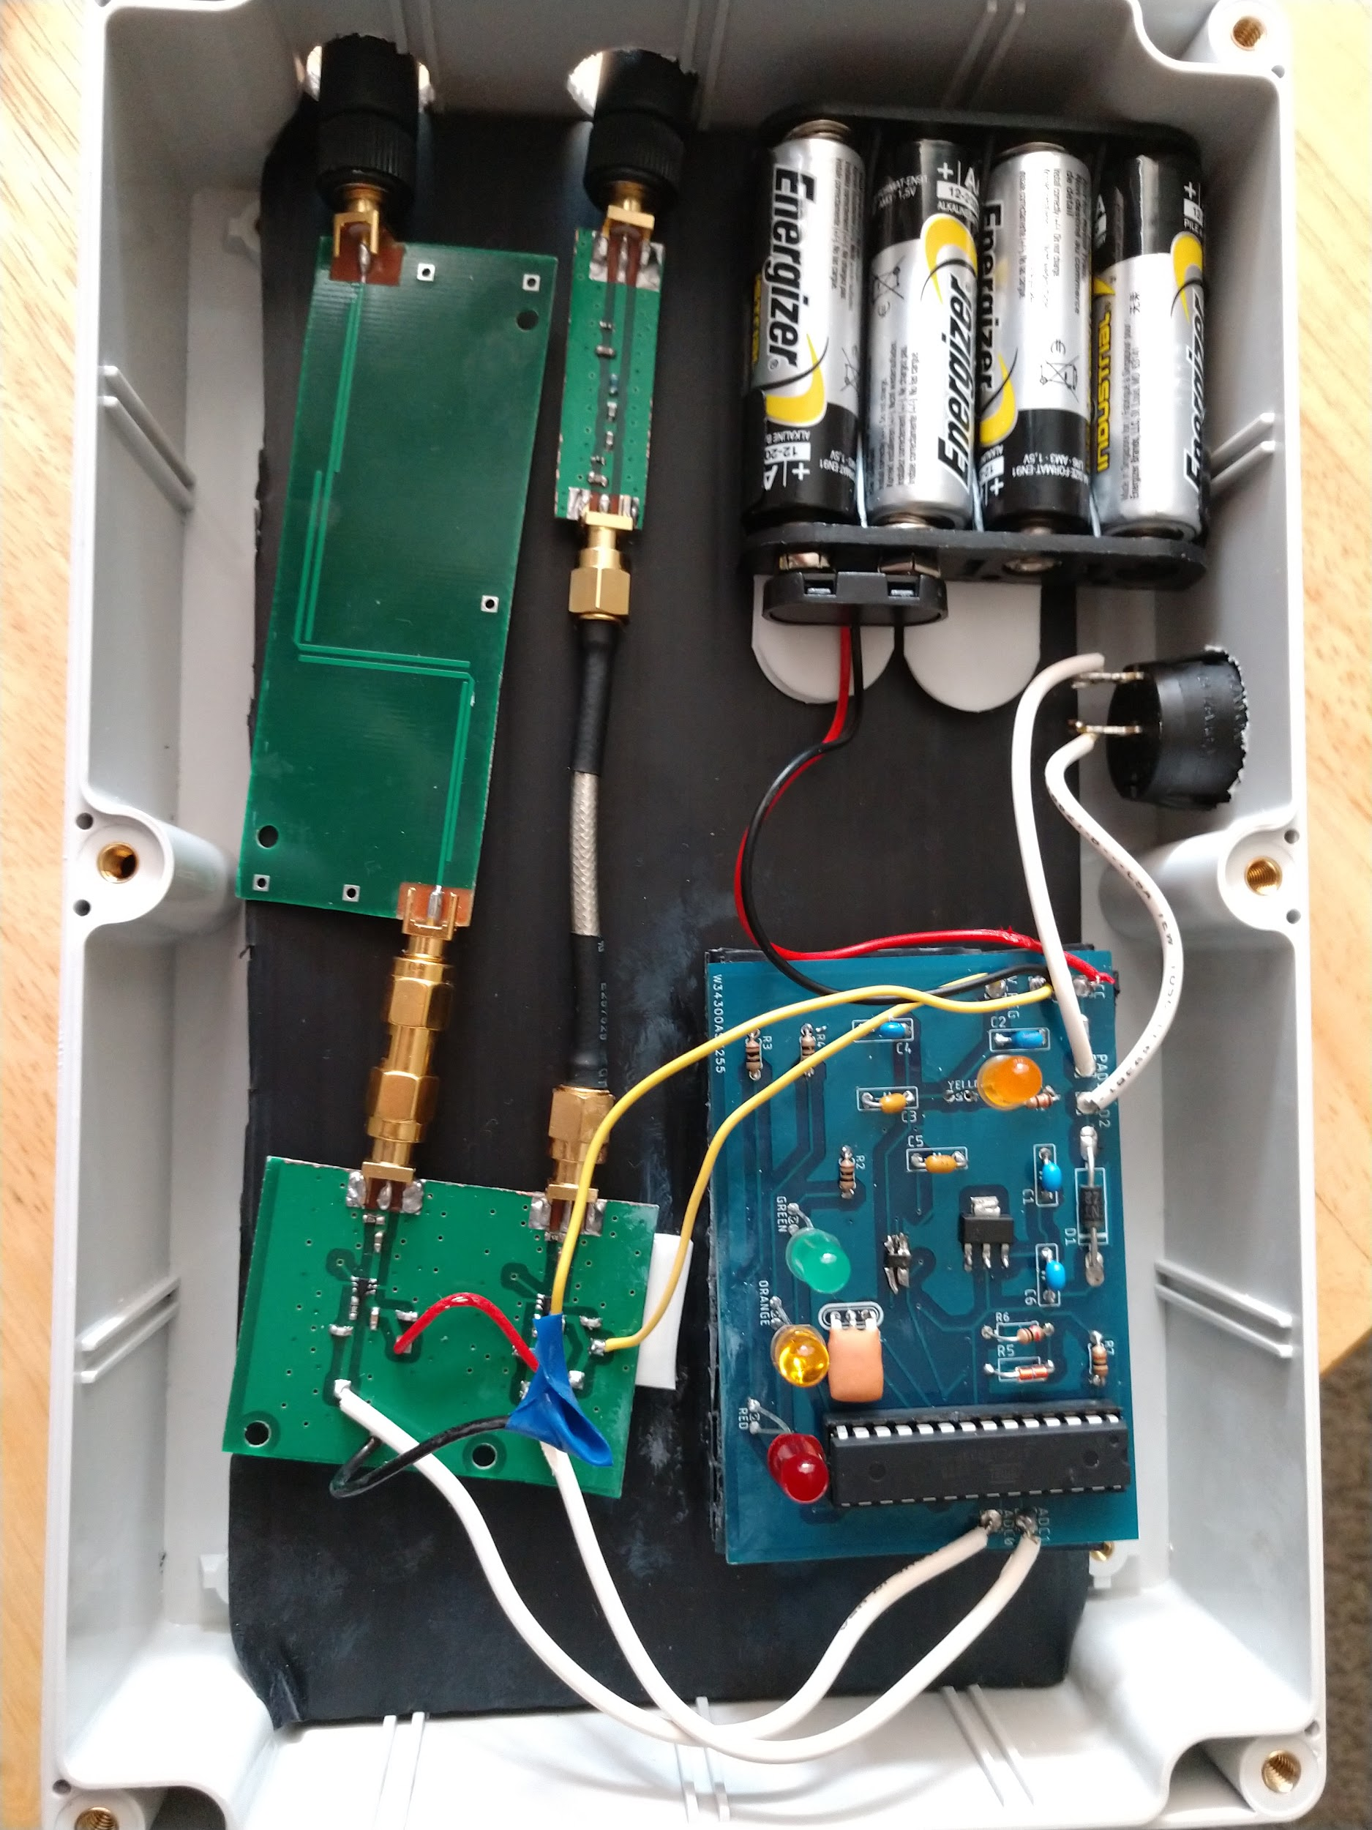

Slide 6
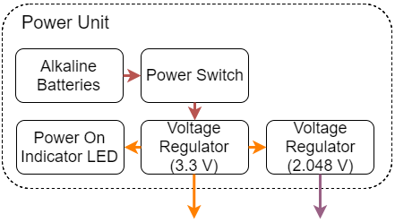
POWER UNIT

Slide 7
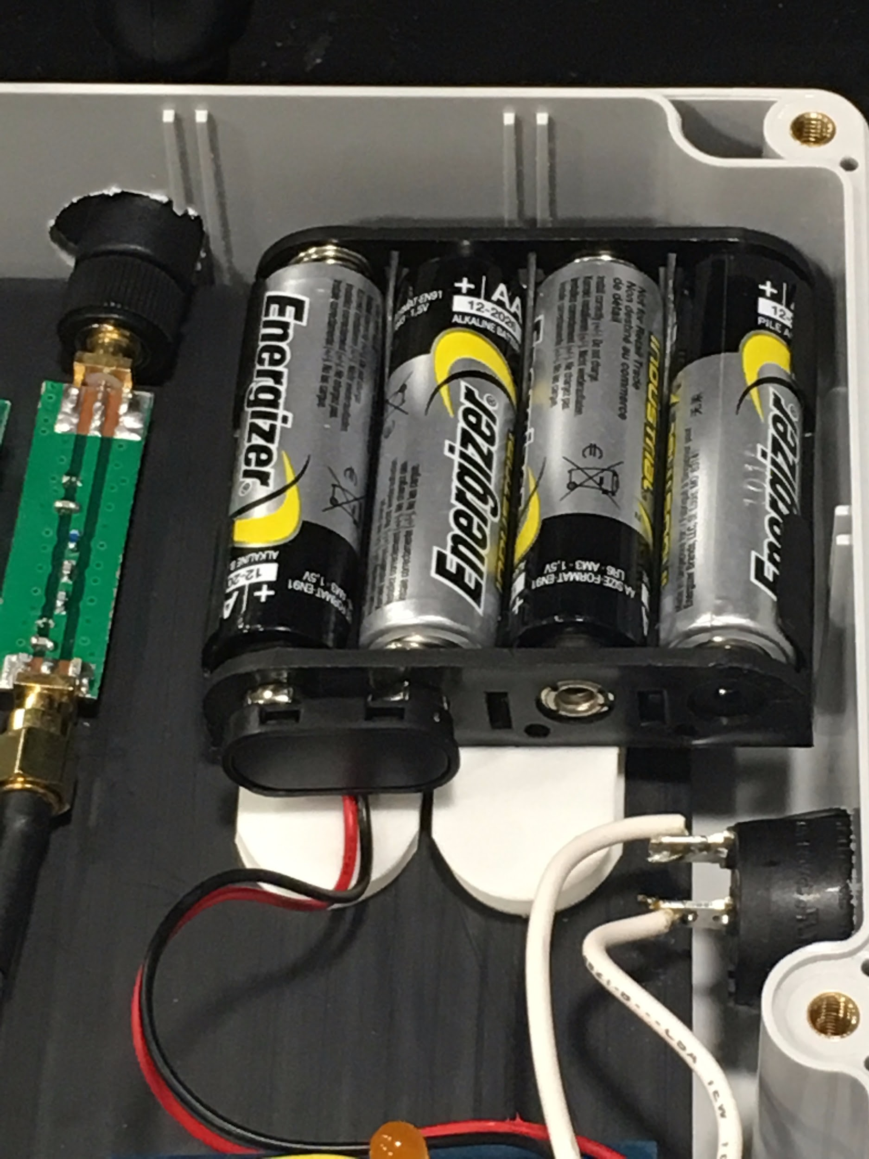
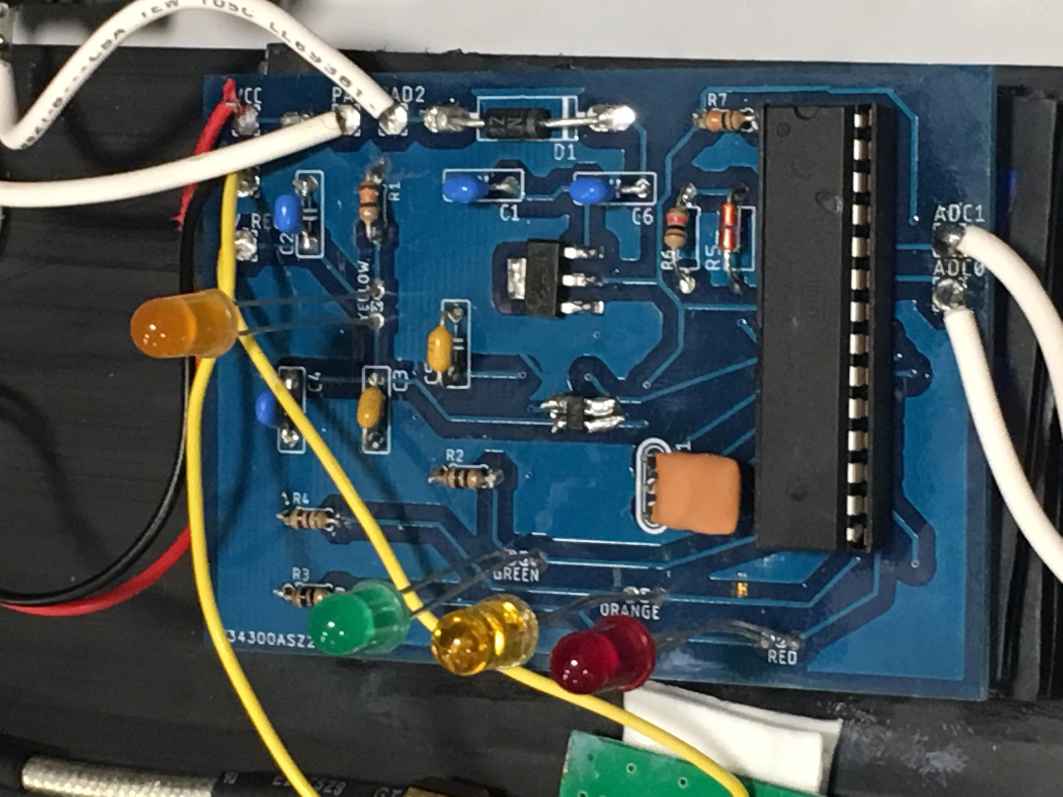
Power Unit
4 AA alkaline batteries to have a starting voltage of 6 V
2 Voltage Regulators
First one steps down the voltage to 3.3V
Second one steps down the voltage to 2.048V
Yellow LED
Indicates that device is on

Slide 8
Power Unit Schematic

Slide 9
Features
Batteries are easily accessible
First Voltage Regulator outputs a steady 3.3V +/- 5%
Second Voltage Regulator outputs a steady 2.048V +/- 5%
Power Switch easily accessible
Yellow LED visible to person using device

Slide 10
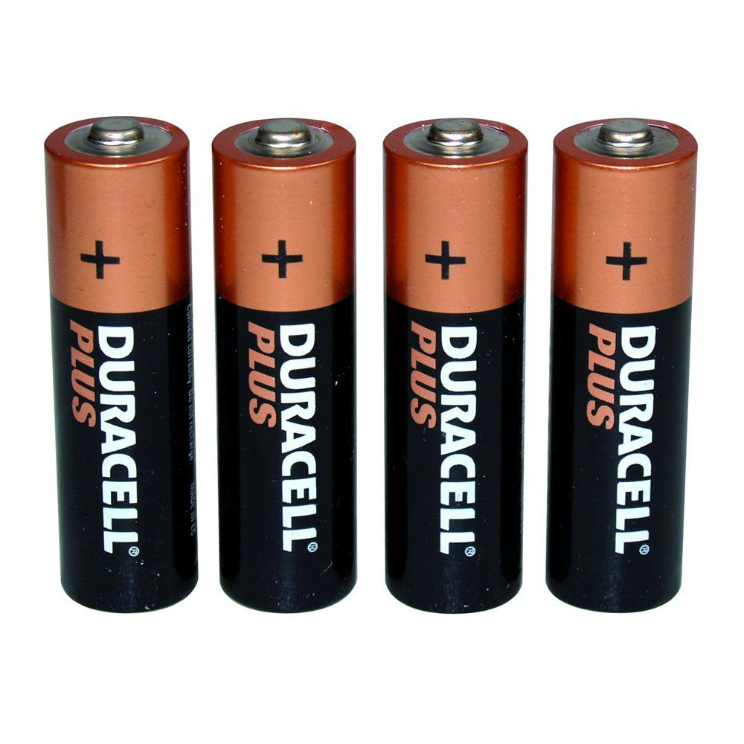
Expected Battery Life
1 AA Battery = 2800 mAh (amp hours)
I_{measured} = 120 mA
Assuming device on 10 minutes per day:
Life Span = 140 days
http://www.presentsformen.co.uk/4-x-aa-batteries-prod7098/

Slide 11
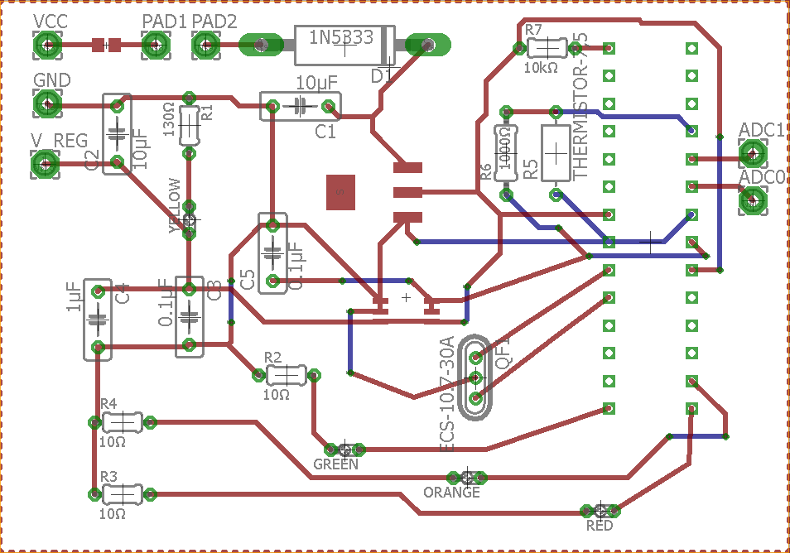
Power and Control Unit PCB

Slide 12
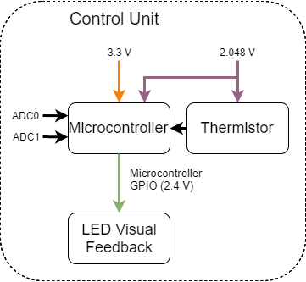
CONTROL UNIT

Slide 13
Control Unit
ATmega328P Microcontroller
Thermistor
LED Visual Feedback
Green: No cell phone detected
Orange: Internal temperature warning
Red: Active cell phone detected

Slide 14
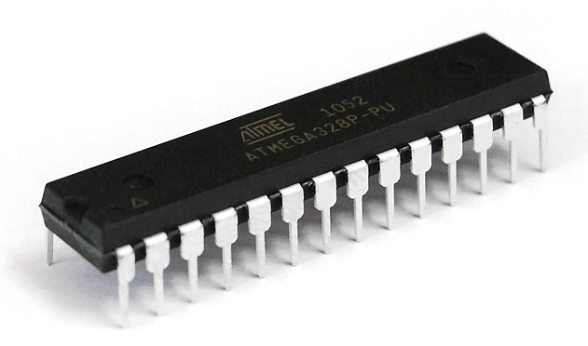
ATmega328P
Multiple 10-bit Analog-to-Digital converters
Uses Arduino ISP
I/O pins support 10 mA, 2.1 V output
https://ktechnics.com/shop/atmega328p-pu/

Slide 15
ADCs
ADCs convert analog voltage to digital number
Based on external reference we provide (2.048 V)
Assigned number between 0-1023

Slide 16
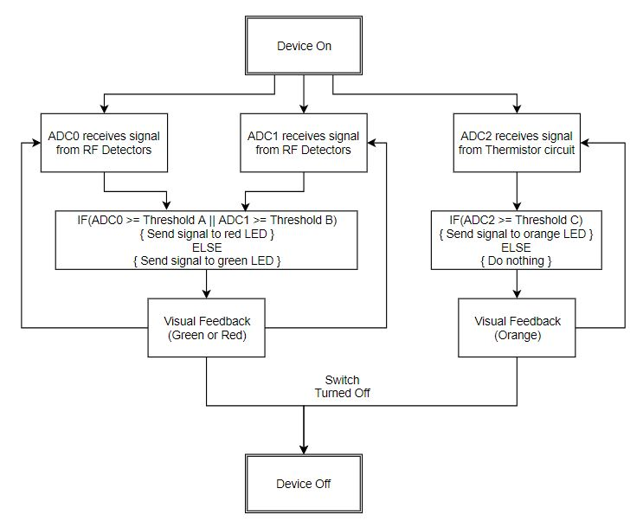

Slide 17
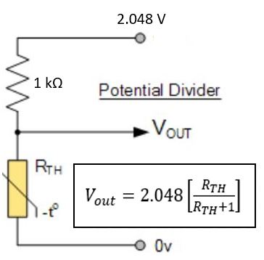
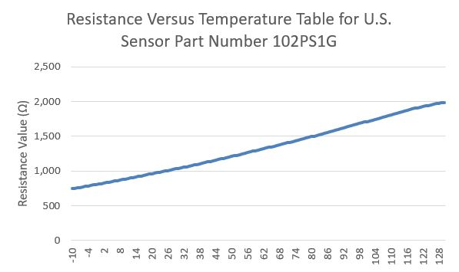
Thermistor Sub-Circuit
V_{out} is sent to ADC₂
R_{TH} changes based on temperature
Safe operating usually around 85 ^{oC}
We set our cutoff at 81 ^{oC}
R_{TH} = 1.504 kΩ
Threshold C set to 615
https://www.altera.com/products/common/temperature/ind-temp.html#table1
http://www.electronics-tutorials.ws/io/thermistors.html
Notes:
If value rises above this, then circuit is too hot

Slide 18
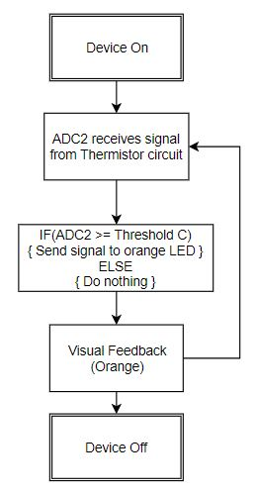

Slide 19
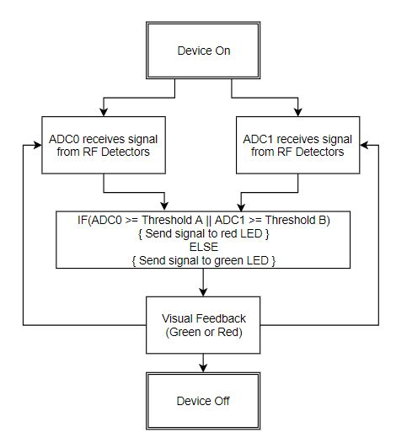

Slide 20
Feedback Logic
Take multiple samples per cycle
Take average of samples to eliminate false positives
Red LED turns on when RF detected
Stays on for 3 seconds unless another packet of RF is sensed
Otherwise green LED is on

Slide 21
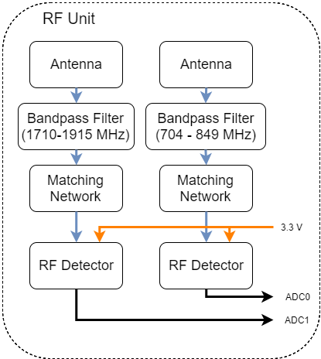
RF UNIT

Slide 23
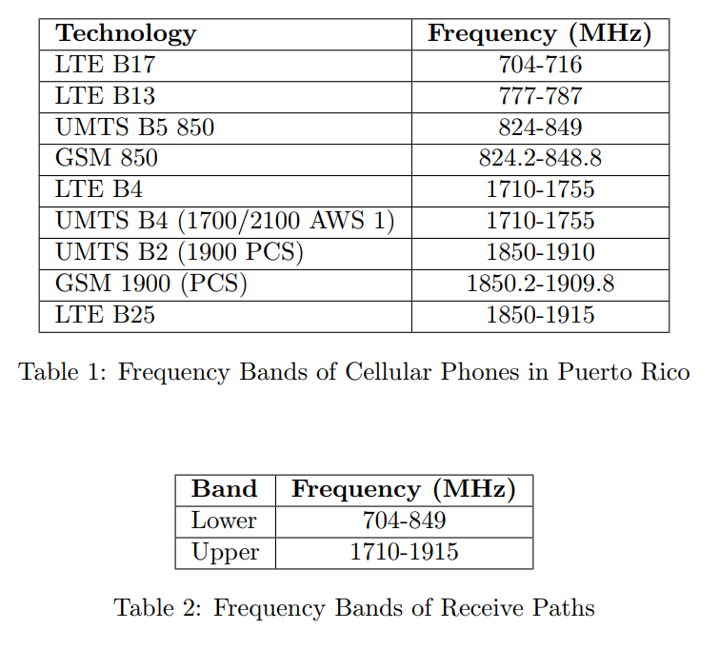
Cellular Frequencies in Puerto Rico

Slide 24
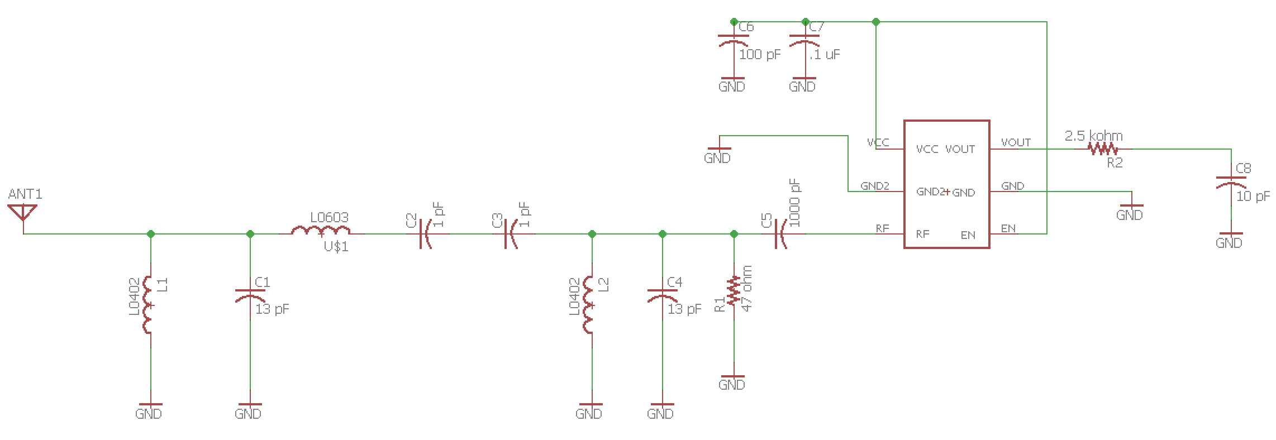
Lower Band RF Schematic

Slide 25
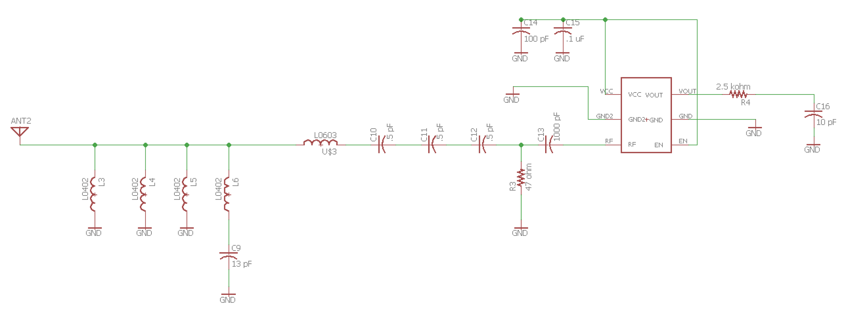
Upper Band RF Schematic

Slide 26
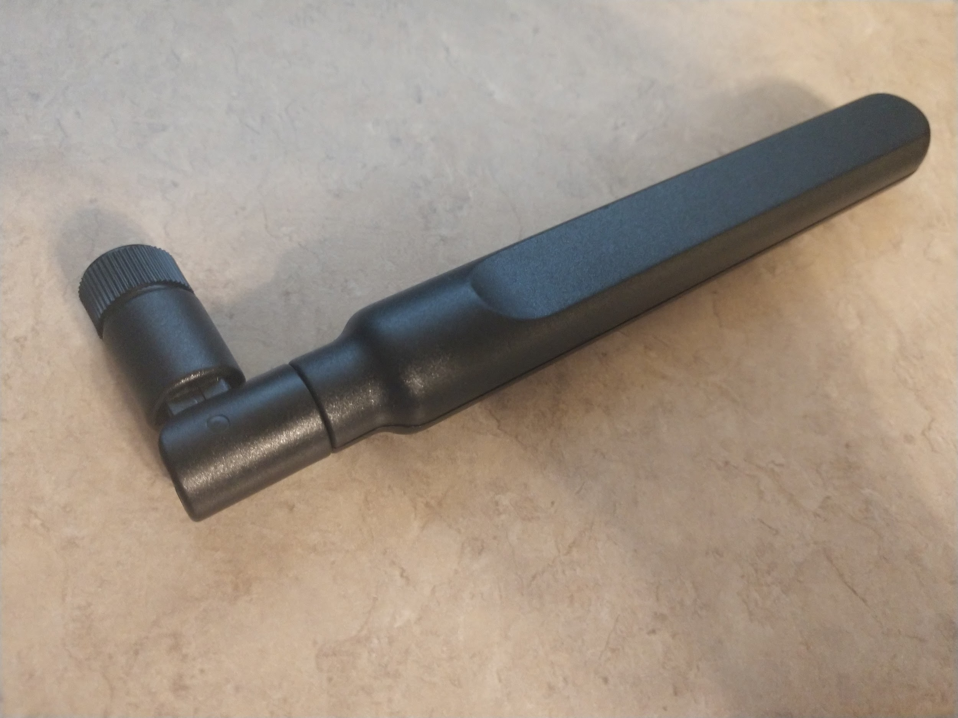
Antennas
Requirement 1: Must receive frequencies 704-849 MHz and 1710-1915 MHz
Requirement 2: Must be matched to 50 ohms at center frequency of each band

Slide 27
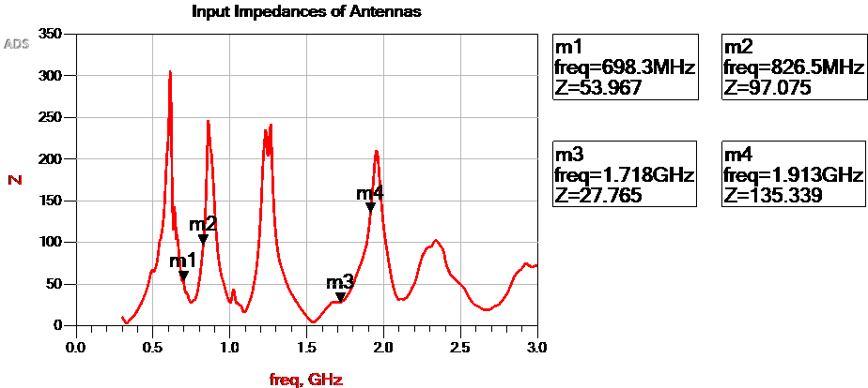
Antennas

Slide 28
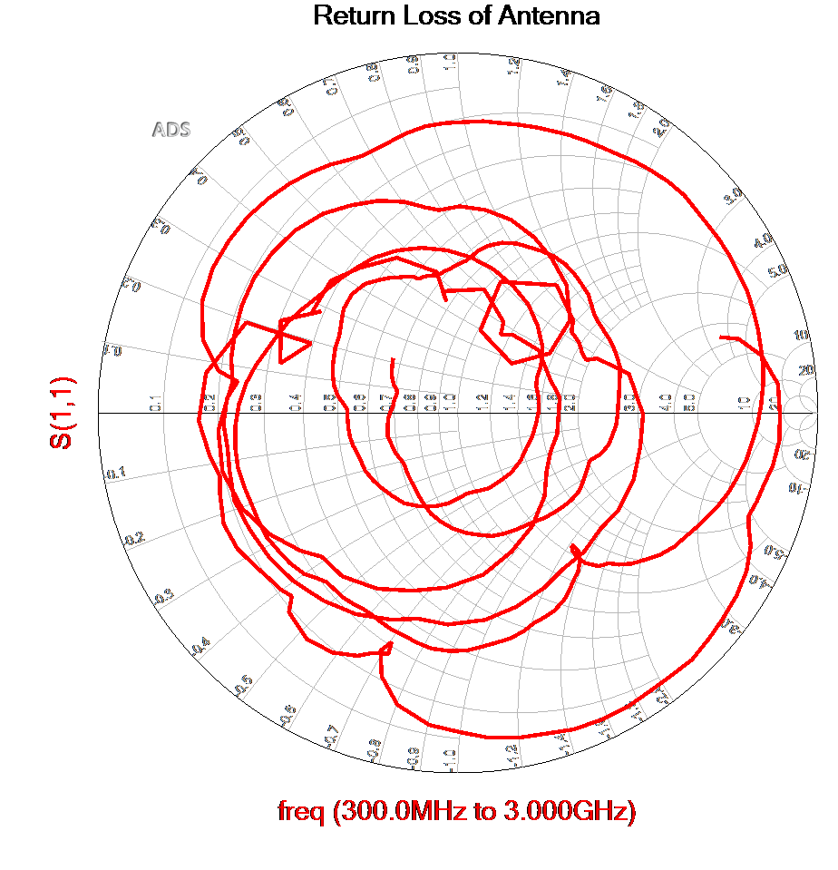
Antennas

Slide 29
Antennas
Requirement 1: Must receive frequencies 704-849 MHz and 1710-1915 MHz
PASS
Requirement 2: Must be matched to 50 ohms at center frequency of each band
FAIL

Slide 30
Bandpass Filters
Lower Frequency Band: 704-849 MHz
Upper Frequency Band: 1710-1915 MHz
Requirement 1: Less than 8 dB of loss within the passband
Requirement 2: 20 dB shape factor less than 7

Slide 31
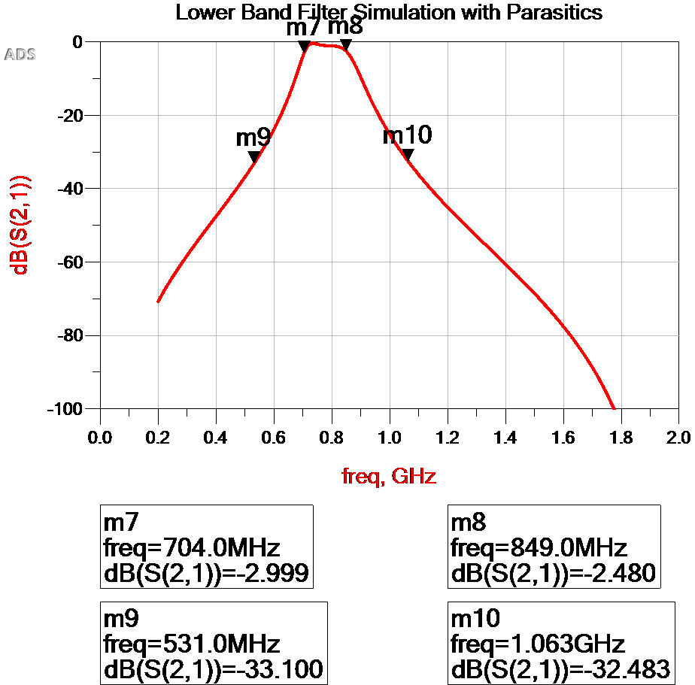
Lower Band Filter
< 3 dB Passband Loss
Shape Factor: 3.67

Slide 32
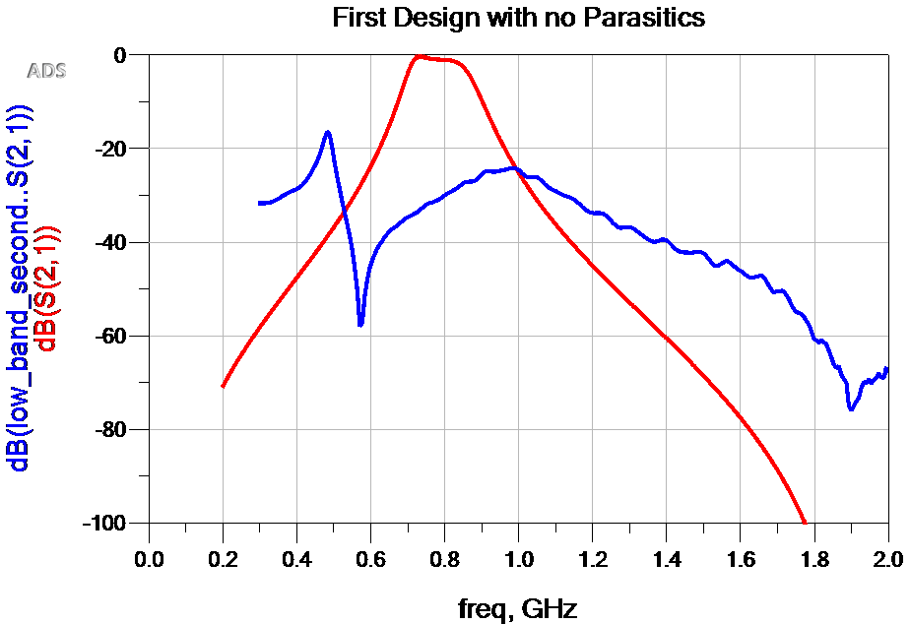
Lower Band Filter
2nd Order Filter

Slide 33
Lower Band Filter

Slide 34
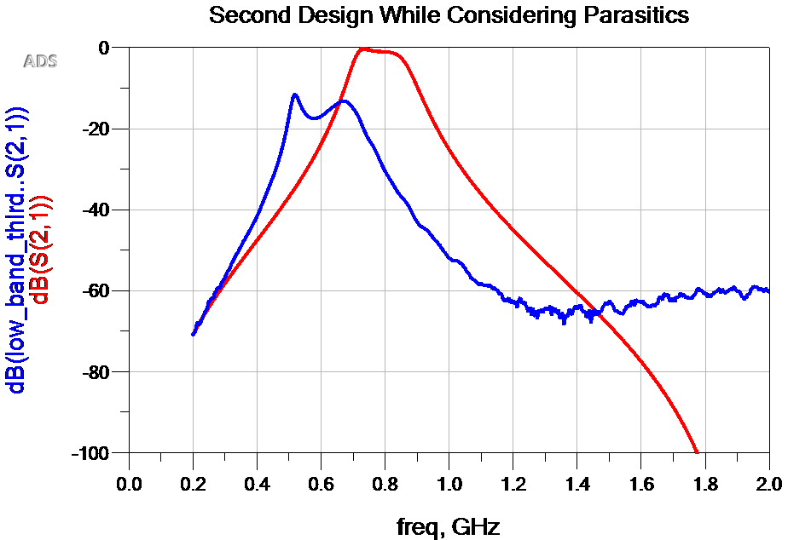
Lower Band Filter

Slide 35
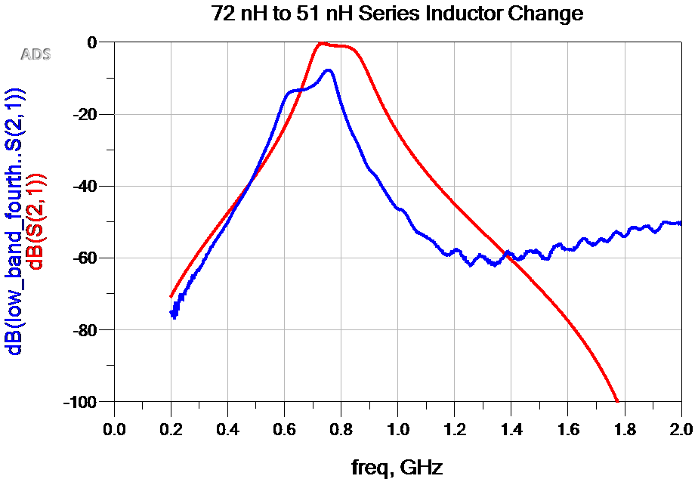
Lower Band Filter

Slide 36
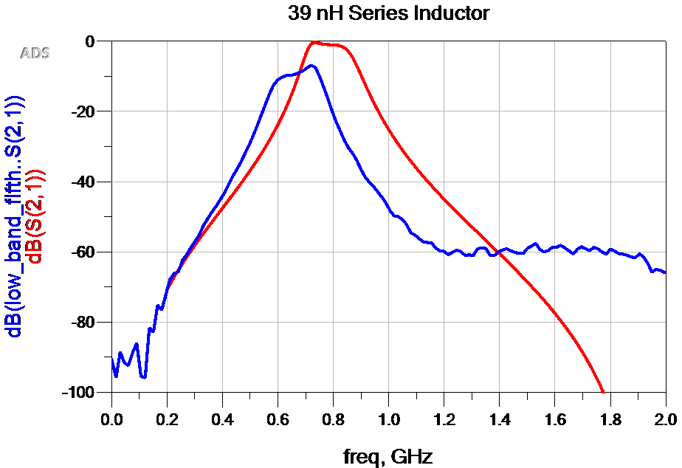
Lower Band Filter

Slide 37
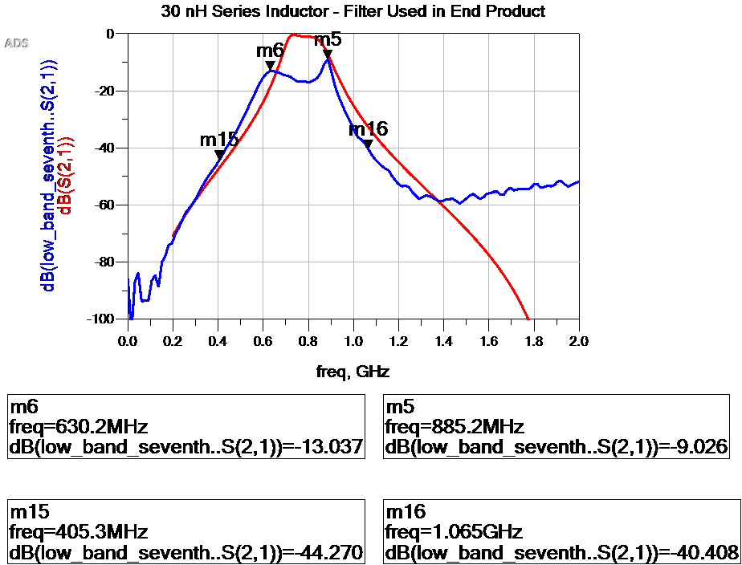
Lower Band Filter
Requirement 1: Less than 8 dB of loss within the passband
Up to 16 dB ---> FAIL
Requirement 2: 20 dB shape factor less than 7
2.58 ---> PASS

Slide 38
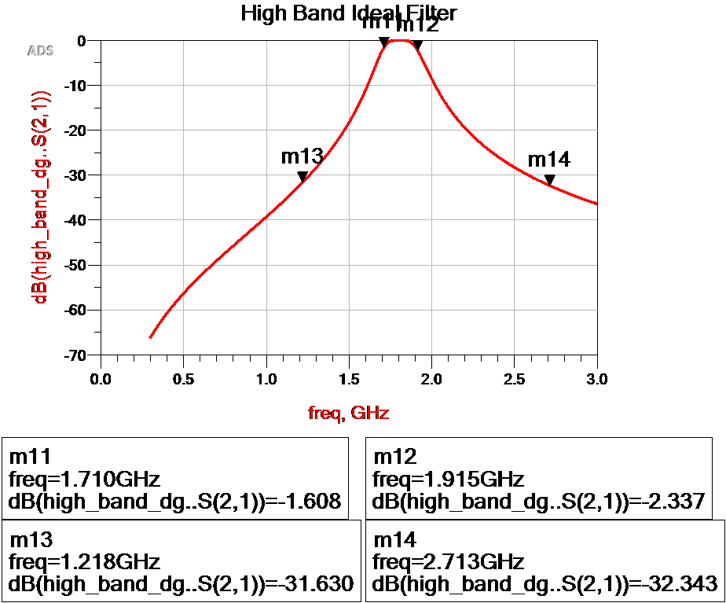
Higher Band Filter
< 2.4 dB Passband Loss
Shape Factor: 7.3

Slide 39
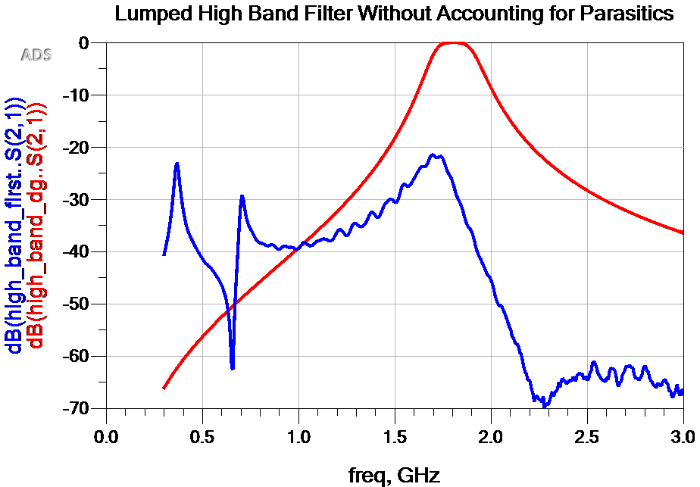
Higher Band Filter

Slide 40
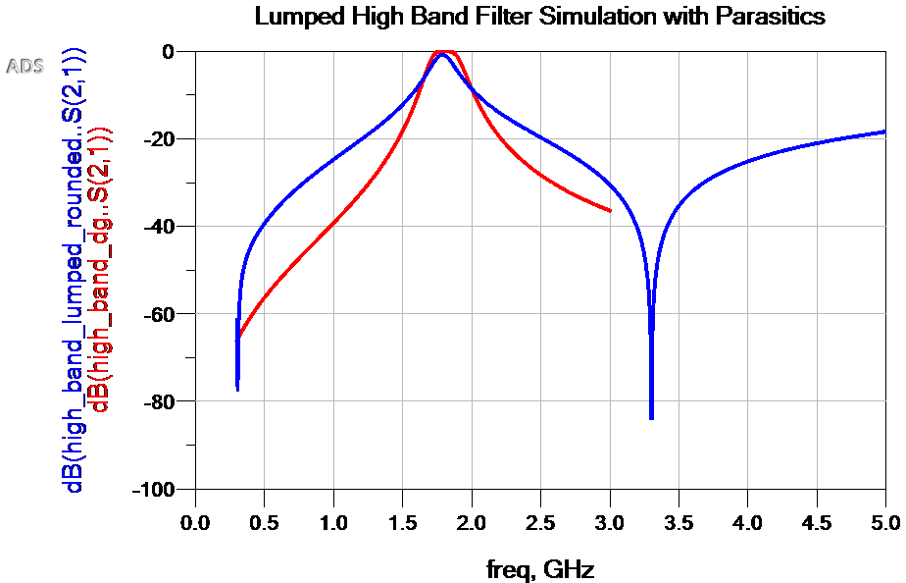
Higher Band Filter

Slide 41
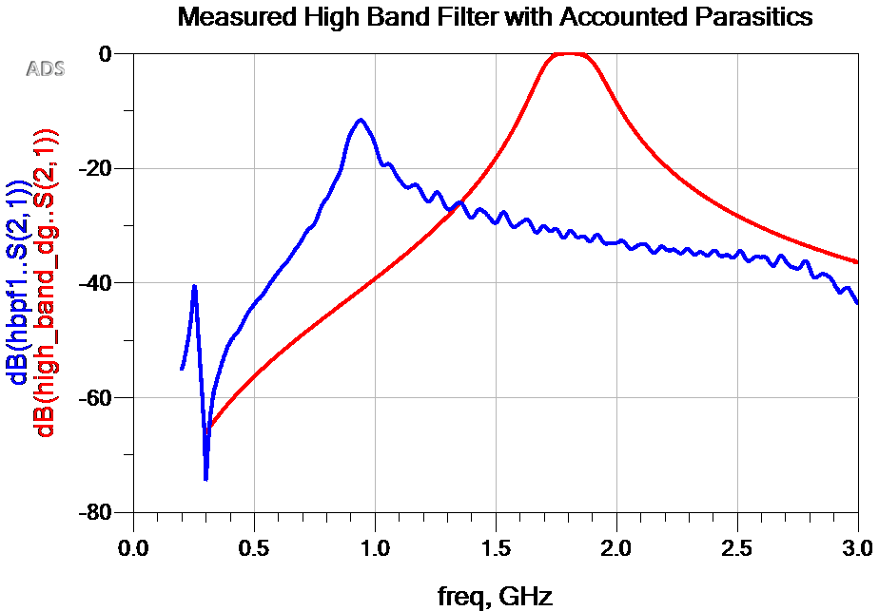
Higher Band Filter

Slide 42
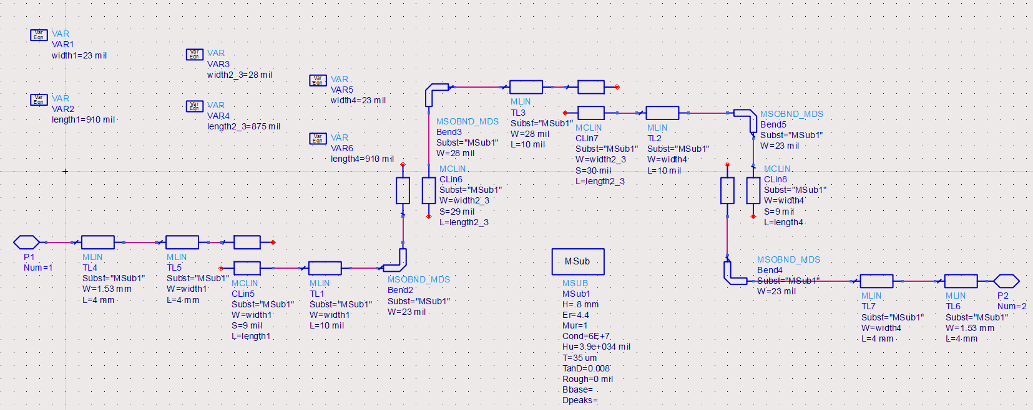
Higher Band Filter

Slide 43
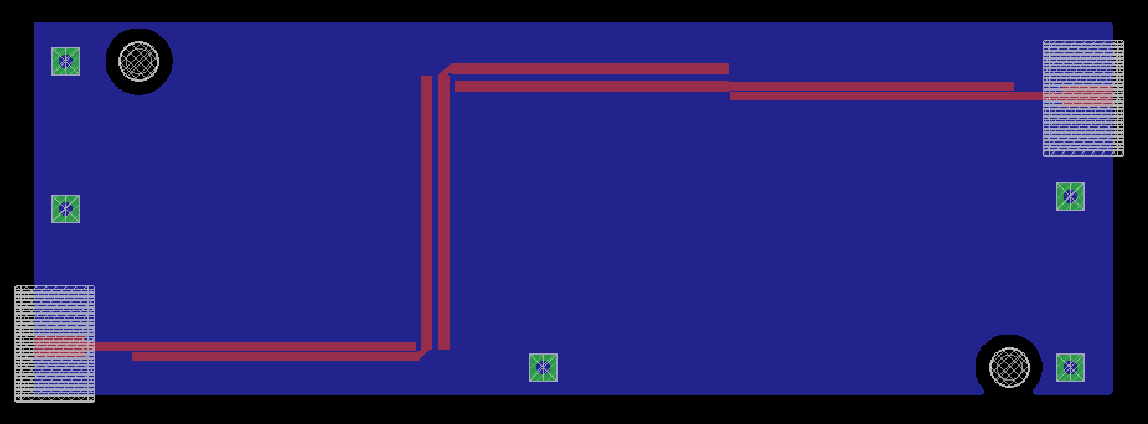
Higher Band Filter

Slide 44
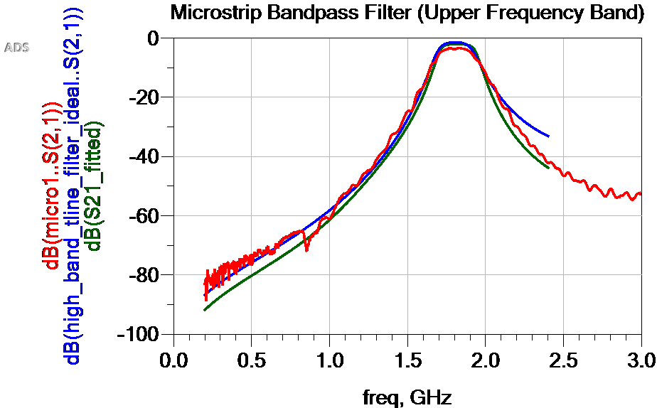
Higher Band Filter

Slide 45
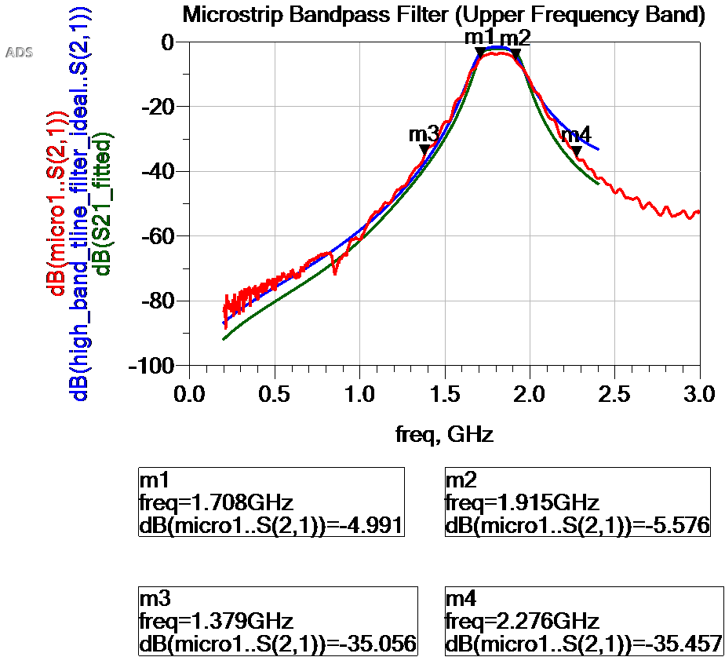
Higher Band Filter
Requirement 1: Less than 8 dB of loss within the passband
< 5.6 dB ---> PASS
Requirement 2: 20 dB shape factor less than 7
4.38 ---> PASS

Slide 46
Matching Networks
Requirement: Less than 3 dB of loss within passband

Slide 47
Lower Band Matching

Slide 48
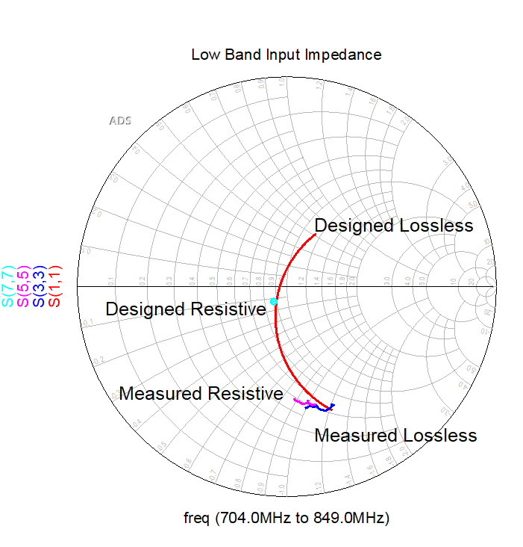
Lower Band Matching

Slide 49
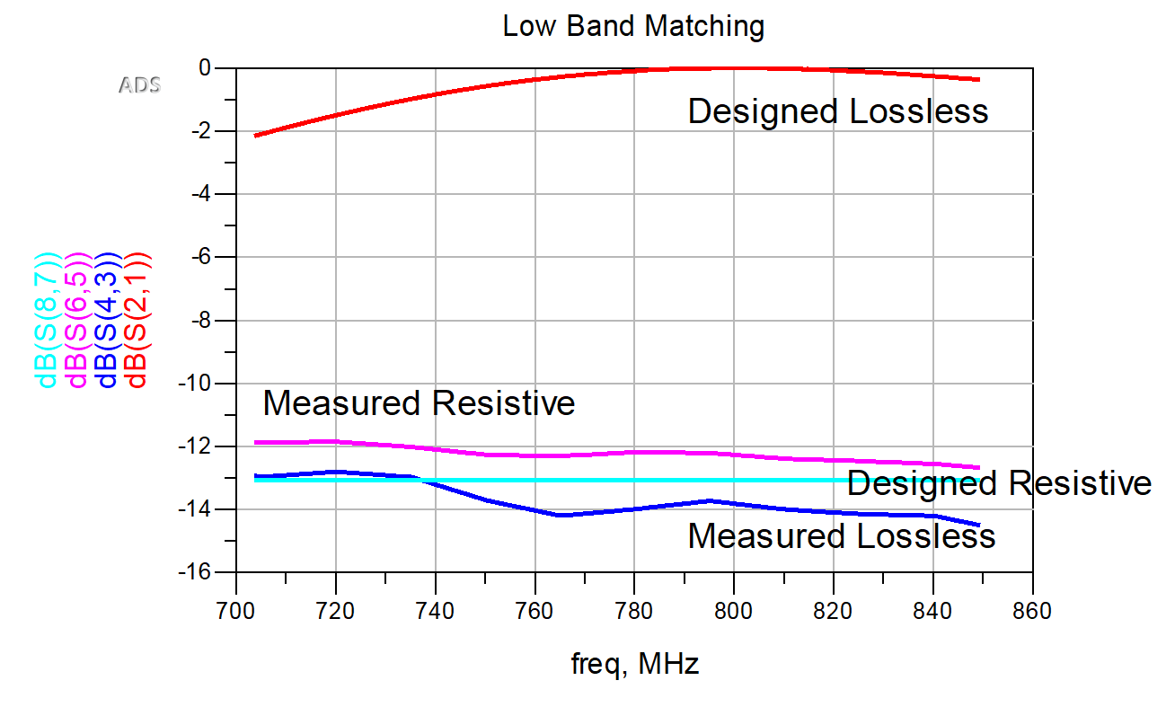
Lower Band Matching
Requirement: Less than 3 dB of loss within passband
> 12 dB ---> FAIL

Slide 50
Higher Band Matching

Slide 51
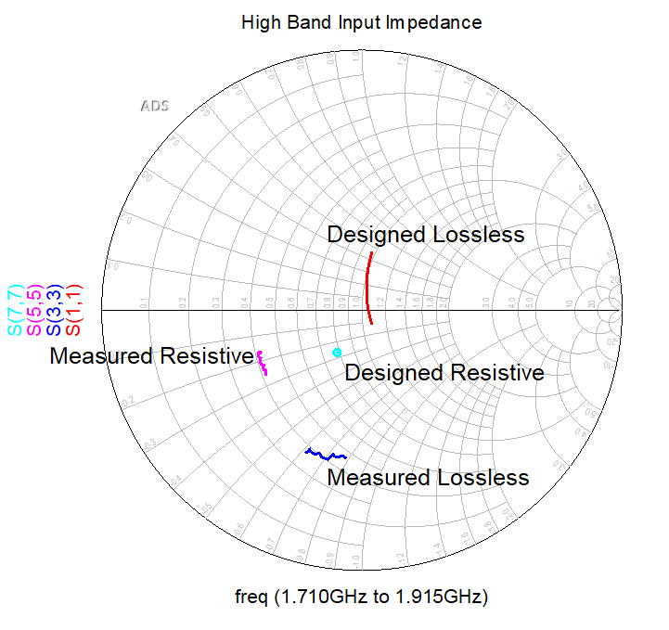
Higher Band Matching

Slide 52
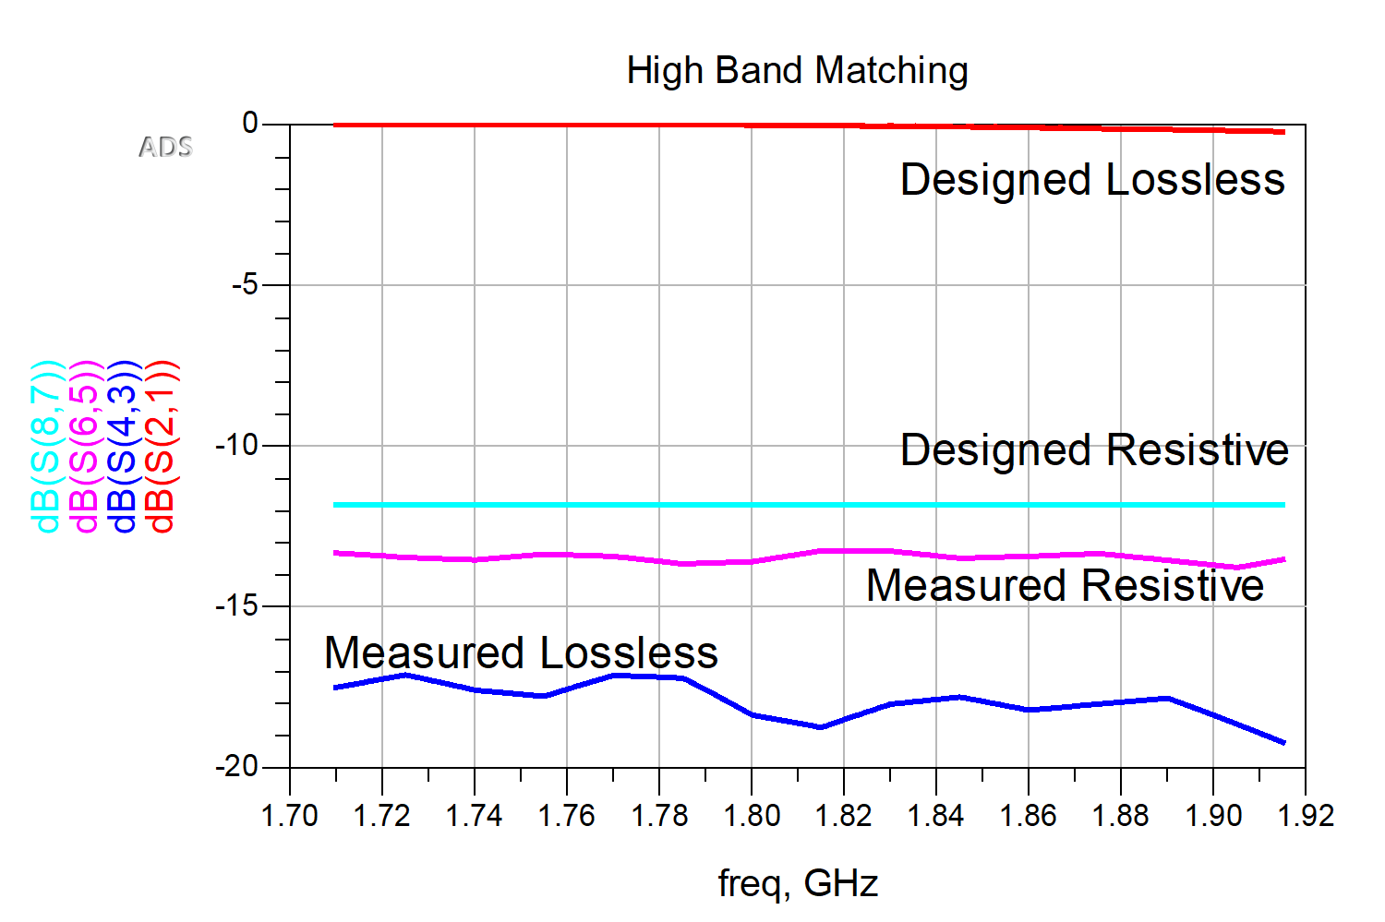
Higher Band Matching
Requirement: Less than 3 dB of loss within passband
> 13 dB ---> FAIL

Slide 53
RF Detector
Requirement 1: Must detect 704-849 MHz and 1710-1915 MHz
PASS
Requirement 2: Must detect down to -40 dBm
PASS
Both verified with a conducted signal from signal generator and a multimeter

Slide 54
RF PCB

Slide 55
Demo

Slide 56
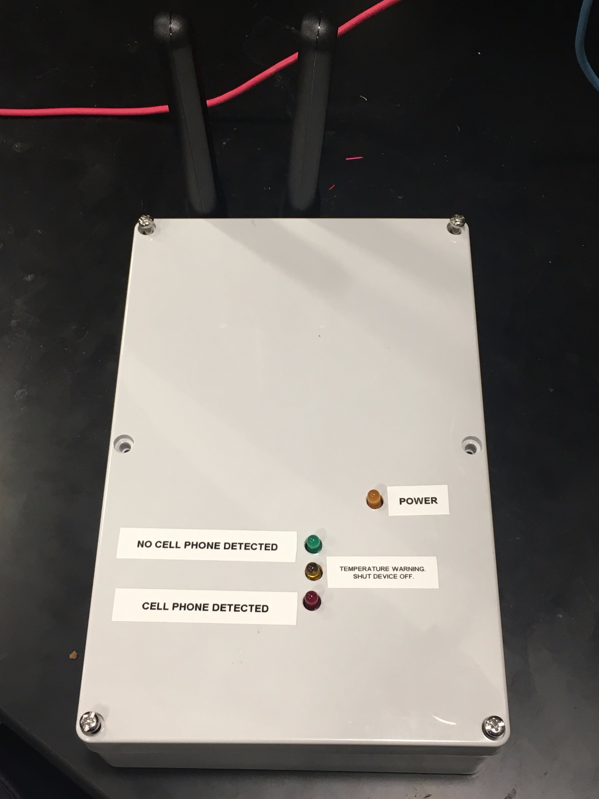
Conclusion
Iterative design
Non-idealities in components
Communication of deadlines and concepts

Slide 57
Future Work
Lumped component filter -> Microstrip filter
Higher quality substrate
Combine all subsections onto one PCB
More efficient current draw

Slide 58
Questions?

