Slide 1
Data Logger
Michael Jang
Jacob Drewniak
Team #10

Slide 2
Introduction
Intake CAN messages and store it into an SD card.
Read stored data through USB and Bluetooth

Slide 3
Objective
The current logger that is used by the Illini Motorsports FSAE team is very expensive and difficult to use
Our data logger will reduce cost issue and have a simple one step process for reading the data

Slide 4
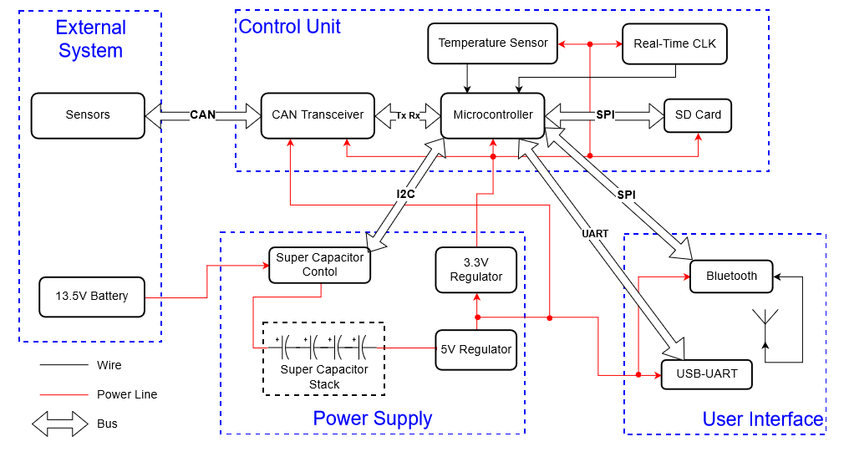

Slide 5
Data Flow
CAN Transceiver
Microcontroller
SD Card
SPI
UART
SPI
CAN Bus
USB
Bluetooth

Slide 6
Typical CAN Message

Slide 7

Super Capacitor Calculation
$$I=C\frac{dV}{dt}=−500mA$$
$$\frac{dV}{dt}= \frac{6.5−12}{2}=−2.75=constant$$
$$C=0.18F$$
$$\frac{4}{C_{individual}}=\frac{1}{C_{stack}}→C_{individual }=0.72F$$

Slide 8
Conclusion
Add Bluetooth headers and integrate Bluetooth
Wrap up software integration
Develop software on the receiving end of data to parse and display in a readable format

Slide 9
Questions?

