Slide 1
Wobblebot Project Presentation
Team 25 - Marc Backas, Phillip Lovetere, Mingrui Zhou

Slide 2
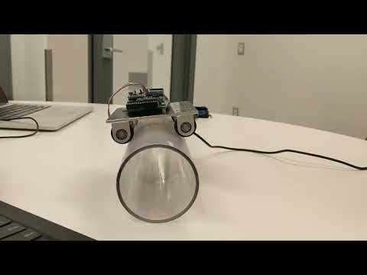

Slide 3
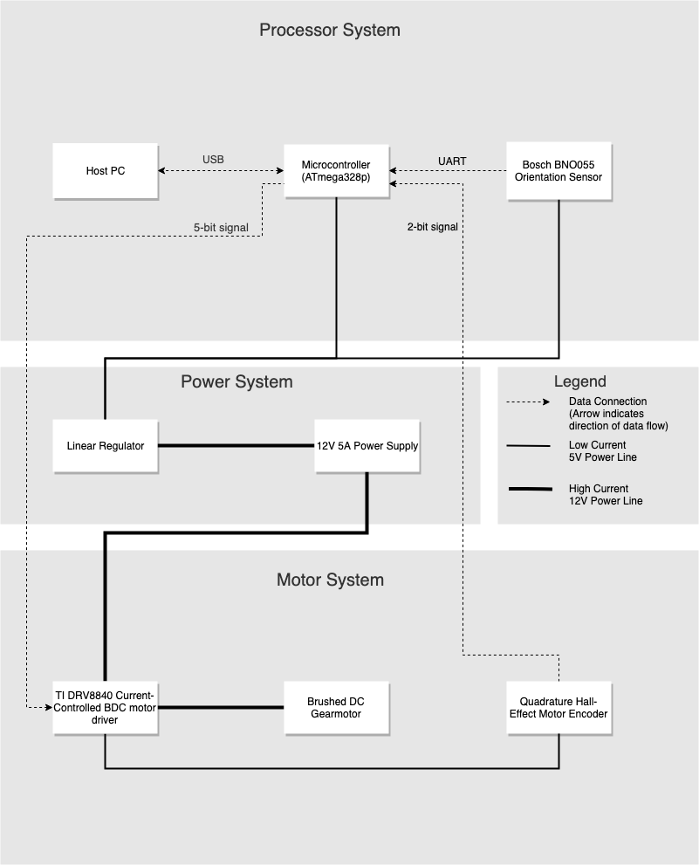
Project Layout
Processor System:
-AT328p used as microcontroller
-takes input from orientation
sensor(tilt angle) & motor
encoder(shaft position), uses this info
to generate & send digital control
signal to the motor driver

Slide 4
Project Layout (cont.)
Power System:
-12V 5A power supply(limited to ~1A due to greater need for fine motor control than for speed)
-used to power the motor & motor driver
-Connected to a 5V linear regulator
(used to power the microcontroller,
orientation sensor, & motor encoder)

Slide 5
Project Layout (cont. 2)
Motor System:
-Motor driver converts the digital control signal from the microcontroller into a current used to drive the motor
-Motor encoder reports shaft position of the motor to the microcontroller so the proper control signal can be computed

Slide 6
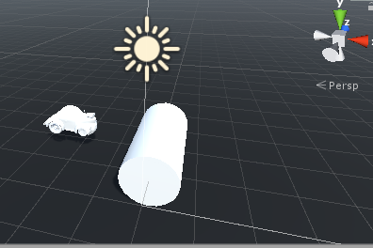
Unity3D Simulator
Unity’s built-in physics engines provide
components that handle the physical sim
ulation for our projects.
In our unity simulator, we set the size and
weight of the cylinder and motor to be the
same as our wobblebot. Even size of the wheels. All of them are in 3-d models.

Slide 7
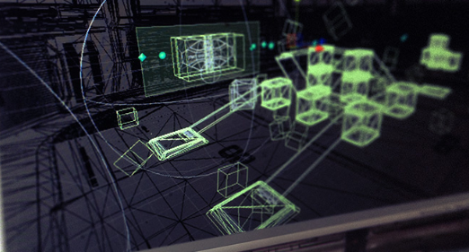
Features of Unity3D simulator
Physics engines, Physics parameters and Physical connection.
Mock orientation sensor and motor encoder. UnityEngine includes the Gyroscope.input package which can access the tilt angle and shaft position and assign these features to the controller.
Functions and equations related to the movement between motor and cylinder. By changing some the parameters, it will break the equations and the motor will not stay balance on the cylinder.
MonoBehaviour includes the SystemObject (cylinder and motor) and Collections.

Slide 8
Goal of the Unity3D simulator
Test the functioning requirement of the wobblebot with the same data set up as the real hardware has. By changing the parameters of some features such as resistance, velocity or mass, it will differ the result of whether the motor can balance on the cylinder.
Using the simulator, it is easier to set the mass, velocity, resistance and anything on the board and controller. It will be more convenient to test the functionality by using the simulator.

Slide 9
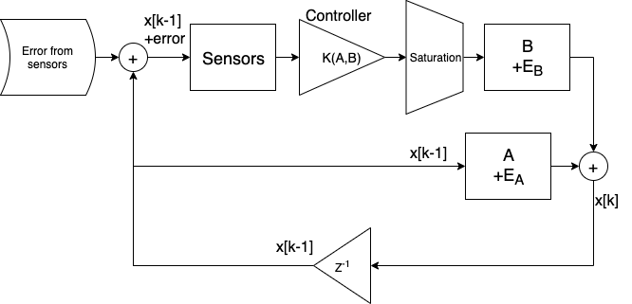
Controller design
Sensor precision:
Motor encoder: 2*pi/(197*6) = .005 rad/count
Motor Driver precision:
2.2/(5*0.8) = 0.55 Amps
64 current levels -> 0.017 A per step

