Slide 1
Deadlift Assistant
Team 32
Sean Luo, Nosa Egiebor, Johan Mufuta

Slide 2
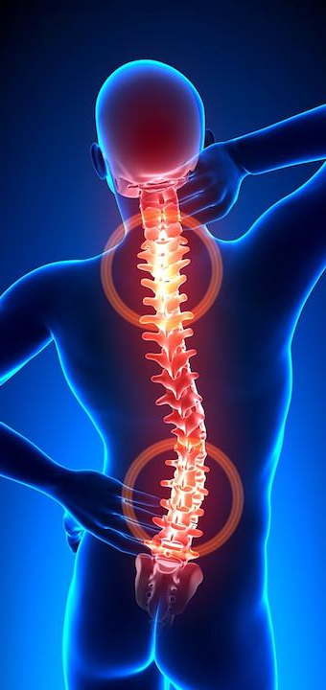
Introduction
500,000 annual gym-related injuries in the US
Existing solutions and their problems:
Only 15% of gym-goers utilize physical trainer services
Unreliable information from the internet

Slide 3
Objective
Develop an affordable and reliable feedback system for the deadlift exercise
Utilize computer vision to analyze joint-angles
Create a simple product that can be used by anyone

Slide 4
Design

Slide 5
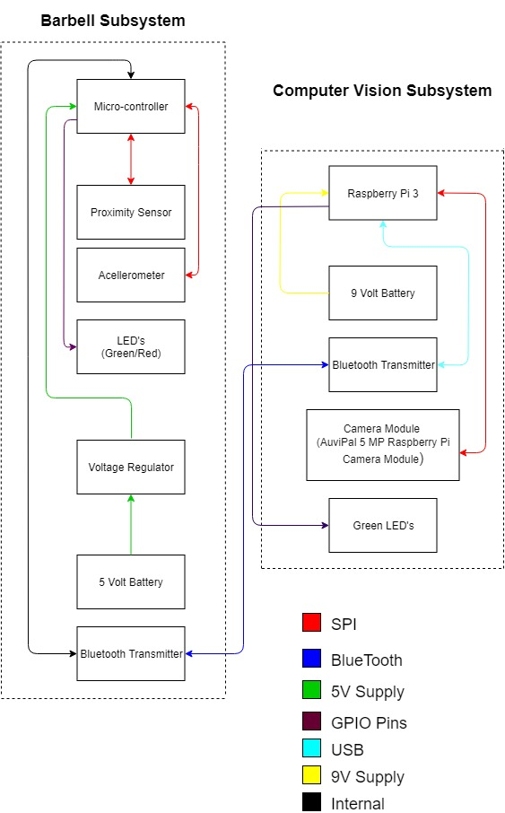
Original Design - Block Diagram

Slide 6
Original Design - Barbell Subsystem R/V
Requirement | Verifications
Barbell Subsystem can receives and sends data to and from the RaspberryPi | Port connection line in wrapper.py does not throw an error Barbell Module sends signals to Raspberry to take pictures at different lift stages
The Barbell Module can distinguish its own orientation | The LEDs stay on when the module faces upward The LEDs turn off when the module faces downward
The Red/Green LEDs light up when CV subsystem determines form quality | Can see the Red LED turn on after bad form Can see the Green LED turn on after good form

Slide 7
Original Design - Computer Vision Subsystem R/V
Requirement | Verifications
The laptop can send and receive signals to and from the Barbell Module via Bluetooth | Connection confirmed by the Bluetooth window displayed by the laptop No error message from the port connection in wrapper.py
The Computer Vision Subsystem can distinguish which stage of the lift the user is on and takes pictures at each one | Unique terminal log indicating webcam and OpenCV are ready for use Pictures taken at each lift stage are in output folder
The Computer Vision Subsystem processes photos taken during the lift and sends feedback on form quality to the barbell subsystem | Output pictures show lines correlated to the user’s body parts Red/green LED lights up on barbell subsystem according to the processed feedback

Slide 8
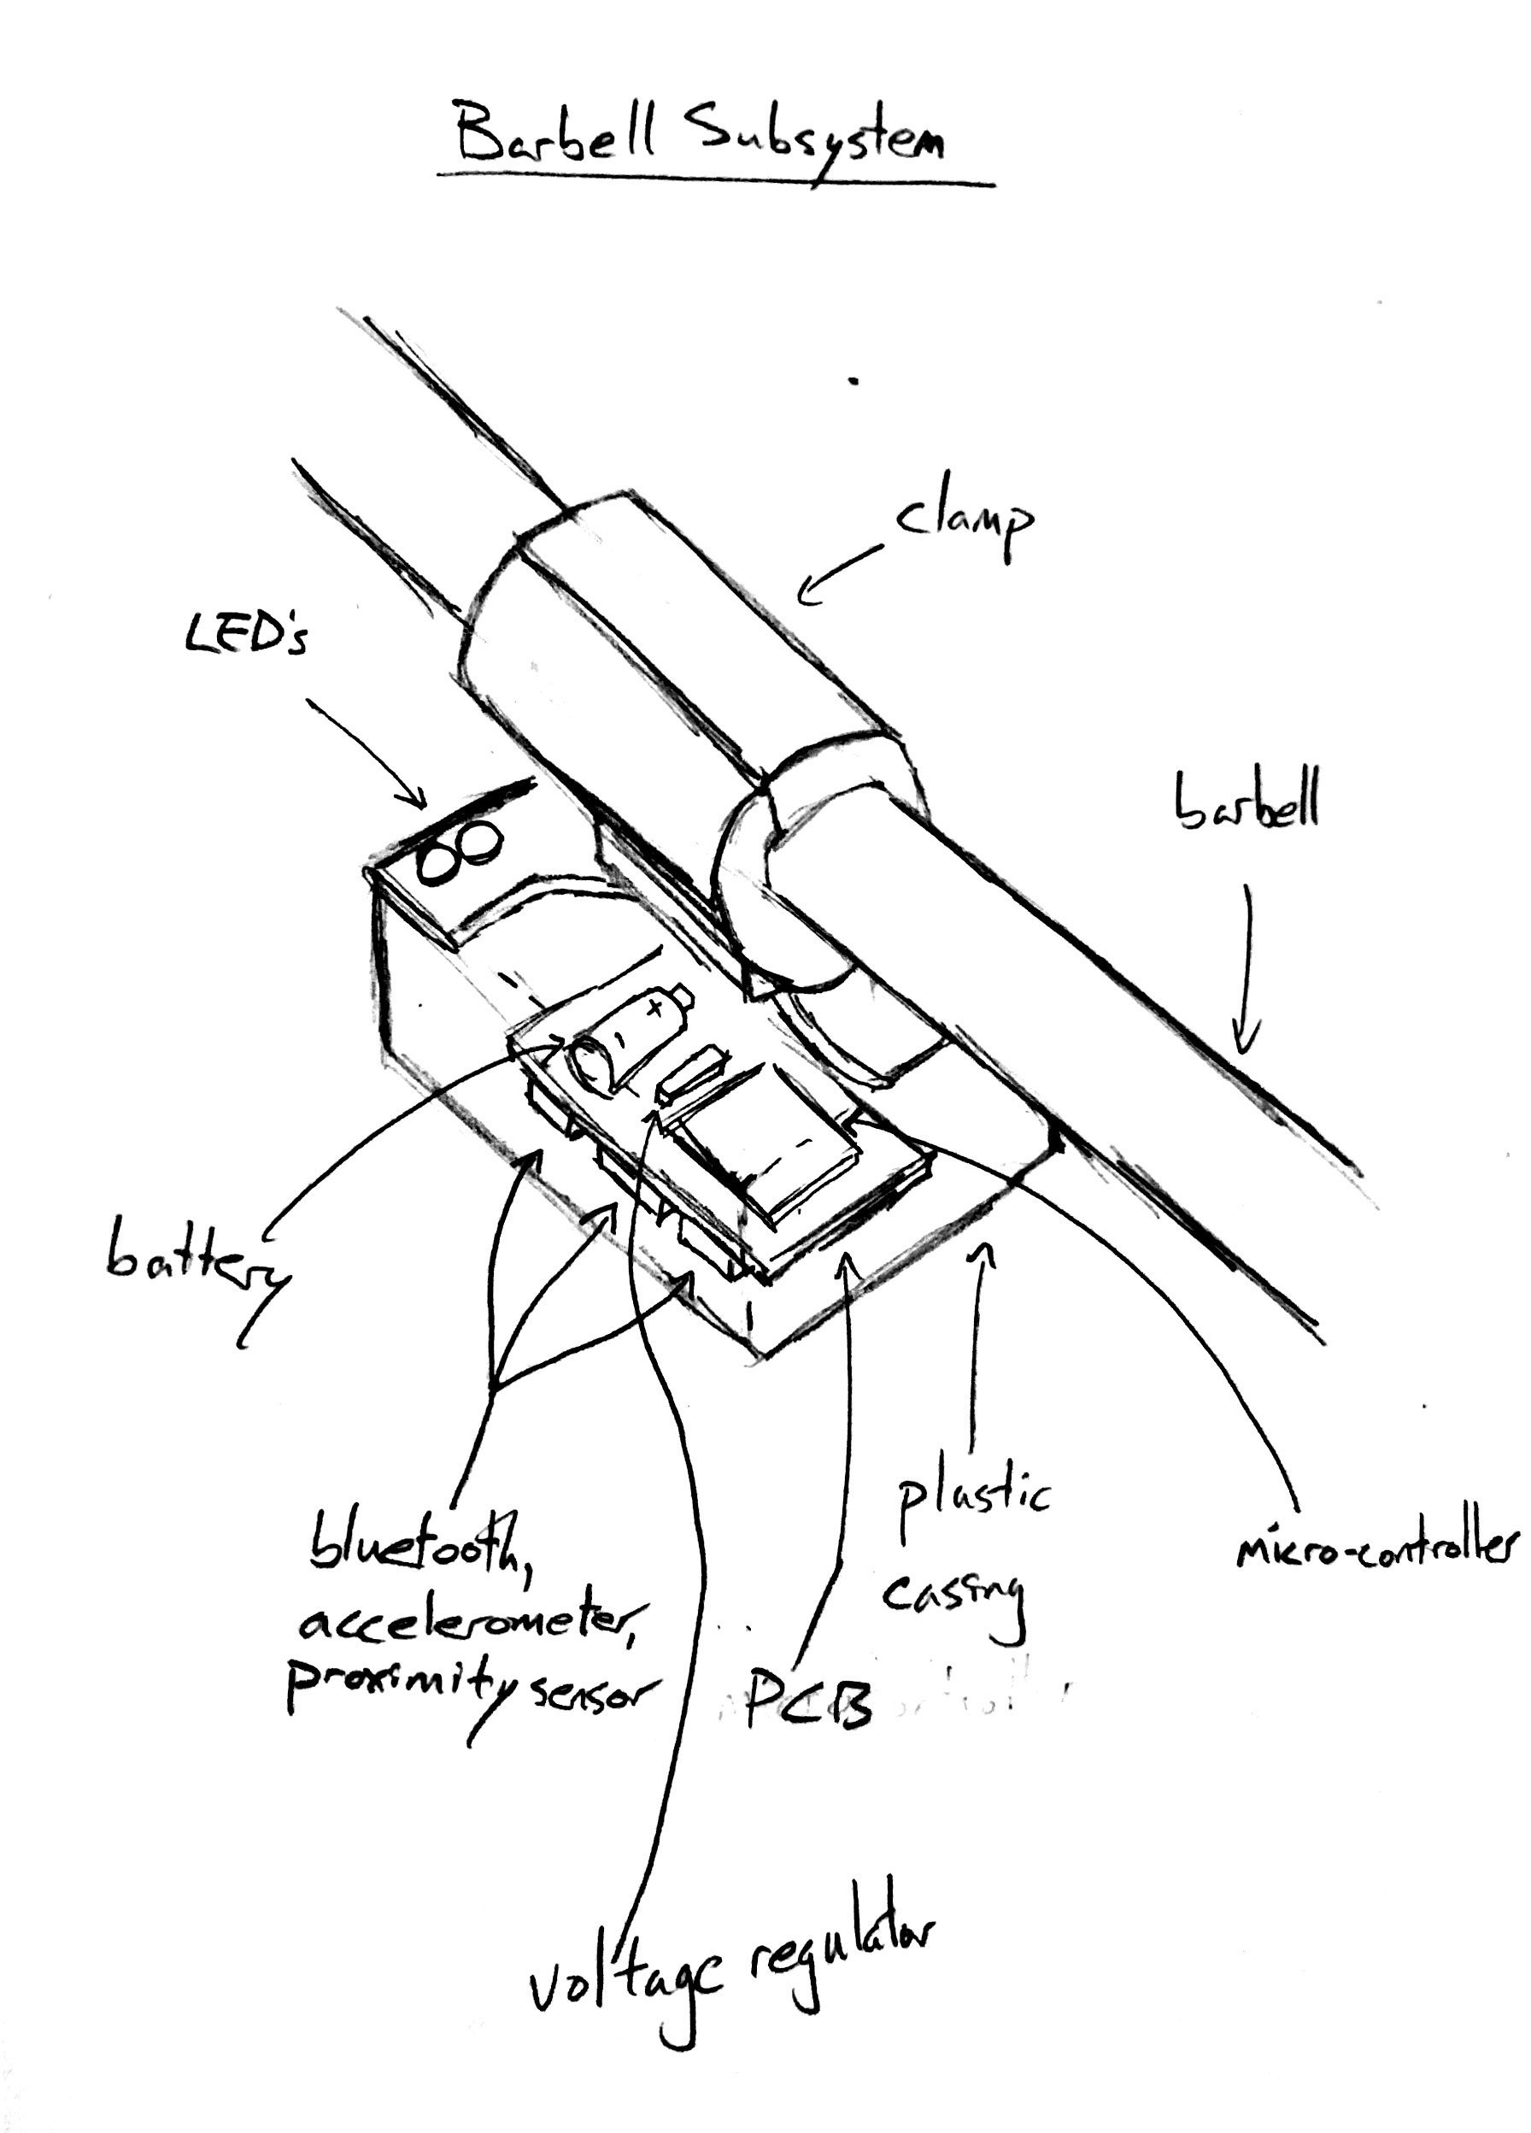
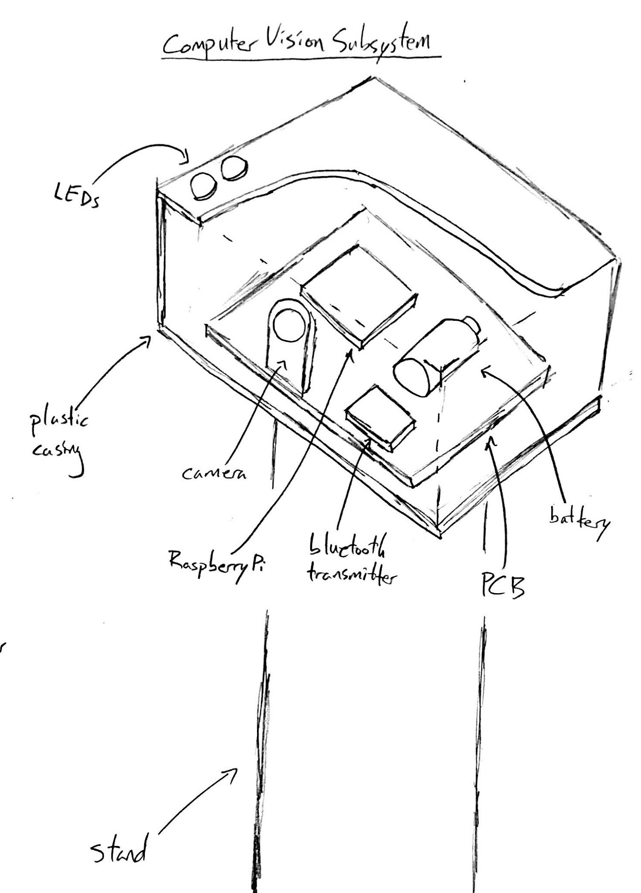
Original Design - Physical

Slide 9
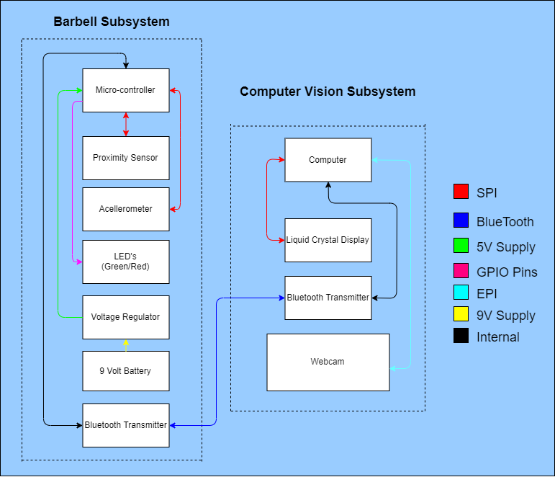
Final Design - Block Diagram

Slide 10
Final Design - Barbell Subsystem R/V
Requirement | Verifications | Passed?
Barbell Subsystem can receives and sends data to and from laptop | Port connection line in wrapper.py does not throw an error
The Barbell Module can distinguish its own orientation | The LEDs stay on when the module faces upward The LEDs turn off when the module faces downward
The Red/Green LEDs light up when CV subsystem determines form quality | Can see the Red LED turn on after bad form Can see the Green LED turn on after good form

Slide 11
Final Design - Computer Vision Subsystem R/V
Requirement | Verifications | Passed?
The laptop can send and receive signals to and from the Barbell Module via Bluetooth | Connection confirmed by the Bluetooth window displayed by the laptop No error message from the port connection in wrapper.py
The Computer Vision Subsystem can distinguish which stage of the lift the user is on and takes pictures at each one | Unique terminal log indicating webcam and OpenCV are ready for use Pictures taken at each lift stage are in output folder
The Computer Vision Subsystem processes photos taken during the lift and sends feedback on form quality to the barbell subsystem | Output pictures show lines correlated to the user’s body parts Red/green LED lights up on barbell subsystem according to the processed feedback

Slide 12
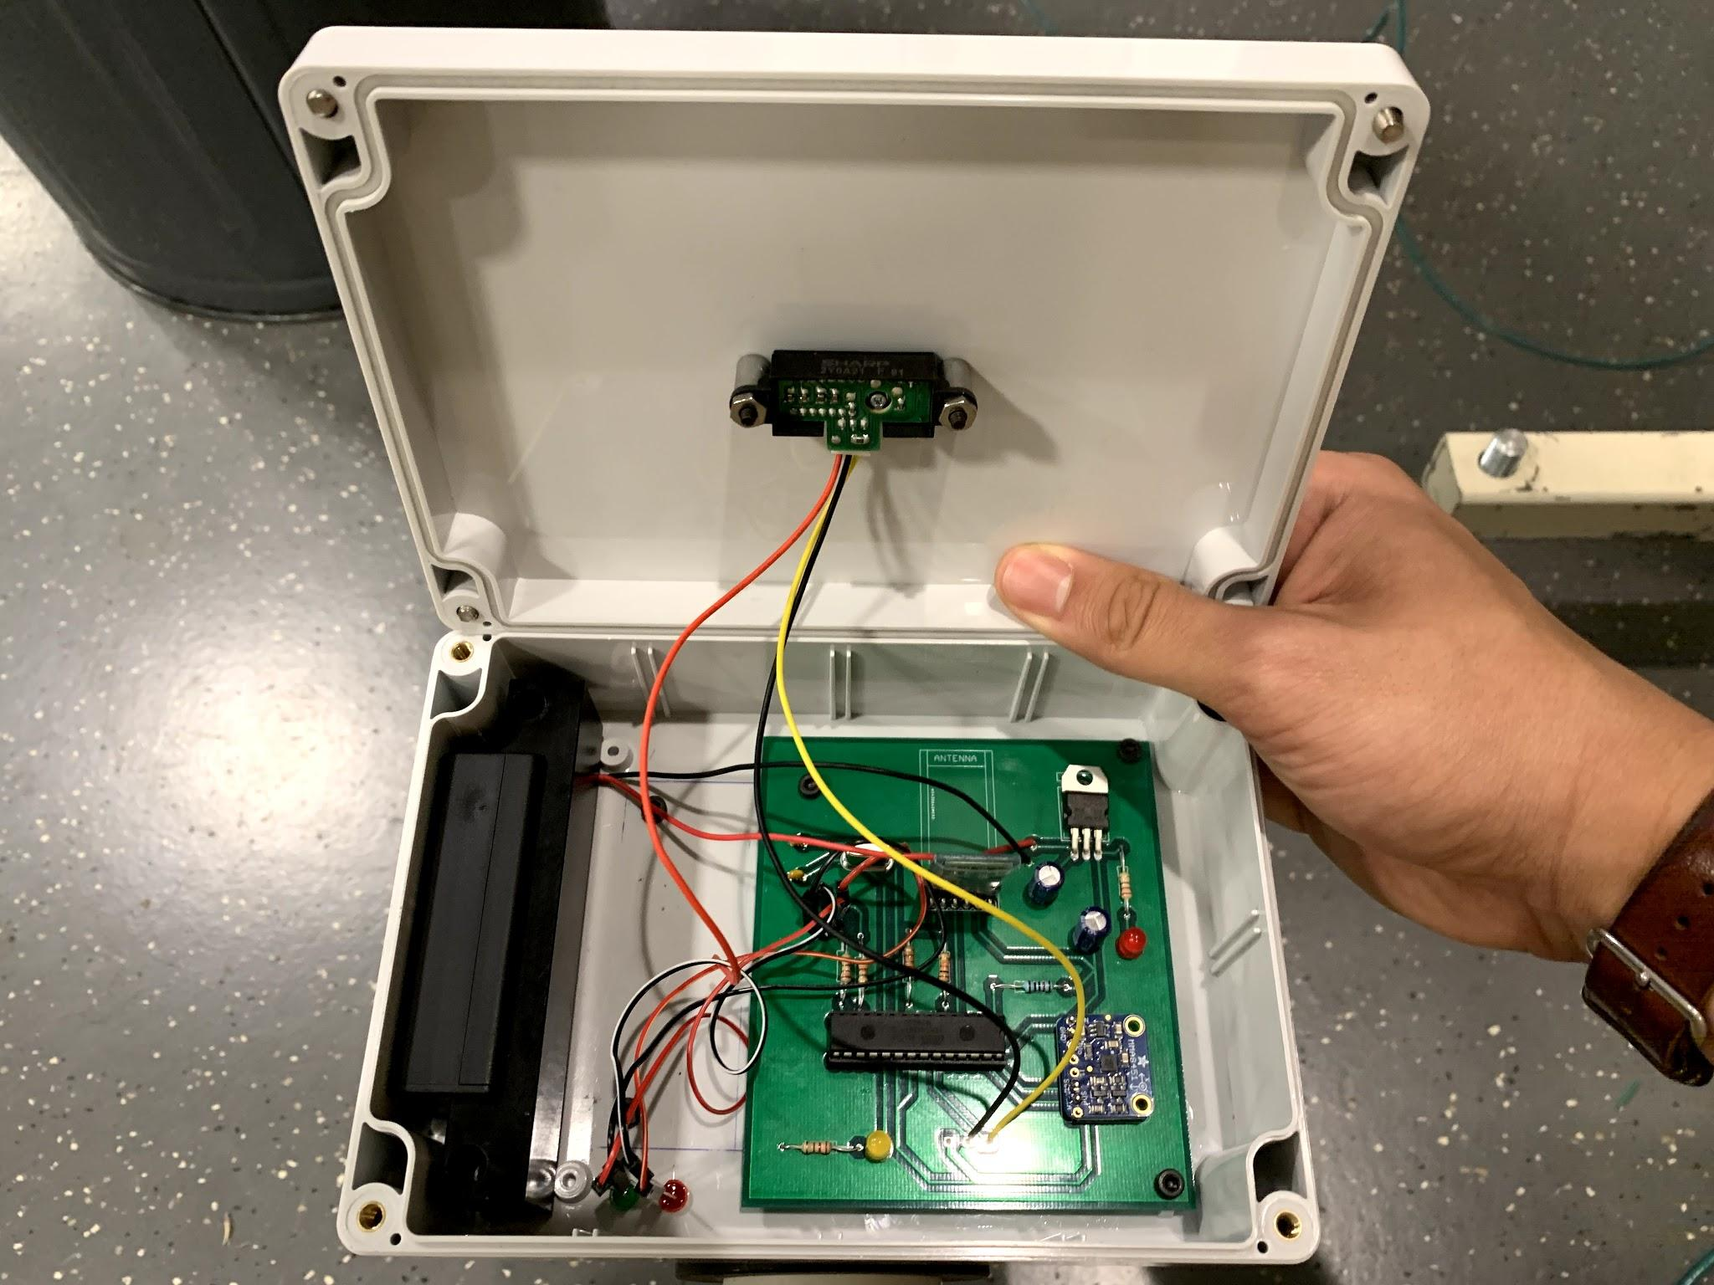
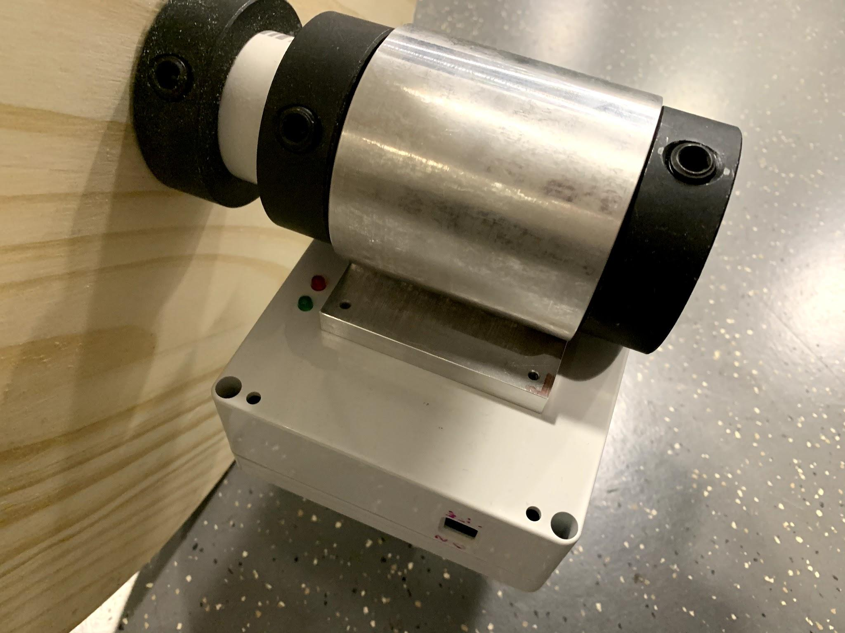
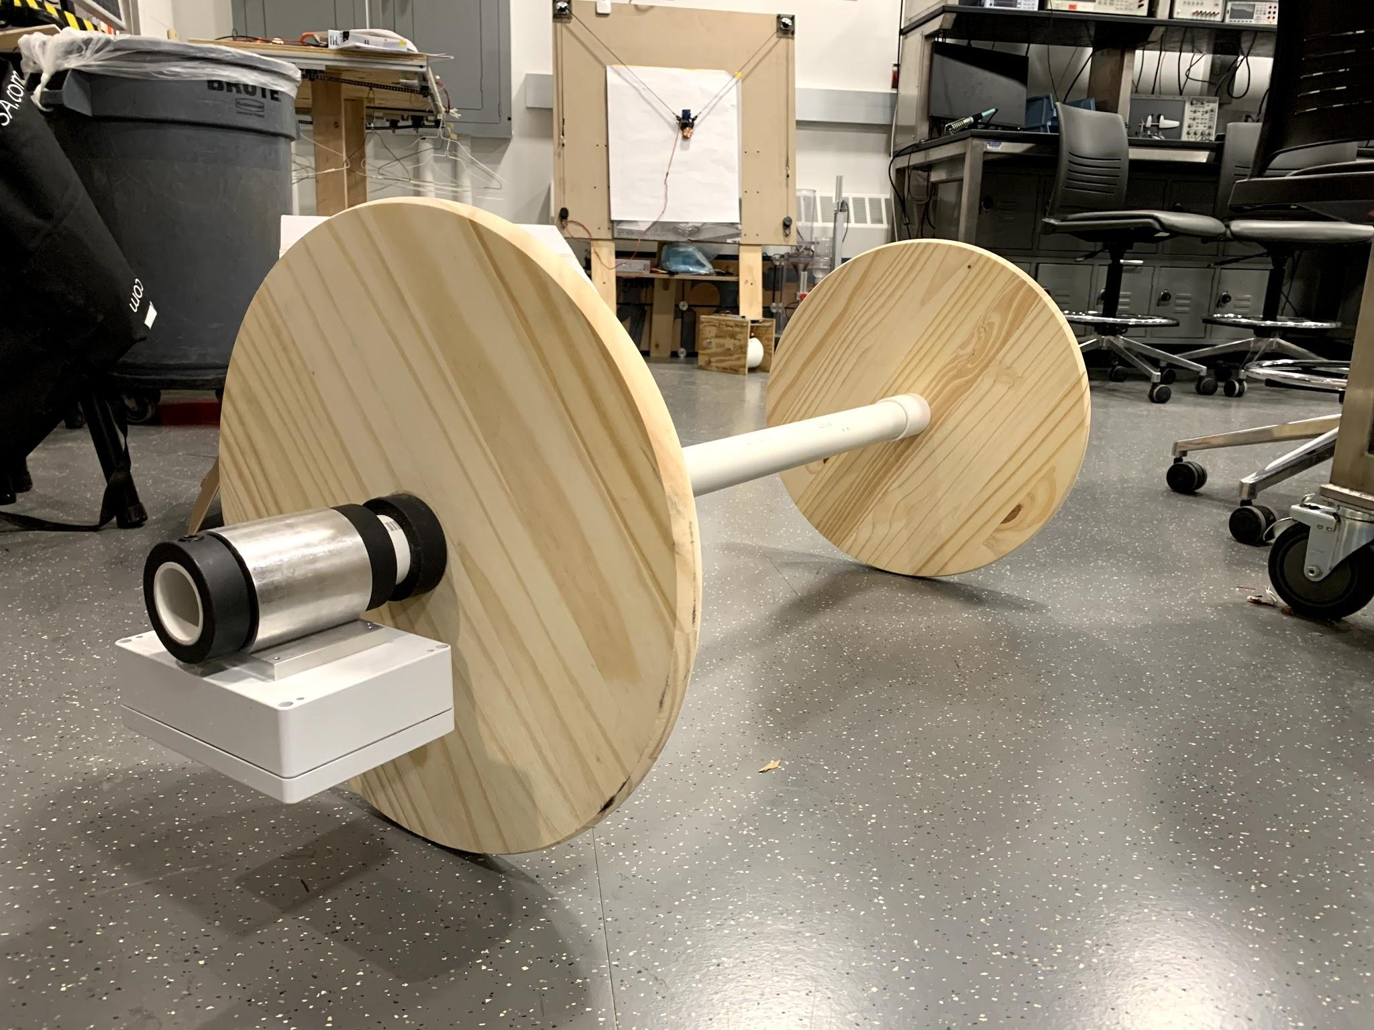
Final Design - Physical

Slide 13
Successes
Reliable deadlift feedback system
Kept cost under $150

Slide 14
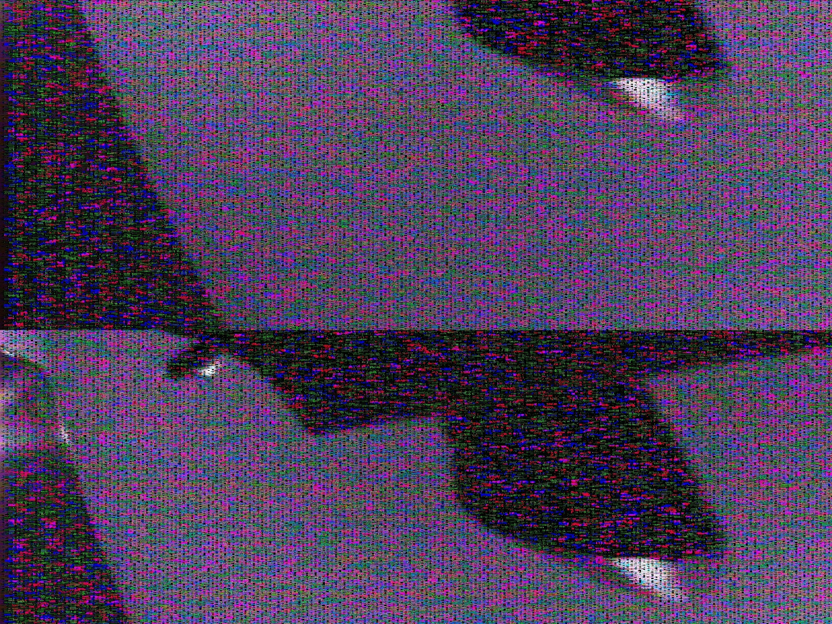
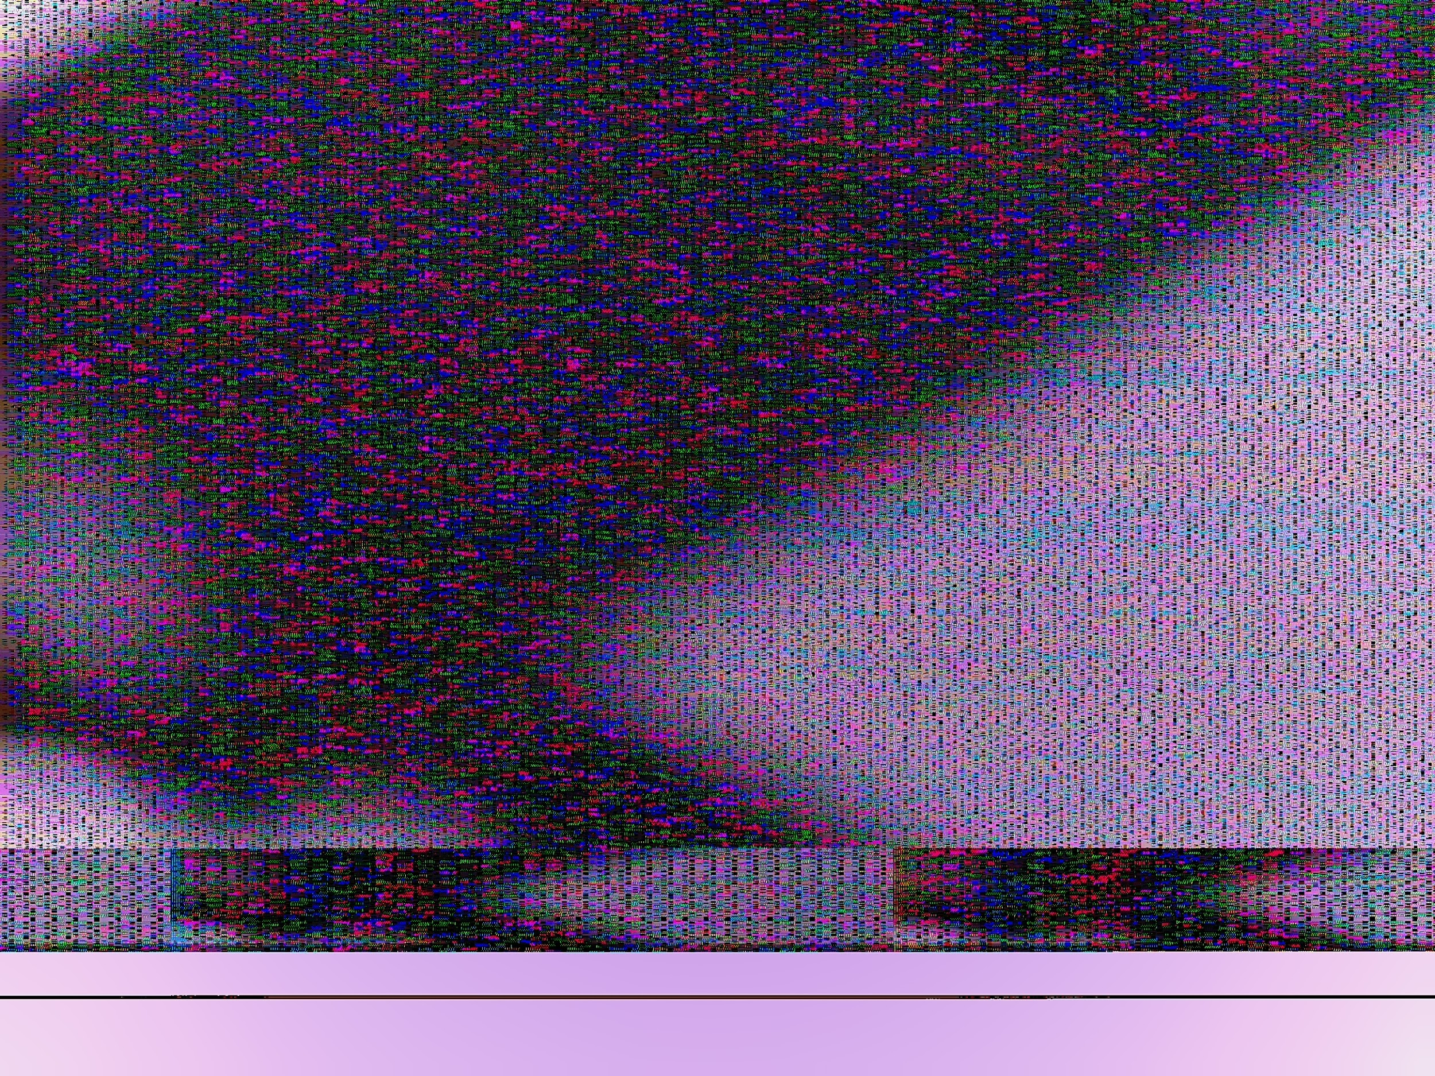
Challenges
RaspberryPi camera module
Bluetooth module malfunction
Inaccurate, sporadic sensors

Slide 15
Other Tests
Trial and error with sensor values
Getting the bluetooth message timing down

Slide 16
Conclusion/Future Work
Seamless live feedback on deadlift routine
No trainer needed
Practices Good Form
Visual Feedback
If we were to continue:
Make Barbell Module more compact
Conduct industry analysis
Make completely software-based via a mobile app
Include different exercises

