Slide 1
Get Active Gaming System
Team 30: Carolyn Nye, Bing Singhsumalee, and Madison Wilson
Notes:
Your slides should generally include:
Title slide: Names, group #, title.
Introduction slide: What is the project?
Objective slide: What problem does this solve?
Design Slides: A few slides on design, requirements and verification (should include block diagram, math, graphs, figures, tables).
Conclusion: Wrap things up, future work.

Slide 2
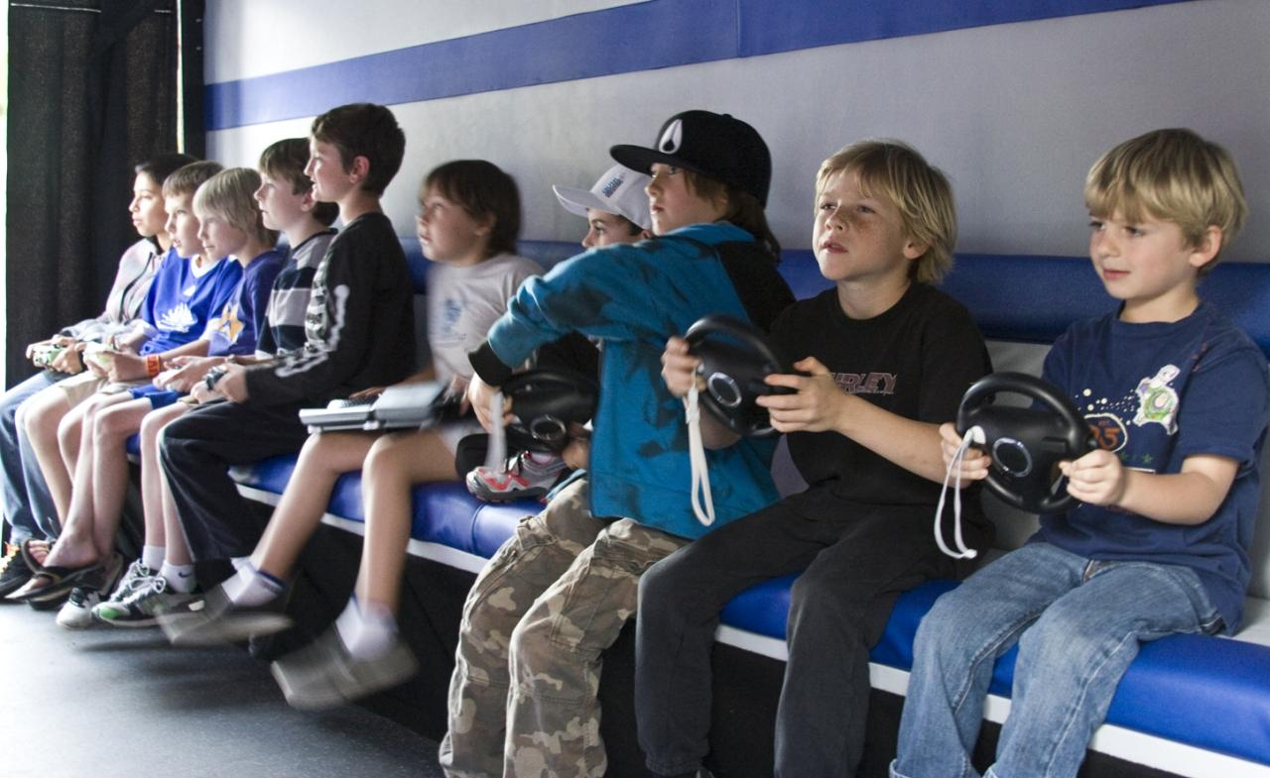
Objective
Get people moving!
Kids
Adults
Elderly
Pets
Portable/mobile
Easy setup
Set up in any orientation
Interactive & fun
Minimize screen devices
Notes:
Electronic screen devices are inescapable
Kids - entertainment
Adults - work
Cause future health problems
Encourage people to spend a few minutes during the day to stand up and move around
Need exercise?? - yeah still dont know what we want to say here lol should i say obesity is a problem or is that weird

Slide 3
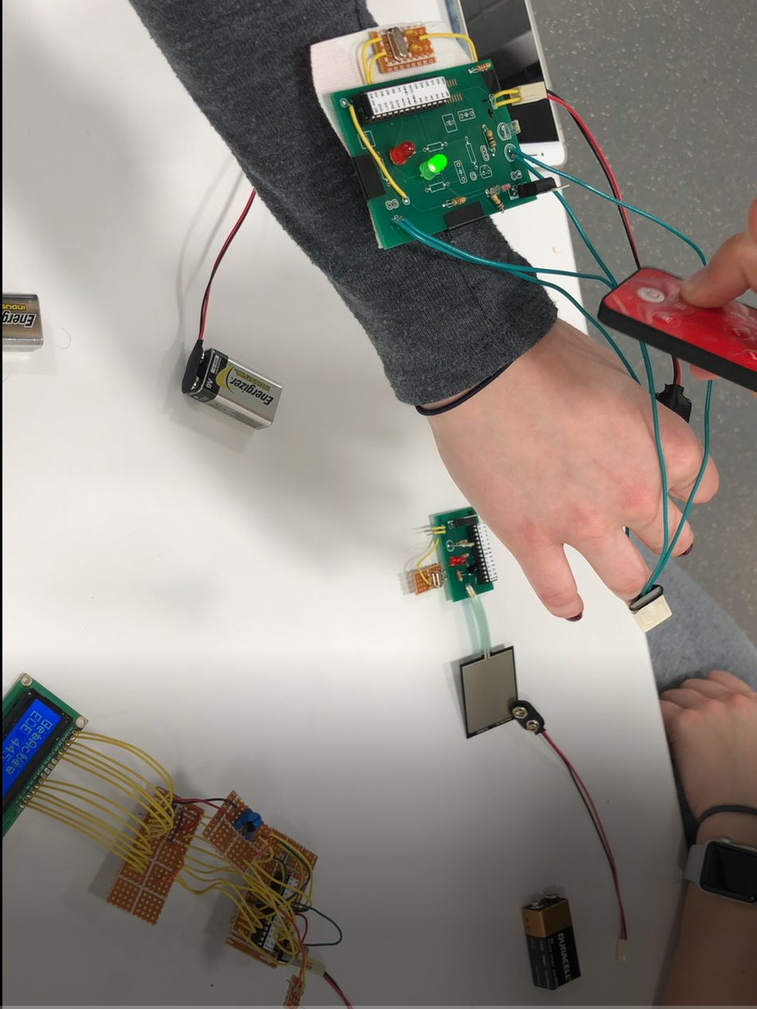
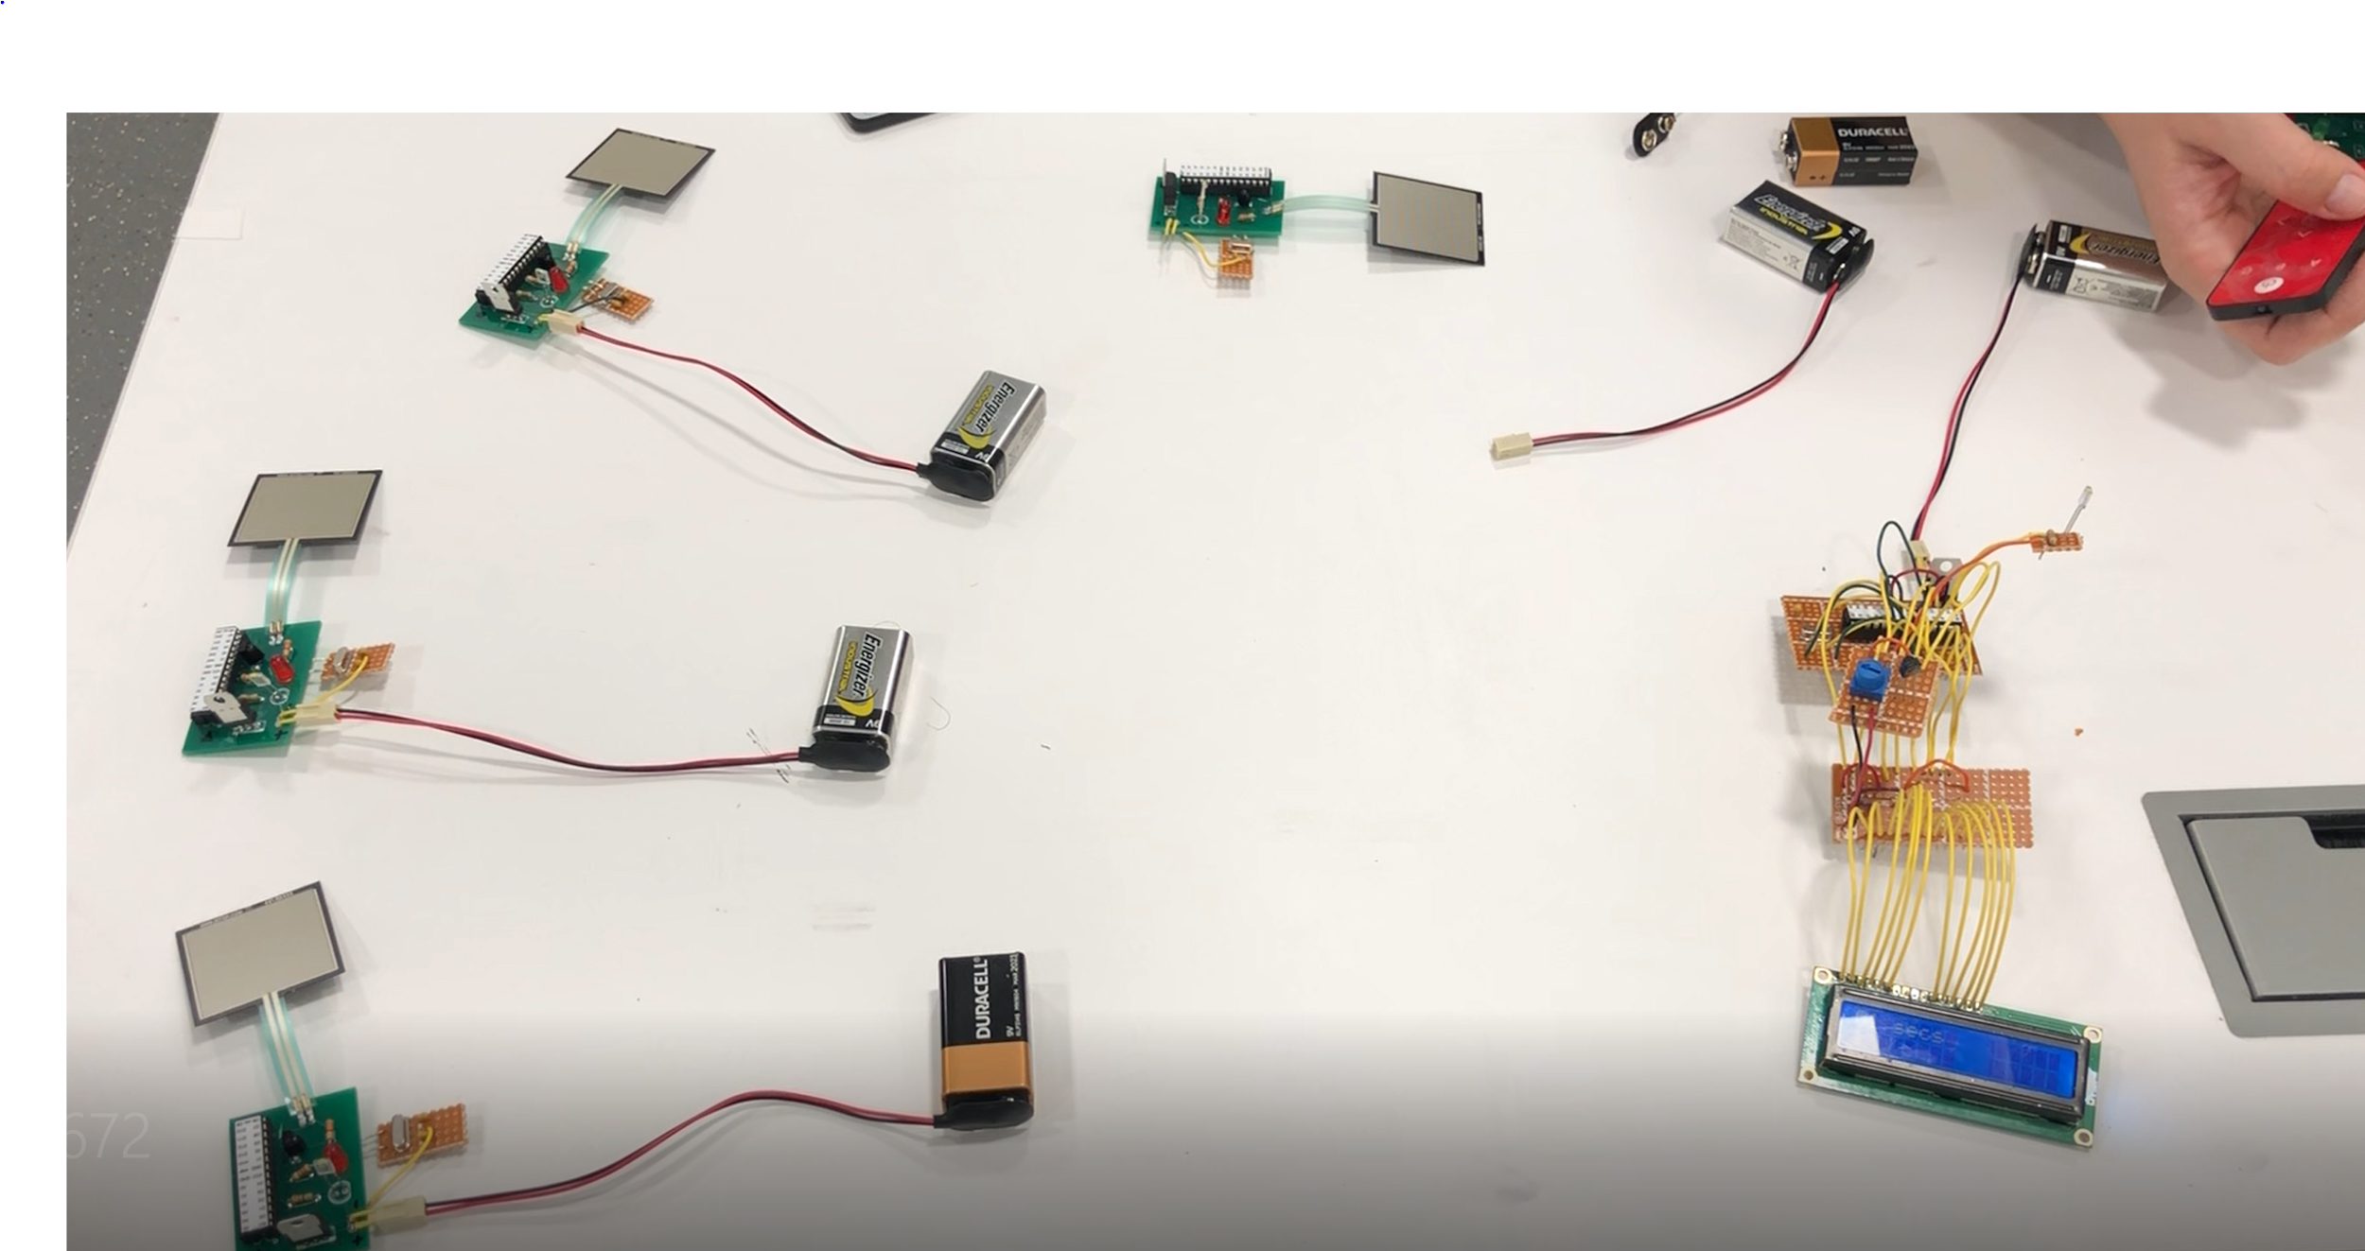
Introduction
Game system for people of any age range
Supports multiple games
Flexibility to add more or different games

Slide 4
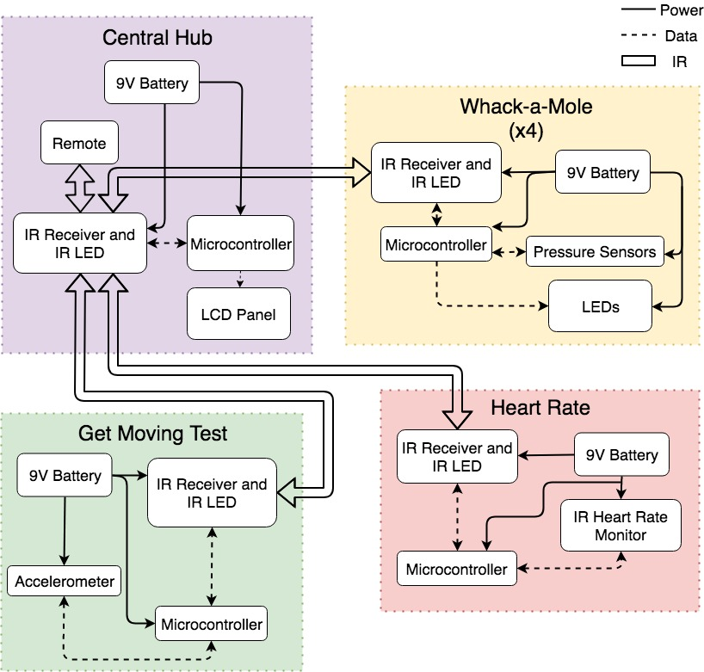
Notes:
Block Diagram
4 Main Modules
Central Hub
Get Moving Game
Whack-a-Mole Game
Heart Rate Monitor
IR Communication
9 V Battery Power for each module
Microcontroller controls each module (ATMEGA328P)

Slide 5
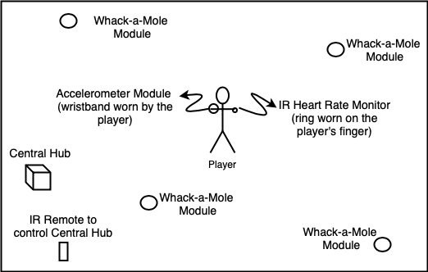
Physical Diagram
Notes:
This diagram shows an example set up of the Get Active Gaming System. The system has been created to be:
Portable
Easy to set up
Set up in any orientation
Interactive and fun
Minimize screen devices

Slide 6
IR Communication
➡ Accurate Signal
➡ Signal Detected, not correct
➡ No signal detected
More sensitive than anticipated
IR signals can send specific values, but only from short distances
Longer distance increases the likelihood of signal distortion
IR remote has large accuracy range
IR LED
IR LED
IR LED
IR LED
35°
35°
15° 15°
2 feet away
5 feet away
13 feet away
17 feet away
Notes:
IR Receiver Requirement
Detects IR transmissions within 1 second of IR signal being sent from a distance of up to 25 feet.
Detects unique IR patterns and can display. timing and frequency of pulses (within 20% accuracy) on microcontroller console.
IR LED Requirements
Transmission range > 25 feet.
850 nm +/- 100 nm wavelength (low IR range).
Operates at less than 100 mA of continuous forward current.
Forward voltage between less than 1.7 V.
Power dissipation at or below 150 mW.

Slide 7
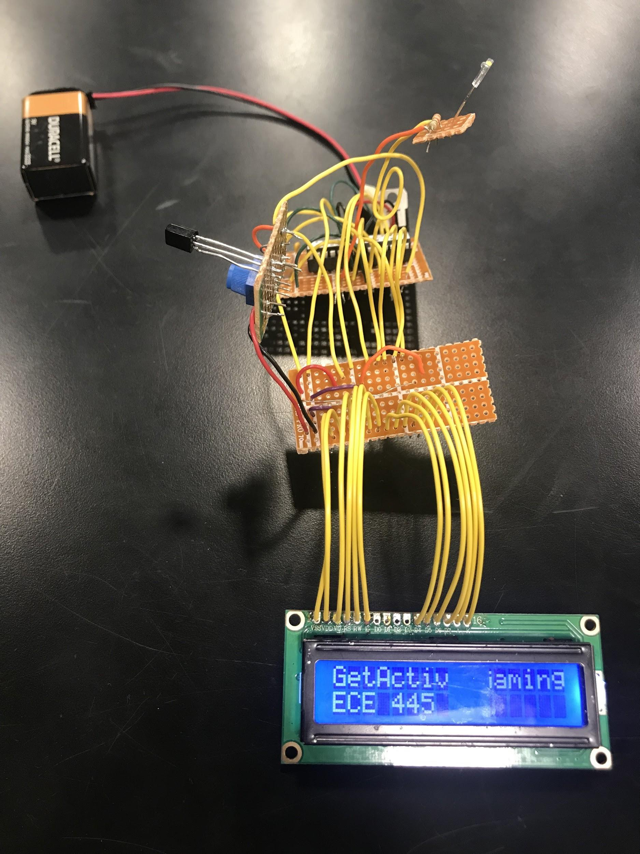
Central Hub Functionality
Communicate with peripheral modules
IR transmission and receiving
Control game play
Microcontroller code and IR signals
Display current score and game
Important for user experience
Notes:
Still important to have a screen in order to communicate with the player. We used an 16x2 LCD display since it is sma
Had difficulties with the PCB. With the central hub created on protoboard, I was able to keep the IR LED and IR Recevier above some of the other components in the module. This made it slightly easier to communicate with peripheral modules.

Slide 8
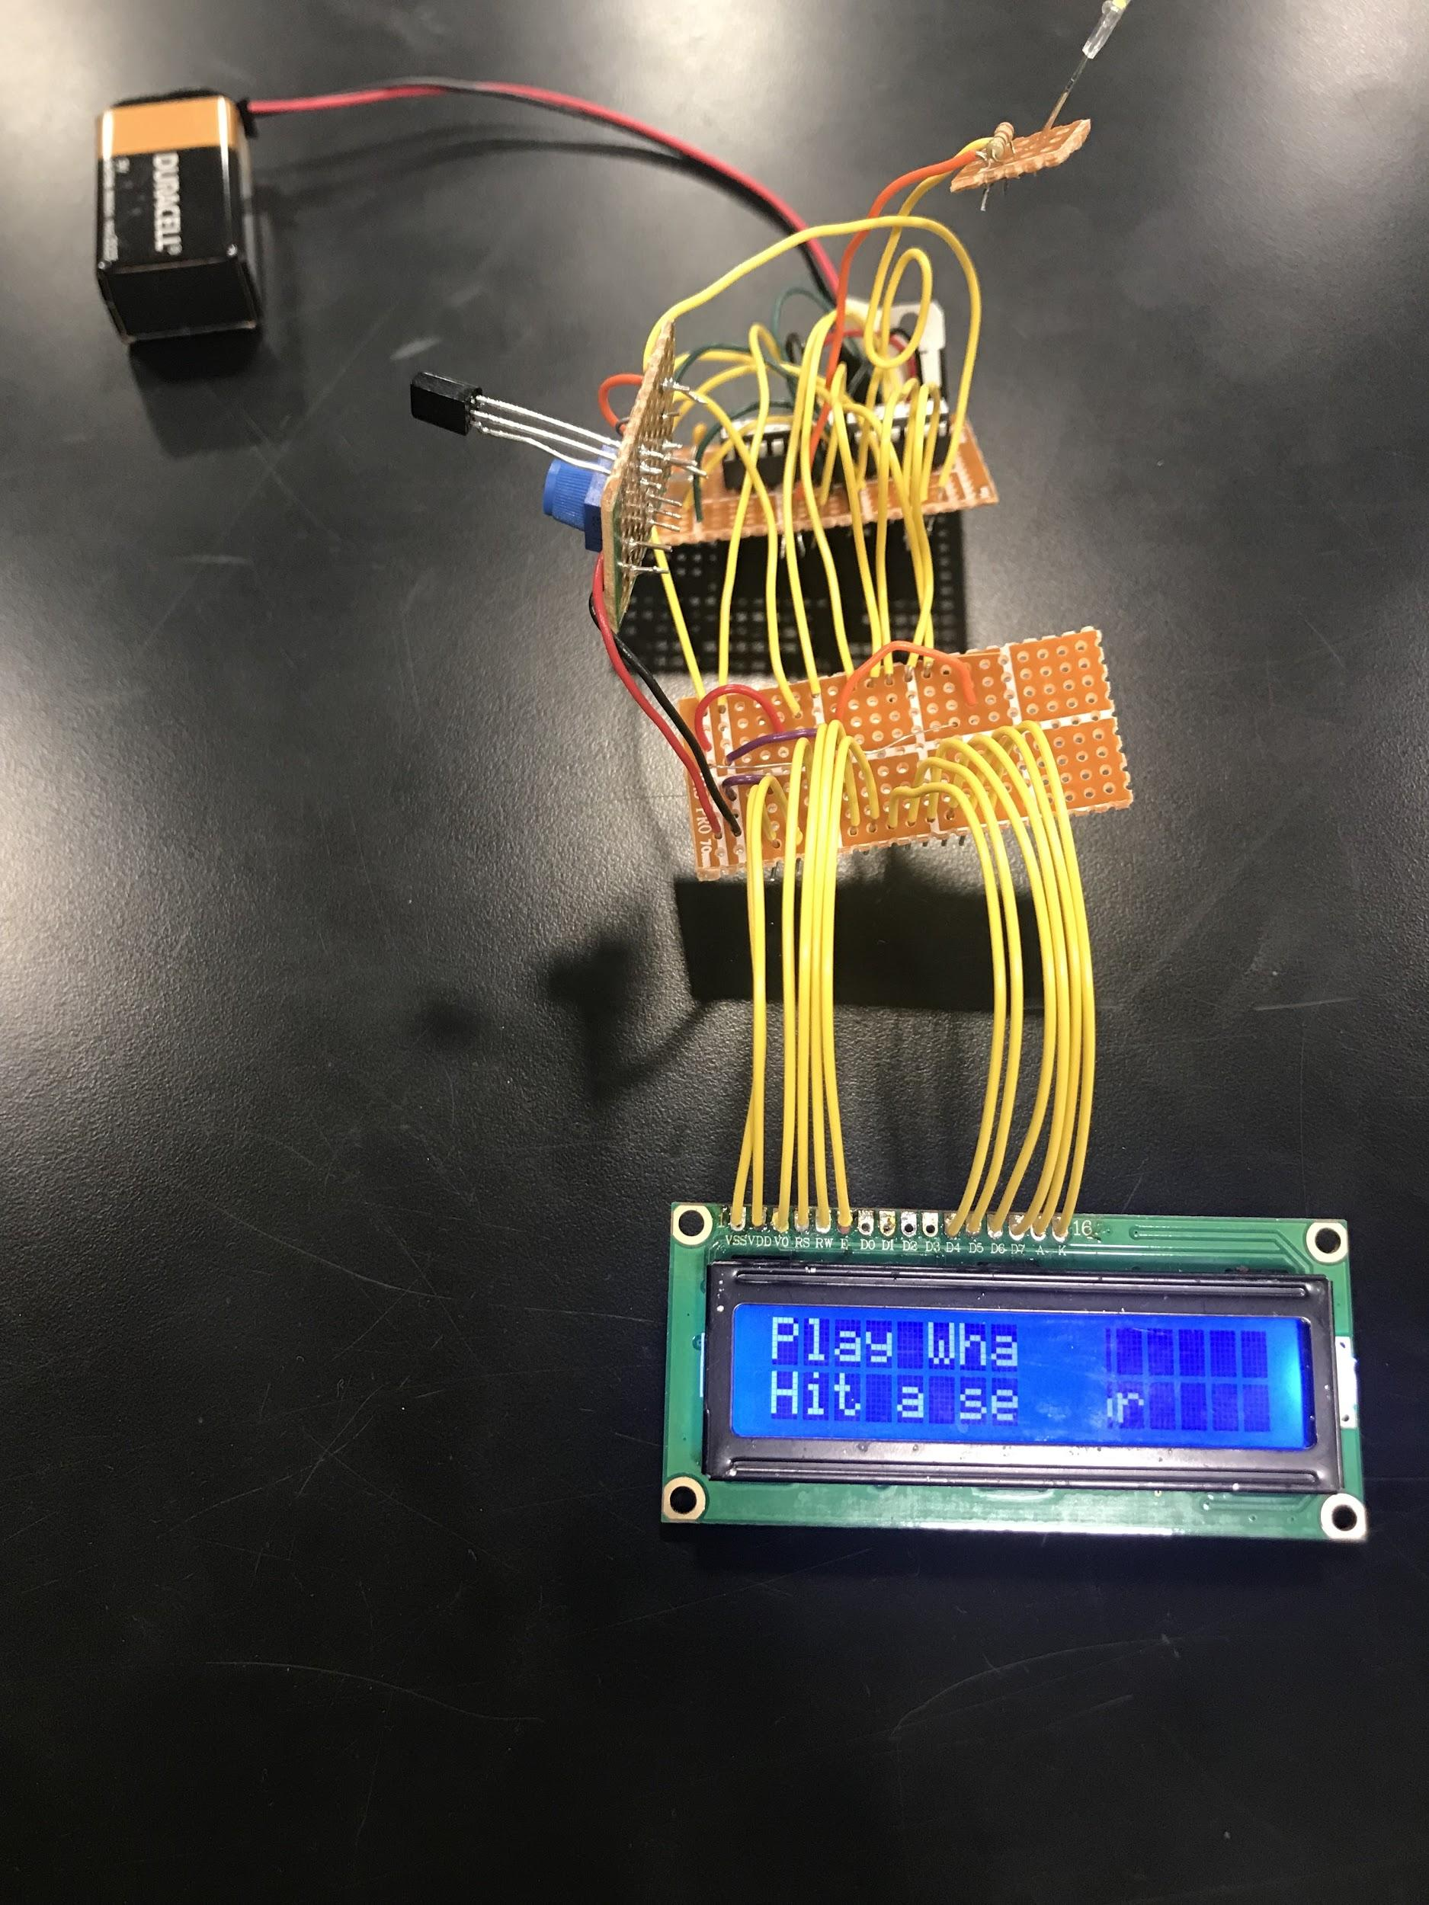
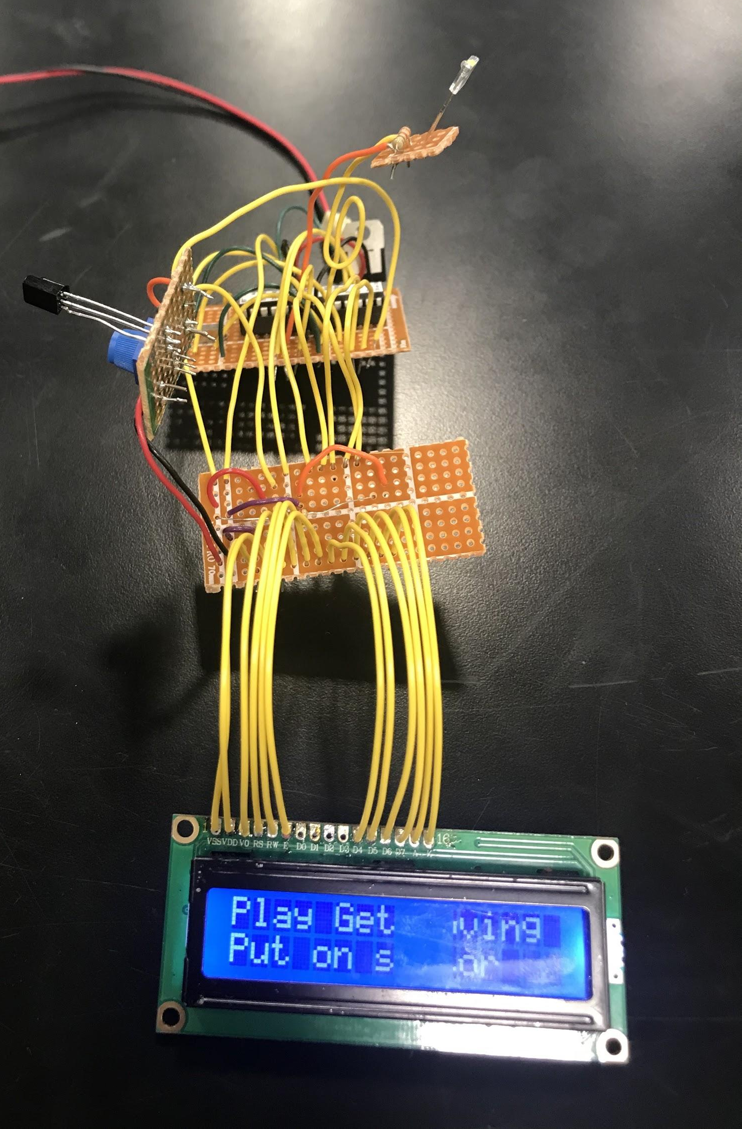
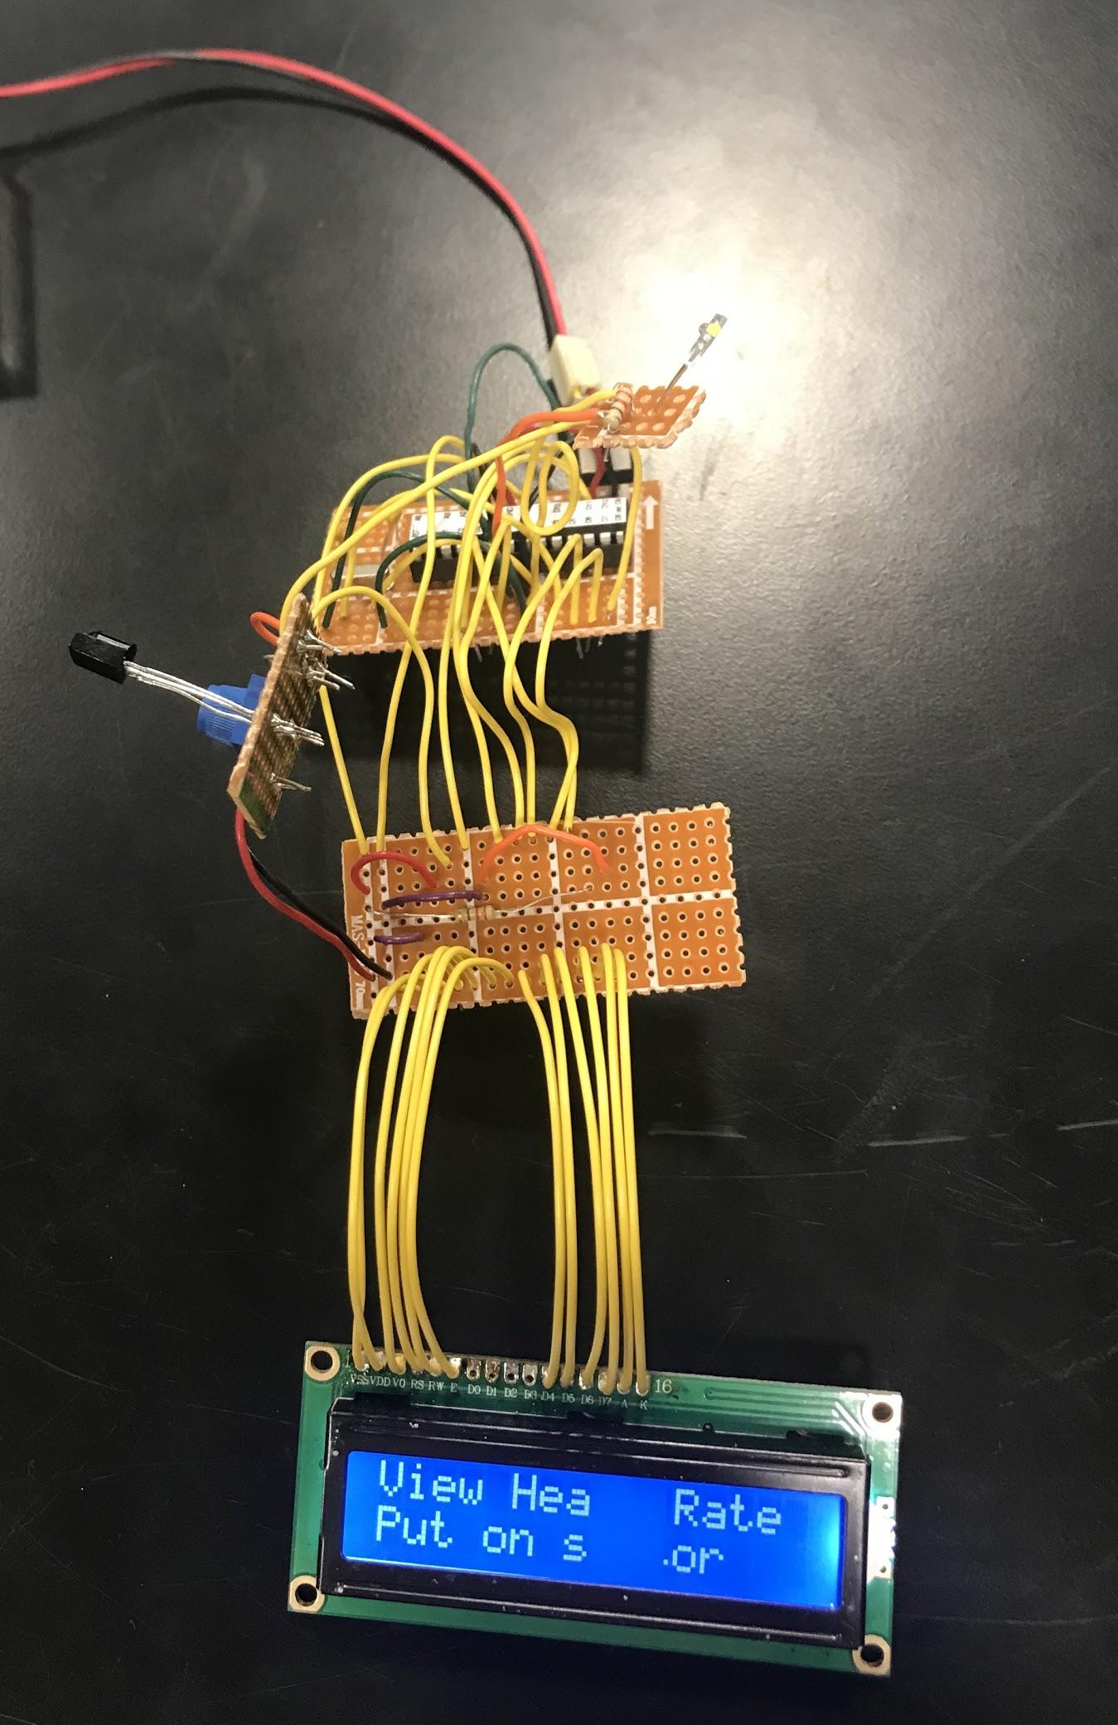
Central Hub

Slide 9
Central Hub
Requirements and Verification
Module accurately sends and receives signals to and from the peripheral modules via IR
The microcontroller handles multiple game modes individually (not simultaneously)
The LCD panel displays output corresponding to the game being played (determined by the microcontroller)
The IR remote is able to switch games and connect via IR with the microcontroller

Slide 10
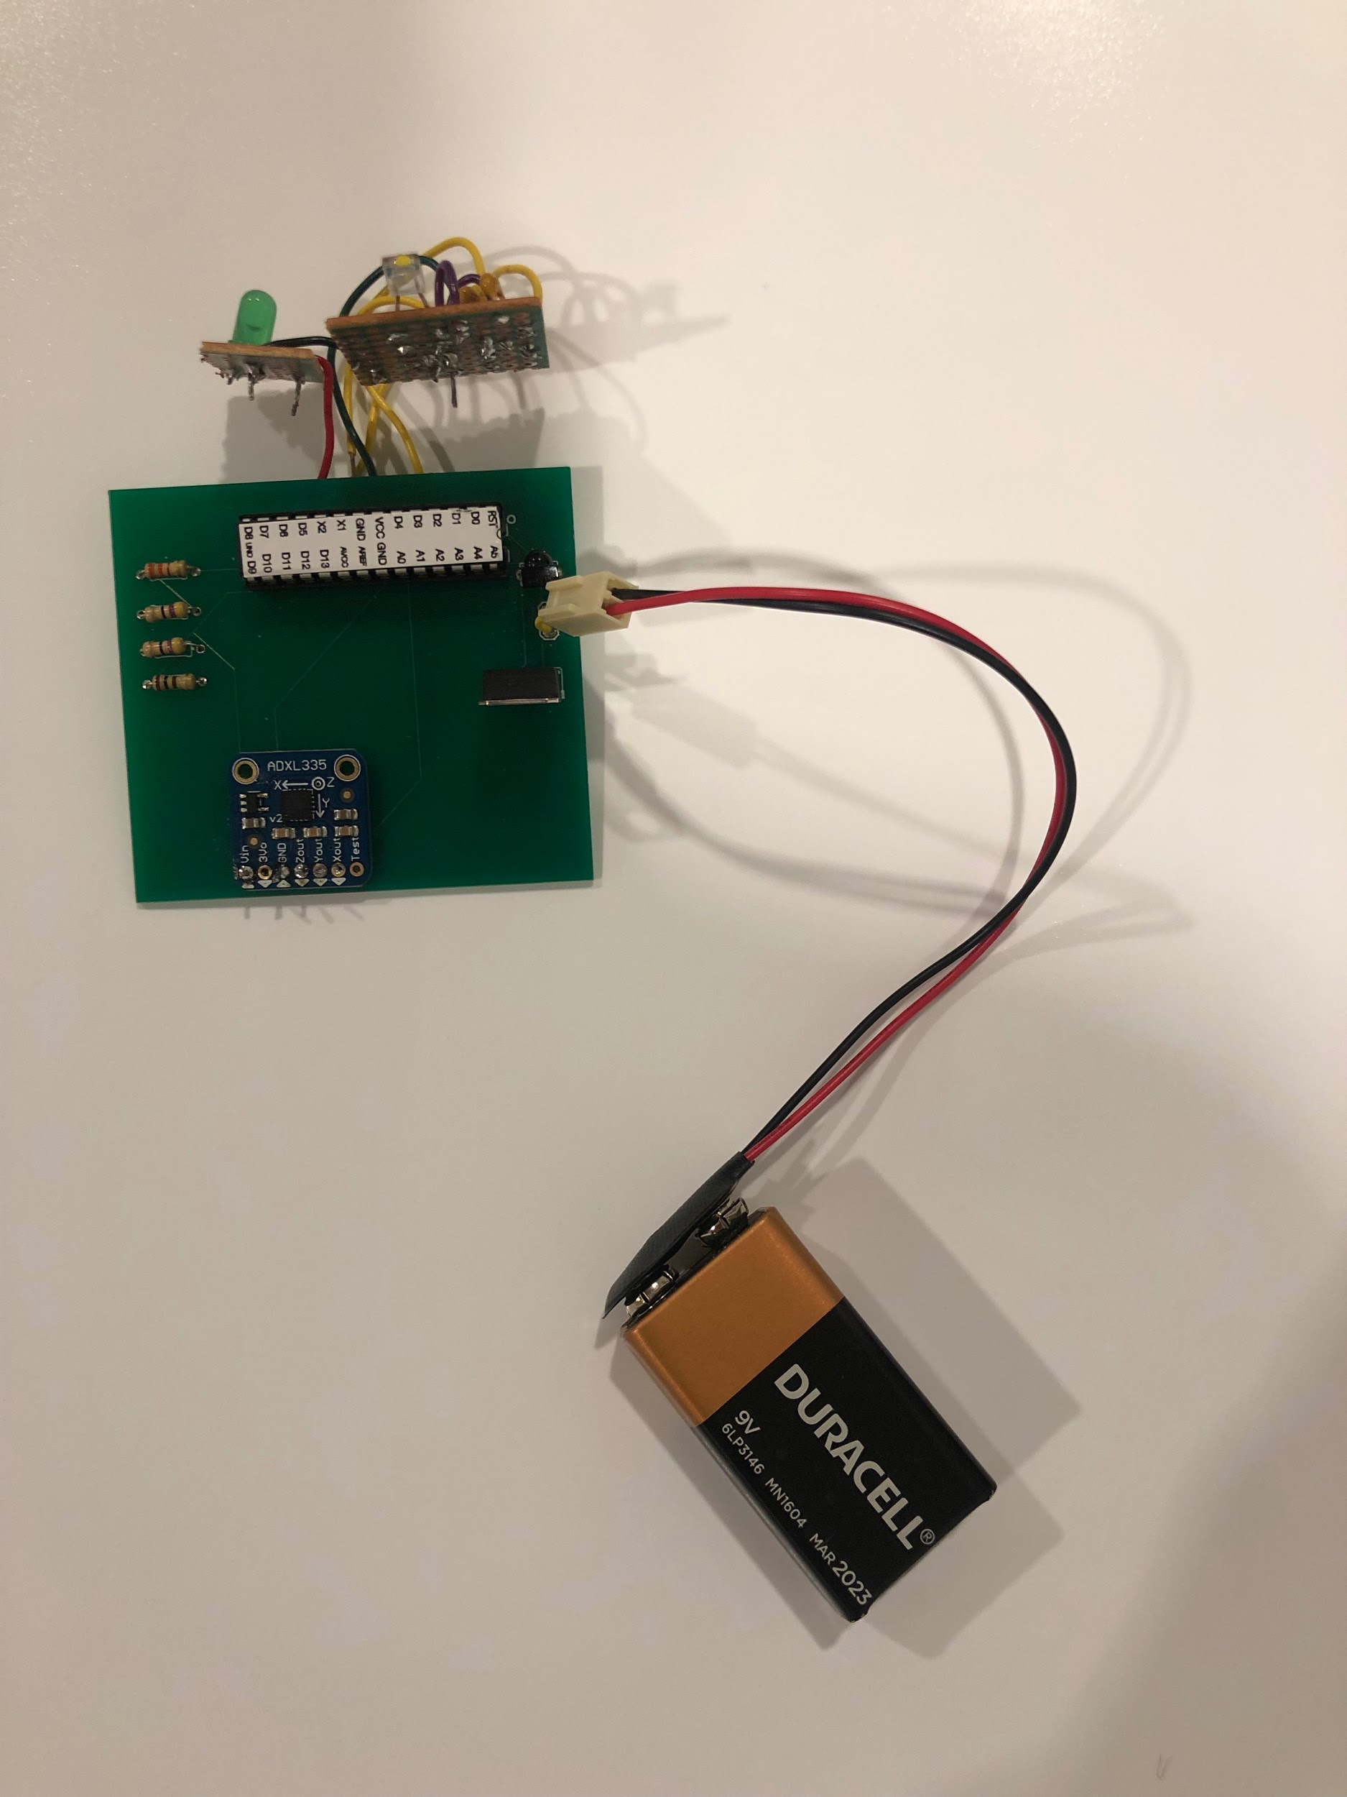
Get Moving Game
Functionality
Records user jumping jack count
Sends number back to Central Hub

Slide 11
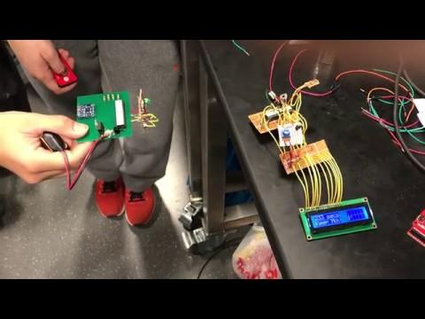
Get Moving Game

Slide 12
Get Moving Game
Requirements and Verification
The microcontroller can record accelerometer data from user’s arm movements accurately
The microcontroller connects with the IR Receiver and must receive a certain IR signal for start and stop commands
The microcontroller connects with the IR LED and sends a unique IR signal back to the central hub
The module stays on the user’s arm during movement

Slide 13
Whack-a-Mole
Functionality
Lights up when receives unique IR pattern from Central Hub
Sends confirmation signal back to Central Hub upon force sensor press

Slide 14
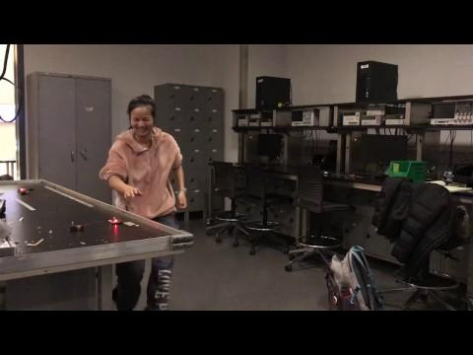
Whack-a-Mole

Slide 15
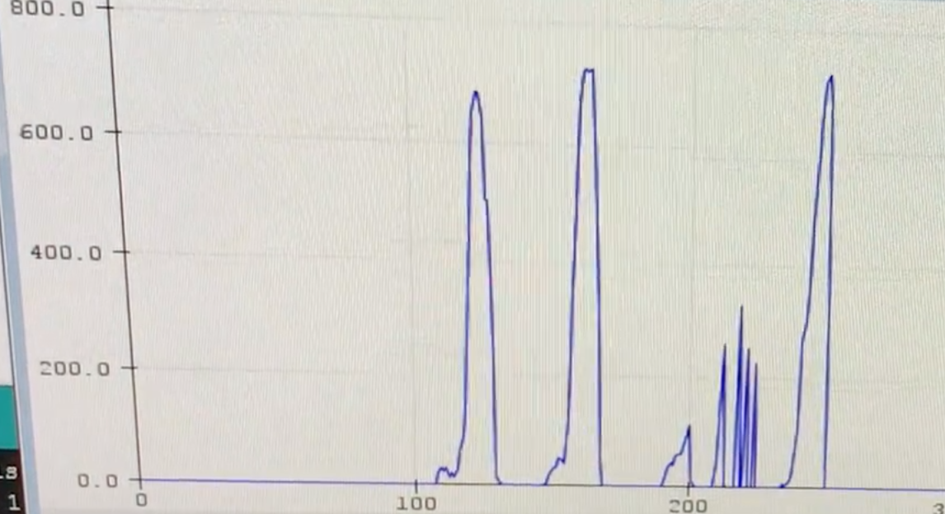
Whack-a-Mole
Requirements and Verification
Module sends and receives IR signals from the Central Hub
Microcontroller receives input from pressure sensor presses
Module can be placed in any orientation within a 25’x25’ room
Force sensor values vary depending on applied force
Users can determine which module to hit based on the LED light attached to the module

Slide 16
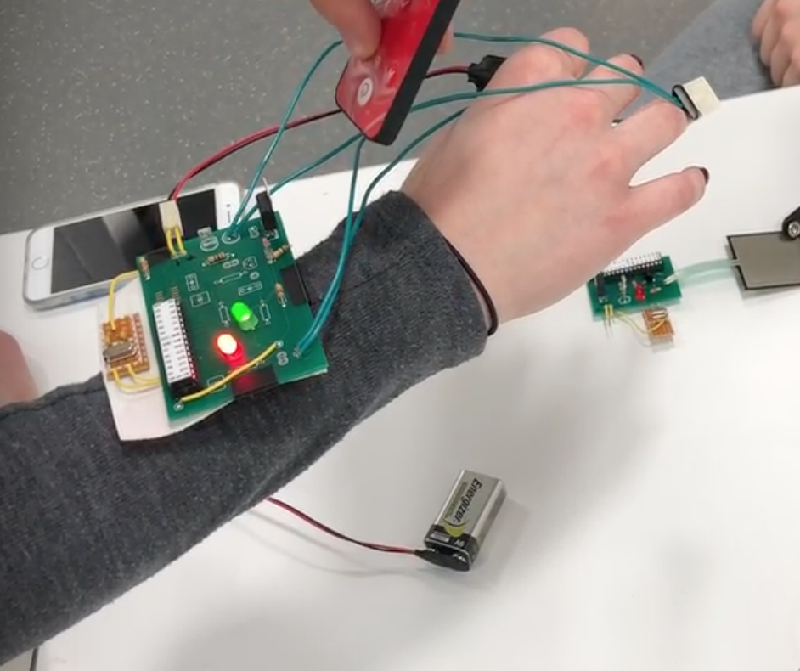
Heart Rate Monitor
Functionality
Records heartbeat using IR transmitter and receiver
LEDs display heartbeat and recording period
Communicates with Central Hub to send heart rate recording

Slide 17
Heart Rate Monitor

Slide 18
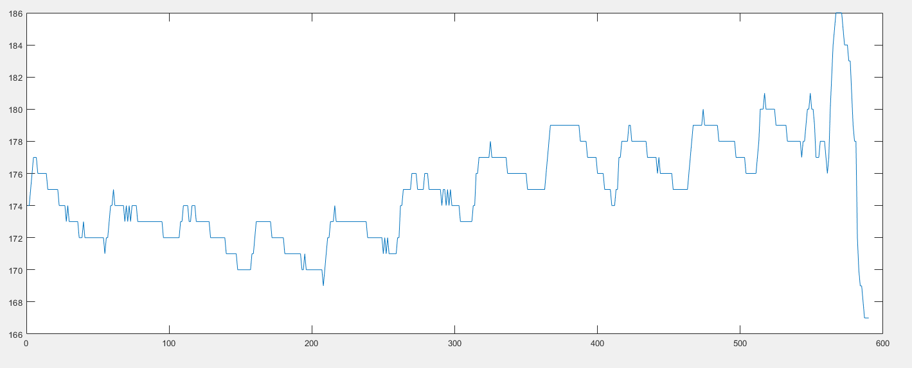
Heart Rate Monitor
Requirements and Verification
Accurately record the user’s heart rate (+/- 10 beats/min)
Microcontroller sends the score back to central hub (via IR)
Module can fit on a variety of user finger sizes
Module stays on the user’s finger

Slide 19
Conclusion
It worked!
Module functionality complete
Communication between modules
Future Work:
Smaller components
Improve IR LED range
Encase each module in more formalized packaging
Add more games
Notes:
As you saw in our videos, all functionality was there
We were able to connect our modules and pass information between them
However, there are always ways to improve and some future work would be to...
Alternative communication methods (RF or Bluetooth) may have been more effective
Improve IR LED range or implement an alternative communication method like Radio frequency (RF) signals or Bluetooth
Perfect the current functionality of the Get Active Gaming System
Use smaller components like surface mount components on PCBs
Add constrations on electrical current and ensure low power consumption of the system
Encase each module in more formalized packaging
Add more games

