Slide 1
ECE 445 – Fall 2017
Dorm Door Locking Mechanism
Group #44: Mason Hoppe, Thomas Orr, Karan Usgaonkar
TA: Zhen Qin
Notes:
Thomas

Slide 2
Project Introduction
The Problem
Crime logs indicate that dorm room theft is still a problem^{[1]}
Existing security measures are RFID scanners at building entrances and keys for individual rooms but..
Residents frequently leave their doors unlocked
“Tailgating” into a building is easy
Notes:
Thomas

Slide 3
Project Introduction
The Solution
Create a dorm door lock attachment to automatically lock the door
Provide new security measures in addition to the existing key-and-lock system
Power this security system by wall power with a battery backup in case of power outages.
Notes:
Thomas

Slide 4
Project Objective
The Project had 3 High Level Objectives to Accomplish:
1
Implement 2 new unlocking methods: Numerical keypad, RFID sensor
Use power efficiently by implementing passive (low power) mode and an active (high power) mode
2
3
Lock the door automatically when the door swings shut
Notes:
Karan

Slide 5
Overall Project Block Diagram
Notes:
Karan

Slide 6
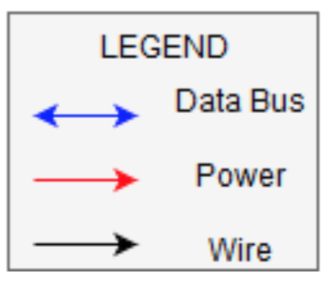
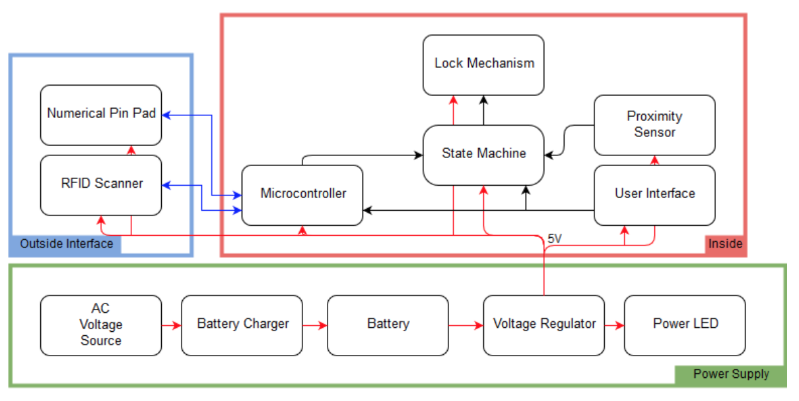
Notes:
Karan

Slide 7
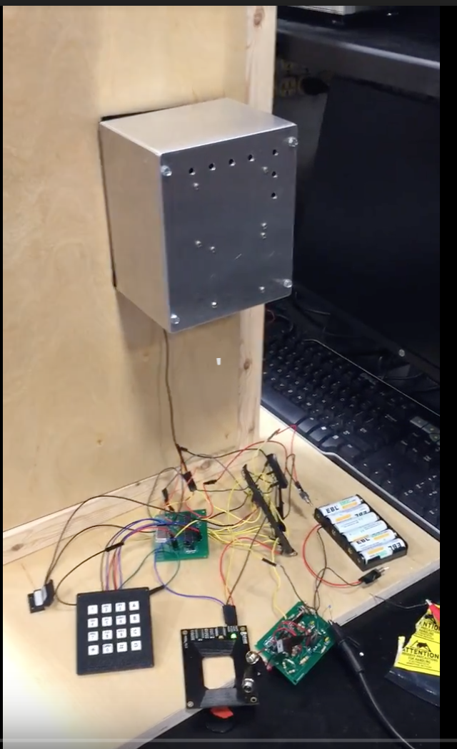
Visual Layout of the Project
Case
(Servo Inside)
Lock/Unlock PCB
Proximity Sensor
Batteries
Pin pad
Power PCB
RFID Scanner
Notes:
Mason

Slide 8
Individual Module Review

Slide 9
Microcontroller Overview
Operational Overview
Took data from all devices (keypad, UI, RFID, prox) and decided if the bolt should be locked or unlocked
Atmega328
Inputs
Outputs
RFID Sin/Sout signal
4 Keypad lines
Proximity Sensor
3 buttons and 3 switches
5 V Power & Ground lines
4 Keypad lines
Lock/Unlock PWM to Servo Motor
Notes:
Mason

Slide 10
Reasons for Using the Atmega 328
Current Output Limit:
Current draw of 40 mA from each port at the most
Limit on the Number of Input/Outputs:
Number of ports were sufficient for all sensors, UI components, and the servo (more than 17 ports)
Memory Limit:
Space requirements were more than sufficient
Ease of Programming:
Easily programmable and debuggable with TX/RX and Arduino IDE
Convenience of Unit Testing:
Allows us to test the microcontroller separately from the circuit
Notes:
Mason

Slide 11
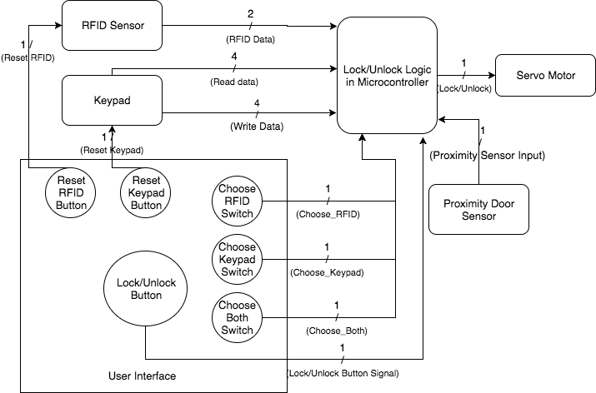
Data Flow for the Microcontroller
Notes:
Mason

Slide 12
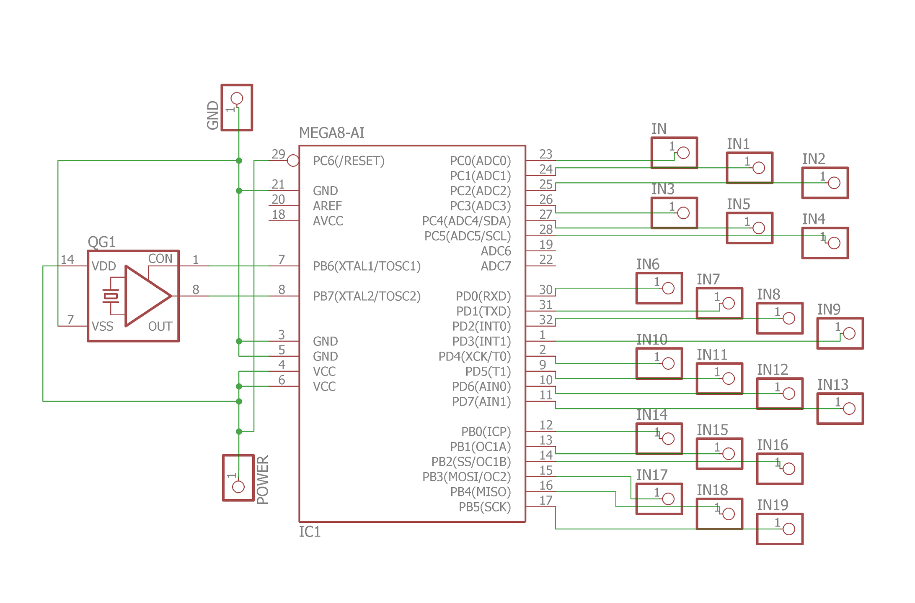
Schematic for the Microcontroller
Notes:
Mason

Slide 13
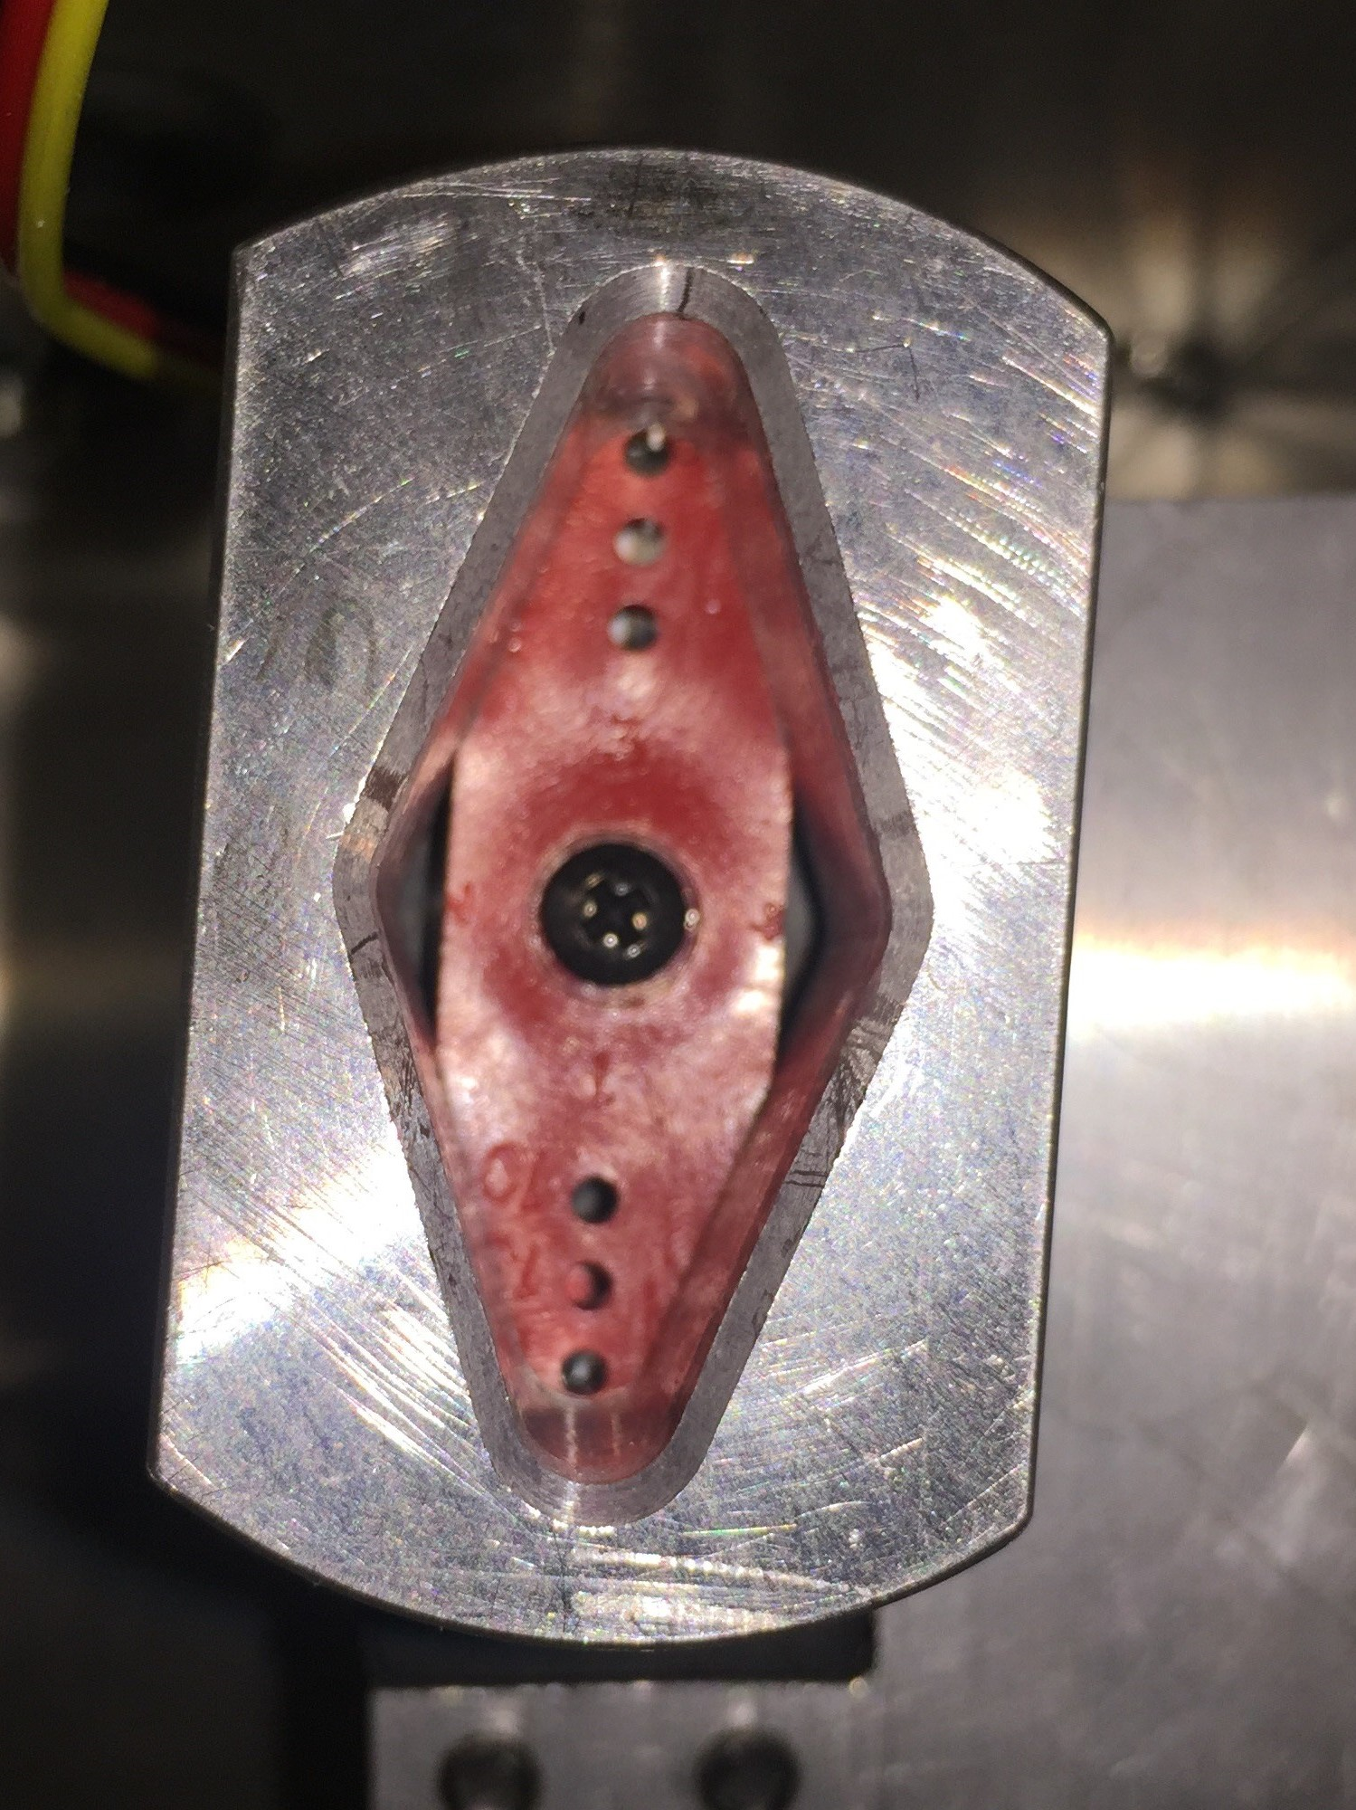
Lock Mechanism Overview
Mechanical Construction
The servo motor was fit onto the deadbolt of the door and would remain on the inside of the door
A wooden door was built and the lock was fixed firmly into the door
The servo fit directly on top of the deadbolt and the user would no longer need to touch the deadbolt by hand: all locking and unlocking is automatic
Inputs
Outputs
Ground line
5 V Power line
Pulse Wave Modulation
signal (PWM)
Mechanically locking or unlocking the door by moving the deadbolt from the inside
No signals returned from the servo
Notes:
Karan

Slide 14
Servo Motor Parameters
Parameters of the PWM
Power Consumption Testing
Frequency: 350 Hz
Peak-to-Peak Voltage: 4V
Duty Cycle: Variable. 25% Locked the door, 60% Unlocked the door
Test Number | Current Drawn
1 | 520 mA
2 | 508 mA
3 | 511 mA
4 | 516 mA
5 | 512 mA
Power Consumption Summary
Estimated Active Mode: 2.54 W
Passive Mode: 0 W
Notes:
Karan

Slide 15
RFID & Keypad Overview
Mechanical Construction
Potential Input Devices for User
Set up on outside of door
96 Series 16 Button Keypad
Parallax 28840 RFID Read/Write Module
Inputs
Outputs
RFID Serial In
4 power lines for Keypad
5 V Power line
RFID Serial Out
4 power lines for Keypad
Notes:
Mason

Slide 16
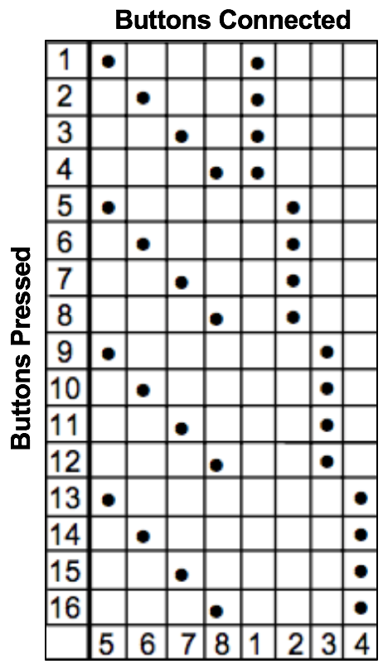
RFID & Keypad Parameters
RFID Parameters
Keypad Connection Mapping
Voltage Supply: 5 V
Idle Current Draw: <10 mA
Active Current Draw: approx. 150 mA
Asynchronous Serial 9600 bps 5V TTL
Keypad Parameters
4 Row signals & 4 Column signals
Idle & Active Current Draw: Negligible
Notes:
Mason

Slide 17
Power Circuit Overview
Operational Overview
The Power Circuit takes any combination of wall and battery power to output 5V to the rest of the project
While both the wall and battery power are connected, the batteries will charge while idle the circuit is idle
The DS2715 microchip is used to regulate charging
Inputs
Outputs
18V Wall Power and Ground
7.2V Battery Power and Ground
5V Output Power and Ground
Notes:
Thomas

Slide 18
DS2715
State Machine[2]
Notes:
Thomas

Slide 19
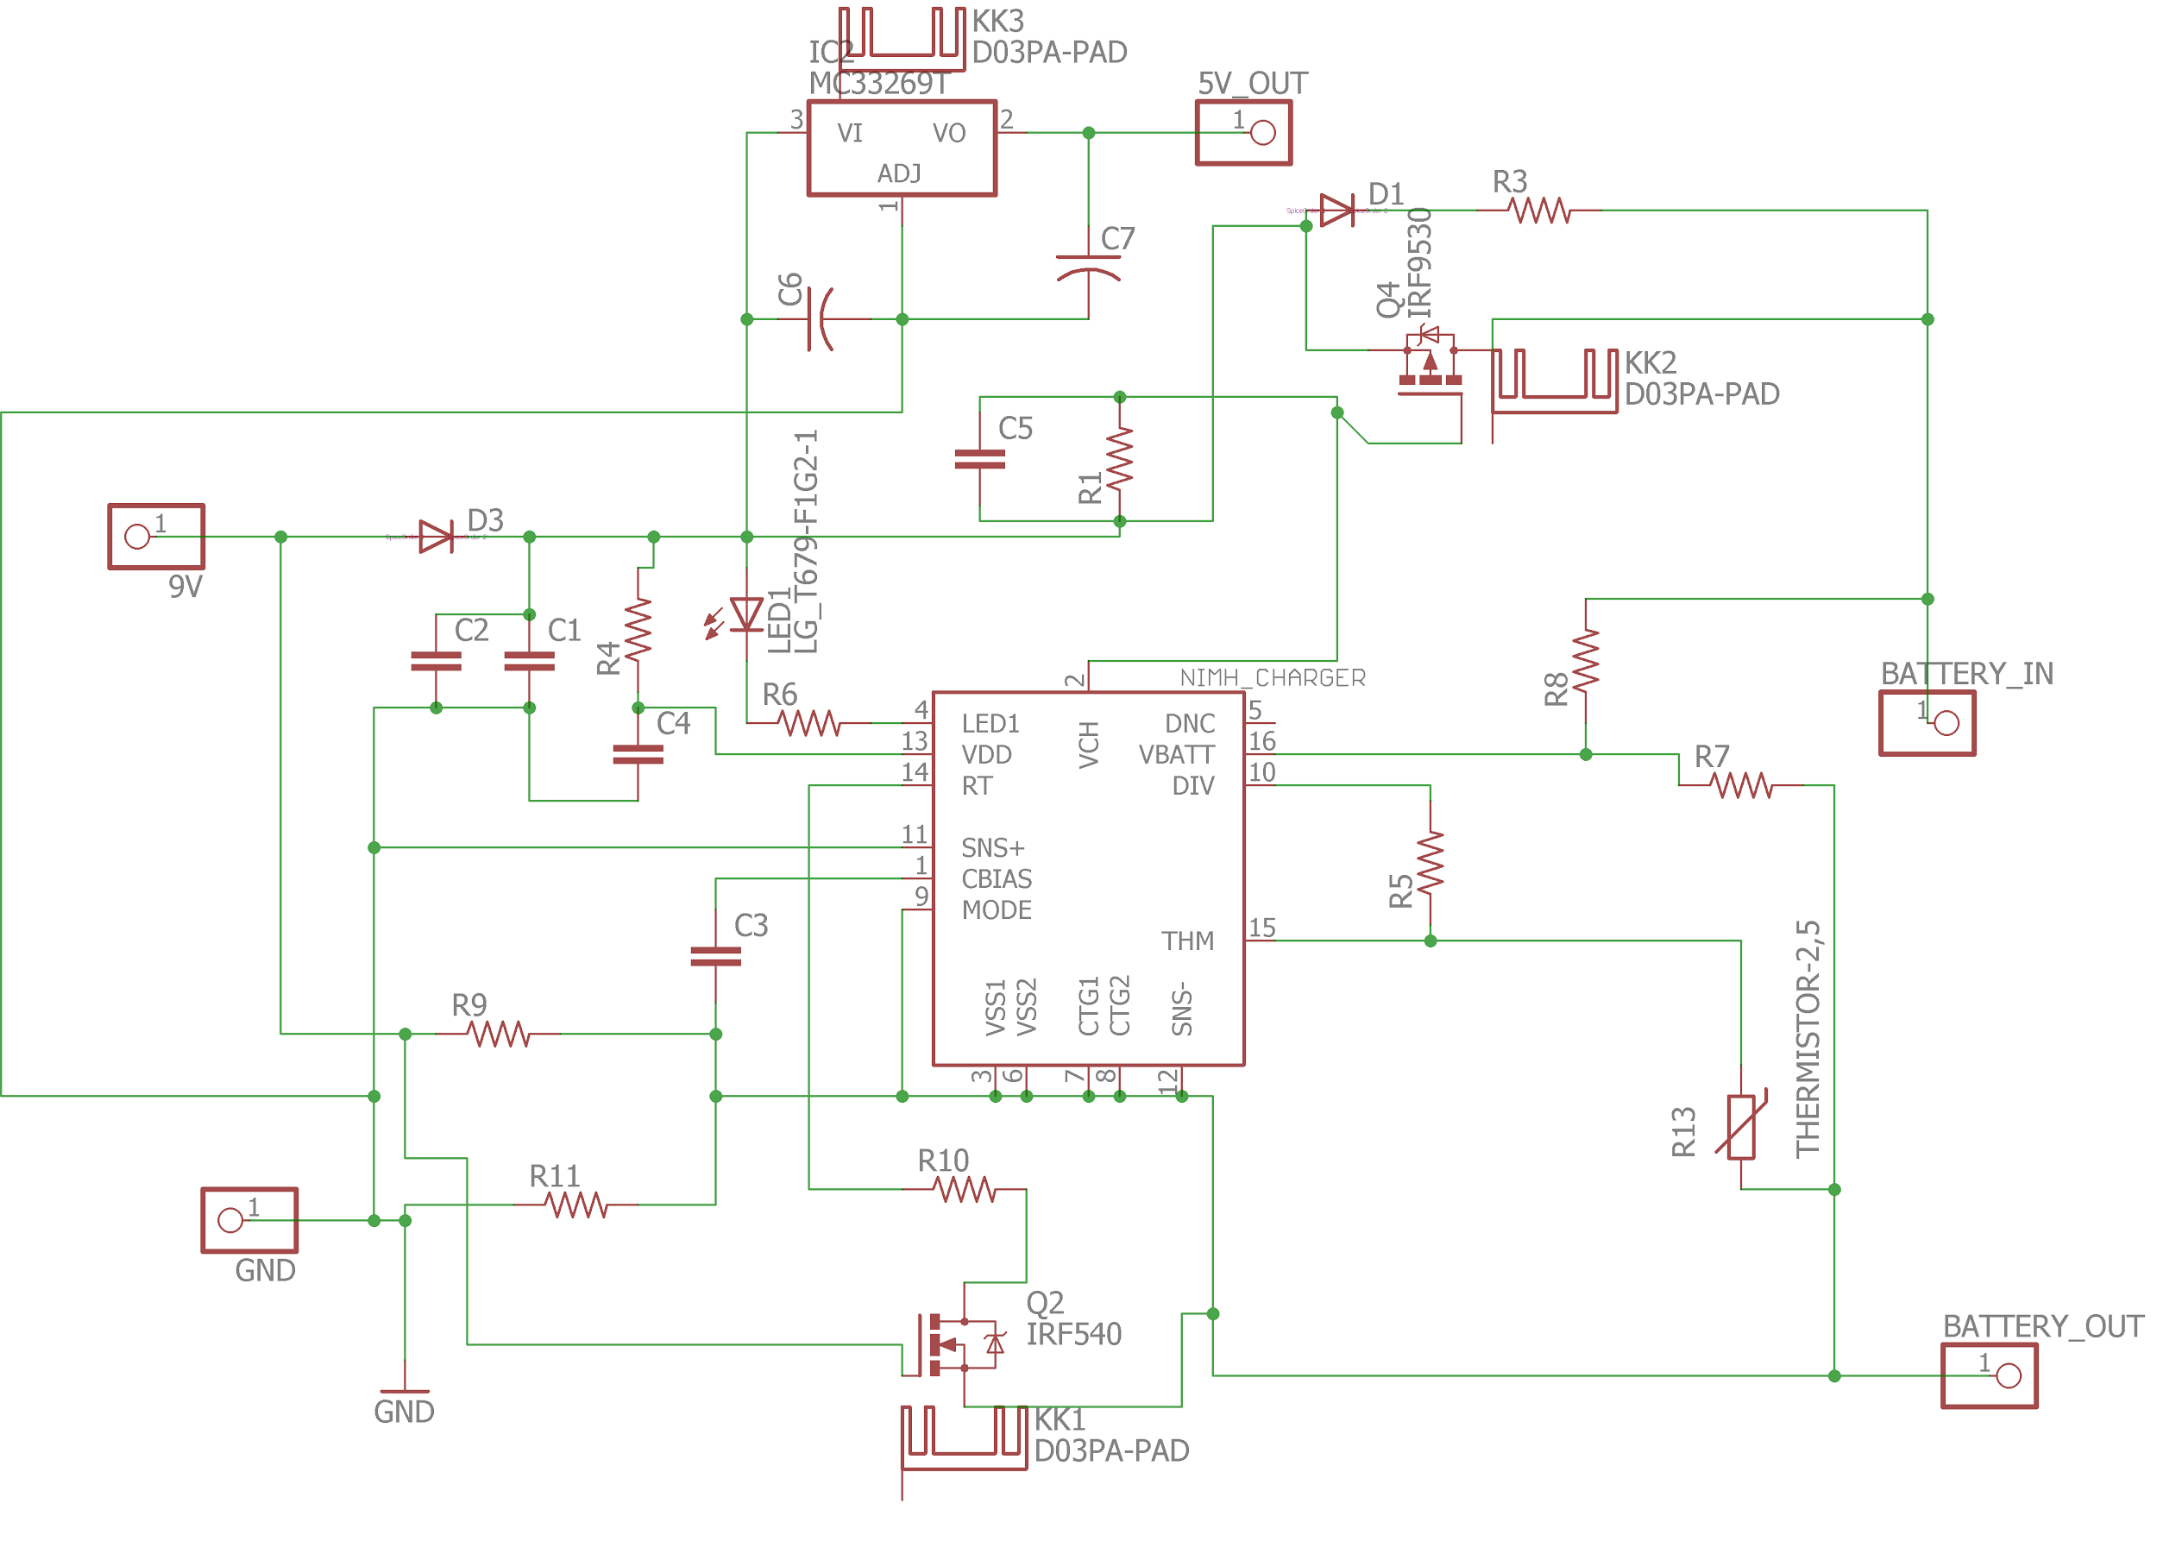
Power Circuit Schematic
Resistor Values
Resistor | Value
R1 | 830 𝜴
R3 | 220 𝜴
R4 | 150 𝜴
R5 | 10 K𝜴
R6 | 780 𝜴
R7 | 100 K𝜴
R8 | 500 K𝜴
R9 | 10 K𝜴
R10 | 160 K𝜴
R11 | 3 𝜴
Notes:
Thomas

Slide 20
Power Circuit Schematic
Capacitor Values
Capacitor | Value
C1 | 1 𝛍F
C2 | 33 𝛍F
C3 | 0.1 𝛍F
C4 | 0.1 𝛍F
C5 | 4.7 𝛍F
C6 | 0.33 𝛍F
C7 | 0.1 𝛍F
Notes:
Thomas

Slide 21
Power Circuit Parameters
Measured Battery Current
Test Parameters
Test Number | Circuit Conditions | Current Drawn
1 | Idle | 57 mA
2 | Idle | 56.5 mA
3 | RFID | 280 mA
4 | RFID | 281 mA
5 | Servo | 570 mA
6 | Servo | 575 mA
7 | Both | 740 mA
8 | Both | 744 mA
The circuit is solely running off battery power
The wall power is open
The RFID is active for 4 seconds
The Servo is active for 0.5 seconds
DS2715 Parameters
The DS2715 is in presence mode
Notes:
Thomas

Slide 22
Power Circuit Parameters
Measured Wall Current
Test Parameters
Test Number | Circuit Conditions | Current Drawn
1 | Idle | 57 mA
2 | Idle | 56.5 mA
3 | RFID | 280 mA
4 | RFID | 281 mA
5 | Servo | 570 mA
6 | Servo | 575 mA
7 | Both | 740 mA
8 | Both | 744 mA
The circuit is solely running off wall power
The battery power is open
The RFID is active for 4 seconds
The Servo is active for 0.5 seconds
DS2715 Parameters
The DS2715 is in presence mode
Notes:
Thomas

Slide 23
Power Circuit Parameters
Measured Battery Current
Test Parameters
Test Number | Circuit Conditions | Current Drawn
1 | Idle | -1.7 mA
2 | Idle | -1.7 mA
3 | RFID | 67 mA
4 | RFID | 68 mA
5 | Servo | 300 mA
6 | Servo | 305 mA
7 | Both | 475 mA
8 | Both | 480 mA
The circuit is running off battery power and wall power
The RFID is active for 4 seconds
The Servo is active for 0.5 seconds
DS2715 Parameters
The DS2715 is in charging/discharging mode
Notes:
Thomas

Slide 24
UI & Proximity Sensor Overview
Operational Overview
Set up inside the door
Proximity sensor detects when door is open or closed
3 Buttons / 3 Switches are user control
UI Functions
Buttons:
Lock / Unlock Locks/unlocks the door
Reset RFID Change valid RFID Tag
Reset Keypad Change valid PIN
Switches:
/ Enable RFID Use RFID
/ Enable Keypad Use keypad
/ AND Mode Require both
Notes:
Karan

Slide 25
UI & Proximity Sensor Parameters
Proximity Sensor Measurements
Inputs
Input | Status | Outputs
5V | Close | 8mV | 6mV | 6.5mV | 9mV
5V | Far | 5V | 4.99V | 5V | 5V
4V | Close | 4mV | 6mV | 5.5mV | 4.5mV
4V | Far | 4V | 4V | 4V | 4V
Prox 5V VCC
UI 5V VCC, 0V GND
Outputs
Prox 5V when far, 0V when close
UI 5V when OFF, 0V when ON
Notes:
Karan

Slide 26
Results
Notes:
Mason

Slide 27
Successes
Key Successes
- Programming on the atmega328 was convenient due to the availability of library functions with detailed documentation
- Power circuit was complex but worked to support all components of the project both on battery as well as wallpower
- Mechanical interface of the lock and servo motor was robust
- All components had an effective low-power mode to extend survival on battery life by approximately 400%.
Notes:
Mason

Slide 28
Challenges
Key Challenges & Solutions
- Fitting all buttons & Switches inside the metal casing onto the door
Solution: Larger and non-conducting box to fit onto the door.
- Lack of datasheets and proper documentation for servo motor and proximity sensor during design phase
Solution: Use other component providers with better documentation.
- Voltage drop when using battery power
Solution: We altered the ground of the voltage regulator to be the battery ground.
Notes:
All

Slide 29
Details of Other Tests
Tests
Findings
- Battery temperature sensing on the power circuit using a thermistor
- Attempted to use an ICard with the RFID
- Servo motor Operating parameter testing (frequency, PWM, operating voltage, and duty cycle range)
- Verified that for temperatures over 50 degrees Celsius, the battery stops charging
- The RFID only works with pre-made tags
- Discovered that 350 Hz is the best operating frequency, and that PWM needs to be 4V peak-to-peak with 20-80% duty cycle.
Notes:
All

Slide 30
Conclusions & Further Work
Conclusion
Our project was able to integrate an RFID, Pinpad, servo motor, and more components in an intuitive way to allow a user to control the entire system with a simple user interface of 3 buttons and 4 switches.
All components were tested and all requirements were achieved.
Potential Future Work & Next Steps
Next steps would be to integrate a BlueTooth functionality to reduce the system’s fragility due to wires and to improve the communication of the system between both sides of the door.
Notes:
Mason

Slide 31
References
[1] - University of Illinois Police Department, ‘Daily Crime Log’, (2017,September 20).
[Online] Available: https://illinois.edu/blog/files/7512/557491/118800.pdf [Accessed:
21-September-2017]
[2] - Maxim Integrated, “NiMH Battery Pack Charge Controller,” DS2715 Datasheet,
2009
Notes:
None

Slide 32
Questions?
Notes:
None

