Slide 1
Team 49: Head Trauma Data Transmission and Logging
Philip Meyer, Fahim Sheikh, & Conner Cecott

Slide 2
Introduction
3.8 million sports-related concussions every year
Researchers have many questions…
What causes concussions?
What data is useful?

Slide 3
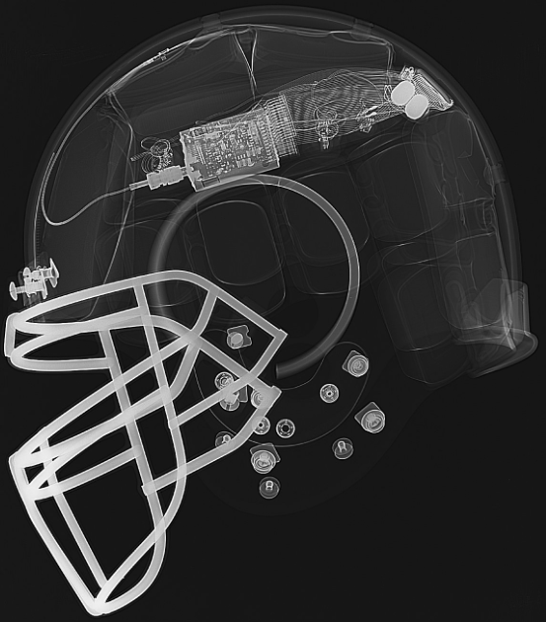
Introduction
Similar devices exist that…
Collect pure accelerometer data
Infer impact location
Attempt to predict concussions

Slide 4
Our Device
Infers both linear and rotational acceleration
Collects heart rate data
Wirelessly transmits data to the sideline
Logs data for researchers
Does not predict concussions

Slide 5
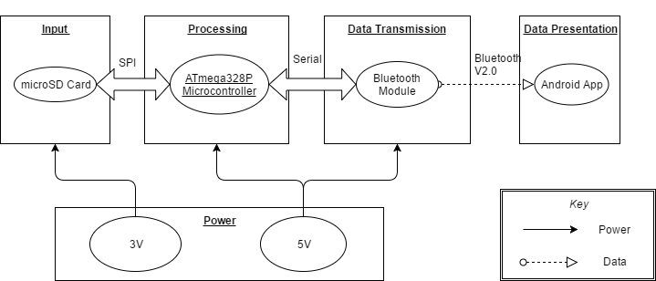
High-Level Block Diagram

Slide 6
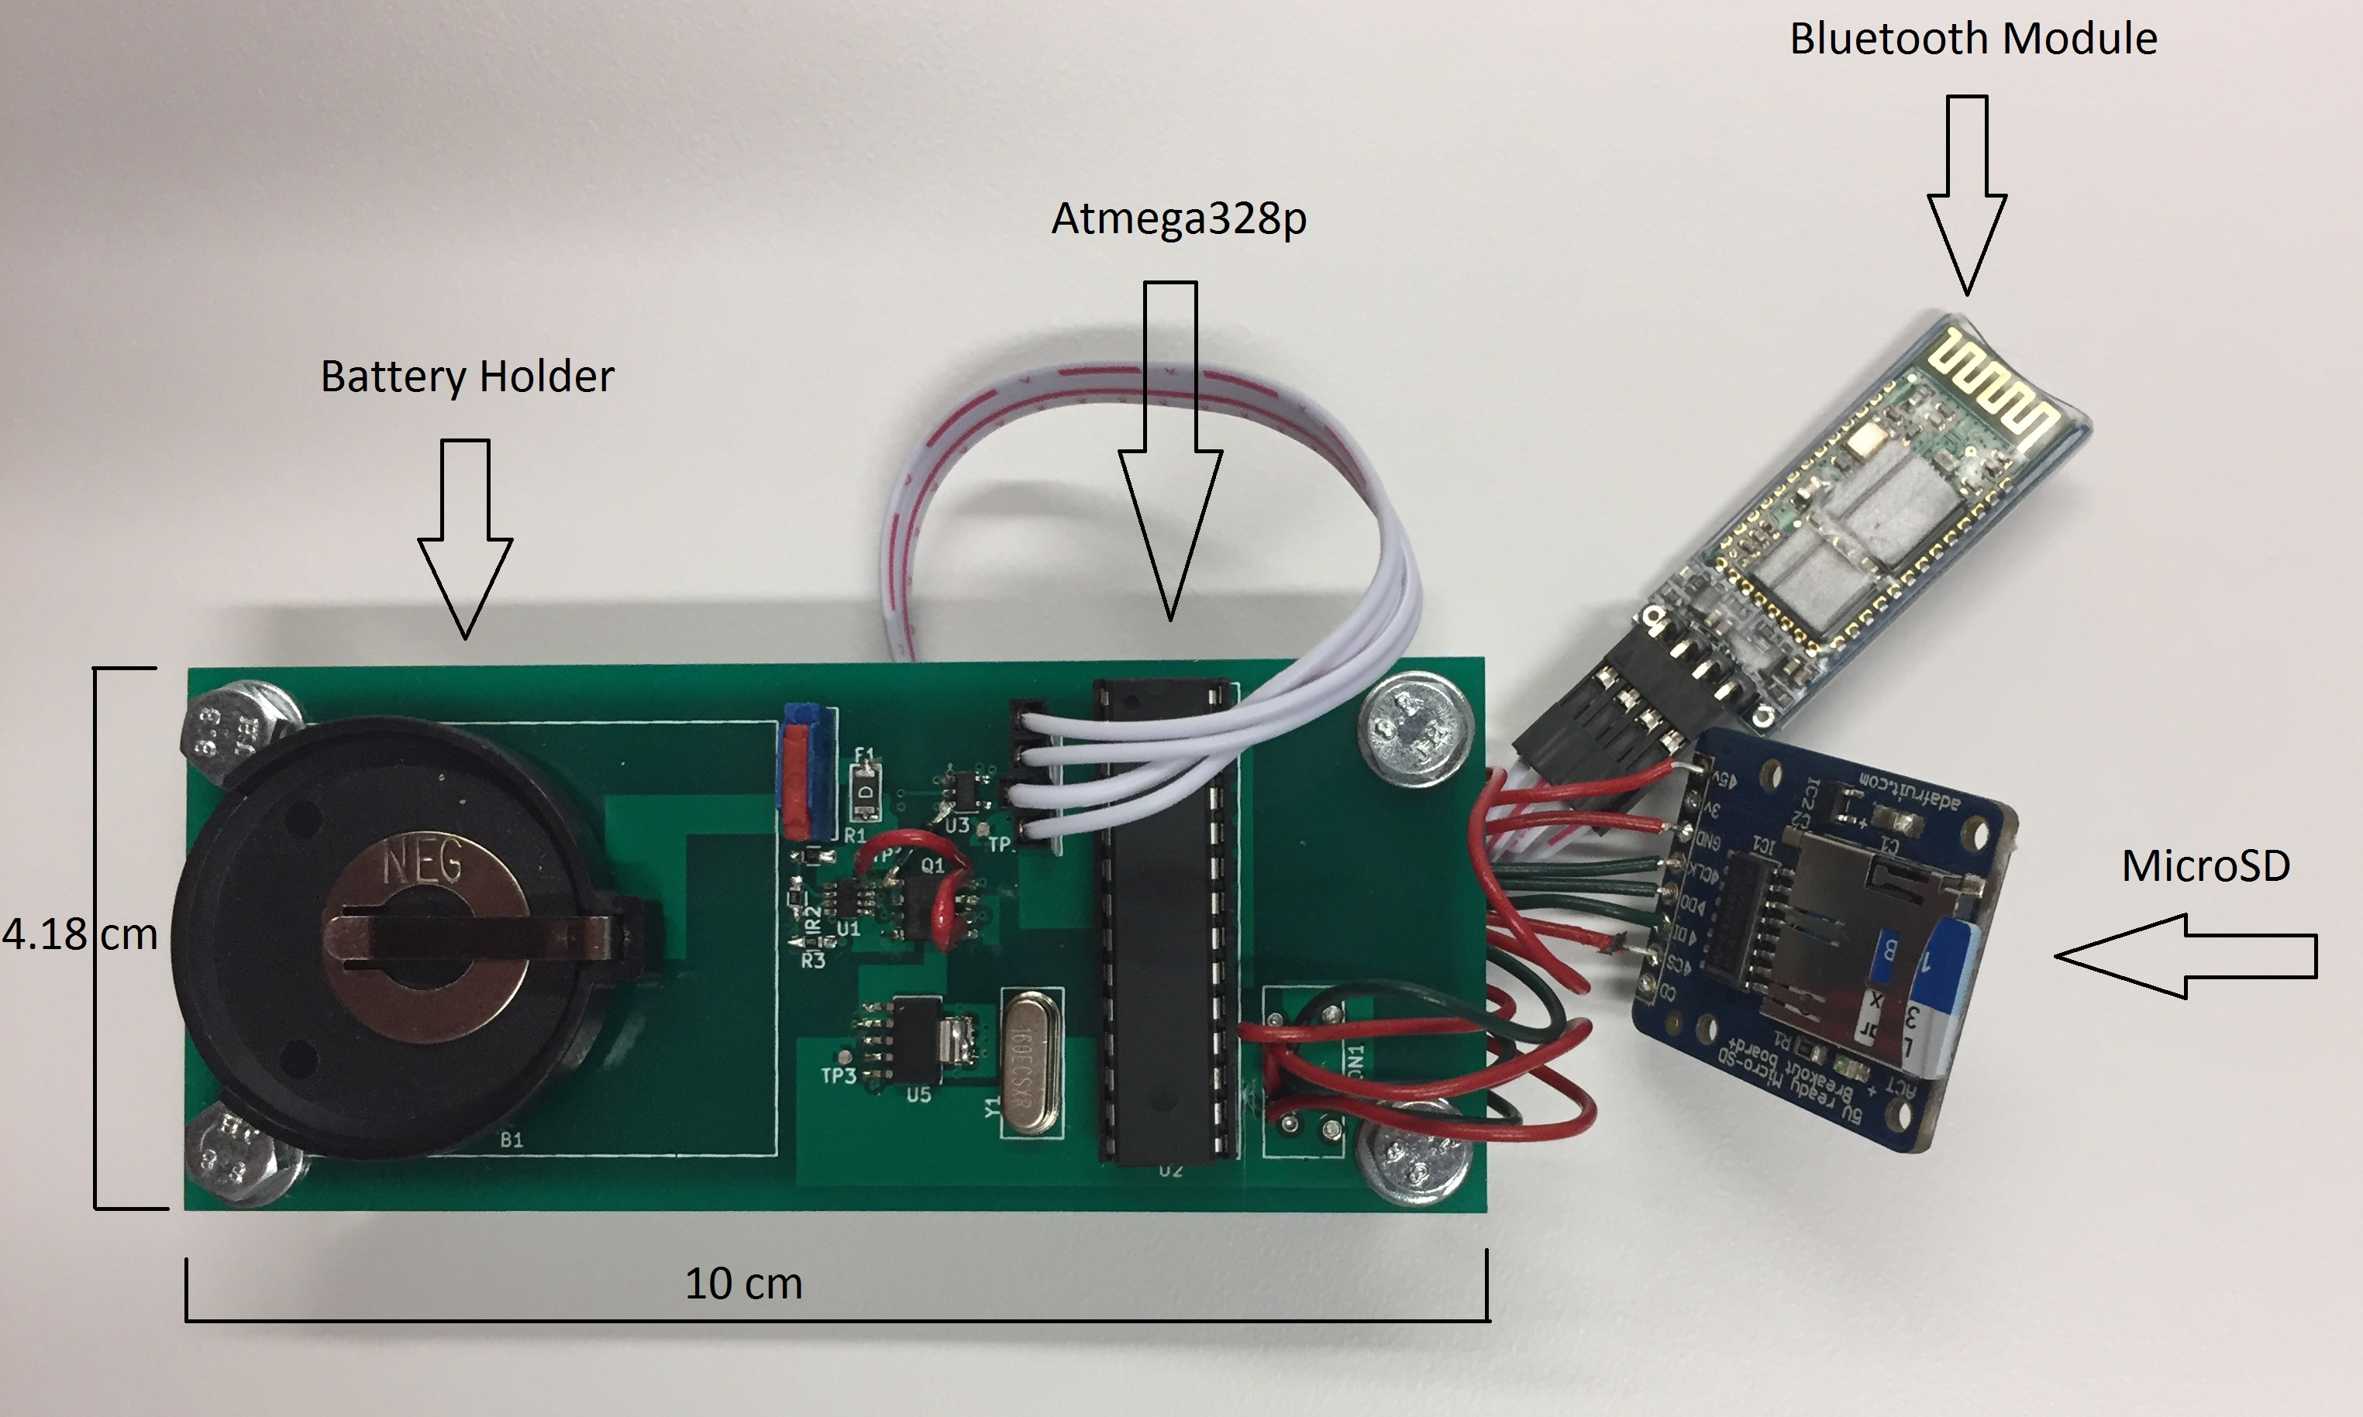
Completed Design

Slide 7
Power and PCB Design
Lithium-Ion coin cell battery
Current protection
Over voltage/under voltage protection
Supplies both 3V and 5V within 10%
Fits within 101 x 42 x 20 mm

Slide 8
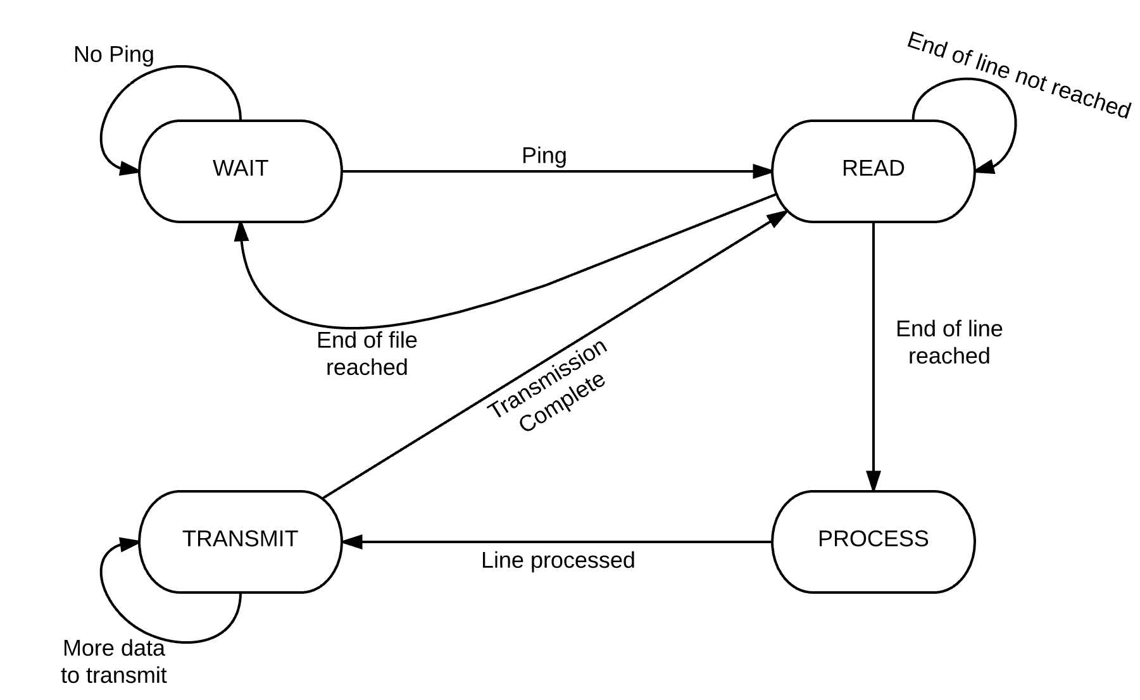
Processing: State Machine

Slide 9
Processing: Algorithm
Relationship between accelerometer data and the actual acceleration of a head’s center of gravity:
$$\left\|\overset{⃑}{a_{i}}\right\|=\overset{⃑}{r_{a_{i}}}∙\overset{⃑}{H}+\overset{⃑}{r_{a_{i}}}∙\left(\overset{⃑}{α}×\overset{⃑}{r_{i}}\right)$$
Loss function we optimized:
$$\sum_{i=1}^{n}{\sum_{j=1}^{3}{{\left[\left\|\overset{⃑}{a_{i_{j}}}\right\|−\left(\overset{⃑}{r_{a_{i_{j}}}}∙\overset{⃑}{H}+\overset{⃑}{r_{a_{i_{j}}}}∙\left(\overset{⃑}{α}×\overset{⃑}{r_{i}}\right)\right)\right]}^{2}}}$$

Slide 10
Data
Test data created in three parts
Unity simulation
Matlab script
Simulink block
Scalability
Generated data for 3, 6, and 9 accelerometers

Slide 11
Results and Recommendations
Power
Higher current capable battery required
Algorithm
Converged faster as number of accelerometers increased
Inaccurate data

