Slide 1
ADAPTIVE FAST CHARGER AND POWER PACK
Group #25:
Brian Uznanski, Dalton Hite, Nikhil Kamath
ECE 445 Spring 2017

Slide 2
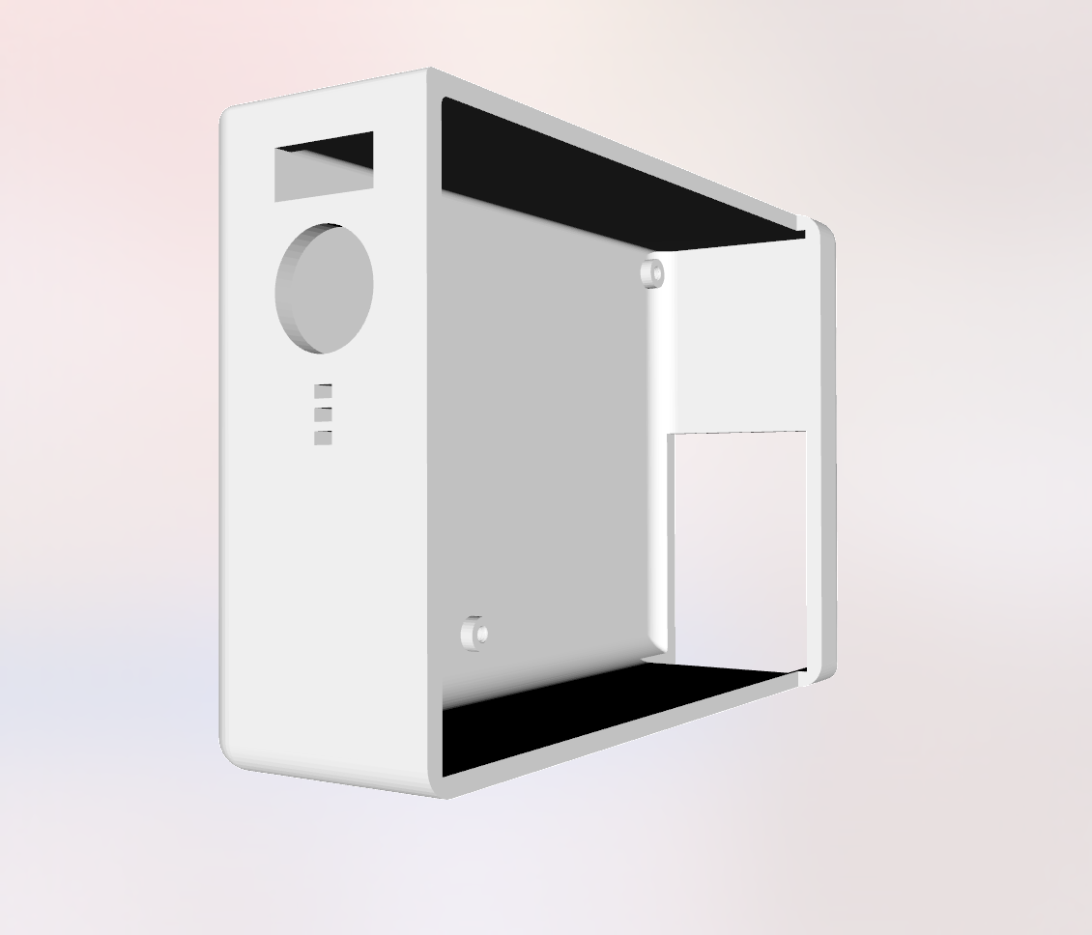
Introduction
A variable current rate phone charger
Switches between fast and slow charging
A power pack that allows for
on the go charging

Slide 3
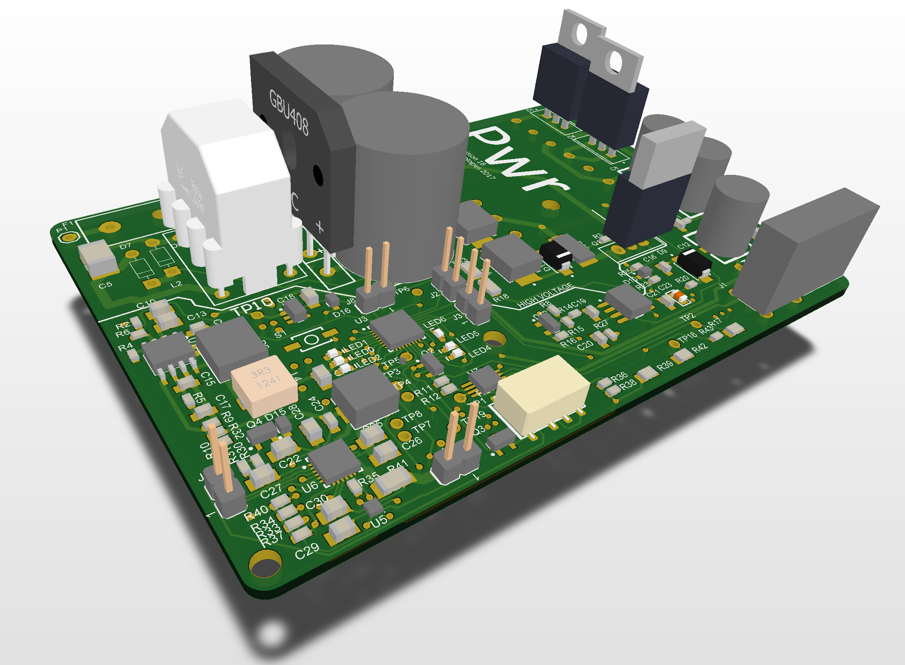
Objectives
Decrease battery degradation due to increased heat during rapid charging
Reduce time spent at 100% SOC (State of Charge)
Allow the user to select the desired charge rate
Adaptively charge the internal battery

Slide 4
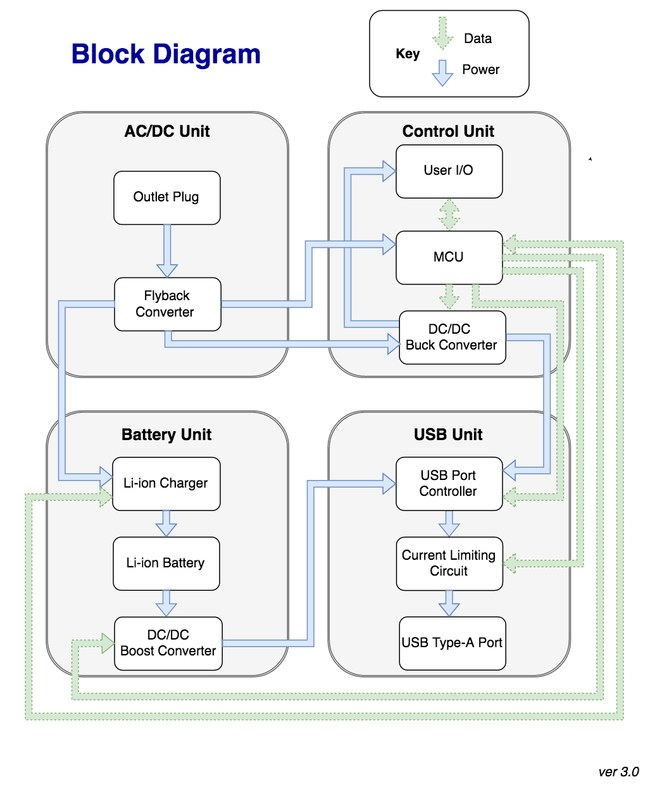

Slide 5
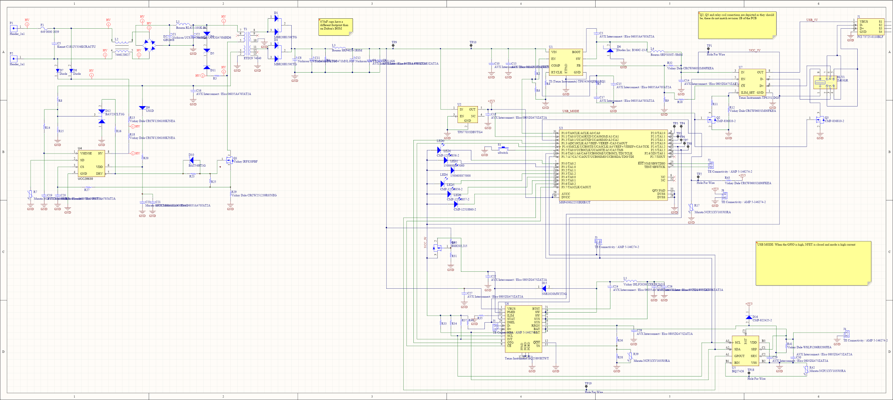
Schematic - AC/DC Unit

Slide 6
Schematic - AC/DC Unit

Slide 7
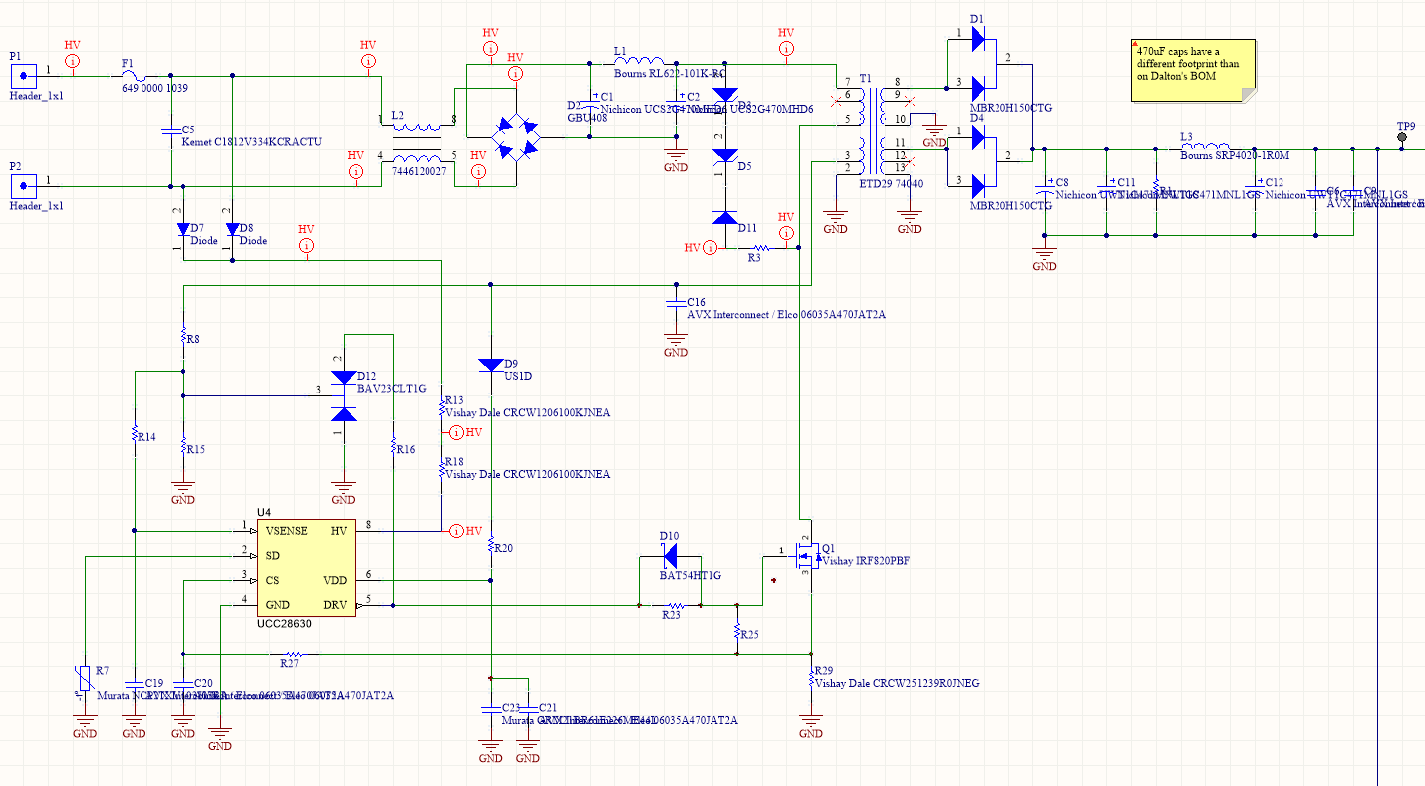
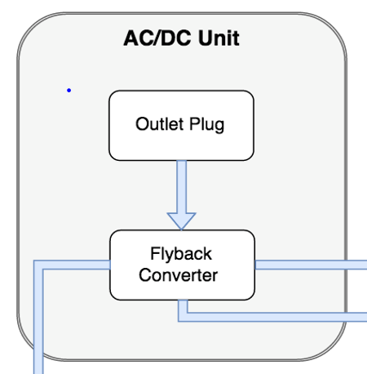
Schematic - AC/DC Unit

Slide 8
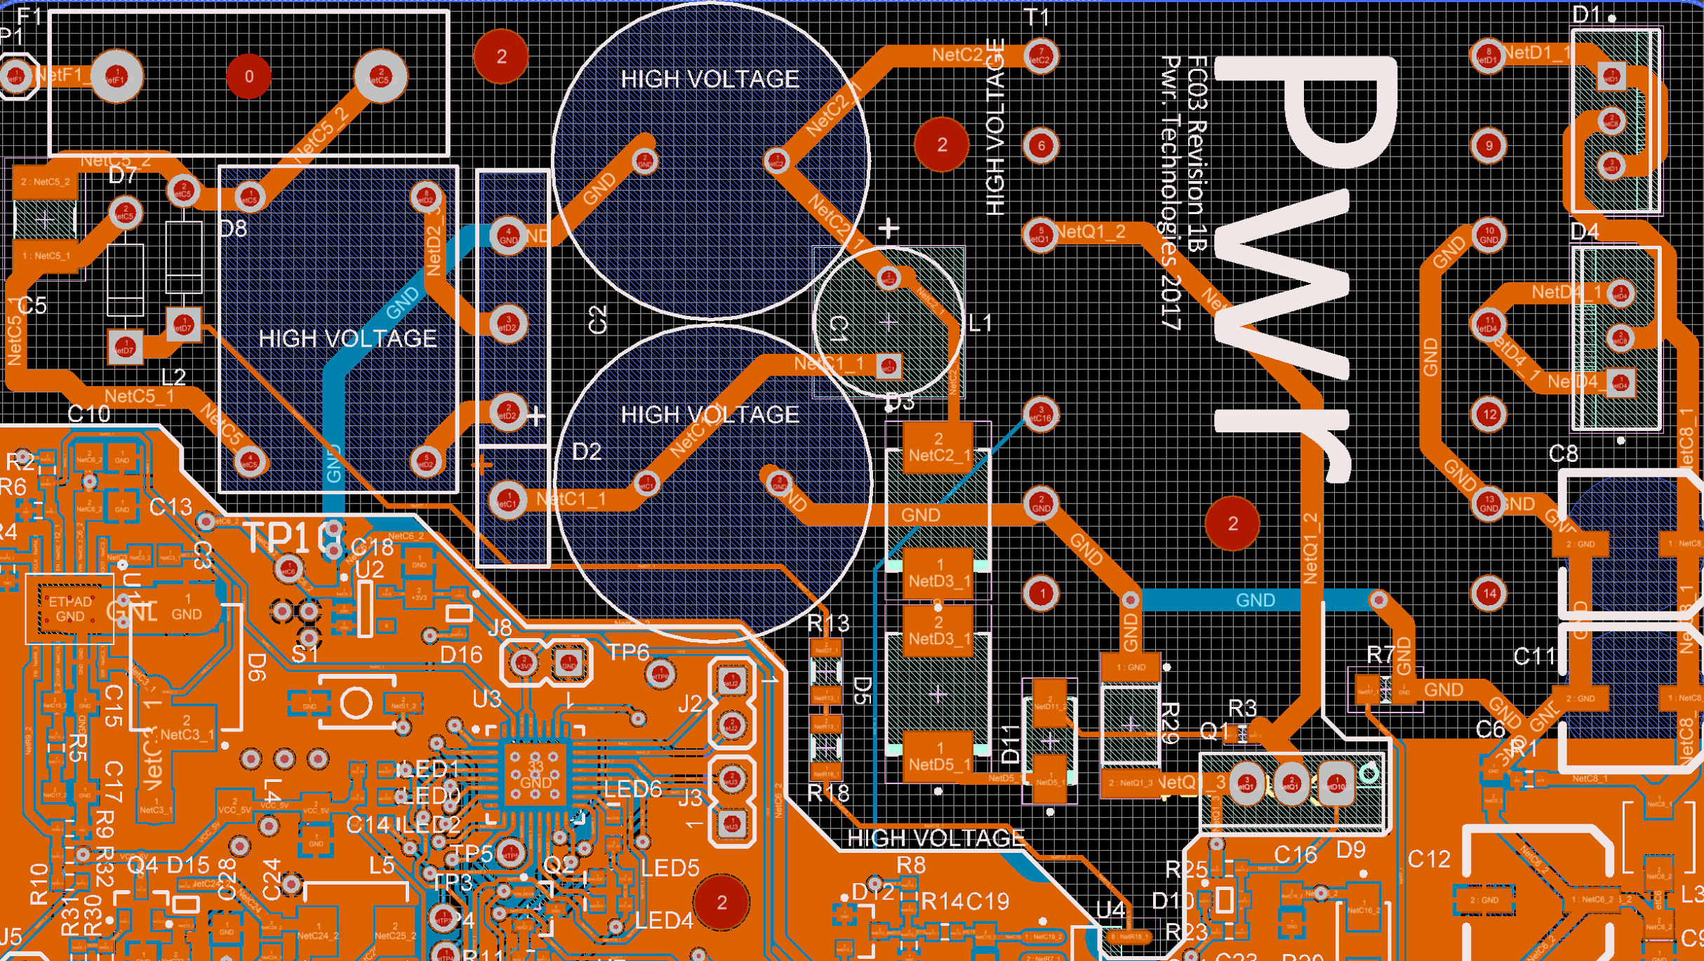
AC/DC Unit - Requirements
Convert 100-240 VAC to 12 VDC to power Control and Battery Unit
Provide up to 45W rated power
$P_{rated}>\frac{V_{usb}∗I_{usb}}{ɳ_{trans}∗ɳ_{buck}}+\frac{V_{bat}∗I_{bat}}{ɳ_{trans}∗ɳ_{bat}}=\frac{5V∗2.1A}{\left(0.88\right)∗(0.86)}+\frac{4.352V∗5A}{\left(0.88\right)∗(0.90)}=41.35W$
Consume less than 100mW, during no load operation

Slide 9
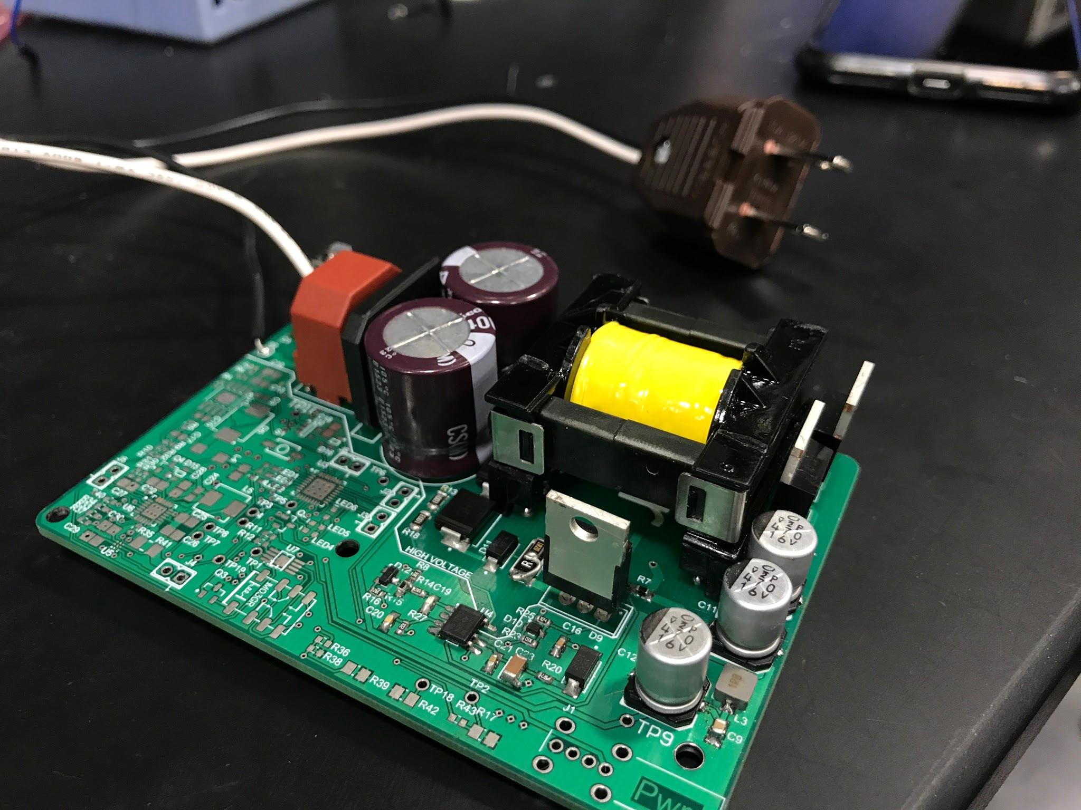
AC/DC Unit - Results
Flyback Controller wouldn’t leave start up mode
Flyback transformer contained parameters different than listed on datasheet
Rewired the flyback transformer

Slide 10
Schematic - Control Unit

Slide 11
Schematic - Control Unit

Slide 12
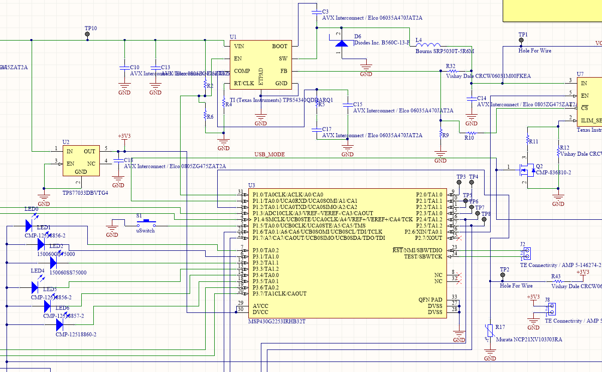
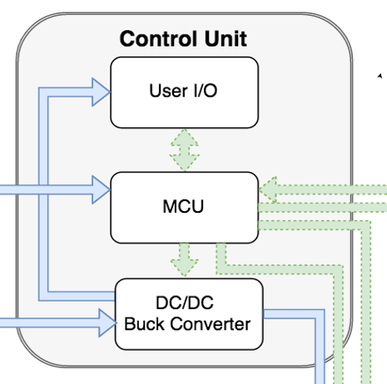
Schematic - Control Unit

Slide 13
Control Unit - Requirements
Toggles current limiting in the USB port
Converts 12V to 5.1V at up to 2.1A
Displays information to the user via LEDs
Receives button input from user

Slide 14
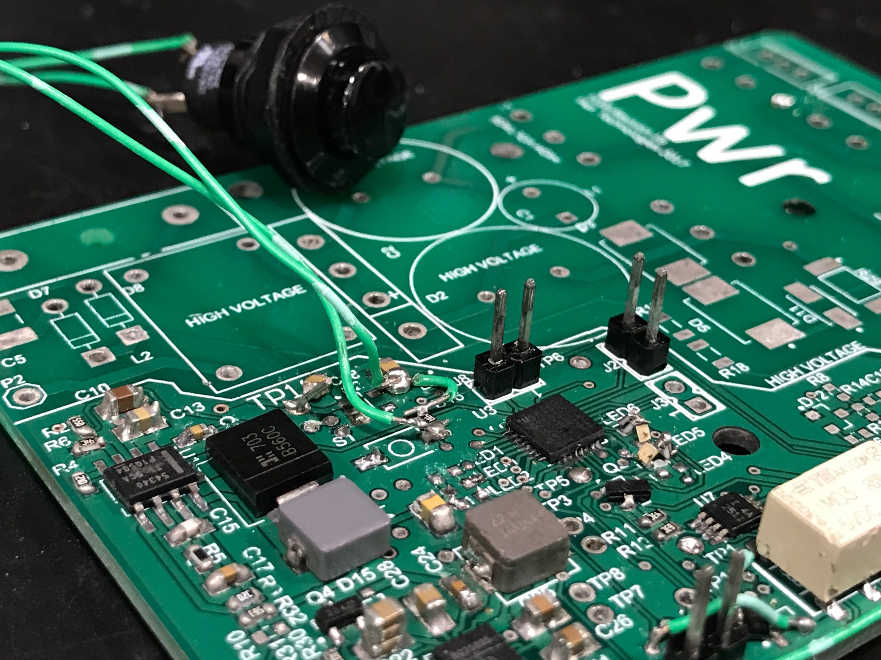
Control Unit - Results
All logic level requirements met
Buck converter tested to requirements
User interface is fully functional - button input and LED output

Slide 15
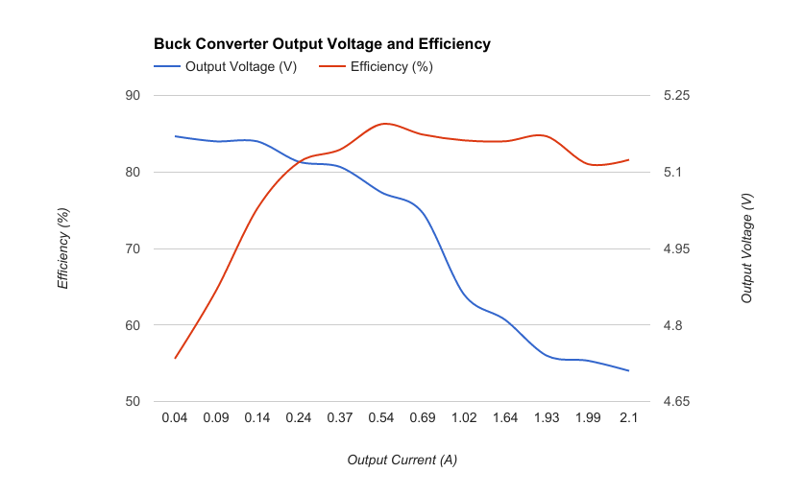
Control Unit - Results
Requirement: 12V Input, 5.25V to 4.55V DC up to 2.1A Output

Slide 16
Schematic - Battery Unit

Slide 17
Schematic - Battery Unit

Slide 18
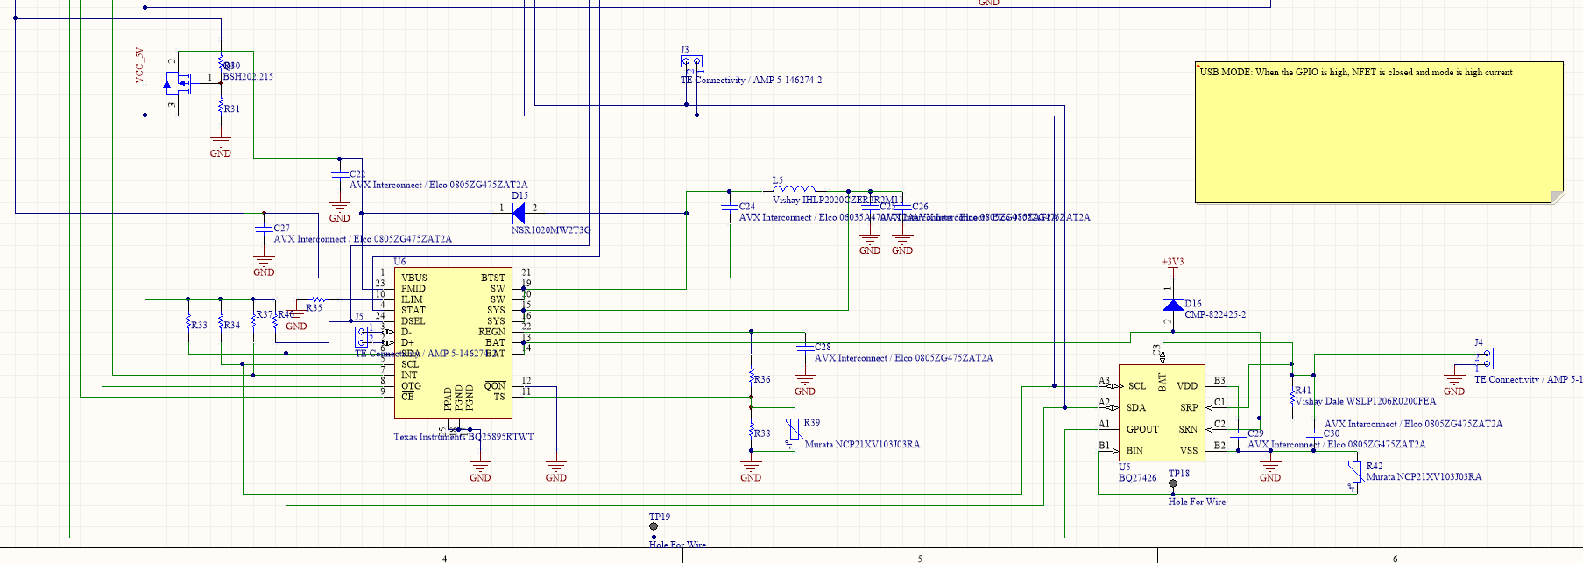
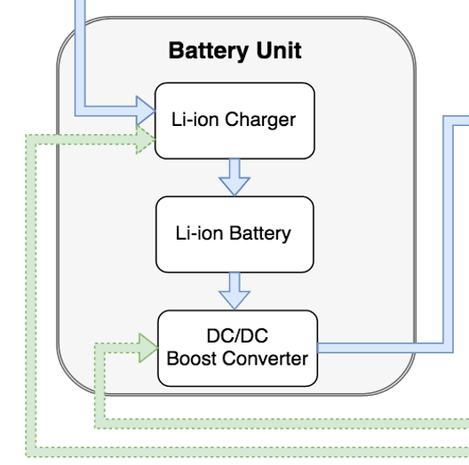
Schematic - Battery Unit

Slide 19
Battery Unit - Requirements
Charges a Li-ion battery from the 12V rail at 1A
Outputs 5.1V @ 2.1A to USB Unit from the battery
Powers the MCU during standby

Slide 20
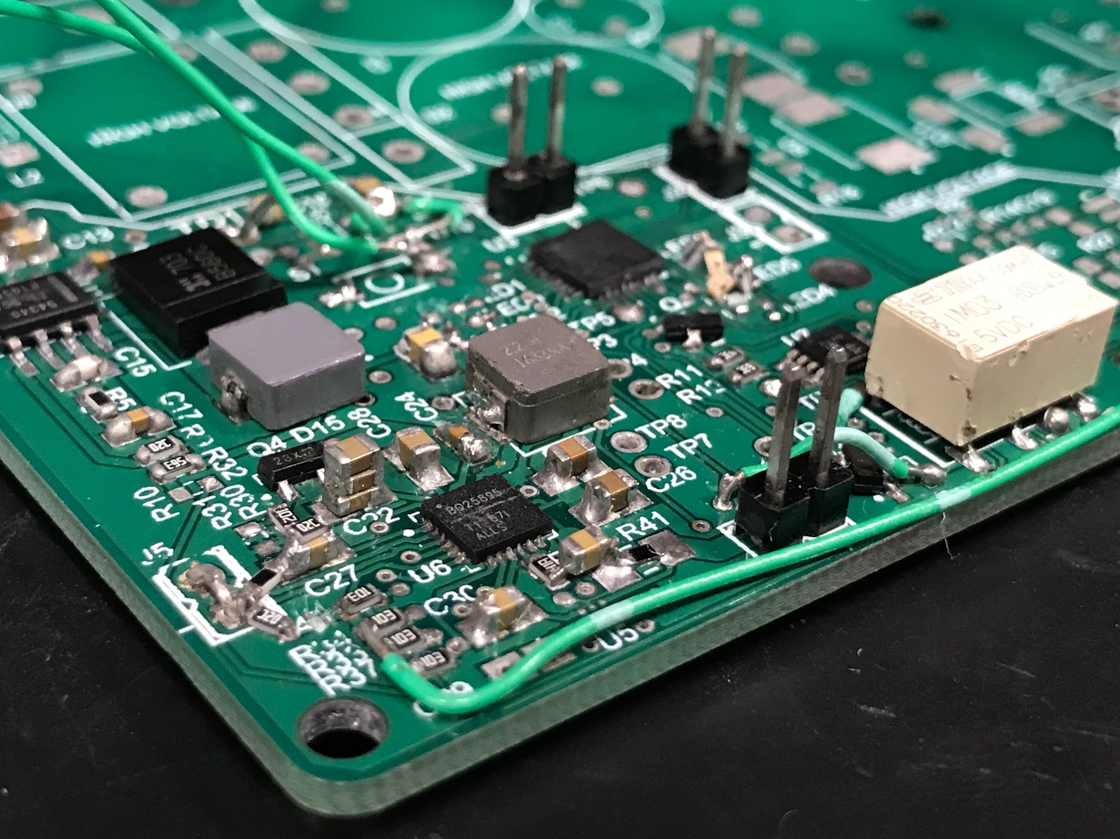
Battery Unit - Results
Tested charging from 12V at above 1A output
Boost converter startup was unsuccessful, cause unknown
Low voltage operation requirements met

Slide 21
Schematic - USB Unit

Slide 22
Schematic - USB Unit

Slide 23
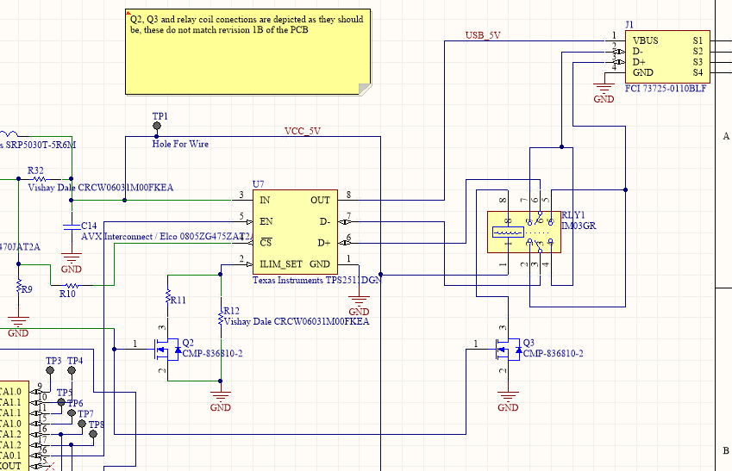
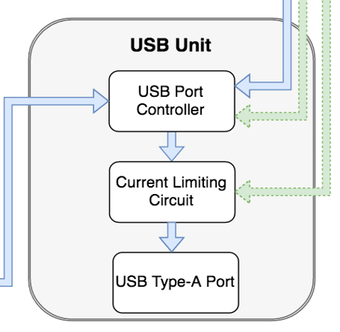
Schematic - USB Unit

Slide 24
USB Unit - Requirements
Recognized by a USB connected device as a 12W or 5W charger depending on mode
Limits output current to 1A in 5W mode

Slide 25
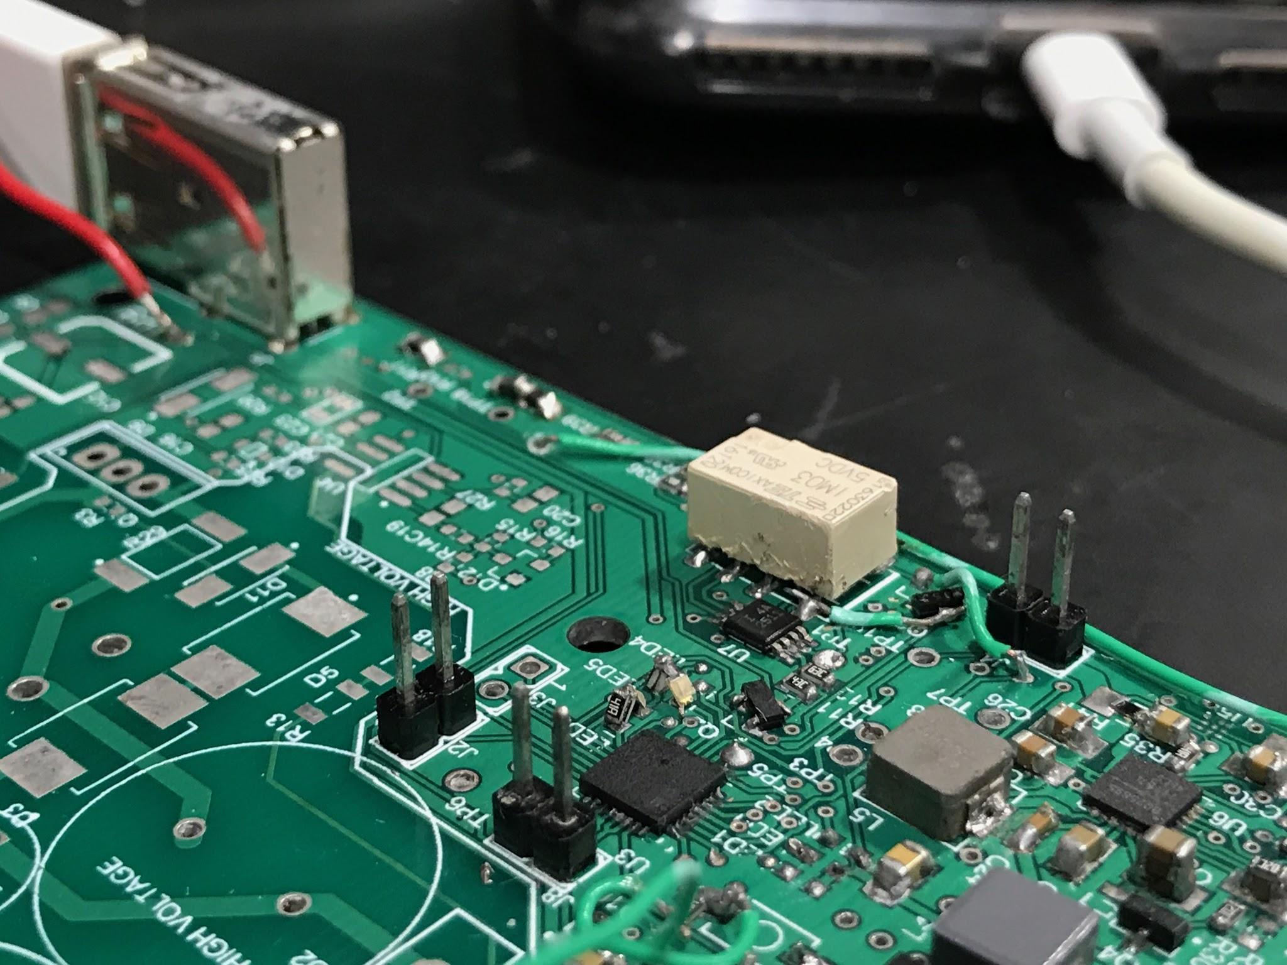
USB Unit - Results
Successfully recognized by an Apple iPhone 7+
Current limited to 1A in “slow mode”

Slide 26
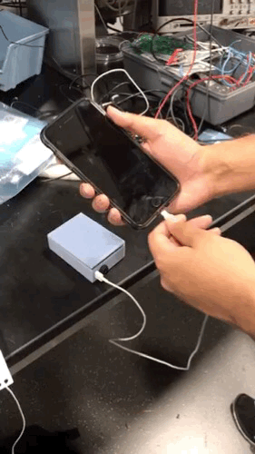
Conclusions
Buck converter tested and verified
USB interface fully functional
Battery charger functional, boost converter needs continued debugging
AC/DC issues still unresolved
80% of overall requirements met

Slide 27
Further Work
Finish integration with the AC/DC unit
Implement a predictive algorithm
Refine design for manufacturability
Create a Kickstarter campaign

Slide 28
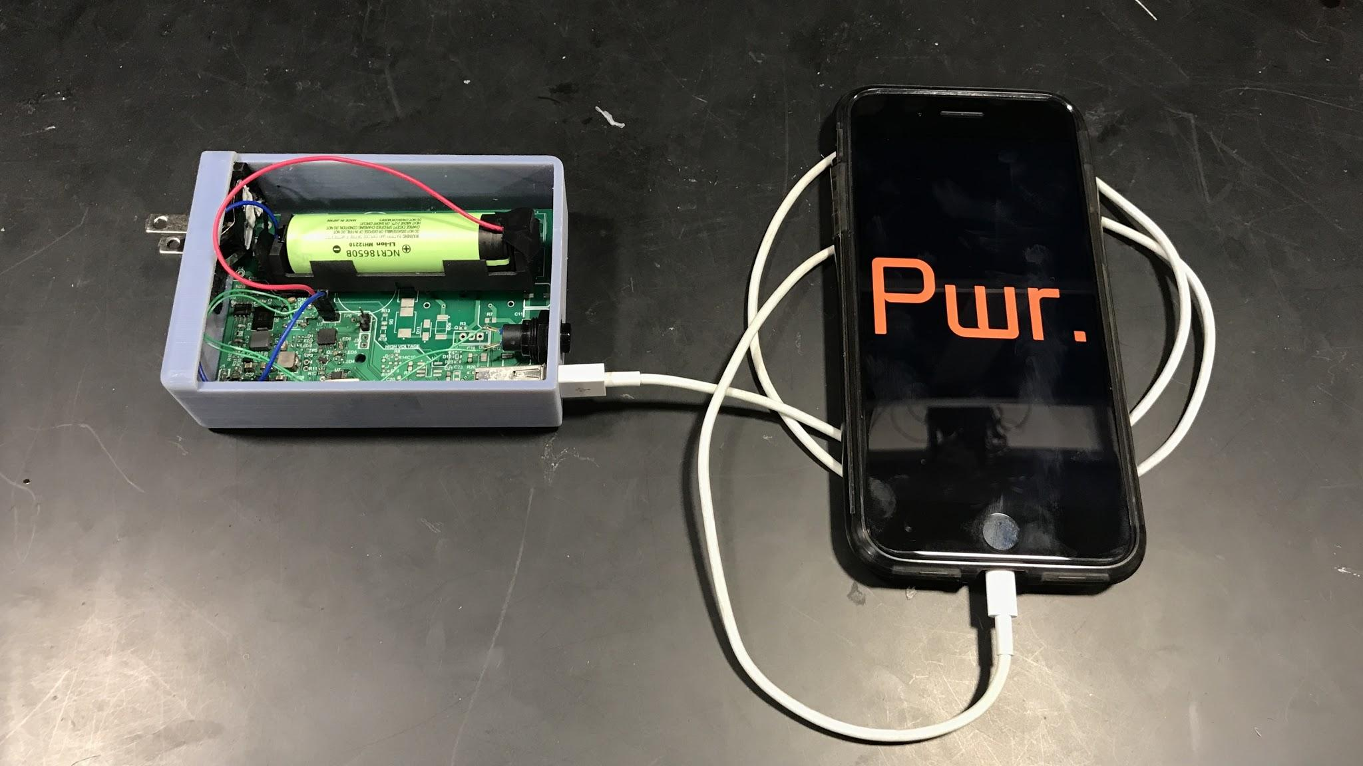
Questions?

