Slide 1
Web-Based Weather Responsive Window
Group 84
Fengling Wang, Hanyu Wang, Kaishen Wang
ECE 445 Senior Design
May 2, 2017

Slide 2
Outline
Introduction
Objectives
Product Shown
System Overview
Power Supply
Hardware
Control Block
Sensor Block
Display Block
Motor Block
Software
Server
Arduino Program
Recommendation for Future Work
Demo Video Links

Slide 3
Introduction
Weather is unpredictable
We design a web-based responsive window system, which can open the window to different levels, based on user instructions or weather conditions from the Internet

Slide 4
Objectives
The window has four levels: 0 - fully closed, 3 - fully open.
User can adjust window level remotely (by WiFi) or manually.
Users can input desired room temperature and the city they live in from website. The window level will be adjusted smartly based on the current room temperature and user inputs.
When room temperature is impossible to be adjusted through the window system, the AC LED will be turned on denoting that the air conditioner should be turned on.
Notes:
On one hand, by exchanging air, the room temperature will approach desired result, on the other hand, if there is bad weather outside, the window will be closed automatically.

Slide 5
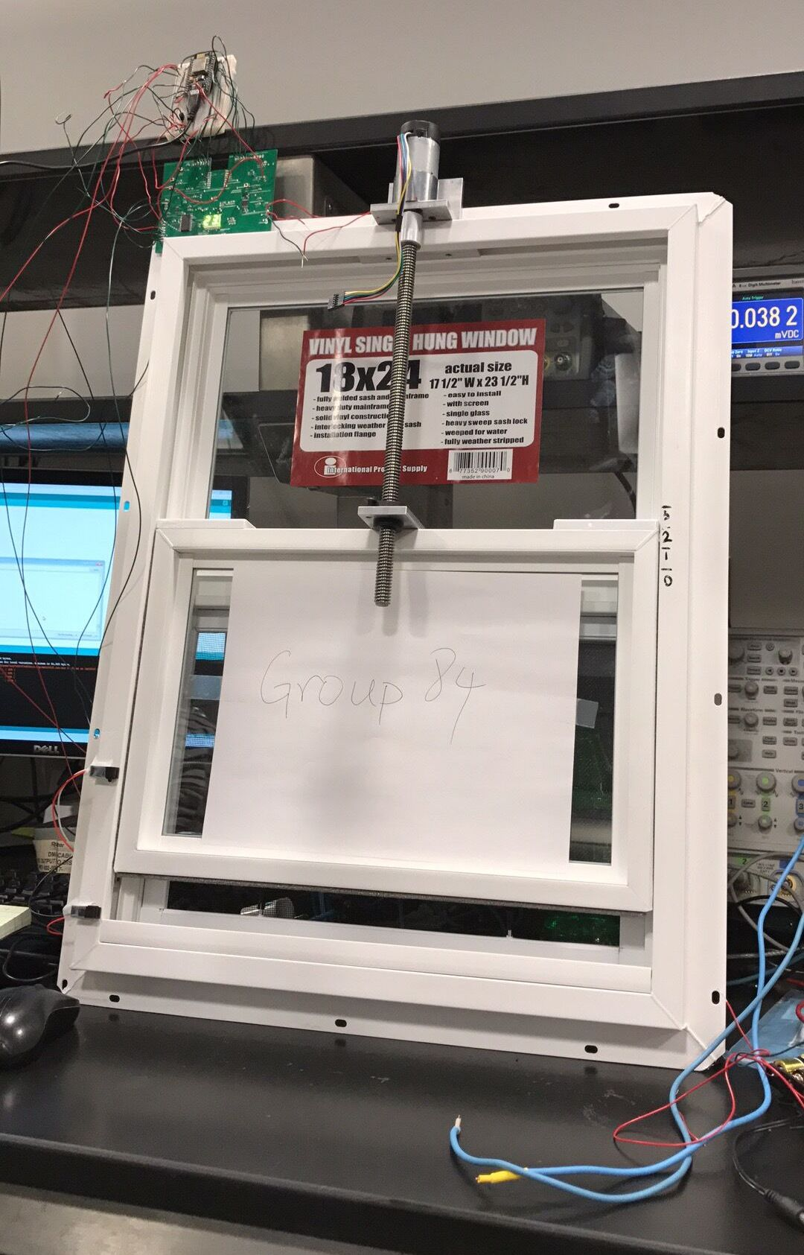
Product Shown

Slide 6
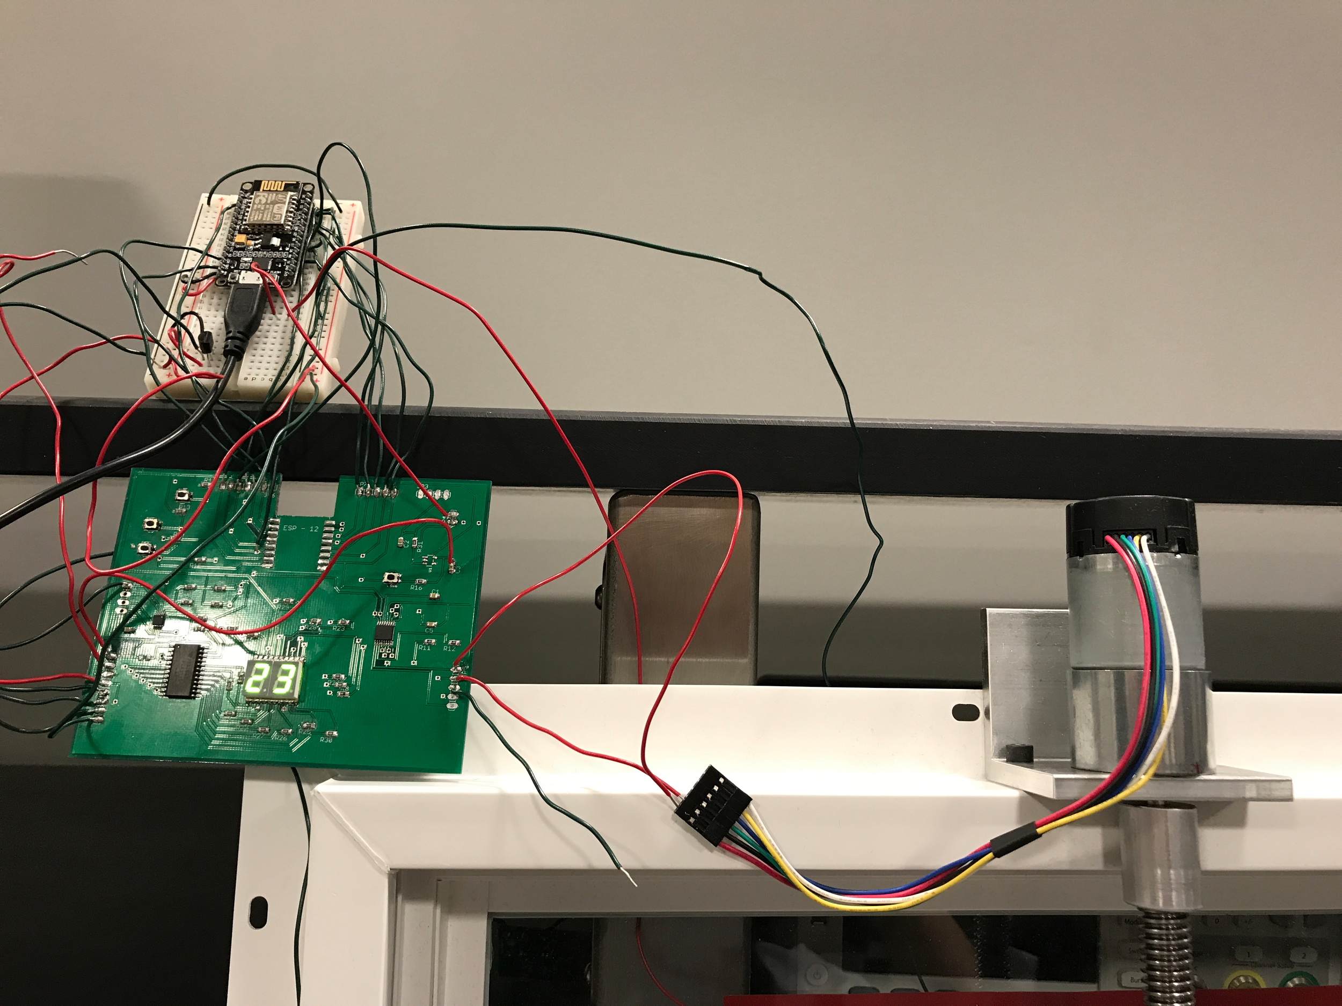
Product Shown

Slide 7
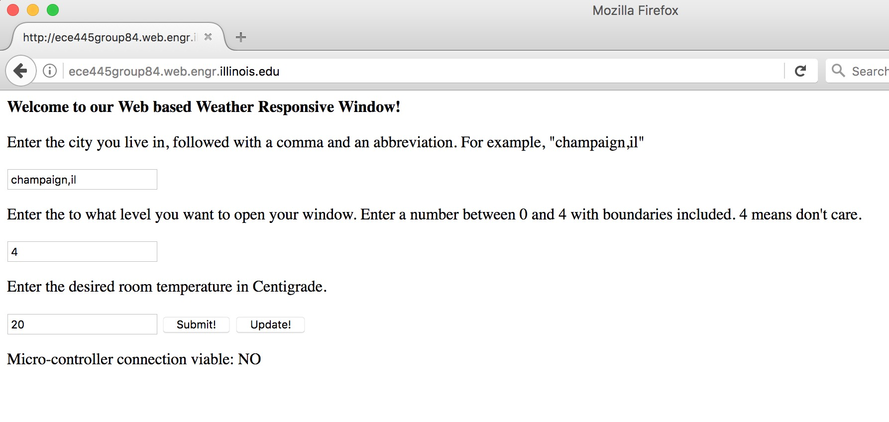
Our website: https://ece445group84.web.engr.illinois.edu/

Slide 8
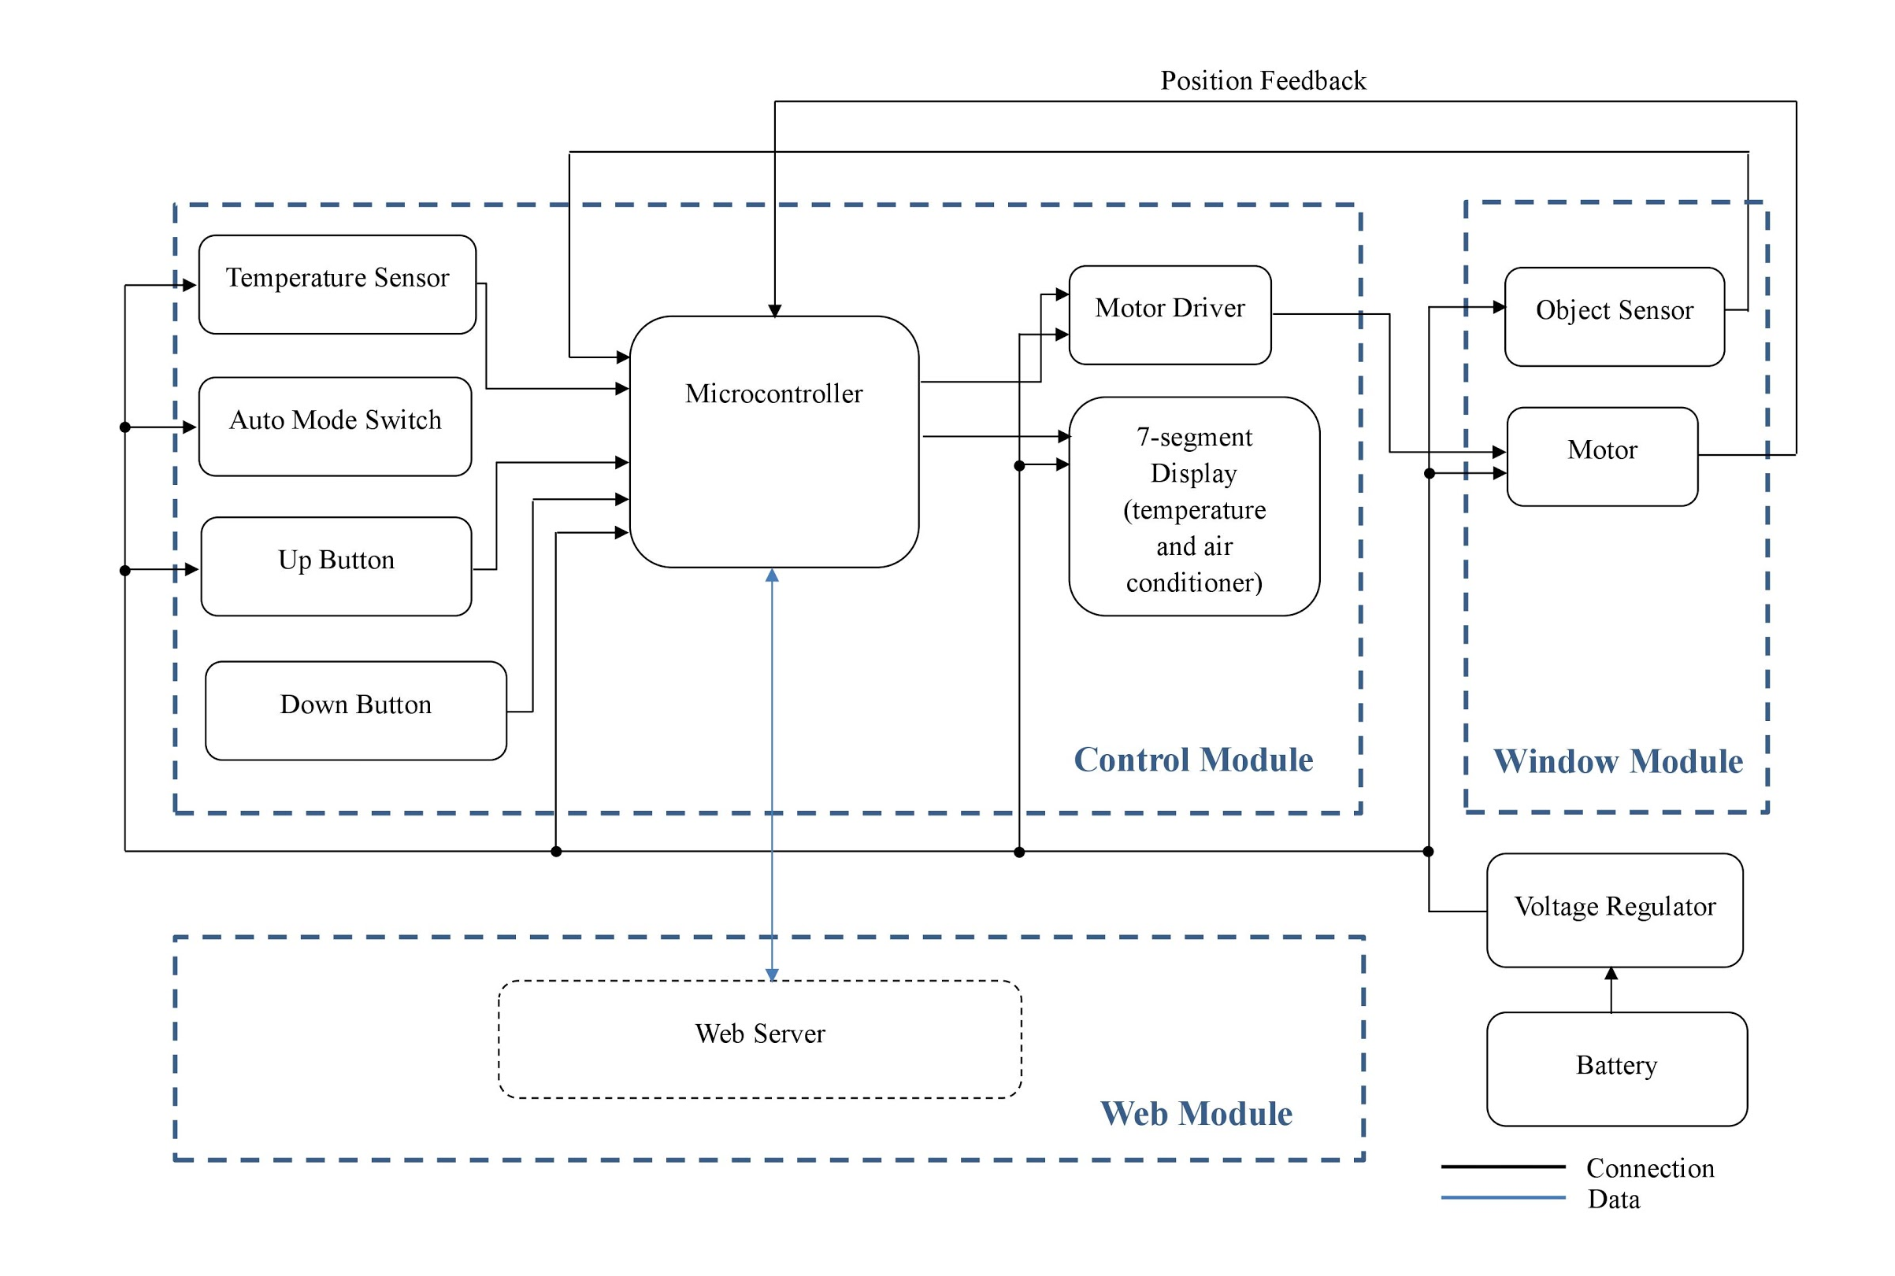
System Overview

Slide 9
Outline
Introduction
Objectives
Product Shown
System Overview
Power Supply
Hardware
Control Block
Sensor Block
Display Block
Motor Block
Software
Server
Arduino Program
Recommendation for Future Work
Demo Video Links

Slide 10
Power Supply
Supply motor driver with 6V battery composed of 4 AA alkaline batteries in series
Supply other components with 3.3V regulated from 6V

Slide 11
Outline
Introduction
Objectives
Product Shown
System Overview
Power Supply
Hardware
Control Block
Sensor Block
Display Block
Motor Block
Software
Server
Arduino Program
Recommendation for Future Work
Demo Video Links

Slide 12
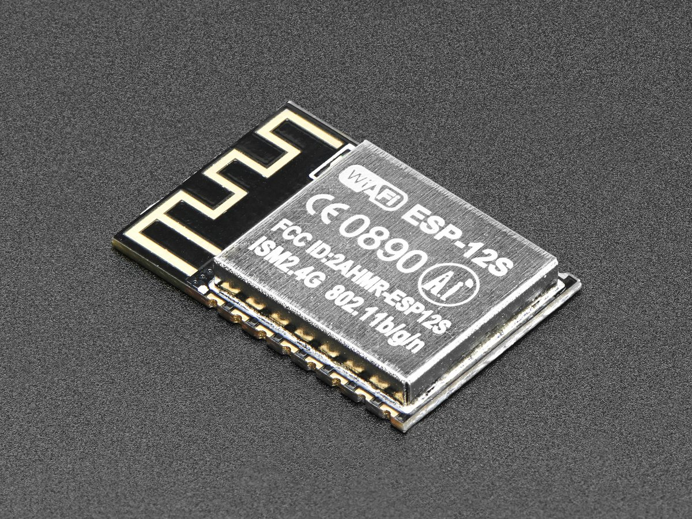
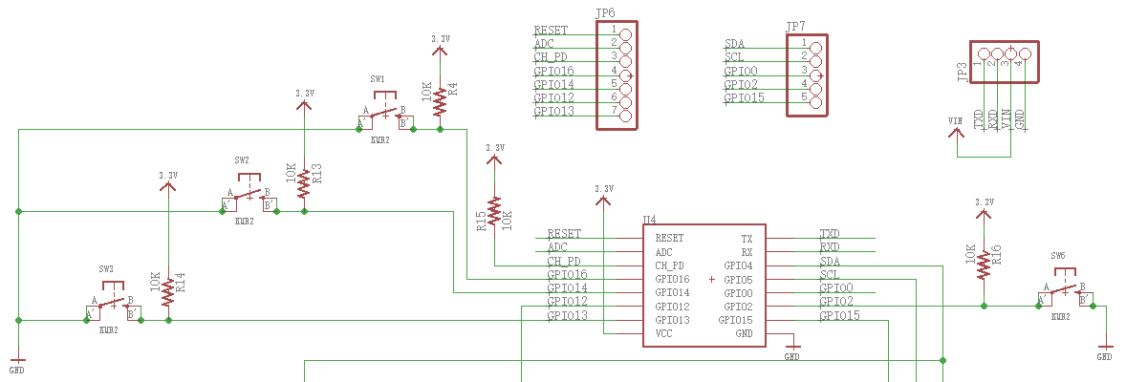
Control Block
Microcontroller (ESP8266)
Switches

Slide 13
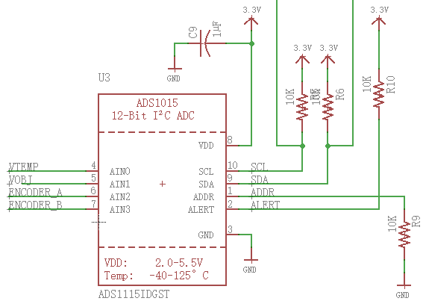
Sensor Block
I2C ADC chip
Temperature sensor
Object sensor

Slide 14
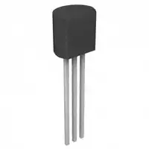
Sensor Block
Temperature Sensor (LM35)
Communicate with microcontroller through ADC
Verification result - calculated temperature matches current room temperature

Slide 15
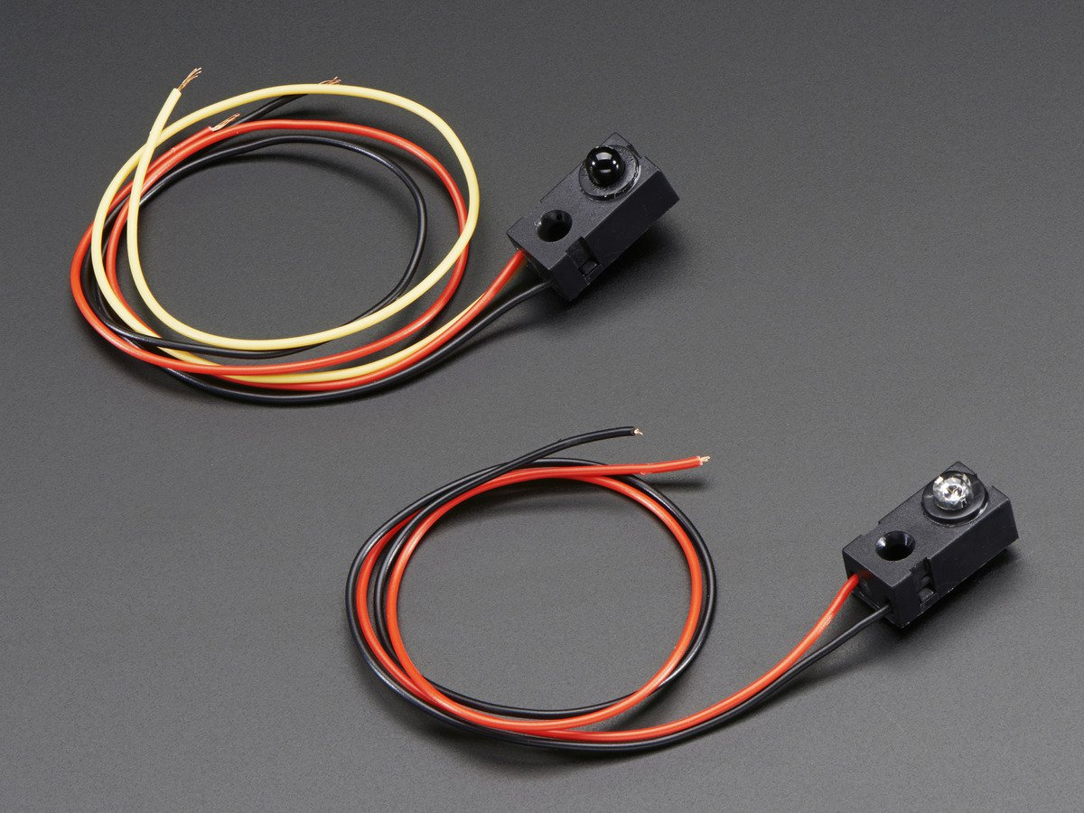
Sensor Block
Object Sensor
IR beam-break sensor
Communicate with microcontroller through ADC
Verification result
ADC chip informs microcontroller when any object blocks the window
7-segment display’s first decimal point turns on

Slide 16
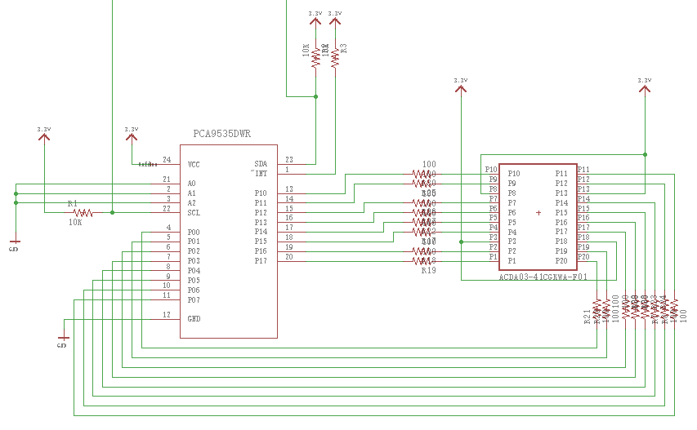
Display Block
16-bit I/O expander
2-digit 7-segment display

Slide 17
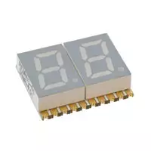
Display Block
16 bit I/O Expander (PCA9535)
2-Digit 7-Segment Display
Should have correct mapping from each pin to each segment in the 7-segment display
Verification result
7-segment display can show numbers from 0 to 99 correctly
Has moderate luminosity with proper resistance

Slide 18
Display Block
Resistance Calculation
Determine resistor needed to be in series with LED:
Drive the I/O expander at 3.3V from the microcontroller and LED consumes 2.2V, then
Vresistor = 3.3V - 2.2V = 1.1 V.
Let LED take 10 mA current.
Resistance = Vresistor /I = 1.1V/10mA = 110 Ohms.

Slide 19
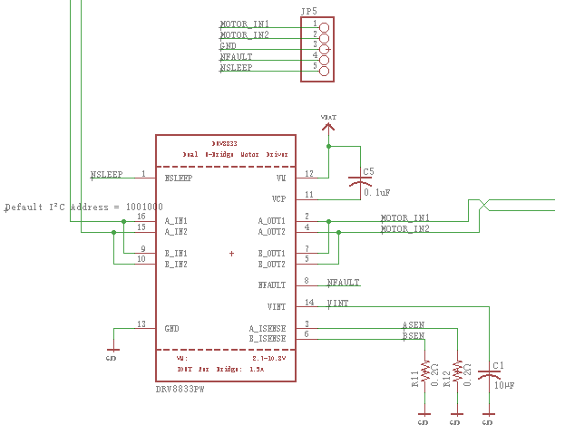
Motor Block
Motor driver (DRV8833)
Motor

Slide 20
Motor Block
Motor Driver (DRV8833)
Communicate with microcontroller
Provide 6V to motor
Verification result
The motor can be driven in clockwise and counterclockwise directions

Slide 21
Outline
Introduction
Objectives
Product Shown
System Overview
Power Supply
Hardware
Control Block
Sensor Block
Display Block
Motor Block
Software
Server
Arduino Program
Recommendation for Future Work
Demo Video Links

Slide 22
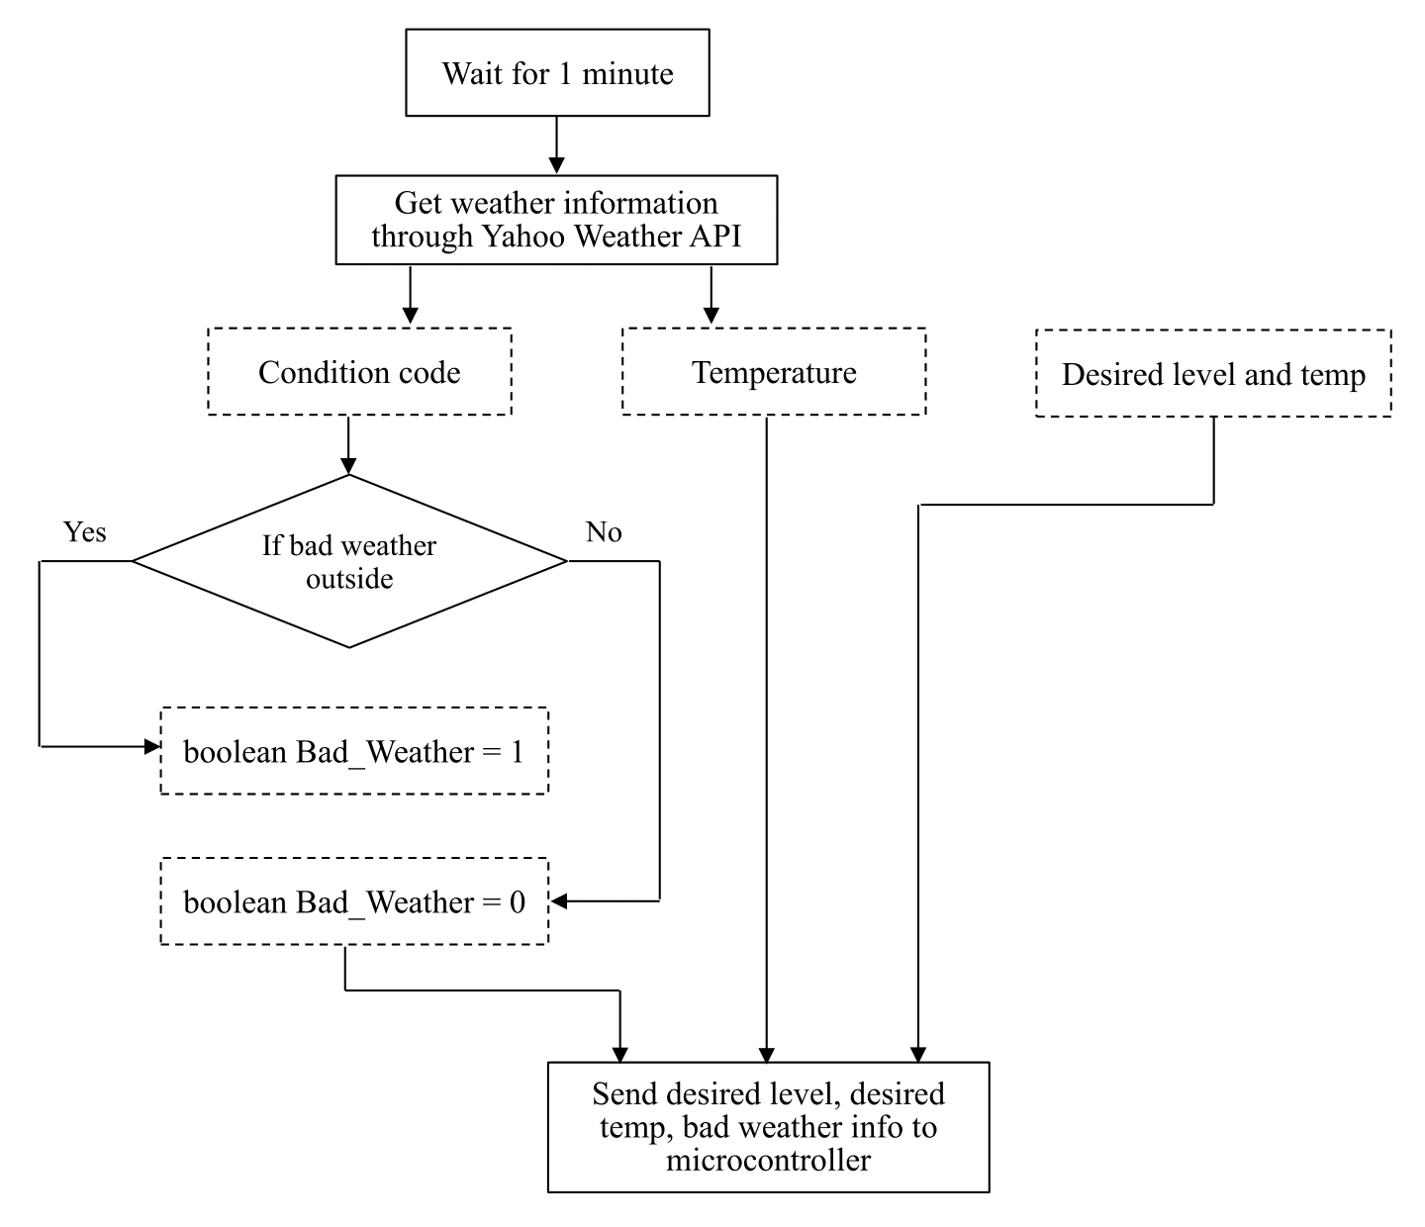
Server Part Overview

Slide 23
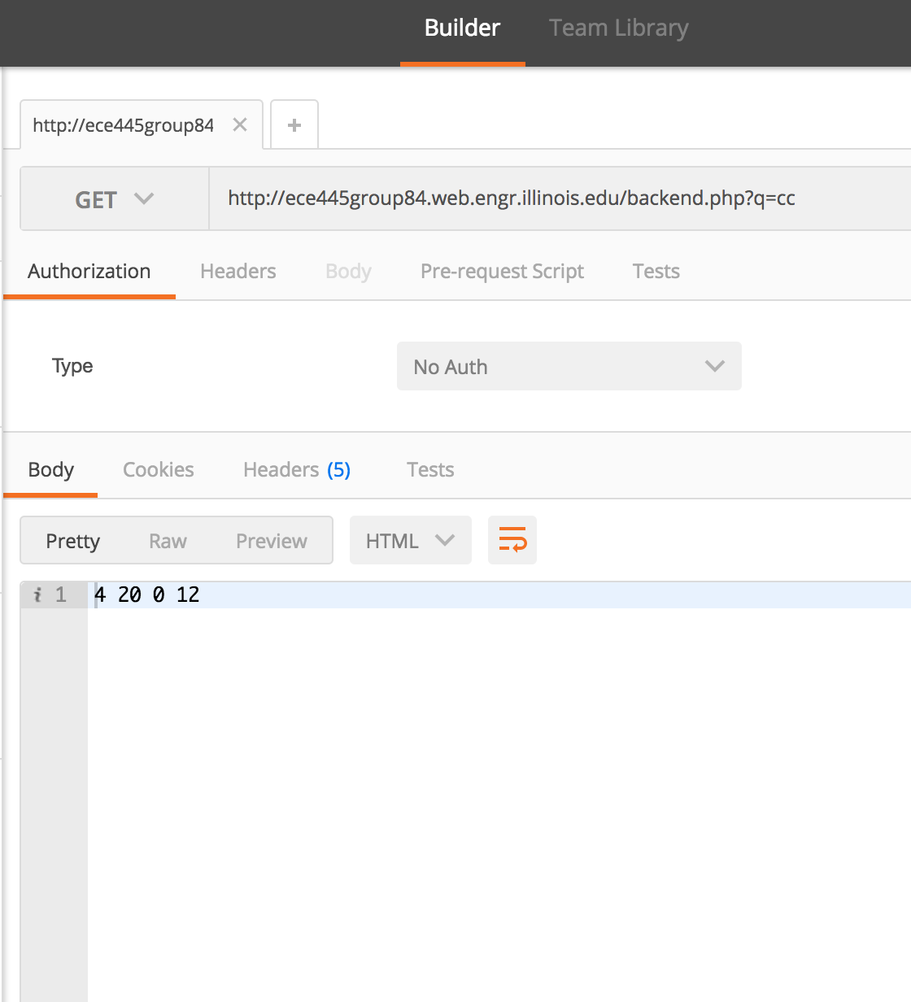
Server Testing
Use curl command to test correctness
Use Postman to test handling requests

Slide 24
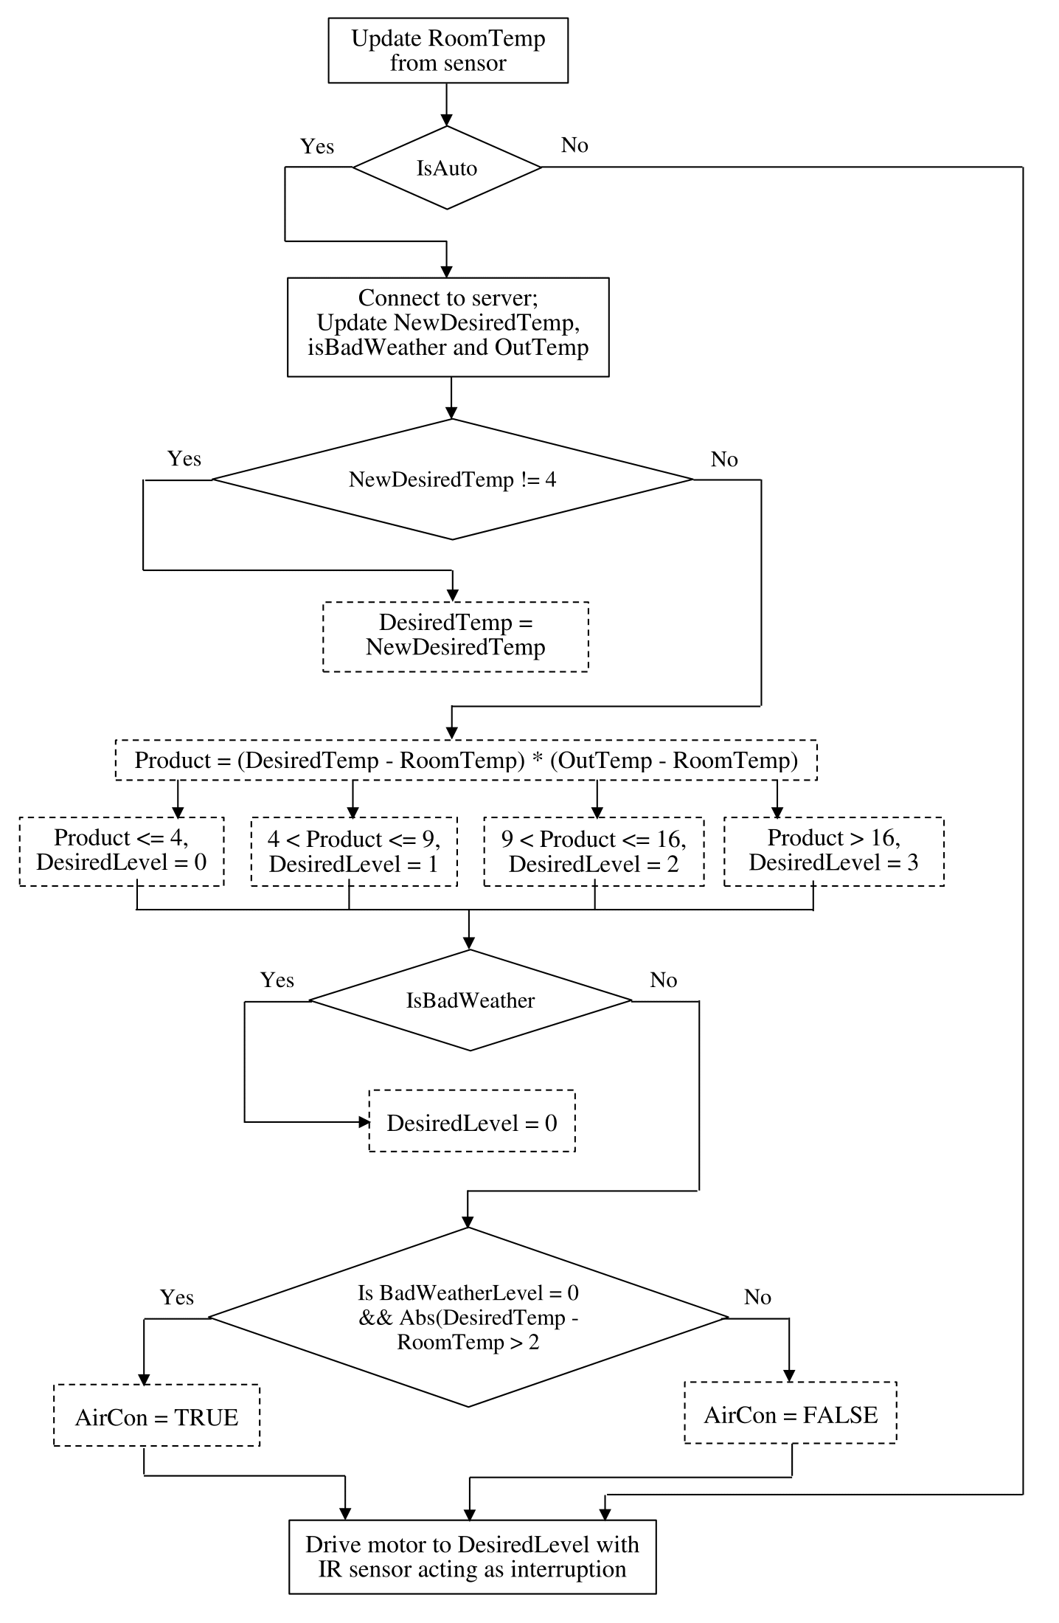
Program Flowchart

Slide 25
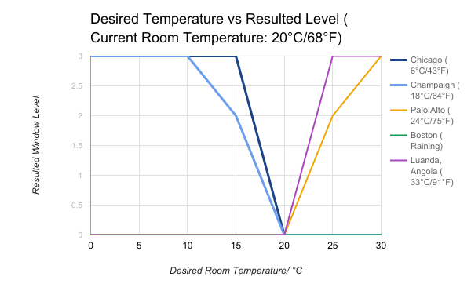
Microcontroller (ESP8266)
Verification results got by simulating different situations

Slide 26
Outline
Introduction
Objectives
Product Shown
System Overview
Power Supply
Hardware
Control Block
Sensor Block
Display Block
Motor Block
Software
Server
Arduino Program
Recommendation for Future Work
Demo Video Links

Slide 27
Recommendation for Future Work
Object Sensor
Need to be integrated in the whole program which can change the running status of the motor
Motor Encoder
Provides position feedback to make level change more accurate
Boundary Condition Handles
Handle boundary condition where desired temperature and room temperature are close, avoid continuously changing window level

Slide 28
Here is all the testing demo...
R&V:
Server Part: https://youtu.be/8EPli2ch1Vw
Switch Part: https://youtu.be/SwBZEFEoDuw
Temperature Sensor Part: https://youtu.be/zOzVMWjKdlE
Motor Part: https://youtu.be/u7sX91AXl1A
Seven Segment Display Part: https://youtu.be/0iZzy0zJ9Lo
Hardware Part:
https://youtu.be/I2CV_xO7r78
https://youtu.be/IX5k9F2ZPxY
Whole Project Demo:
Part1: https://youtu.be/cs5rNgnF8OY
Part2: https://youtu.be/f5ecZEobPlk

Slide 29
Questions?

Slide 30
Thank You！
(Special thanks to our TA Michael)

Slide 31
Program Testing
IO expander and switches have their own testing code
For instance of testing switches, print the name of button to serial monitor whenever a button is pressed
Use serial monitor to view data retrieved from server
Change condition, and use serial monitor to view current level and desired level, to see if they meet our expectation

Slide 32
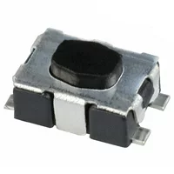
Switch (KMR211GLFS)
Requirement | Verification
The program flags, e.g. Auto, Up and Down, should be set to its opposite Boolean value once the according switch is pressed. | Print flag value before and after the switch is pressed. It should change from TRUE to FALSE or from FALSE to TRUE.

Slide 33
Micro Controller (ESP8266)
Requirements
Pull data from the website
In non-AUTO mode, adjust window through UP / DOWN button
In AUTO mode and user desired level between 0~3, adjust window to user desired level
In AUTO mode and desired level == 4 (meaning don’t care), adjust window smartly based on input city’s weather condition and room temperature

Slide 34
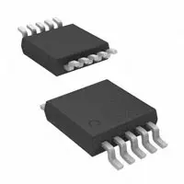
I2C ADC Chip (Chip ADS1115)
Requirement | Verification
With Adafruit_ADS1115 library, the program can read pin A0-A3 values. | Connect a working temperature sensor to each pin. Warm or cool down the sensor. The program should output increasing or decreasing value.

Slide 35
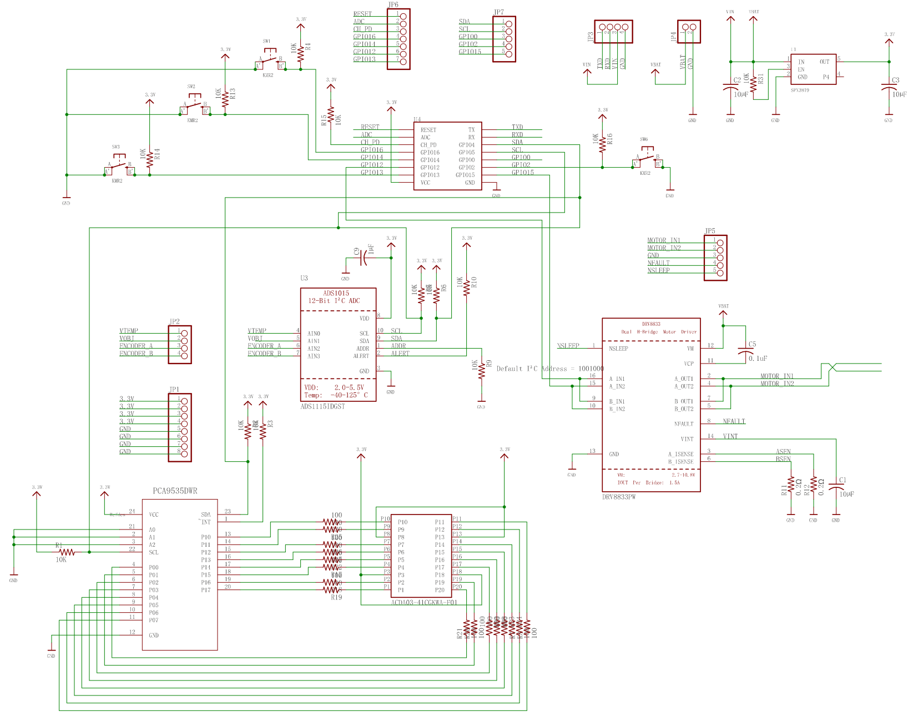
PCB Schematic

