Slide 1
P2P-Bikeshare
ECE 445 FA18
Team 24
Kanchi Shah
Matthew Daniel

Slide 2
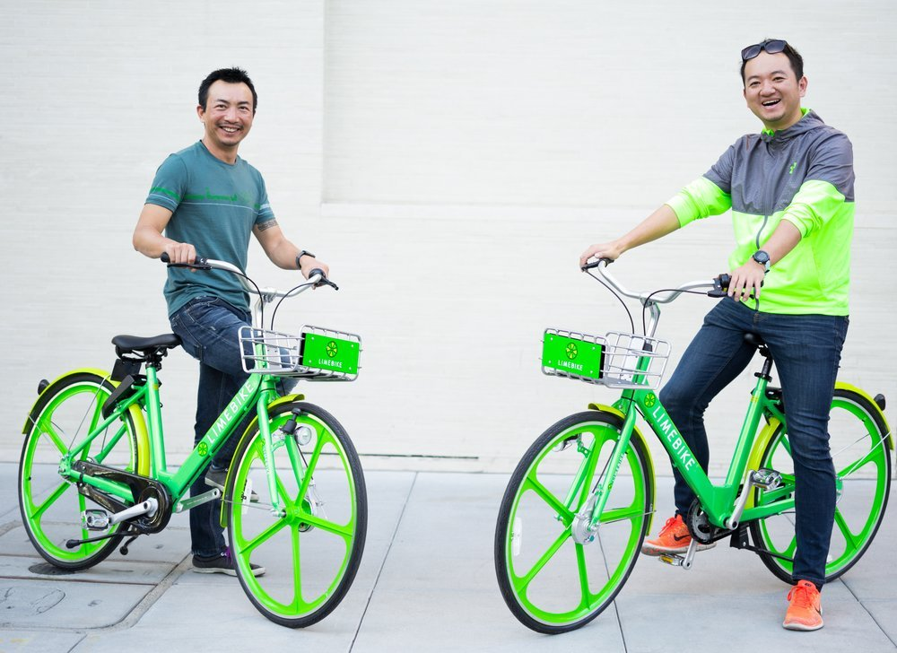
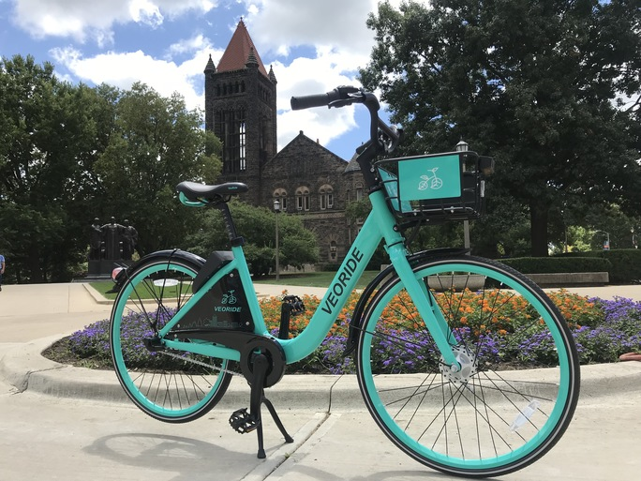
Background
Ridesharing on the rise across the nation
https://communityimpact.com/austin/san-marcos-buda-kyle/business/2018/08/29/texas-state-university-city-of-san-marcos-to-launch-aveoride-bike-share-program/
https://techcrunch.com/2017/03/15/limebike-raises-12-million-to-roll-out-bike-sharing-without-kiosks-in-the-us/
Notes:
Matt

Slide 3
Our Solution
Empower bike owners to share their transportation with others
All-inclusive hardware lock with Bluetooth connection
Operational for long periods of time without recharging
Ability to transfer data to a central server for review
Notes:
Matt

Slide 4
System Overview
Six Subsystems encompassing both hardware and software portions of system
Hardware subsystems embedded inside mechanical housing of lock with battery power -- self contained
Software application connected over Bluetooth to hardware for user control
Notes:
Kanchi

Slide 5
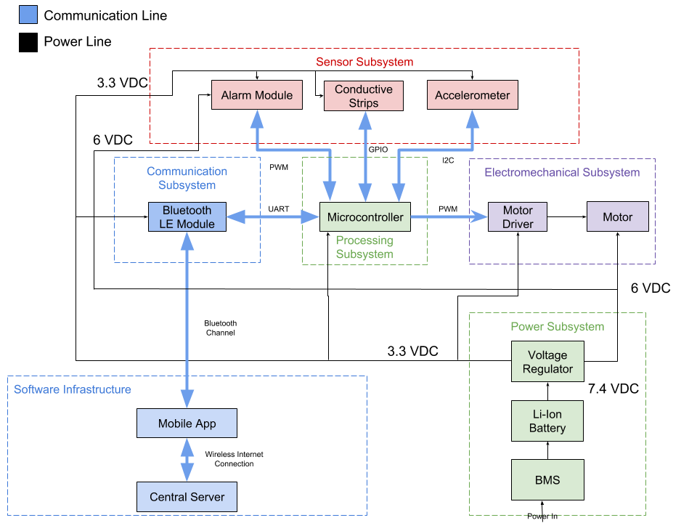
Notes:
Kanchi

Slide 6
Hardware Overview
Mechanical Housing
Power Subsystem
Processing Subsystem
Communication Subsystem
Sensor Subsystem
Electromechanical Subsystem
Notes:
Matt

Slide 7
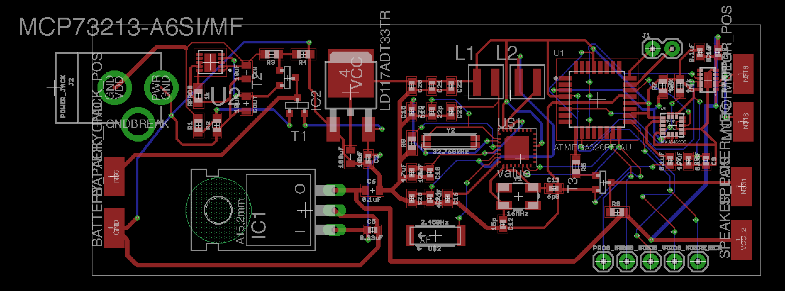
Hardware Overview - PCB
Notes:
Matt

Slide 8
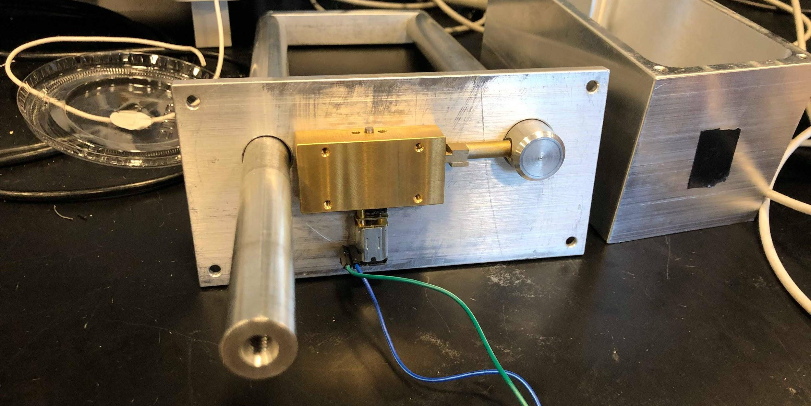
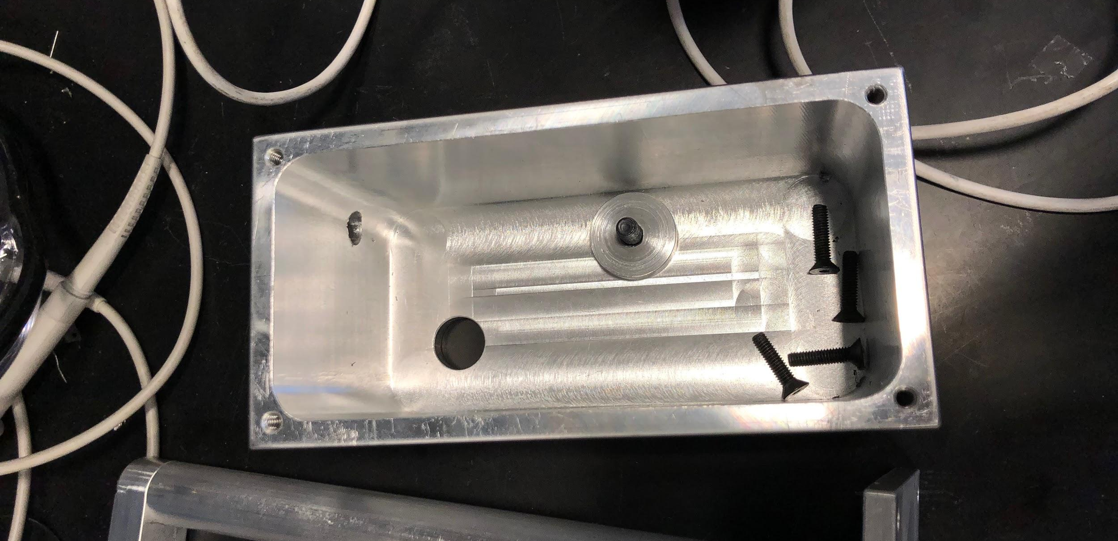
Mechanical Housing
Designed in association with ECE Machine Shop
Rack and Pinion translates motor rotation into linear actuation of bolt
Encloses entirety of hardware system with through-holes for lock and power jack
Notes:
Matt

Slide 9
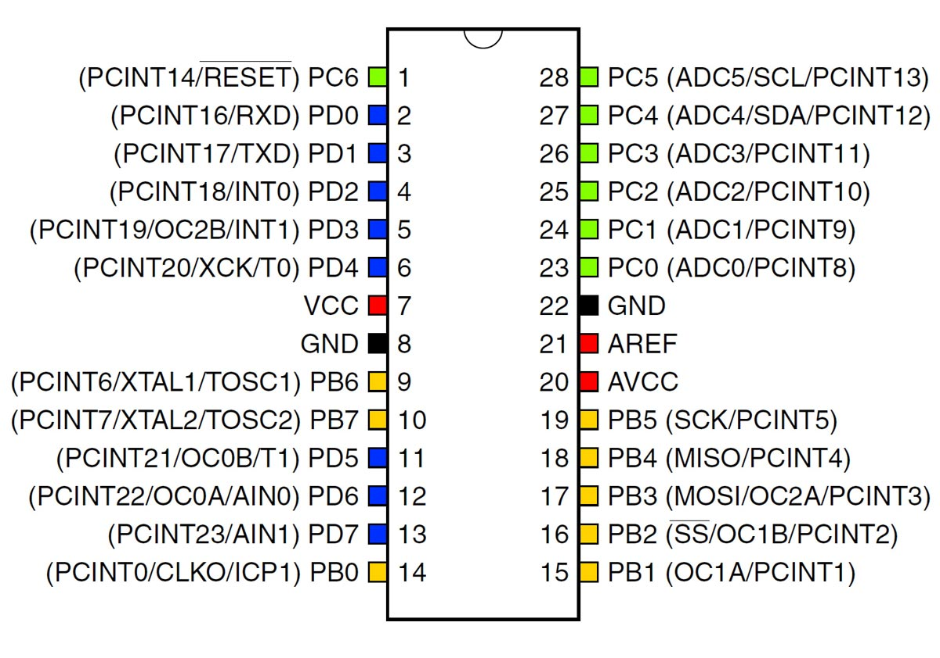
Processing Subsystem
Communicated simultaneously between subsystems for lock, unlock, and alarm signal generation
UART, I2C, and PWM communication interfaces
Original design of ATMega328P surface mounted to PCB replaced with a RedBoard of the same ATMega328P
https://protostack.com.au/shop/microcontrollers/atmega328p-pu-atmel-8-bit-32k-avr-microcontroller/
Notes:
Kanchi

Slide 10
Processing Subsystem - Verification
Requirement | Verification Plan | Result
Microcontroller is able to communicate over UART and I2C simultaneously, while also setting interrupts on GPIO Microcontroller able to generate 0-3.3v PWM signal Microcontroller fast enough to process information and lock/unlock within 1500ms | Final test will be performed with simple messages sent across all interfaces in sync Firmware produces 50% duty cycle 3.3v PWM, output signal measured on oscilloscope. Timer from beginning of bluetooth authentication to start of PWM generation | Communication across interfaces performed nominally PWM measured as 3.3Vpkpk with ±0.05V fluctuation Timed at ~300ms from authentication request to unlock
Notes:
Kanchi

Slide 11
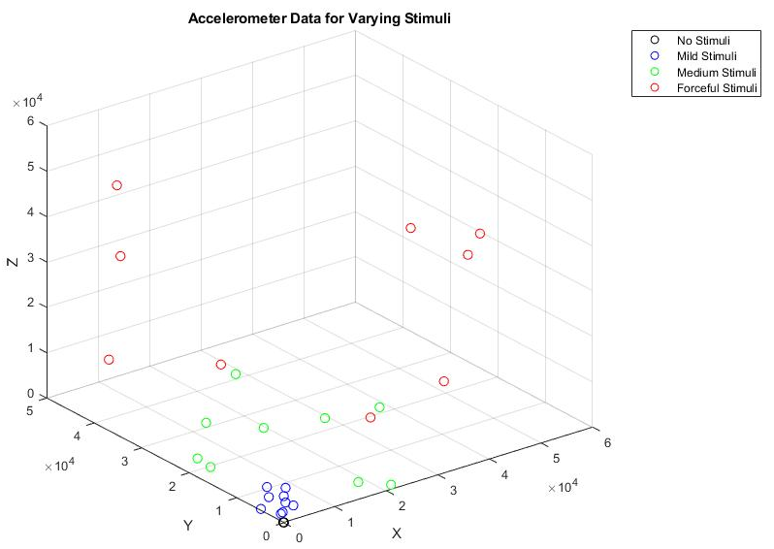
Sensor Subsystem
Accelerometer and Conductive Strips originally designed for tamper detection
Conductive strips scrapped in final demo due to time constraints, GY-521 Accelerometer sourced
AT-16200 85dB Speaker used as alarm, connected through MOSFET driver to PWM from MCU
Notes:
Kanchi

Slide 12
Sensor Subsystem - Verification
Requirement | Verification Plan | Result
The alarm powered by drive transistor through PWM The alarm must be loud and audible up to 5 meters. Accelerometer able to measure vibrations and distinguish intentional damage from light use Accelerometer able to transmit acceleration data over I2C | 3.3v PWM signal from function generator sent to drive transistor, sound will be monitored. 6V PWM signal, sound monitored at various distances while inside lock. Accelerometer output will be logged during tests of banging, sawing, vibration etc from inside housing. I2C interface will be set up and data regularly polled over interface and displayed over serial port | Speaker was audible and drive strength nominal Determined to be audible from within radius of lab Logged output plotted and threshold determined I2C polling displayed floating point results over serial

Slide 13
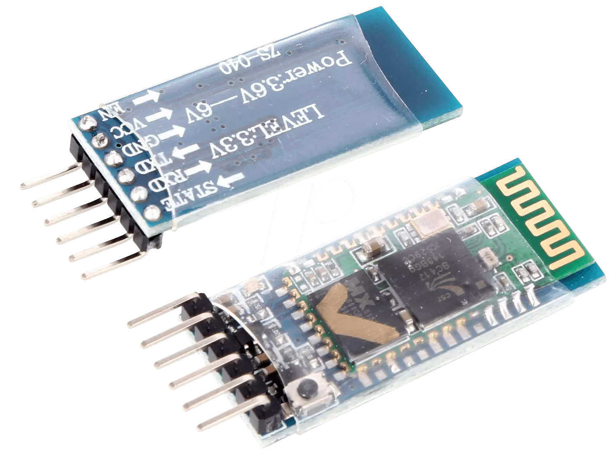
Communication Subsystem
Established Bluetooth connection from hardware module to the smartphone application
Relays data over UART to Processing Subsystem
Original CSR1010 chip from Qualcomm replaced with HC-05 Breakout Board
http://rosetaelectronics.com/shop/bluetooth-hc-05/
Notes:
Kanchi

Slide 14
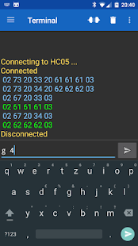
Communication Subsystem - Verification
Bluetooth connected through Android application Bluetooth Terminal
Commands sent through Bluetooth Terminal to HC-05, response observed of LED from state change on MCU
https://play.google.com/store/apps/details?id=de.kai_morich.serial_bluetooth_terminal&hl=en_US
Notes:
Kanchi

Slide 15
Communication Subsystem - Verification
Requirement | Verification Plan | Result
Bluetooth module is able to connect to iOS and transfer data between phone and microcontroller over an open-air distance of 2 meters. Bluetooth module operates over UART interface with microcontroller to send and receive data. | Pair with module and send/receive simple hello world message from 2 meters away. Connect Bluetooth module to microcontroller over UART, send/receive simple hello world message | Reliable Bluetooth communication achieved within 2 meters Nominal serial connection over UART to microcontroller

Slide 16
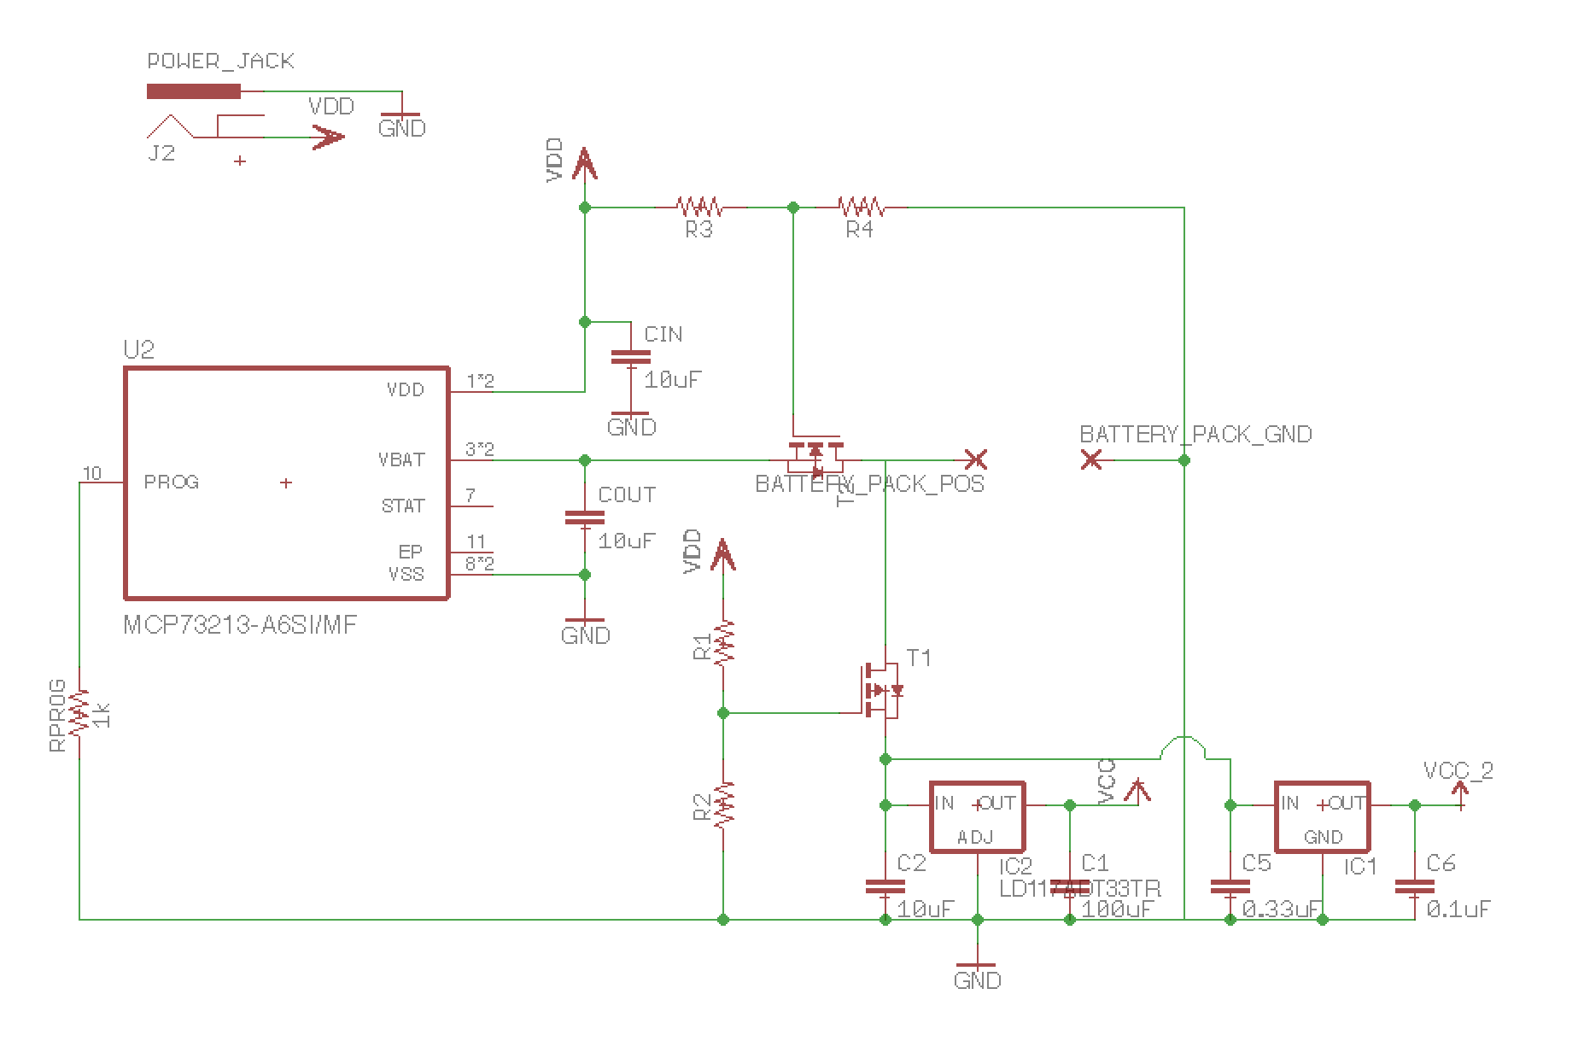
Power Subsystem
Voltage regulation from 7.4V Lithium Ion Battery Pack to 6V for Motor/Alarm and 3.3V for Digital Logic
Original design called for Battery Charging IC - scrapped in final integration when switch to 9V Battery made
Notes:
Matt

Slide 17
Power Subsystem - Verification
Requirement | Verification Plan | Result
Able to translate 7.4V battery voltage into 3.3V for mcu, sensors, and communication and 6V for electromechanical subsystem. Maintain safe operating temperature at a peak current draw of 250mA (motor running full + bluetooth xfer + gps tracking). | Connect voltage regulator to 7.4V DC from power supply in lab, set up configuration and use DMM to monitor output voltages. Connect voltage regulator to load and supply 250mA, monitor temperature to ensure it does not exceed 125 degrees celsius over a 5 minute draw. | DMM probes measure 6V and 3.3V outputs with ±0.020V and ±0.011V fluctuations respectively Monitored with IR Thermometer under load, temperatures did not exceed 25 degrees Celsius
Notes:
Matt

Slide 18
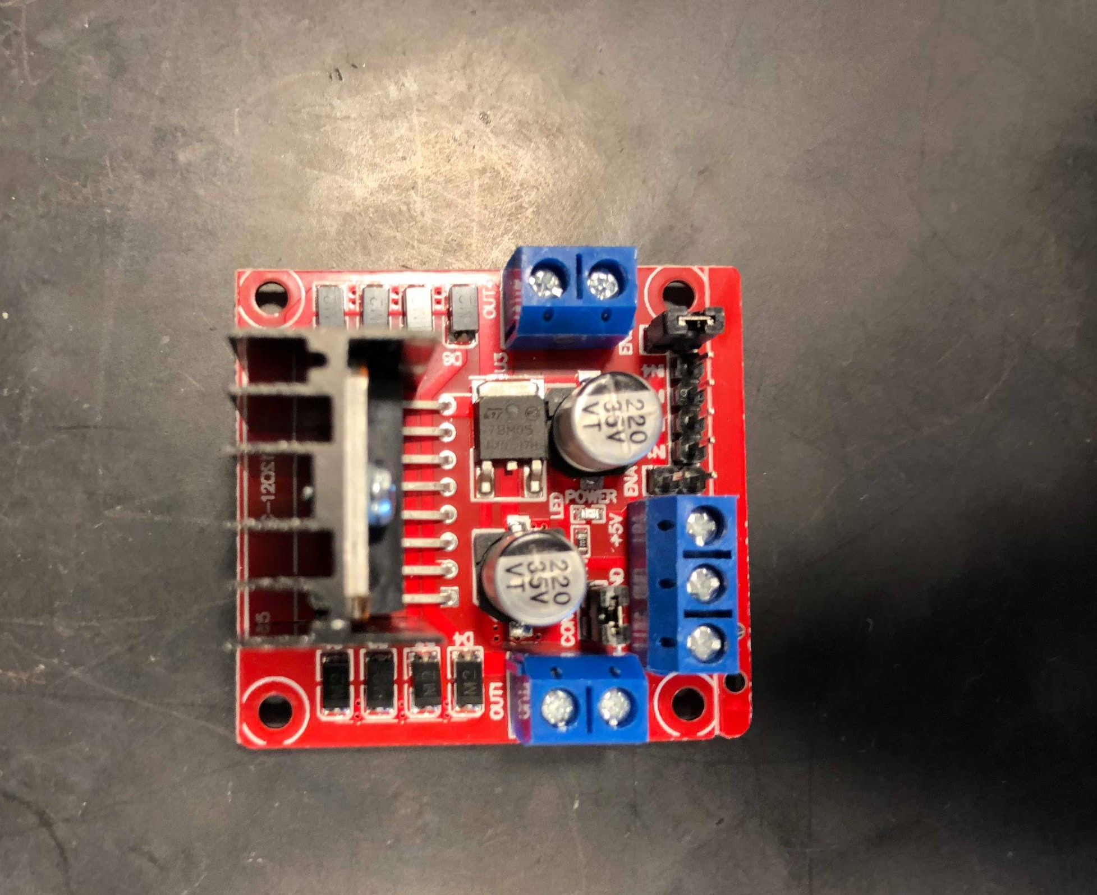
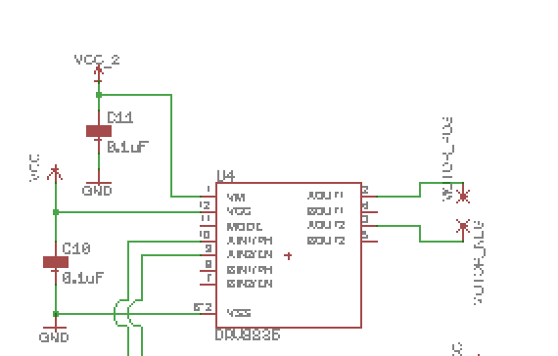
Electromechanical Subsystem
Original SMT motor driver scrapped for L298N motor driver Breakout Board
6VDC supplied to motor through motor driver
PWM and logic control supplied to motor driver from Processing subsystem

Slide 19
Electromechanical - Characterization
Input: 6V, 800mA
Angular Velocity: ω = rpm x 2π / 60 = 7.85 rad/s
Torque: τ = I x V x E / ω
Gives us torque of 0.0917 Nm or 0.935 kg cm, more than enough to move our 100g bolt for a travel of 2 cm.
Notes:
Matt

Slide 20
Electromechanical - Verification
Requirement | Verification Plan | Result
Motor driver is capable of reversing motor motion Motor driver can translate a 0-3.3v PWM into 6VDC motor drive signal Able to provide enough torque to push and pull 100g bolt back with linear motion. Powered by 6V LiPo battery with 1000mAh | Measure switch in polarity of PWM on oscilloscope Isolate motor driver with 3.3v PWM signal and measure output voltage Use sample bolt and run 6VDC 160mA from power supply through motor. Determine how long motor will need to run to release and relock bolt, run that cycle off of battery power. | Polarity reverse on driver control led to reverse motor motion Output voltage observed at 6VDC ± 0.30V worst case, nominal current Motor achieved linear bolt motion through rack and pinion when connected to supply Determined to be 2 second run for optimal travel
Notes:
Matt

Slide 21
Software Overview
Central Server
Central server used to store all data
Mobile application on the user’s smartphone device
Firmware on ATmega328P MCU
Wifi
Mobile Application
Bluetooth
Microcontroller
Notes:
Kanchi

Slide 22
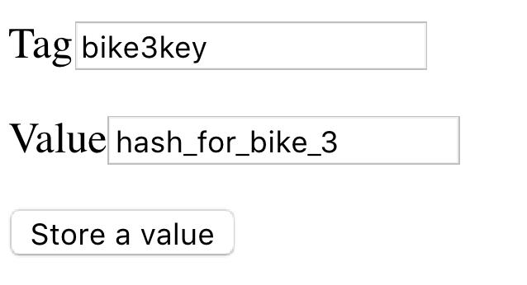
Central Server
The central server stores:
Data from bicycles rides
Log of bicycles storing bicycle ids and keys
Log of users
TinyWebDB service used to work with GoogleAppEngine Database
Notes:
Kanchi

Slide 23
Central Server - Verification
Requirement | Verification Plan | Result
Able to connect to mobile device over wifi and send and receive accurate data. Able to access and process blocks of data. Able to store a months worth of data. | Unit test wifi connection by sending/receiving plaintext between mobile application and central server Create test function to access, modify, and display given data Verify data storage by checking size of single ride data, and extrapolating that to amount our server can store | Mobile application was unable to connect to server; data needed to be inserted and retrieved manually We were able to modify, access, and display data Google Cloud Platform offers unlimited storage; rates increase as amount of data does

Slide 24
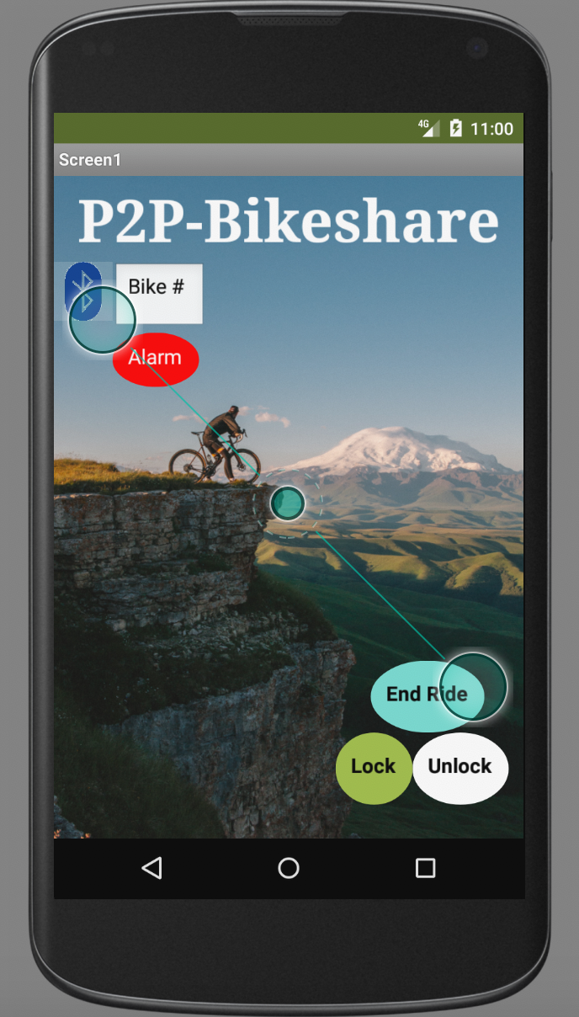
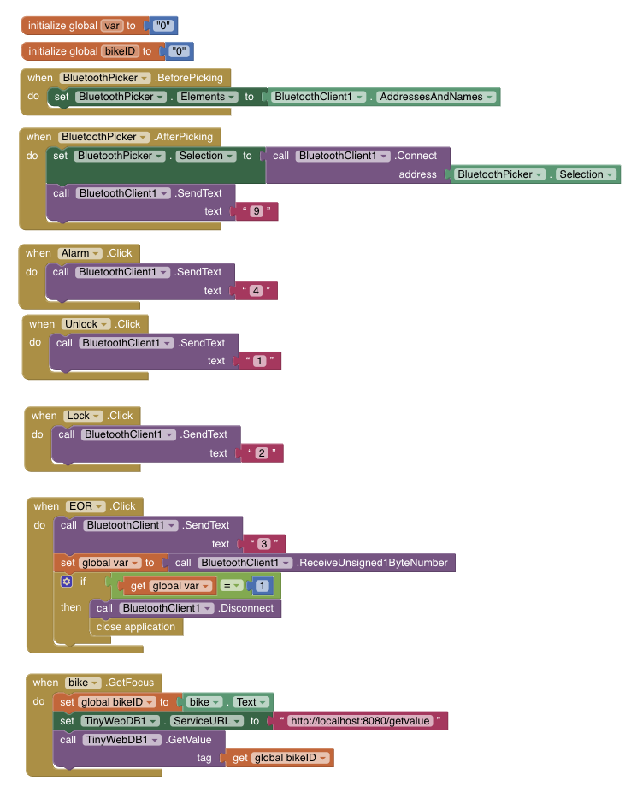
Mobile Application
Intermediate communication method between the central server and microcontroller
Sends user input to firmware via bluetooth
Developed for Android phones via MIT AppInventor
Notes:
Kanchi

Slide 25
Mobile Application - Verification
Requirement | Verification Plan | Result
Able to pair with bluetooth module on mcu and send and receive accurate information. Able to connect with central server over wifi and send and receive accurate information. | Unit test bluetooth connection by sending/receiving plaintext between MCU and mobile application Unit test wifi connection by sending/receiving plaintext between mobile application and central server | Mobile application accurately sent and received data from MCU Mobile application was unable to connect to central server; data needed to manually be inserted and retrieved

Slide 26
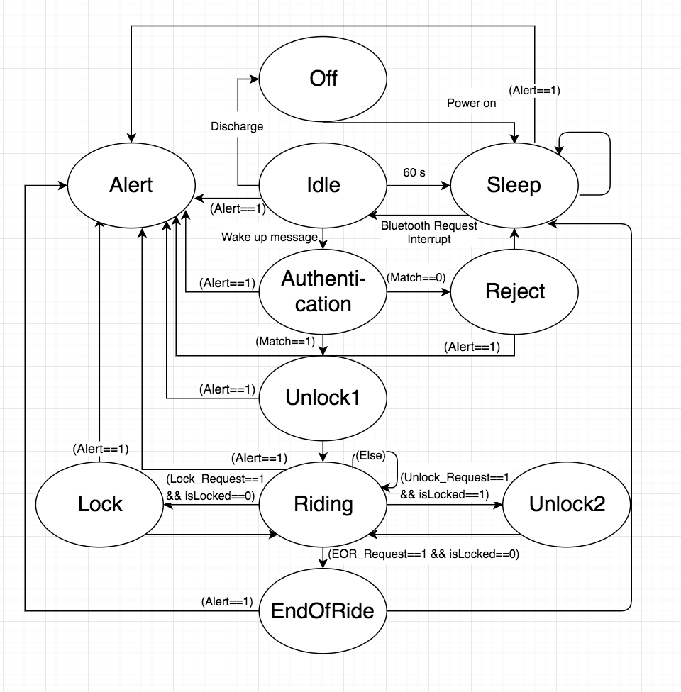
Firmware
Firmware was developed in ArduinoIDE
Interfaces with mobile application via HC-05 bluetooth module’s UART connection
Interfaces with accelerometer via I2C
Capable of sending and receiving data, as well as sending pwm signals to motor and alarm
Notes:
Matt

Slide 27
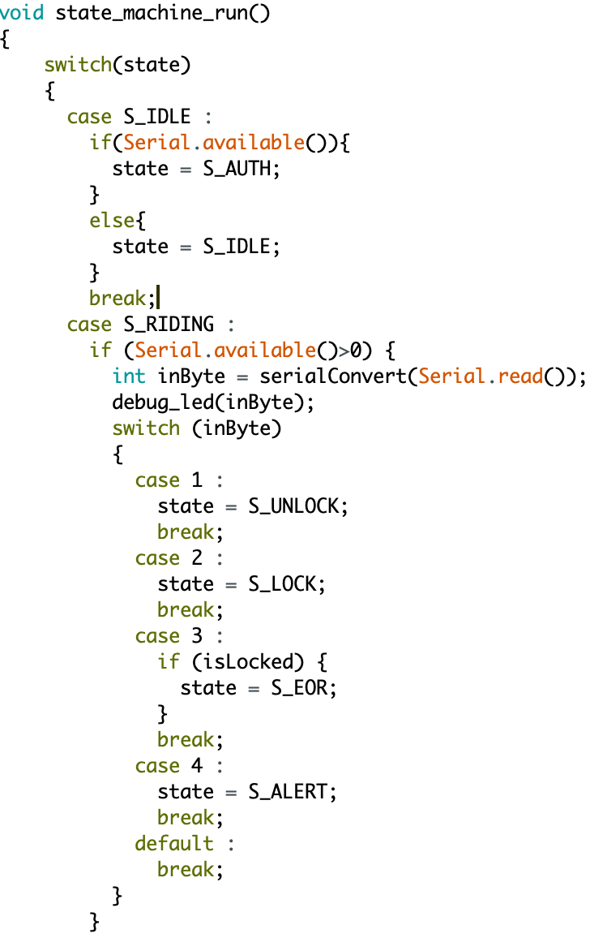
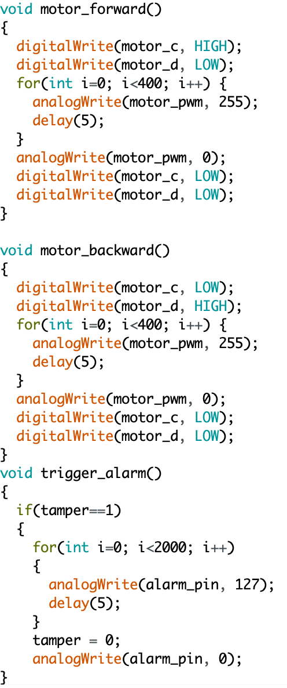
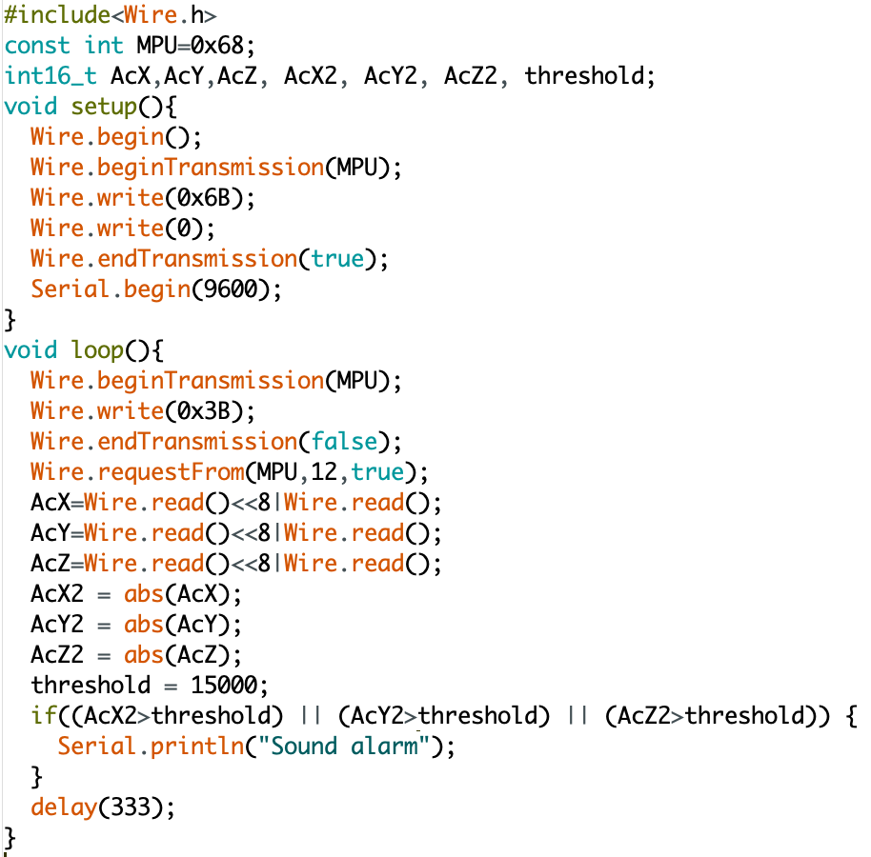
Firmware for:
FSM (Left)
PWM (Center)
Accelerometer (Right)
Notes:
Matt

Slide 28
Conclusions
Original hardware design failed due to PCB issues, but a redesigned prototype was built and demonstrated to achieve high-level requirements
Software application performed well with connection to hardware
Notes:
Kanchi

Slide 29
Future Work
Redesign of PCB using simplified, spread out components and test points
Consolidate MCU and Bluetooth Transceiver to all-encompassing SoC
Redesign of mechanical housing for more realistic compact form-factor, longer rack for bolt actuation
Redesign of central server to be accessible by mobile application
Integration of wifi module and gps into hardware module
Development of iOS mobile application
Notes:
Kanchi

Slide 30
Acknowledgements
Gregg Bennett
ECE Machine Shop
Soumithri Bala
Notes:
Kanchi

Slide 31
Thank you!
Q & A
Notes:
Kanchi

