Slide 1
Hearing Alarm System
ECE 445 Final Presentation
Alex Yuan
Jake Fava
Jinzhi Shen
Team 8
TA: Hojoon Ryu
Professor: Arne Fillet

Slide 2
Agenda
Objective
Design Overview
Testing
Challenges
Successes
Conclusion
ECE 445
GRAINGER ENGINEERING

Slide 3
OBJECTIVE
ECE 445
GRAINGER ENGINEERING

Slide 4
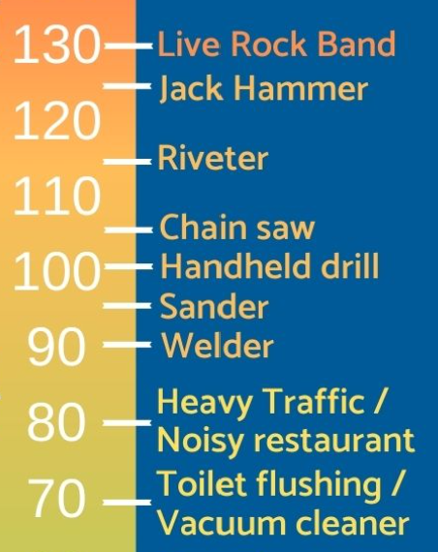
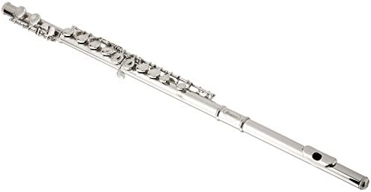
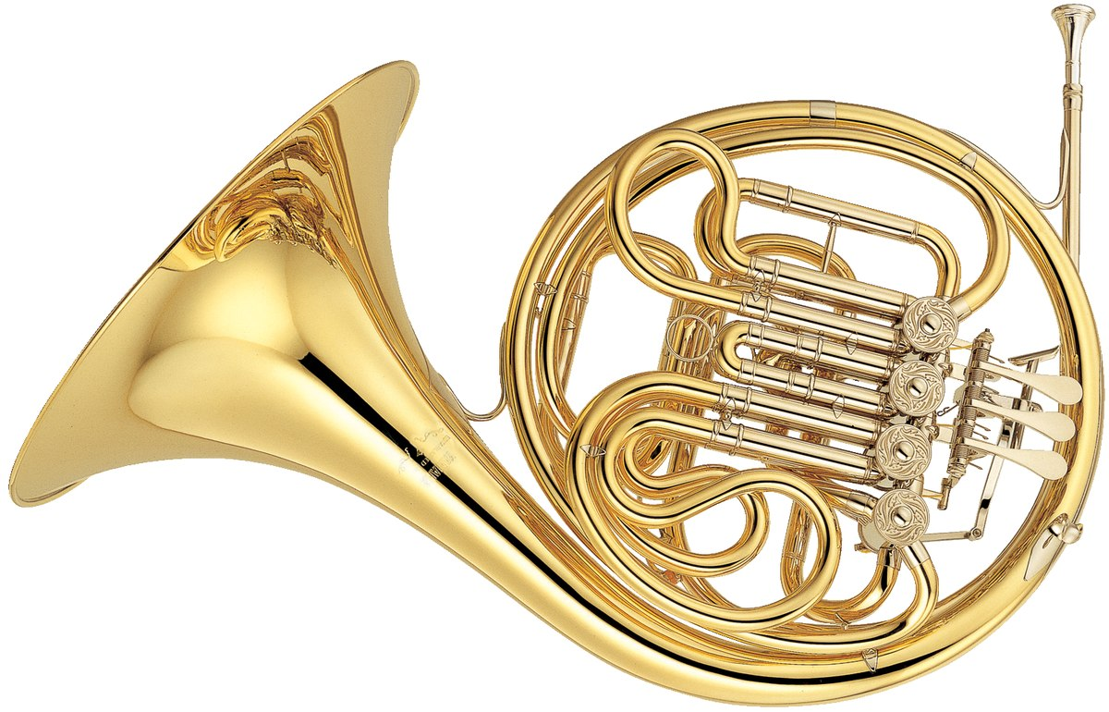
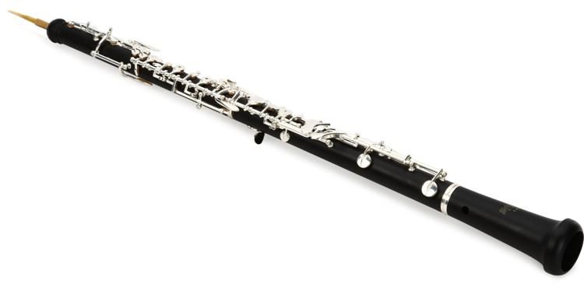
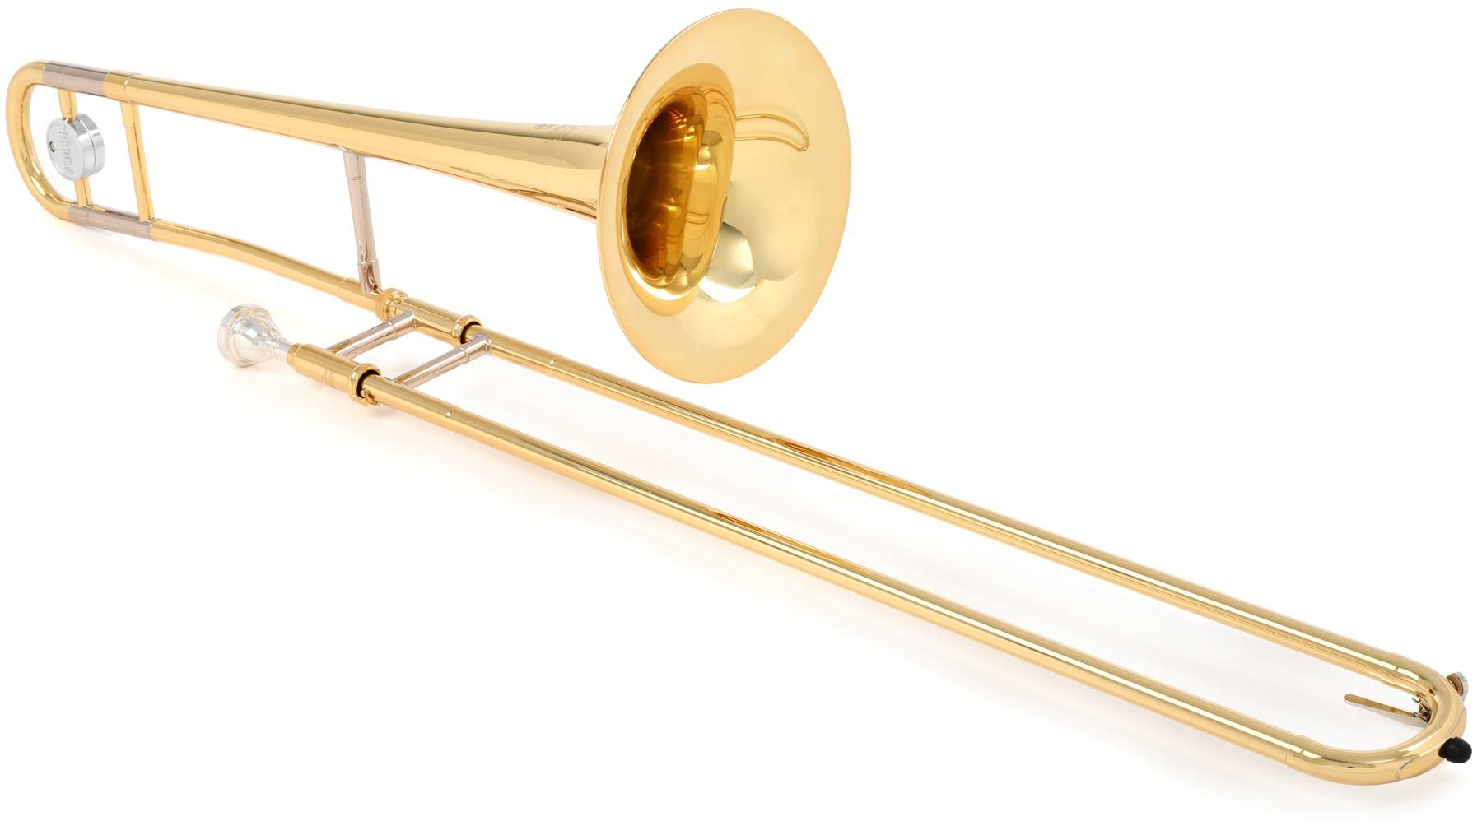
Musical Instruments are LOUD
Flute | 92-103dB
French Horn | 90-106dB
Oboe | 95-112dB
Trombone | 85-114dB
ECE 445
GRAINGER ENGINEERING

Slide 5
According to the CDC, Dangerously Loud
ECE 445
GRAINGER ENGINEERING

Slide 6
But Students Don’t Use Hearing Protection
“Despite these findings, the survey revealed that 21 out of the 27 participants surveyed reported never using hearing protection devices.”
“The average sound levels across various positions throughout the ensemble were above 98 dB at every position, with peaks of at least 112 dB in every position. Over 50% of participants reported that they did not ever use hearing protection during rehearsals.”
ECE 445
GRAINGER ENGINEERING

Slide 7
Our Objective:
How might we educate middle and high school musicians on their sound exposure levels and encourage them to use hearing protection?
ECE 445
GRAINGER ENGINEERING

Slide 8
DESIGN OVERVIEW
ECE 445
GRAINGER ENGINEERING

Slide 9
Initial High-Level Design
Visual aid from design document
High-Level Requirements:
Detect and signal when sound levels are dangerous (indicated by red LED)
Detect and signal when dosage threshold is surpassed (indicated by blinking LED)
Transmit collected data via USB and generate a user-friendly graphical report
ECE 445
GRAINGER ENGINEERING

Slide 10
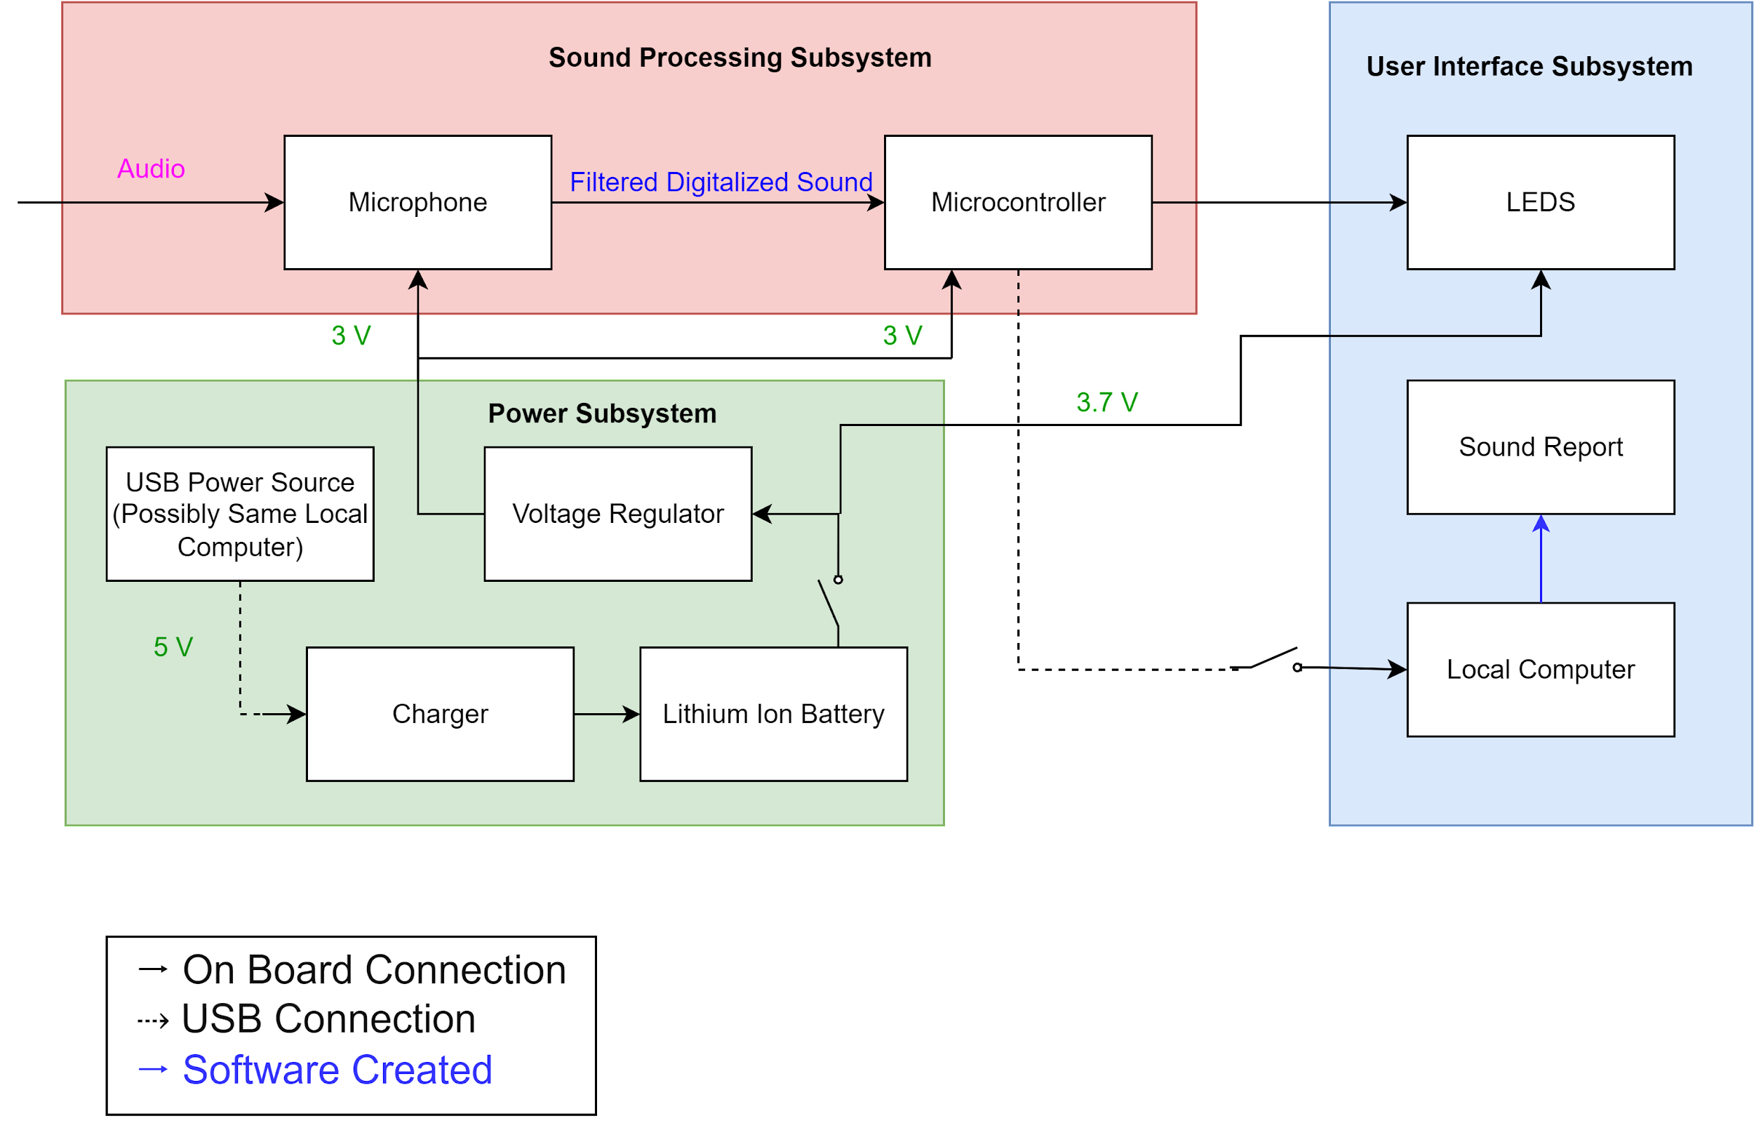
Initial Subsystem Block Diagram
Initial Subsystems:
Sound Processing
User Interface
Power
Initial block diagram from design document
ECE 445
GRAINGER ENGINEERING

Slide 11
Design Change #1 - Battery Removal
Description:
Lithium-Ion battery and charger removed from power subsystem
Replaced with USB power
Rationale:
Reducing design complexity
Consideration of context (music practice rooms with computers)
O
O
Changes reflected in block diagram
ECE 445
GRAINGER ENGINEERING

Slide 12
Design Change #2 - Microcontroller Unit Change
Description:
Changed MCU to another in same family
STM32F103 > STM32F401
Rationale:
New chip needed to accommodate I2S protocol from microphone
Old chip unable to be programmed directly via USB
High-level view of I2S protocol
ECE 445
GRAINGER ENGINEERING

Slide 13
TESTING
ECE 445
GRAINGER ENGINEERING

Slide 14
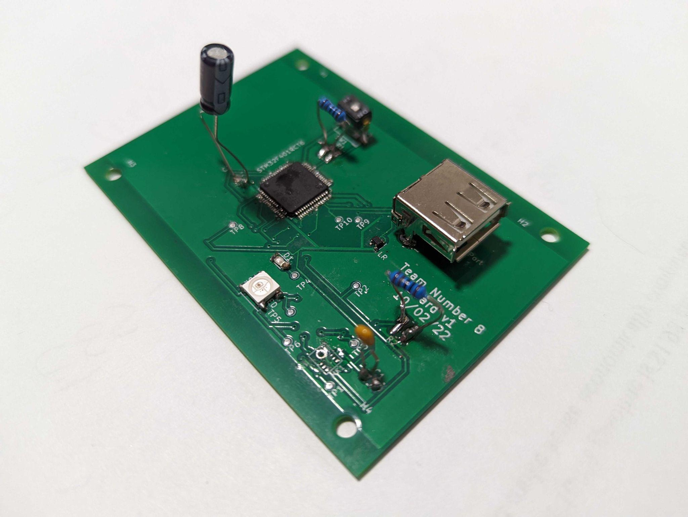
PCB Testing Was Largely Unsuccessful
Description:
Replacement components did not arrive in time
Made an attempt at fixing initial soldering job
Found linear regulator to be malfunctioning
Final soldered PCB
ECE 445
GRAINGER ENGINEERING

Slide 15
Sound Processing Software Example Readout
First example: raw decibel readings from microcontroller
Arrows show spikes in SPL from clapping
ECE 445
GRAINGER ENGINEERING

Slide 16
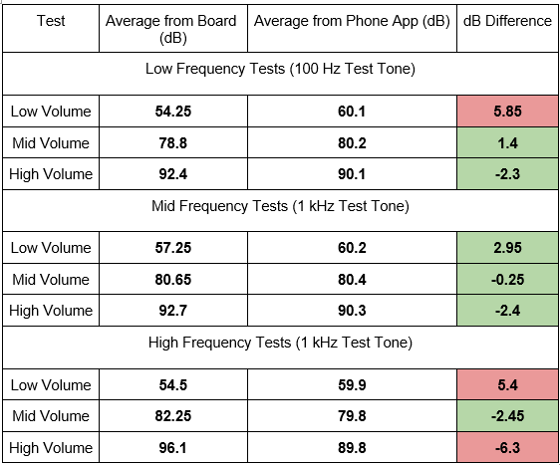
Sound Processing Calibration Was Largely Successful
Sound processing subsystem test results
ECE 445
GRAINGER ENGINEERING

Slide 17
Video of Successful LED Response
Colored LEDs responding to different dB levels
Green — Safe
(80dB or less)
Yellow — Potentially harmful (80-90dB)
Red — Certainly harmful (90dB+)
ECE 445
GRAINGER ENGINEERING

Slide 18
CHALLENGES
ECE 445
GRAINGER ENGINEERING

Slide 19
Challenge #1 - Initial Design Impracticalities
Description:
Initial PCB design missing boot switch
Solution:
Identified issues early enough
Changed MCU
Built and ordered second PCB
Updated PCB design
ECE 445
GRAINGER ENGINEERING

Slide 20
Challenge #2 - Shipping Delays
Description:
International shipping MCUs caused delays multiple times
Solution:
Next time:
Order farther ahead in advance
Order multiples of every part
Screenshot of UPS shipping status
ECE 445
GRAINGER ENGINEERING

Slide 21
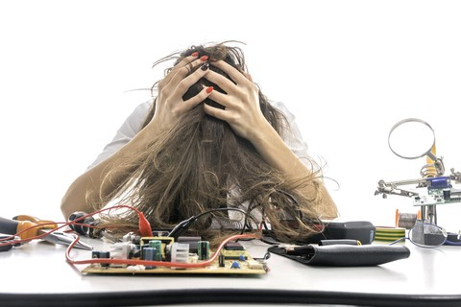
Challenge #3 - Hand Skill Deficiencies
Description:
No team members had microelectronic soldering experience
First attempt at soldering PCB failed
Multiple crossed MCU pins
Irreparable damage to microphone
Solution:
Extensive practicing on old board/chips
Dramatization of lab sessions
ECE 445
GRAINGER ENGINEERING

Slide 22
Challenge #4 - PuTTY Logging Issues
Description:
Unable to get PuTTY to save logs
Affected efficacy of sound reports
Solution:
Next time:
Budget more troubleshooting time
Find alternative logging solution(s)
Persistent PuTTY error we kept getting
ECE 445
GRAINGER ENGINEERING

Slide 23
Challenge #5 - Acquiring Frequency Data
Description:
Unable to accurately collect frequency information from I2S microphone
Solution:
Next time:
Budget more troubleshooting time
Potential causes:
Data filtering
Incorrect I2S data configuration
Depreciated ARM math functions
Raw USB data showing
static frequency values
ECE 445
GRAINGER ENGINEERING

Slide 24
SUCCESSES
ECE 445
GRAINGER ENGINEERING

Slide 25
Success #1 - PCB Design Passed Audit
Description:
Despite lack of PCB experience, we were able to successfully design our PCB to pass the PCBWay audit
Approved PCB design
ECE 445
GRAINGER ENGINEERING

Slide 26
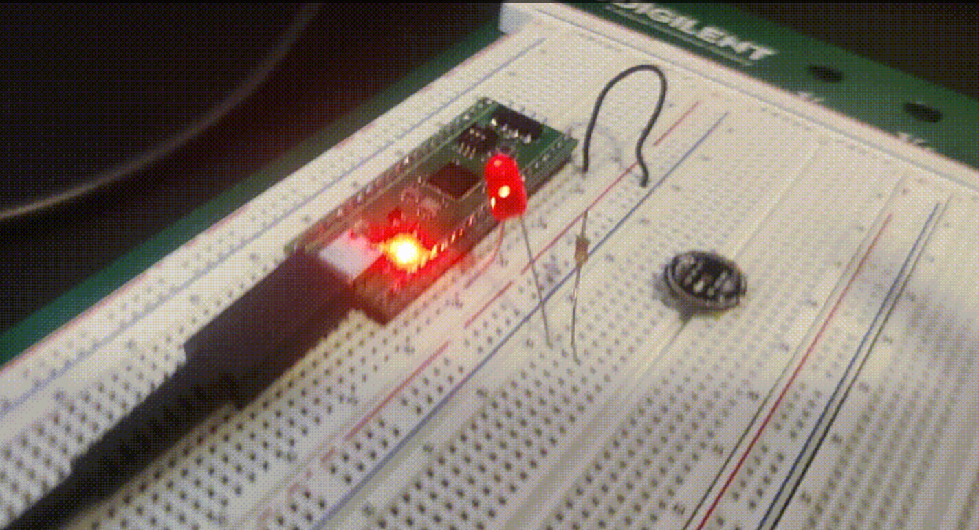
Success #2 - Development Board
Description:
Purchased a development board for the MCU family we were using
Allowed us to prototype and test software without working hardware
Built multiple development boards for parallel testing
First tests on development board
ECE 445
GRAINGER ENGINEERING

Slide 27
Success #3 - Sound Processing Software
Read microphone data
Description:
Software was successfully able to collect information from I2S microphone
Accurately computed instantaneous SPL and sound exposure over time
Correctly signaled LEDs
Filter out bad data
Identify peak value
Calculate calibrated SPL
Calculate dose contribution
Turn on LED(s)
High level software flow
ECE 445
GRAINGER ENGINEERING

Slide 28
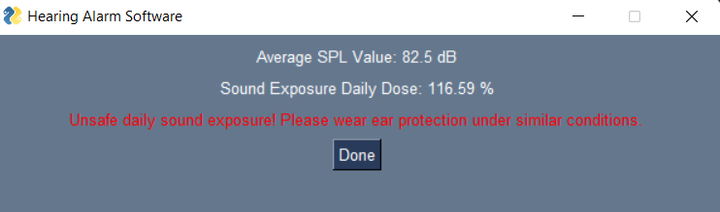
Success #4 - Sound Processing Report
Description:
Software was successfully able successfully create sound exposure report from collected data
Two example sound exposure reports
ECE 445
GRAINGER ENGINEERING

Slide 29
CONCLUSION
ECE 445
GRAINGER ENGINEERING

Slide 30
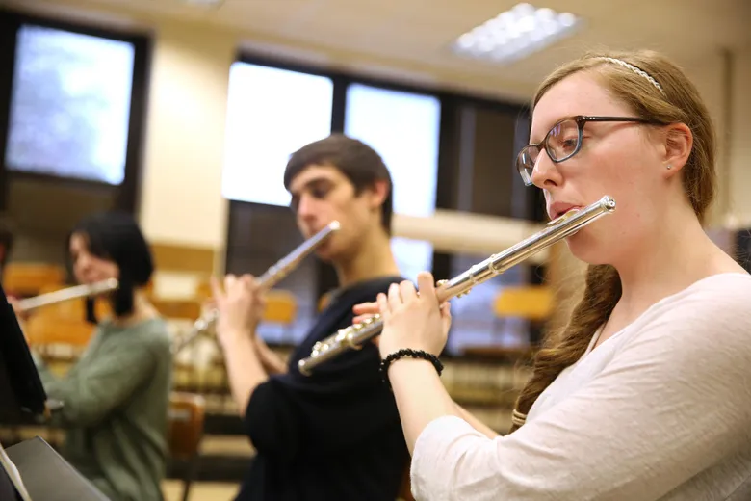
Ethical Concerns
This device only alerts users when they’re being exposed to dangerous amounts of sound; it’s up to the user to use hearing protection themselves
Slight inaccuracies in calibration of prototype could compound over time
ECE 445
GRAINGER ENGINEERING

Slide 31
What We Learned
Design a schematic and PCB
Change designs to better fit our objective
Use a development board to prototype a design
Develop software for a microcontroller
Handle I2S and USB data
ECE 445
GRAINGER ENGINEERING

Slide 32
What We Would Do Differently
Purchase extra components further in advance
Purchase and use development board even sooner
Use UART instead of USB
Develop stronger hand skills before attempting soldering
ECE 445
GRAINGER ENGINEERING

Slide 33
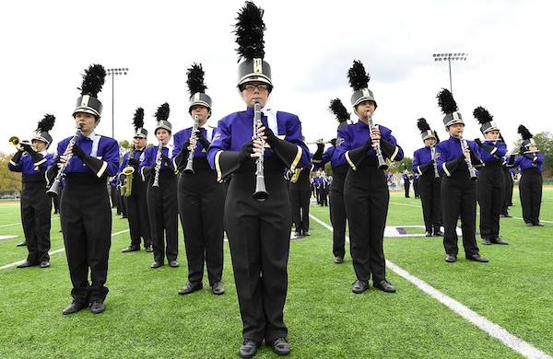
Recommended Extensions
Add rechargeable battery support
Added portability could make it useful to more contexts (ie. on the marching band field)
Add bluetooth functionality
For greater portability and ease-of-access to results
Miniaturizing design
For greater portability
ECE 445
GRAINGER ENGINEERING

Slide 34
Thank You!
Questions?

Slide 35
APPENDIX
ECE 445
GRAINGER ENGINEERING

Slide 36
Final circuit schematic
Arrows highlight changes from initial design
ECE 445
GRAINGER ENGINEERING

Slide 37
Final PCB design
Arrows highlight development issues
ECE 445
GRAINGER ENGINEERING

