Slide 1
Smart Solar Powered Streetlight
Brian Keegan, Joshua Song, Corey Weil
ECE 445 | Group 10 | Spring 2019

Slide 2
Introduction
Cost-saving alternative for traditional fluorescent streetlights
Radar detection for vehicles/pedestrians controls output light intensity
Solar power to charge an external battery with option to default to grid power

Slide 3
Objective
Reduce energy usage and operational costs through LEDs, solar generation, and intensity control
Provide sufficient light for safe roadway usage during entire operation period

Slide 4
High-Level Requirements
Supply and sustain at least 12 hours of continuous use with at least 0.3 cd/m² average luminance for the entire duration.
Detect a typical United States road-legal passenger vehicle, cyclist, or pedestrian travelling at a maximum of 40MPH speed within a lane width of 12 feet.
Maintain at least an average 0.3 cd/m² (minimum legal luminance as specified by Illinois Department of Transportation) at all times.

Slide 5
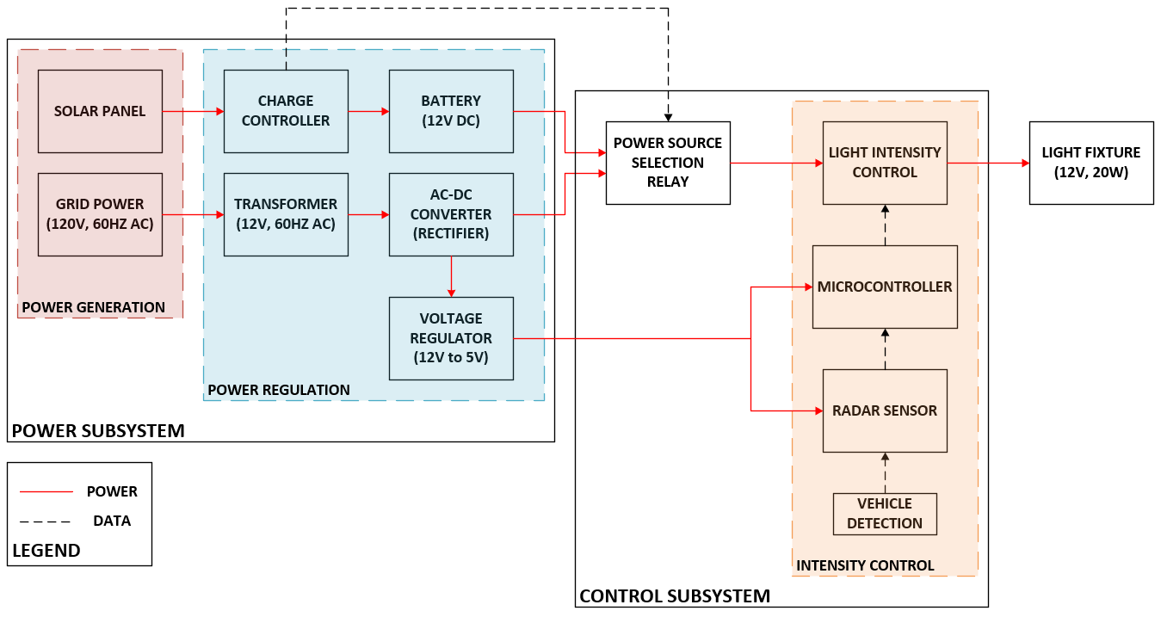
Block Diagram

Slide 6
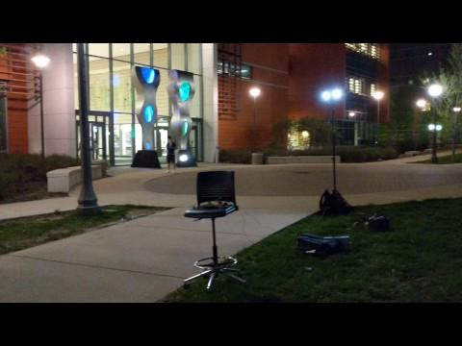
Demonstration Video - Pedestrian/Bike

Slide 7
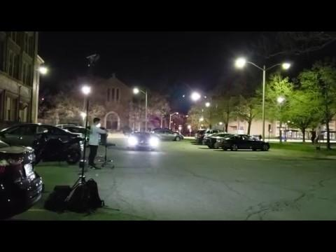
Demonstration Video - Vehicle

Slide 8
System Overview
Hardware
Solar Panels
Battery System
Radar Sensor
Power Relay
Gate Driver
Microcontroller (ATmega328)
Software
Intensity Control (PWM)

Slide 9
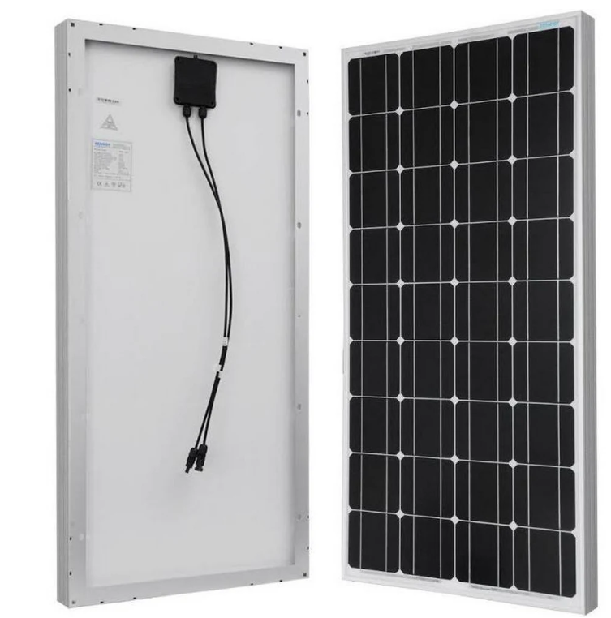
Hardware Overview- Solar Panels
Renogy 100 W
Voc = 22.4 V
Vmp = 17.8
Imp = 5.62

Slide 10
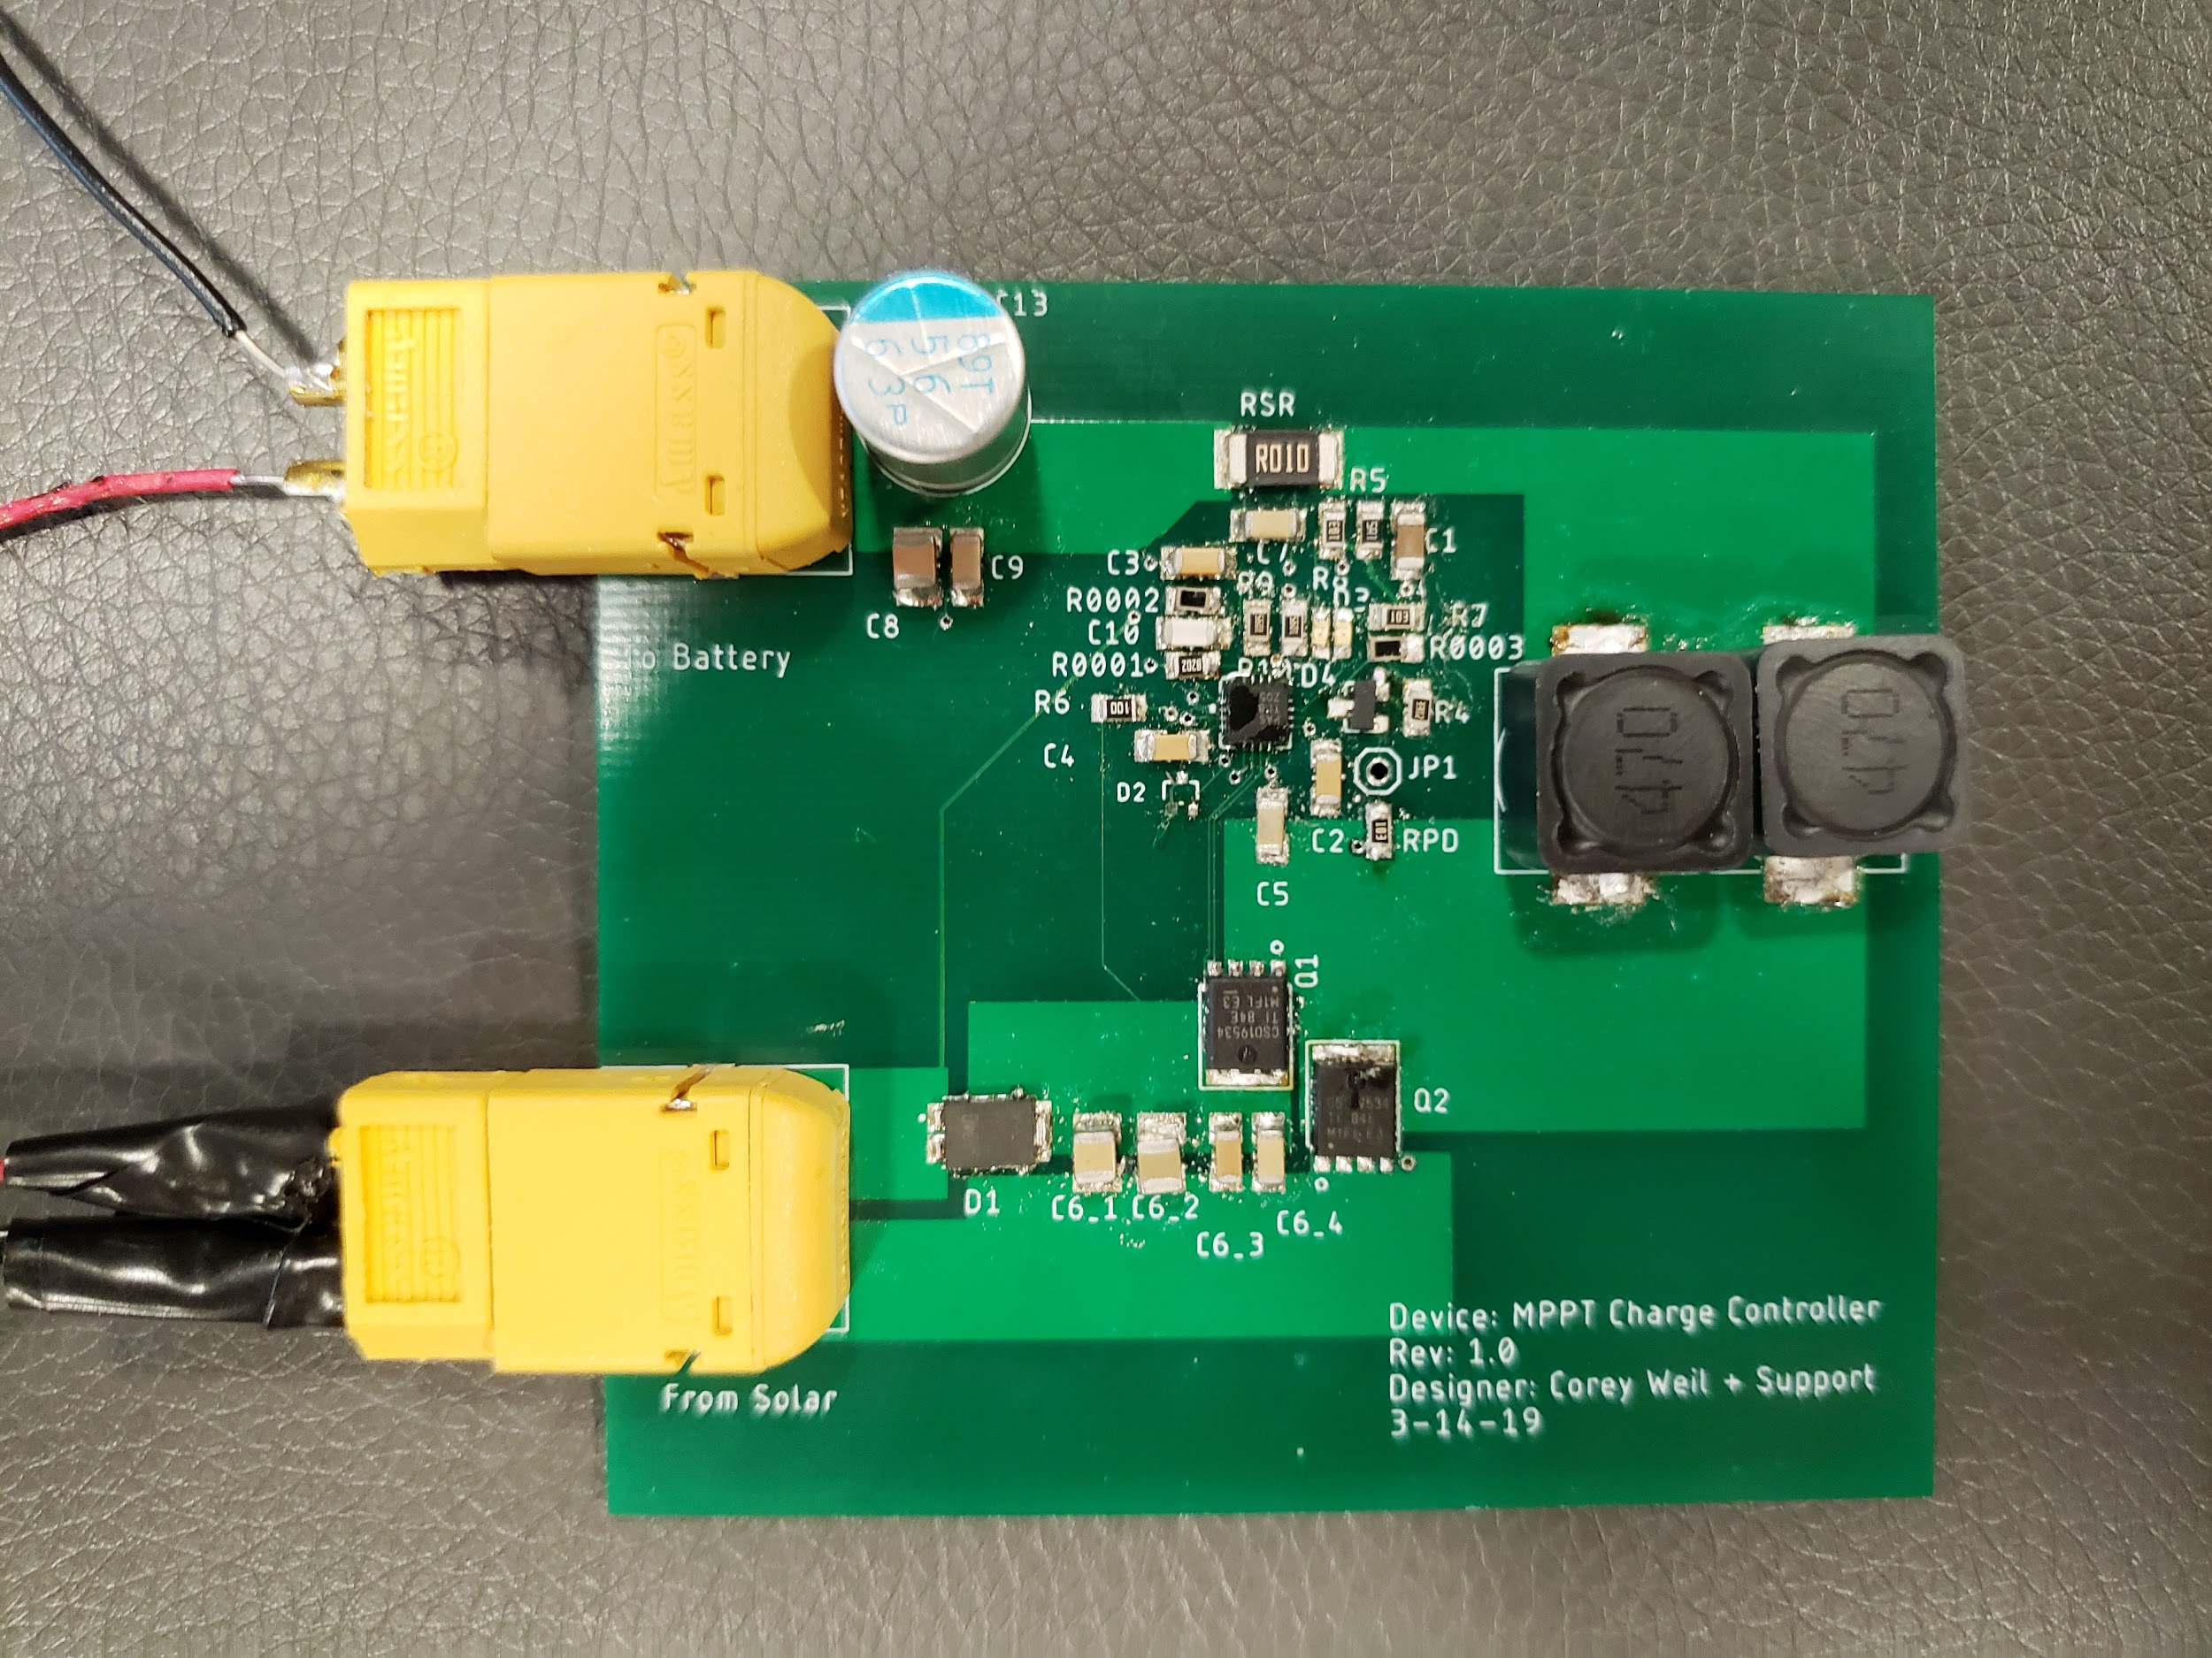
Hardware Overview- Charge Controller
Pack Thermistor
Charge Pump for Switching

Slide 11
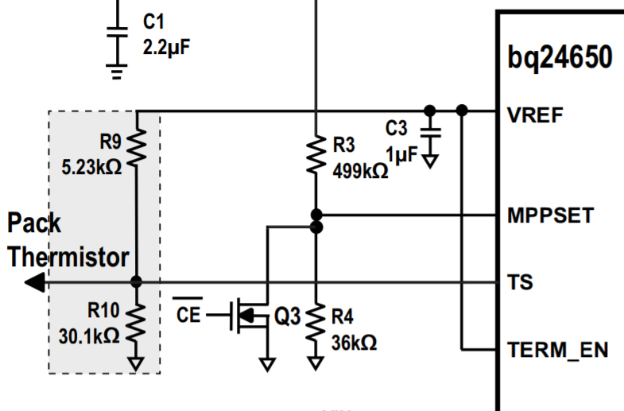
Hardware Overview- Pack Thermistor

Slide 12
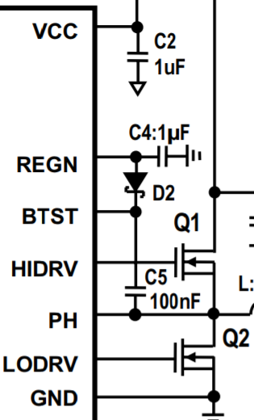
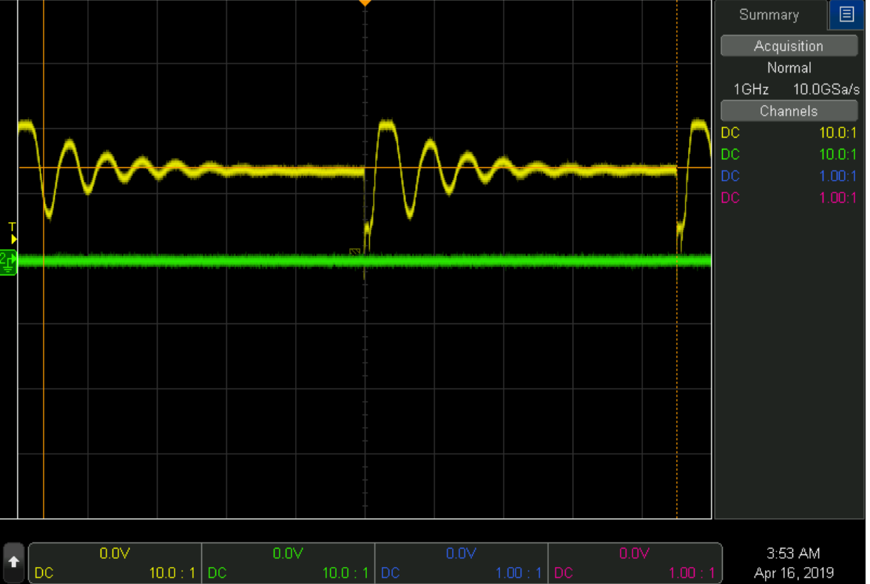
Hardware Overview- Bootstrap Circuit
Notes:
https://en.wikipedia.org/wiki/Charge_pump
https://training.ti.com/dc-dc-fundamentals-charge-pump-regulator-overview

Slide 13
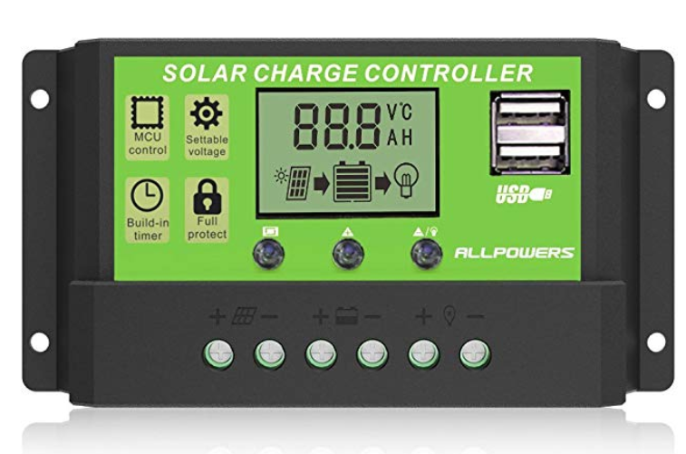
Hardware Overview- Charge Controller
11.5 V from panel
5.5 A from panel
63.25 W
Protection Features

Slide 14
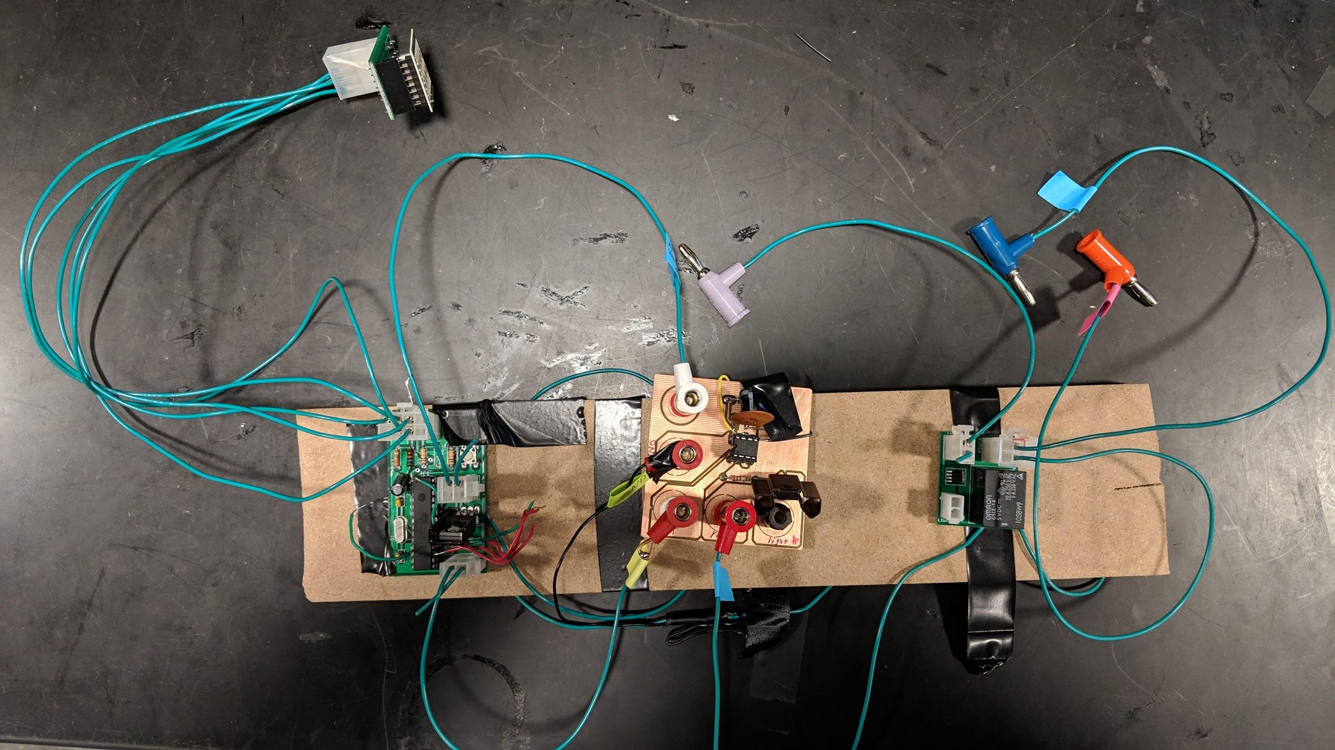
Control Subsystem Integration
Radar Sensor
Gate Driver
Power Relay
Microcontroller

Slide 15
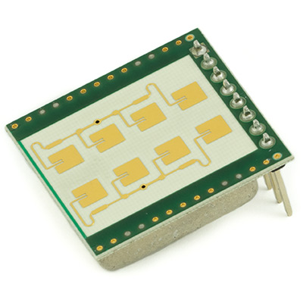
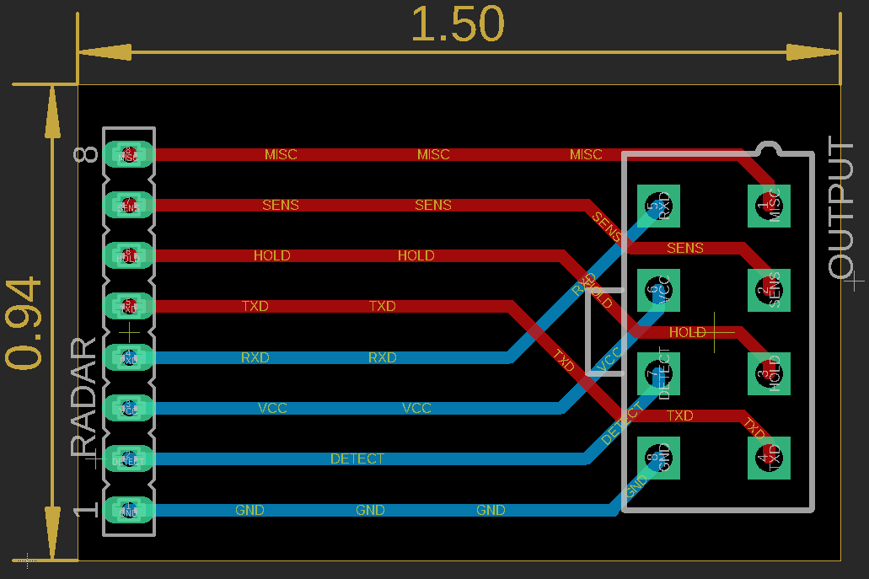
Radar Sensor
K-LD2 Radar Transceiver (24GHz)
30m Vehicle, 15m Pedestrian Detection
Internal signal processing unit
Hold time and sensitivity settings
Notes:
Hold Time: 0.2 to 160s
Sensitivity: 0 to 34dB

Slide 16
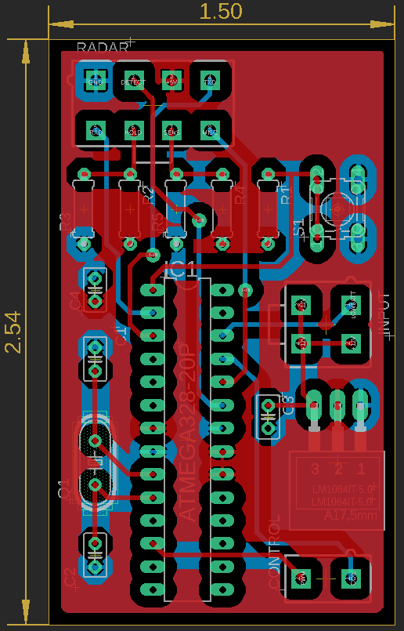
Control Board
ATmega328 Microcontroller
Digital Input From Radar Sensor
PWM Output to Gate Driver

Slide 17
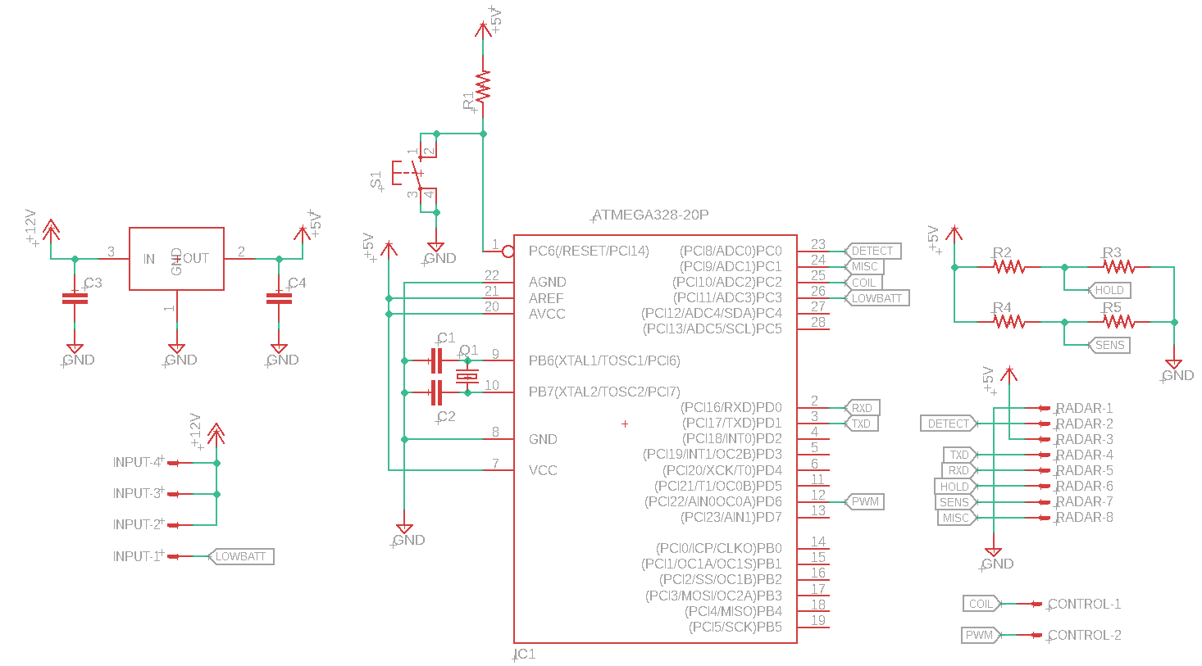
Control Board Schematic
12V to 5V Linear Regulator
Connector to Radar,
Sensitivity and Hold Time Setting
ATMega328
Microcontroller

Slide 18
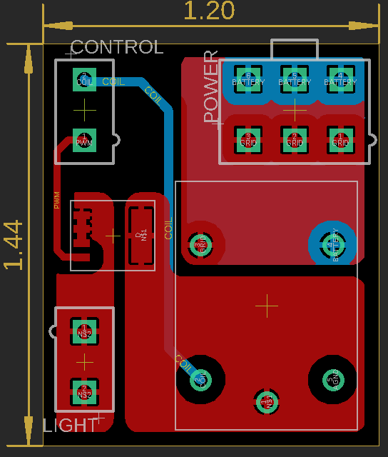
Power Relay
G5LE-14 DC12
Allows for power source switching
12V Battery (from solar)
12VDC from rectifier (Grid)

Slide 19
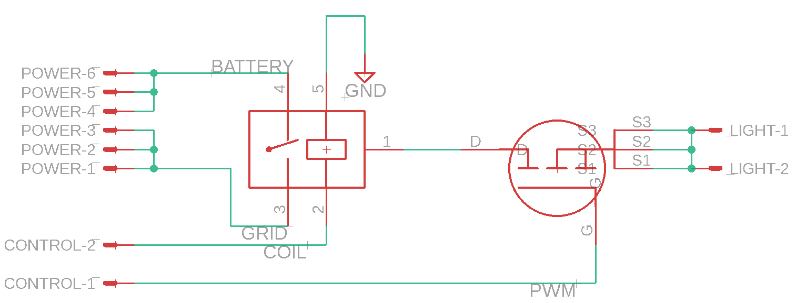
Power Relay Schematic

Slide 20
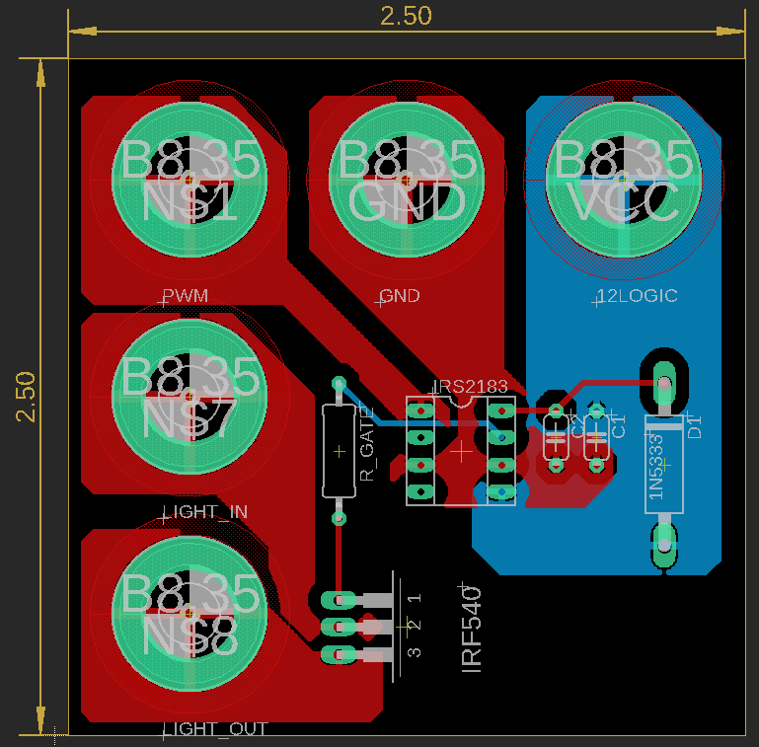
Gate Driver
IRS2183 Half-Bridge Driver
IRF540 Power MOSFET
Boost PWM signal from ATmega328, output to MOSFET gate

Slide 21
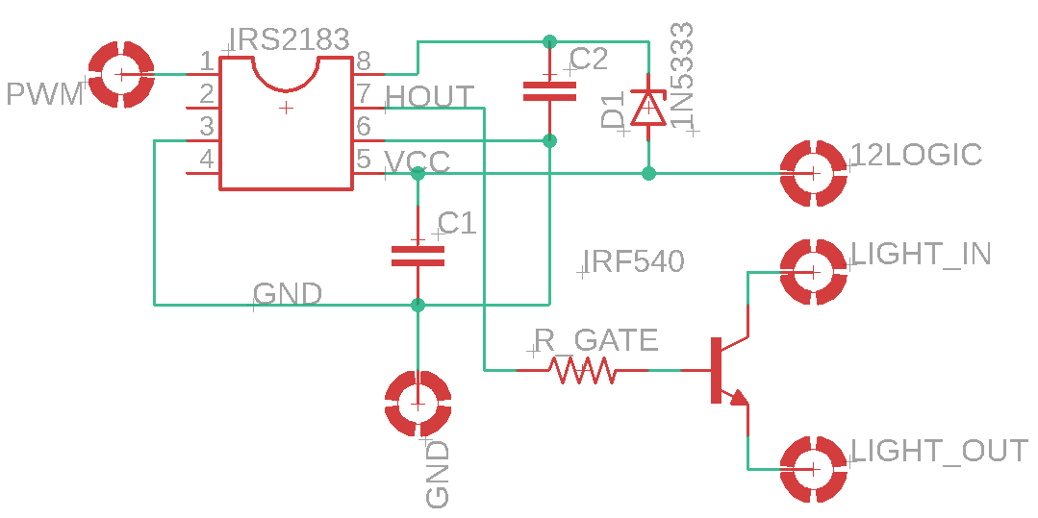
Gate Driver Schematic

Slide 22
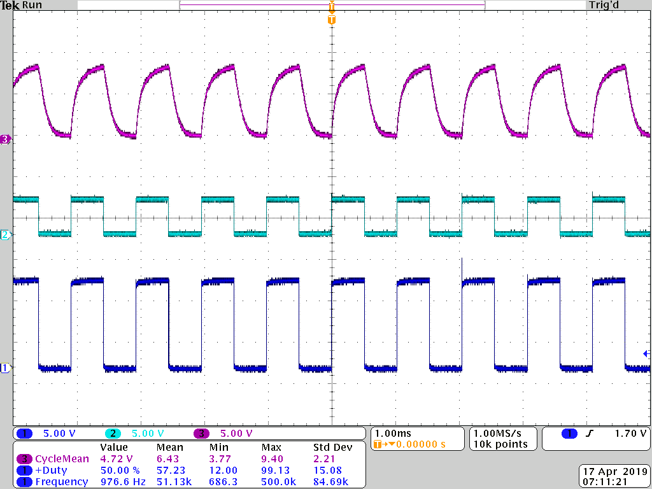
Gate Driver Waveform

Slide 23
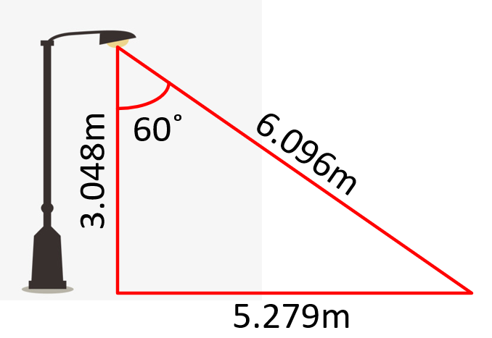
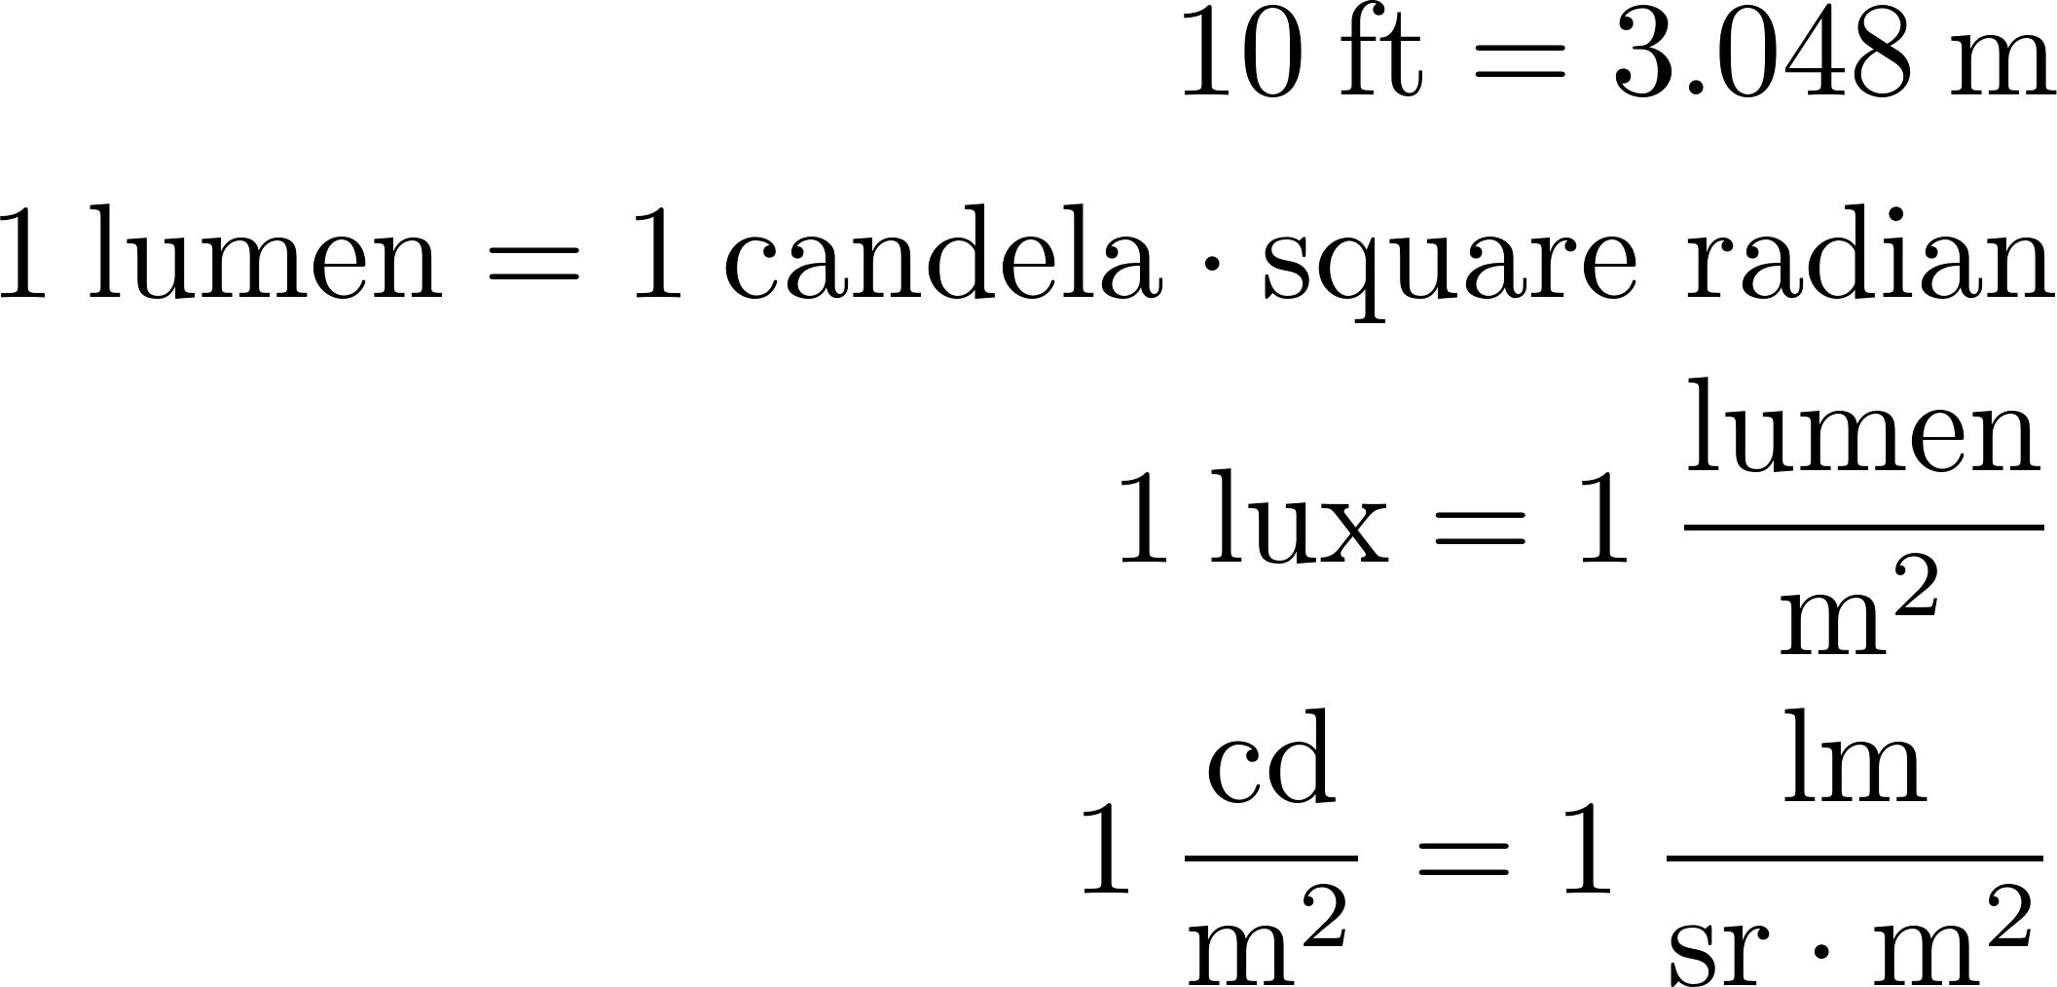
Luminance Calculations

Slide 24
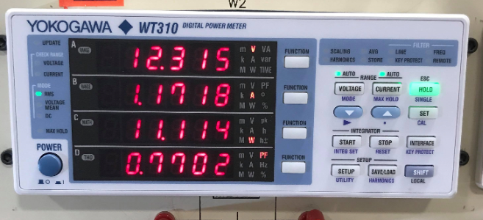
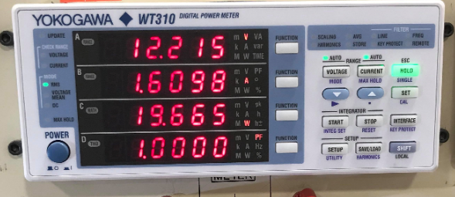
Power Analysis
11.11 W
19.66 W
~50% savings with half and full intensity PWM

Slide 25
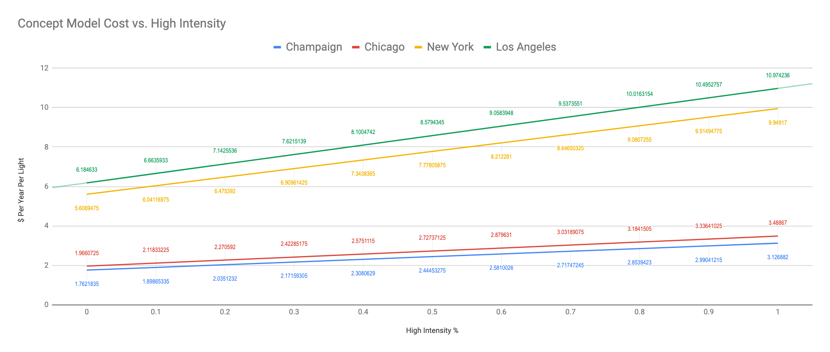
Prices Per kWh for different locations
Champaign: $0.0363 kWh
Chicago: $0.0405 kWh
New York: $0.1155 kWh
Los Angeles: $0.1274 kWh
20W Light

Slide 26
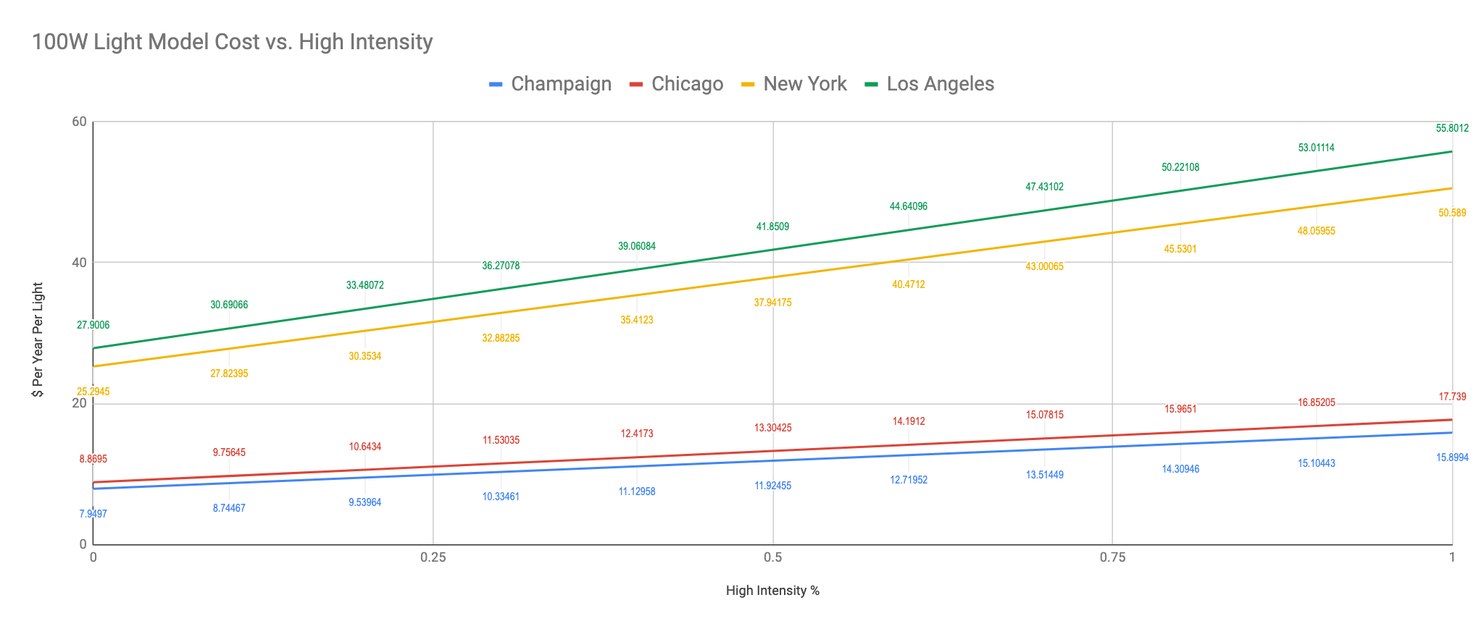
Prices Per kWh for different locations
Champaign: $0.0363 kWh
Chicago: $0.0405 kWh
New York: $0.1155 kWh
Los Angeles: $0.1274 kWh
100W Light

Slide 27
Benefits to Large Cities
Los Angeles recently reporting their transfer to LED street lights is saving them $9M annually
Approximately 220,000 streetlights in operation
50% intensity means cost of ~$9.2M per year
Chicago Department of Transportation oversees more than 300,000 street lights
50% intensity means cost of ~$4M per year

Slide 28
Part | Cost (prototype) | Cost (bulk)
Solar Panels: RNG-100P 100W, 12V solar panel | $125 | $100
Battery: BC35-12, 12V, 100Ah flooded lead acid | $300 | $200
Charge Control: BQ24650 MPPT Charge Controller | $5.52 | $4.07
AC-DC Converter: LS50-12 | $22.94 | $22.94
Voltage Regulator: LM1084IT-5.0/NOPB-ND | $2.60 | $1.28
PCBs: PCBWay (class bulk order) | $6.20 | $0.20
Microcontroller: ATmega328 | $1.96 | $1.63
Radar Sensor: K-LD2-RFB-00H-02 | $53.04 | $36.17
Power Relay: G5LE-14 DC12 | $1.44 | $1.08
Light Fixture: Coolkun-copp1 (20W) (Amazon) | $25 | $25
Power MOSFET: IRF540 | $1.91 | $1.40
Gate Driver: IRS2183 | $2.60 | $1.88
Crystal: CTX1084-ND | $0.39 | $0.27
Passives | $2.00 | $2.00
Total | $550.60 | $397.92
Cost

Slide 29
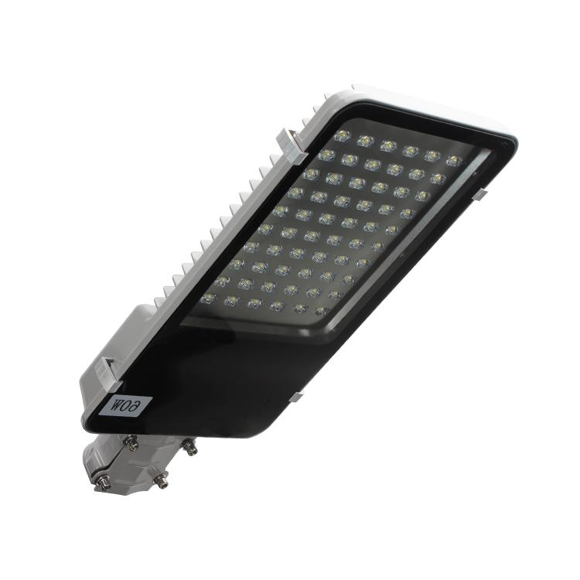
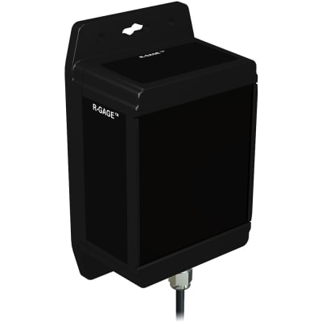
Conclusion
Real world applications
Full system
Wireless communication between modules
Larger range detection
Differentiate between detected target (vehicle or pedestrian)
Mounted solar panels
Smaller battery per light
100 Watt 240V LED street light
Q120RA-US-AF2Q
(40 m range, cost $2,100)

Slide 30
Questions?

