Slide 1
Team 70: Air Guitar Gloves
Akshay Ivatury, Bobby Zhang, Brian Tsai

Slide 2
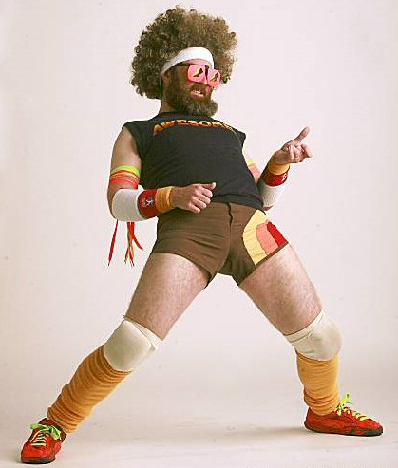
Inspiration
Gloves that simulate playing a guitar to an extent, with less hassle and difficulty

Slide 3
Objectives
Portability
No use of cameras, laptops, or other hardware
Full-sized guitars are bulky and unwieldy for travel
Accessibility
Easier to learn than guitar
Table of gesture chord mappings

Slide 4
High Level Goals
The gloves should be able to play any combination of strings.
The gloves can operate for 2 hours without being recharged
Gloves will include major and minor variations of the C, A, G, E, and D chords

Slide 5
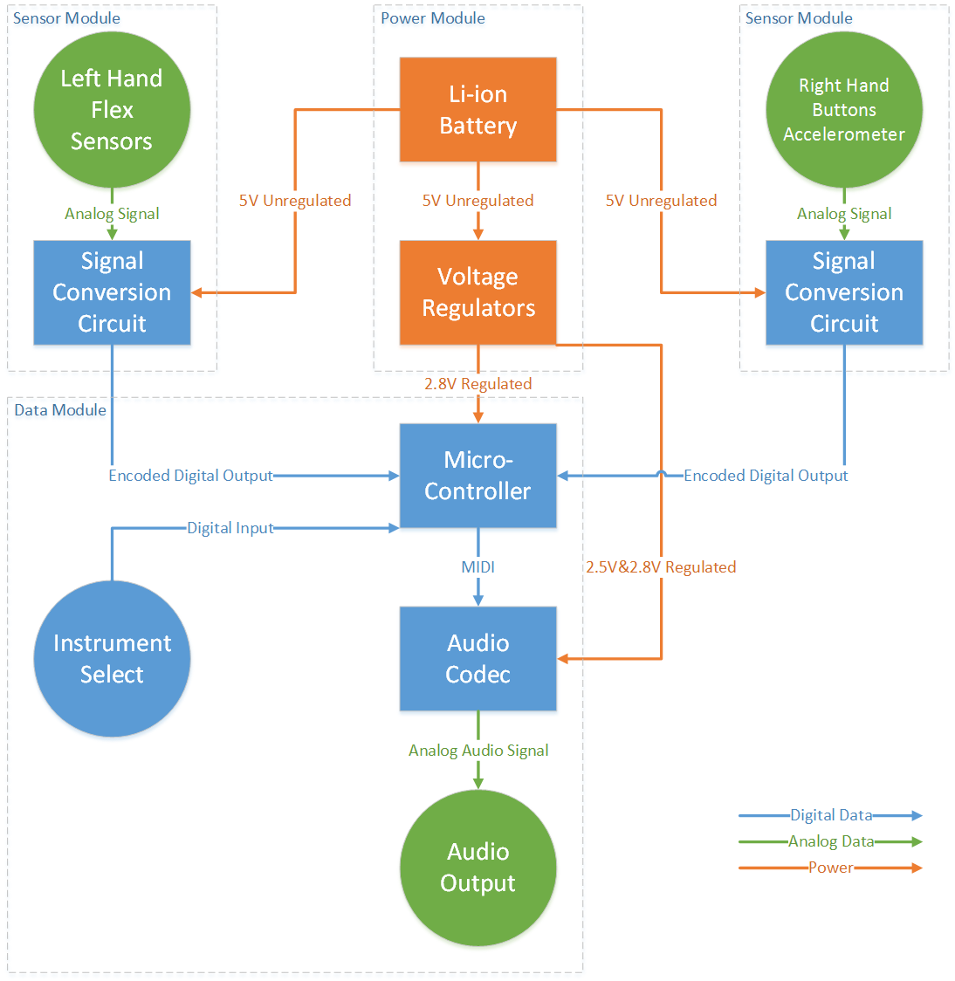
Block Diagram

Slide 6
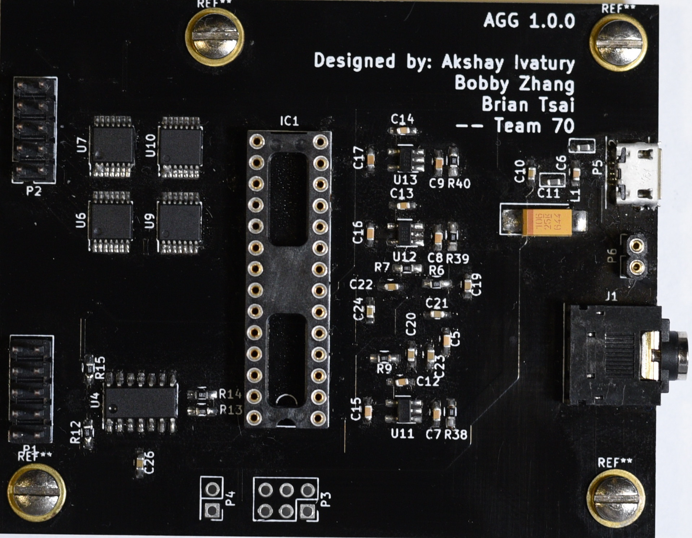
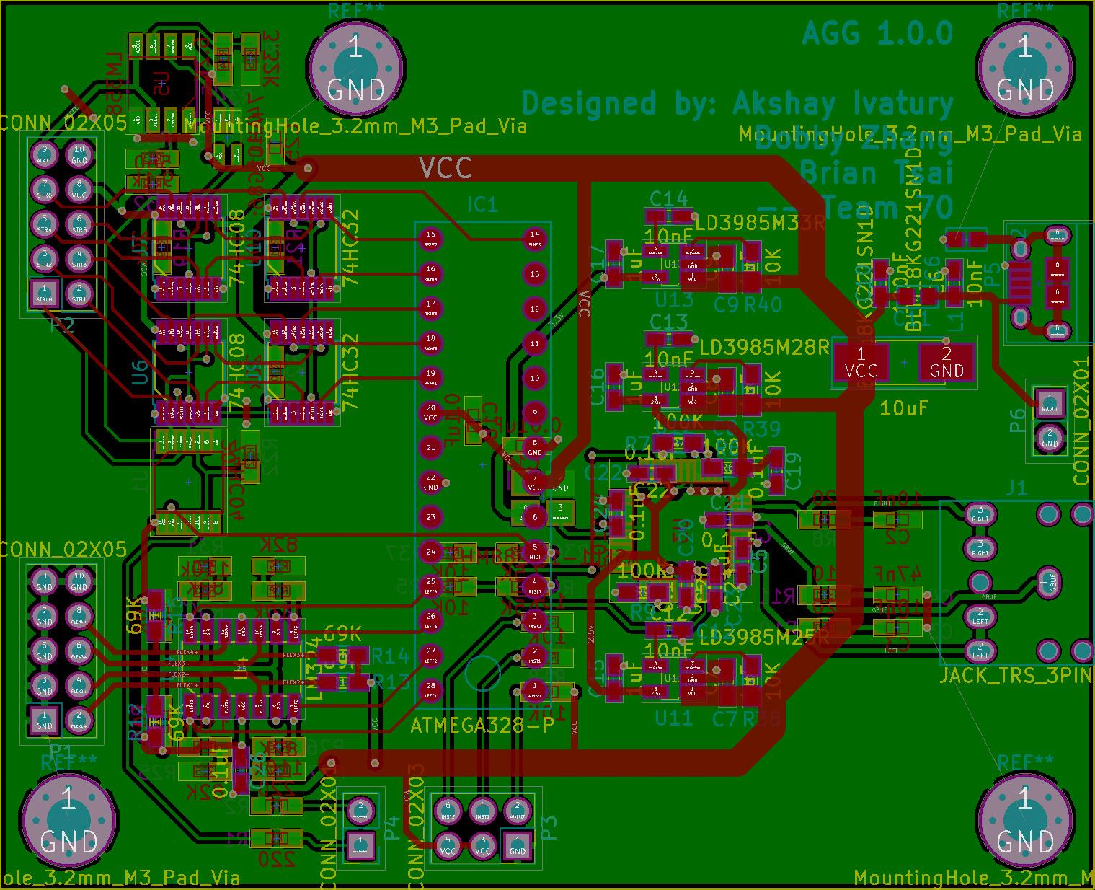
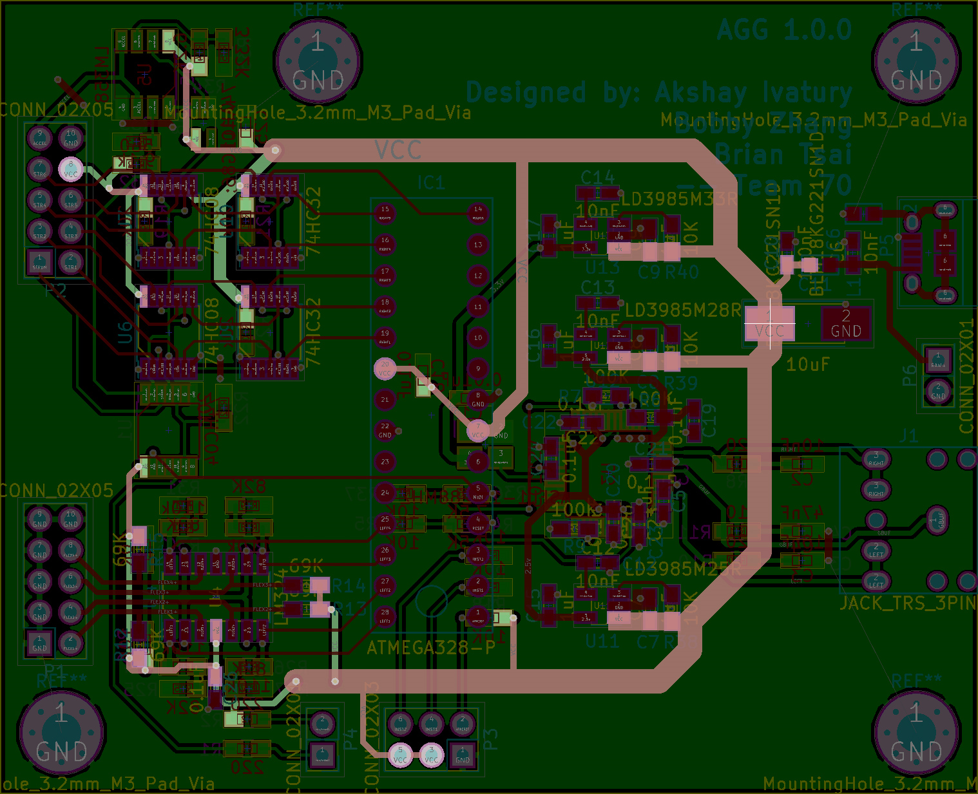
PCB

Slide 7
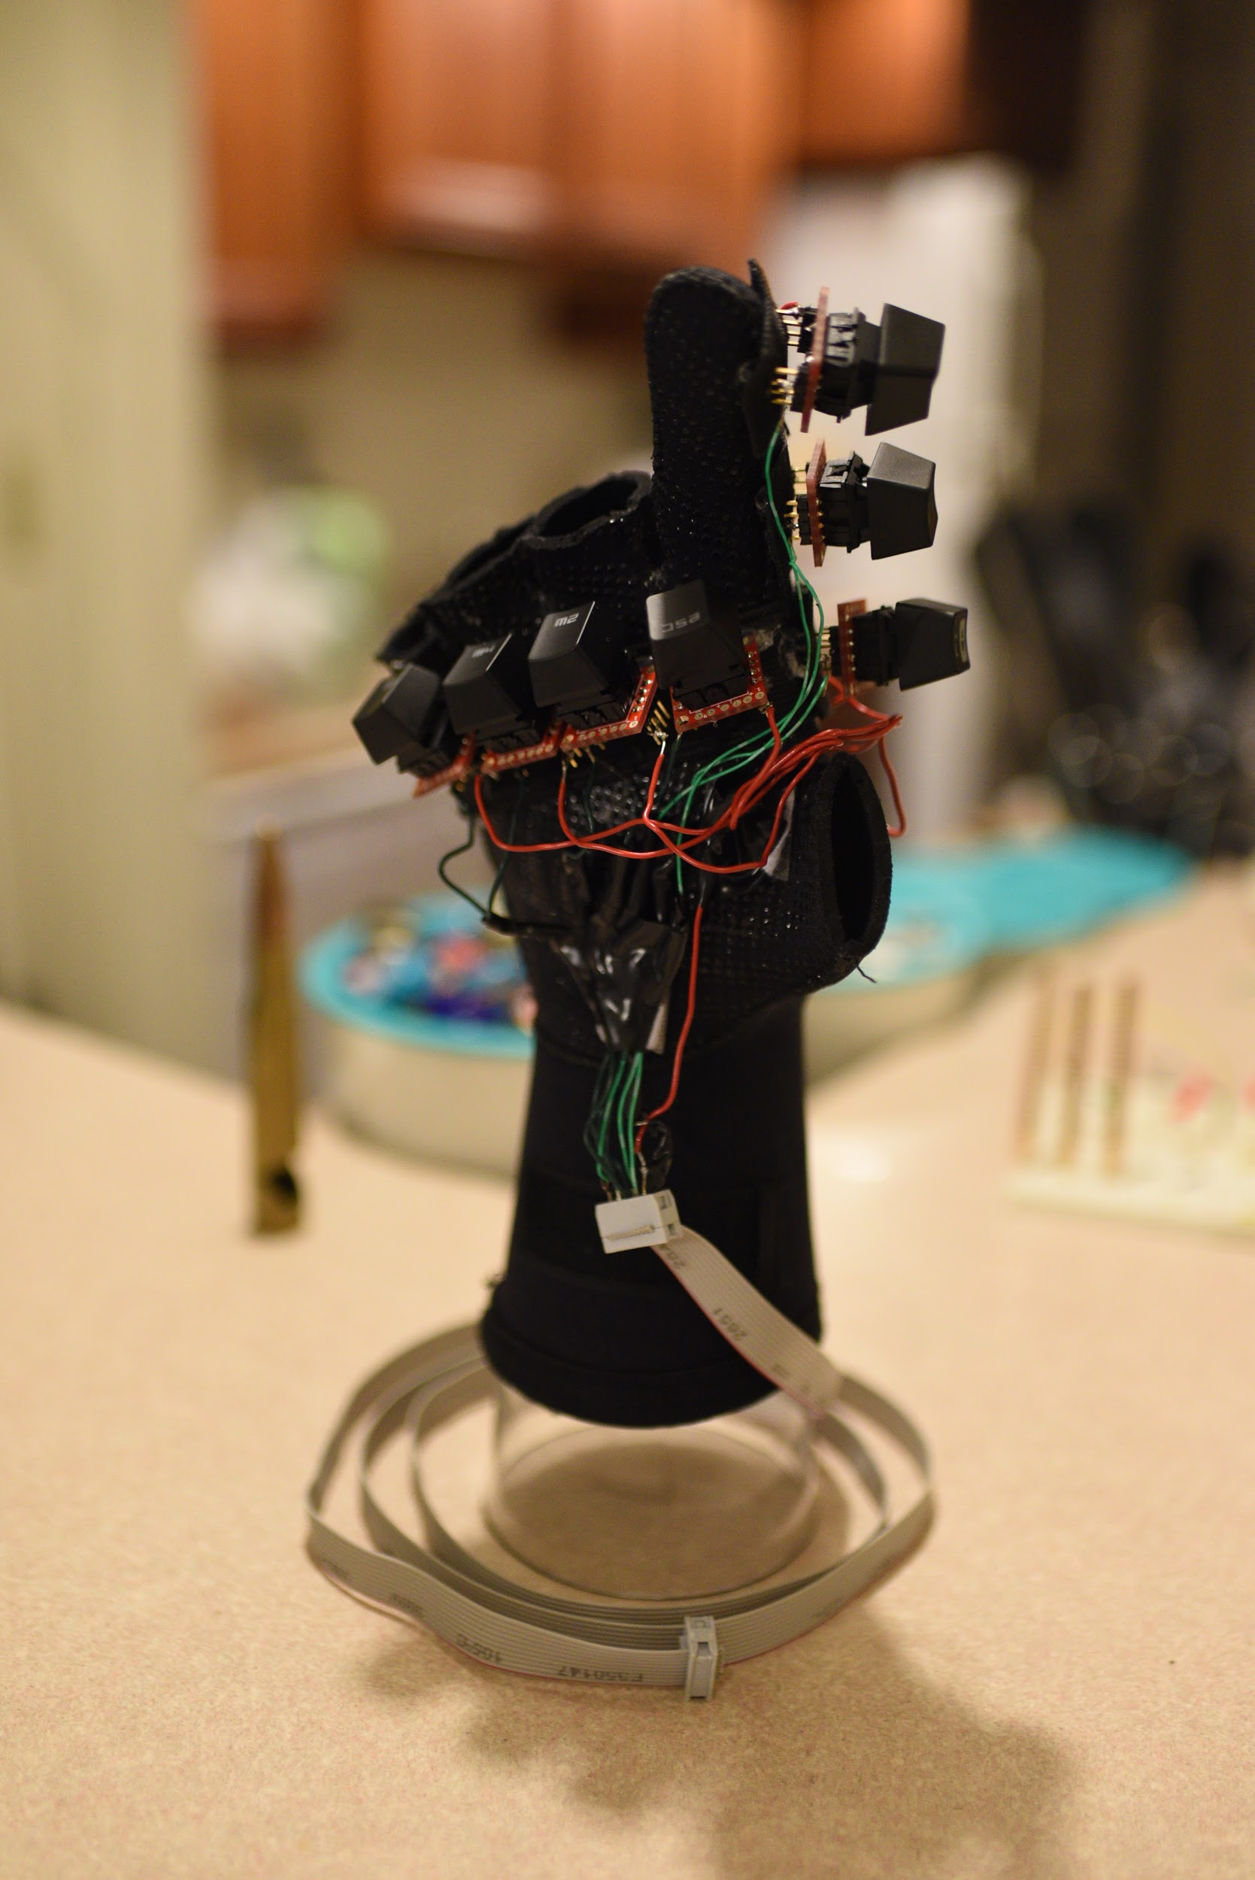
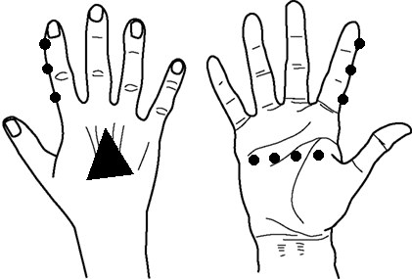
Right Hand
Sensor Module
Mechanical Switches
Accelerometer
Notes:
Explain what all the hardware is for (mechanical switches correlate to each string as well as an extra strum switch, accelerometer for up and down sensing)
Say that there are 6 outputs from the RHSM (1 for each string on a guitar) that are sent to the microcontroller
END SLIDE WITH ACCELEROMETER IS USED FOR UP AND DOWN SENSING

Slide 8
Accelerometer Calculations
Output at 0 g’s of acceleration:
V_{out} (0) = ½ * V_{supply}
= 2.5 Volts as our supply is 5V
Sensitivity = 1.33 V/g:
V_{out} = (Acceleration * Sensitivity) + V_{out}(0) Volts
Resting Output (Including Gravity) and Thresholds:
V_{resting} = 3.6V, Lower Threshold = 2.7V, Upper Threshold = 4.3V
Notes:
Discuss default 0 acceleration output, how sensitivity plays into the voltage, and why our resting voltage is not 2.5V due to gravity. Comparators output
The thresholds convert our analog accelerometer data into digital logic values for the STRUM SWITCH LOGIC (TRANSITIONS)

Slide 9
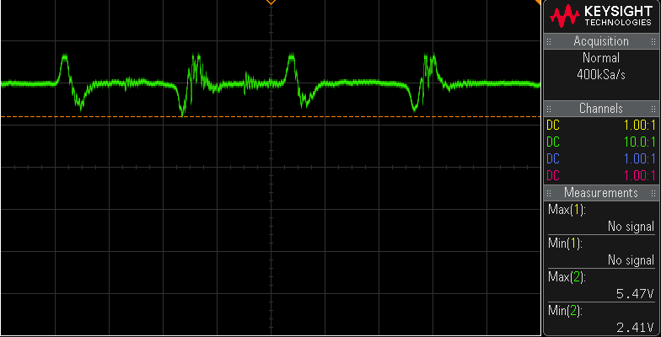
Accelerometer Output Waveform

Slide 10
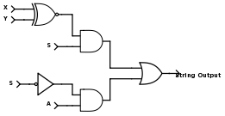
Strum Switch Logic
X and Y: accelerometer thresholds
S: strum switch
A: string switch
String Output: bit sent to microcontroller
Boolean Logic
of Each String
Notes:
Discuss holding strum switch takes accelerometer and released strum switch takes string switches

Slide 11
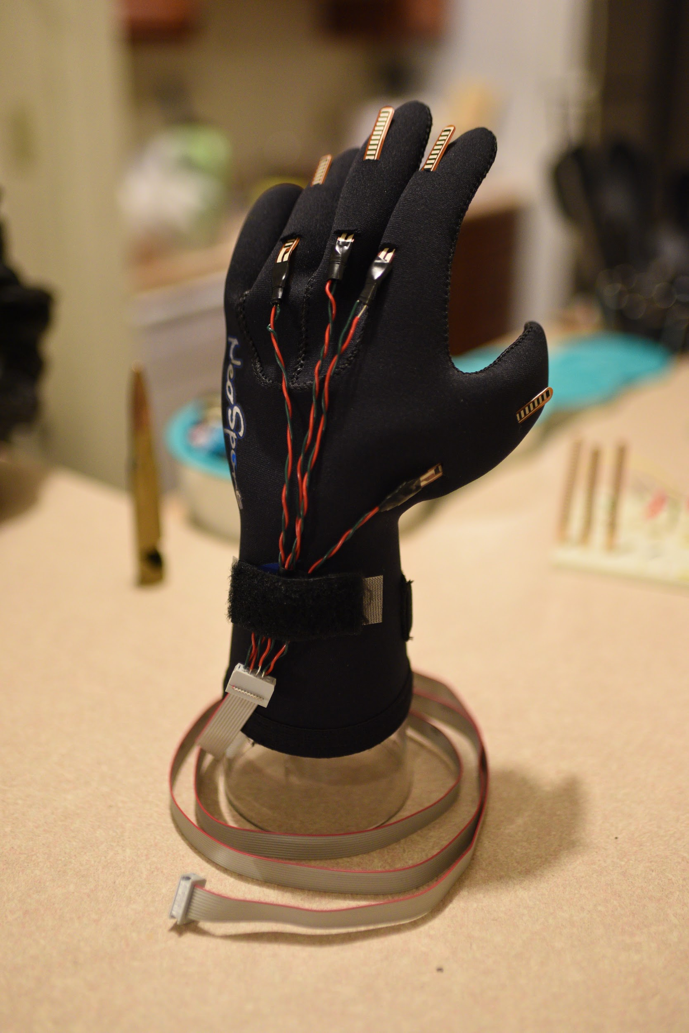
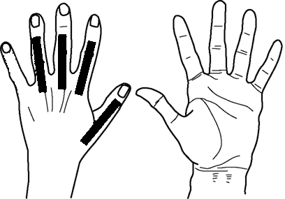
Left Hand
Sensor Module
Flex Sensors
Notes:
LHSM has 4 output bits that are sent to the microcontroller, 1 for each flex sensor
Used to select what chord is chosen
Can see that each flex sensor was connected to wires and then to ribbon cables

Slide 12
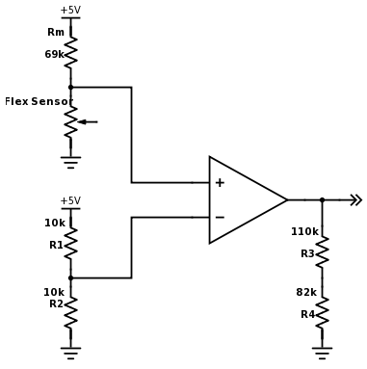
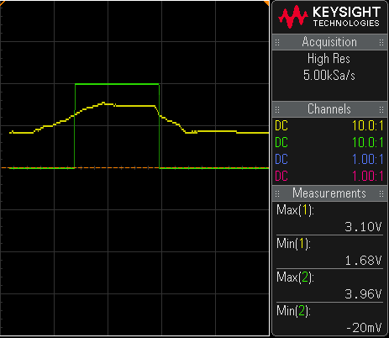
Flex Sensors
Flat to Bent
PUT IMAGE OF VOLTAGE OUTPUT HERE
Flex Sensor Comparator
Notes:
Flex sensors had a varying flat resistance of 25k to 35k
When bending, the resistance rises from 30k to 70k, causing the voltage divider output to change from 1.5V to 3V
The circuit shown on the right uses 2.5V as the comparative voltage and converts the voltage from the flex sensor’s voltage divider into digital logic values

Slide 13
Flex Sensor Functionality
30 degree bend
5 sets of chords: C, A, G, E, and D
Major
Minor
Miscellaneous
Notes:
Digital logic value should flip at a 60 degree bend of the finger roughly
4 outputs gives us a range of 16 chords and we chose 5 sets of chords with 3 variations

Slide 14
Microcontroller Overview
Takes in left and right hand inputs
Outputs corresponding MIDI values

Slide 15
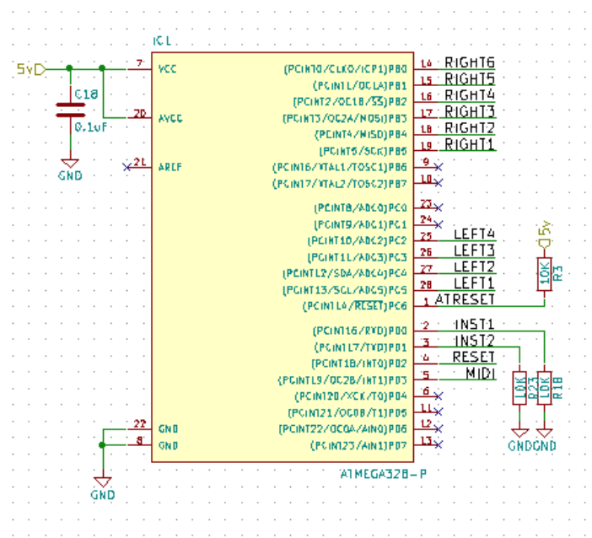
Microcontroller
Schematic

Slide 16
Microcontroller factors
Internal speed of the microcontroller
Talking to the audio codec chip
Speed of reading inputs

Slide 17
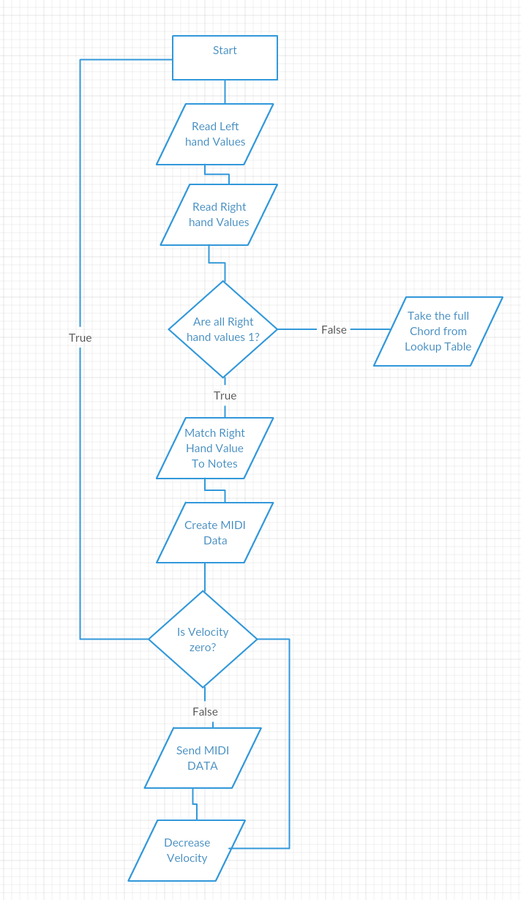
High Level Algorithm
MIDI Protocol
Attack Velocity
Channel
Command
Note

Slide 18
Future Microcontroller Considerations
Only used about 44% of available flash memory
Providing a Faster internal clock

Slide 19
Audio Codec Chip
Takes in MIDI values
Outputs Analog Signal

Slide 20
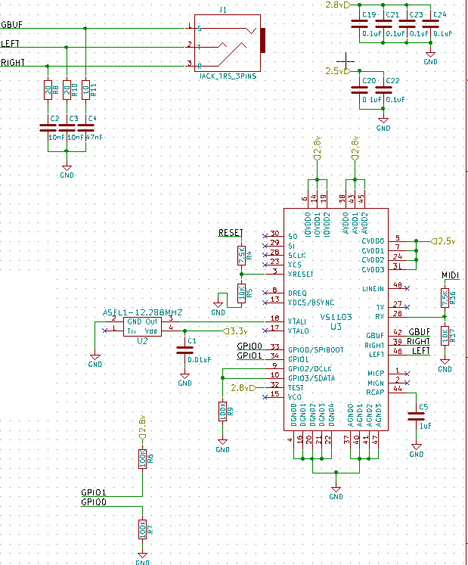
Audio Codec Schematic

Slide 21
Issues
We were not able to connect the accelerometer due to connectivity issues
We were not able to properly port code to the atmega

Slide 23
Conclusion
Future Work:
Add a MIDI data output for connection to other MIDI synthesizers
Allow for more instrument options
More variations of guitar
Other string instruments

Slide 24
Questions
?

