Slide 1
ECE 445: The Automated Closet
Team 13: Shania Arora, William Doherty, Nikhil Parmar
TA: Enliang (Jack) Li
Fall 2019
Notes:
Billy

Slide 2
Team Members
Shania Arora
Nikhil Parmar
Billy Doherty

Slide 3
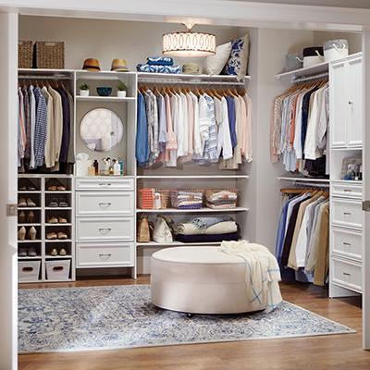
Problem Overview
Choosing an outfit is a part of everyone’s daily routine
The average American can spend up to 17 minutes every day deciding what to wear¹
Currently no automation to the process
Notes:
Shania

Slide 4
Our Solution
Automated closet that looks up the weather using the user’s location
Outfit based on color, weather, and fit
Notes:
Shania

Slide 5
High Level Requirements
The closet connects to a database and can pull information on current weather and about clothing in the closet
The closet suggests an outfit to the user
The closet spins with all the clothes in the system and is able to track the position of clothes that are input into the system by the user
Notes:
Shania

Slide 6
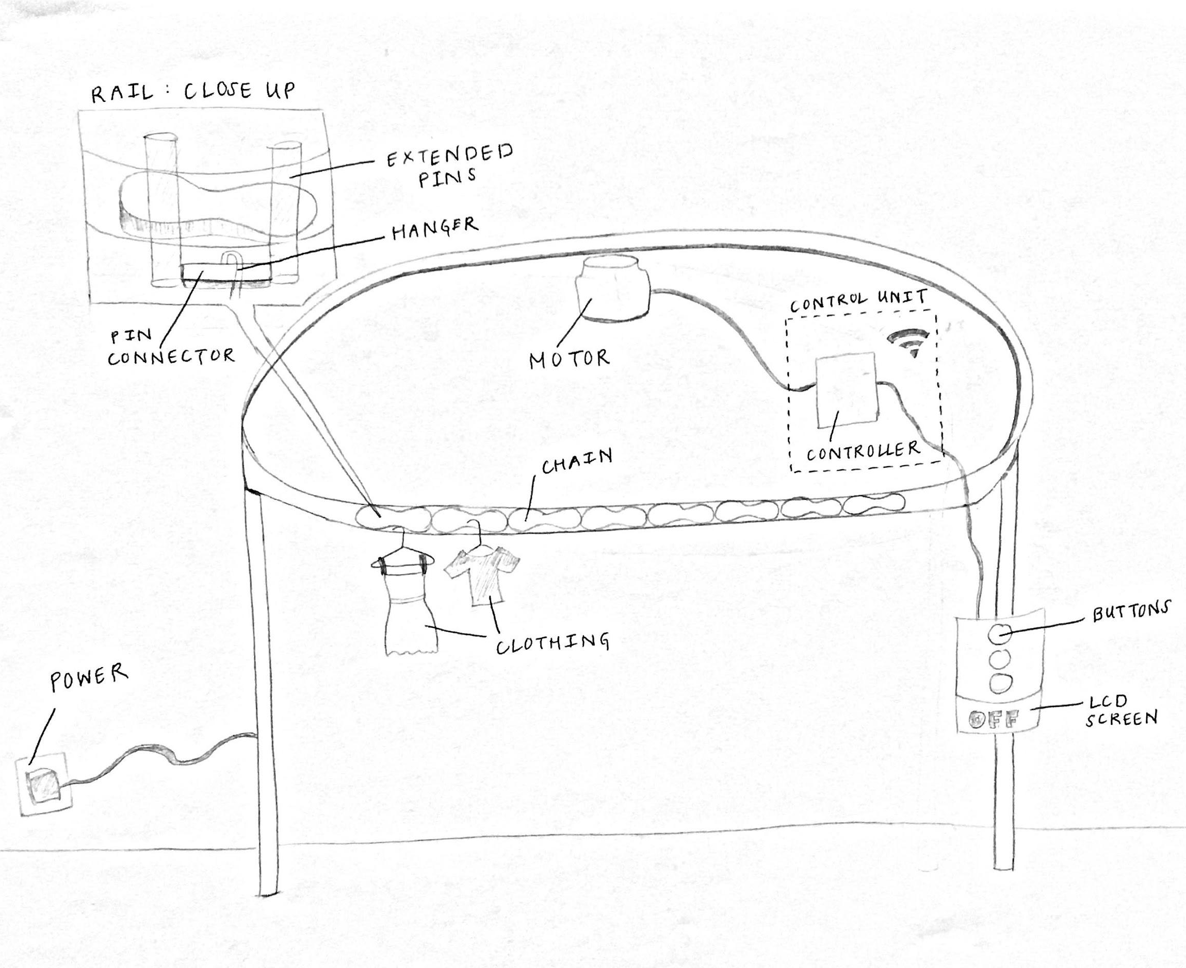
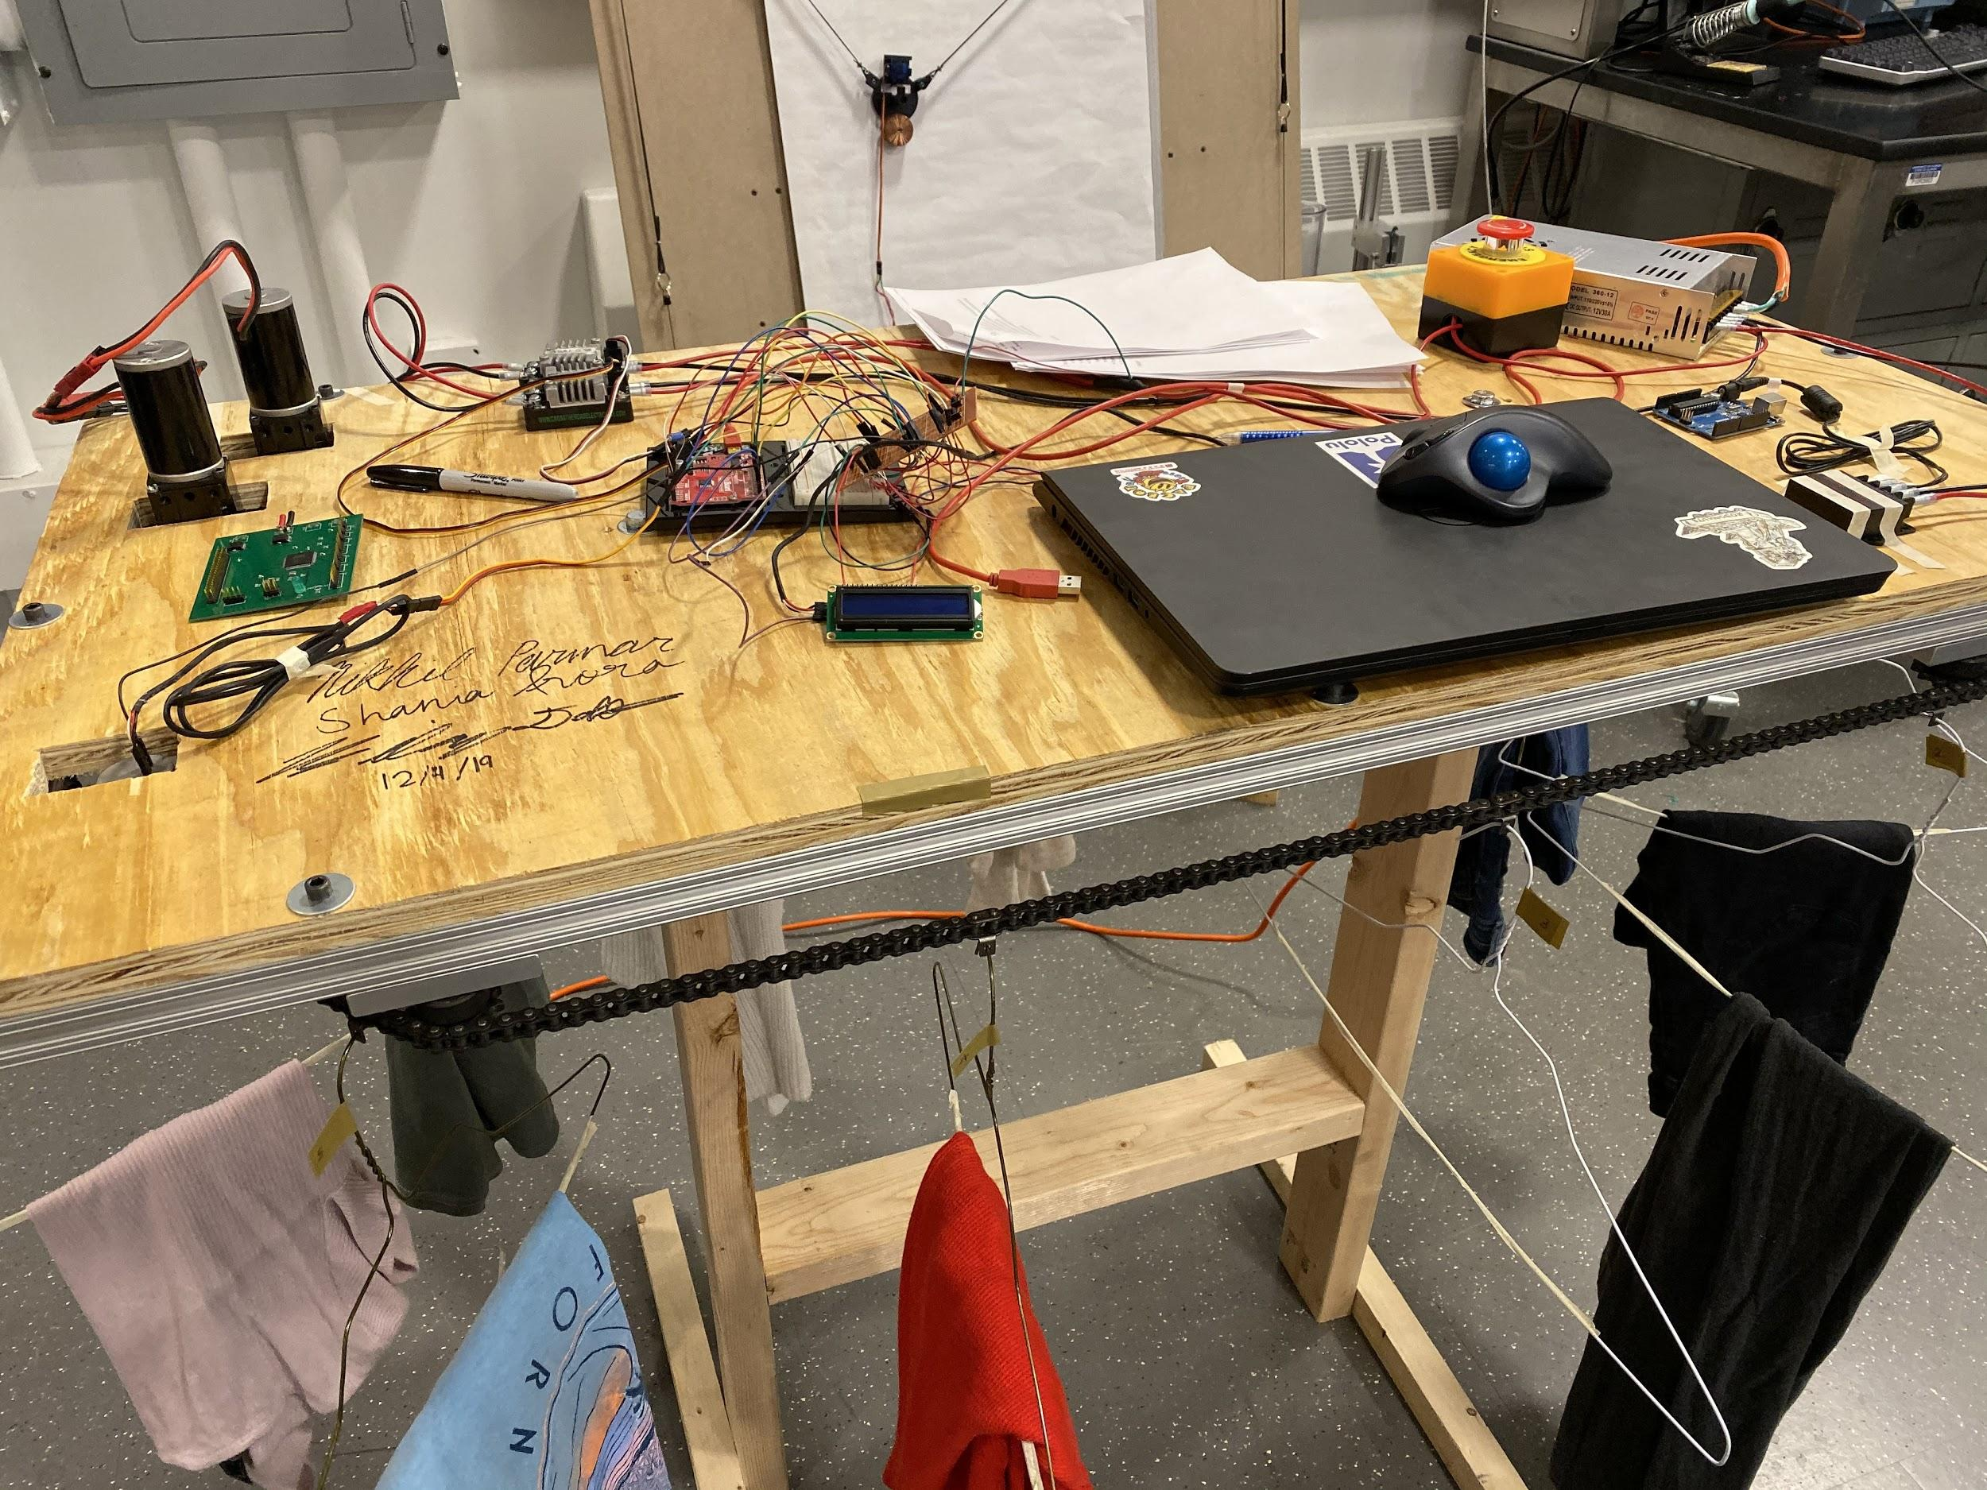
The Closet
Visual Aid
Final Project
Notes:
Nikhil

Slide 7
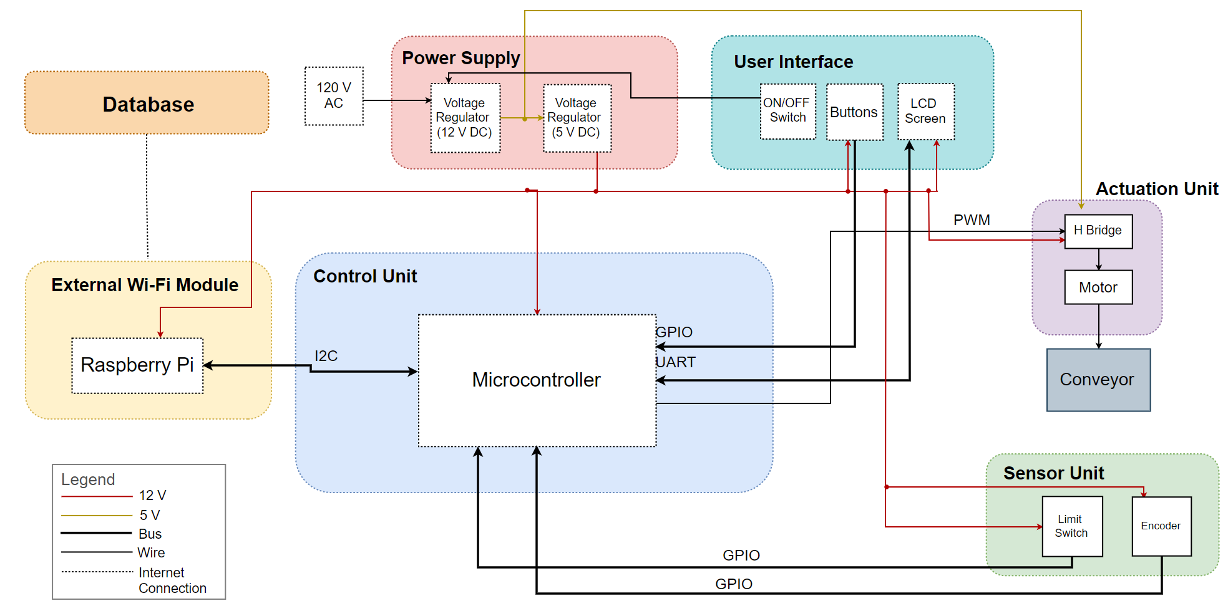
Design

Slide 8
R&V - Control Unit
Control Unit Requirements | Control Unit Verification
Must be able to read input to and send output from a Raspberry Pi so devices can communicate information | Connect Raspberry Pi to Control Unit and send a serial message from the Raspberry Pi and see if we can read the serial message on the control unit
Must be able to send a PWM signal to motor controllers to move closet at an appropriate speed | Command a known PWM signal frequency and duty cycle, and measure the output with an oscilloscope to ensure the output meets expectations
Can make closet stop at a specific index | Spin encoder a measured distance, use response from callback functions to ensure no counts were missed.

Slide 9
R&V - Actuation Unit
Actuation Unit Requirement | Actuation Unit Verification
Produce a voltage anywhere from -12V - 12V, which is the operating range for our motors | Attach a multimeter to the output of the motor controller and gradually change the commanded output from -12V to 12V. Ensure that output meets these levels and that behavior is linear.
Supply at least 6A, the current required to move the closet with appropriate force | Attach a resistor at the output of the motor controller and use a multimeter to measure current through the circuit without the motor attached. The motor controller should be able to handle a current of 6A.
Move a load of 20 lbs at at least 4 in/sec | Attach a 20lb weight to the output shaft of the motor and wind it upwards, attaching a winch drum that accounts for any reductions added after the gearboxes. We will use a timer to measure the time it takes to move the weight a predetermined distance to check for speed

Slide 10
R&V - Sensor Unit
Sensor Unit Requirement | Sensor Unit Verification
Hanger index must be able to be calculated using the encoder position. | Spin the closet system one hanger index at a time.
Control unit must be able to determine the magnitude and direction of the speed of the closet system. | Attach encoder output pins to oscilloscope and turn in both directions. Ensure that both pins produce a visible output and reverse their phase when the encoder is turned the opposite direction.

Slide 11
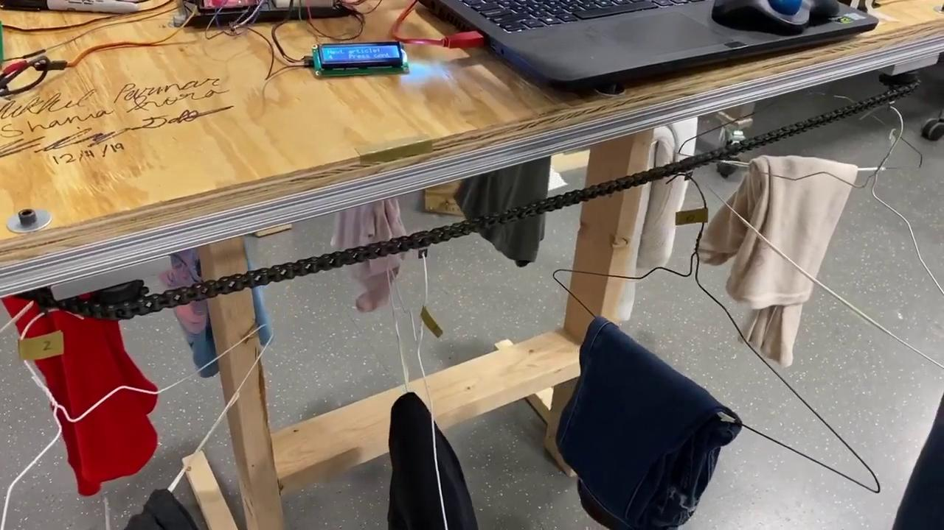

Slide 12
Decision Making - Clothing Type
Continued
Continued

Slide 13
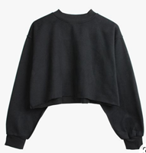
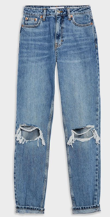
Decision Making - Outfit Recommendation
Weather - Clothes filtered according to weather
Color
Light, medium, dark washed jeans → pastel, patterned, neutral, hot, or cold colored tops
Odd colored/patterned bottoms → neutral colored tops
Fit
Relaxed bottoms: normal or tight fit top
Normal bottoms: relaxed or tight fit top
Tight bottoms: relaxed or normal fit top

Slide 14
Ethics and Safety
Emergency Stop
Filed down edges
Intentionally Slow Motion
Privacy
Notes:
The average human reaction time is between 150 ms - 200 ms [5] which means our system will give the user a lot of time to act in case there is an issue (i.e. something gets caught, clothing item slips off hanger, etc.)

Slide 15
Conclusion
Project was fully functional
All high-level requirements met

Slide 16
Future Work
Make an external database
Move Raspberry Pi functionality → PCB
User able to choose an outfit again if they do not like it
Program the user’s style preferences into the system

Slide 17
Questions?

Slide 18
Citations
[1] The Daily Mail Online. (2016). Women spend SIX MONTHS of their working lives deciding what to wear. [online] Available at: https://www.dailymail.co.uk/femail/article-3626069/Women-spend-SIX-MONTHS-working-lives-deciding-wear.html [Accessed 8 Dec. 2019].
[2] “ Mom Jean,” American Eagle Outfitters. [Online]. Available: https://www.ae.com/us/en/p/women/mom-jeans/mom-jeans/mom-jean/0436_2202_961?ip=off&cid=PLA_AE_NonBrand_Womens_Jeans_Mom&gclid=CjwKCAiA27LvBRB0EiwAPc8XWXrEa_neMrHWZOqzymBFB4K5nGCk7JbOeyTMlWsJRD-4AzKbstyipRoCBDcQAvD_BwE. [Accessed: 09-Dec-2019].
[3] “Mock Turtleneck Top - Black -: H&M US,” H&M. [Online]. Available: https://www2.hm.com/en_us/productpage.0678983002.html. [Accessed: 09-Dec-2019].
[4] “Walk-In Closet Ideas,” The Home Depot. [Online]. Available: https://www.homedepot.com/c/ai/walk-in-closet-ideas/9ba683603be9fa5395fab9004d71be1. [Accessed: 09-Dec-2019].
[5] K. Amano, N. Goda, S. Nishida, Y. Ejima, T. Takeda, and Y. Ohtani, “Estimation of the Timing of Human Visual Perception from Magnetoencephalography,” The Journal of Neuroscience, Apr. 2006. [Accessed 8 Dec. 2019].

Slide 19
R&V - Power Supply Module
Power Supply Requirements | Power Supply Verification
The first regulator must be able to provide up to 10A of continuous current | Attach a resistor at the output of each regulator and use a multimeter to measure current through the circuit when skipping over downstream components. The first regulator should be able to handle a current of 10A. The second should be able to handle a current of 4A.
The second regulator must be able to handle current draws of 4A.

Slide 20
R&V - External Wi-Fi Module
External Wi-Fi Requirements | External Wi-Fi Verification
Must be able to talk to control unit. | See Verification A for Control unit
Must be able to fetch information from weather API | Ping openweathermap.org and check for a valid response
Must be able to connect to a system that stores information about the clothing | See “Database” for verification process

Slide 21
R&V - UI Module
Control Unit Requirements | Control Unit Verification
Must be able to read input to and send output from a Raspberry Pi | Connect Raspberry Pi to Control Unit and send a serial message from the Raspberry Pi and see if we can read the serial message on the control unit
Must be able to send a PWM signal to move closet at an appropriate speed | Command a known PWM signal frequency and duty cycle, and measure the output with an oscilloscope to ensure the output meets expectations
Can make closet stop at a specific index | Spin encoder a measured distance, use response from callback functions to ensure no counts were missed.

Slide 22
R&V - Database Module
Database Requirements | Database Verification
Must be able to store information and send it to the External Wi-Fi module when queried. | Set up a fake database and see if we can query it from the External Wi-Fi module using the Firebase API (or a textfile as mentioned by David Null).

