Slide 1
ECE 445 Project
Digitizing the Restaurant Experience
Aman Kishore (amank2@illinois.edu), Jun Woo Seo (jseo35@illinois.edu), Patrick Moore (ptmoore2@illinois.edu)

Slide 2
Introduction
Digitizing the Restaurant Experience with Neil Miask
Junwoo Seo
Patrick Moore
Aman Kishore

Slide 3
Features
A web platform to virtually manage status of tables
A physical tool to adjust the status of a particular table
A physical authentication tool (RFID key)
Certain changes can be made without authentication

Slide 4
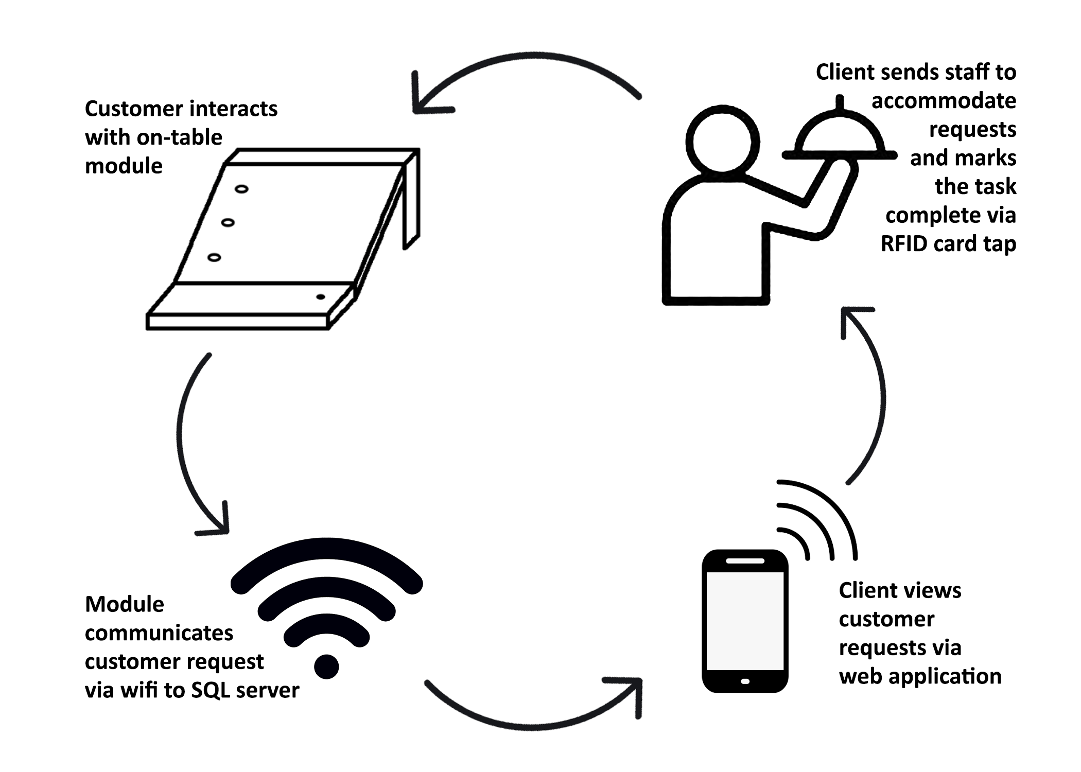
System Overview
Notes:
Aman

Slide 5
Subsystems for Hardware
Power Subsystem
Voltage regulator
Li-po Battery
Control Unit
Microcontroller
I/O Interface
Buttons
LEDs
RFID Module

Slide 6
Subsystems for Software
Database
Restaurant, Table, Menu File
Client & User
Google Cloud Platform, Heroku, and Netlify
Application
Table Dashboard
Menu
Analytics

Slide 7
High Level Requirements
Module Name | High Level Requirement | Points
Power subsystem | Provides power to RFID and Microcontroller | 5
RFID Reader/tag | Receives the data by tagging, then transfers to microcontroller LEDs indicates the proper RFID tag | 15
Client Module | The web application properly fetch within 1.5s from the SQL tables The web application properly fetch within 400ms from the SQL tables The web app properly refreshes when in dashboard view within 15 seconds after SQL table is updated Be able to update table status via the web platform Allow User to order from Menu (which is updated based on current restaurant) and keep track of total order Enable multiple user functionality Add statistics analysis that shows that keeps track of multiple statistics per table | 20
Microcontroller | Sends table status update to the server when the button is pressed Clears table status when correct RFID is scanned | 10
 | Total | 50

Slide 8
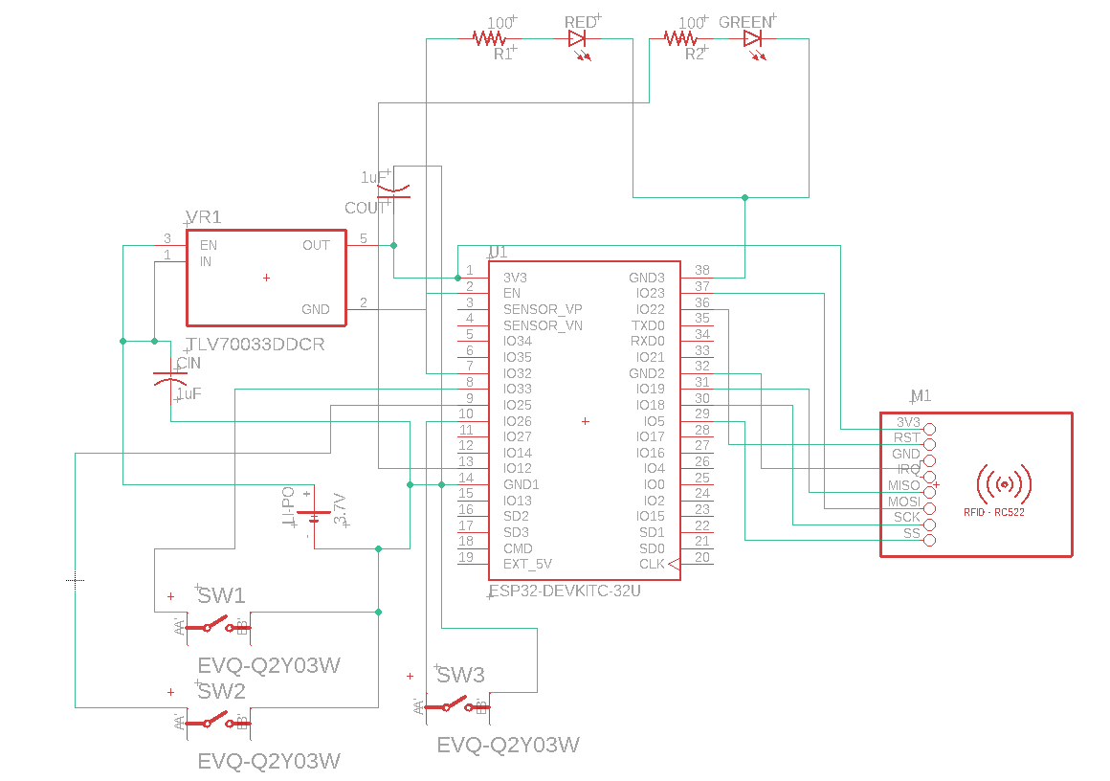
Circuit Schematic
Notes:
SPI for ESP32 - RC522
GPIO (General Purpose Input/Output) for buttons and LEDs

Slide 9
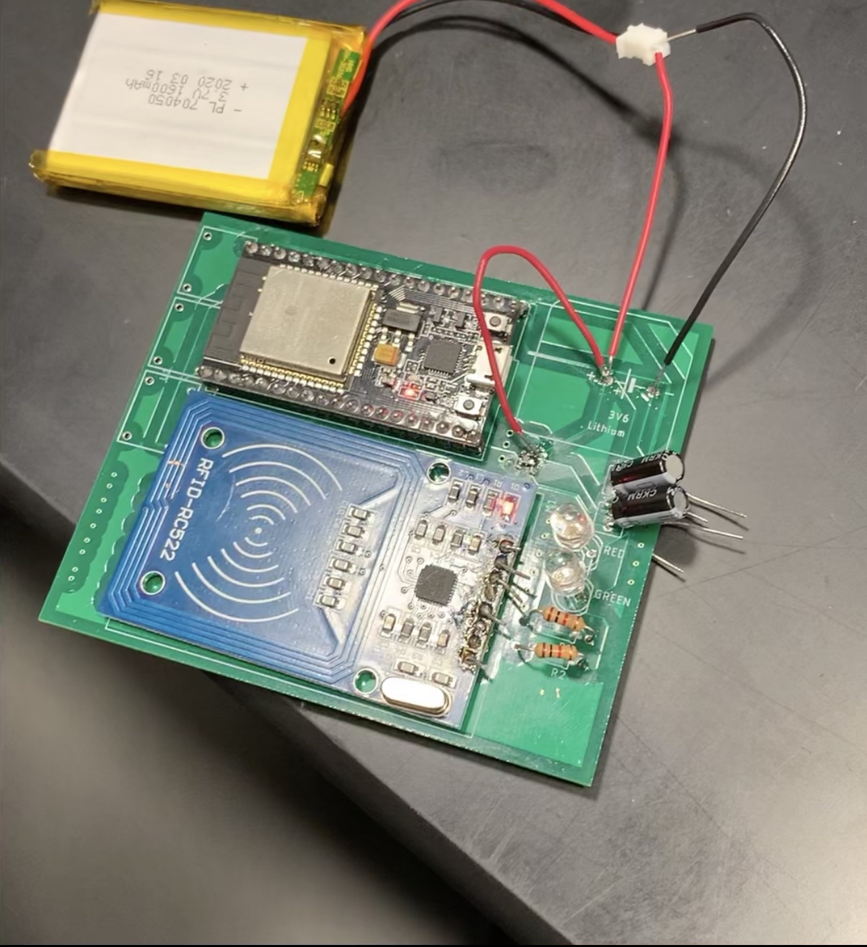
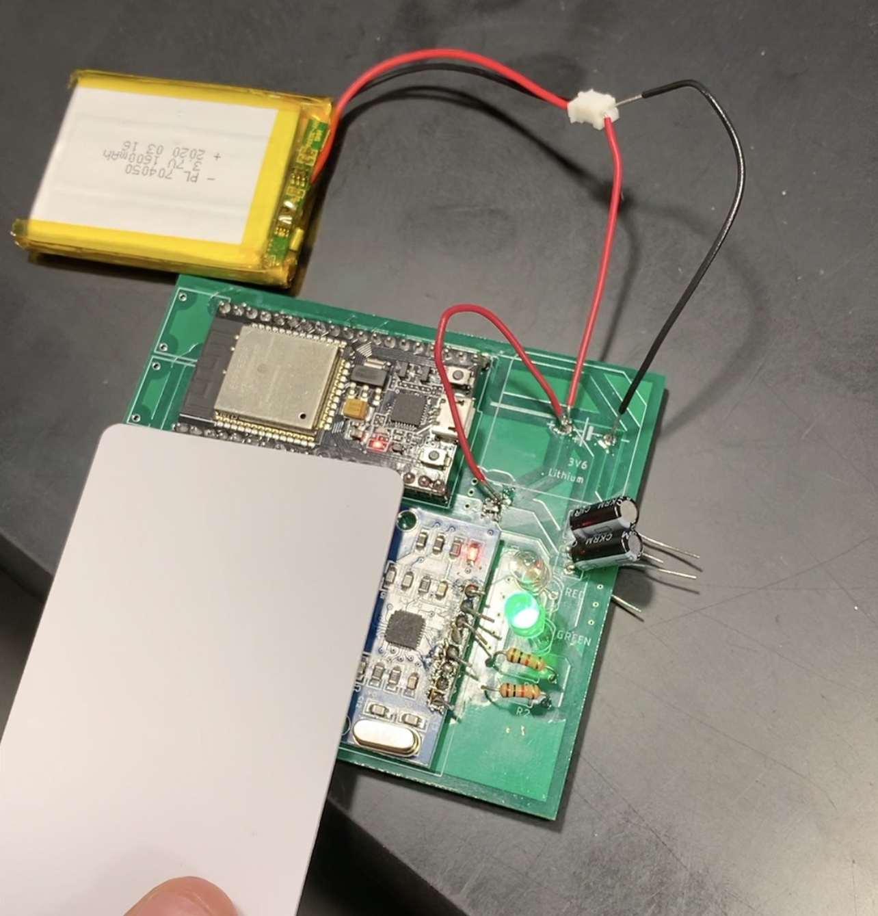
Power Subsystem
Provides power to RFID and Microcontroller
li-po
battery
Voltage Regulator

Slide 10
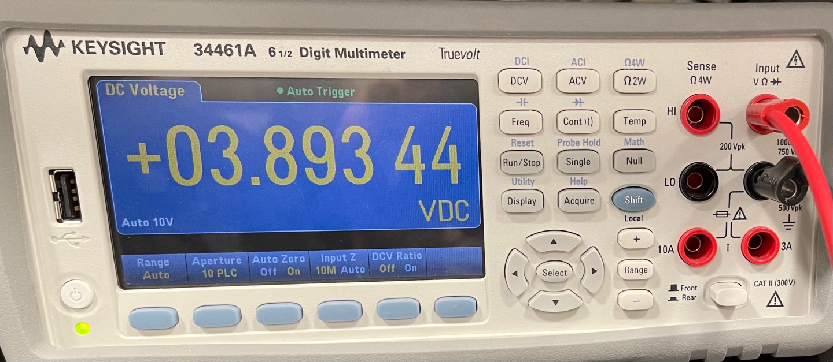
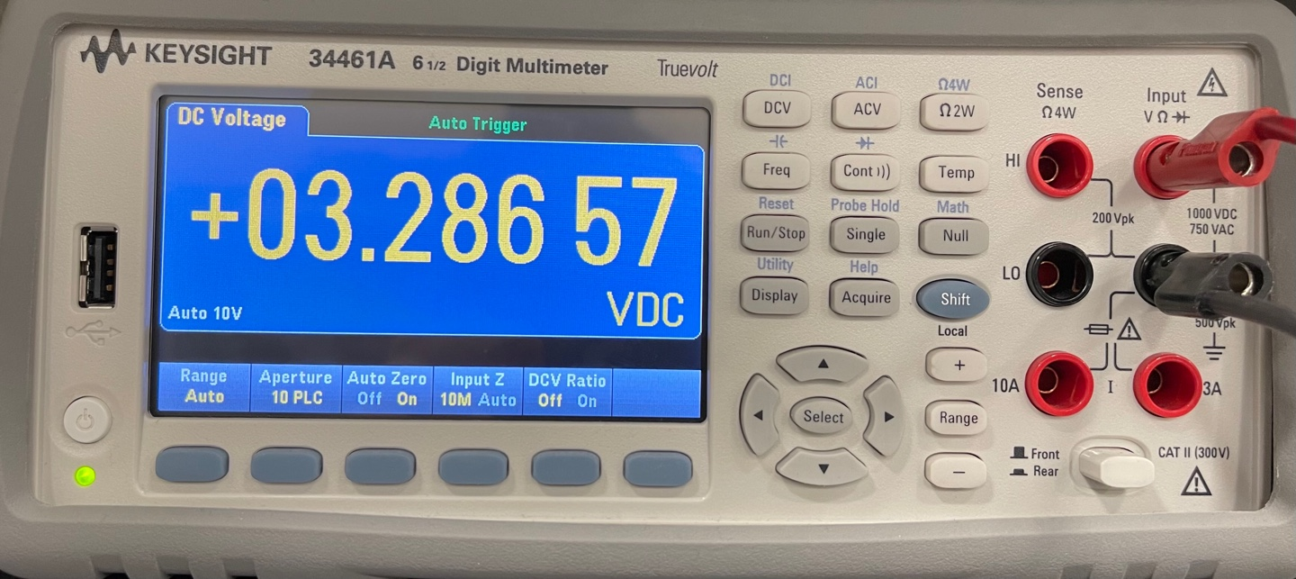
RV for Power Subsystem
Output Voltage of Battery: 3.7V +- 10%
Output Voltage of Voltage Regulator: 3.3V +- 10%

Slide 11
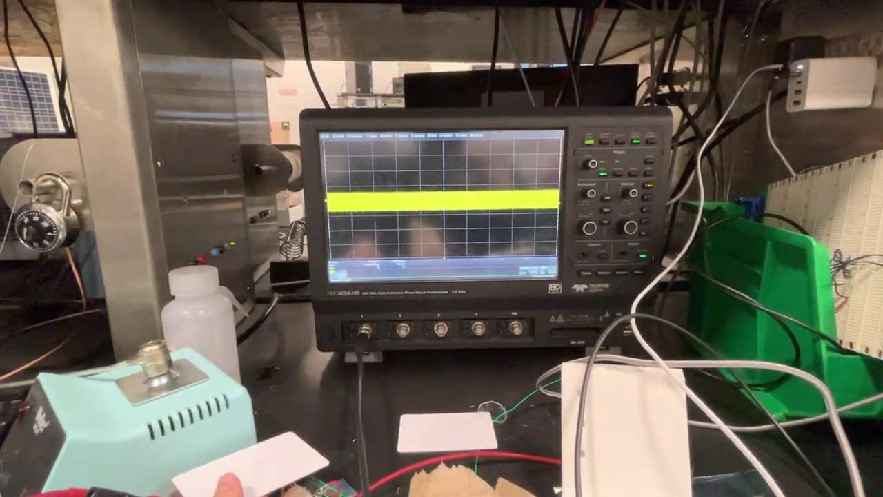
RV for RFID Subsystem
Operating Frequency: 13.56MHz

Slide 12
Data Tables - Client & User

Slide 13
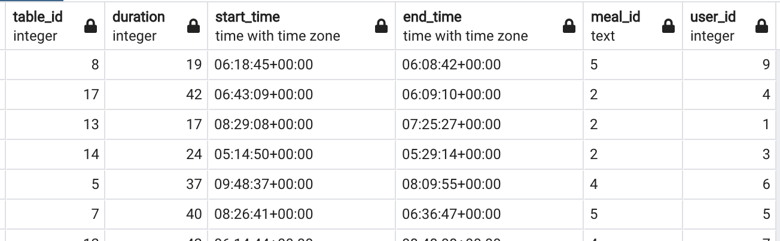
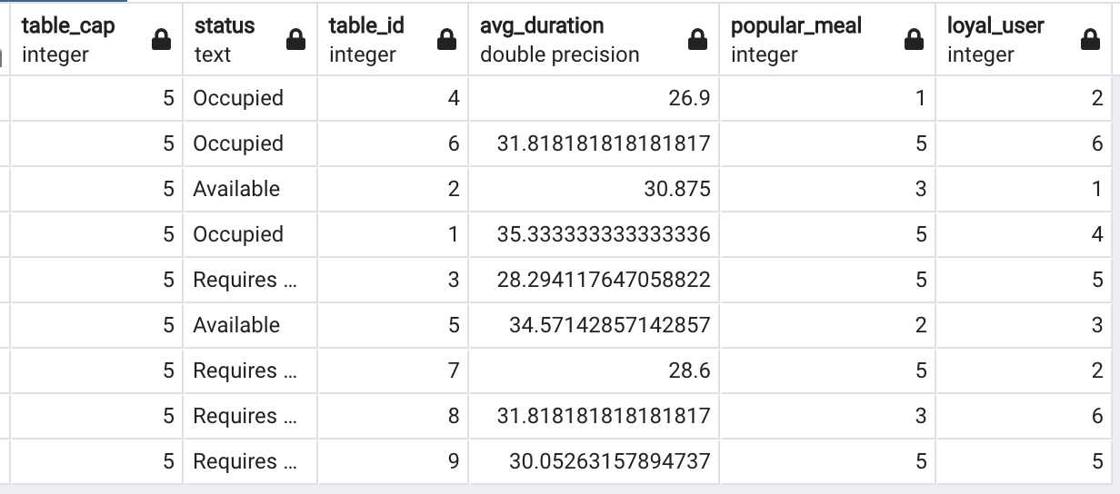
Data Tables - Menu, Restaurant, Table File

Slide 14
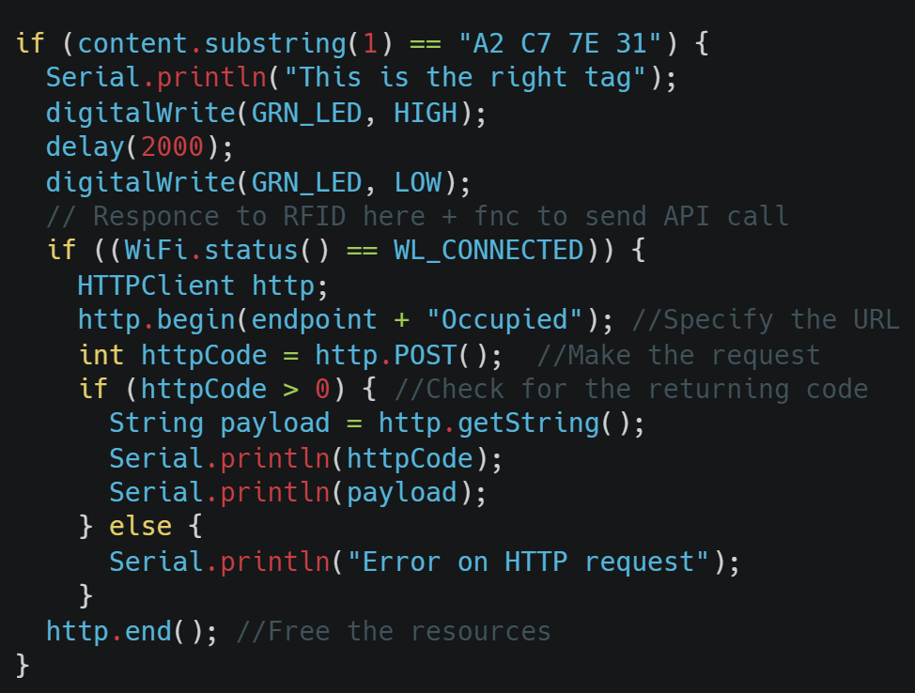
RFID Subsystem
Hadeware code

Slide 15
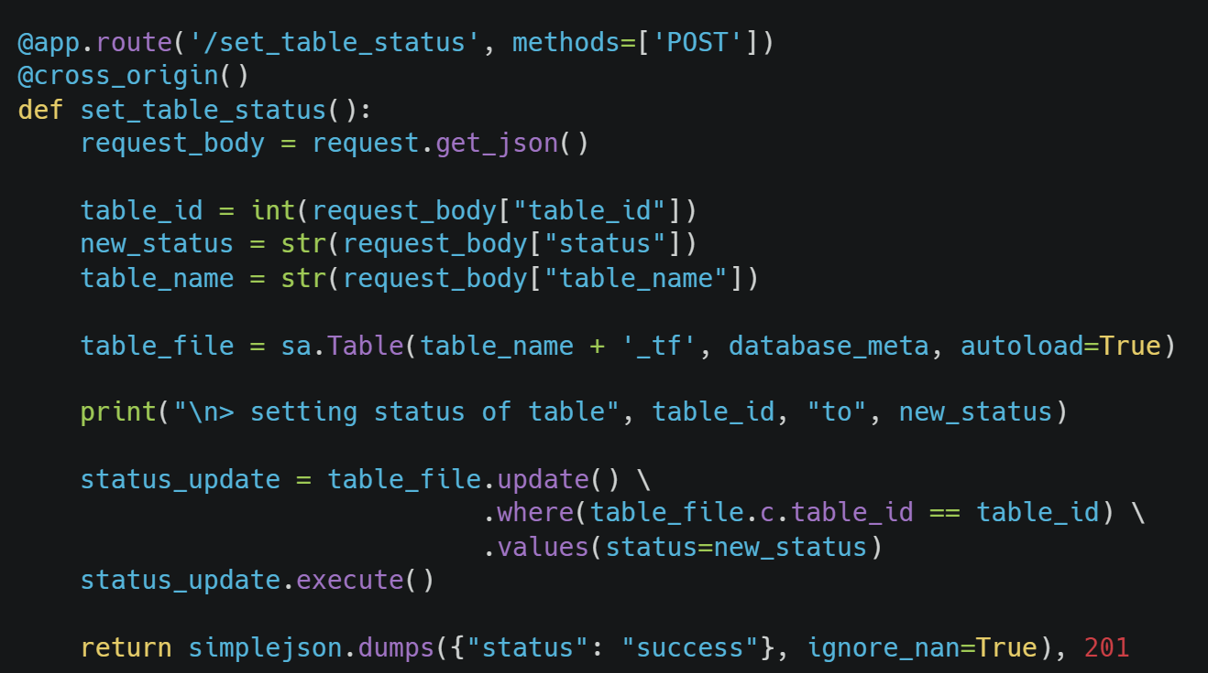
RFID Subsystem
The API Call

Slide 16
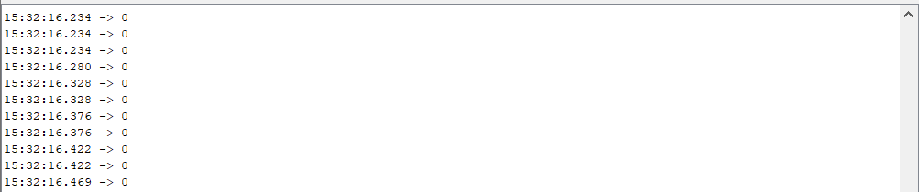
I/O Interface - Buttons
Serial Out: No contact
Serial Out: Pressed

Slide 17
I/O Interface - Buttons
Solution:

Slide 18
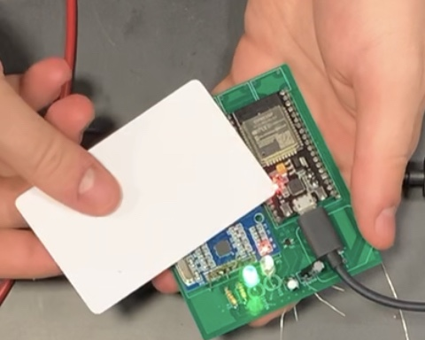
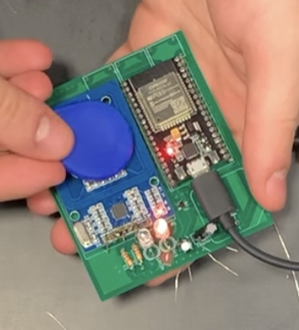
I/O Interface - LEDs

Slide 19
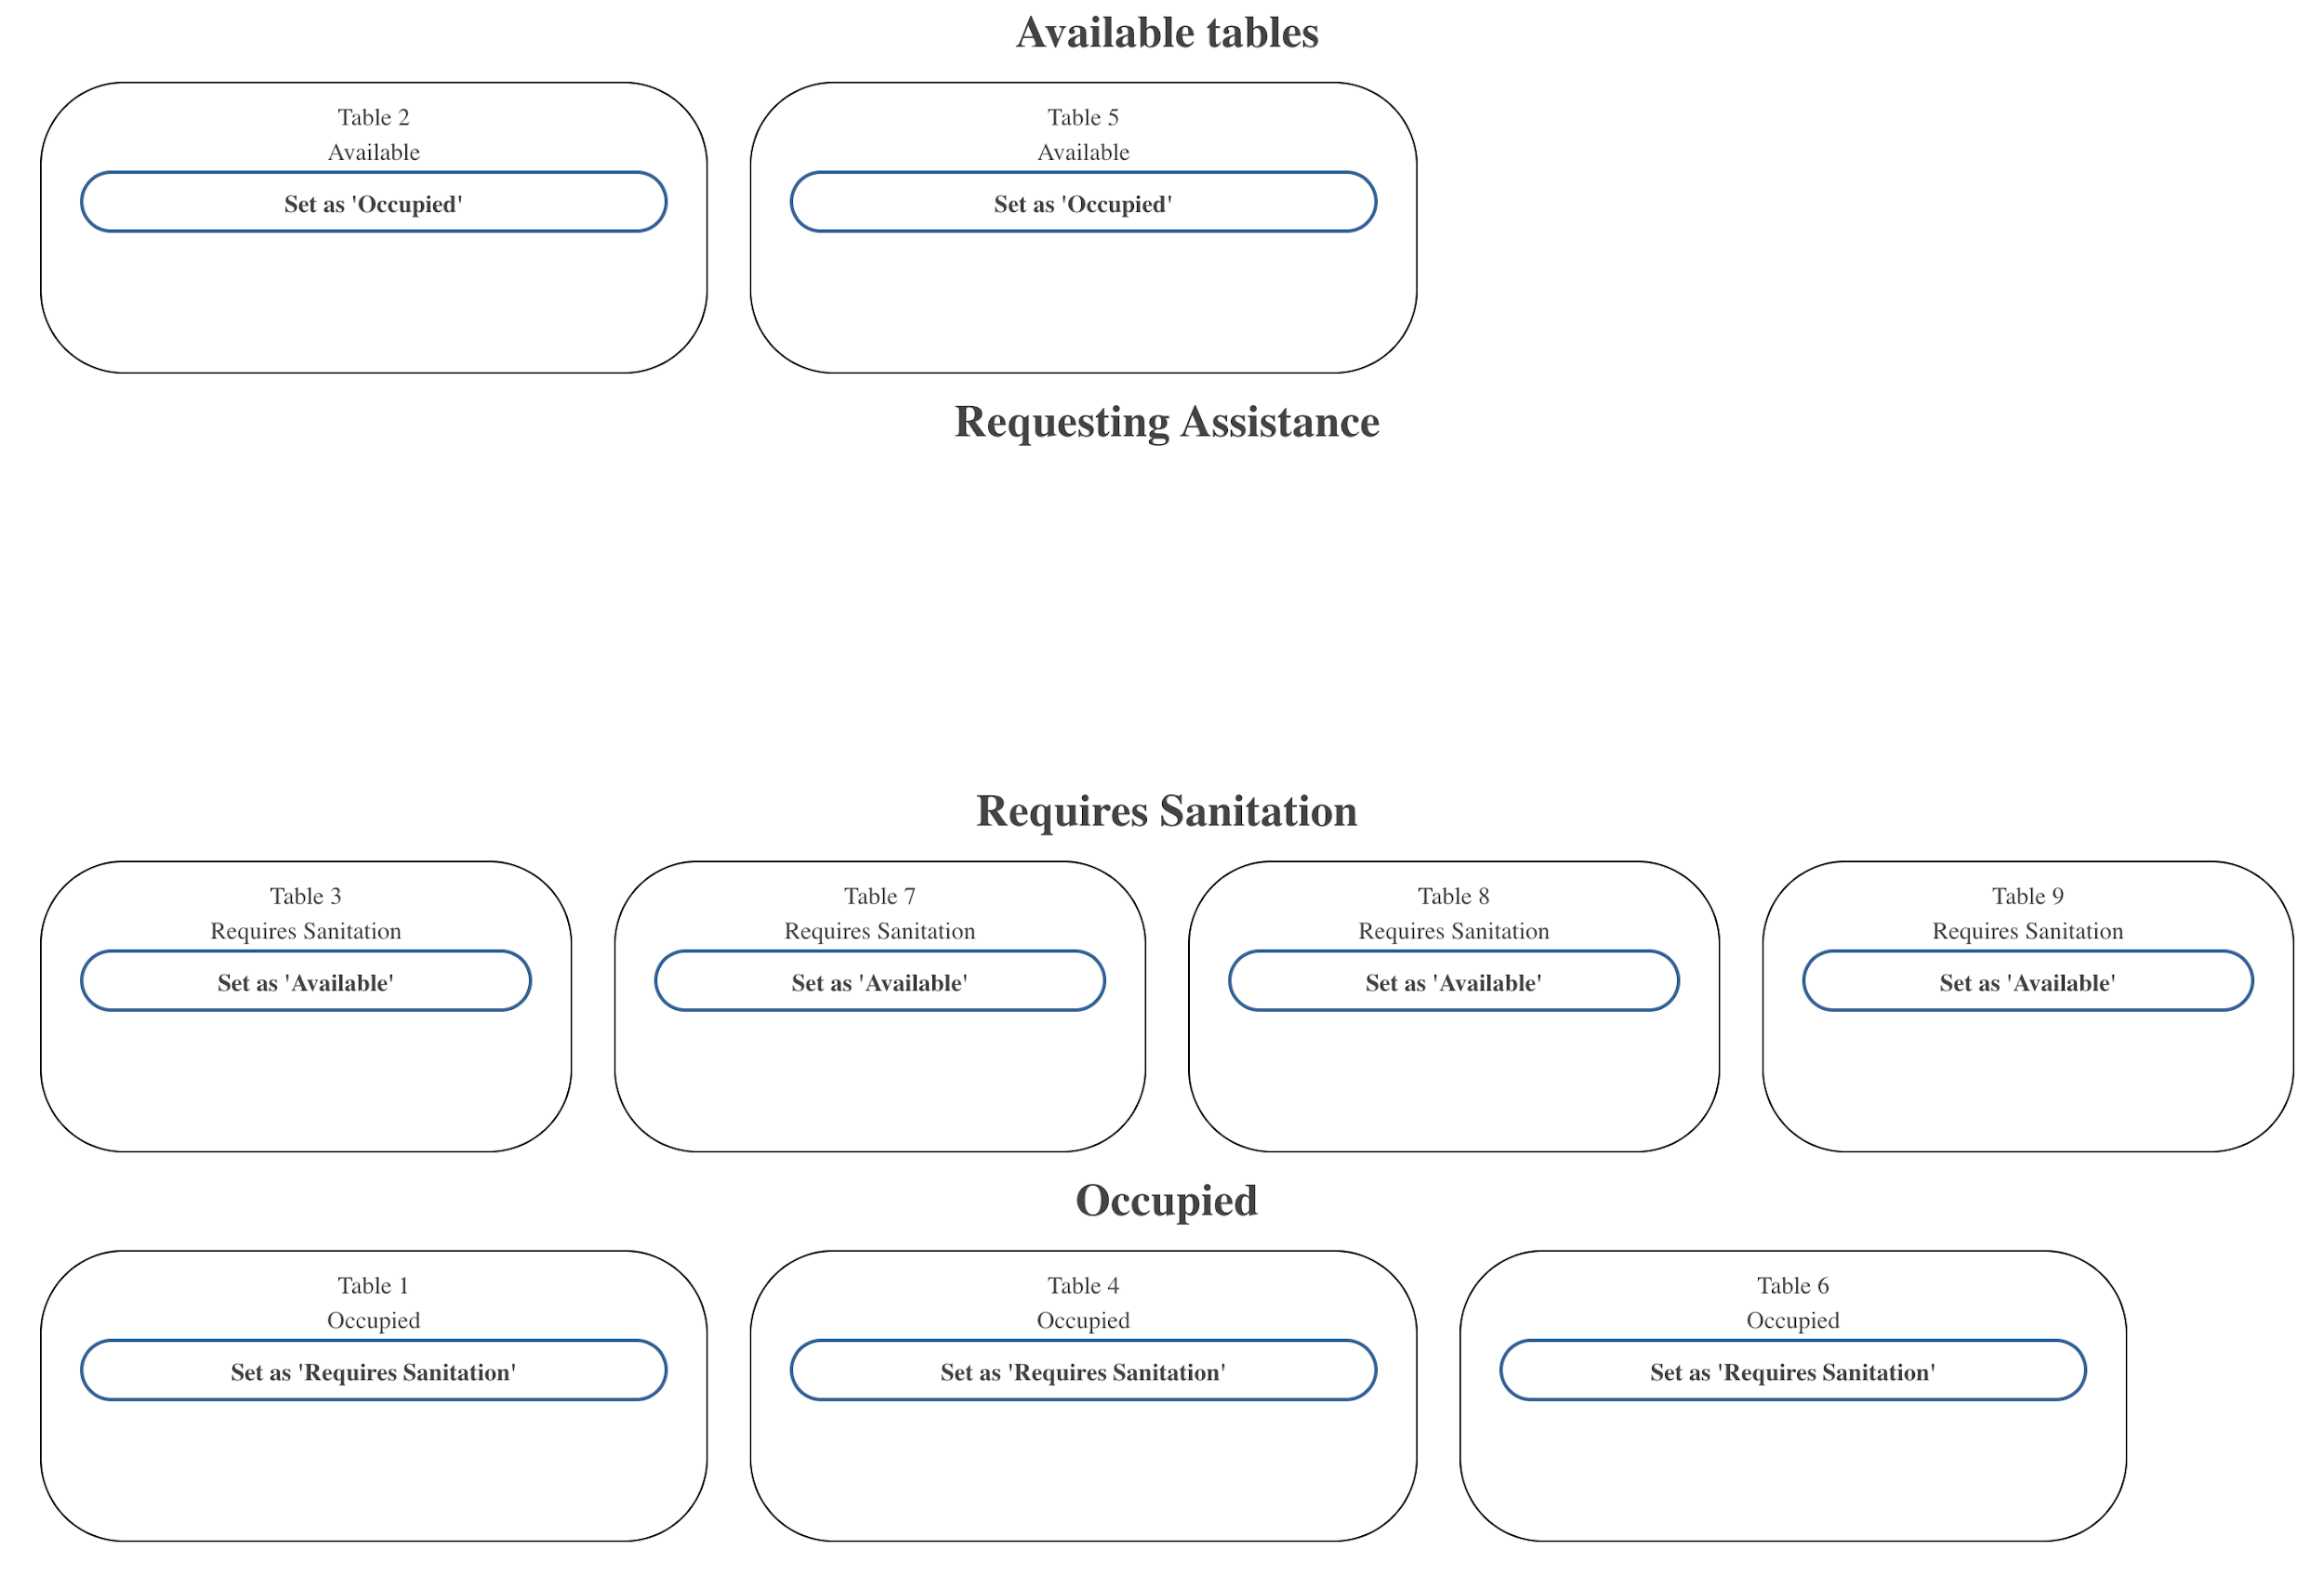
Application - Main Dashboard

Slide 20
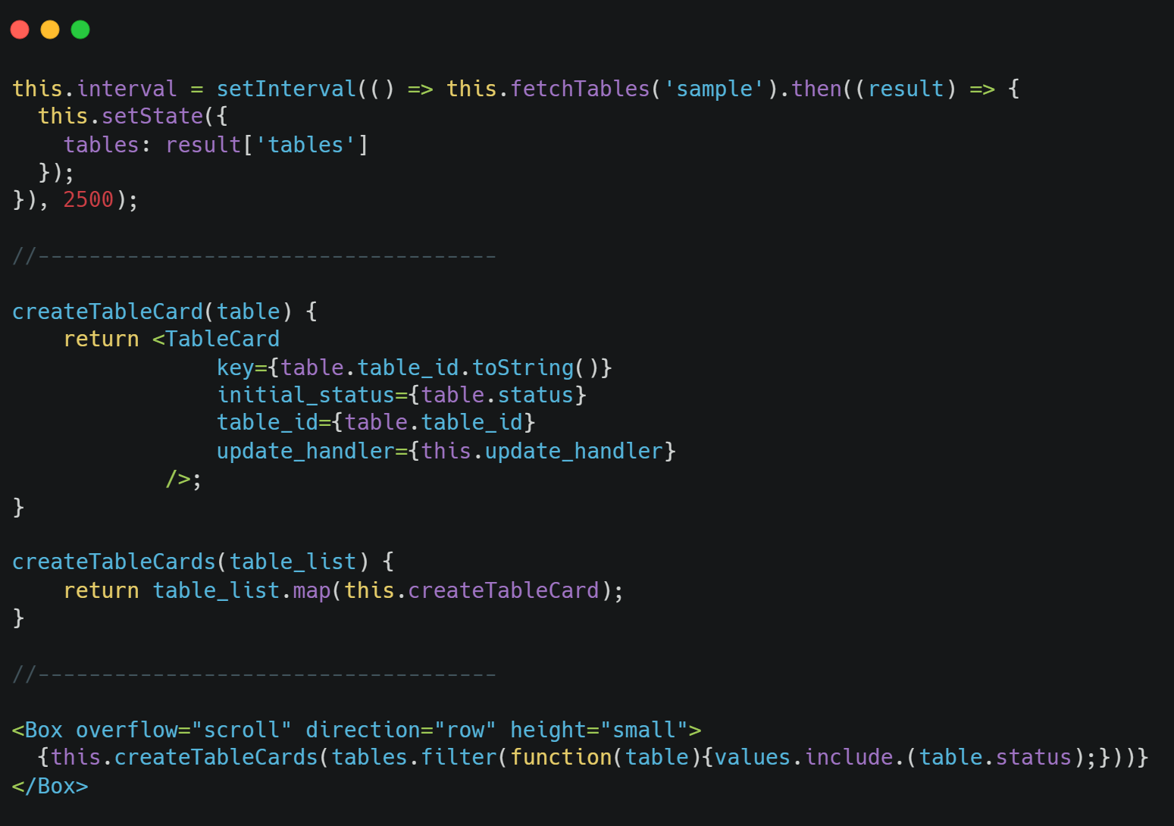
Application - Main Dashboard

Slide 21
Application - Main Dashboard
Consistent Response Time

Slide 22
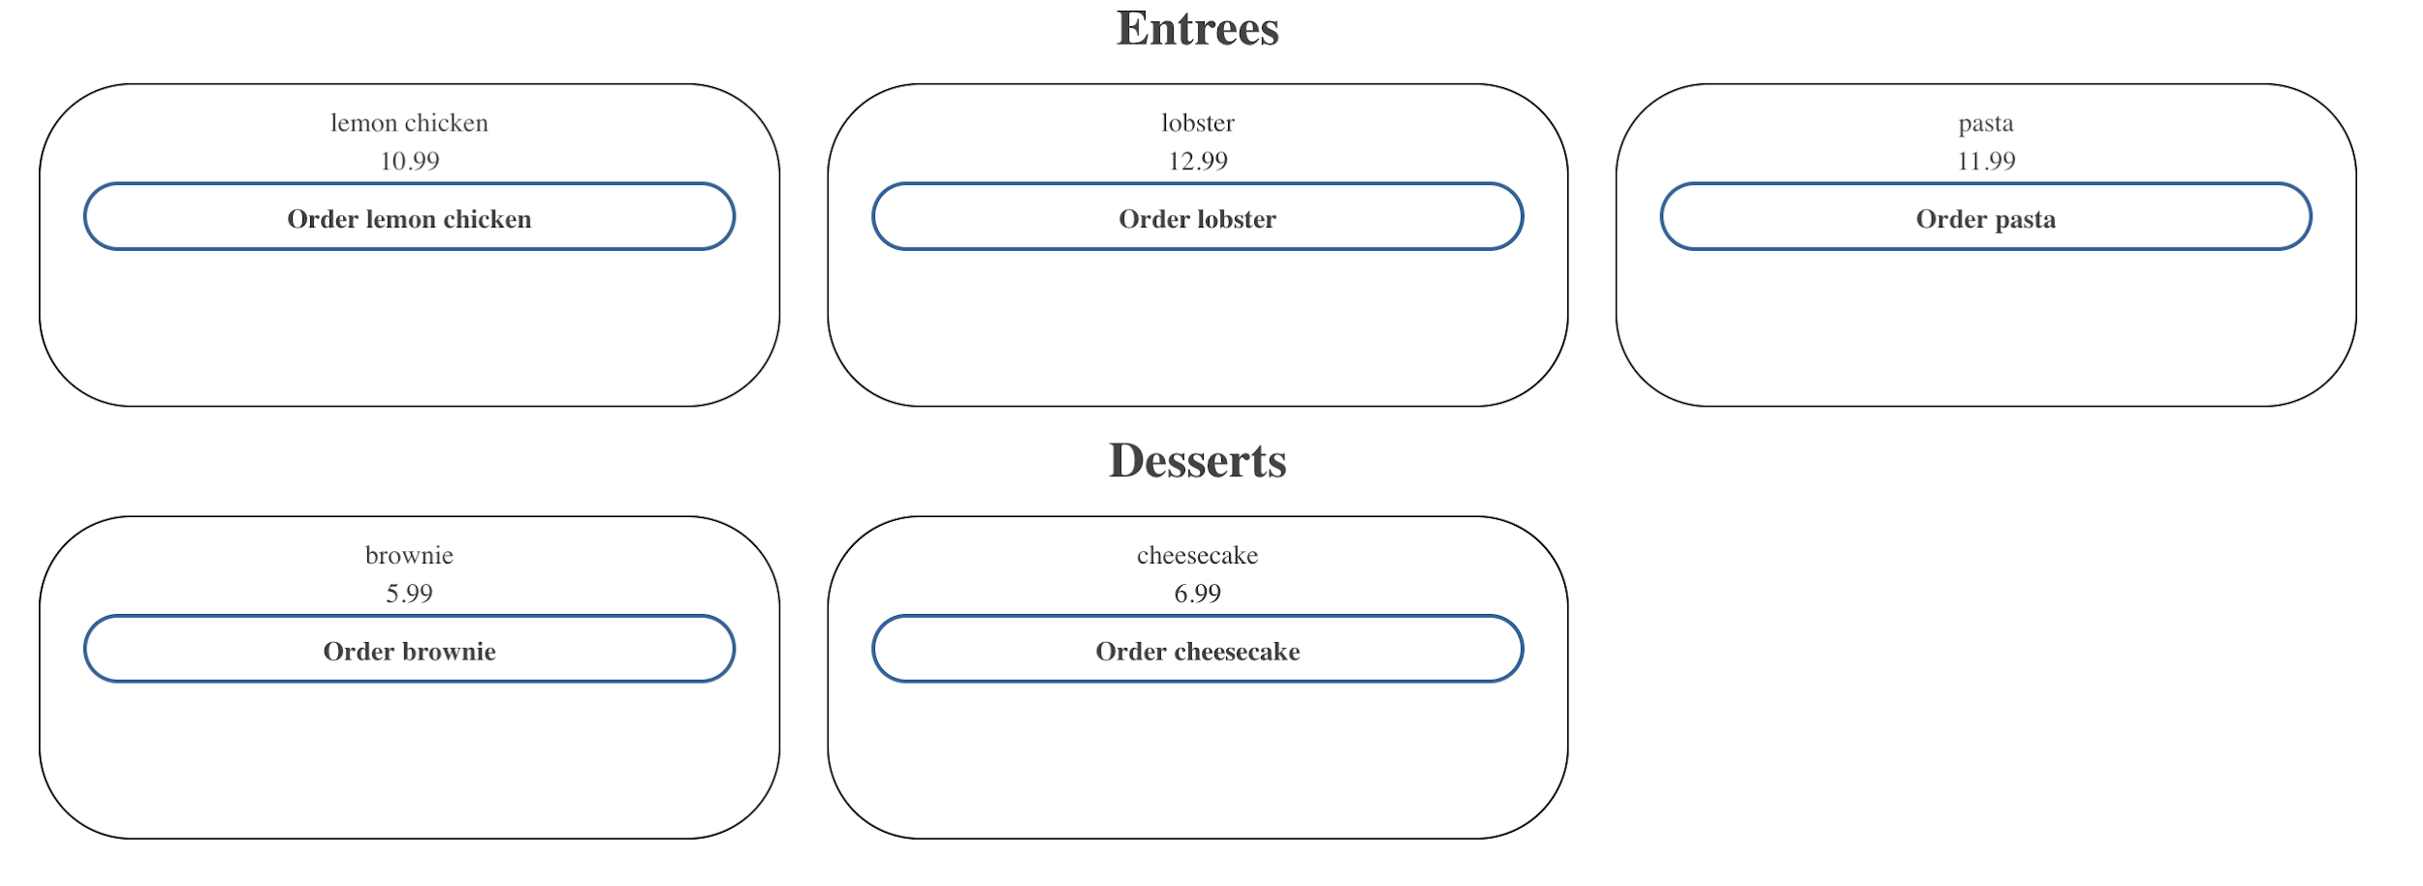
Application - Menu

Slide 23
Application - Analytics

Slide 24
Software Deployments
Google Cloud Platform
SQL
Dynamic databasing
Heroku
API
Process Handler
Authentication
Netlify
Front End
State Management

Slide 25
Failures
USB port connection error via Arduino IDE

Slide 26
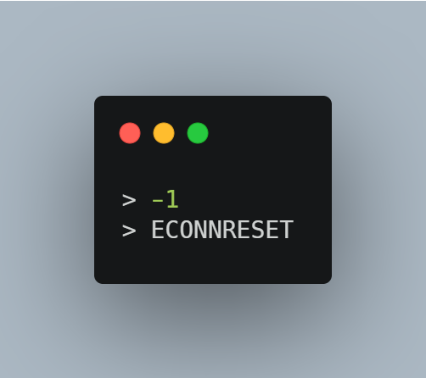
Failures
2. Timeout sending the data via Hotspot (poor internet)

Slide 27
Conclusion
Future…
UI/UX
Account Roles
Maintaining Scalability

Slide 28
Thank You
Any Question?

