Slide 1
Integrated Lithium-ion Battery Sensors
James Wyeth Karl Mulnik
Group 4
TA : Evan Widloski
12/8/2018

Slide 2
Overview
This system monitors the voltage and temperature of the Illini Solar Car battery modules

Slide 3
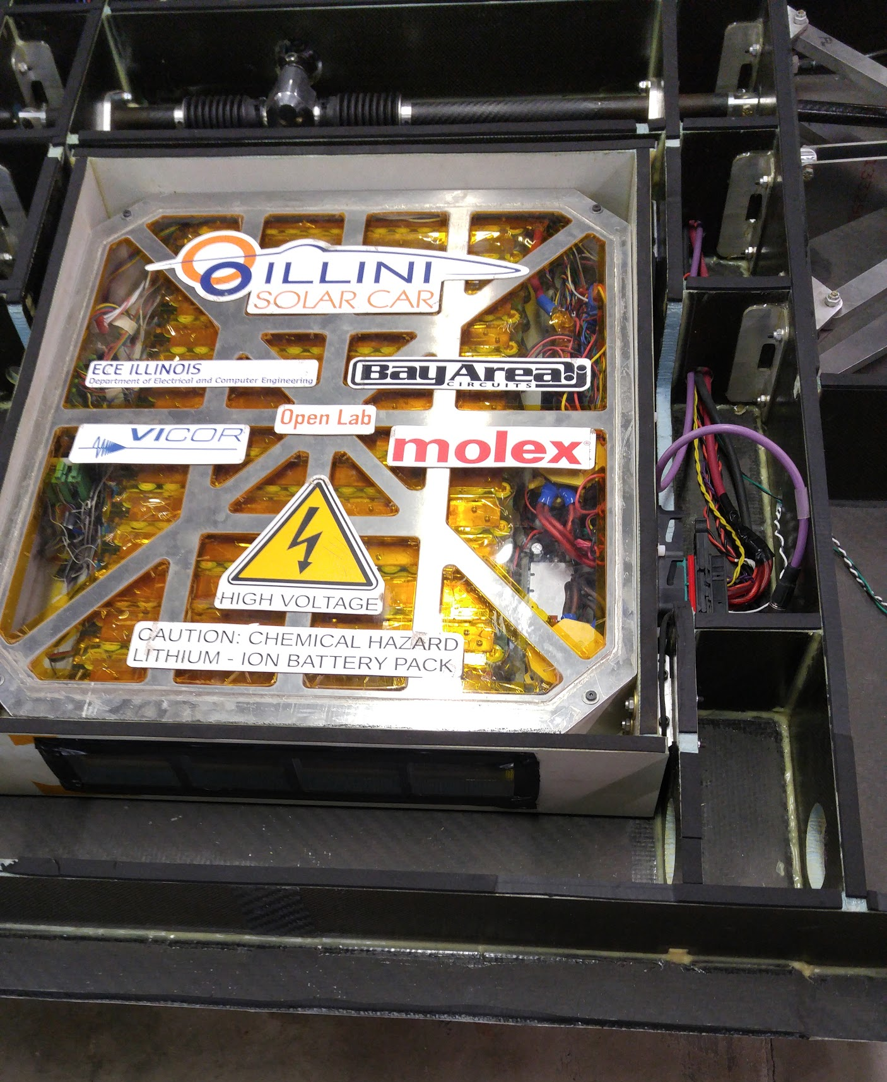
Objective
Sense battery temperature and voltage
Fit on battery module
Powered from module
Minimal isolation voltages

Slide 4
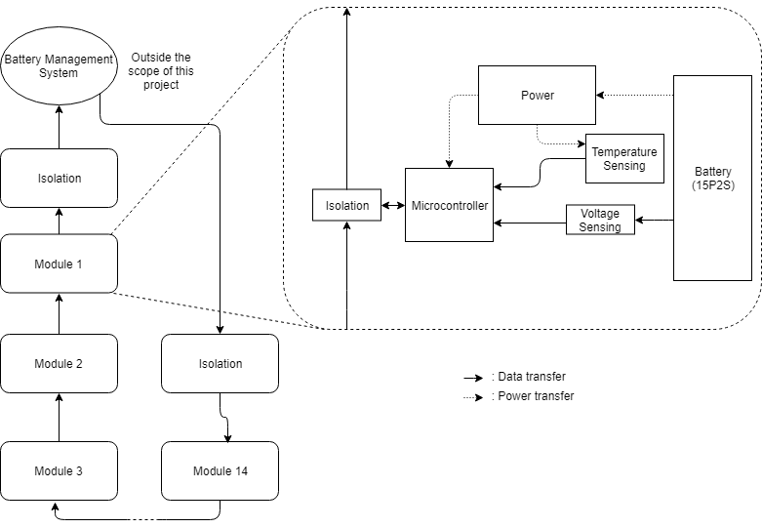

Slide 5
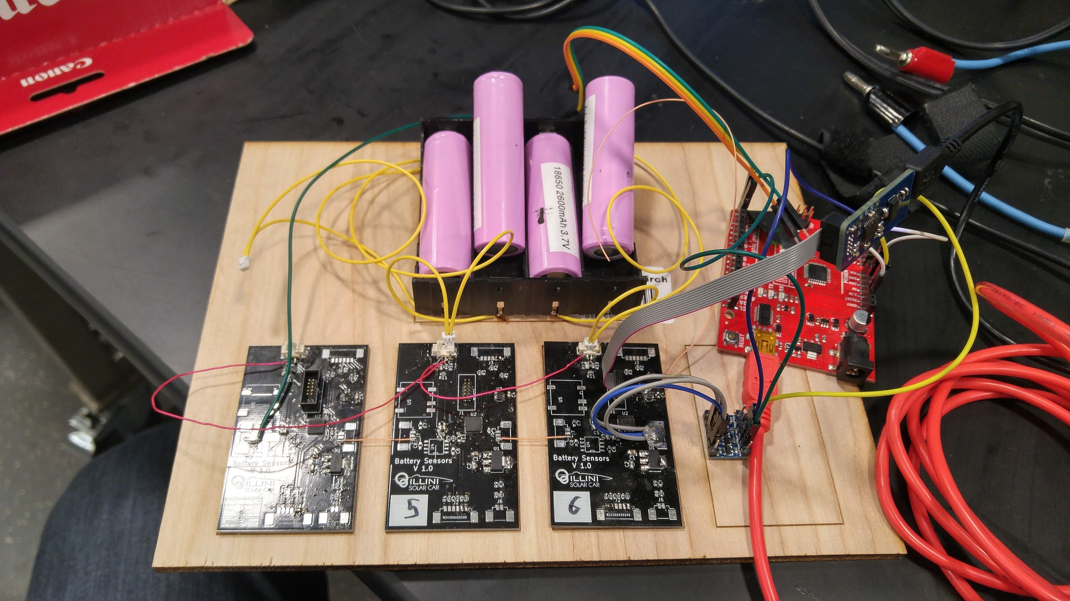
Voltage sensing
Step down voltage for measuring
Meet ADC limits
Notes:
The battery voltage will need to be stepped down for sensing by the microcontrollers ADC.
Using the highest possible value of Vbat and highest possible values of R1 and R2 to minimize current. However, the variation in restor value from the labeled value must be taken into account. This must be done to maintain a voltage accuracy within 10mV. There for R1 and R2 will be replaced with values that represent the worst case scenario of their tolerance levels

Slide 6
Voltage sense testing
ADCs inaccurate at low voltages
Fails verification
ADCs should be separate from micro

Slide 7
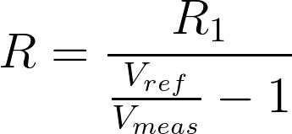
Temperature Sensing
NTC Thermistors
Exponential
Steinhart-Hart Equation
Notes:
Steinhart-Hart eqn

Slide 8
Temperature sense testing
Measured different values
Math too complicated
ADCs inaccurate

Slide 9
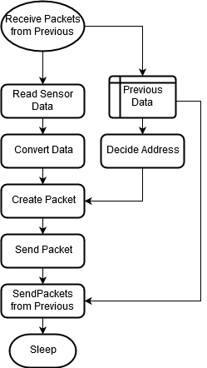
Microcontroller
ADC
6 Temp
2 Volt(minimum of 10 bits for 10 mV accuracy)
UART
Low power

Slide 10
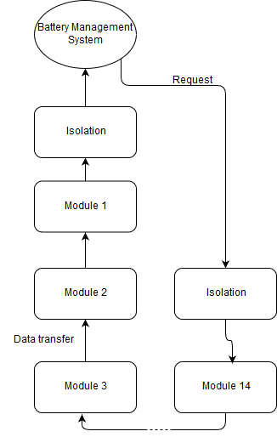
Communication and Isolation
115 kbaud UART
Daisy chain
Self-Addressing
Fixed Packets
Notes:
Our communication will be 115,200 baud, the highest standard UART speed, to reduce communication time and allow for smaller isolation caps. Since each module can go to 8.4V, we need the caps to work to slightly above this, allowing headroom for faulted communication lines. In most designs these are used to filter high frequency from power lines. We will use this to our advantage to ‘filter’ the communications to the next board

Slide 11
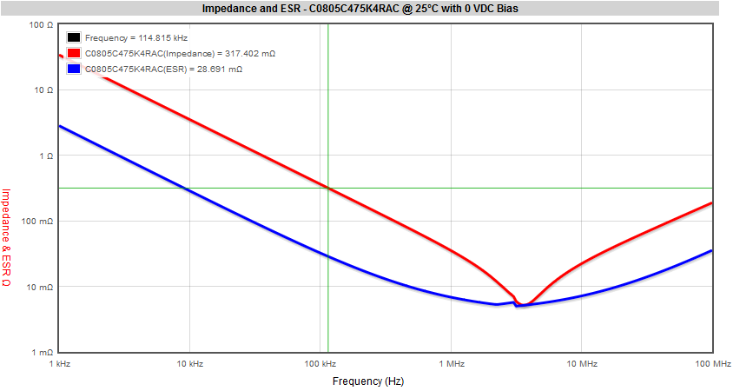
Isolation
Capacitor coupling
Pullup on RX
3kV Isolator for HV

Slide 12
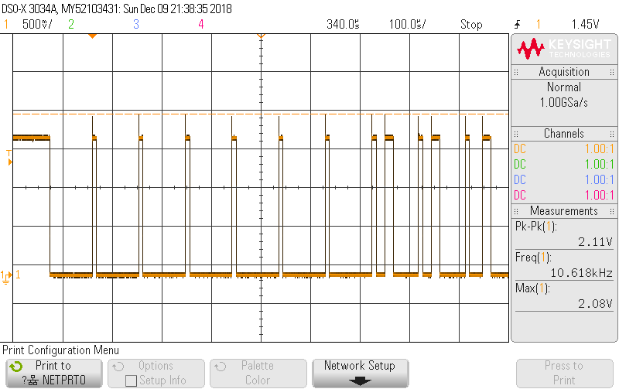
Isolation tests
Data transferred
Minimal DC drift

Slide 13
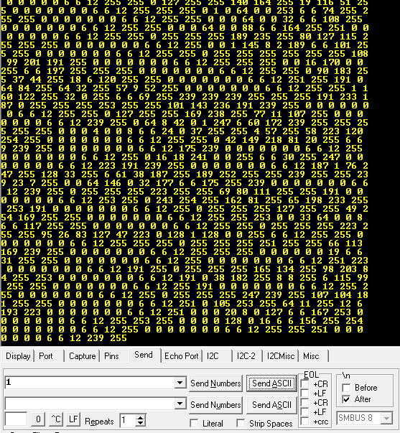
Communication Testing
Send request
Receive data
Correct data and address

Slide 14
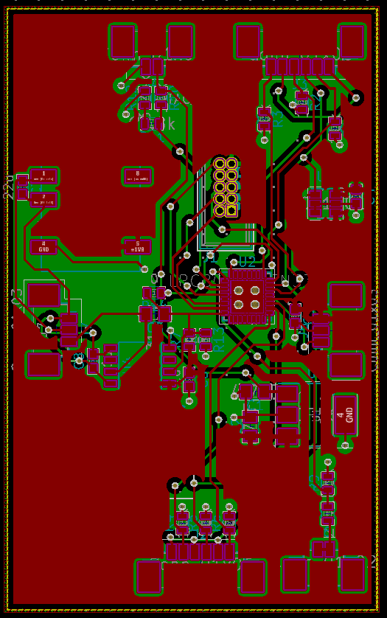
Power
Provide Power from the battery module
Supply 1.024 V reference

Slide 15
Conclusion
Currently does not work
Easy to break
Drained batteries

Slide 16
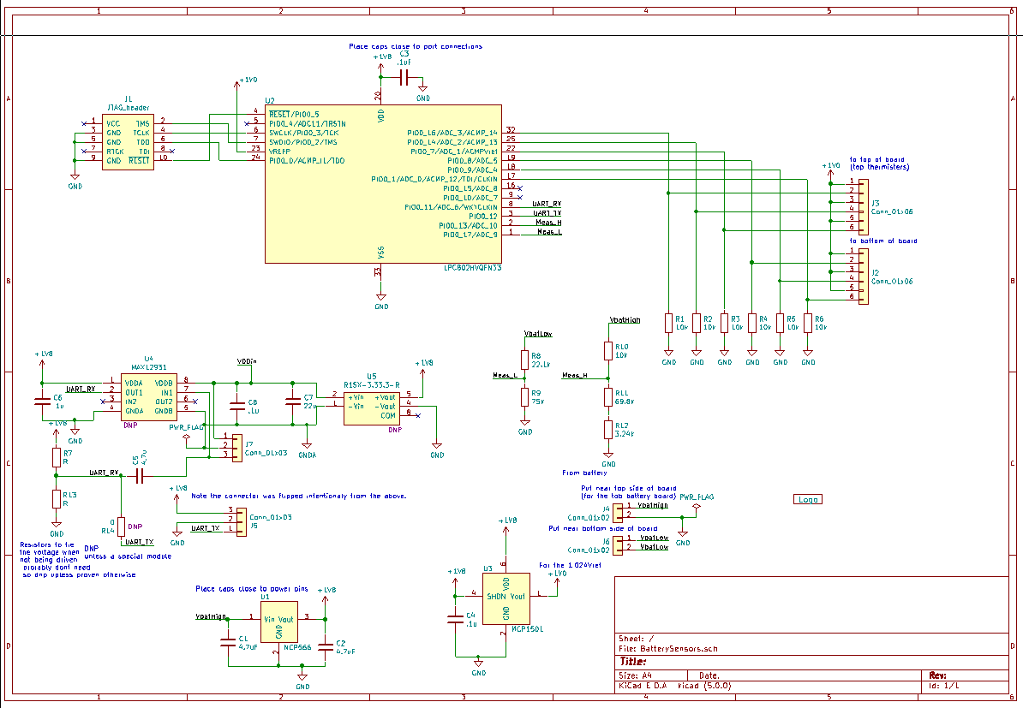
Future work
Use seperate ADC’s
Input protection
Reduce Power consumption
Integrate into final modules

Slide 17
Questions?

Slide 18
References:
[1] KEMET K-SIM: Capacitor Model Simulation Tool. [Online]. Available: http://ksim.kemet.com/Ceramic/CeramicCapSelection.aspx. [Accessed: 01-Oct-2018].
[2] L. Fried, “Using a Thermistor,” 01-Jan-2018. [Online]. Available: https://learn.adafruit.com/thermistor/using-a-thermistor. [Accessed: 05-Dec-2018].

