Slide 1
Easy Bake PCBs
Electrical & Computer Engineering
Team 51
ECE 445 – SP 23
May 02, 2023

Slide 2
Introduction
Team Introduction
Problem
Solution
High-Level Requirements
Block Diagram
Final Product Clip
ELECTRICAL & COMPUTER ENGINEERING
GRAINGER ENGINEERING

Slide 3
Introduction
Bhaven Shah
Computer Engineering
Raghav Narasimhan
Computer Engineering
Zak Kaminski
Electrical Engineering
ELECTRICAL & COMPUTER ENGINEERING
GRAINGER ENGINEERING

Slide 4
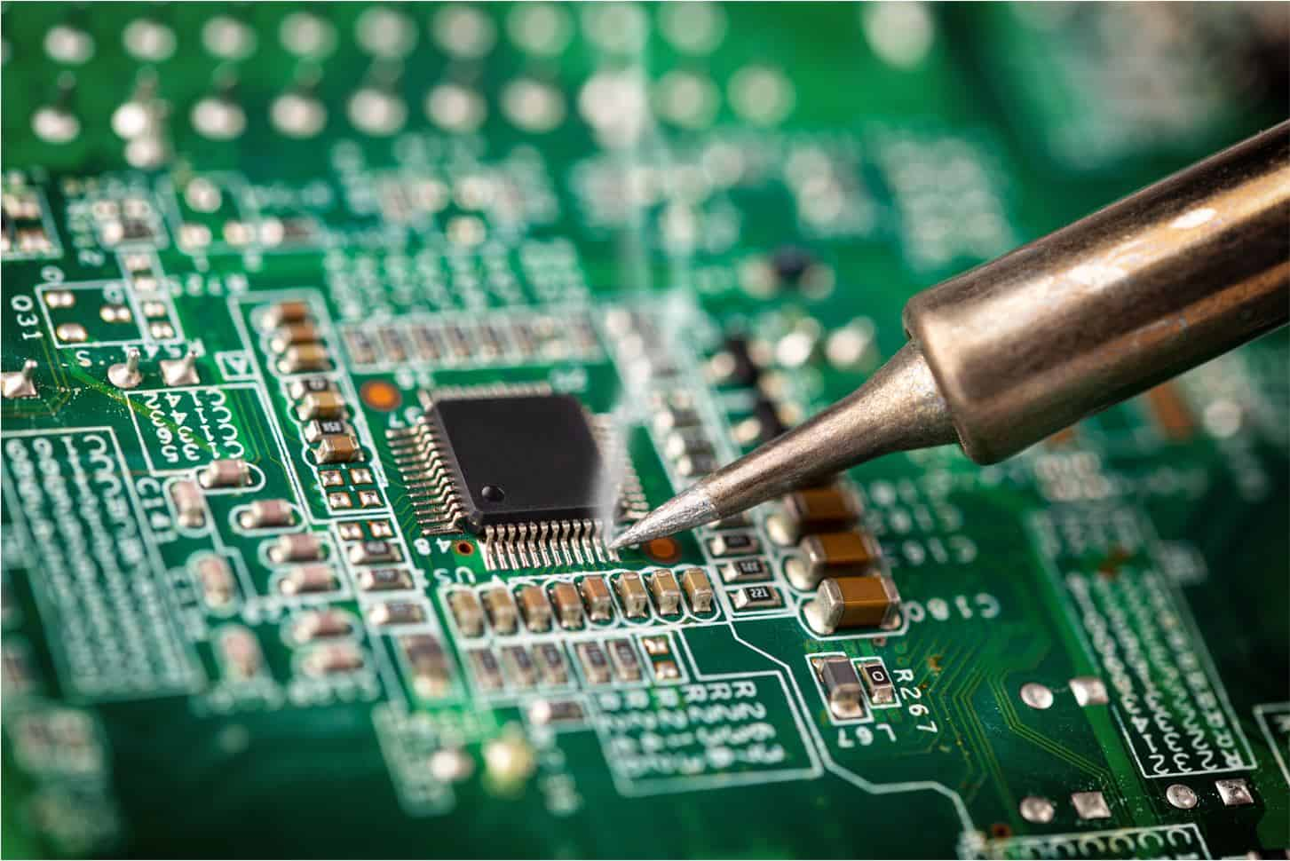
Introduction
Problem:
Soldering is time consuming and requires technical skill
Hand soldering requires larger pads for Surface Mount Devices(SMD) increasing PCB size
Need for increased efficiency of soldering for testing and production
Reflow ovens exist, but are expensive ($250 minimum)
ELECTRICAL & COMPUTER ENGINEERING
GRAINGER ENGINEERING

Slide 5
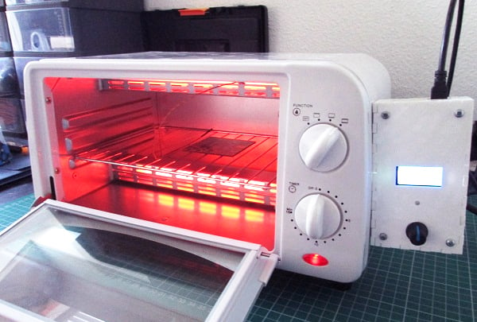
Introduction
Solution:
Toaster Oven based Reflow Oven
Breakout board to control the reflow process following the JEDEC recommendation
Camera to watch process and stop from any failures occurring
ELECTRICAL & COMPUTER ENGINEERING
GRAINGER ENGINEERING

Slide 6
Introduction
High-Level Requirements:
Solder PCBs with a margin of error of 10%
Detect when a component covers less than 50% of the pad
Reach temperatures of up to 270°C with a tolerance of ± 10°C
ELECTRICAL & COMPUTER ENGINEERING
GRAINGER ENGINEERING

Slide 7
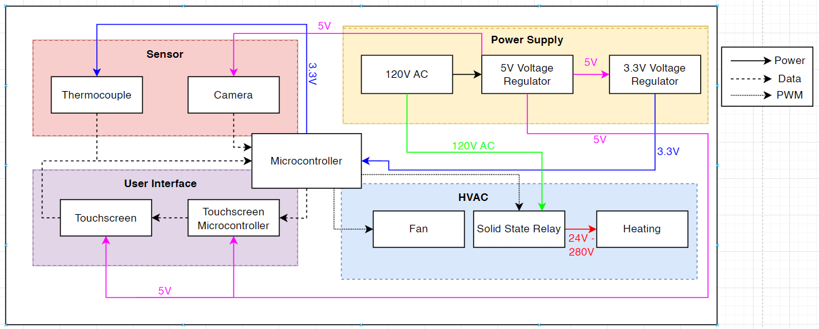
Introduction
Block Diagram (Original):
ELECTRICAL & COMPUTER ENGINEERING
GRAINGER ENGINEERING

Slide 8
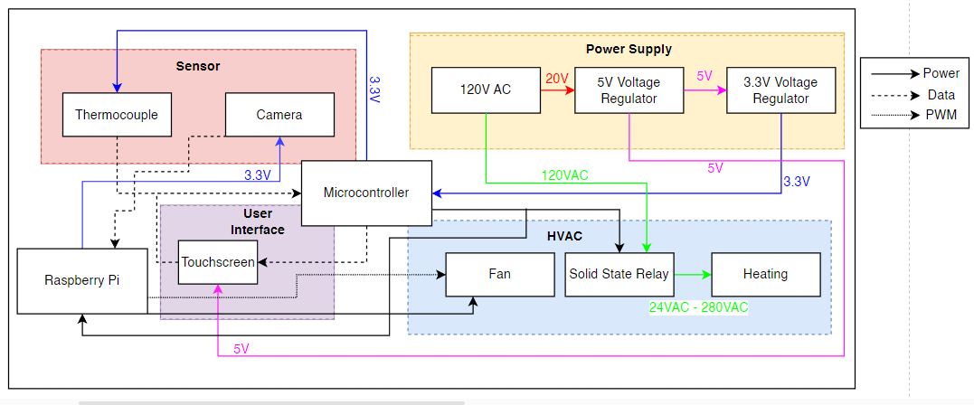
Introduction
Block Diagram (Updated):
ELECTRICAL & COMPUTER ENGINEERING
GRAINGER ENGINEERING

Slide 9
Introduction
Demo Clip:
ELECTRICAL & COMPUTER ENGINEERING
GRAINGER ENGINEERING

Slide 10
Subsystem Designs
Power
Sensors
HVAC
User Interface
ELECTRICAL & COMPUTER ENGINEERING
GRAINGER ENGINEERING

Slide 11
Power Subsystem
ELECTRICAL & COMPUTER ENGINEERING
GRAINGER ENGINEERING

Slide 12
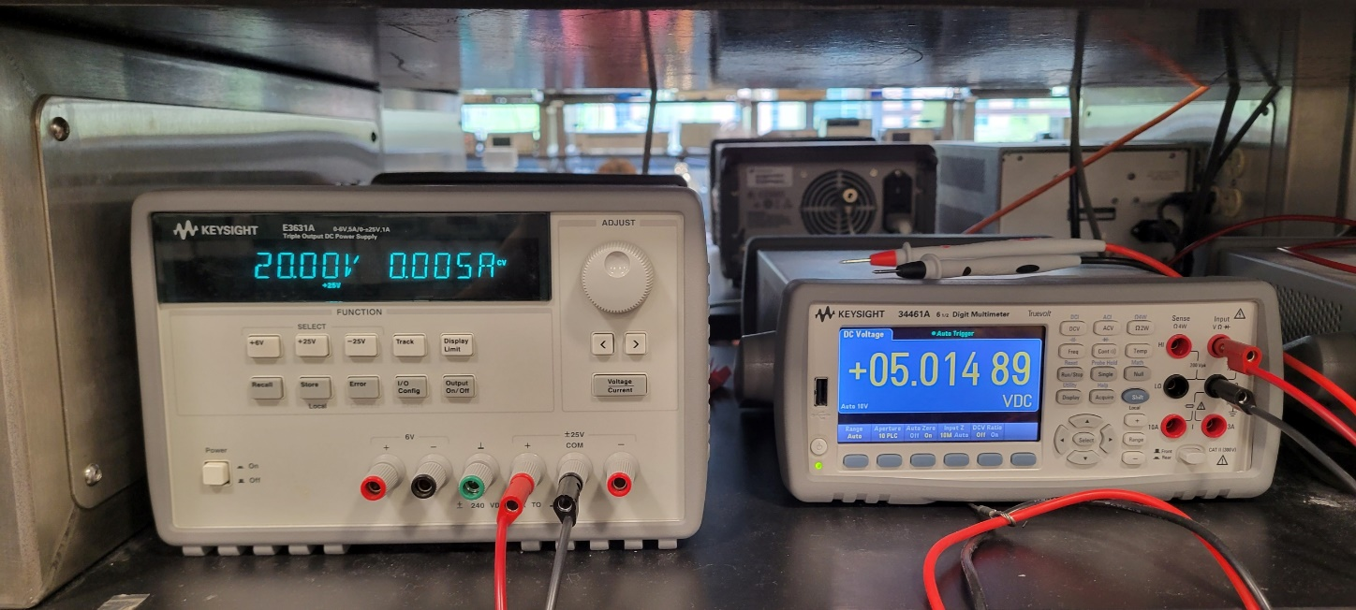
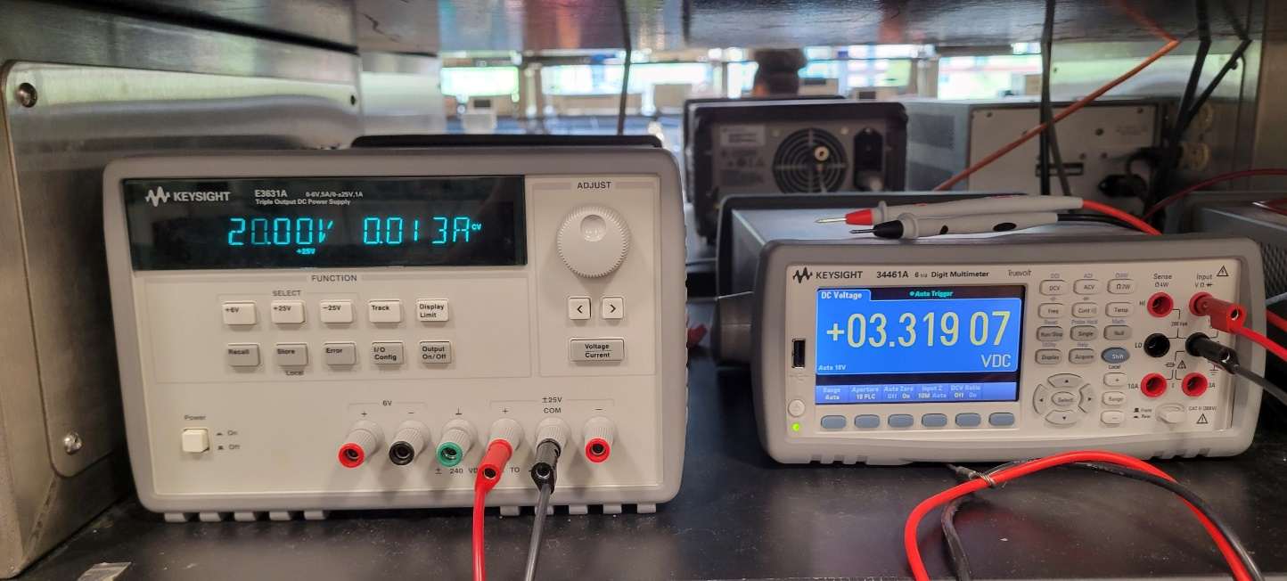
Design – Power
Power Supply R&V:
Requirements | Verified?
5V regulator circuit outputs 5V ± 10% for a 120V AC power supply. | Yes
3.3V regulator outputs 3.3V ± 0.3V given a 5V ±10% input. | Yes
ELECTRICAL & COMPUTER ENGINEERING
GRAINGER ENGINEERING

Slide 13
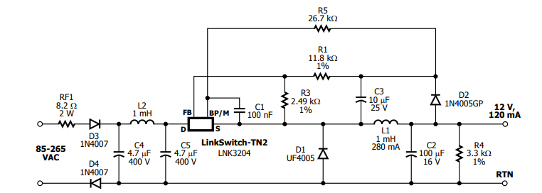
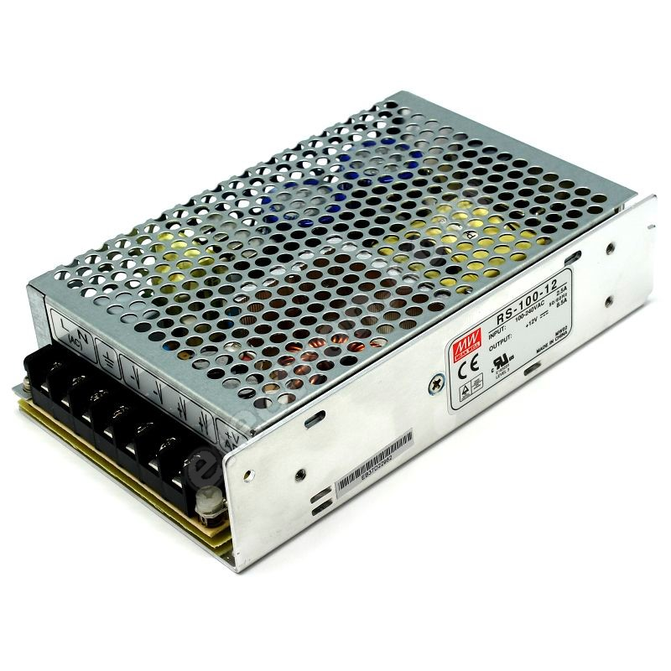
Design – Power
Results:
Had to switch from the Link Switch 120 VAC to 5 VDC circuit to an off-the-shelf power supply
Original circuit was too complex and difficult to debug
The power supply is much easier to use and understand
ELECTRICAL & COMPUTER ENGINEERING
GRAINGER ENGINEERING
Notes:
https://www.electron.com/12v-dc-switching-power-supply-mean-well-rs-100-12-p53684/

Slide 14
Sensor Subsystem
ELECTRICAL & COMPUTER ENGINEERING
GRAINGER ENGINEERING

Slide 15
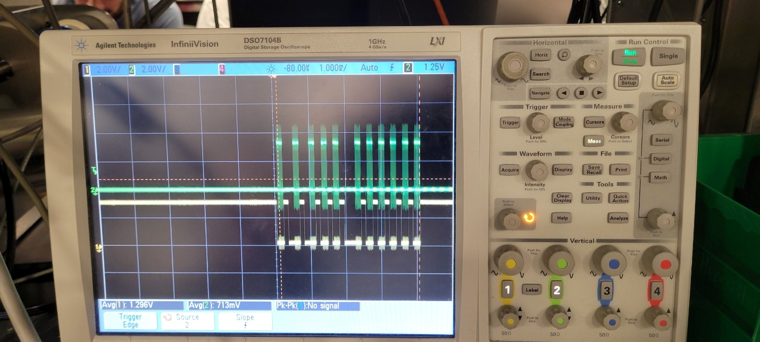
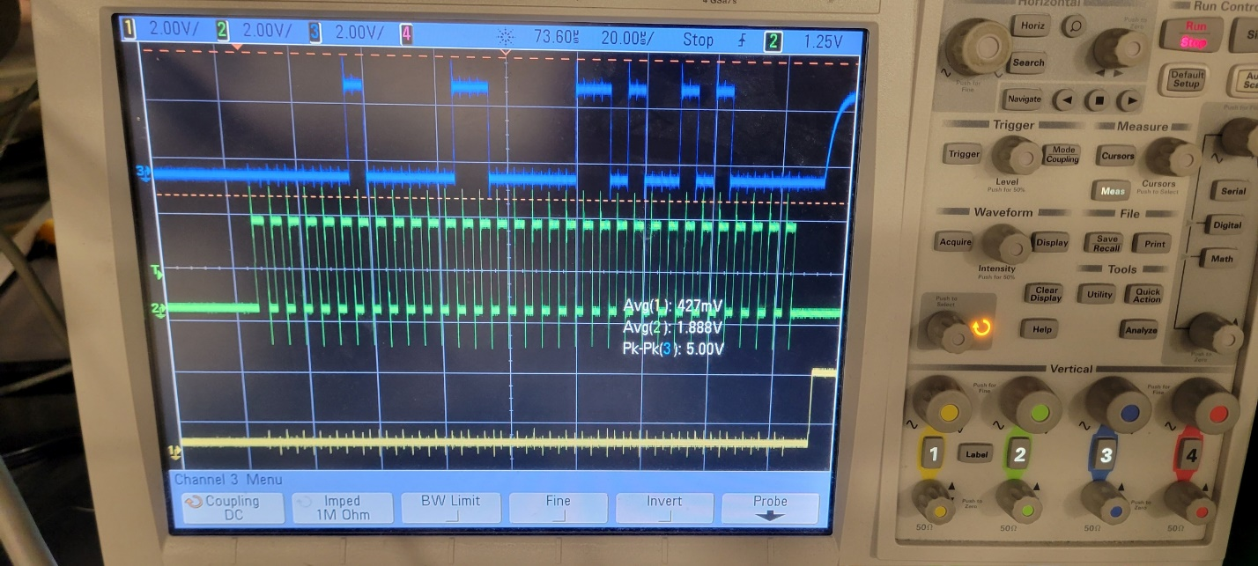
Design – Thermocouple
Thermocouple R&V:
Requirements | Verified??
Thermocouple must be accurate within ± 2°C | Yes
Thermocouple must be able to give a temperature every 0.5 ± 0.1 second | Yes
Blue: SPI Signal, Green: Clock Signal, Yellow: Chip Select
ELECTRICAL & COMPUTER ENGINEERING
GRAINGER ENGINEERING
Notes:
https://courses.engr.illinois.edu/ece445/getfile.asp?id=19638

Slide 16
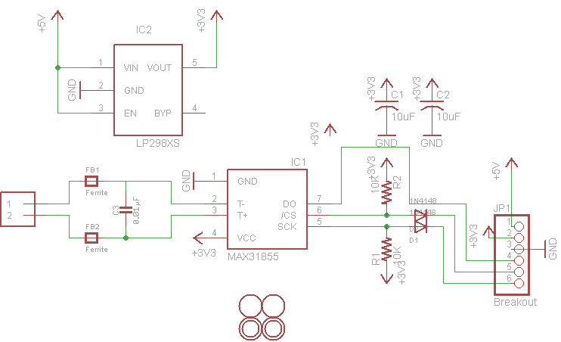
Design – Thermocouple
Results:
Had to use I2C ports on the touchscreen microcontroller in order to read the SPI output of the thermocouple
Able to do this because the MAX31855 does not receive any serial data (no MOSI port)
MISO to SDA
Clocks and chip selects connect together
ELECTRICAL & COMPUTER ENGINEERING
GRAINGER ENGINEERING
Notes:
https://courses.engr.illinois.edu/ece445/getfile.asp?id=19638

Slide 17
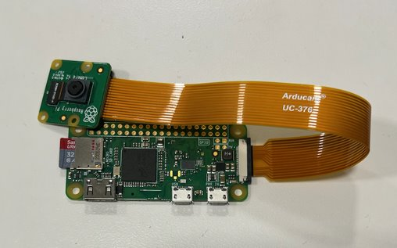
Design – Camera
Camera R&V:
Requirements | Verified?
Camera must be able to detect when a component is covering less than 70% of its corresponding pad | Yes
Camera must be able to send a frame once every 0.5 ± 0.1 second | Yes
ELECTRICAL & COMPUTER ENGINEERING
GRAINGER ENGINEERING
Notes:
https://courses.engr.illinois.edu/ece445/getfile.asp?id=19638

Slide 18
Design – Camera
Results:
Used OpenCV along with Image Processing library to determine image similarity
One photo would be captured in the beginning of the soldering process
Subsequent pictures would be taken at 0.5-second increments
The similarity with the most recent picture and the original picture is determined
A threshold is set stating if the similarity is too low, a 'slip' occurs
ELECTRICAL & COMPUTER ENGINEERING
GRAINGER ENGINEERING
Notes:
https://courses.engr.illinois.edu/ece445/getfile.asp?id=19638

Slide 19
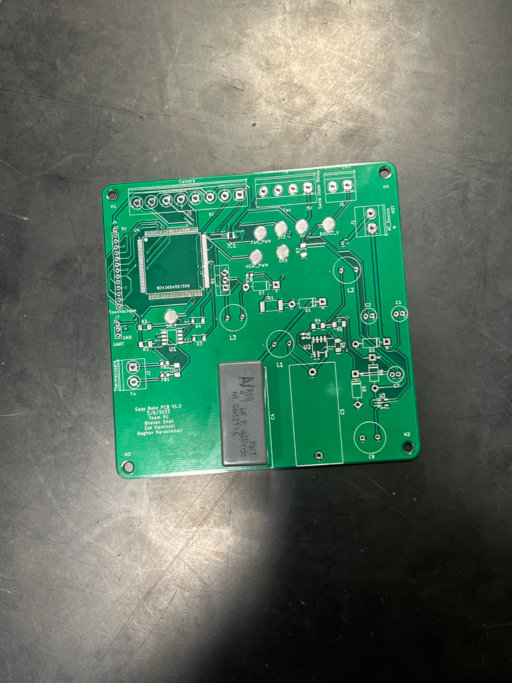
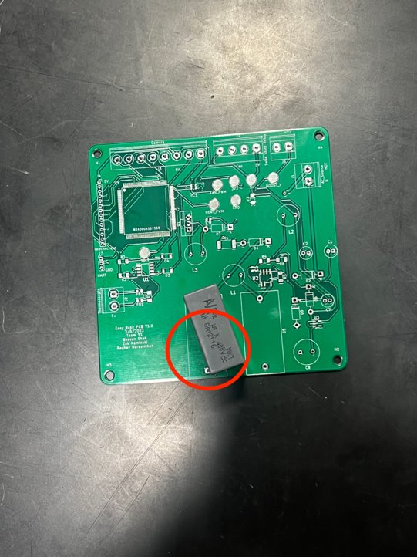
Camera Algorithm - Results
Example:
ELECTRICAL & COMPUTER ENGINEERING
GRAINGER ENGINEERING
Notes:
https://courses.engr.illinois.edu/ece445/getfile.asp?id=19638

Slide 20
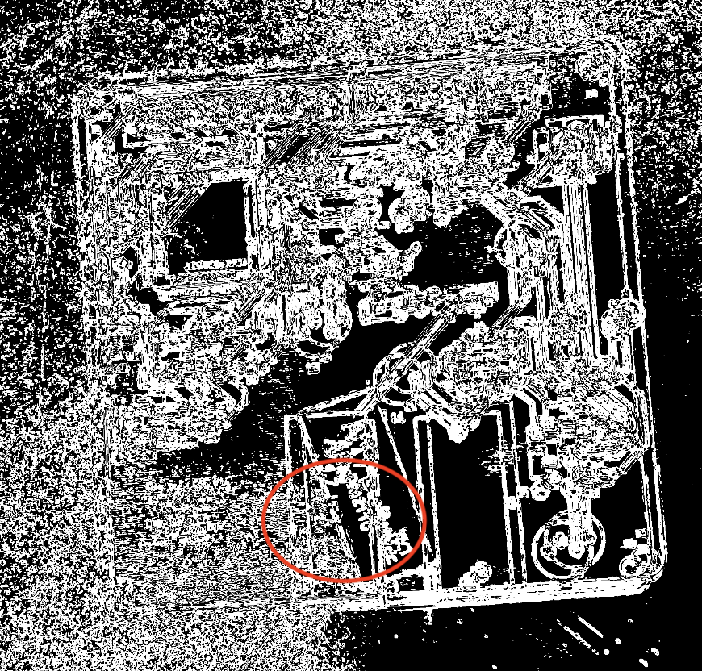
Camera Algorithm - Results
Example:
ELECTRICAL & COMPUTER ENGINEERING
GRAINGER ENGINEERING
Notes:
https://courses.engr.illinois.edu/ece445/getfile.asp?id=19638

Slide 21
Design – Microcontroller
Microcontroller R&V:
Requirements | Verified?
Microcontroller digital output pins must correctly output a 1 or 0 for a corresponding voltage of ≥ 3.0V and ≤ 0.2V respectively. | Yes
Microcontroller digital input pins must correctly read a 1 or 0 for a corresponding voltage of ≥ 3.0V and ≤ 0.2V respectively | Yes
Microcontroller can produce a variable PWM signal at a frequency of 100kHz | No
ELECTRICAL & COMPUTER ENGINEERING
GRAINGER ENGINEERING
Notes:
https://courses.engr.illinois.edu/ece445/getfile.asp?id=19638

Slide 22
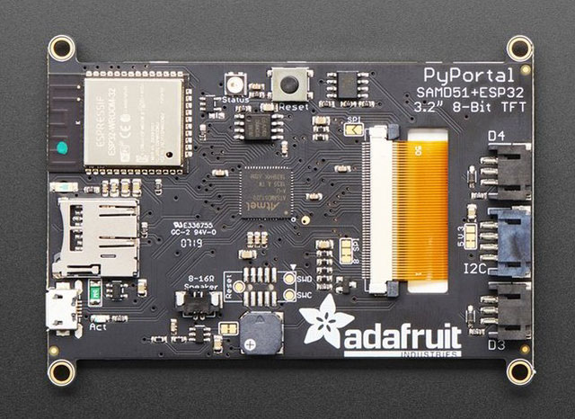
Design – Microcontroller
Results:
Had to shift away from using a PWM and instead used GPIO pins for the same use
Solid-state relay worked differently from what we initially thought
Can use a GPIO for the fan and the heating instead
Changed microcontroller to the one on the touchscreen
NXP microcontroller was difficult to program and the IDE was difficult to use
Power traces were not connected to the microcontroller on the PCB
ELECTRICAL & COMPUTER ENGINEERING
GRAINGER ENGINEERING
Notes:
https://www.digikey.com/en/maker/projects/adafruit-pyportal-iot-for-circuitpython/3a9b824ec105490daff240ba4496ef80
https://courses.engr.illinois.edu/ece445/getfile.asp?id=19638

Slide 23
HVAC Subsystem
ELECTRICAL & COMPUTER ENGINEERING
GRAINGER ENGINEERING

Slide 24
Design – HVAC
Heating R&V:
Requirements | Verified?
When the user begins the reflow process, the coils should begin to heat the chamber and follow the specified profile that was chosen within ±10°C | Yes
When the reflow process reaches ± 10°C peak temperature the fan will turn on at 7600 ± 10% RPM. | No
10 – 30 seconds after reaching the peak temperature ± 5°C the fan will run at 8300 ± 10% RPM. | No
Preheat
Soak
Reflow
Cool
ELECTRICAL & COMPUTER ENGINEERING
GRAINGER ENGINEERING

Slide 25
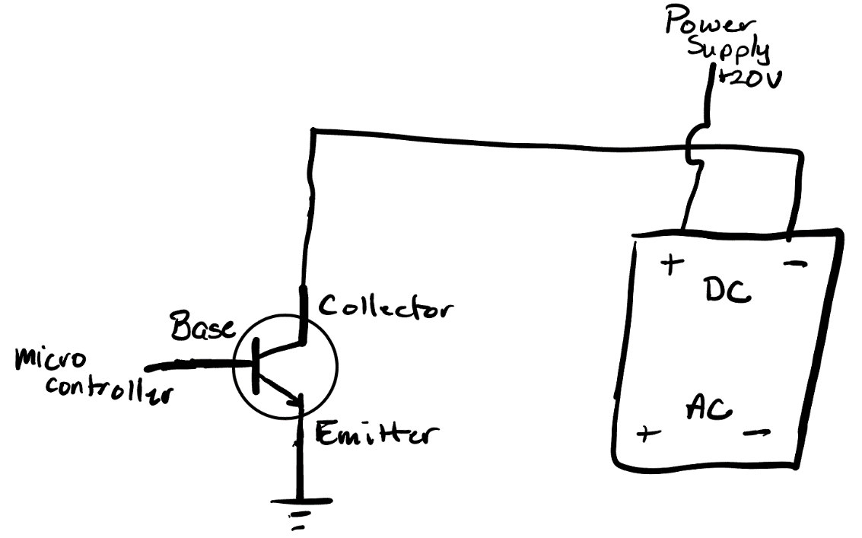
Design – HVAC
Results:
We were able to successfully control the heating of the toaster oven
Had to use a BJT transistor circuit
We were unable to get the fan integrated into the circuit, but could integrate it as we have the data
ELECTRICAL & COMPUTER ENGINEERING
GRAINGER ENGINEERING
Notes:
https://courses.engr.illinois.edu/ece445/getfile.asp?id=19638

Slide 26
User Interface Subsystem
ELECTRICAL & COMPUTER ENGINEERING
GRAINGER ENGINEERING

Slide 27
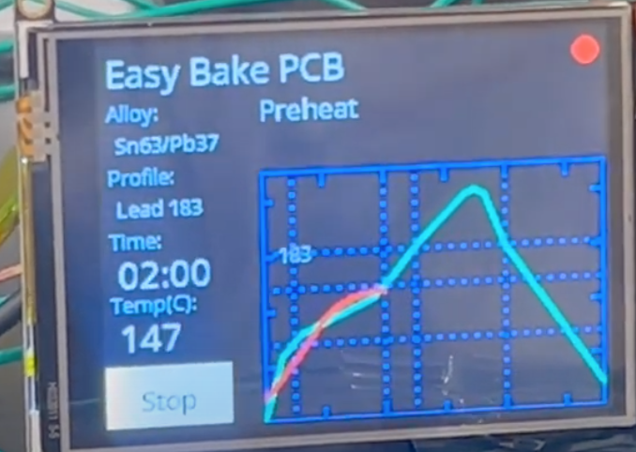
Design – User Interface
Results:
Easy to read and responsive touchscreen
Displayed the reflow profile graph
Created a new graph that showed the current temperature in the oven with a red line
Profile selector
Press profile button and then press save
ELECTRICAL & COMPUTER ENGINEERING
GRAINGER ENGINEERING

Slide 28
Conclusion
Lessons Learned
Future Work
Thank You & Questions
ELECTRICAL & COMPUTER ENGINEERING
GRAINGER ENGINEERING

Slide 29
Lessons Learned
ELECTRICAL & COMPUTER ENGINEERING
GRAINGER ENGINEERING

Slide 30
Conclusion
Lessons Learned
More careful consideration is needed when picking components
GPIO pins on microcontrollers provide very little current and can create issues
Breadboarding is very useful and helps provide confirmation that our circuit works
Dev boards and through-hole components are useful for testing
Order backup components
ELECTRICAL & COMPUTER ENGINEERING
GRAINGER ENGINEERING

Slide 31
Future Work
ELECTRICAL & COMPUTER ENGINEERING
GRAINGER ENGINEERING

Slide 32
Conclusion
Future Work
Run full tests to ensure the reflow process is working
Use a PID controller to get more accurate temperature readings
Use a Solid-State Relay with +3.3VDC as a viable input voltage
Integrate the Camera Module with the microcontroller so that it can halt the process
ELECTRICAL & COMPUTER ENGINEERING
GRAINGER ENGINEERING

Slide 33
Thank You
Any questions?
ELECTRICAL & COMPUTER ENGINEERING
GRAINGER ENGINEERING

