Slide 1
Environment Aware Bike Light
Team 31
Hosang Chun
Sid Sharma
Guan Qin
TA : Anthony Caton

Slide 2
Motivation
The number of cyclists has been steadily increasing in major US cities such as New York, Chicago, Portland and San Francisco
Bike lights aren’t sensitive to environment changes such as fog
Pedalcyclist fatalities increased by 11% between 2015 and 2016
Notes:
The reason we chose to build this bike light is because the number of cyclists has been consistently increasing in major US cities. A lot of major cities have adverse environmental conditions including fog. None of the bike lights currently in the market are sensitive to the environmental changes especially fog. On the other hand, the number of fatalities for cyclists has also been increasing, and it increased by 11% between 2015 and 2016 in the US.

Slide 3
Our Project
Our bike light is sensitive to fog
Provides the rider with higher degree of safety
Notes:
Our project in essence aims to combat these issues. So our bike light should be sensitive and aware of fog in the immediate vicinity, and also make sure that the rider is safer while using the bike light.

Slide 4
Objective
Detect fog via a DIAL based approach
Power all modules long enough using AA batteries
Making lasers safe for human eyes
Notes:
The first high level requirement for our project include detecting fog via a DIAL based approach which will be touched upon by Hosang in the following slides. The next requirement to satisfy would be to make sure that the bike would be sufficiently lit for a reasonable time just using AA batteries. And lastly, since we were using lasers in our project, we wanted to make sure that they were safe for human eyes.

Slide 5
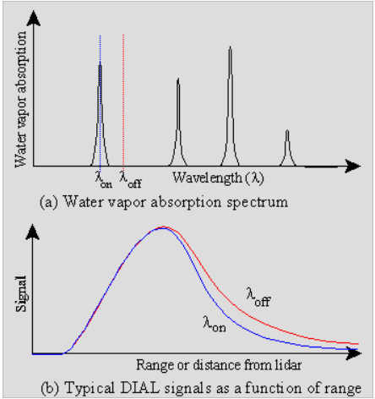
DIAL
Stands for DIfferential Absorption Lidar
Measures concentration of gases or aerosol
Relies on difference of two near wavelength beams
Notes:
So, what is DIAL? DIAL stands for Differential Absorption Lidar. It is used to measure the concentration of gases or aerosol. The way DIAL works is that just like Lidar system, a ray would be transmitted through a medium. In our case, air. But, unlike a regular lidar, it transmits two beams close but slightly off that one is on the absorption band and one isn’t. The difference in returned energy would signify how much aerosol is present.

Slide 6
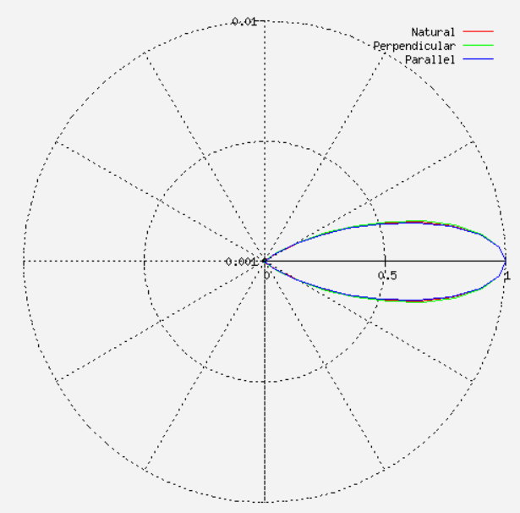
Backscattering
Mie Scattering
Mostly forward scattering
Take as much advantage of returned signal
Notes:
Since the particle size of the fog molecules are larger than the wavelength of the light, Mie scattering would be the dominating scattering mechanism and doing the simulation of mie scattering results in a pattern as you see on the screen. Most of the scattering is forward, but you do see some that are directed backward. Since we can’t put a sensor in front of the fog, we have to take as much advantage of the returned signal.

Slide 7
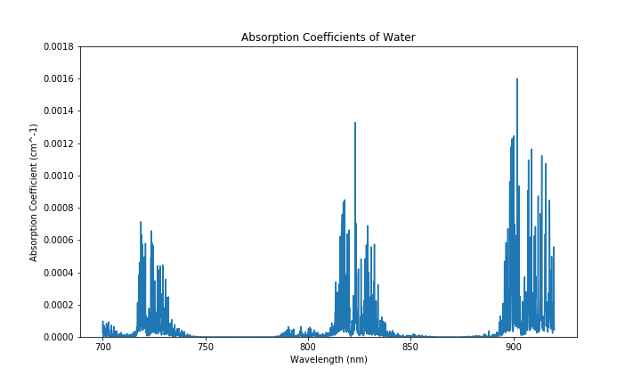
DIAL on Fog
Fog is an aerosol of water molecules
Water has couple absorption bands
Avoid visible range for our purpose
Avoid wavelengths that are hard to get
808nm and 850nm
Notes:
Fog is an aerosol of water molecules. So, we looked into the absorption bands of water using HITRAN. We wanted to avoid visible range because we didn’t want to annoy the pedestrian or passersby with our laser beam. Also, we wanted to avoid wavelengths that were hard to get. So we focused on the 820nm absorption band and settled with 808nm and 850nm lasers.

Slide 8
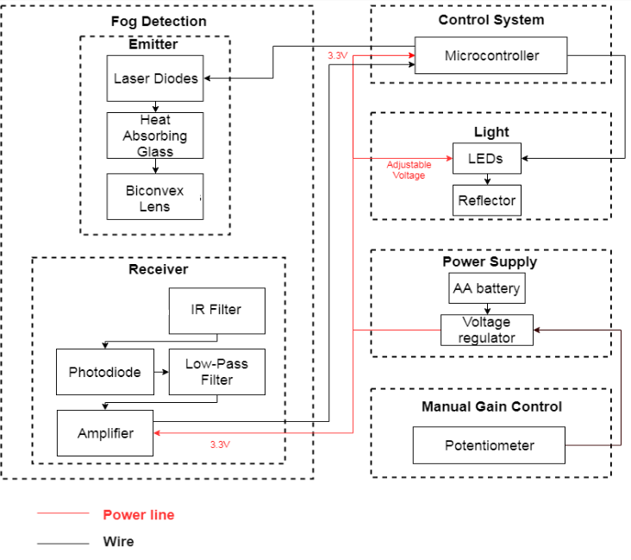
Block Diagram

Slide 9
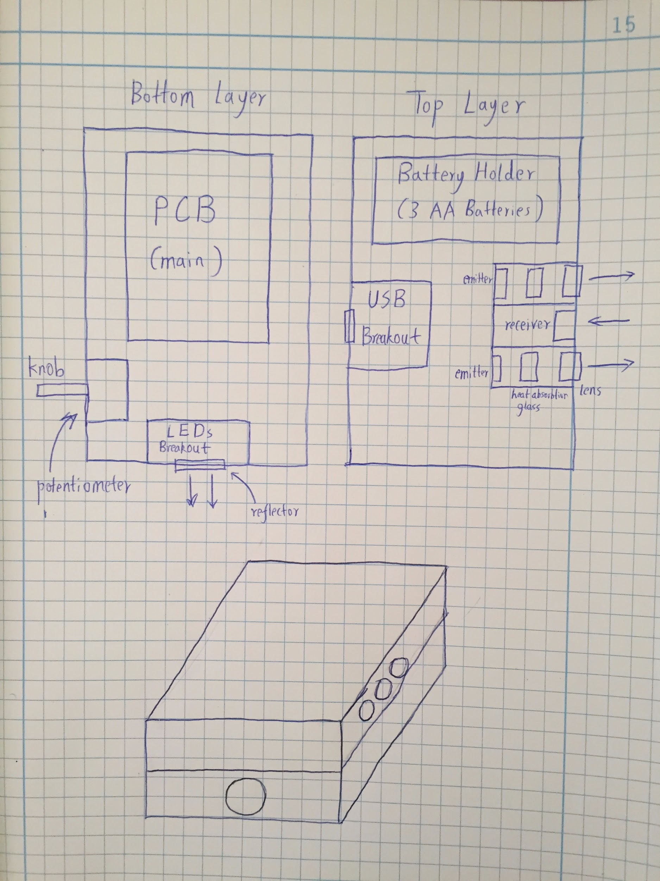
Physical Design
2 layers
Emitters and receiver are at same height.
Direction of lasers and direction of LEDs are orthogonal to each other.

Slide 10
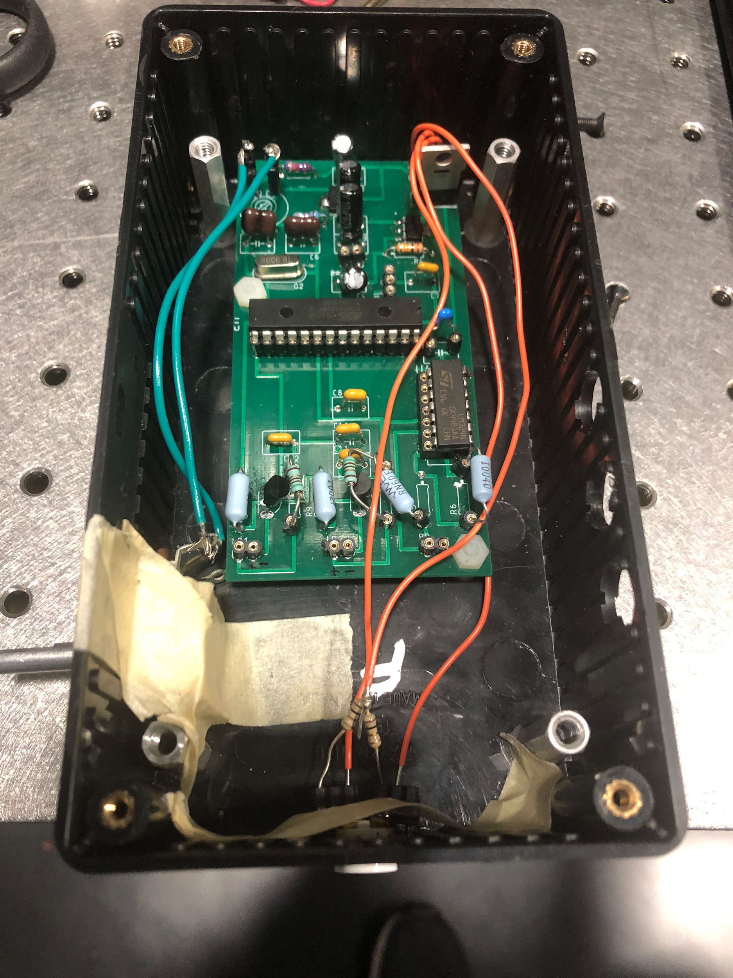
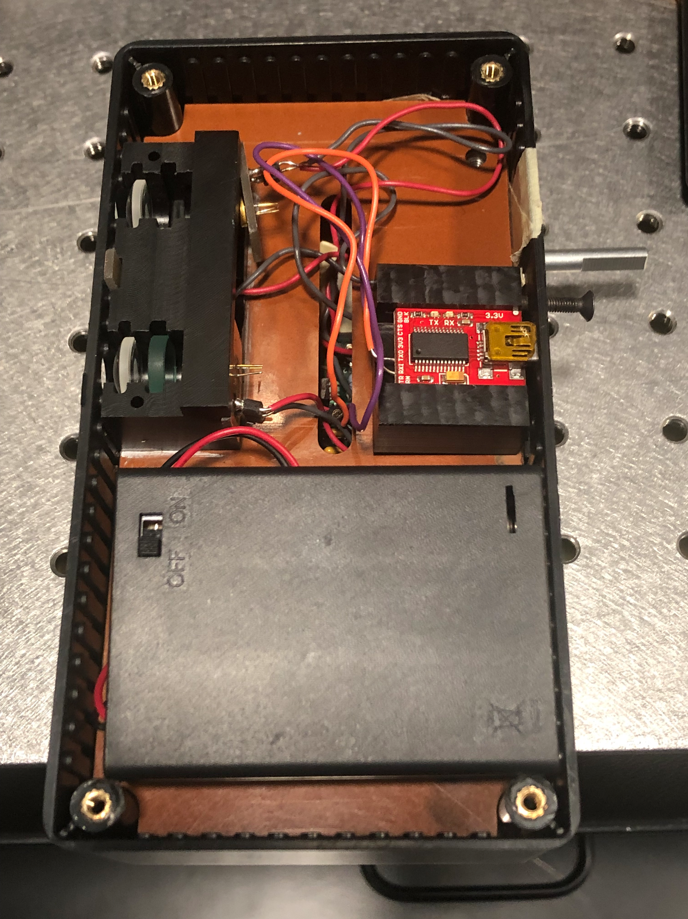
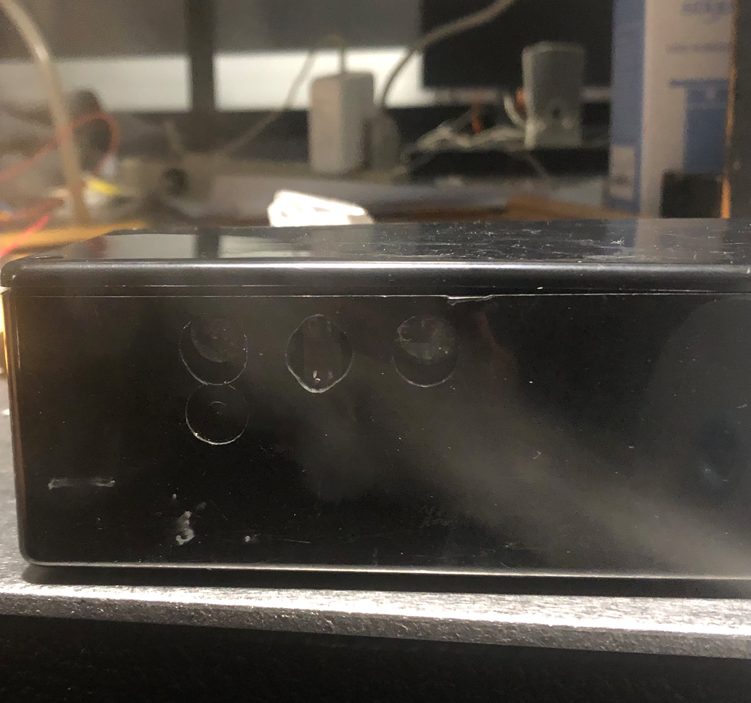
Physical Design

Slide 11
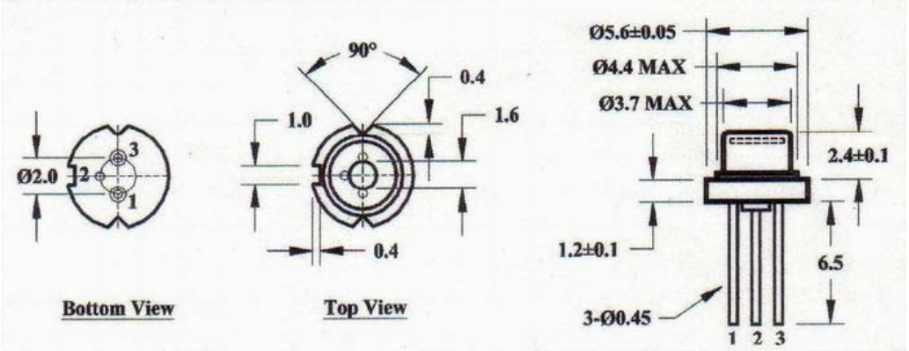
Lasers
5.6mm Diameter
5mW Output
808nm and 850nm
Notes:
We have settled on the lasers that were 5.6mm in diameter, because typically smaller lasers are cheaper and we also didn’t want the size to be too big.
The outputs are 5mW because those were the smallest we were able to find that were affordable and obtainable through resellers. As for the wavelength, as forementioned, we wanted to avoid visible range because we didn’t want passersby to be annoyed with our lasers. Tuneable lasers are astronomical in cost, so we had to stick to whichever wavelengths available yet in the absorption bands of the water molecules. We had chosen 808nm because it was the closest to 820nm absorption peak and 850 for being closest to 808nm

Slide 12
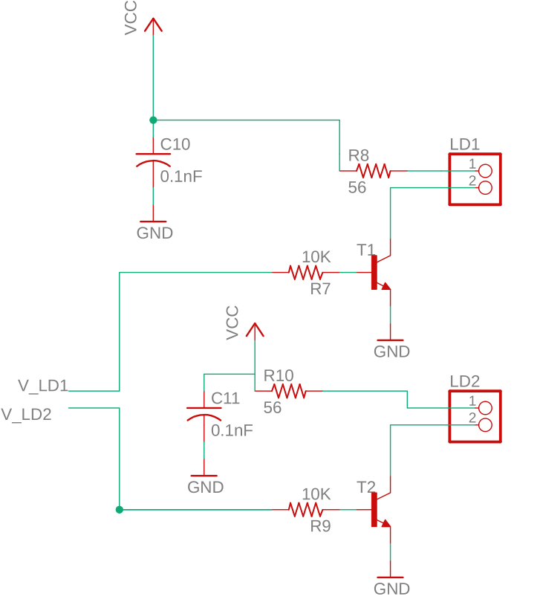
Laser Diode Driving
Microcontroller’s max current : 40mA
Current range of diodes: 22~35mA
Used BJTs to safeguard the microcontroller
Simple resistor to limit current on the diode
Notes:
Laser diodes are very sensitive device. A slightly higher current beyond the operating current will destroy the diode. Also, there are multiple devices hooked up to the microcontroller and we were worried about exceeding the current limit of the microcontroller. Therefore, we used BJTs to switch the diodes on and simple resistors to limit the current. Also the current is held stable because the voltage is regulated by 3.3v voltage regulator.

Slide 13
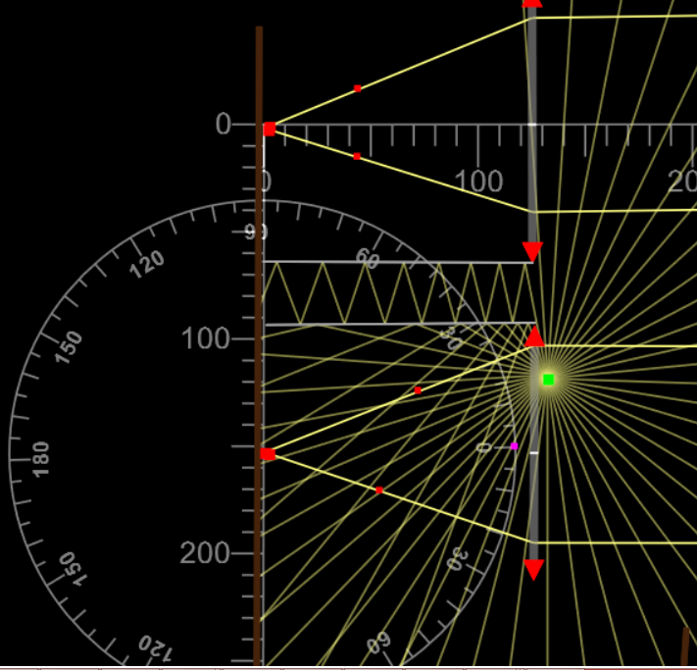
Laser Divergence
Rays from lasers are divergent
Collimate the divergent rays to have a limited range
Notes:
The laser rays are divergent. According to the datasheet of the laser, we have 23~35 degrees of divergence on perpendicular axis and 7.0 ~ 12 degrees of divergence on parallel axis. We collimated the rays so that the range of rays would be limited which limits the range of scattering.

Slide 14
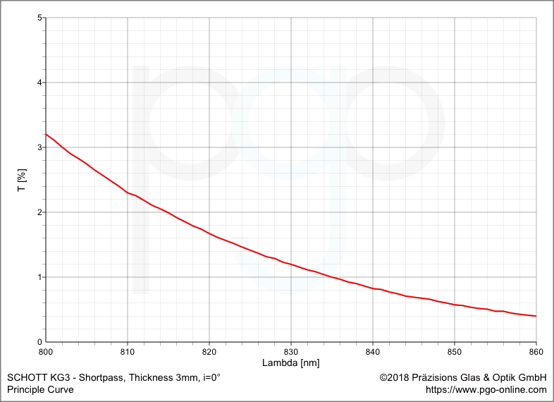
Eye Safety
5mW is enough to cause permanent eye damage
Use heat absorbing glass to attenuate the power level
Complies with ANSI Z136.1
Notes:
5mW is enough to cause eye damage and we had to attenuate the power. We looked at options of attenuation around 800 to 850nm and we found heat absorbing glasses.
They were able to bring down the power by approximately 2.5% at 808nm and at 850, 0.5%. We wanted to make sure that this wouldn’t blind people not only during the demo but also when out in public, so we verified this.

Slide 15
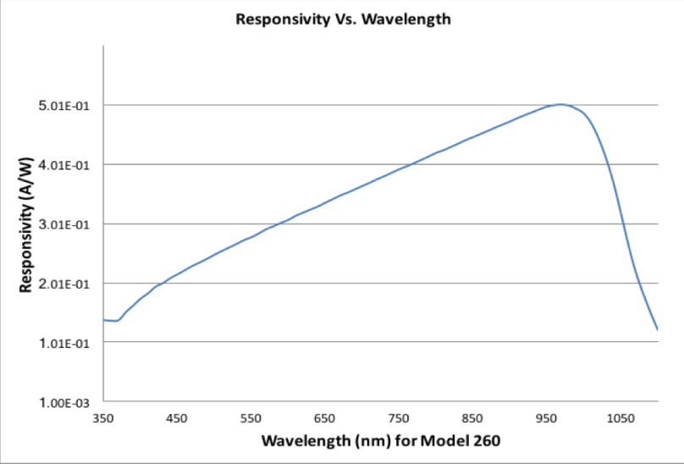
Eye Safety Verification
Used UDT-260 Photodetector
Measured the output of our system at point blank range
Notes:
We measured the output power of our system at point blank range using a photodetector with known responsivity curve.

Slide 16
Verification Continued
We measured:
18.3 uA @ 808nm
14.4 uA @ 850nm
The photodetector’s responsivities approximately are:
0.401 A / W @ 808nm
0.45 A / W @ 850nm
Resulting measured optical power are:
0.0456 mW @ 808nm
0.032mW @ 850nm
Notes:
We got the current from the detector and using the responsivity of the photodetector, we got the following results.

Slide 17
ANSI Z.136.1 Maximum Permissible Exposure
10^{0.002*(λ-700)} mW * cm⁻²
1.644 mW * cm⁻² @ 808nm. 1.995 mW * cm⁻² @ 850nm
Lens Diameter 1.25cm
Our System:
0.0456 mW / 1.227 cm⁻² = 0.0372 mW * cm⁻²
0.032 mW / 1.227 cm⁻² = 0.026 mW * cm⁻²
Notes:
For lasers from 700 to 1050nm, ANSI Z.136.1 dictates that MPE for 10 to 30000 second exposure to the beam is 10^{0.002*(λ-700)} mW * cm⁻²
Which gets the following upper bounds. Our system is way below that.

Slide 18
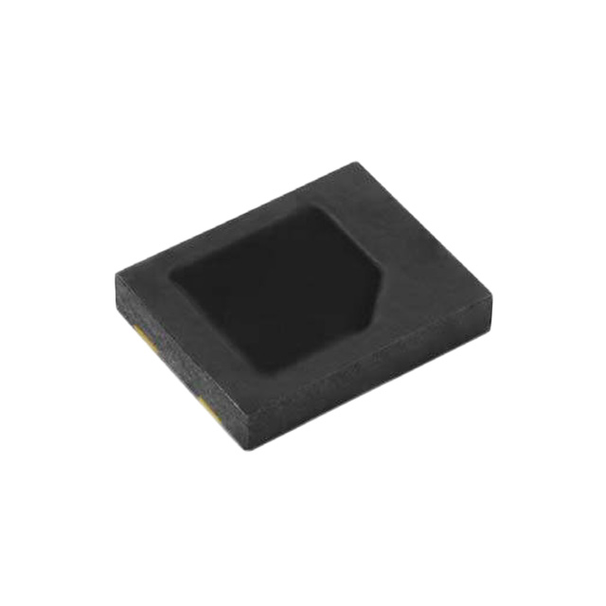
Photodiode
Most sensitive one we could find
Built-in IR filter
0.03uA @ 0.01 mW * cm⁻²
Notes:
As to measure our backscattering, we’ve decided to use a photodiode. This photodiode is the most sensitive one that we found. Another attractive thing was it had a built-in IR filter so that other bandwidths we aren’t interested would be filtered.

Slide 19
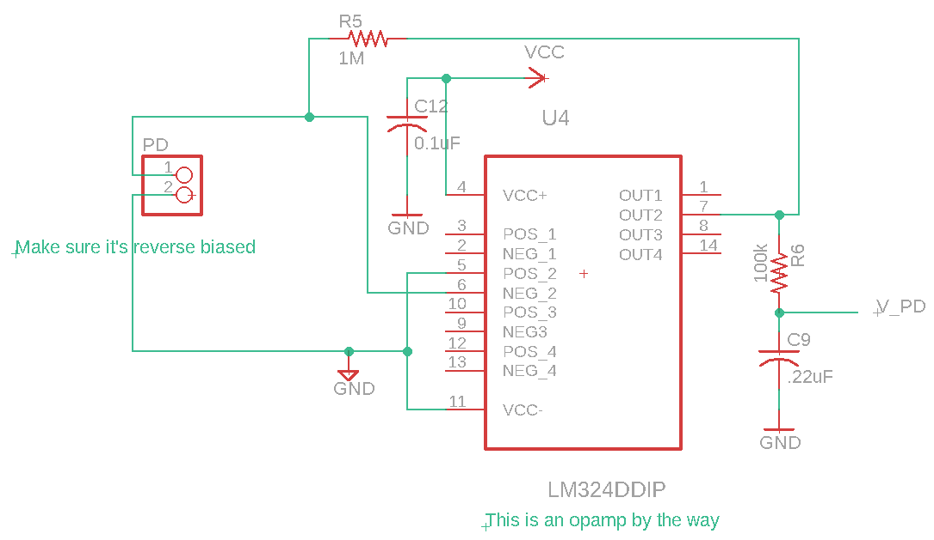
Photodiode Circuit
Photodiodes operate usually in reverse bias
V_{out} = I_{PD} * R_{feedback}
R_{feedback} = 1MΩ
Lowpass RC filter at 7.62Hz
Notes:
Since the output current is very tiny, we have used an opamp to amplify our current and convert into voltage. 1Mohm negative feedback resistor is used to achieve a high gain and output is filtered out with a passive RC low-pass filter, since sensors are noisy by nature.

Slide 20
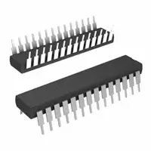
Microcontroller
ATMega 328P - PU
8 bit 32 KB flash memory
Operates from 1.8 - 5.5 V
Notes:
The microcontroller we used was the ATMega 328P - PU. It has 28 pins and is an 8 bit microcontroller with 32 Kb of flash memory which is more than enough for our program. It can operate from 1.8 - 5.5 V which is optimal for our needs since our circuit runs on 3.3 V.

Slide 21
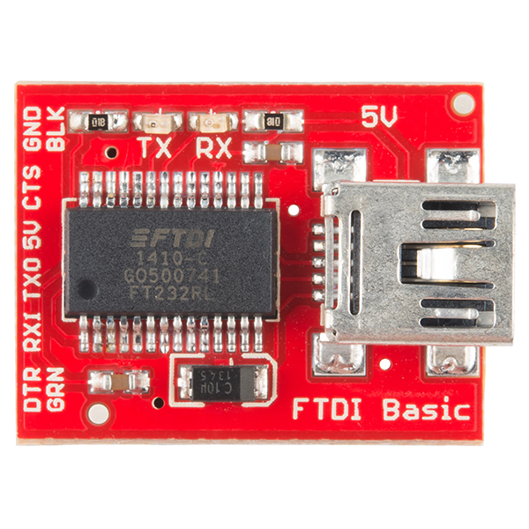
USB Communication
LEDs
FT 232 R Chip
Breakout board with 6 headers
Auto - resets Arduino sketches
Notes:
Used an FT232 R chip for USB communication and used a serial breakout board with 6 headers which allows for easy access. Has LEDs which show USB communication easily. The DTR pin also allows for auto resets for Arduino sketches.

Slide 22
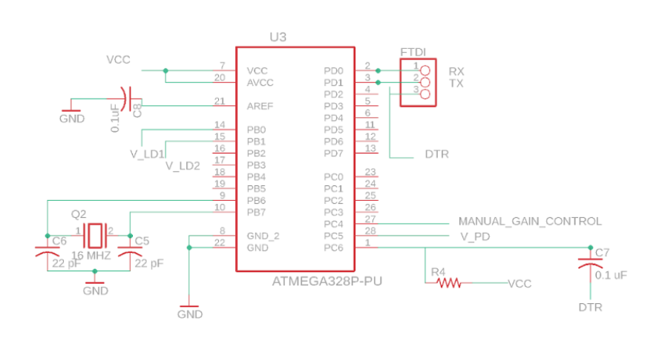
Schematic
Schematic for microcontroller and subsystems
USB communication
External Clock (16 Mhz)
Notes:
This is the basic schematic for the microcontroller unit. The boxes represent the subsystems which were externally connected to the microcontroller in order for it to properly work. We use an external clock for the ATmega since the clock allows us to run at a speed of 16MHz as compared to the 8MHz internal clock present. Also the internal clock might not be as precise as the external clock. The internal clock might also be sensitive to temperature and voltage. The capacitor to the DTR pin allows for auto resetting.

Slide 23
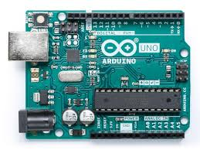
Programming Microcontroller
Added Arduino Bootloader for bypassing the need to buy a programmer
Used Arduino IDE for programming and monitoring outputs
Notes:
Bootloader is needed to add new firmware onto the microcontroller.
Used the Arduino ISP sketch along with an Arduino UNO to burn the bootloader.

Slide 24
Code Requirements
Microcontroller should be able to control LEDs as required
The LEDs should be switched on due to the backscattering
Laser diodes should be switched on in an alternating fashion
Measure photodiode values before switching to the other diode
Notes:
The code for the microcontroller had a few high level requirements. The first one was to control multiple LEDs at once. The next and most important feature was to empirically test what threshold would give the most difference between photodiode values and switch on the LEDs from backscattering. The third requirement would be to switch on the laser diodes in an alternating way to record the values of the receiver.

Slide 25
Code Breakdown
#define LD1 8 #define LD2 9 #define LED A4 #define PD A5 bool LD1_ON false; int PD_values[2]; int threshold = 10;
void setup() { pinMode(LED, OUTPUT); pinMode(PD, INPUT);
pinMode(LD1, OUTPUT); pinMode(LD2, OUTPUT); Serial.begin(9600); PD_values[0] = 0; PD_values[1] = 0; }
Notes:
PC4 : LED PC5 : Photodiode PB0 : Laser Diode 1 PB1 : Laser Diode 2
This code sets up the variables we need to actually work through the microcontrollers requirements.

Slide 26
Code Breakdown
void loop() { // put your main code here, to run repeatedly: if (LD1_ON) { digitalWrite(LD1, HIGH); PD_values[0] = analogRead(PD); LD1_ON = false; digitalWrite(LD1, LOW); } else { digitalWrite(LD2, HIGH); PD_values[1] = analogRead(PD); LD1_ON = true; digitalWrite(LD2, LOW); } if abs(PD_values[0] - PD_values[1]) > threshold digitalWrite(LED, HIGH); else digitalWrite(LED, LOW); delay(500); }
Notes:
The main code of the program is written here. The Laser Diodes are turned on in an alternating fashion and their backscattered values are recorded by the photodiode. If the difference between those values crosses our defined threshold, then fog has been detected and the LED is turned on else it is turned off. The program would run once every 500ms.

Slide 27
Power Supply
Three AA batteries in series (4.5V Output)
Voltage Regulators
(1) TL1963A-33DCYR: 3.3V Output
(2) TL1963ADCQT: Adjustable Output (Manual Gain Control)

Slide 28
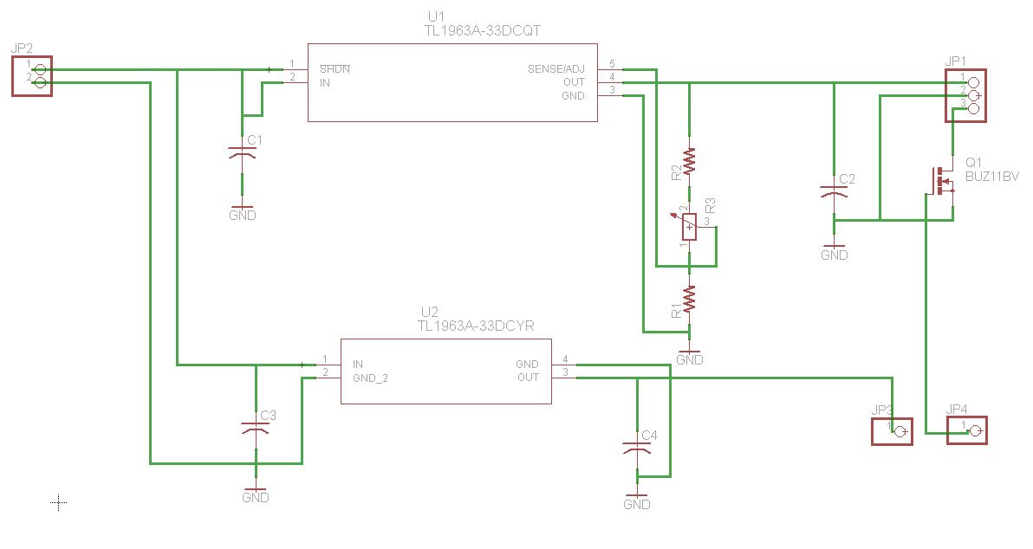
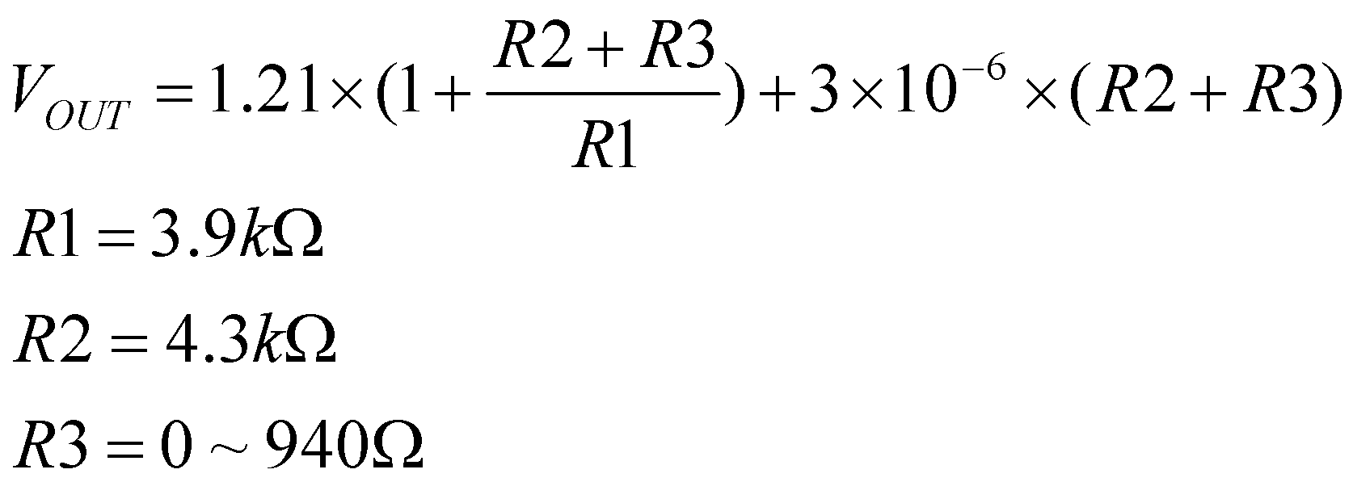
Schematic

Slide 29
Power Supply Tests
AA batteries
TL1963A-33DCYR: 3.3V Output
 | Output Voltage (V)
#1 | 5.42
Input Voltage (V) | Output Voltage (V)
5.50 | 3.30
4.50 | 3.30

Slide 30
Power Supply Tests
TL1963ADCQT: Adjustable Output
Input Voltage (V) | R1(Ω) | R2(Ω) | R3(Ω) | Output Voltage (V)
4.51 | 4k | 4k | 1.5k | 2.90
5.50 | 3.9k | 4.3k | 3 | 2.56
5.50 | 3.9k | 4.3k | 940 | 2.85

Slide 31
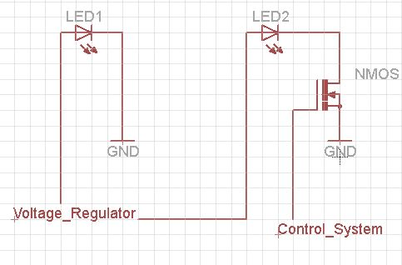
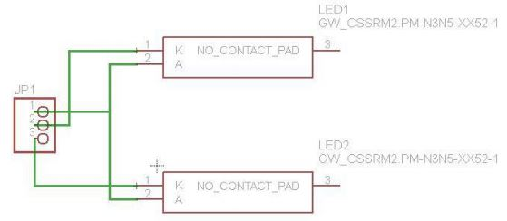
LEDs
Typical Forward Voltage:
V _{F}= 2.8V
Gate Threshold Voltage:
V _{GS} = 2.35V max

Slide 32
LED Tests
Forward Voltage (V) | State
2.90 | On
2.80 | On
2.70 | On
2.60 | On
2.50 | On (dim)
2.40 | Off
From power supply tests:
Vout = 2.56V ~ 2.85V

Slide 33
Post-Mortem Analysis
Laser wasn’t strong enough
Photodiode wasn’t strong enough
Notes:
We tried our best but unfortunately our project failed to detect fog. Interelated, but the reasons why we failed is because laser wasn’t strong enough and the photodiode wasn’t strong enough. In order to be eyesafe, we had to lower the power, but with our means, it might’ve lowered too much to even measure a back scattering. Now if the photodiode was strong enough, it might’ve been able to pick it up, but our photodiode was the best that we’ve found. So, in retrospect, DIAL might’ve been too far fetched of a system for us to build.

Slide 34
Further Work
Alternative laser attenuation
More sensitive photodiode
See if there are safe alternative ways to detect fog
Notes:
If we were to continue on, we would like to work on

Slide 35
Acknowledgements
The team would like to thank the following people:
Anthony Caton
Arne Fliflet
Peter Dragic
Kavita Desai
Glen Hedin
Chenfei Hu
Casey Smith
and others that we’ve gotten support from

