Slide 1
Wearable Communication Device for Mute and Deaf
Group 19: Andrew Ko, Yihan Ruan, Minho Lee
December 7th, 2021

Slide 2
Objective / Introduction
What problem does this solve?
Department of Electrical and Computer Engineering
GRAINGER ENGINEERING

Slide 3
Objective / Introduction
Introduction
Most solutions aim to make the majority feel convenient where they can make more profits. Consequently, we thought it was a good idea to design our project to focus on the people with disabilities and bringing comfort in their everyday lives.
The user will be able to see what he types in, essentially on what is like your regular online chat room. This way, deaf and mute people will be able to have conversations with people other than just those around them who know how sign languages work.
Department of Electrical and Computer Engineering
GRAINGER ENGINEERING

Slide 4
Objective / Introduction
Objective
Most of the time, random encounters and socializing proves to be difficult for Deaf and Mute people as sign languages are not one of the popular options in the verbally dominant world.
Although there are many alternatives in which the user can communicate with people without disabilities, most of the time, they either require the internet or that you have your phone with you
The typing on your phone can never get as fast as to allow for real time communication and the device does not require internet connection for usage.
Department of Electrical and Computer Engineering
GRAINGER ENGINEERING

Slide 5
Design
Department of Electrical and Computer Engineering
GRAINGER ENGINEERING

Slide 6
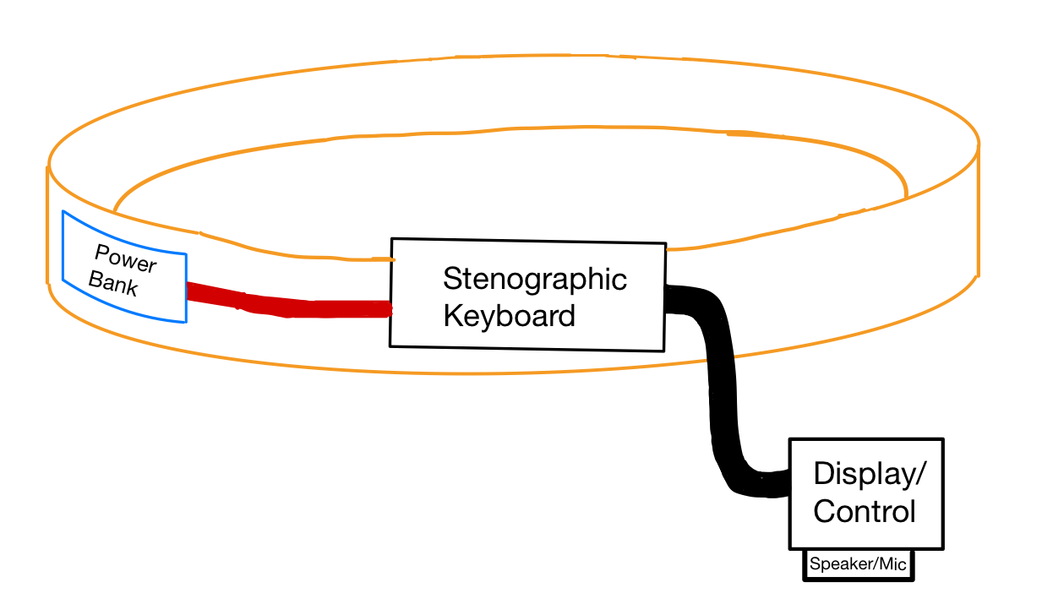
Design
Design changes
Changed Design
Initial Design
Department of Electrical and Computer Engineering
GRAINGER ENGINEERING

Slide 7
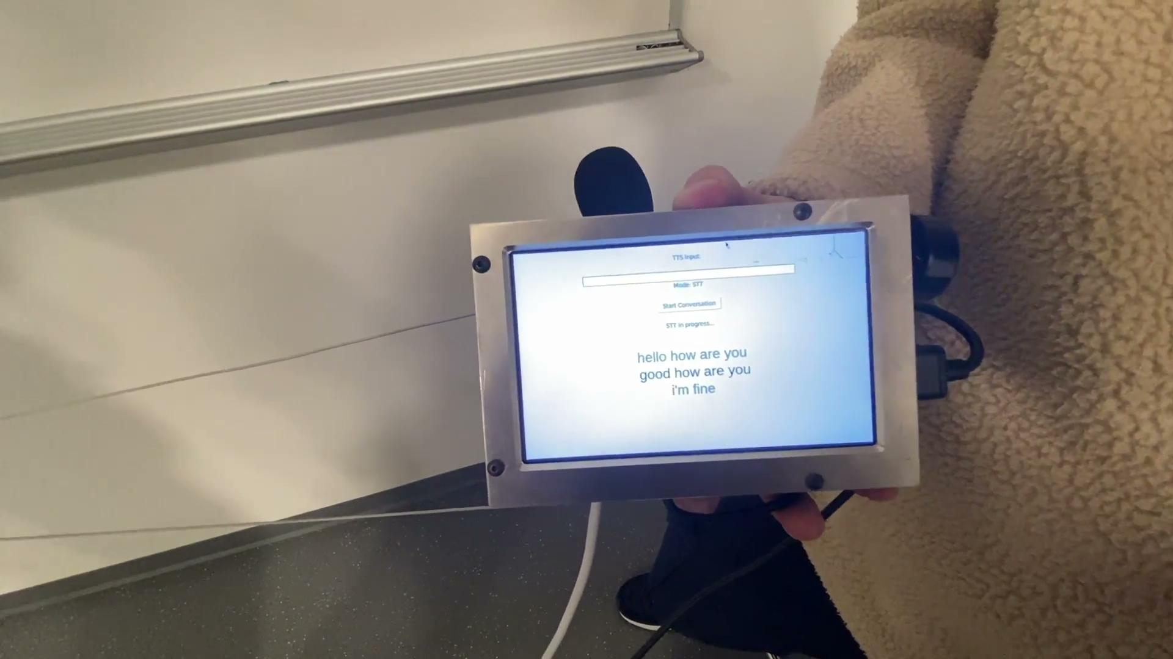
Design
Demo Video
Department of Electrical and Computer Engineering
GRAINGER ENGINEERING

Slide 8
Design
High-Level requirements
Users can have real time communication without using sign languages. Users should be able to type with the keyboard as fast as 150 words/min.
The user can see the interactors’ words instantaneously in milliseconds.
The speaker produces clear and audible sound at a talking distance away (6ft).
Department of Electrical and Computer Engineering
GRAINGER ENGINEERING

Slide 9
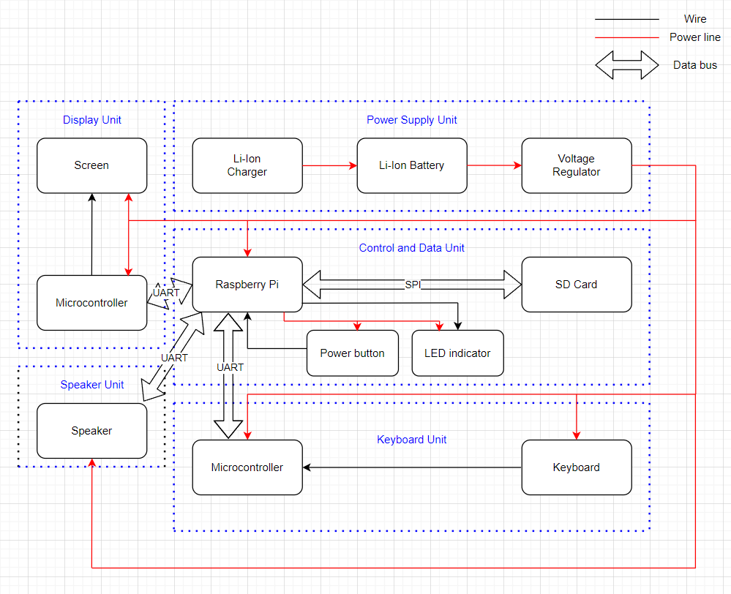
Design
Block Diagram
CHART / GRAPH
Department of Electrical and Computer Engineering
GRAINGER ENGINEERING

Slide 10
Power Bank
Department of Electrical and Computer Engineering
GRAINGER ENGINEERING

Slide 11
Power Bank
Power Bank R&V
7 hrs battery life.
Outputs 5V 2A.
Charging through USB cable Power Consumption
Battery Protection
Department of Electrical and Computer Engineering
GRAINGER ENGINEERING

Slide 12
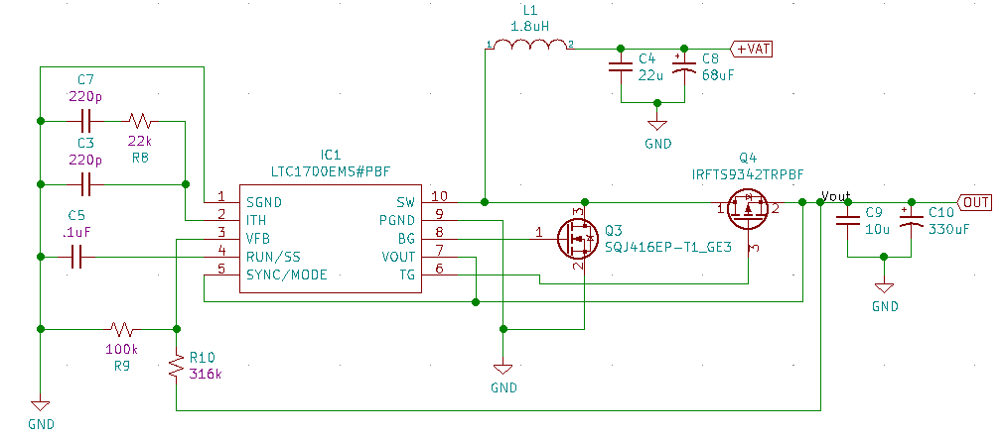
Power Bank
Voltage Regulator
Department of Electrical and Computer Engineering
GRAINGER ENGINEERING

Slide 13
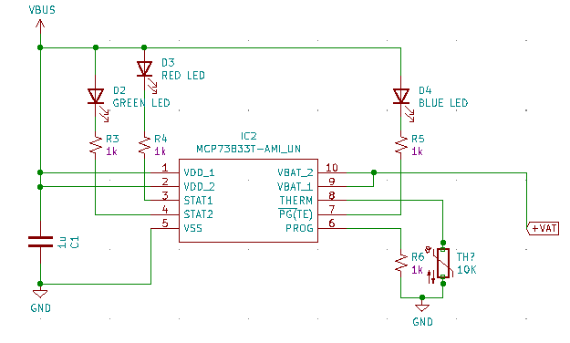
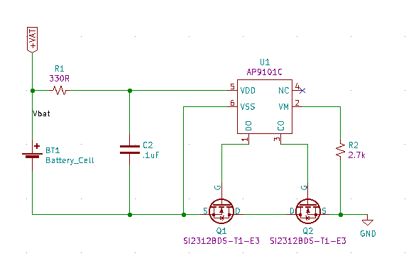
Power Bank
Charger / Protection
Charger circuit
Battery protection circuit
Department of Electrical and Computer Engineering
GRAINGER ENGINEERING

Slide 14
Control / Display
Department of Electrical and Computer Engineering
GRAINGER ENGINEERING

Slide 15
Control / Display
Control Module
Display Module
Connect and transfer signals between different modules
Successfully perform STT and TTS
Device can be turned on or off using one button
Clearly show texts typed by keyboard
Clearly show texts transferred from speech
Display can be charged through connection with raspberry pi
Department of Electrical and Computer Engineering
GRAINGER ENGINEERING

Slide 16
Speaker / Microphone
Department of Electrical and Computer Engineering
GRAINGER ENGINEERING

Slide 17
Speaker / Microphone
Speaker
Microphone
The physical dimension should not be too large to fit in the belt
Produce audio loud and clear enough to hear
Range for microphone is long enough to pick up the interactor’s sound
Sound quality is good enough to be used for STT module
Department of Electrical and Computer Engineering
GRAINGER ENGINEERING

Slide 18
Keyboard
Department of Electrical and Computer Engineering
GRAINGER ENGINEERING

Slide 19
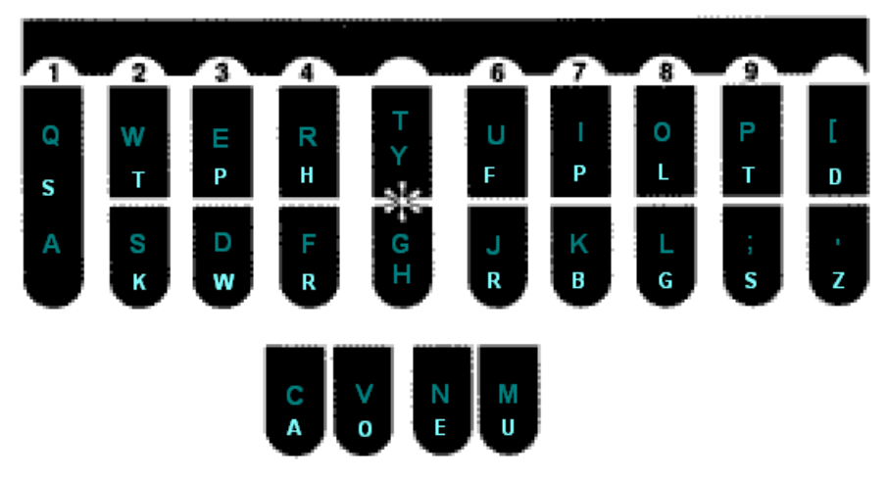
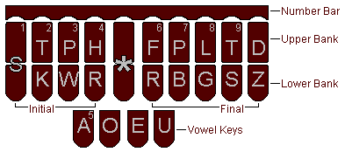
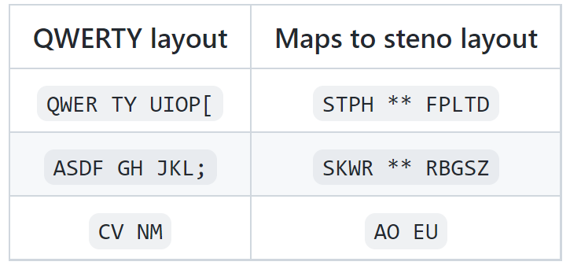
Keyboard
Keyboard Unit
The keyboard should be able to have steno alphabets and be able to run plover.
Users should be able to perform stenography with the keyboard
Stenographic keyboard layout
Department of Electrical and Computer Engineering
GRAINGER ENGINEERING

Slide 20
Keyboard
Keyboard Schematic
Department of Electrical and Computer Engineering
GRAINGER ENGINEERING

Slide 21
Keyboard
Keyboard Schematic
Department of Electrical and Computer Engineering
GRAINGER ENGINEERING

Slide 22
Software
Department of Electrical and Computer Engineering
GRAINGER ENGINEERING

Slide 23
Software
Software Unit
All modules are required to work offline and easy to turn on or off
Modules should not influence each other’s performance
Libraries used for modules
Department of Electrical and Computer Engineering
GRAINGER ENGINEERING

Slide 24
Software
Text-to-Speech (TTS)
TTS Modules
Department of Electrical and Computer Engineering
GRAINGER ENGINEERING

Slide 25
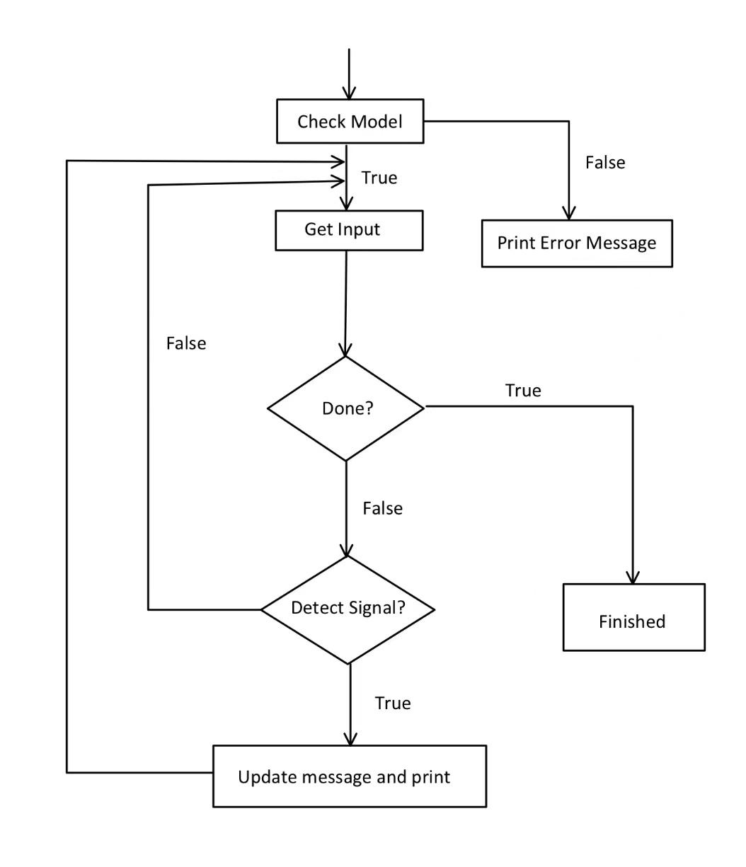
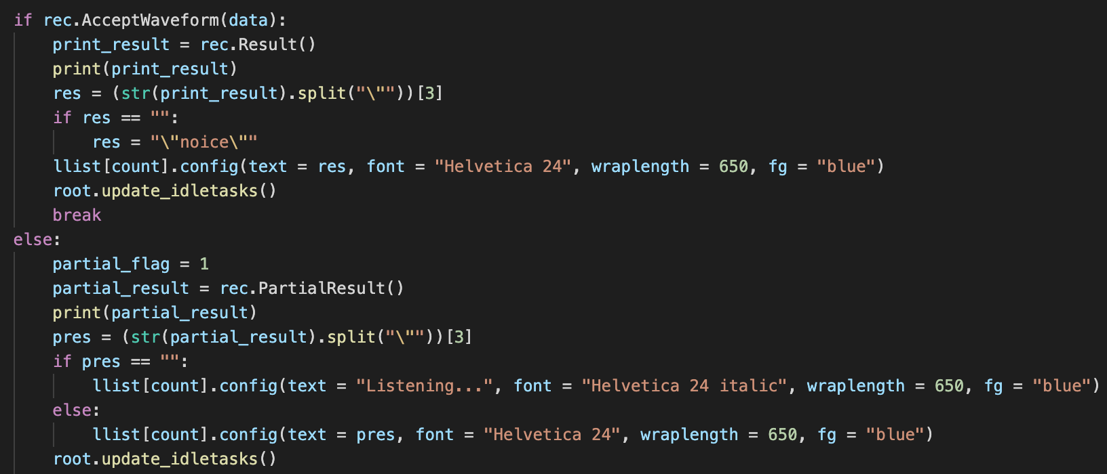
Software
Speech-to-Text (STT)
Code for detect signal
Flowchart for STT
Department of Electrical and Computer Engineering
GRAINGER ENGINEERING

Slide 26
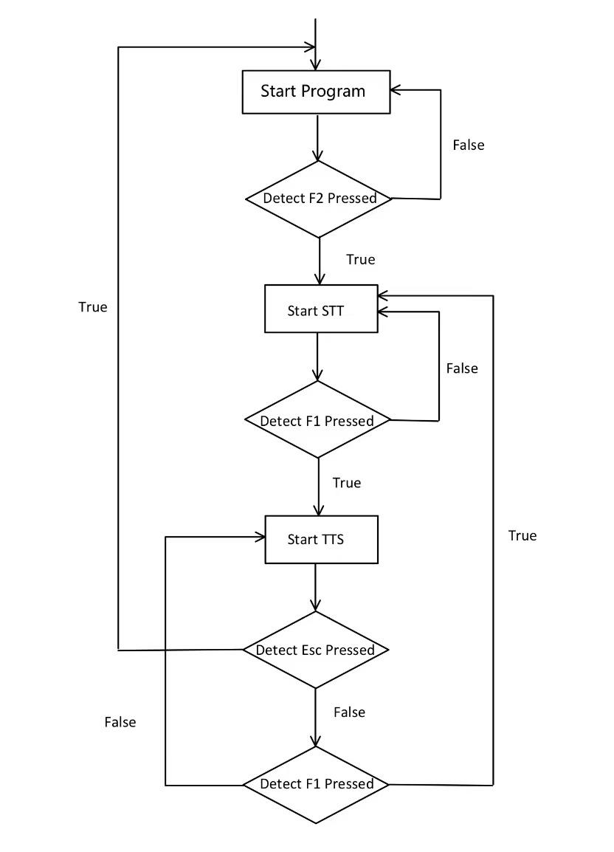
Software
User Interface
Code for Binding Keys
Flowchart for User Interface
Department of Electrical and Computer Engineering
GRAINGER ENGINEERING

Slide 27
Conclusion
what did we learn & future work
Department of Electrical and Computer Engineering
GRAINGER ENGINEERING

Slide 28
Conclusion
Lesson learned
Incorrect data from official website
PCB design with test points
Prioritization of modules
Department of Electrical and Computer Engineering
GRAINGER ENGINEERING

Slide 29
Conclusion
Future Work
Auto start of program
Implement charging through USB cable
Increase the accuracy rate of STT
Improve sound quality and volume for TTS
Make parts lighter
Volume control
Department of Electrical and Computer Engineering
GRAINGER ENGINEERING

Slide 30
Thank You
The floor is open for questions now.
Department of Electrical and Computer Engineering
GRAINGER ENGINEERING

