Slide 1
Motor-Aided Wheelchair
ECE 445
Team 26
Zilin Zhao, Guangxun Zhai, Jiacheng Huang
12/07/2021

Slide 2
Objective
Help the people who push the wheelchair to save effort
ECE445
GRAINGER ENGINEERING

Slide 3
Project Review
ECE445
GRAINGER ENGINEERING

Slide 4
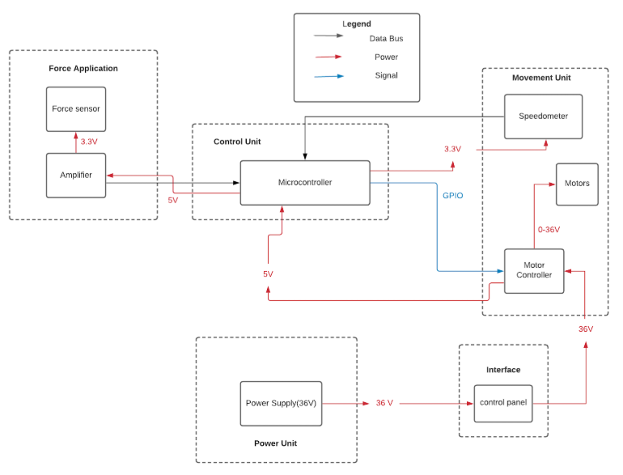
Block Diagram
ECE445
GRAINGER ENGINEERING

Slide 5
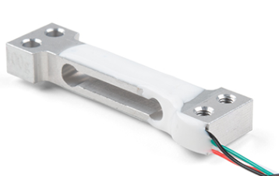
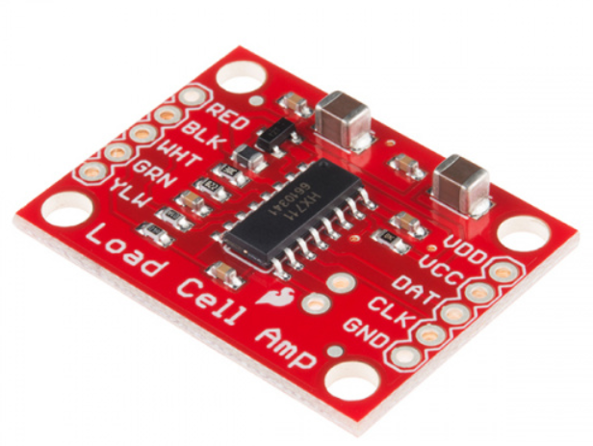
Force Application
A method to control the motor
A source of input
Intuitive
Load Cell
Amplifier
ECE445
GRAINGER ENGINEERING

Slide 6
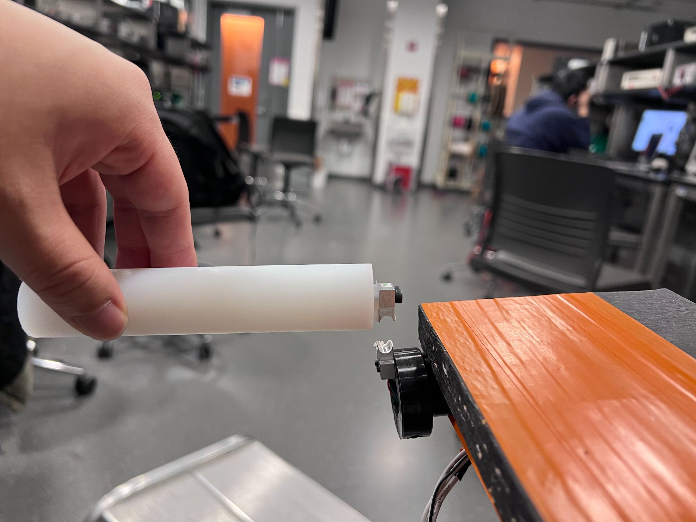
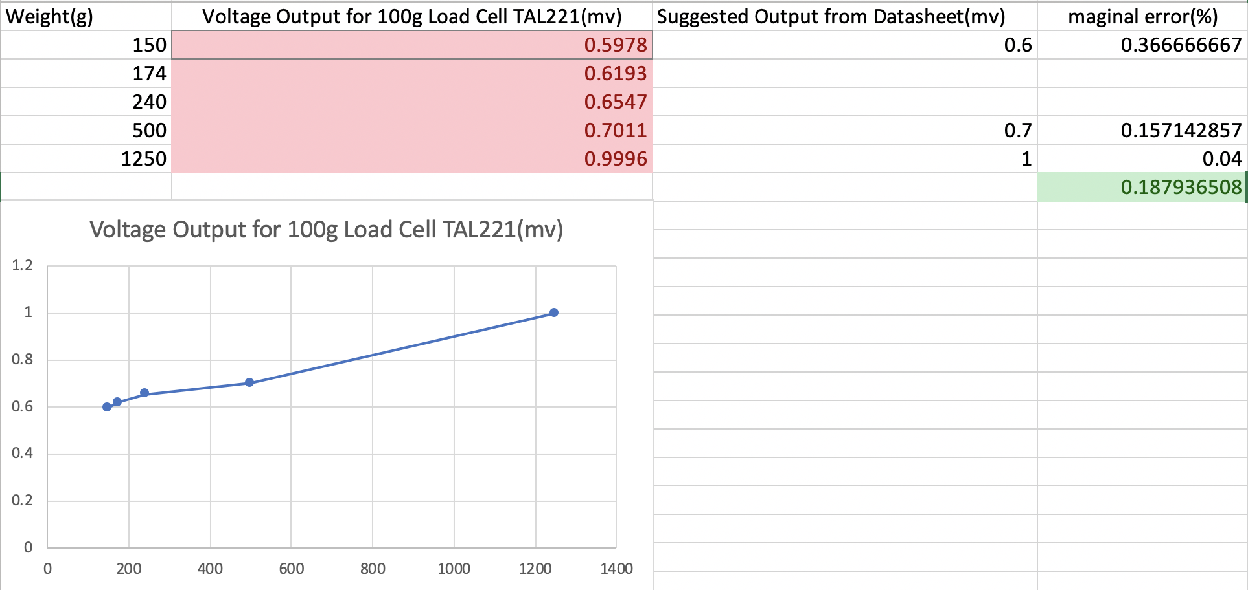
Force Application
100g load cell TAL221
Data for TAL221
ECE445
GRAINGER ENGINEERING

Slide 7
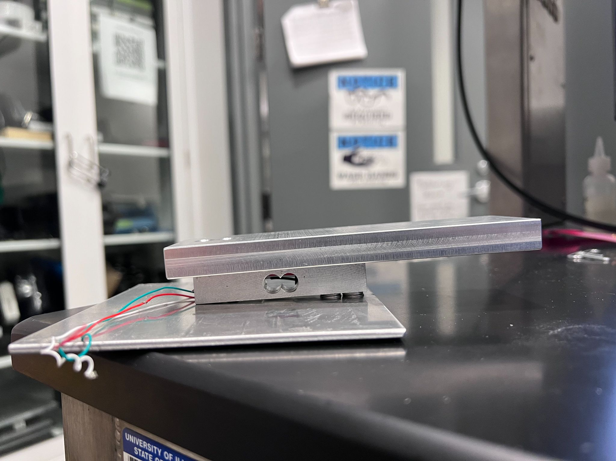
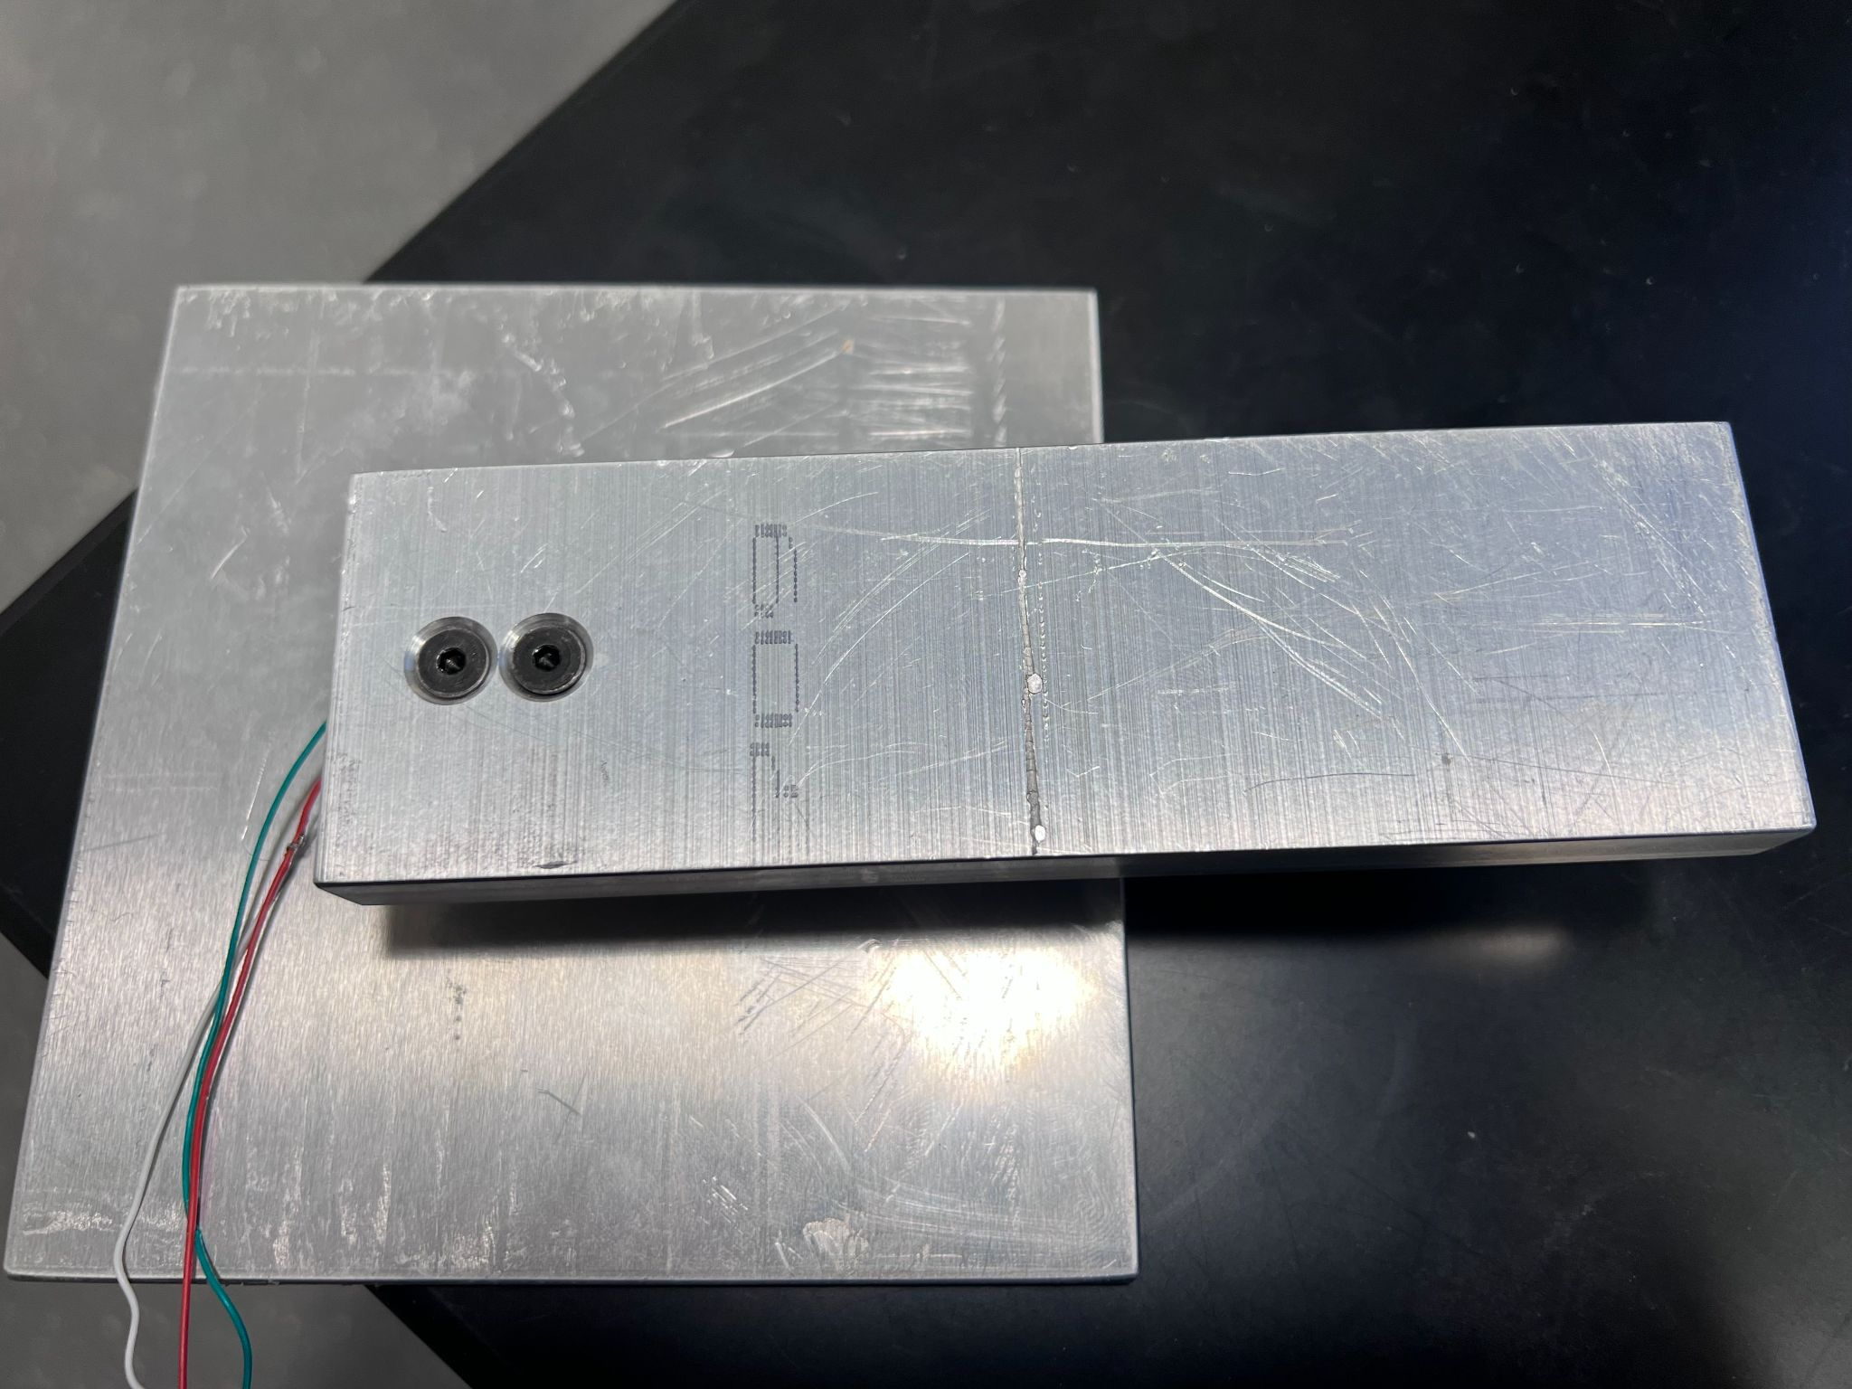
Force Application
Second Load Cell
ECE445
GRAINGER ENGINEERING

Slide 8
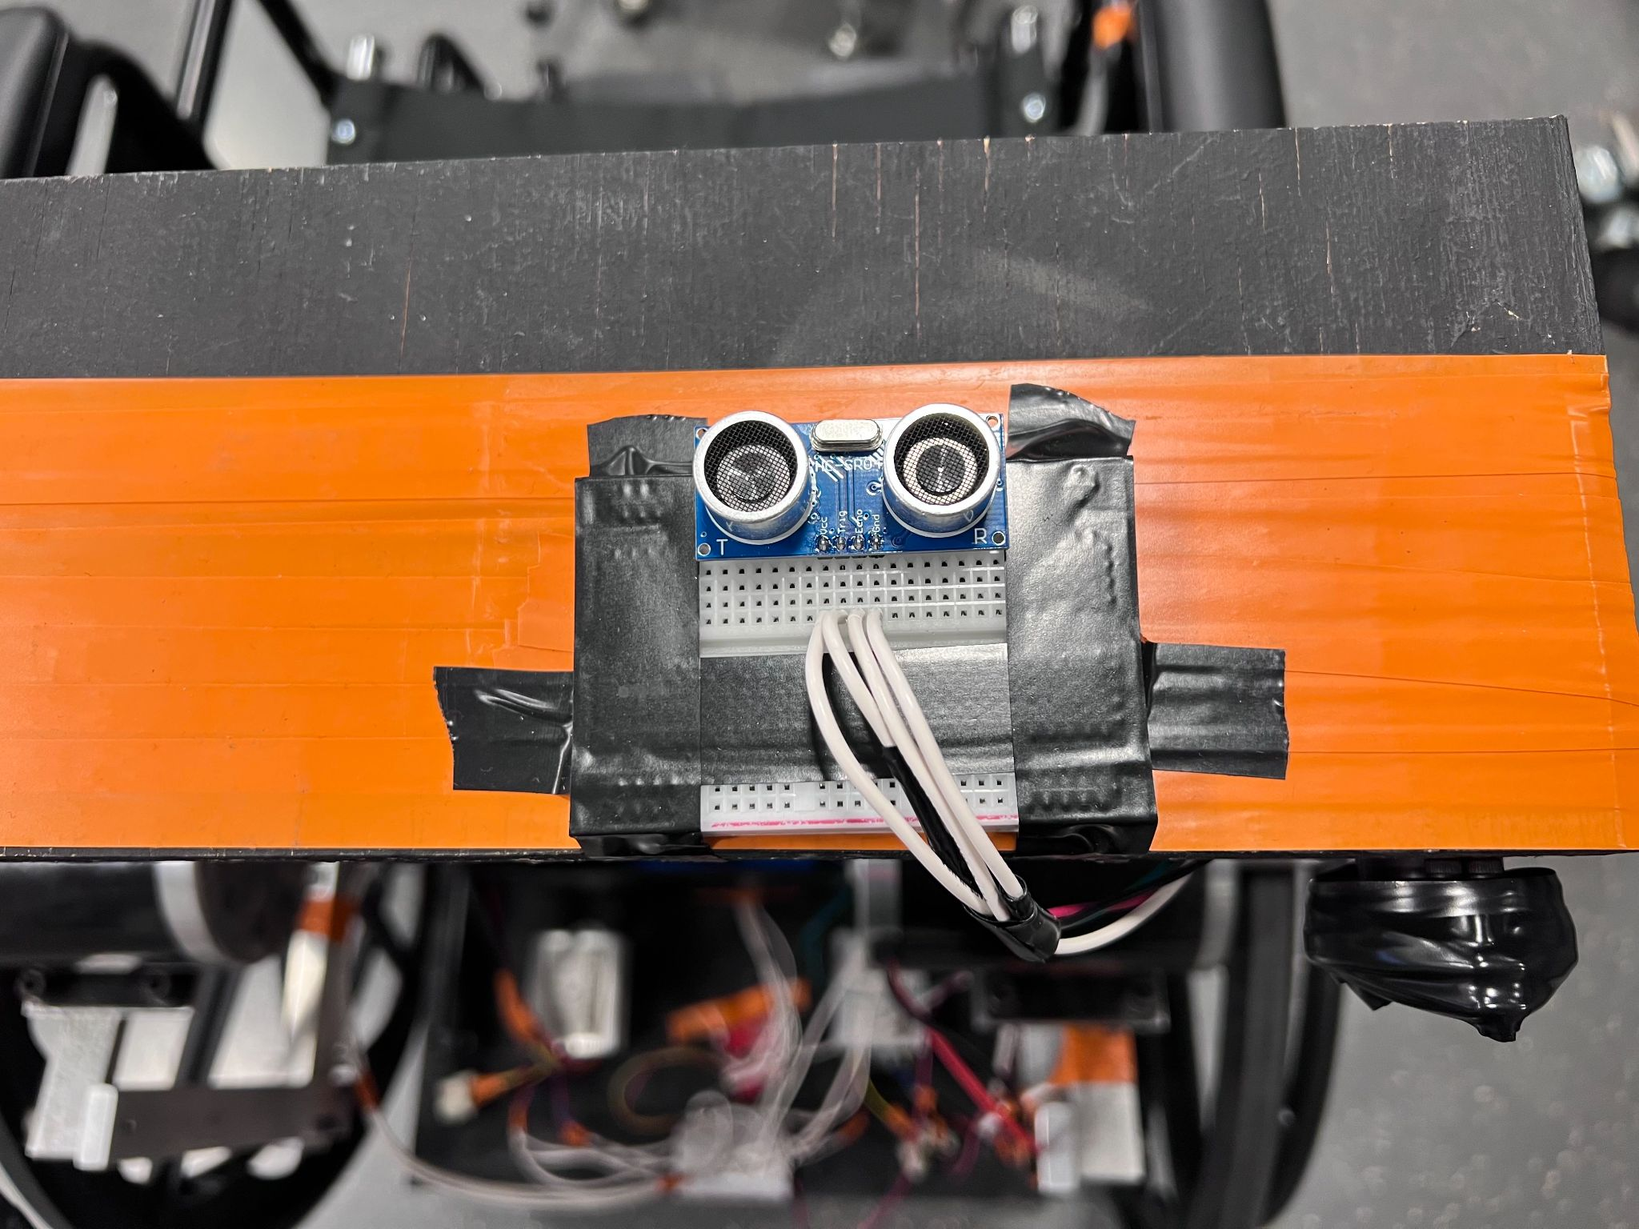
Force Application
Ultrasonic sensor HC-SR04
ECE445
GRAINGER ENGINEERING

Slide 9
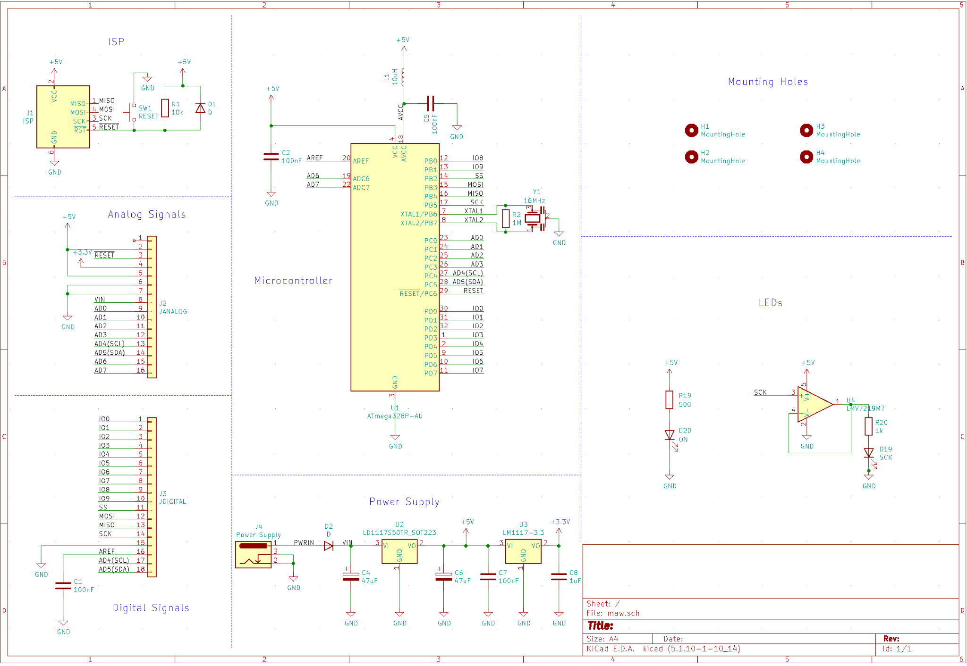
Control Unit
Output of 3.3V and 5V
Reading digital signal from force application unit
Output PWM signal to motor controls
ISP port to program the microcontroller
LEDs that help debug
PCB Schematic
ECE445
GRAINGER ENGINEERING

Slide 10
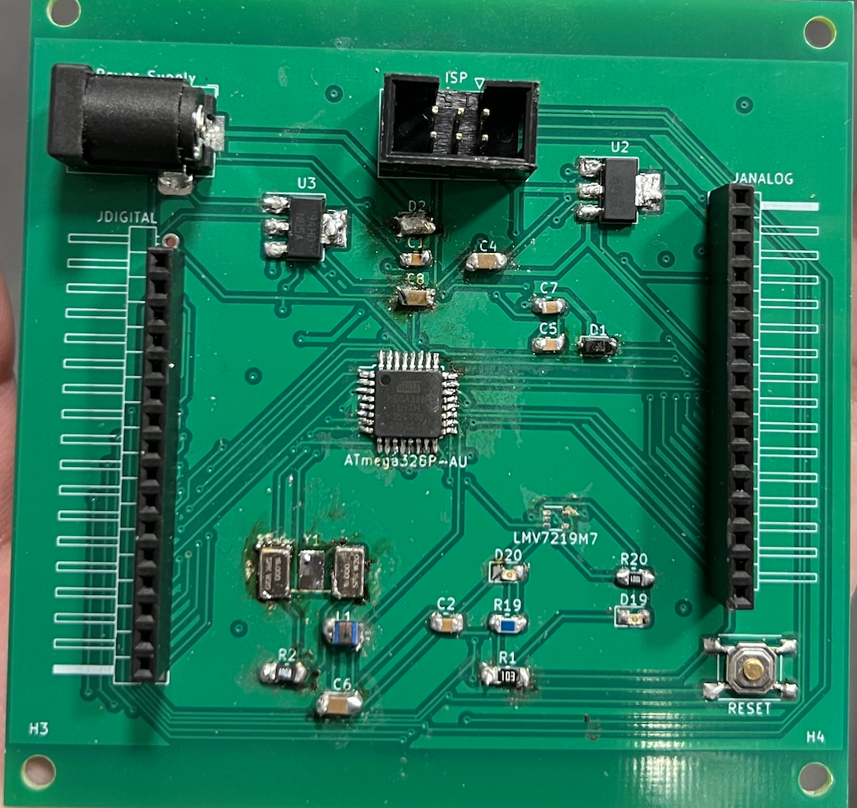
Control Unit
Why it did not work?
Internal frequency from the crystal resonator did not match the signature of the microcontroller chip.
PCB
ECE445
GRAINGER ENGINEERING

Slide 11
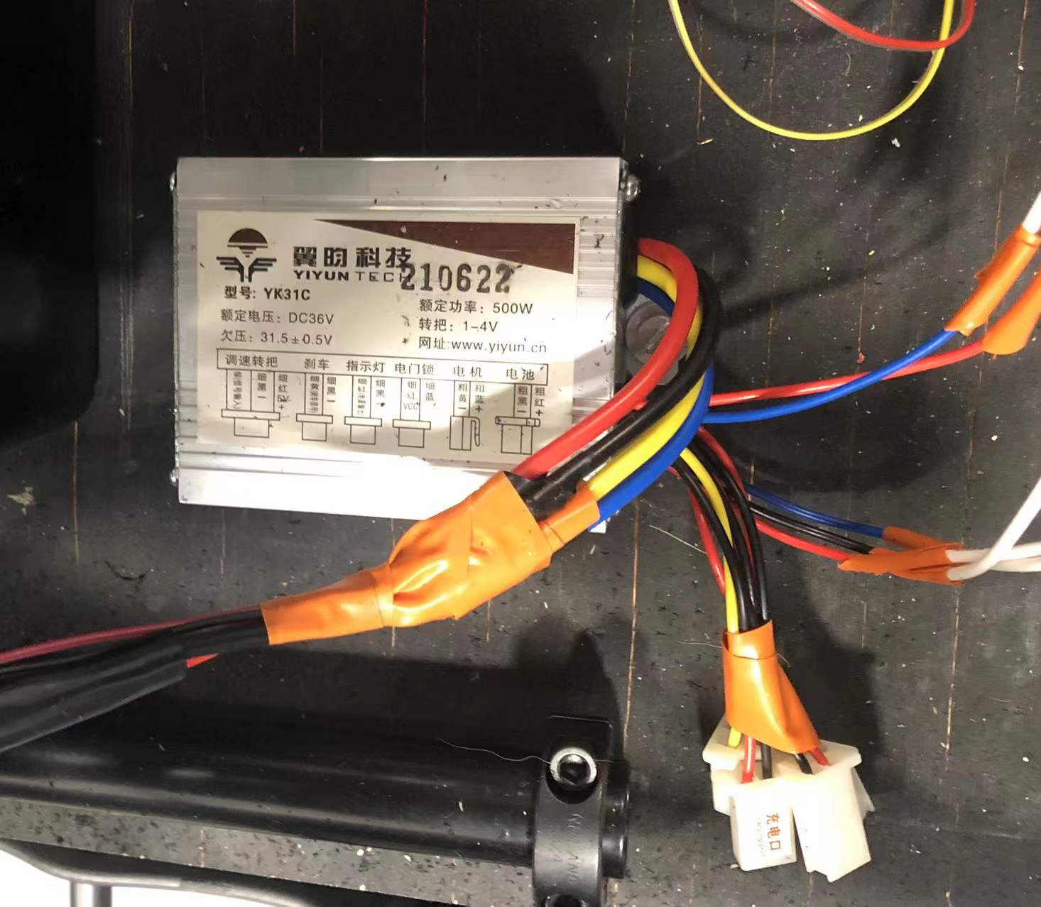
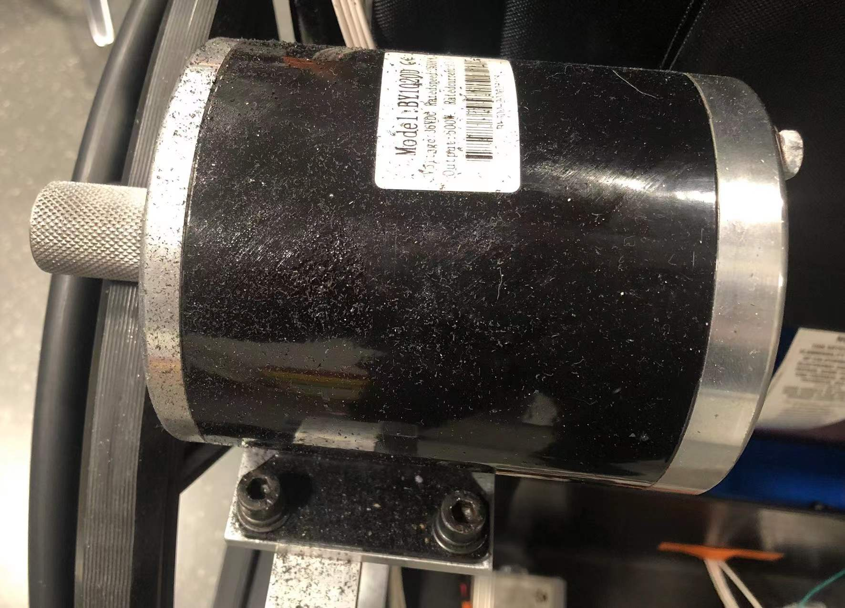
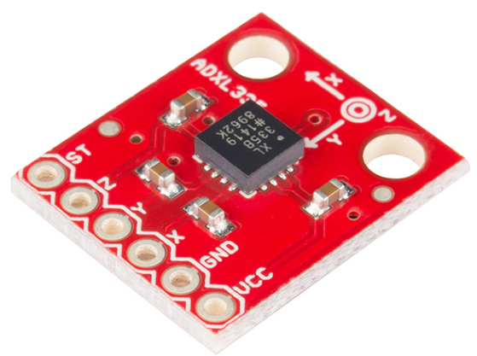
Movement Unit
Accelerometer
Motor Controller
Motor
ECE445
GRAINGER ENGINEERING

Slide 12
Movement Unit
Motor
Battery
Red Board
Switch
Motor Controller
SPD-YK31C
ECE445
GRAINGER ENGINEERING

Slide 13
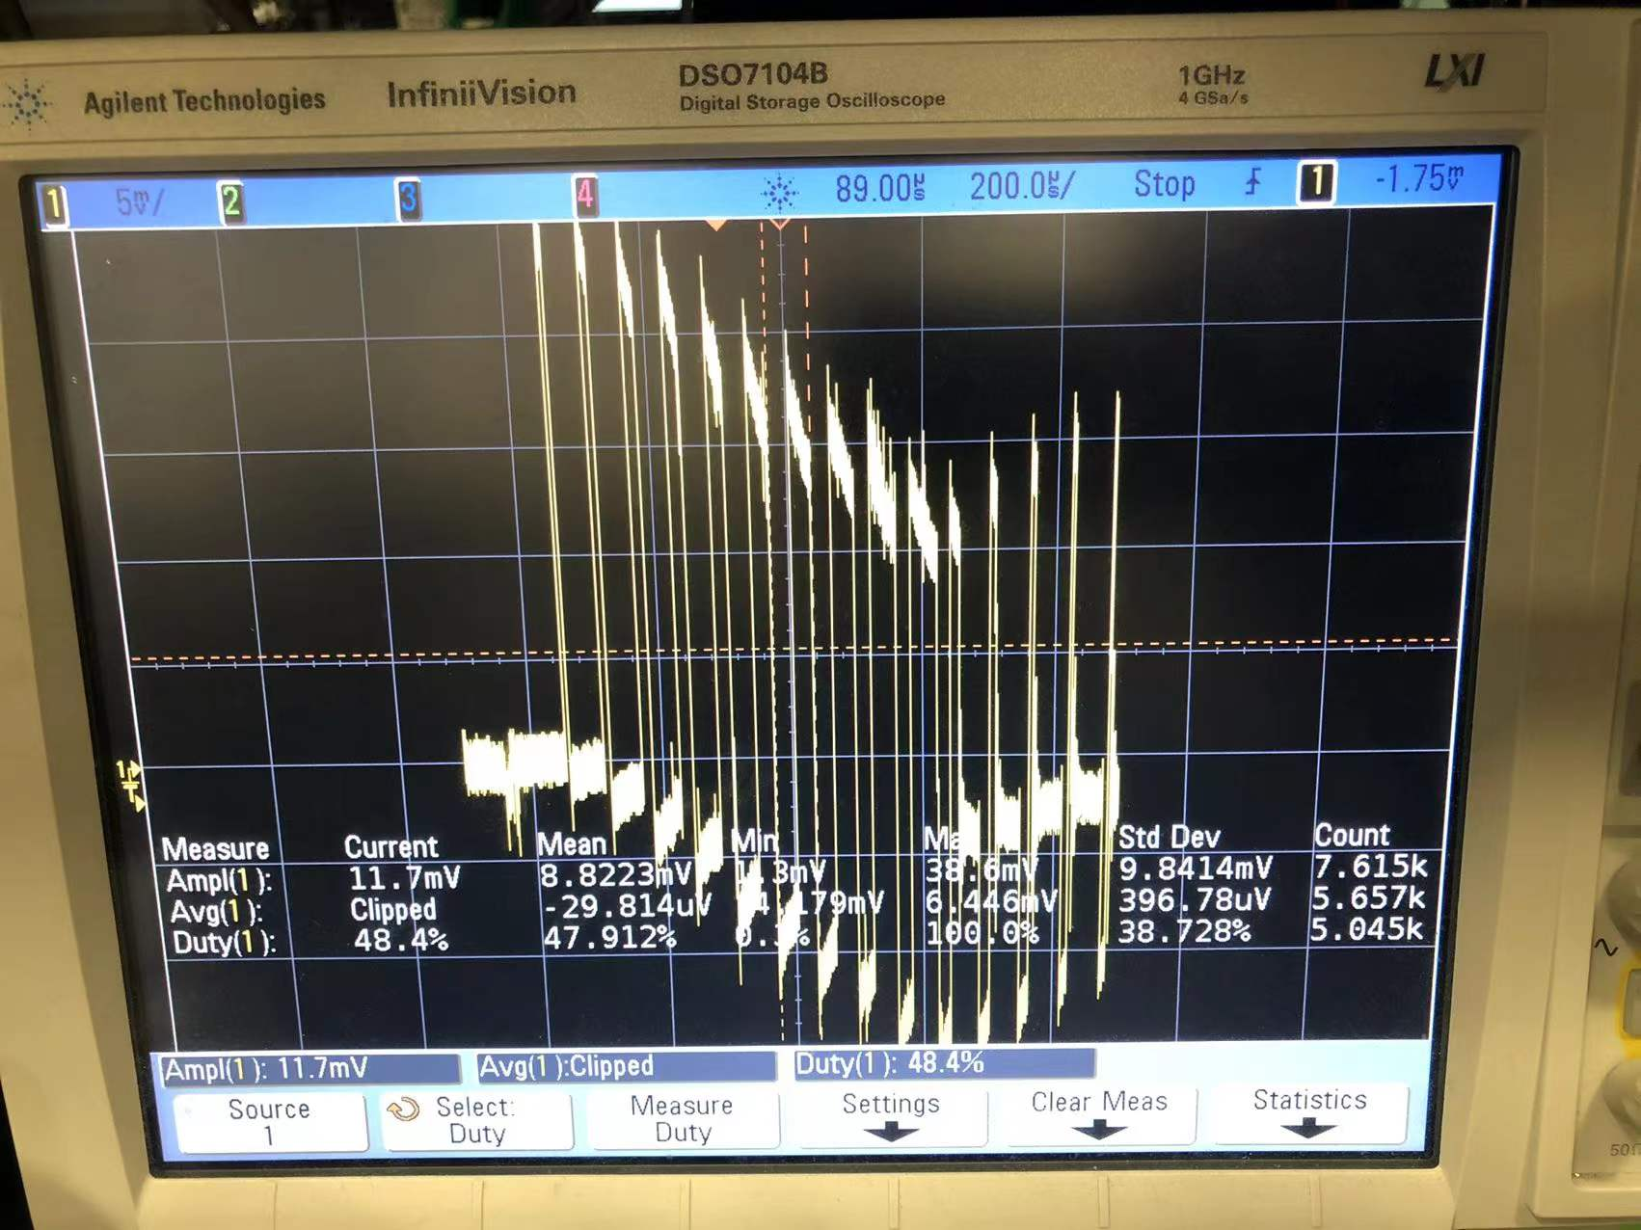
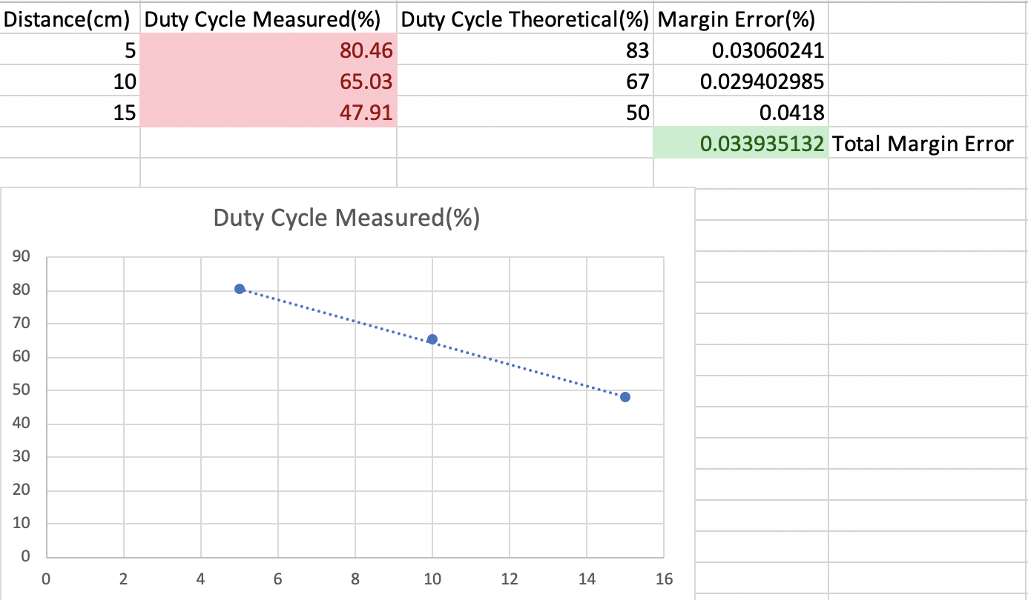
Movement Unit
ECE445
GRAINGER ENGINEERING

Slide 14
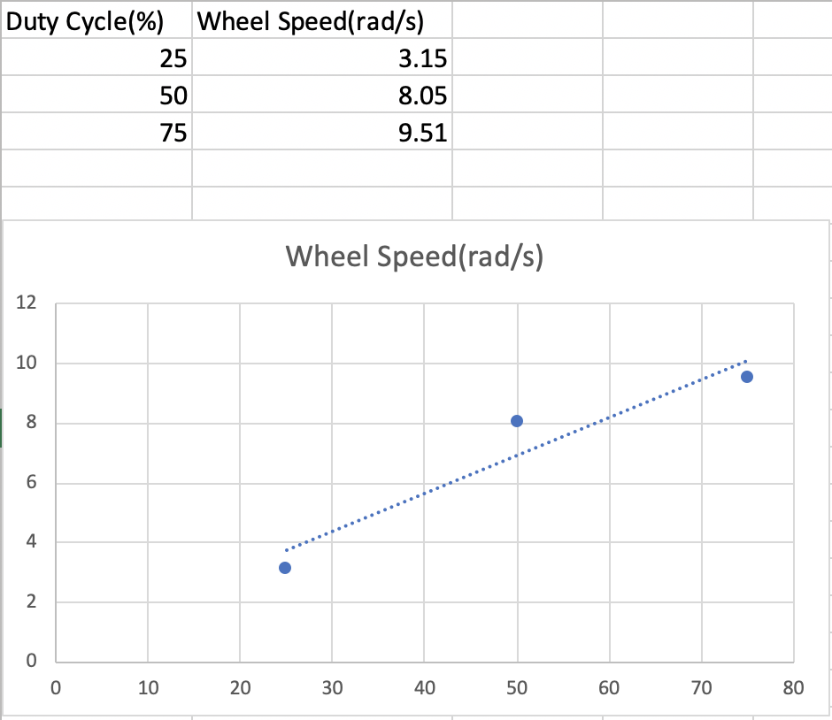
Movement Unit
Motor
BY1020D
ECE445
GRAINGER ENGINEERING

Slide 15
Movement Unit
output: a_x, a_y, a_z.
Integral
Accelerometer
V_x, V_y, V_z
ADXL335
ECE445
GRAINGER ENGINEERING

Slide 16
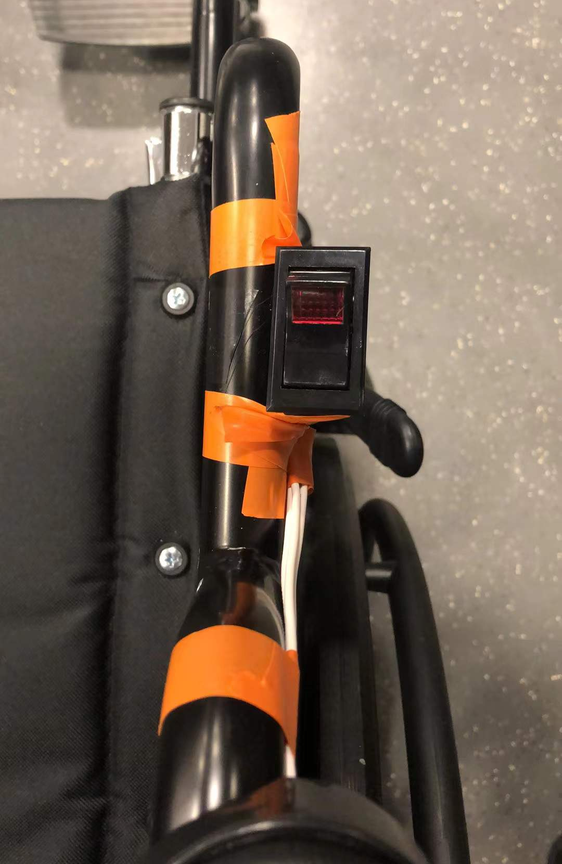
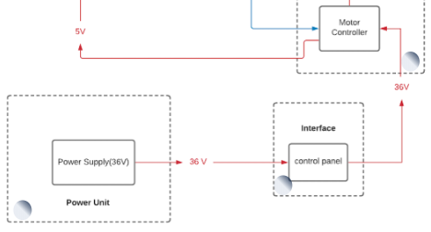
Interface
Tippette Full Sized Rocker Switches
Between Power Supply and Motor Controller
ECE445
GRAINGER ENGINEERING

Slide 17
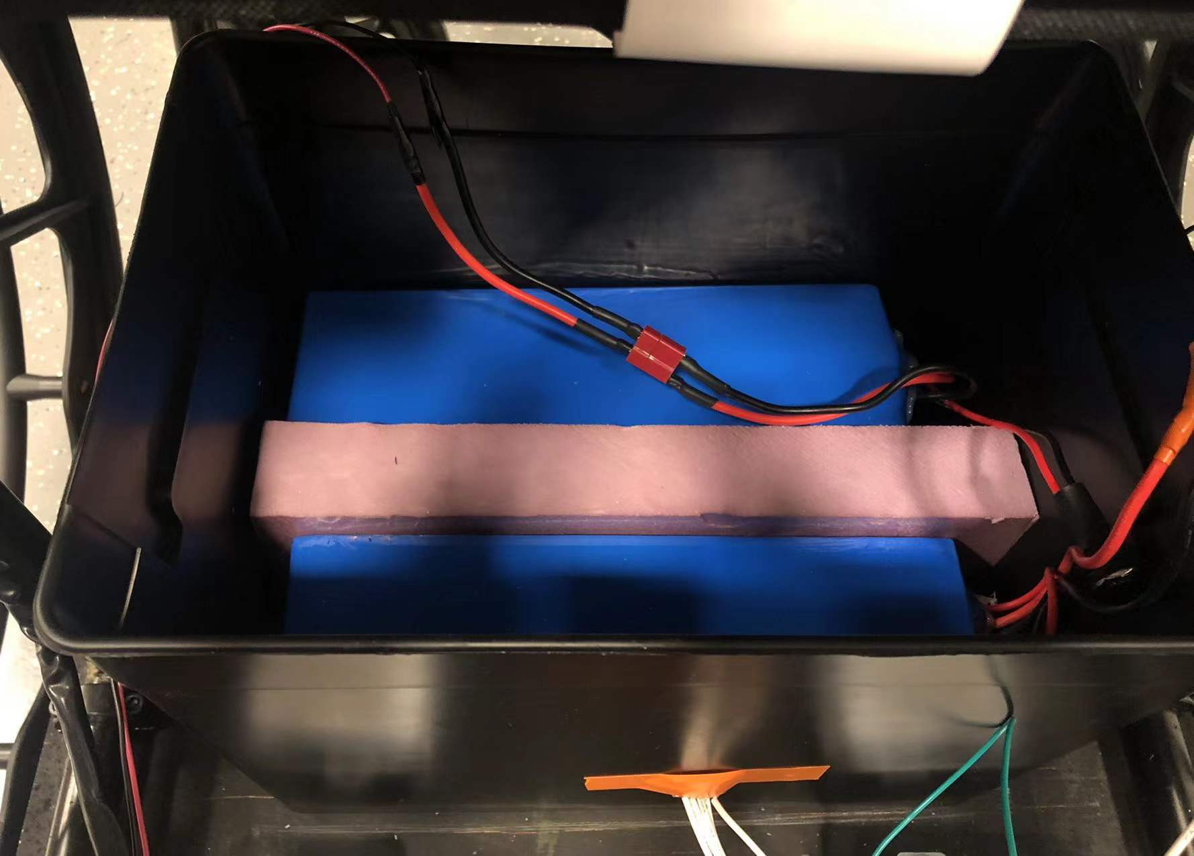
Power Unit
Battery Storage
500 W / 36V = 13.89A
8000 mAh / 13.89A = 0.576 hour
Test on Battery Voltage
36V Li-ion Battery Pack
35.6235V
35.5987V
ECE445
GRAINGER ENGINEERING

Slide 18
Demonstration
ECE445
GRAINGER ENGINEERING

Slide 19
Conclusion
PCB
Writing Arduino code
Learning by ourselves
Plan-ahead
ECE445
GRAINGER ENGINEERING

Slide 20
Future Works
Install back the load cells
debug PCB
change center of mass of the wheelchair
move the position of motors
add buttons to control going left and right
ECE445
GRAINGER ENGINEERING

Slide 21
Thank you
ECE445
GRAINGER ENGINEERING

