Slide 1
ECE 445: PoV Music Display
Group #8:
Adam Belkhadir
Alex Dutrow
John Tran

Slide 2
Introduction
Rotating LED display
Audio taken in from 3.5mm aux cable
Audio channels combined in audio mixer
Microcontroller used to process combined audio signal
Hall sensor used as control point
Display resulting frequency spectrum on LED display
DC/DC converter used to power other portions

Slide 3
Objective
To take in audio from any source via 3.5mm aux cable
To have plug and play accessibility
To create a fun and interesting way to display audio

Slide 4
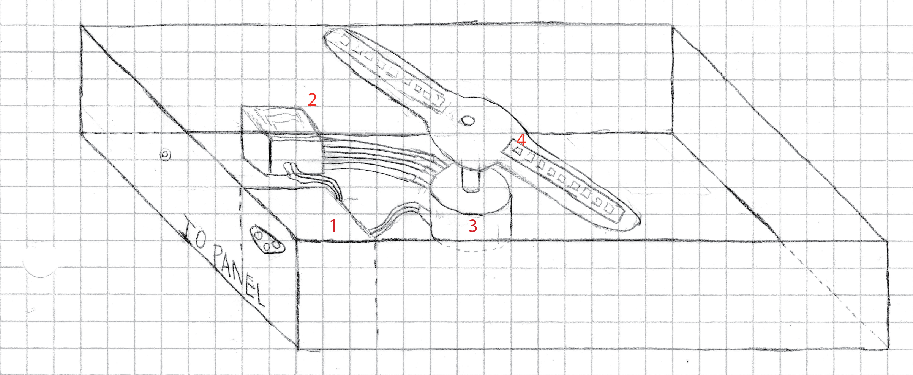
Design - Physical layout

Slide 5
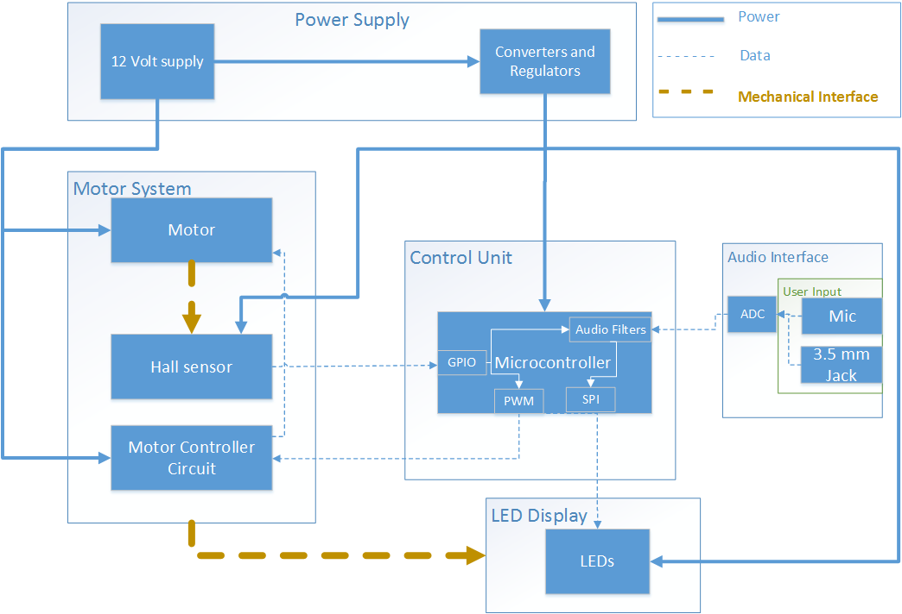
Design - Block Diagram

Slide 6
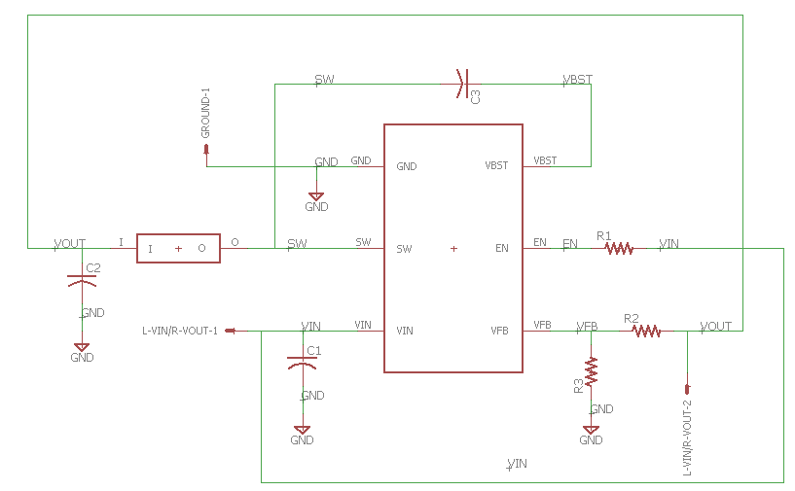
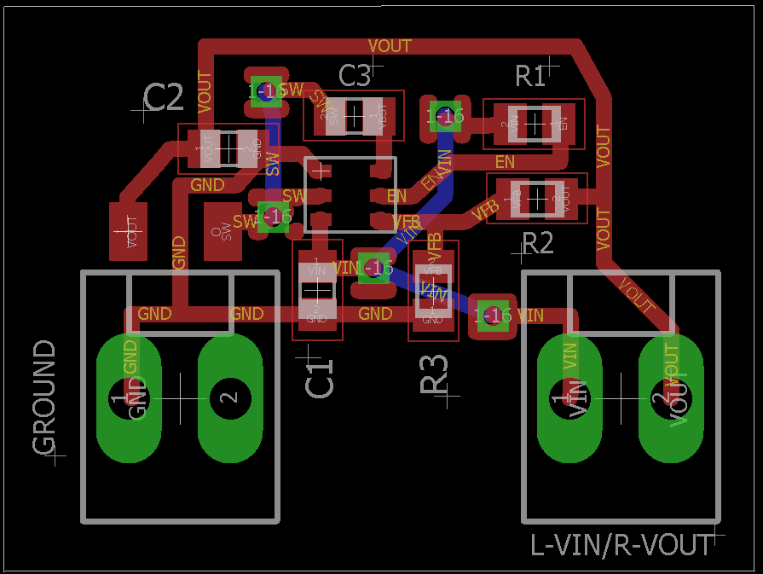
Design - DC/DC Converter

Slide 7
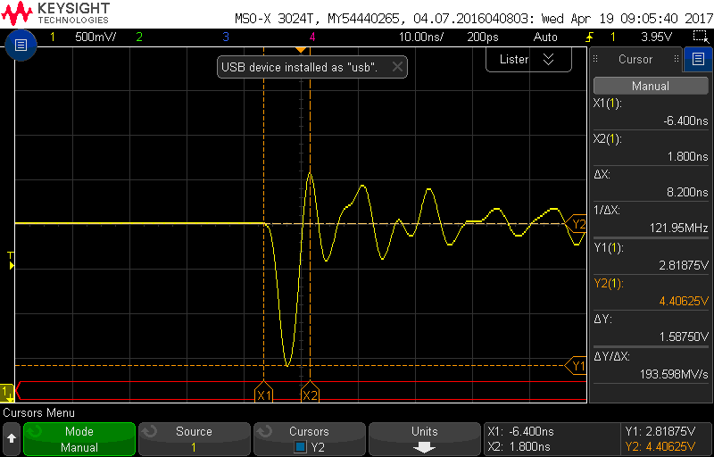
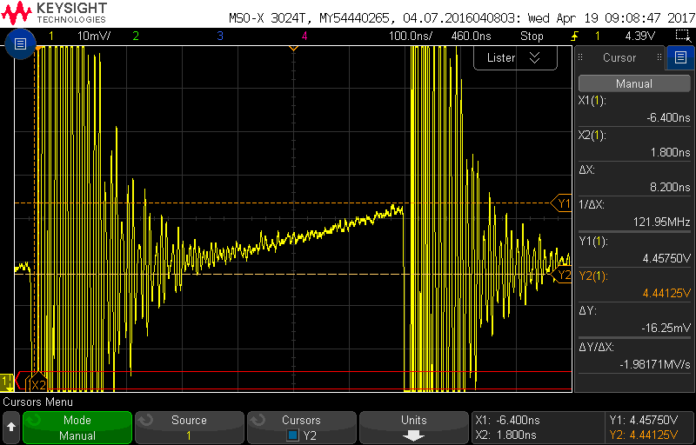
Design - DC/DC Converter

Slide 8
Conclusion
We plan to make many more improvements and modifications to the project
Dampen the sound pollution coming from the motor
Reduce the amount of flashing and increase frame stability by adding another magnet
Increase our design to a 1024 point FFT to implement MAL frequency scalings
In the end we learned quite a lot working on this project

