Slide 1
Prerak Sanghvi | Neil Stimpson | Vassily Petrov

Slide 2
Motivation
To make a safer, intuitive bicycle brake system
Objectives
Combine multiple sensors and motors
Implement an algorithm for optimum braking
Incorporate active battery monitoring
Integrate into a compact assembly

Slide 3
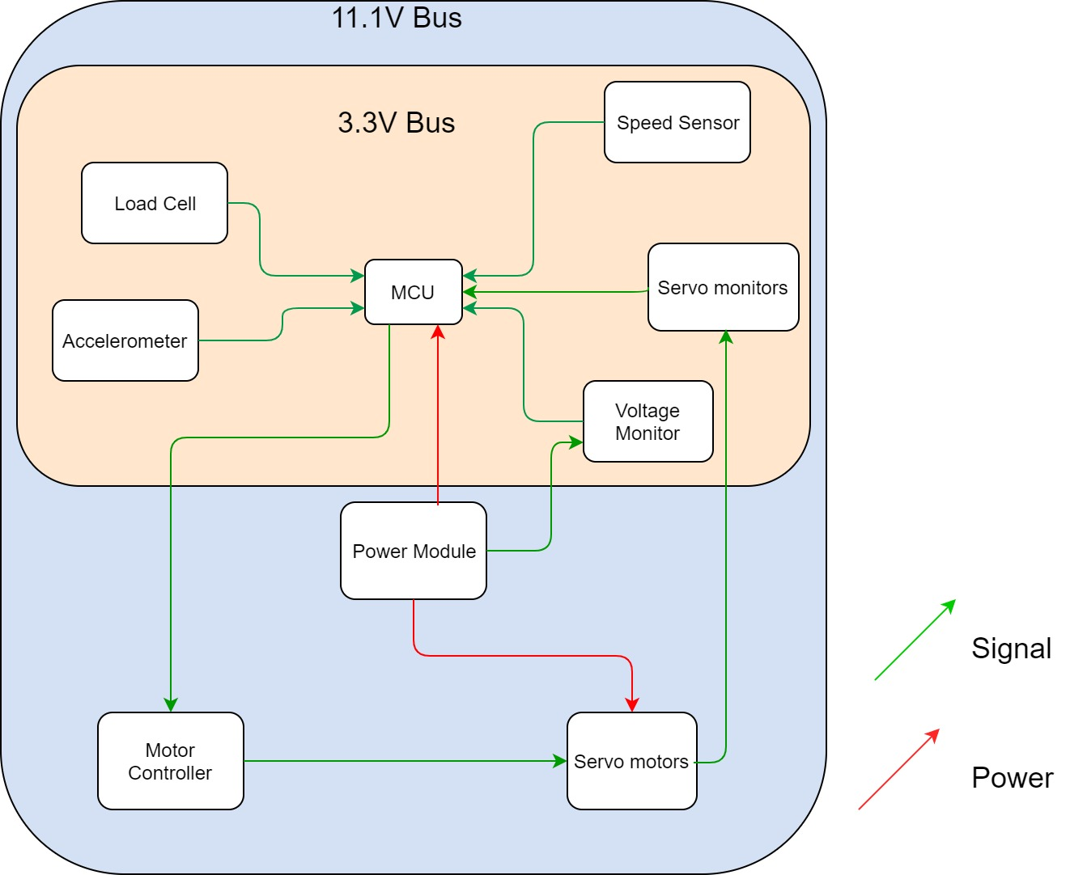

Slide 4
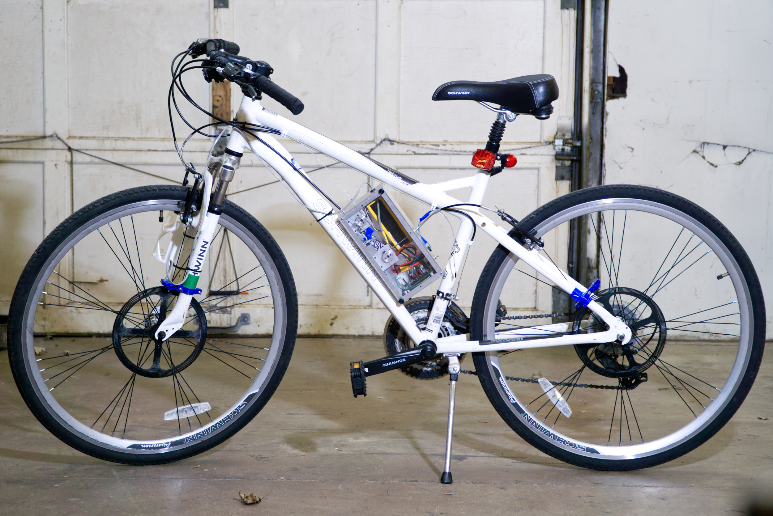
Hand Force Sensor
Master Housing Unit
Optical Sensor
Optical Sensor

Slide 5
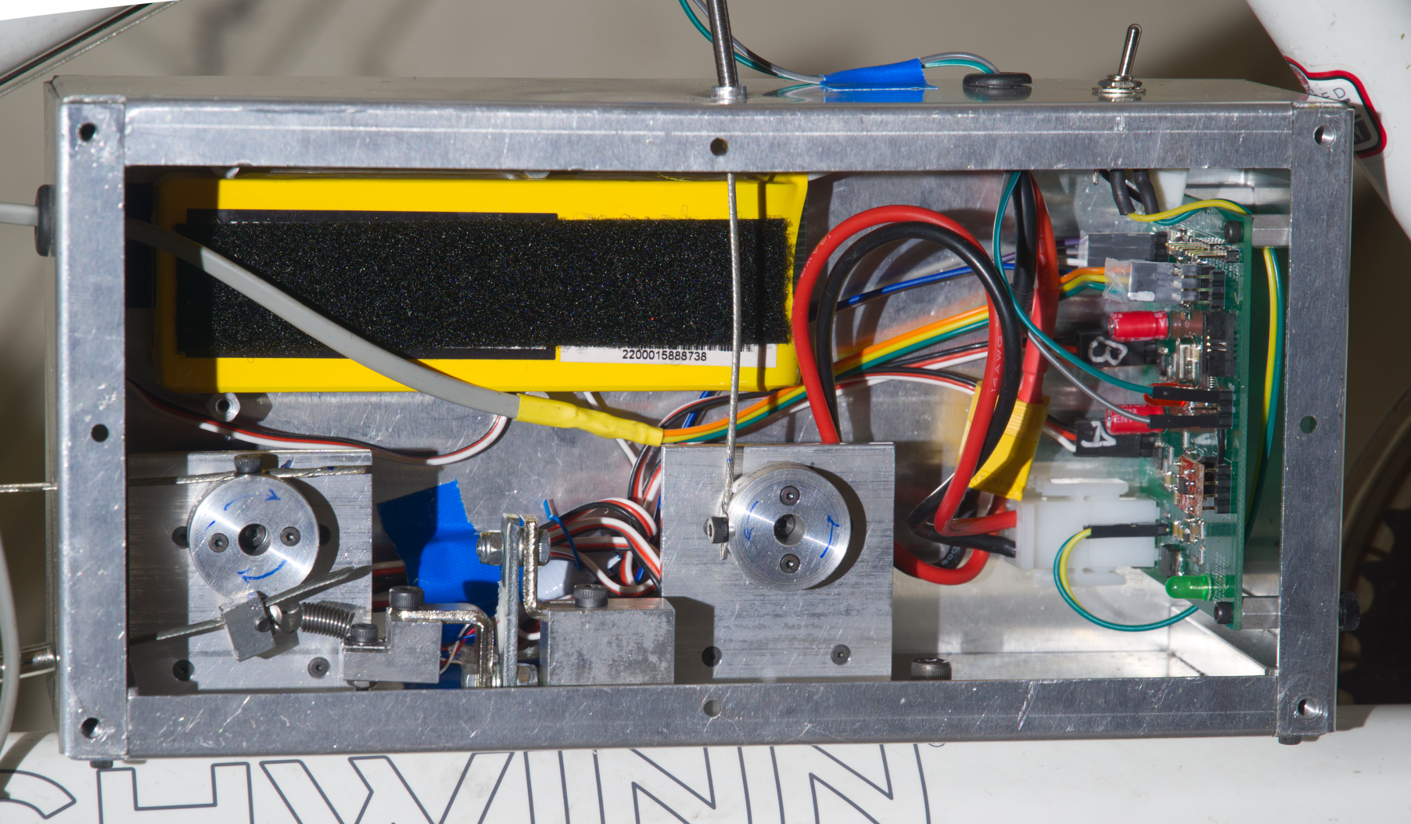
To Optical Sensor
Master PCB
Battery
Front Wheel Servo
Back Wheel Servo
Load Cell

Slide 6
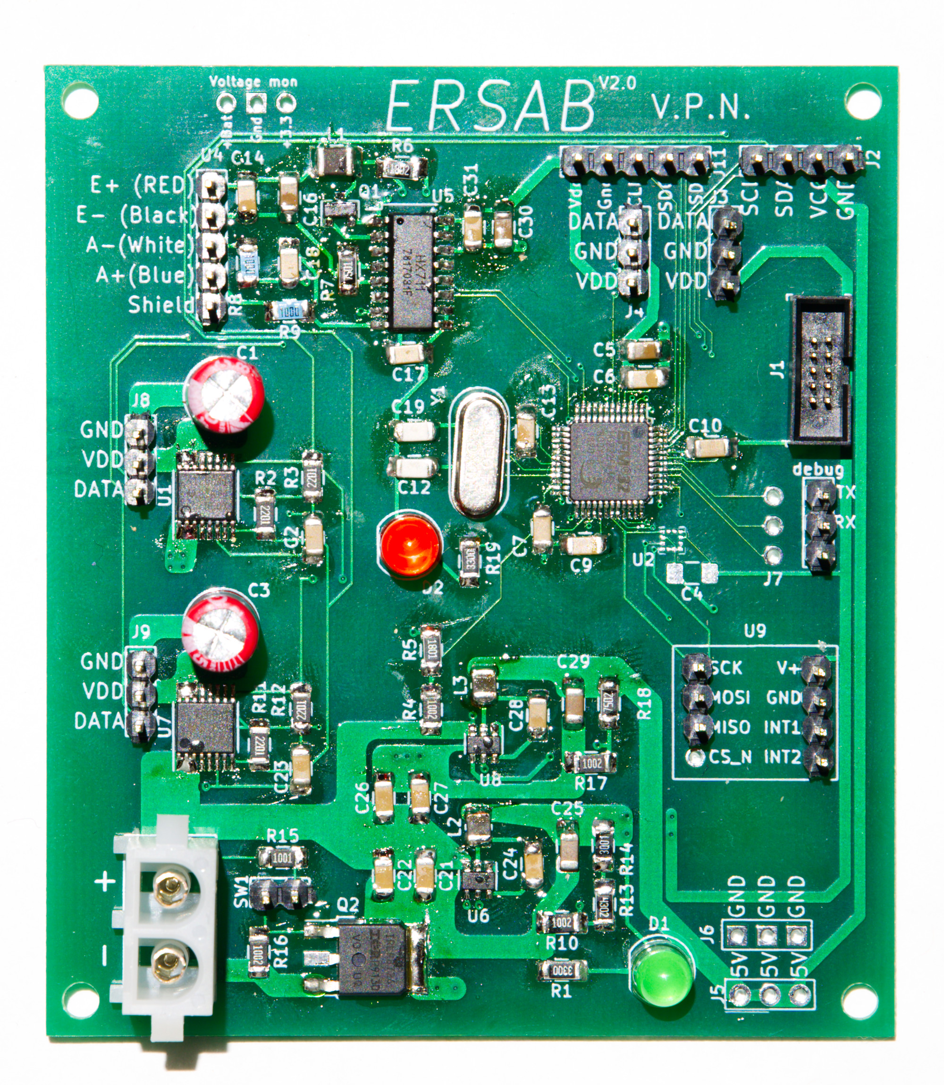
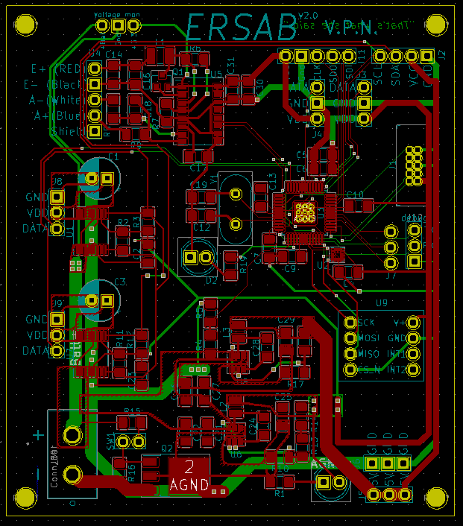
Master PCB

Slide 8
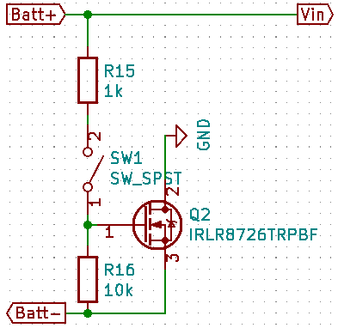
Power Module
Texas Instruments TPS563240 Buck converters (pair)
MOSFET controlled power switch

Slide 10
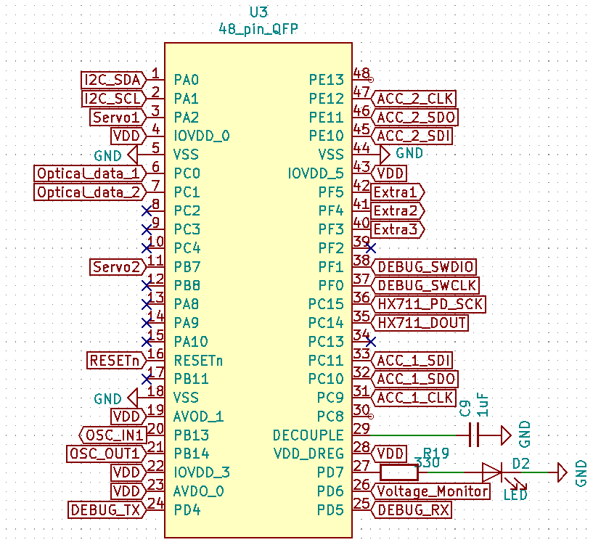
Microcontroller
Silicon Labs EFM32 ARM Cortex M0+ Microcontroller @ 24MHz
Integrates all on-board and external sensors

Slide 11
Uses Serial Com

Slide 12
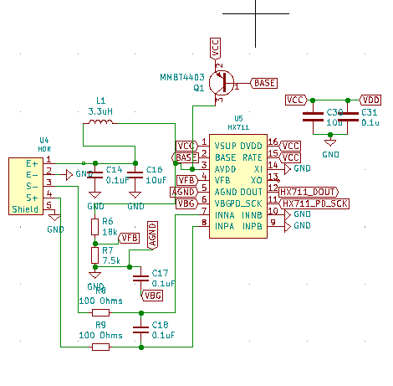
Load Cell Amplifier and ADC
Avia HX711 Load Cell Sensor
Used to measure the force on brake lever

Slide 13
USES I2C Communication

Slide 14
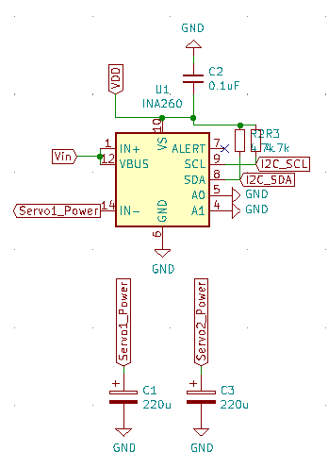
Servo Monitors
Texas Instruments INA260 Power Monitors
Feedback from force applied by servos

Slide 15
Uses PWM signals

Slide 16
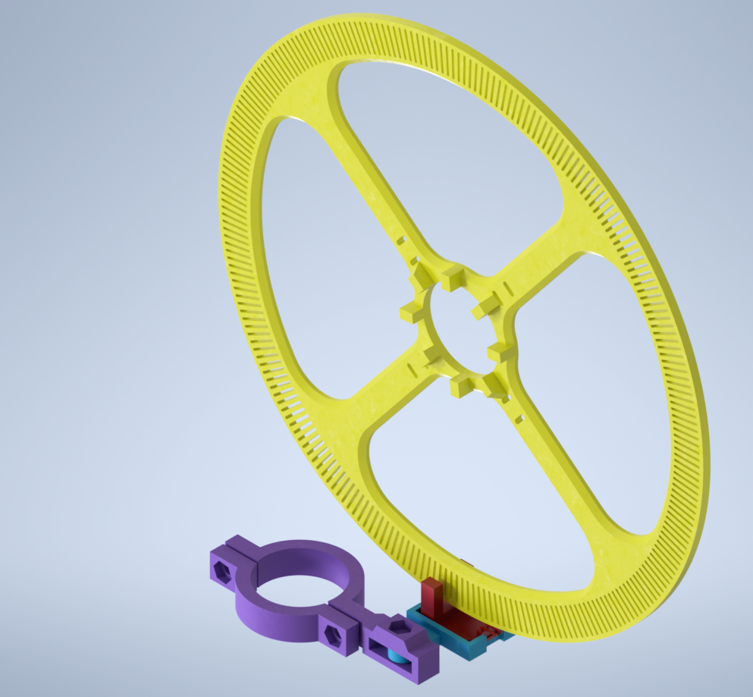
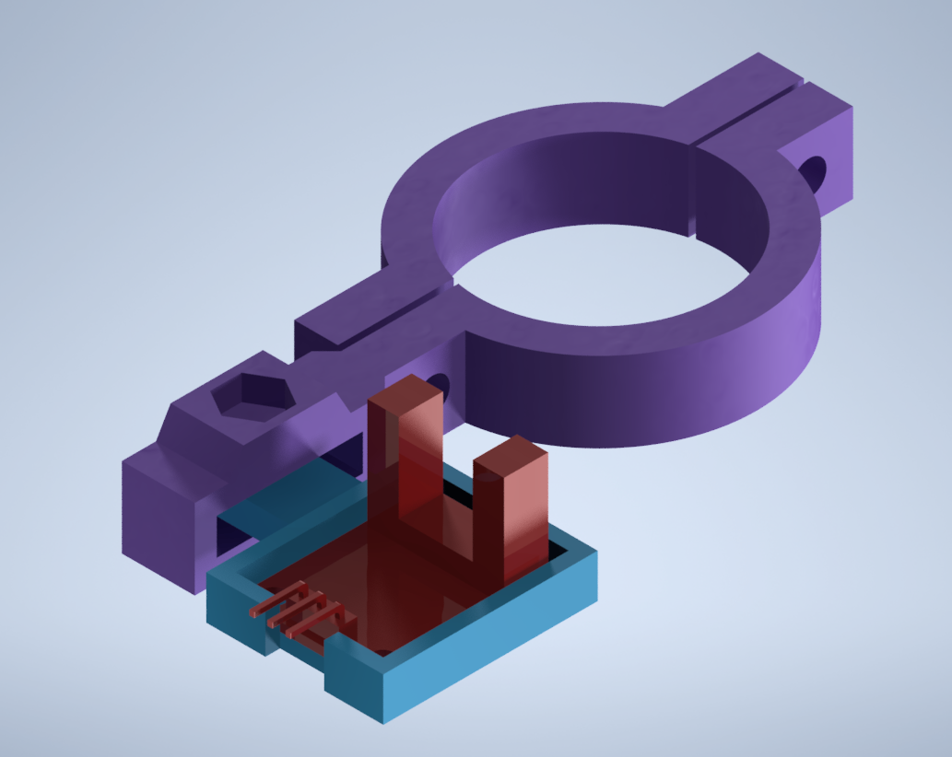
Optical Encoder

Slide 17
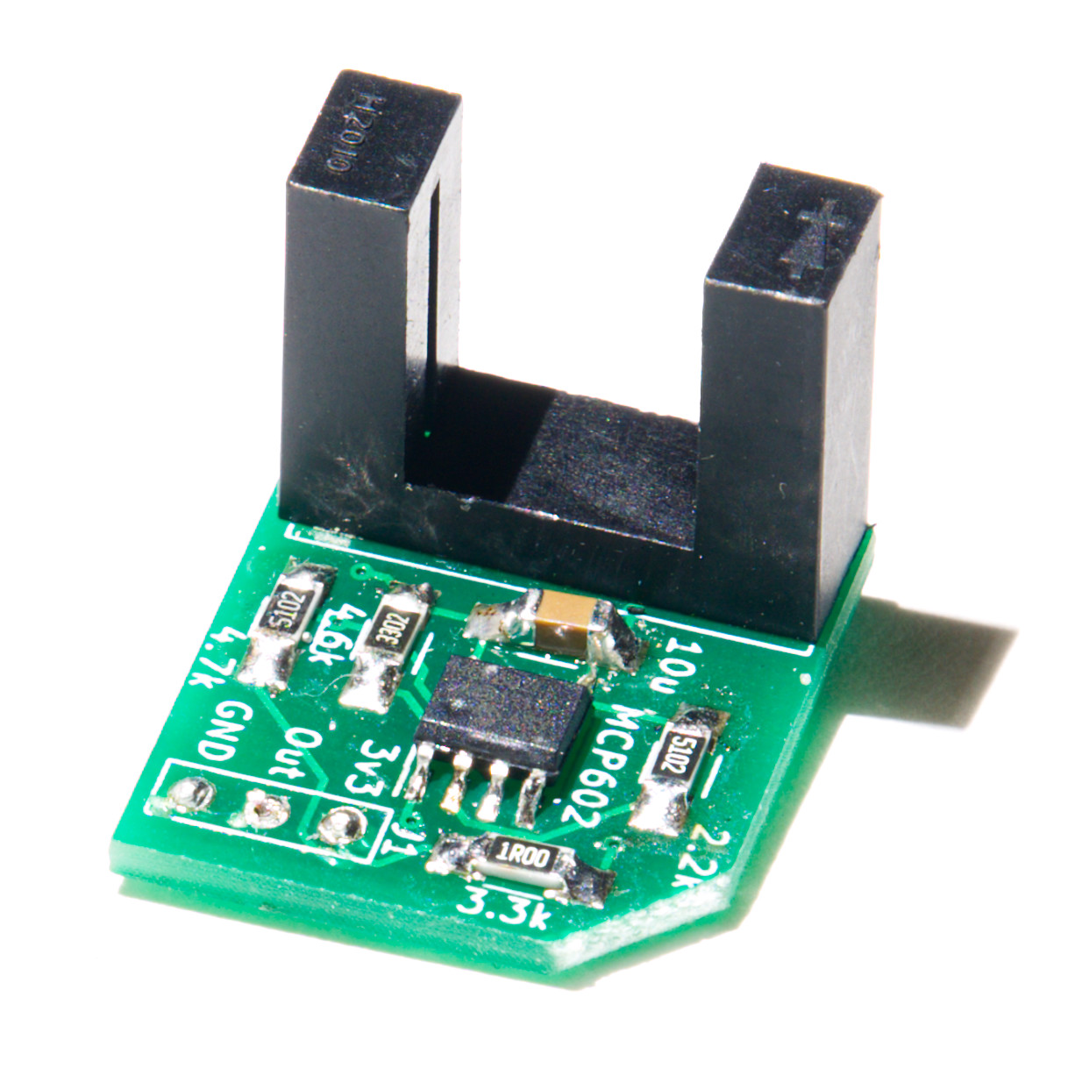
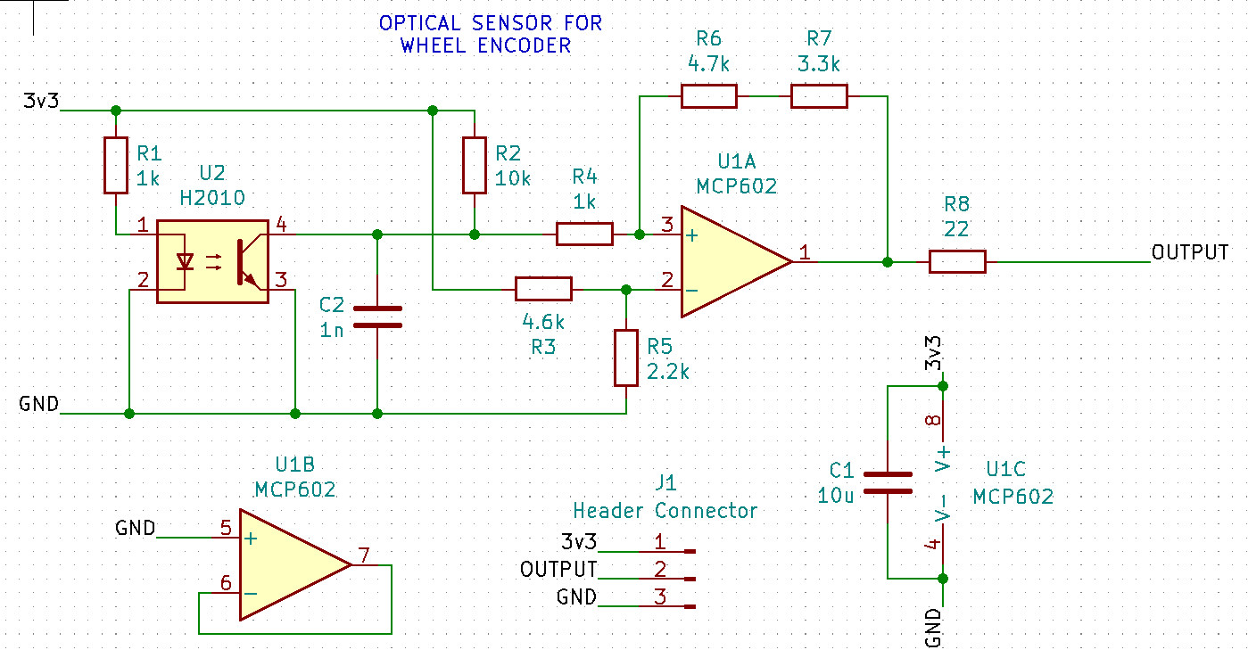
Optical Encoder

Slide 18
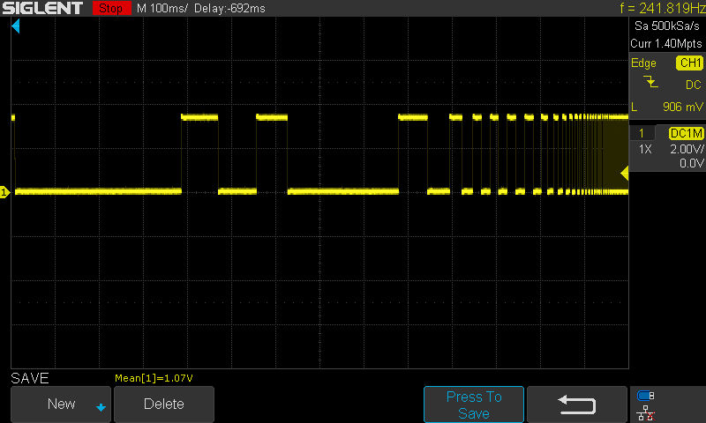
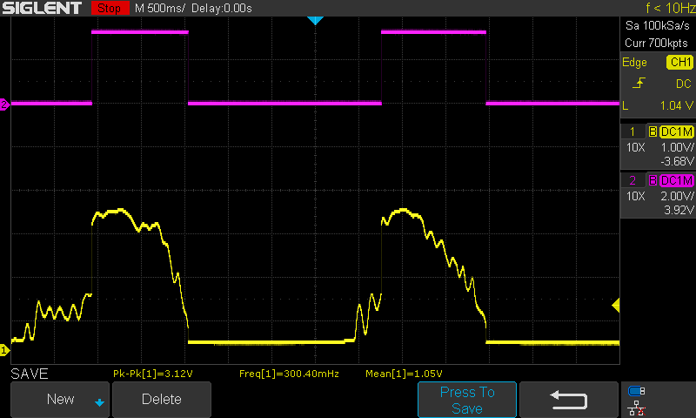
Optical Encoder Behavior
Filtered output
Raw input
Wheel Speed increase

Slide 19
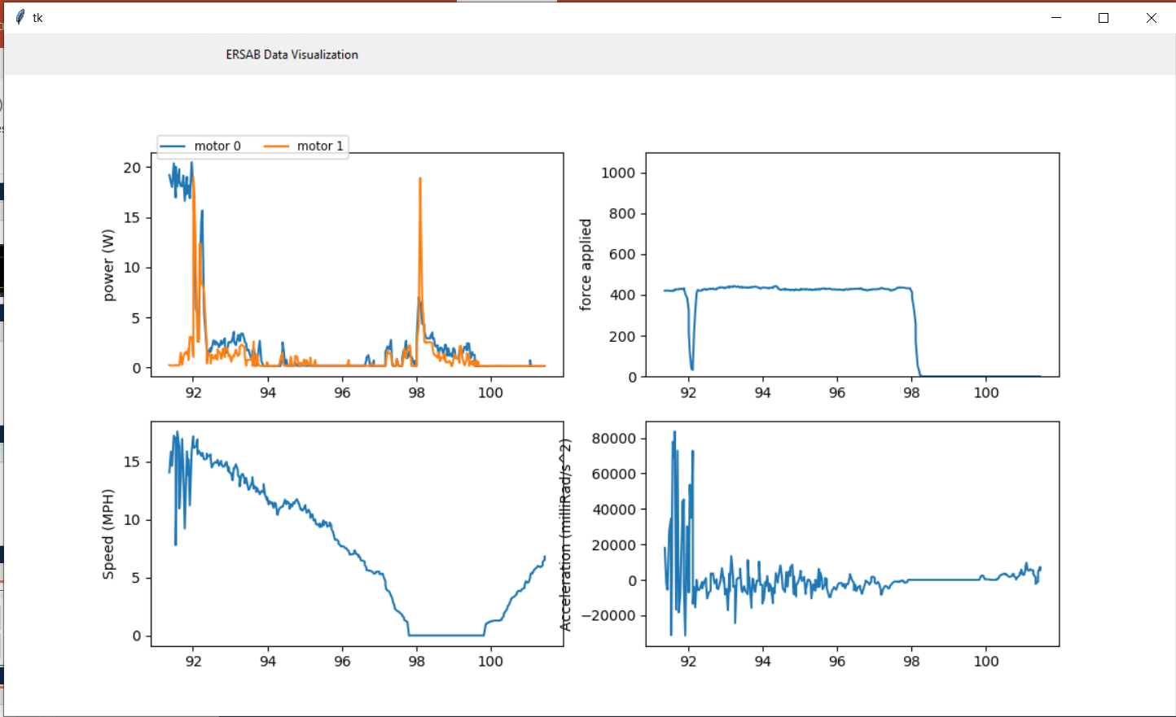
Results
Sensor data sent out through serial interface
Can be displayed in real time using our Python app

Slide 20
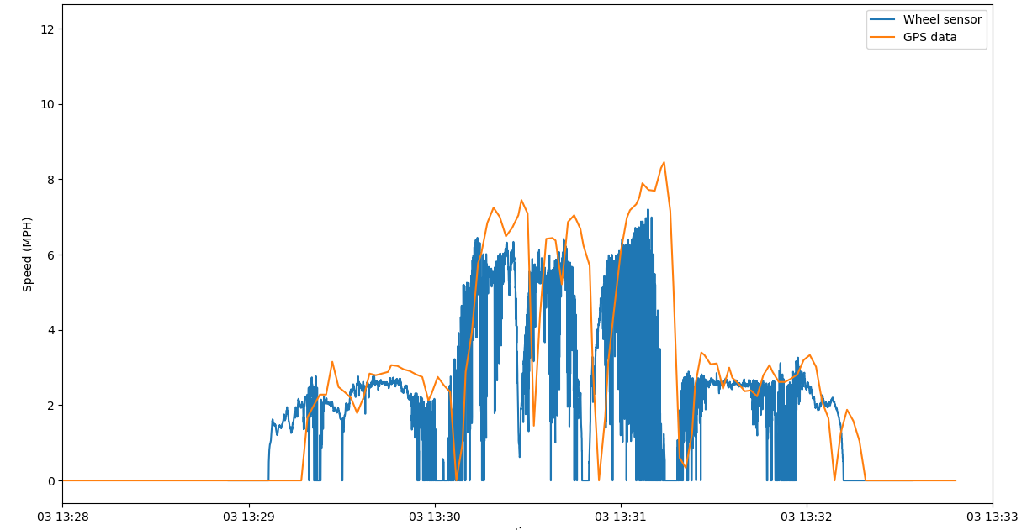
Results
Comparison of GPS speed to wheel sensor speed
Overall accurate, but has lots of noise

Slide 21
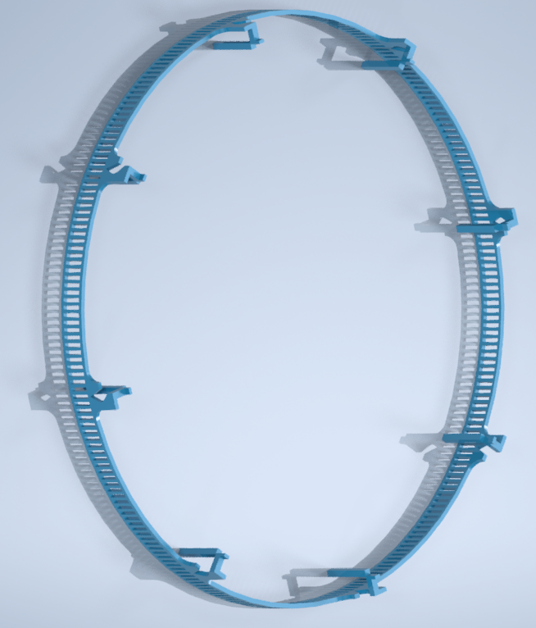
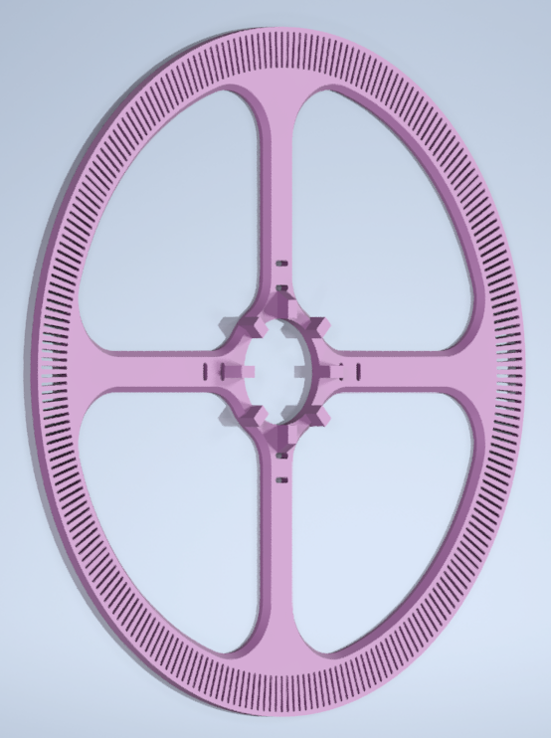
Challenges
Multiple 3D print iterations
PCB modifications
Accelerometer mounting
Non – linearity of the braking system

Slide 22
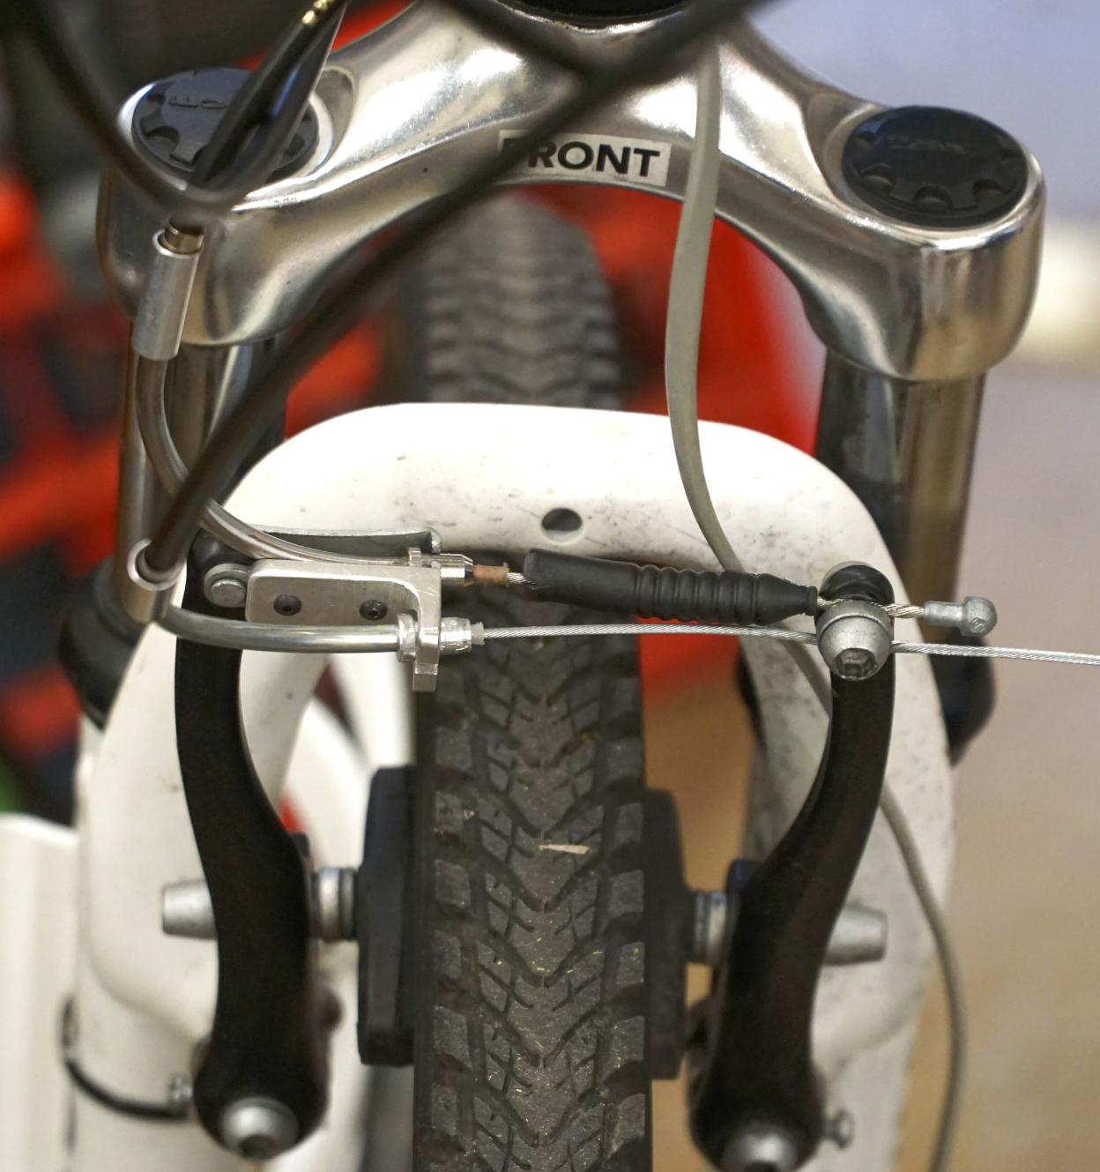
Future Work
Implementing accelerometer
Optical ring precision improvement
Cruise control functionality
Endless possibilities!
Safety Considerations
Mechanical emergency brake

Slide 23
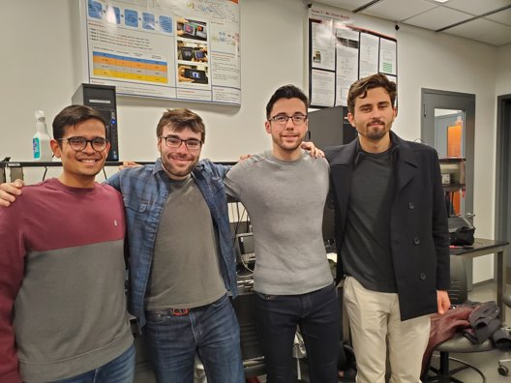
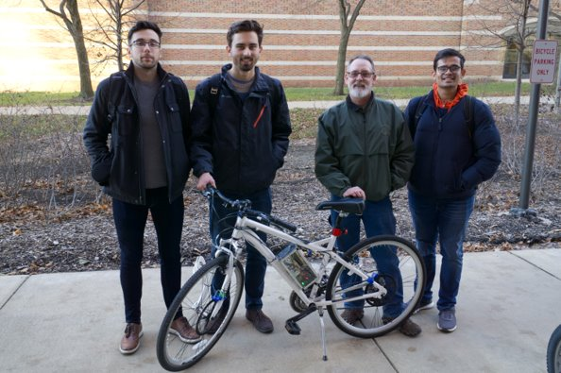
Special Thanks
Glen Hedin, ECE Machine Shop – For their work on the Mechanical assembly and enclosure
Chris Horn – For his guidance throughout the project
For providing free samples of ICs

