Slide 1
Exercise Bike Generator with
Grid Synchronization
Team 3
Elisa Krause, Raihana Hossain, Tiffany Wang

Slide 2
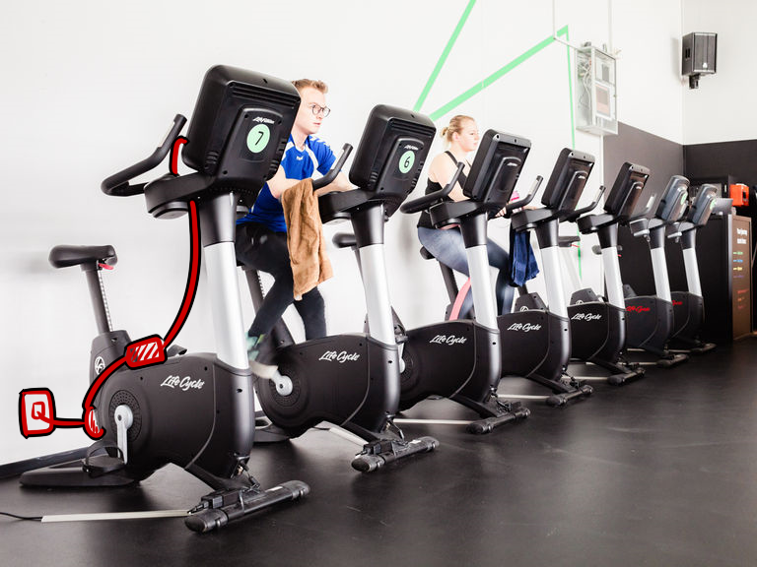
Introduction
Harness the energy from gym members bike workouts
Utilize the energy already being generated in gyms
Add display features to serve as motivation
Notes:
Raihana

Slide 3
Objectives
Rider is able to generate at least 40W 10W of electricity while pedaling exercise bike at moderate biking speed
Power output from bike is able to synchronize to the gym’s grid
Display is able to show current power being generated and total energy generated since the last reset
Notes:
Raihana

Slide 4
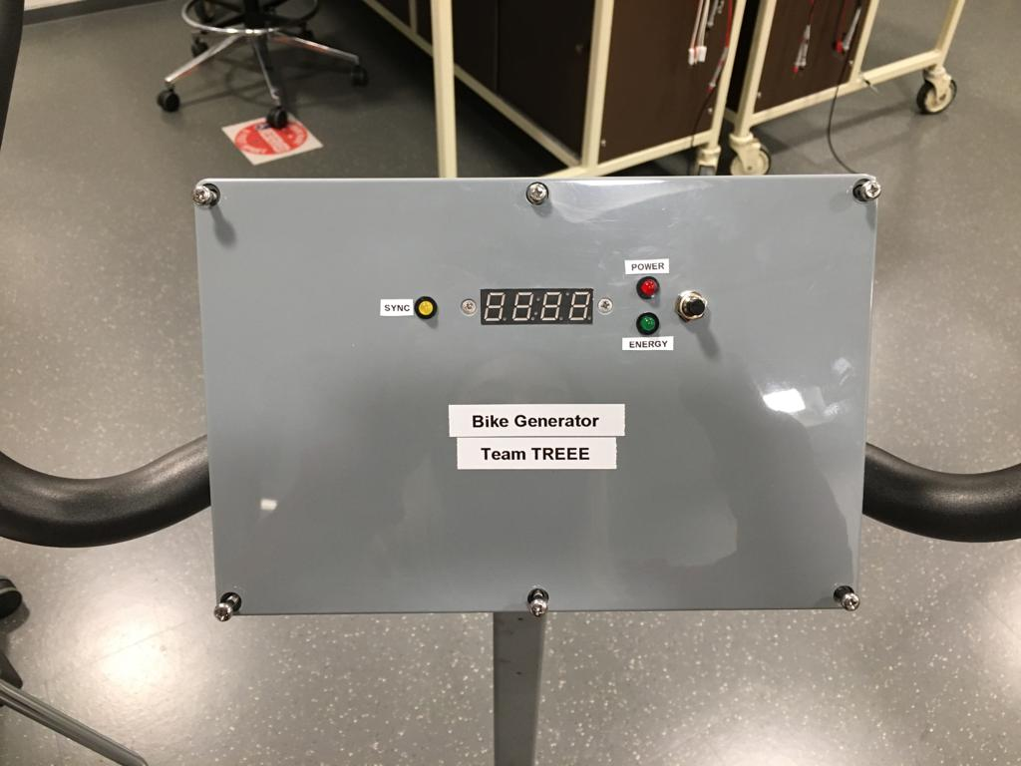
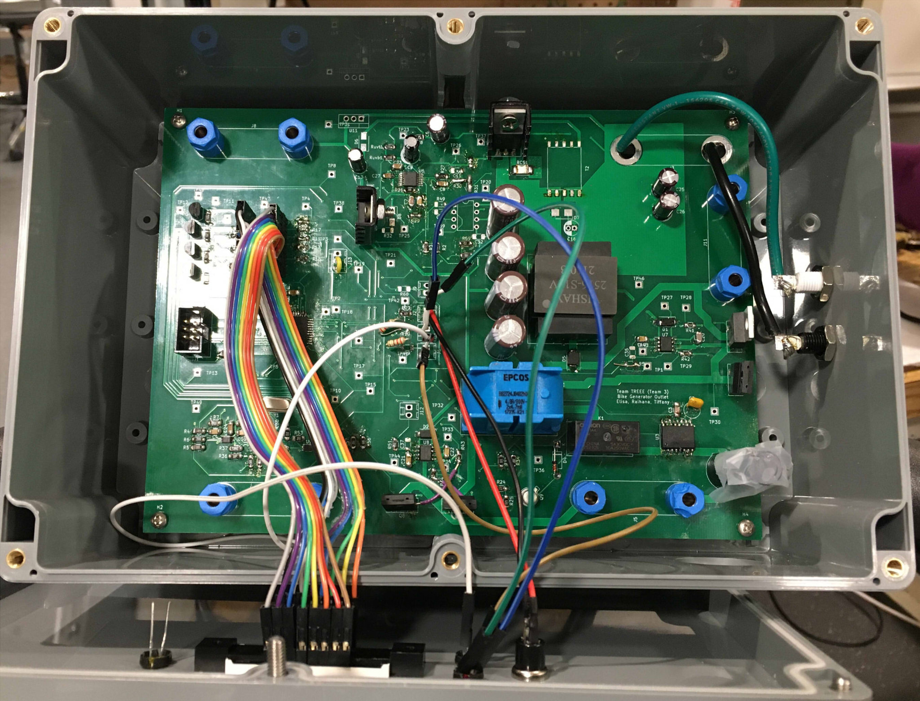
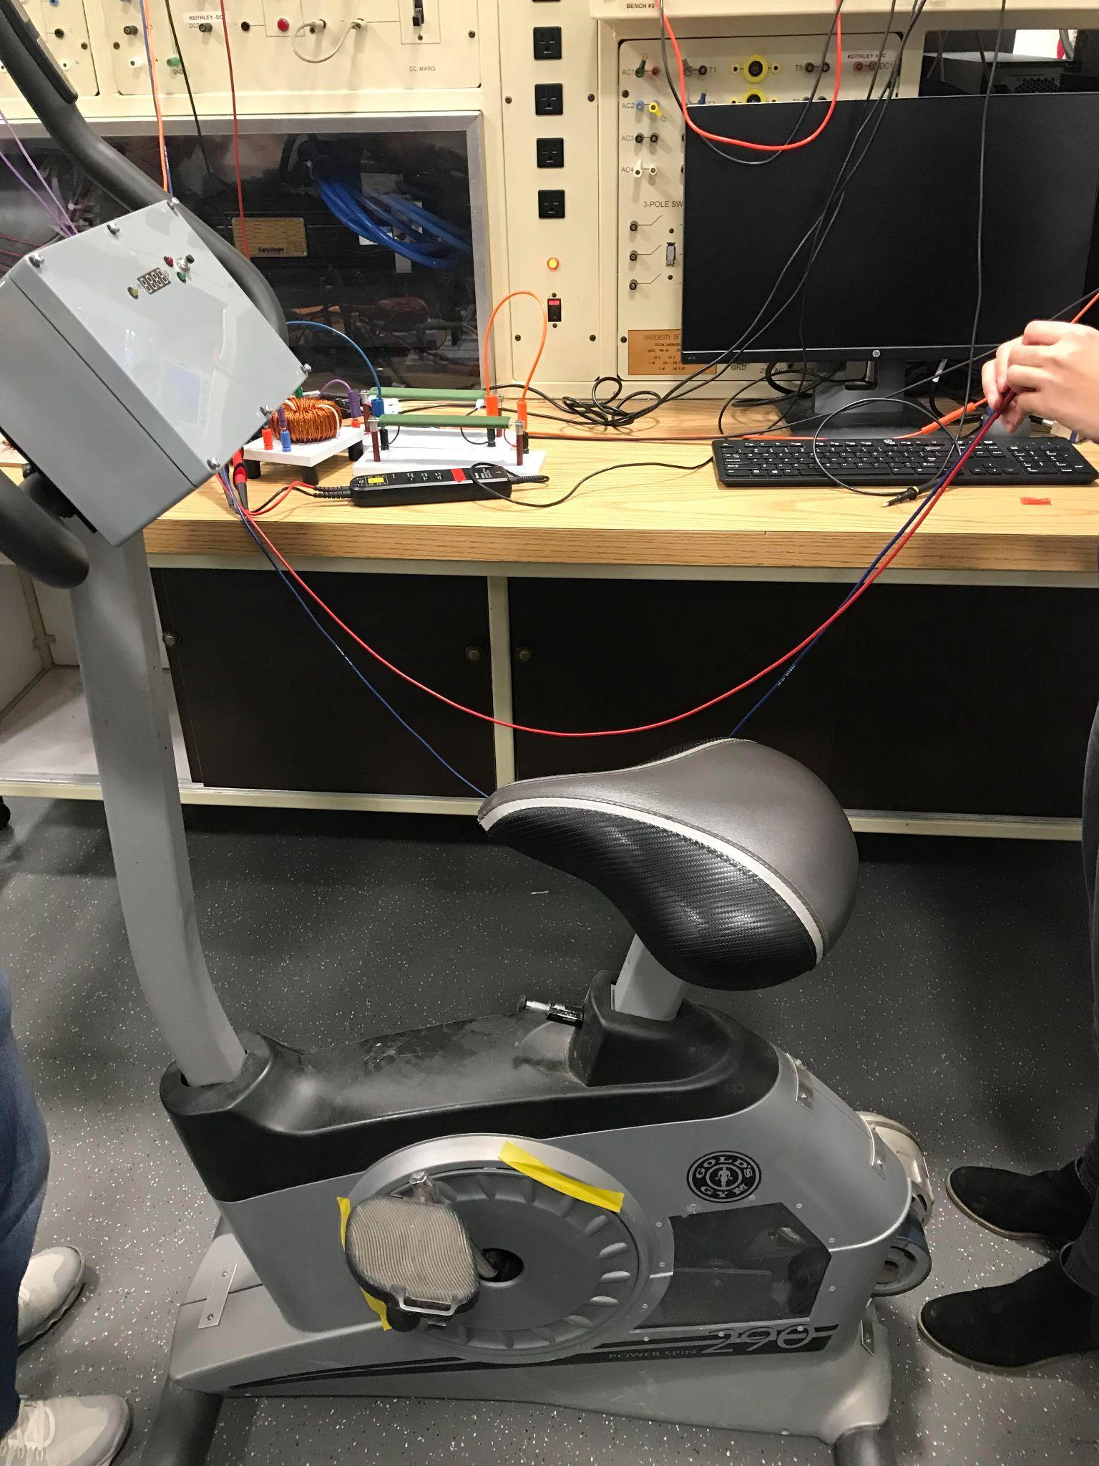
Project Images
Notes:
Raihana

Slide 5
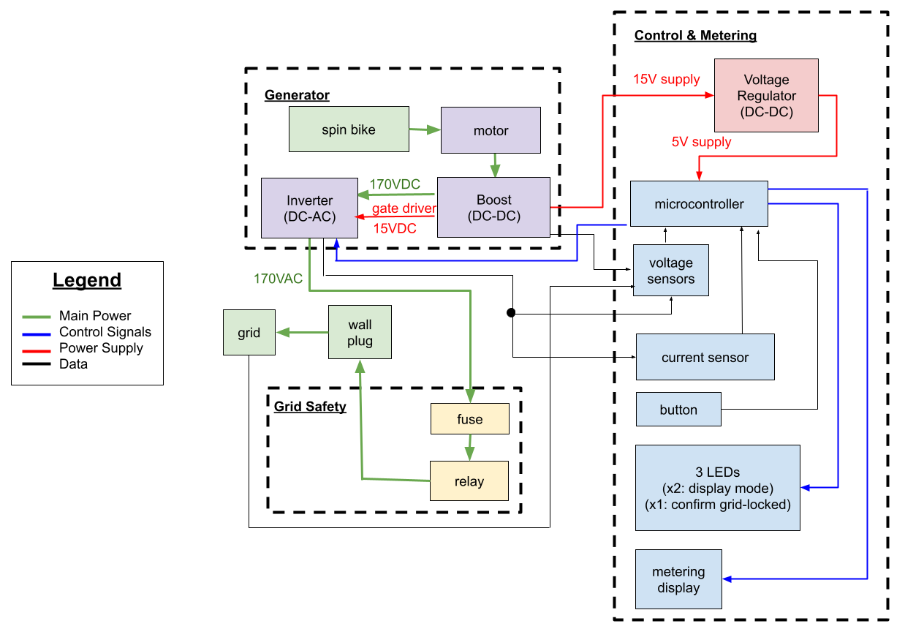
Block Diagram
Notes:
generator:
motor attached to bike -> variable DC motor output -> steady voltage for AC peaks (19V instead of 170V) -> AC
grid being read by sensors, microcontroller process, inverter controlled
path through grid safety
display features

Slide 6
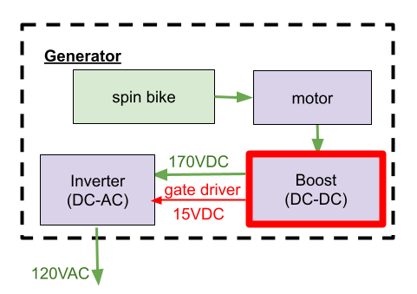
Boost Converter
Requirements
DC-DC converter must be able to output 170VDC ±5% 19VDC ±5%.
DC-DC converter must generate a 15V ±5V supply for the voltage regulators.
Design
Flyback topology
Analog controller
Feedback ratio changes control transfer function
Challenges
Transformer did not match datasheet specifications
Unable to generate secondary output
Large ringing on switch node
MOSFET Vds ringing (20V division)
Notes:
Elisa

Slide 7
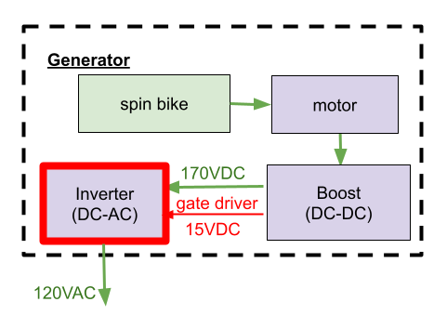
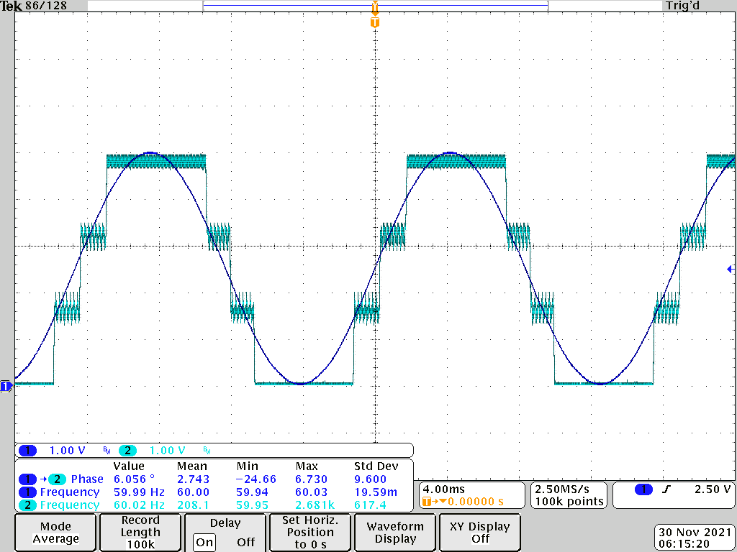
Inverter
Requirements
Inverter must be able to output 19/√2 Vrms ±10% with a power factor of 0.7 or greater.
Must be able to output 80W 10W.
Output voltage frequency must be able to synchronize to an external sinusoidal signal’s frequency within ±10% and have no more than a 20° phase angle between the two.
code works with Arduino Uno
not integrated with our board
Design:
Hardware
full bridge topology
inductive filter on output
Software
Switching signals
PLL algorithm
Challenges:
PLL algorithm
Teal: Averaged output of control switching signal
Blue: Grid reference signal
Notes:
Elisa

Slide 8
Sensing
Requirements
Must be able to measure grid voltage with an accuracy of ±5%.
Must be able to measure inverter voltage with an accuracy of ±5%.
Current measurements processed by the microcontroller must match a reference ammeter measurement within ±5%.
Design
0-5.5V microcontroller input
voltage dividers
op-amps: level-shifters, differential
software
calibration
map from ADC -> 0-5V signal -> original signal
Challenges
difficult to measure small voltages– resolution of voltage dividers (170V -> 50V)
inverter accuracy
noise from many components in inverter path
op-amp outputs change or stop working from higher temperature (no ventilation with box)
Grid Voltage Input | Grid Voltage Read
0V | 0.11V
10V | 10.11V
20V | 20.12V
Notes:
sensing system consists of…
hardware components (needed for microcontroller 0-5.5V input, and differential for inverter two signals)
software components
requirements & challenges
noise -> small voltages couldn’t be read. 0-5V scale read by microcon
frequent calibration still needed (for grid– every new day), but still do-able for grid
inverter issues
noise: calibrate every usage, but still kind of do-able
hot enough– stable (or op-amps just stopped working)
transition to microcontroller– now that i’ve talked about the issues with the sensing system, let’s next talk about all the issues we ran into with the microcontroller

Slide 9
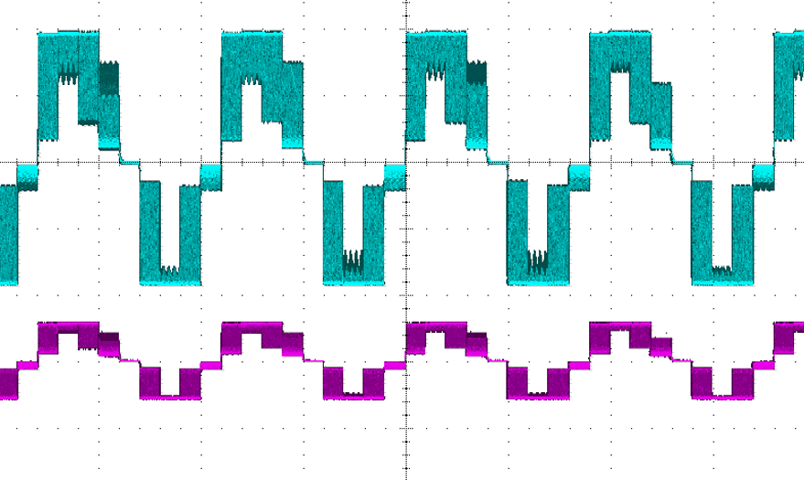
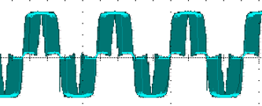
Microcontroller (ATmega32U4)
Challenges
ATmega16U4
internal vs external clock
programming: incorrect default configuration-- crystal needed
incorrect digital output (pulsed when it should be constant)
not fast enough
multi-core, multi-thread
combine: display code, inverter code, PLL
can’t access some pins with shortcuts (DDRx, PORTx instead of pinMode, digitalRead/Write)
inverter output without display code
inverter output with display code
Notes:
no ATmega32U4’s in stock at the time
couldn’t program with Arduino interface
to program– supposedly default internal, but default external -> no crystal footprint on PCB
tried external -> but incorrect output (pulsed)
multi-core– run multiple programs at once. multi-thread– switch back and forth
register manipulation– couldn’t use a library directly as is and we had to revise it– which leads to our discussion on the Display

Slide 10
Display
Requirements
Pressing the button for less than 2 seconds will switch modes.
The red LED is on and the green LED is off when the display is in Mode 1 (power mode). The green LED is on and the red LED is off when the display is in Mode 2 (energy mode).
In Mode 2, holding down the button for more than 2 seconds resets the display to 0.
Design
Revise SevSeg library
Calculate power and energy
Switch modes
Display correct values
Challenges
SevSeg library wasn’t able to work with our microcontroller
Notes:
Raihana

Slide 11
Safety Features
Ethics and Safety
Fuse
Relay
Requirement: The relay disconnects the grid from our device after 2 seconds of inactivity of the bike.
High voltage/current
Revision of original goal
Original goal: output 40W
After design review, we changed plans to 10W or less
Notes:
Raihana

Slide 12
Recommendations for further work
Use LCD display for more visual
Use microcontroller capable of multi-core
Incorporate higher voltages and higher power (higher ratings, heat sinks, ventilation)
Consult grid synchronization professionals and implement additional requirements/features that would be needed
Notes:
Elisa

