Slide 1
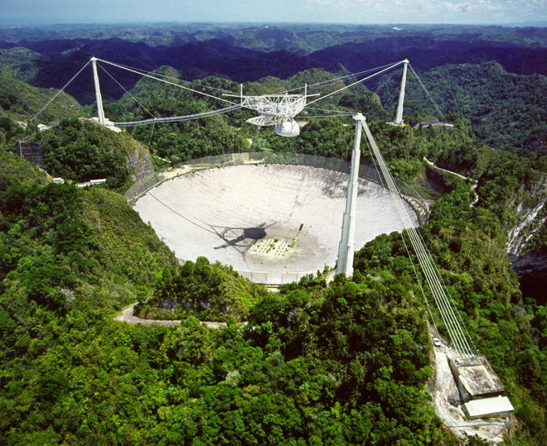
Cell Phone Transmission Detector
ECE 445 Fall 2017
Team 12
Anish Bhattacharya, Shandilya Pachgade, AJ Schroeder

Slide 2
Outline
Motivation and Objectives
General Design
Module Specifications
Successes and Challenges
Conclusion

Slide 3
Motivation
RF interference at Arecibo Observatory in Puerto Rico
Tourists' cell phones
Detect cell phone transmissions to eliminate RFI
Low-cost device easily
operated by anyone
Expedia.co

Slide 4
Objectives
Detect active transmission (LTE data usage, call/text send/receive) in two bands: USA cellular band (700-850MHz) and Puerto Rico cellular band (1.5-1.9GHz)
Use a display to show signal strengths for each band
Notify operator via LEDs (one per band) when a signal of significant strength is detected

Slide 5
Outline
Motivation and Objectives
General Design
Module Specifications
Successes and Challenges
Conclusion

Slide 6
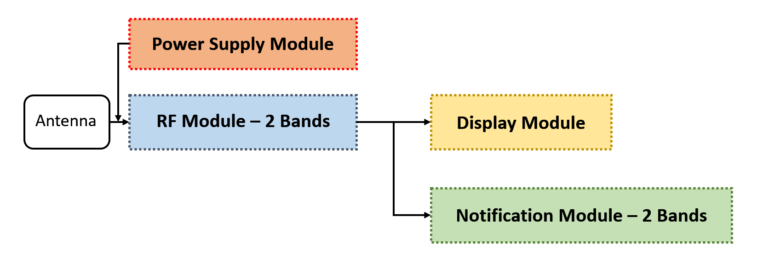
General Block Diagram

Slide 7
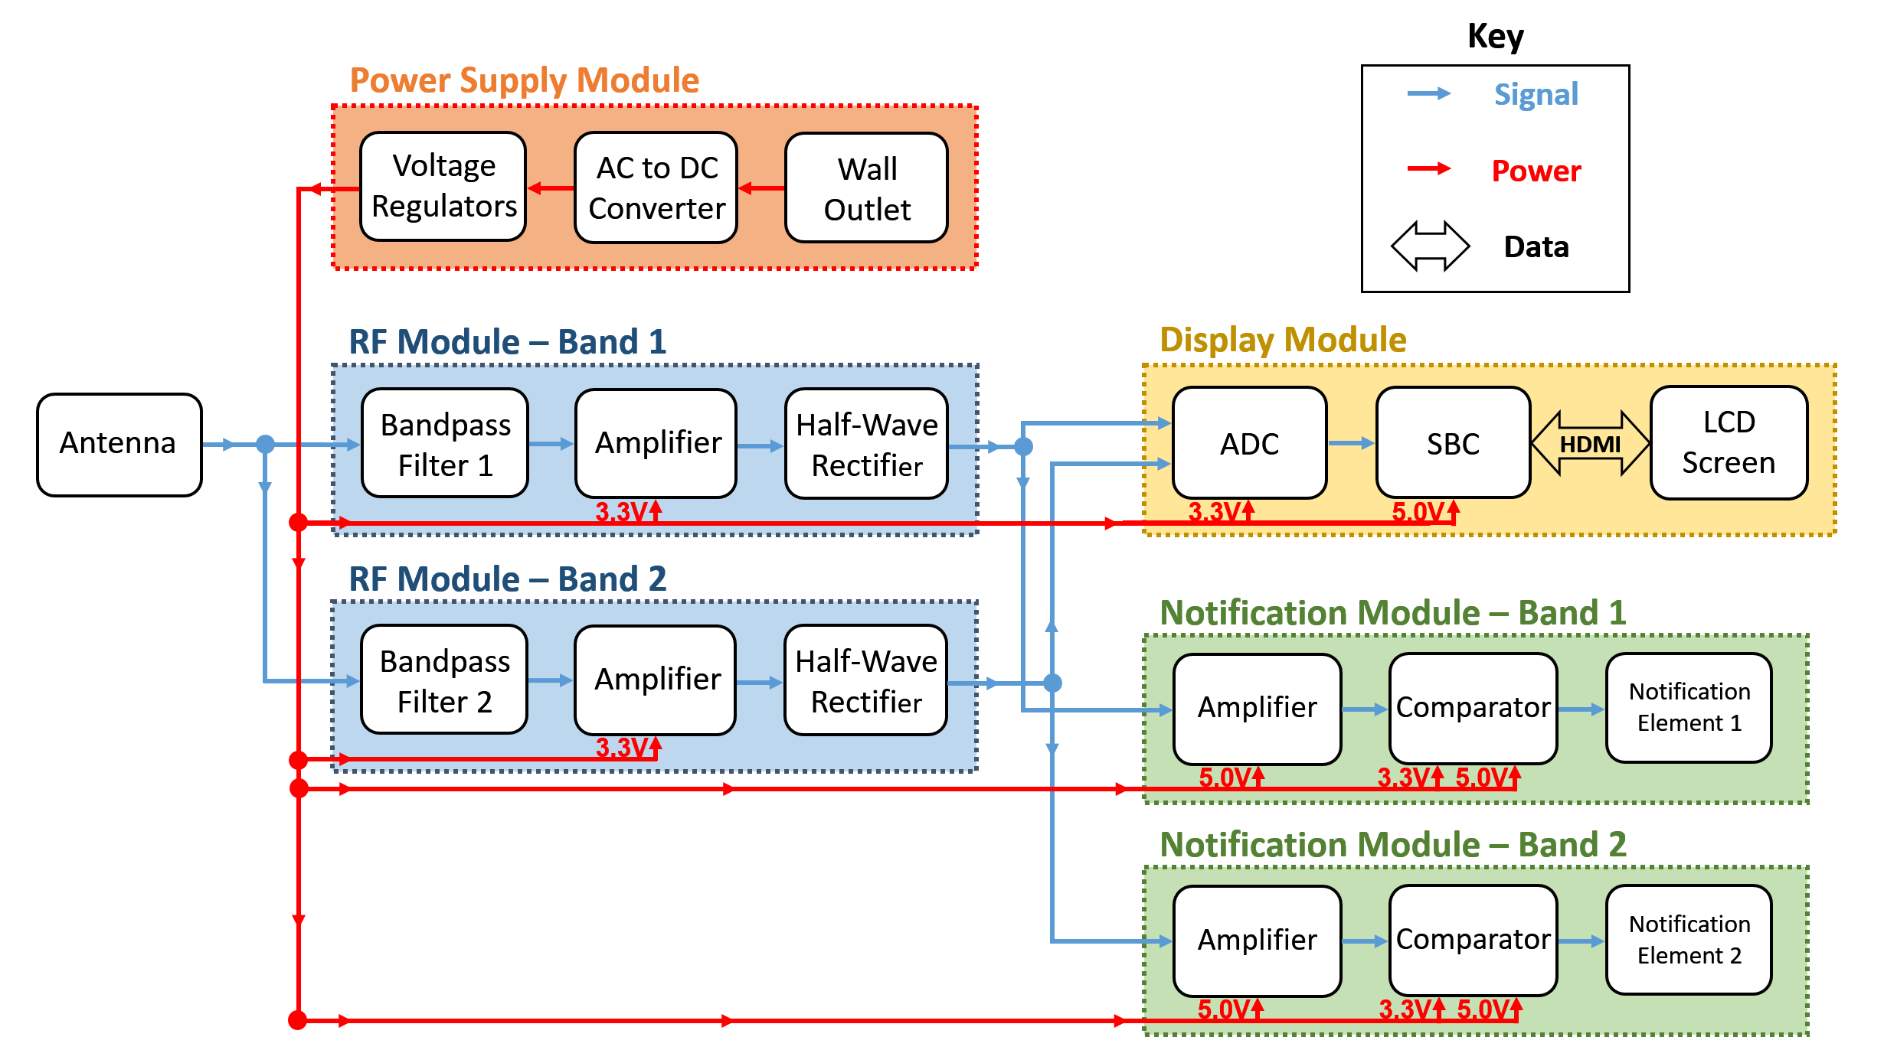
Functional Block Diagram

Slide 8
Outline
Motivation and Objectives
General Design
Module Specifications
Successes and Challenges
Conclusion

Slide 9
RF Module

Slide 10
RF Module: Requirements
Detection distance up to 1 meter
Minimum discernible signal of –50dBm
Attenuate unwanted signals, FM radio (250MHz) and Bluetooth/WiFi (2.4GHz)
3dB drop for higher band
1dB drop lower band
Output DC signal
50mV minimum

Slide 11
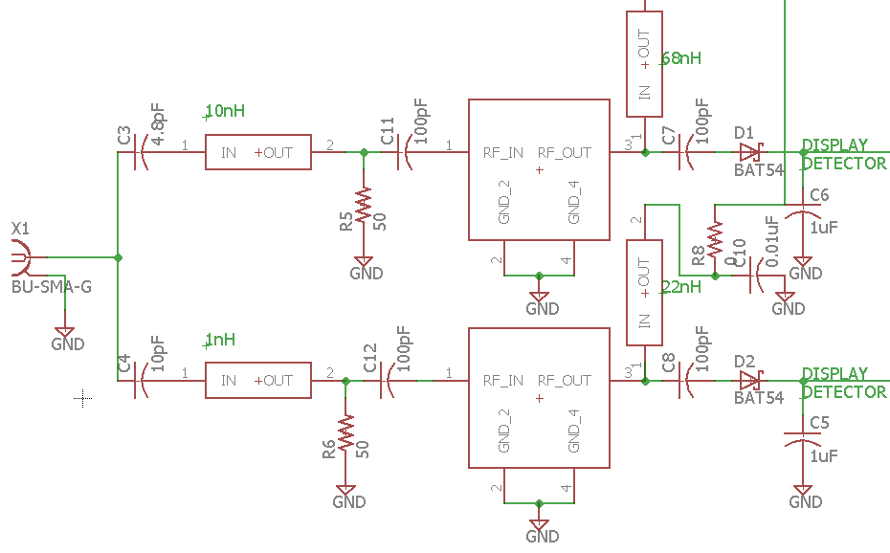
RF Module: Design
Parts
Antenna: Pulse W5084K698MHz – 3.0GHz
BPF: Designed with passive components
Amplifier: Qorvo TQP3m9008, 20dBm Gain, 50MHz – 4.0GHz
Rectifier: Designed with Schottky diode
Bandpass Filter
RF Amp
Rectifier
Antenna

Slide 12
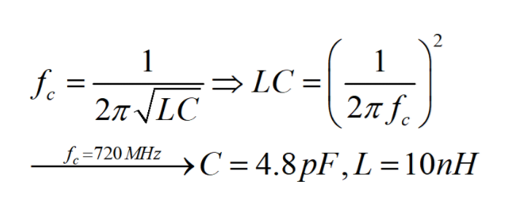
Lower Bandpass Filter: Calculations
Used typical center frequency-resonance formula for bandpass filter to find an LC value:
Values for C and L were chosen according to component availability/tolerances

Slide 13
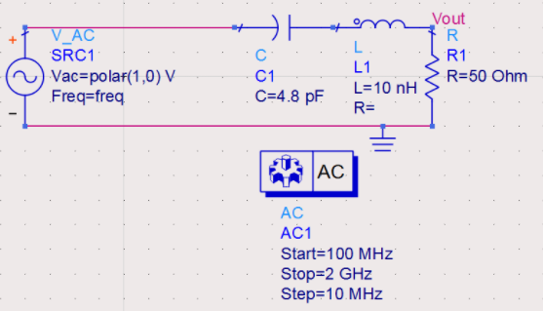
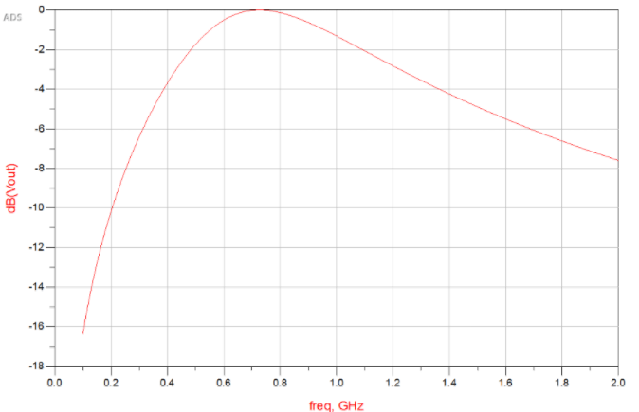
Lower Bandpass Filter: Design Simulations
Created and simulated the calculated filter in Keysight ADS to visualize output

Slide 14
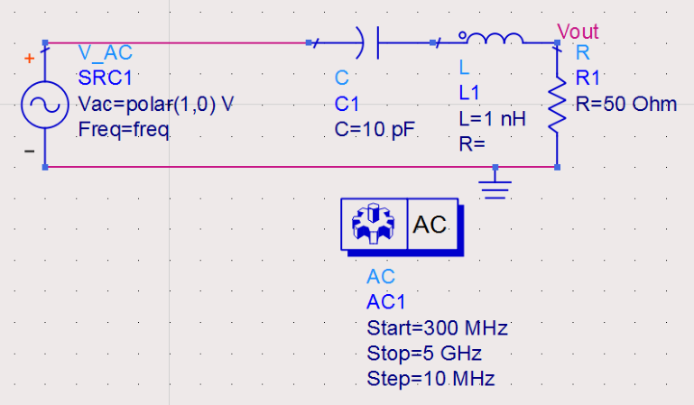
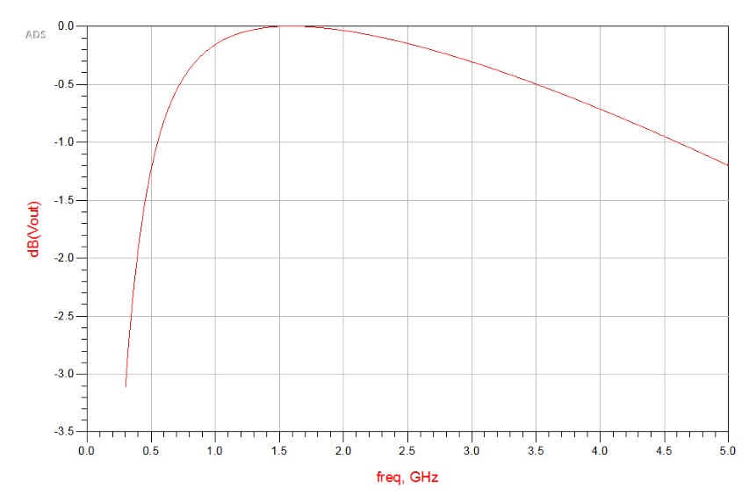
Upper Bandpass Filter: Design Summary
Using the same process for the upper band, the LC value was calculated, L & C values chosen, and the circuit simulated in ADS:

Slide 15
RF Module: Verifications
Detection distance of 1m?
MDS of –50dBm?
Lower band attenuation?
Upper band attenuation?
DC output of 50mV?
Up to 3m detection distance
MDS of ~-60dBm
~8dBm attenuation for FM radio, ~4.5dBm attenuation for BT/WiFi
~1.5dBm attenuation at 800Mhz
~100mV output for active signal

Slide 16
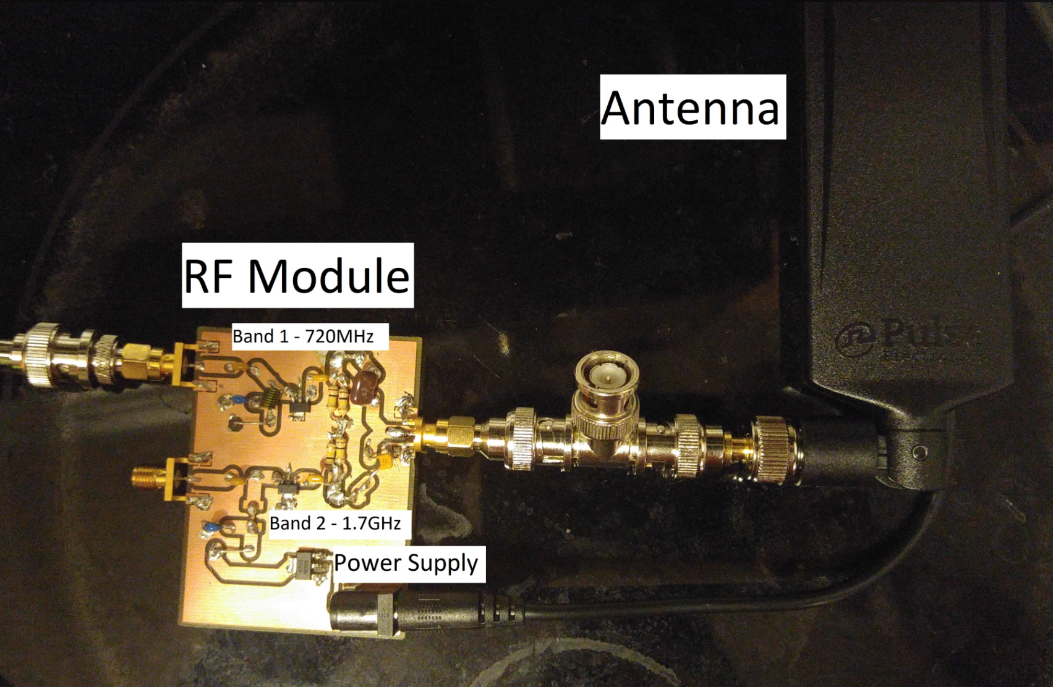
RF Module: Final Product

Slide 17
Notification Module

Slide 18
Notification Module: Requirements
Amplify input signal by at least 3.3V/50mV = 6.67x
Switch output signal within 10mV of Vref (3.3V)
LED switches visibly when signal detected

Slide 19
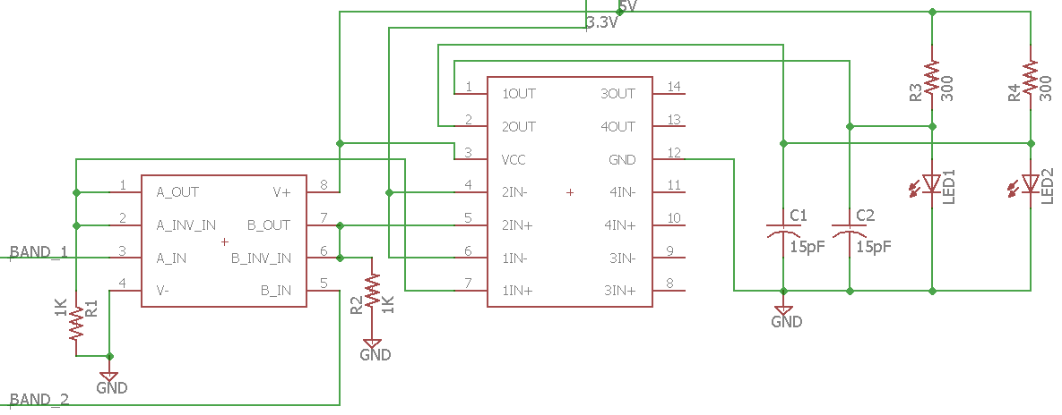
Notification Module: Design
Parts
Amplifier: TI LMC6022IM
Comparator: TI LM339
Notification Elements: 2.7V LED
Comparator
Notification
Amplifier

Slide 20
Notification Module: Verifications
Amplify by at least 6.67x?
Switching at Vref±10mV?
Visible LED switching?
Accurate amplification up to ~50x
Switching at Vref±1mV
LED switches rapidly but visibly

Slide 21
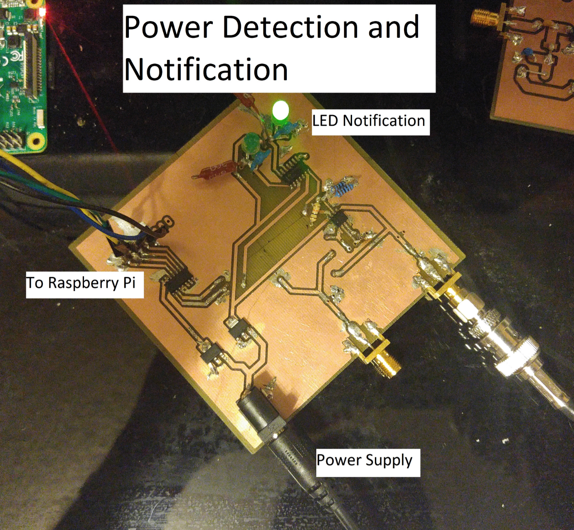
Notification Module: Final Product

Slide 22
Display Module

Slide 23
Display Module: Requirements
Ability to display two bands of interest
US Bands (700-850MHz) and Puerto Rico bands (1.5-1.9GHz)
Display updates in real-time
0.5 seconds delay
Precise signal strength information
Represent the output of half-wave rectifier within 10mV

Slide 24
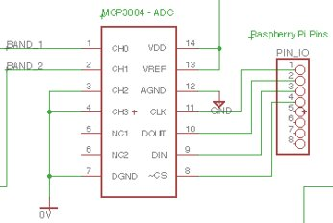
Display Module: Design
Parts
10-bit ADC, MCP3004
Raspberry Pi
Matplotlib (library)
SpiDev (library)
5" HDMI LCD, 800×480
Raspberry Pi
ADC

Slide 25
Display Module: Verifications
Displays two bands?
Real-time plotting?
Accurate readings?
Yes
Samples every 0.1 seconds
10-bit precision with 3.3V reference voltage (≈3.3mV)

Slide 26
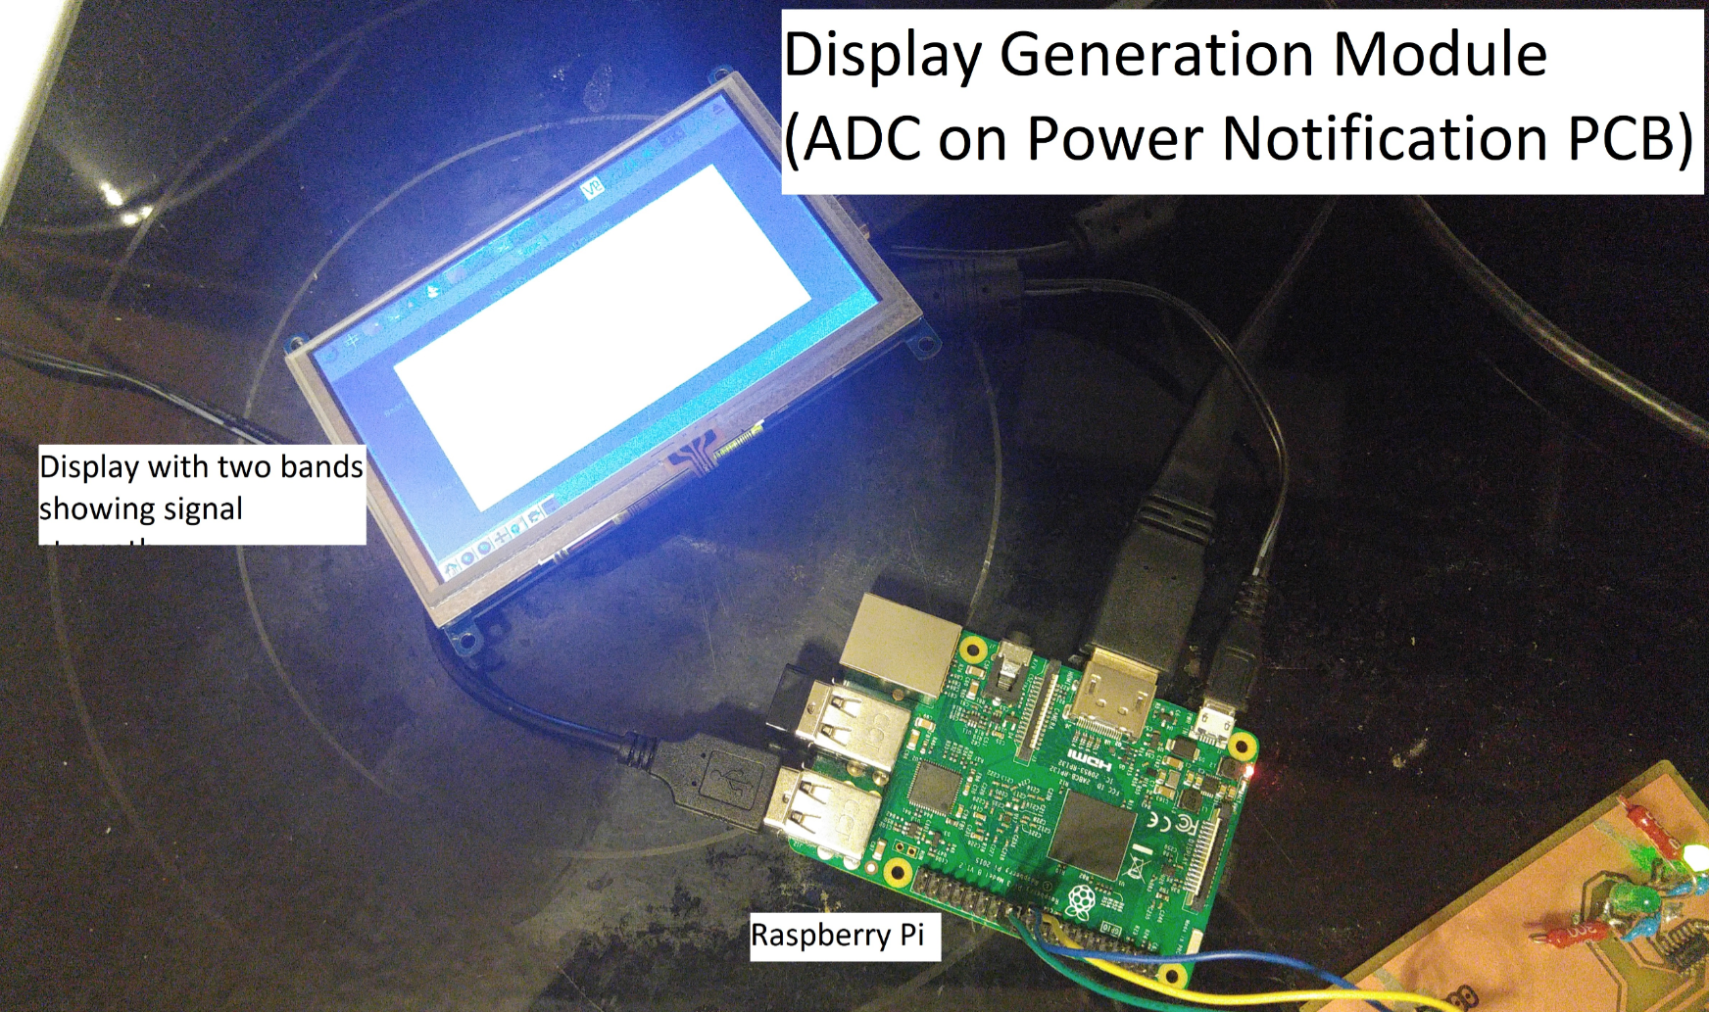
Display Module: Final Product

Slide 27
Power Supply Module

Slide 28
Power Supply Module: Requirements
Need a 3.3V source
±10mV tolerance, able to support 500mA
Need a 5V source
±200mV tolerance, able to support 2A

Slide 29
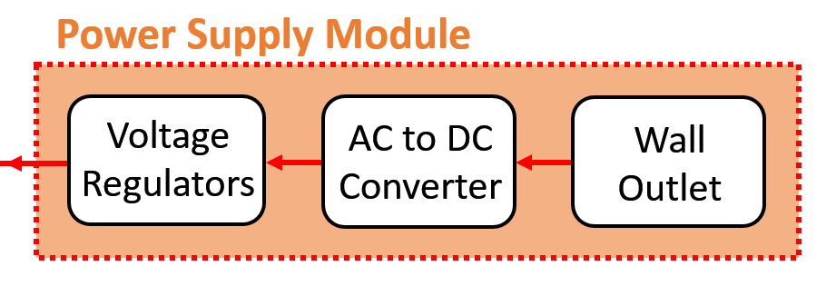
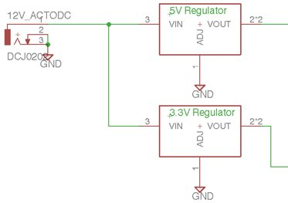
Power Supply Module: Design
Parts
120VAC – 12VDC Wall Adapter: Wonderoto W-T5000
Voltage Regulators: TI LM1117 family
5V Regulator
DC Jack
3.3V Regulator

Slide 30
Power Supply Module: Verifications
3.3V (±10mV) supplied?
5V (±200mV) supplied?
3.3V probed on PCB
5.04V probed on PCB

Slide 31
Demo

Slide 32
Outline
Motivation and Objectives
General Design
Module Specifications
Successes and Challenges
Conclusion

Slide 33
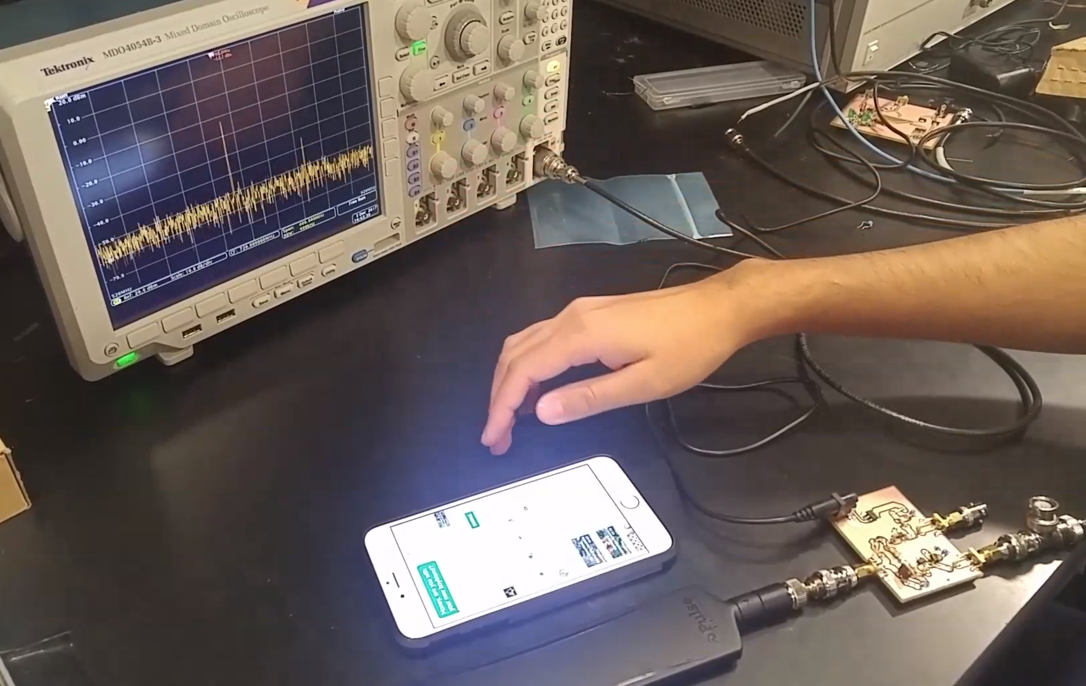
Notable Successes
RF Module phone test
Strong signal peak
Active transmission

Slide 34
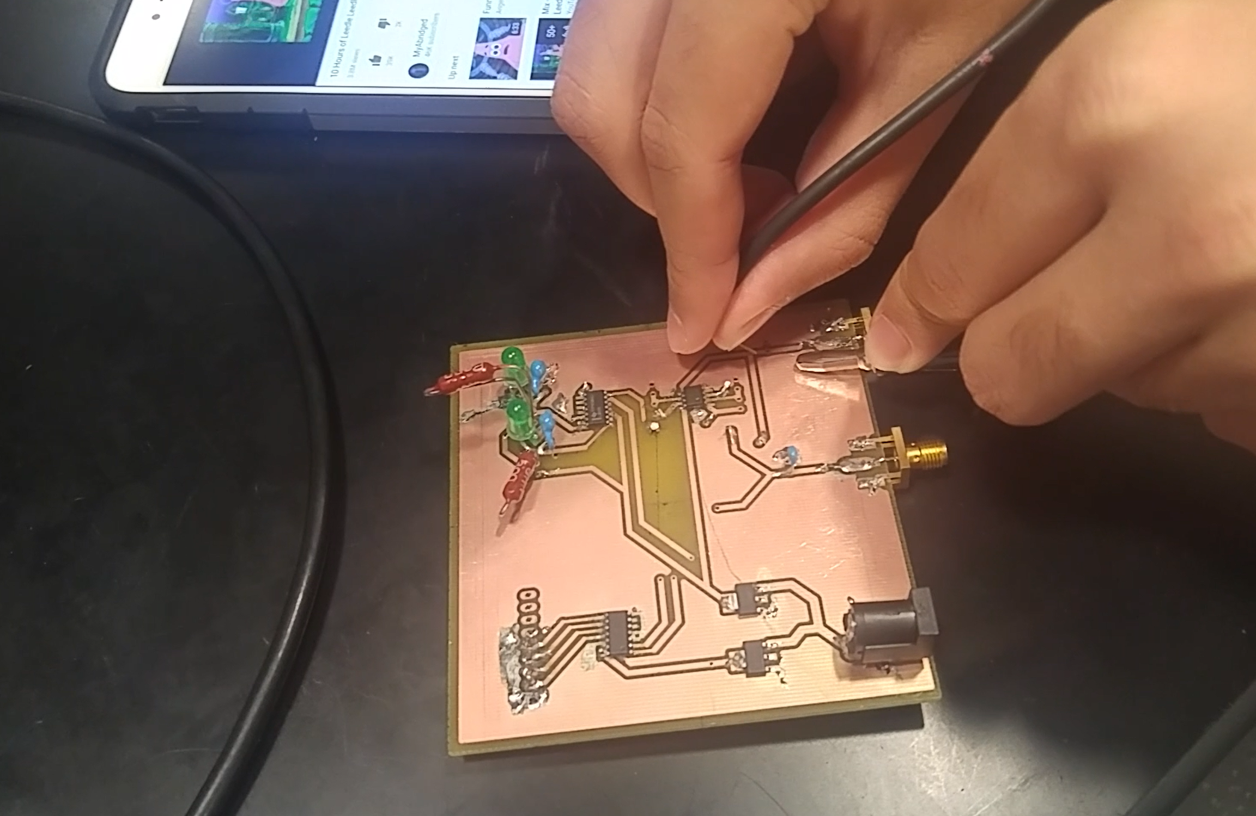
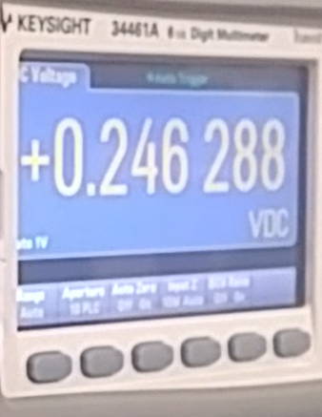
Notable Successes
Rectified signal from phone transmission

Slide 35
Challenges
High-frequency Schottky diode
BAT63
LCD had a "white screen of death"
Had to adjust system configuration parameters
Non-constant connection LED rapid switching
Design decision

Slide 36
Outline
Motivation and Objectives
General Design
Module Specifications
Successes and Challenges
Conclusion

Slide 37
Further Work
Control LED with Raspberry Pi software trigger instead of DC Amplifier and Comparator circuit
Cascade RF Amplifier circuits for farther range
Make device portable

Slide 38
Ethical Considerations
Adhere to IEEE Code of Ethics
Ensure no harm will be caused by components (shocks from 120VAC-12VDC converter, burns from voltage regulators) [IEEE Code of Ethics Section 1]
"Improve the understanding of technology" [Section 5] via our educational display
Abide by FCC regulations
Ensure no arbitrary transmission via our antenna

Slide 39
Acknowledgements and Special Thanks
Yamuna Phal
Benjamin Eng
Zipeng (Bird) Wang
Elias Wilken-Resman
Professor Can Bayram
Professor Karl Reinhardt

Slide 40
Thank you!
Questions?

