Slide 1
Automated Ticket to Ride
Group #43: Matt McCracken & Drew Douglas
TA: Kexin Hui

Slide 2
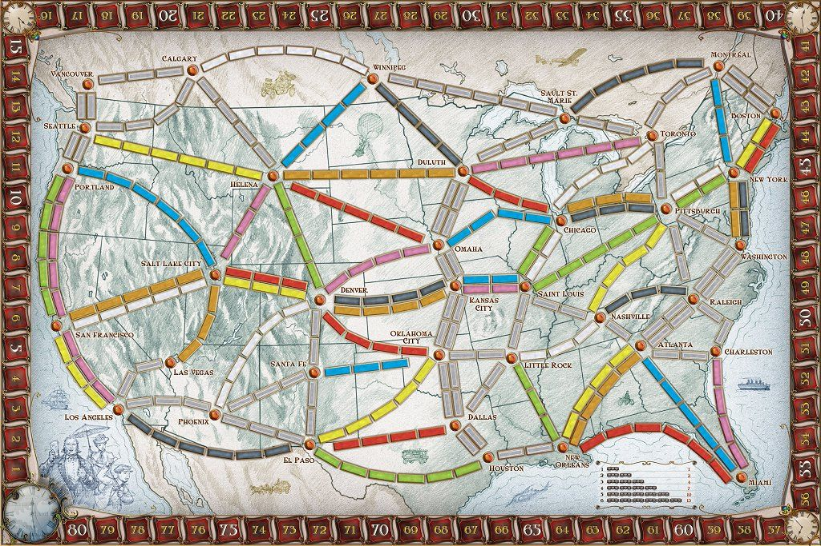
Introduction
Ticket to Ride is a fun game, but the scoring is a tedious process

Slide 3
Goals
Significantly reduce playtime by:
Automating the scoring process for Ticket to Ride
Eliminating the need for physical game pieces
High Level Requirements:
Light up train spaces
Calculate score every round and at end of game
Automatically end game

Slide 4
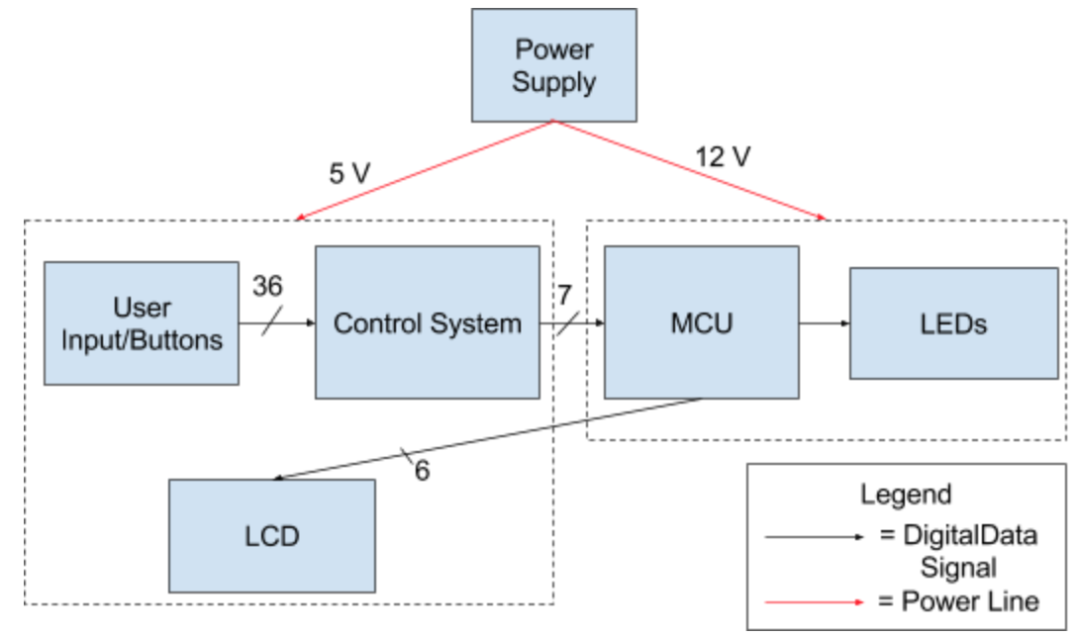
Overall Block Diagram

Slide 5
Power Module Design
Requirements:
Output 12V to LEDs and Arduino
Output at least 6A to drive LEDs
3 RGB LEDs (one addressable strip) draw a max of 60mA
Have 135 3-LED srips
60 mA * 135 = 8.1 A maximum current draw
Given 225 total pieces, only ~ 73% of LEDs can be activated
0.73 * 8.1 A = 5.9 A

Slide 6
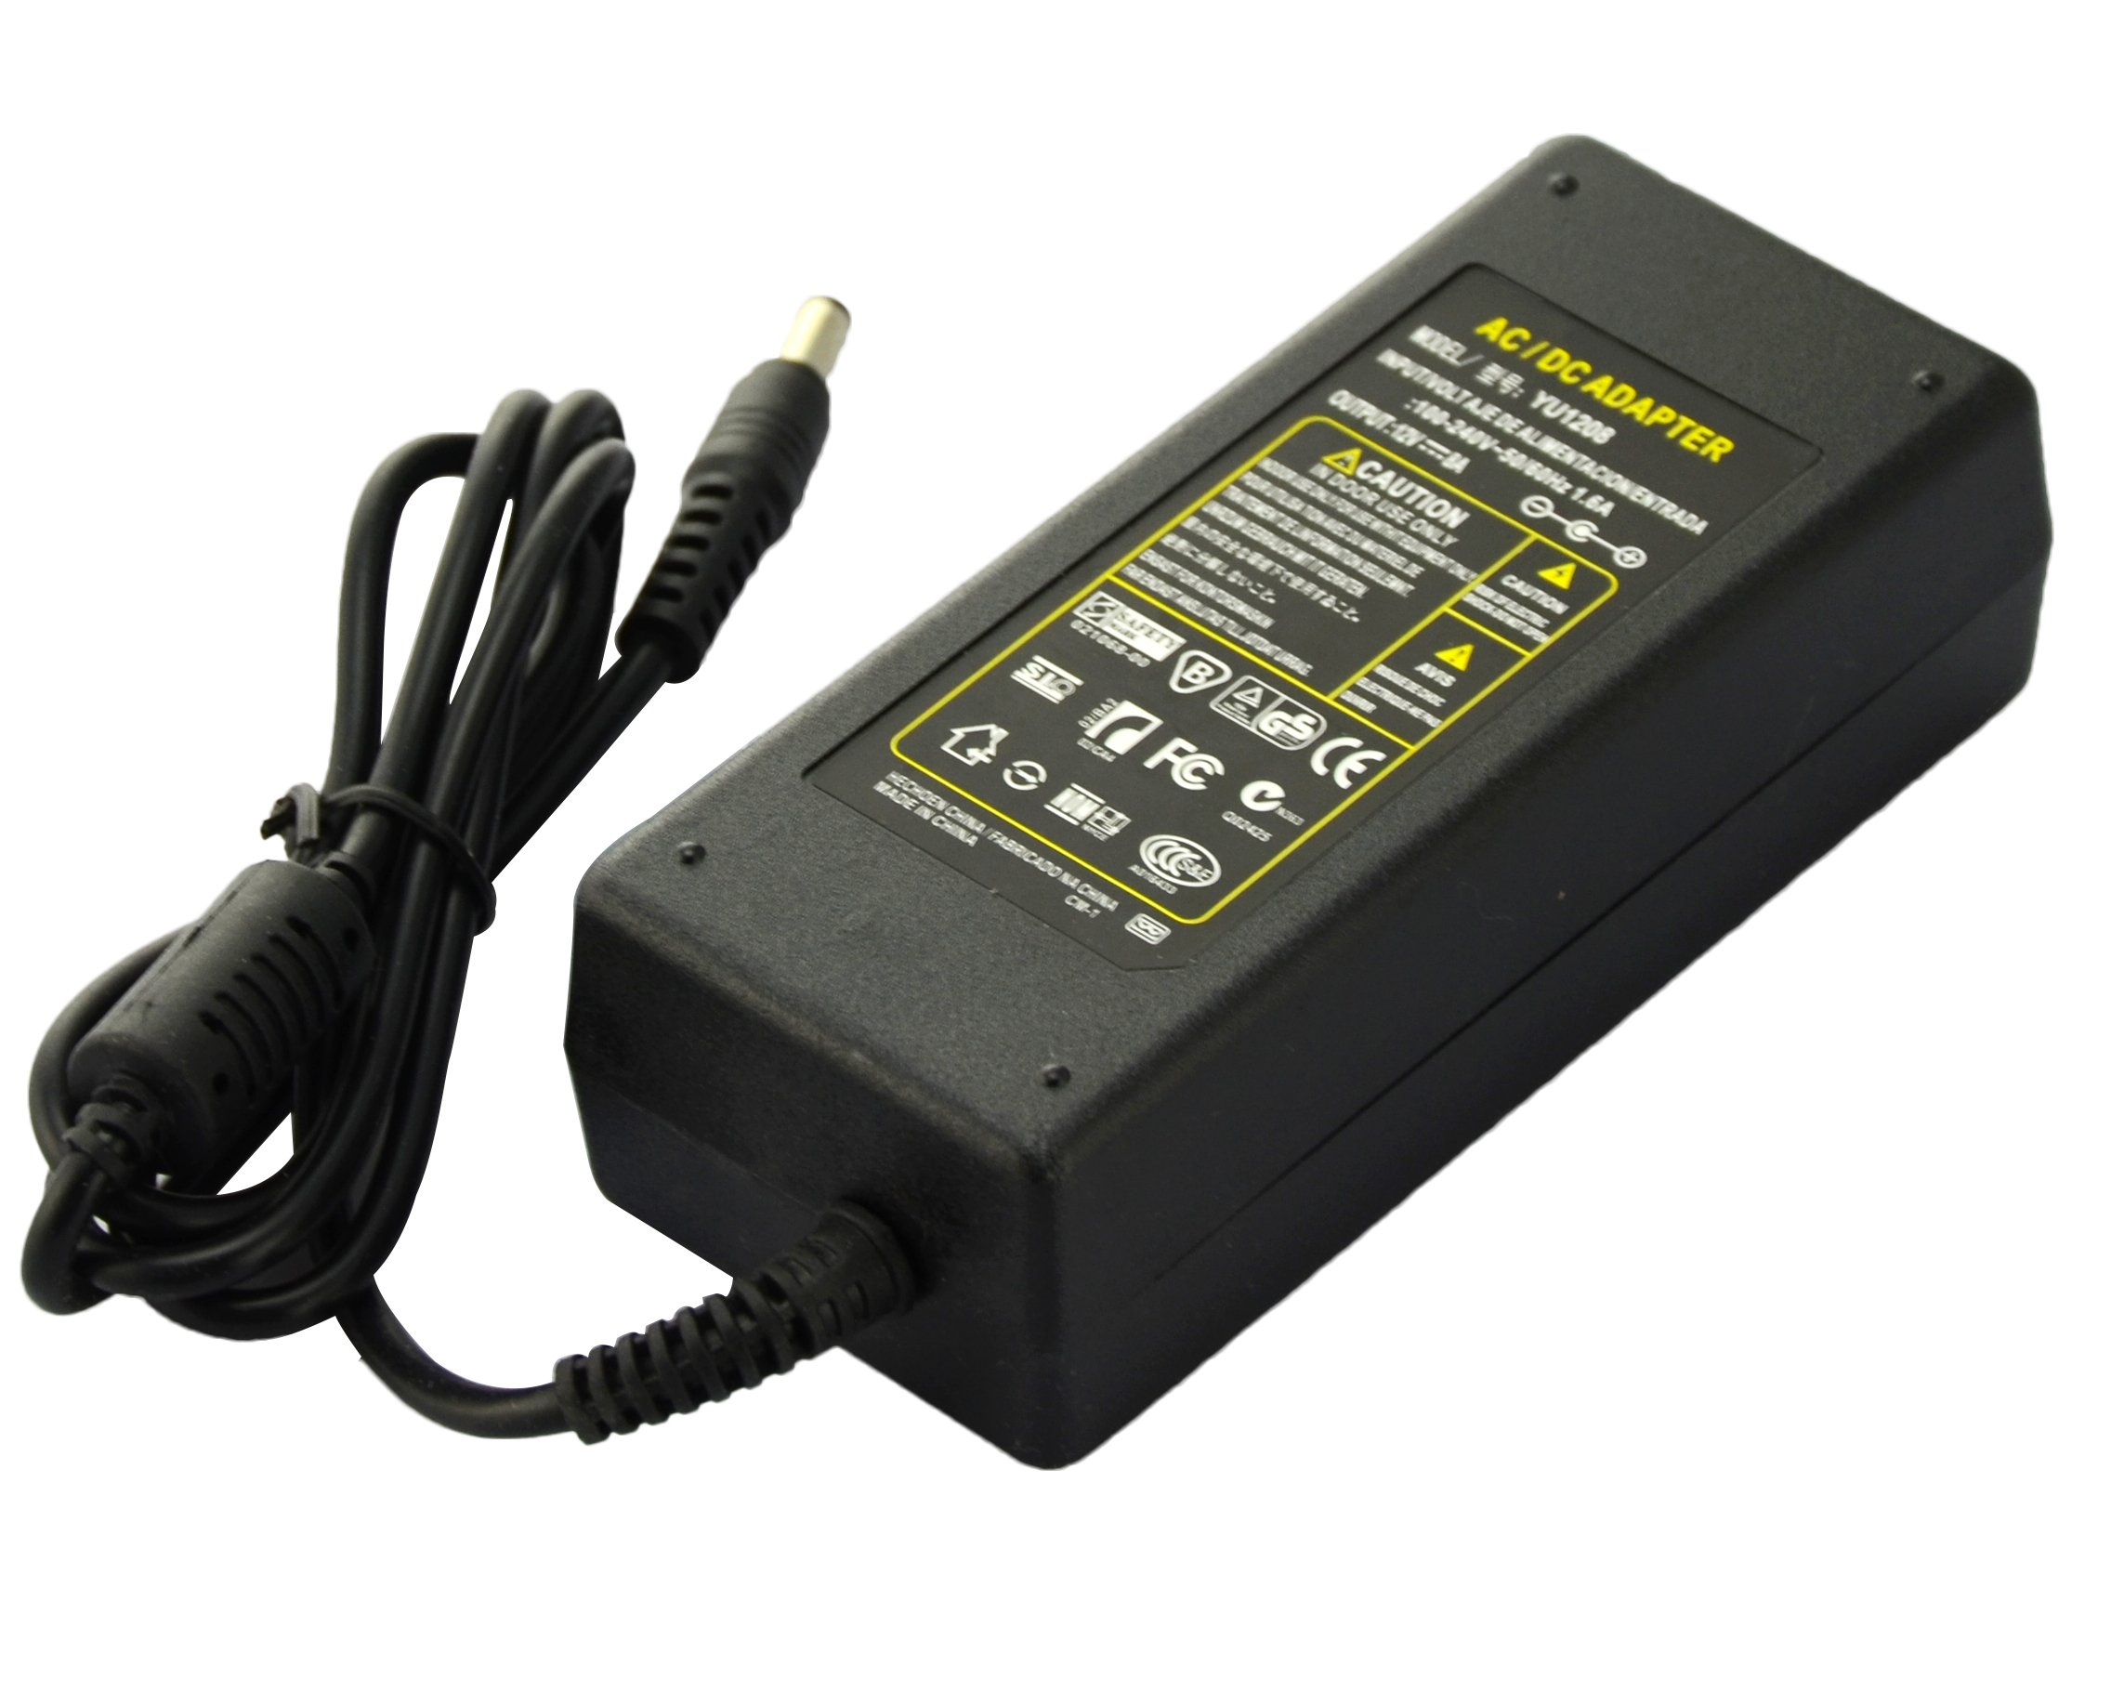
Power Design
Originally thought we would use batteries
Not feasible with the amount of LEDs and power requirement
Decided on a 12V 8A wall power supply

Slide 7
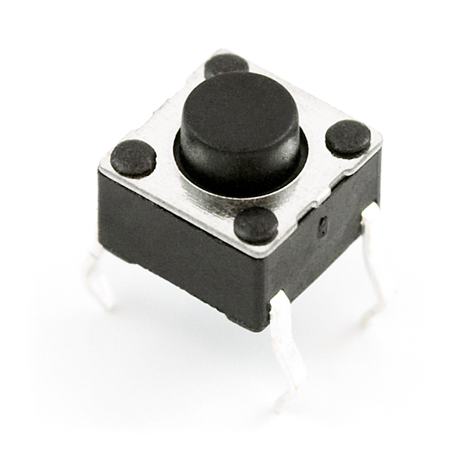
User Interface Module
Requirements
Output 5V when a button is pressed
Grounded when button is not pressed

Slide 8
Initial Design
Designed a PCB to check for valid moves
Used combination of AND and XOR gates
Output a signal for one clock cycle if valid move
Enable = (C_{j} & C_{k}) ⊕ (C_{p} & C_{q}) … ⊕ (C_{x} & C_{y})

Slide 9
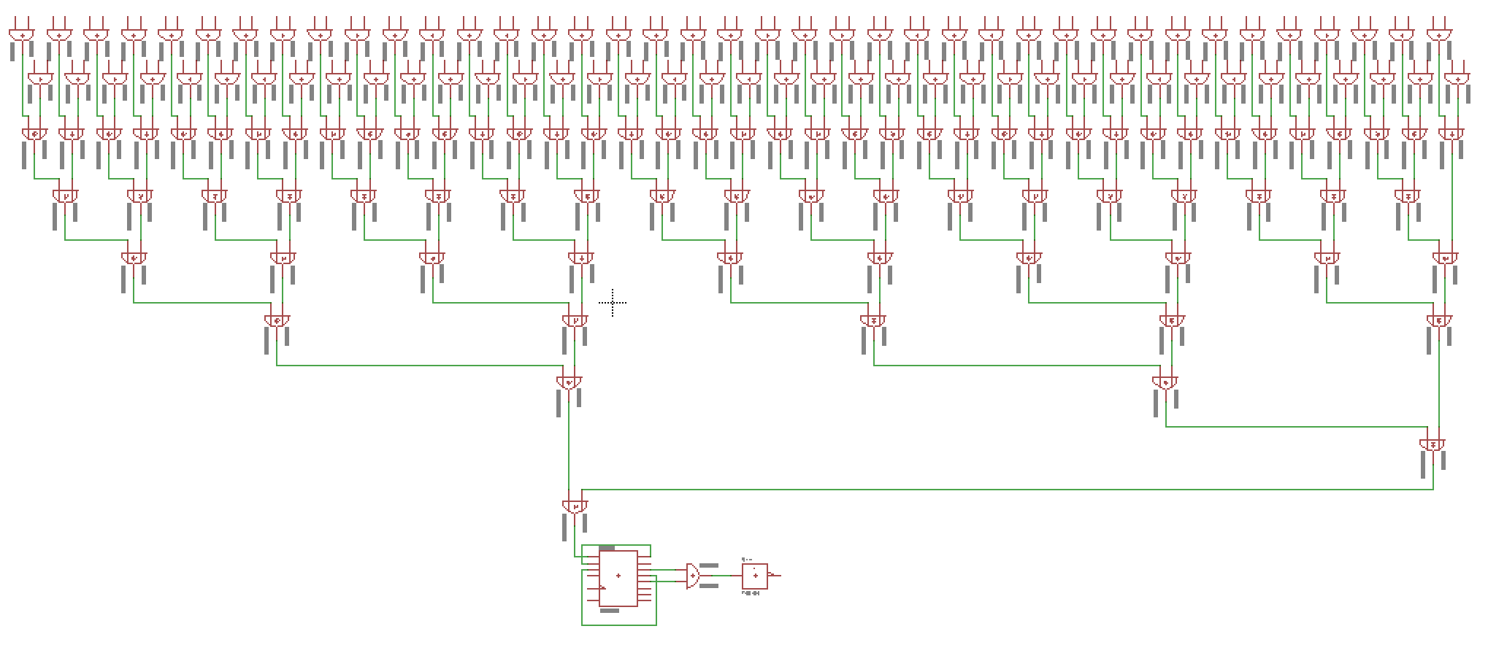
Initial Design

Slide 10
User Input Design Challenges
Button values were floating
Buttons weren’t grounded
Added pull-down resistors to ensure non-floating values
Buttons were bouncing
Added delays in software whenever applicable

Slide 11
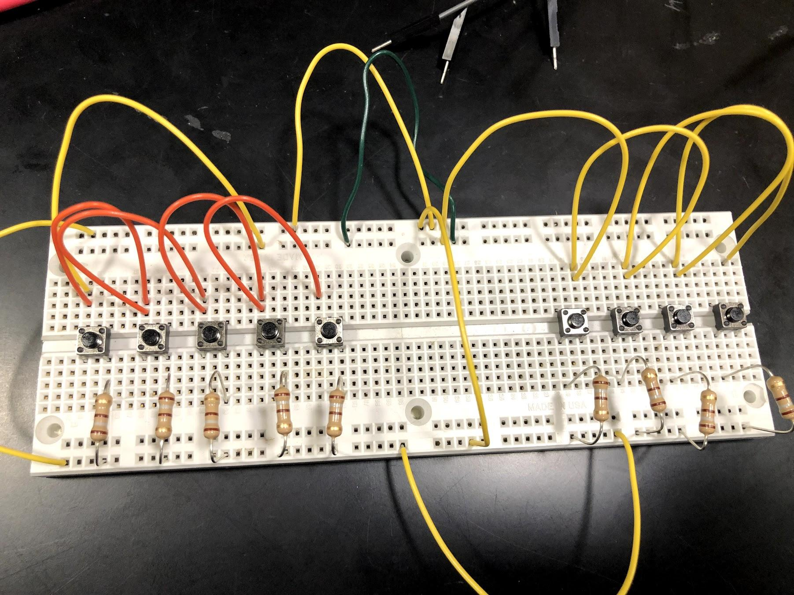
Final Design
Moved error checking to software as well as enable signal
Cut cost
Cut soldering time

Slide 12
Control Module
Purpose
Reduce number of pins used in MCU by compressing button data
Requirements
Output correct 12-bit compression given two button inputs

Slide 13
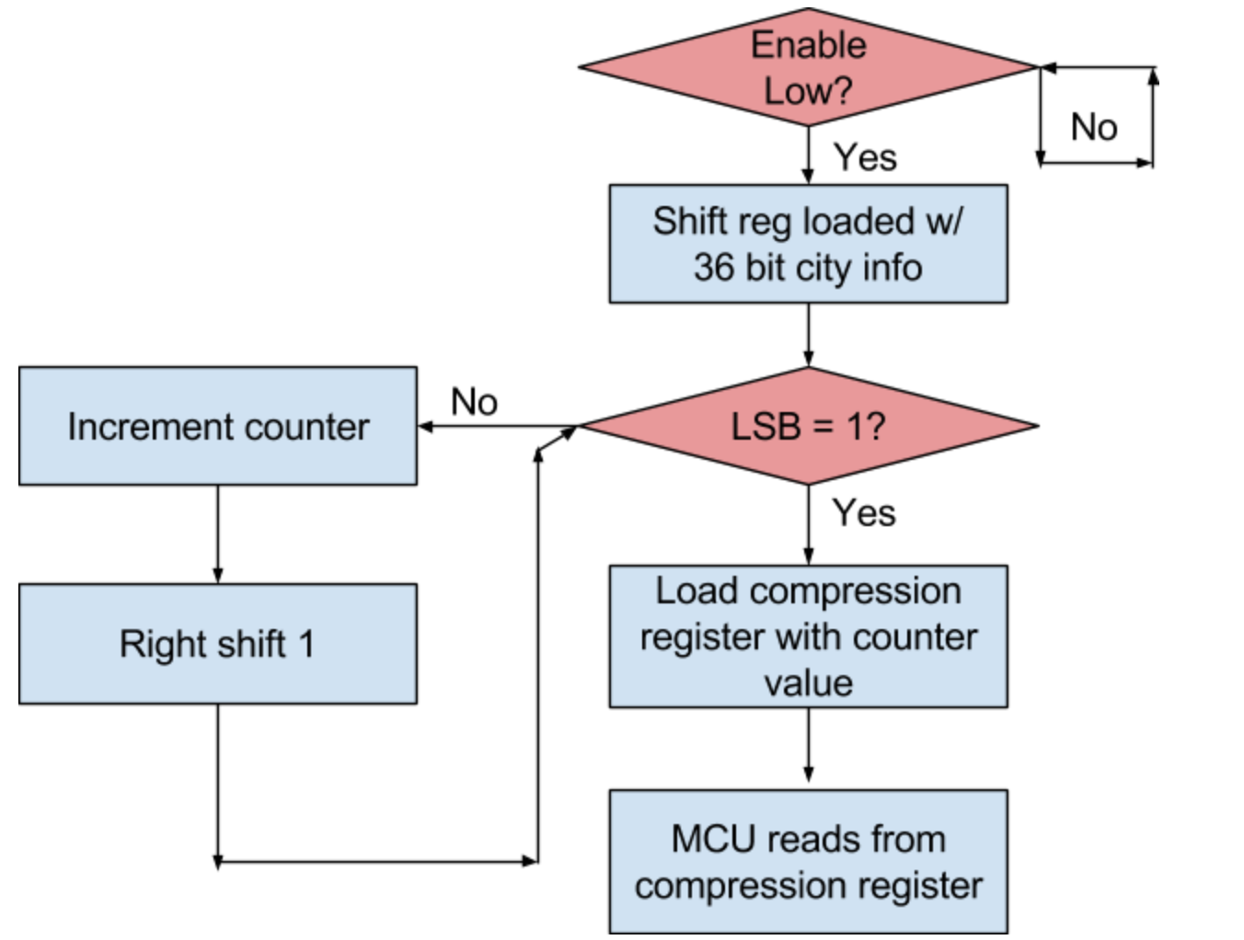
Design

Slide 14
Control Module Challenges
Problems with IC selection:
Outputs (around 2.2V) weren’t high enough to be recognized as logical high (required 3V)
Had to analog read pins and manually set a threshold instead of simpler digital read
Change (digitalRead(PIN) == HIGH) to (analogRead(PIN) > 400)
400 corresponds to a threshold of approximately 2V

Slide 15
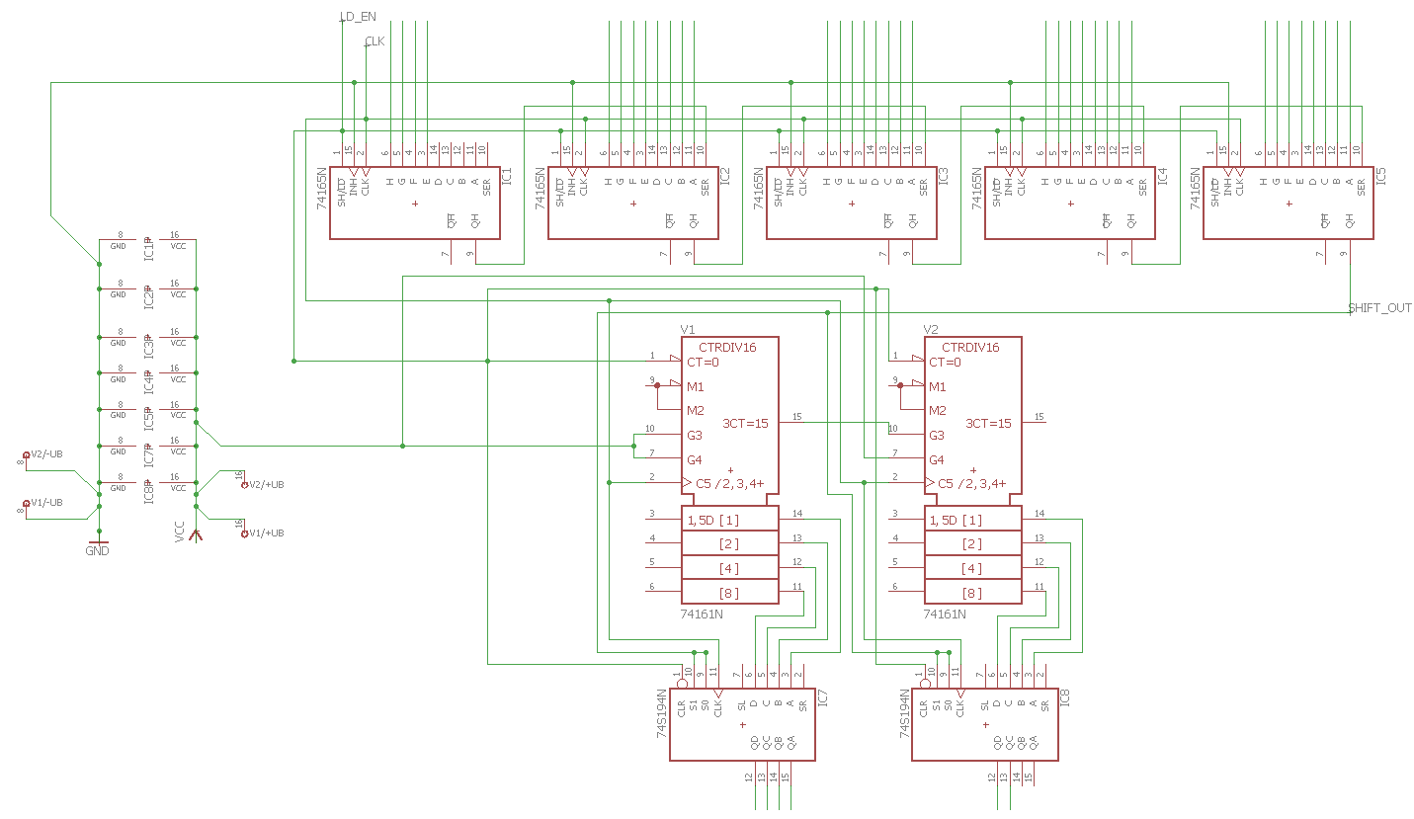
Final Design

Slide 16
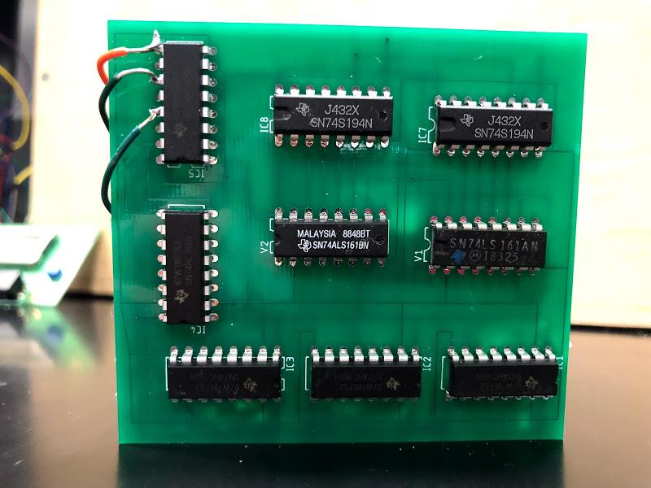
Final Design

Slide 17
Control Verification Video

Slide 18
MCU Module design
Requirements
Keep a running total of scores and cars left
Control LED colors and state
Control LCD output

Slide 19
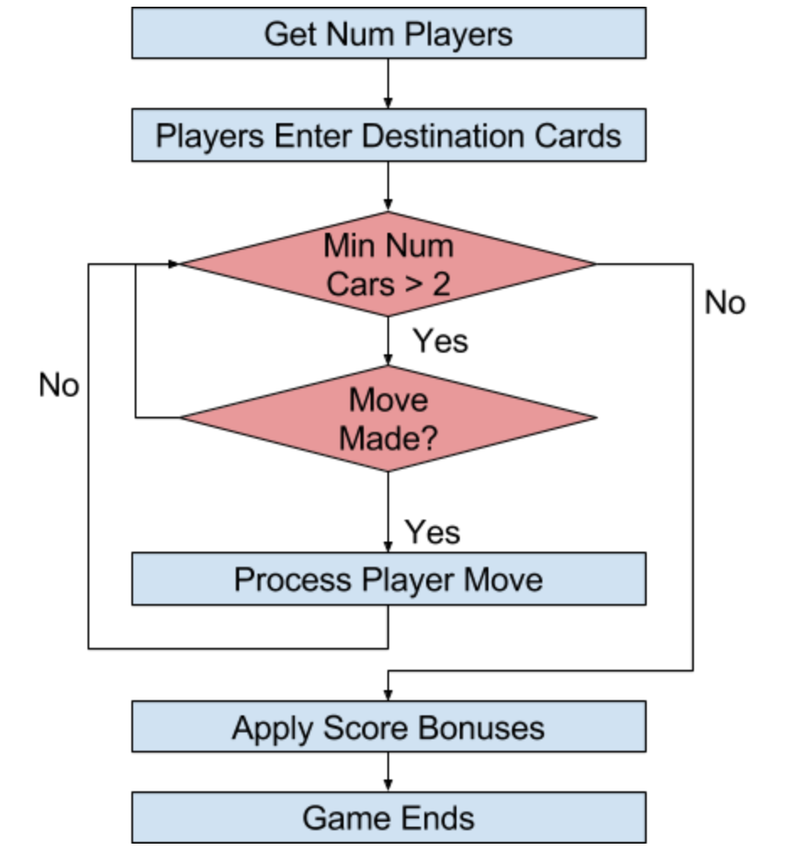
Software Design

Slide 20
Final Design
Ended up using Arduino Mega 2560
Increased memory (256kB)
Increased RAM (8kB)
Data Structures and Algorithms
Used graph structure to represent board
Dijkstra’s algorithm for longest path bonus
Breadth first search to check destination cards

Slide 21
LED Module Design
Requirements
Display correct player color when path is taken
Provide visual aid when selecting double paths

Slide 22
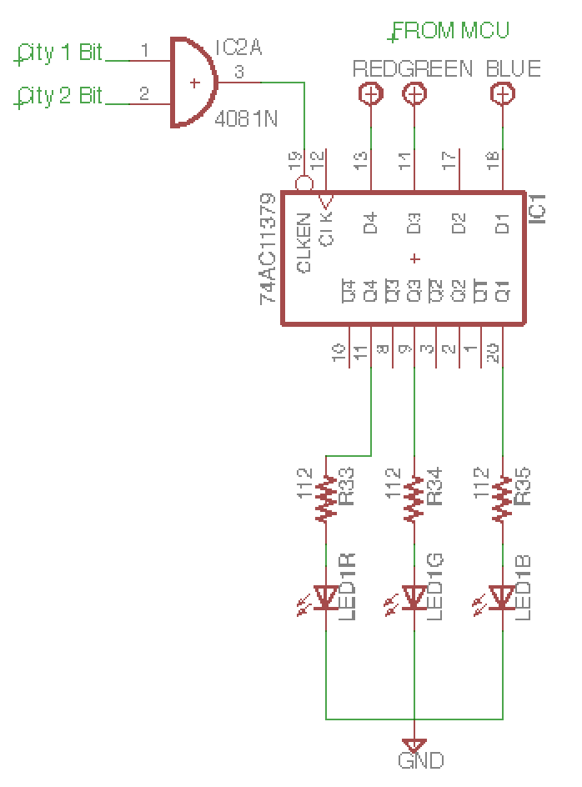
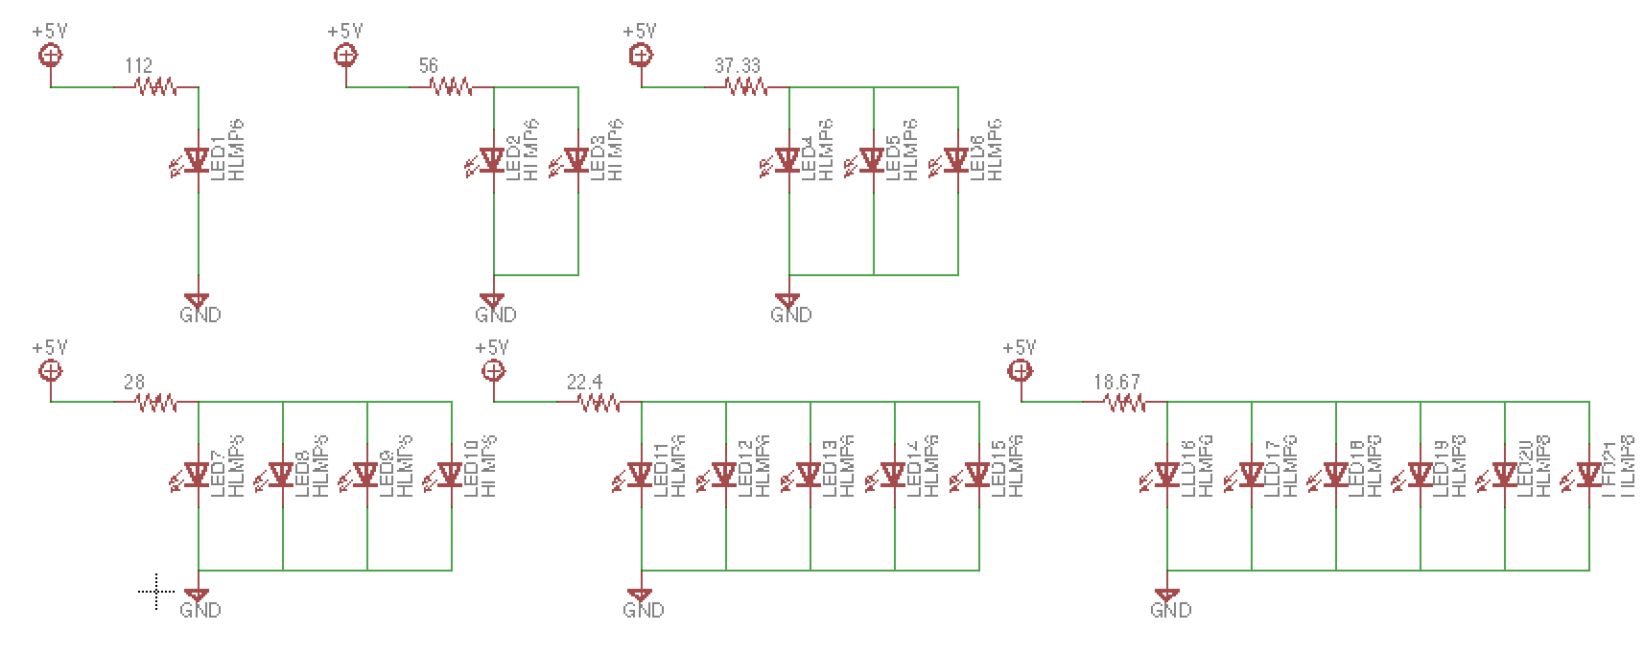
Initial Design

Slide 23
Final LED Design
Using LED Strips
Using 135 total LED strips
Maximum recommended is 500
Much easier to control
Using the FastLED library for Arduino
Cheaper

Slide 24
Video Example

Slide 25
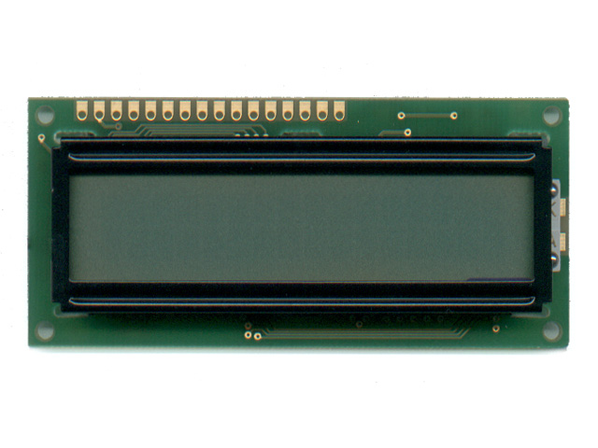
LCD Module Design
Requirements
Display current game state information
Score
Players
Cars left

Slide 26
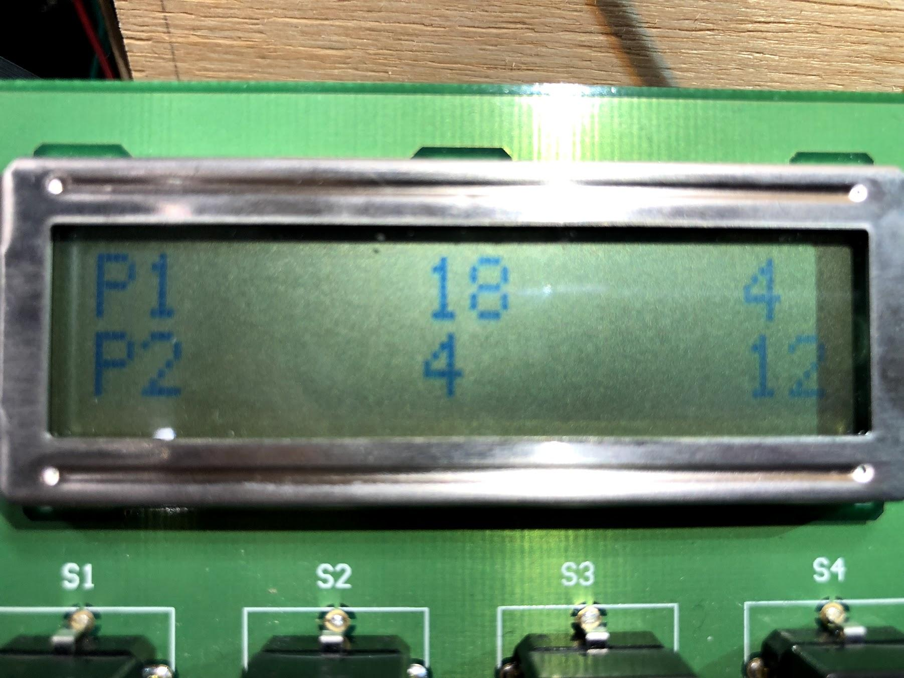
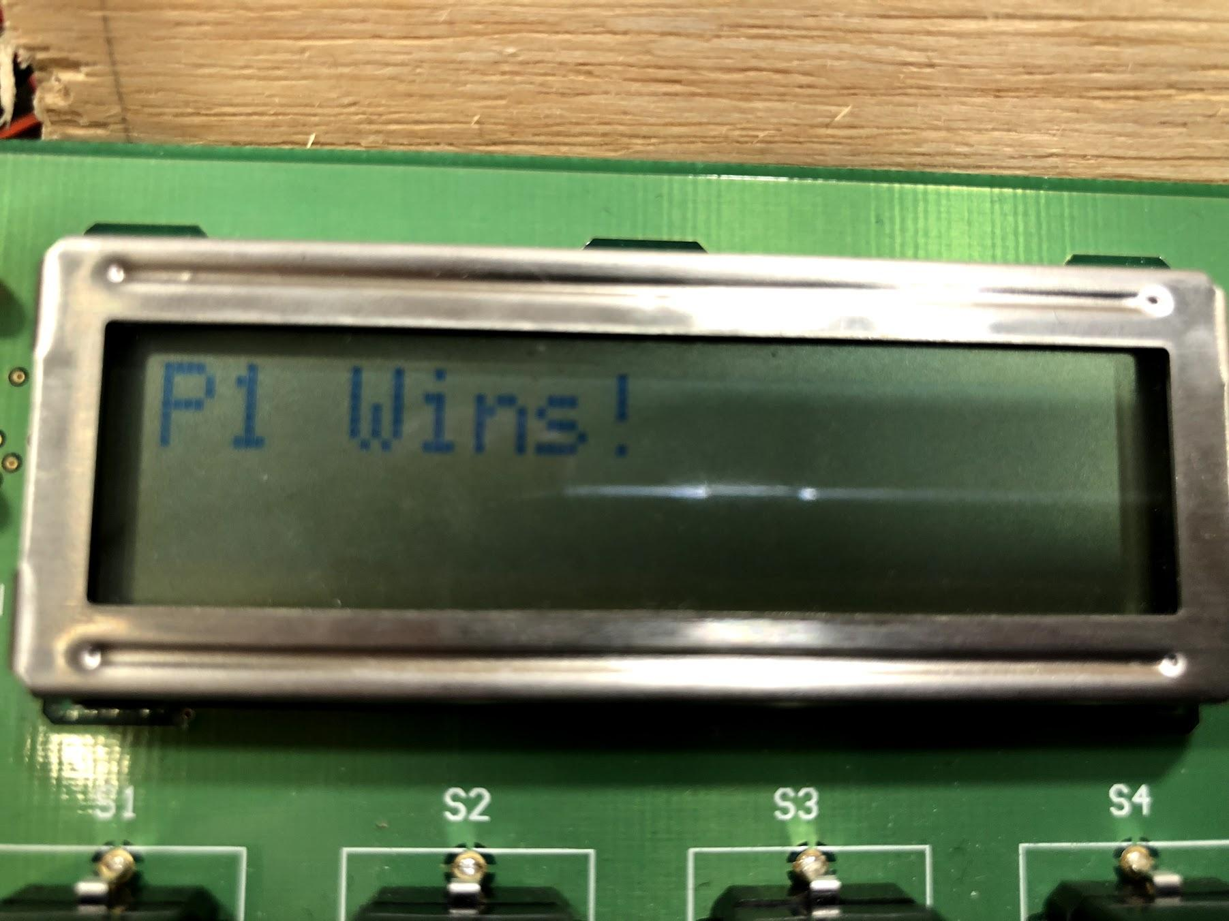
Scoring Example

Slide 27
General Design Challenges
The physical design introduced unexpected problems
Difficult to solder/mount LEDs on back of cardboard
Game board did not provide enough resistance to push buttons
Assembling the LED and User Input modules took significant time

Slide 28
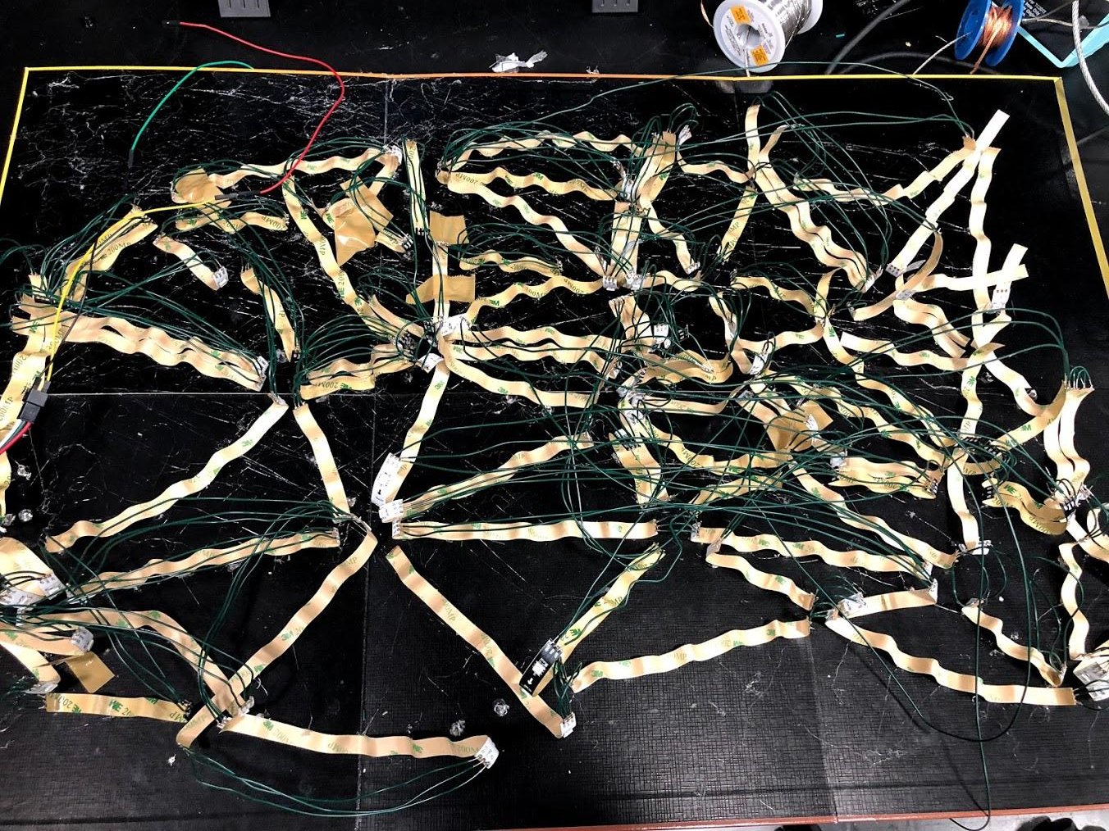
Previous Soldering

Slide 29
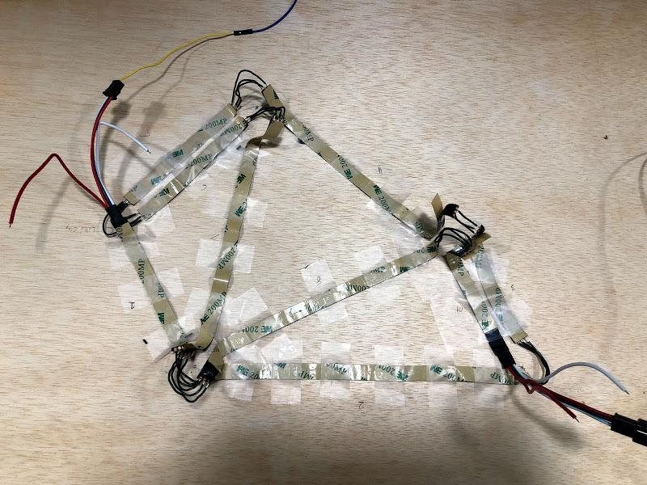
Final Soldering

Slide 30
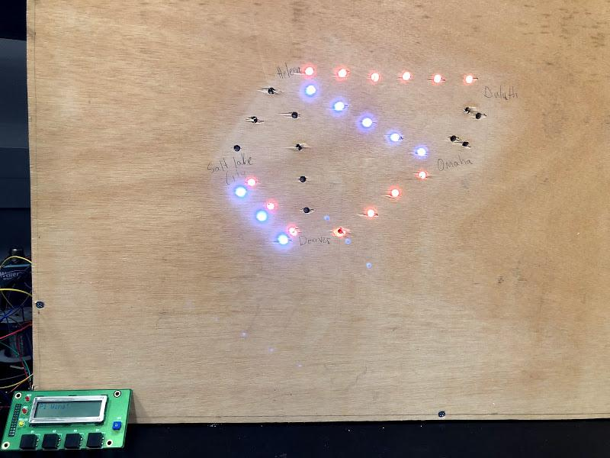
Final Proof of Concept

Slide 31
Lessons learned
Wire neatly
Use a sturdy board
Leave a lot of time for soldering
Scale back if needed

Slide 32
Conclusion
Future work:
Scale up to full game
Do more in software to scale back costs

Slide 33
Thank You

