Slide 1
Remote Water Pump Monitoring System
Team 18 - Masaki Sato, Raynaldi Iskandar, Yun Mo Kang
ECE 445 Senior Design
December 3, 2020

Slide 2
Introduction
Rural villages in Indonesia have difficult access to clean water
Must walk by foot in a 3-hour round trip just to get clean water
An organization named Solar Chapter has built a water pump system to provide clean water access to villages
How to sustain the system considering its remote location? Remote water pump monitoring system!

Slide 3
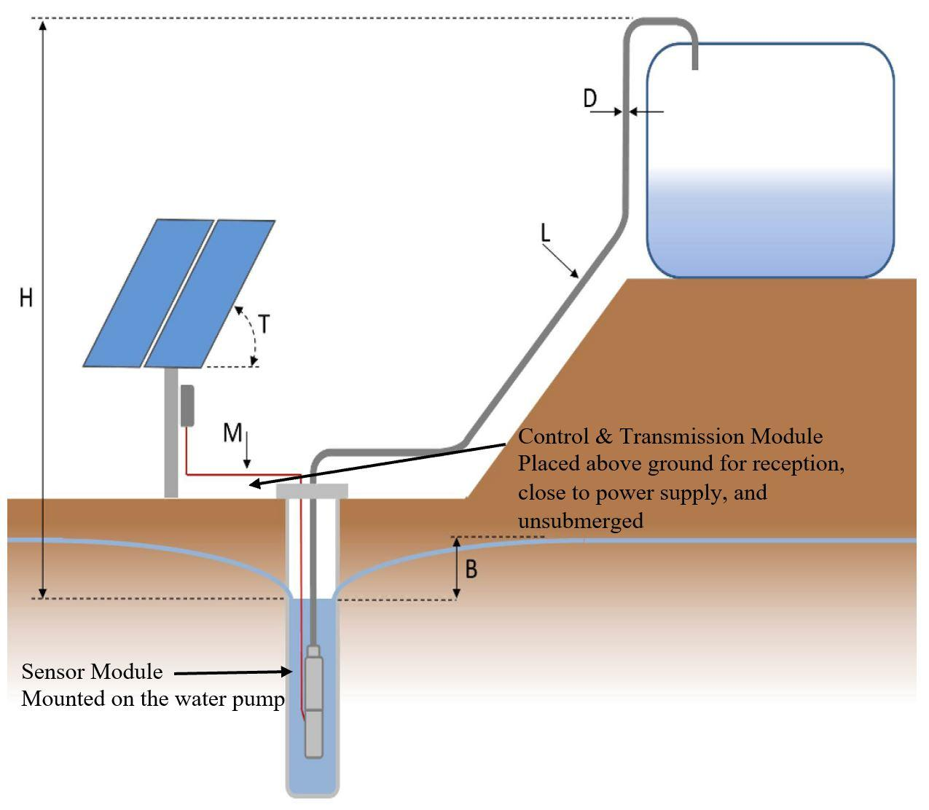
Water pump

Slide 4
High-Level Requirements
Microcontroller must process the output signal of each sensor of varying form and translate them to a quantitative value
Collected data must be transferred through wireless network connection to the cloud based database in an interval of 15 minutes.
Once the cloud database is updated, the updated information should be inserted to a separate database server. Finally, this should be reflected on our website.

Slide 5
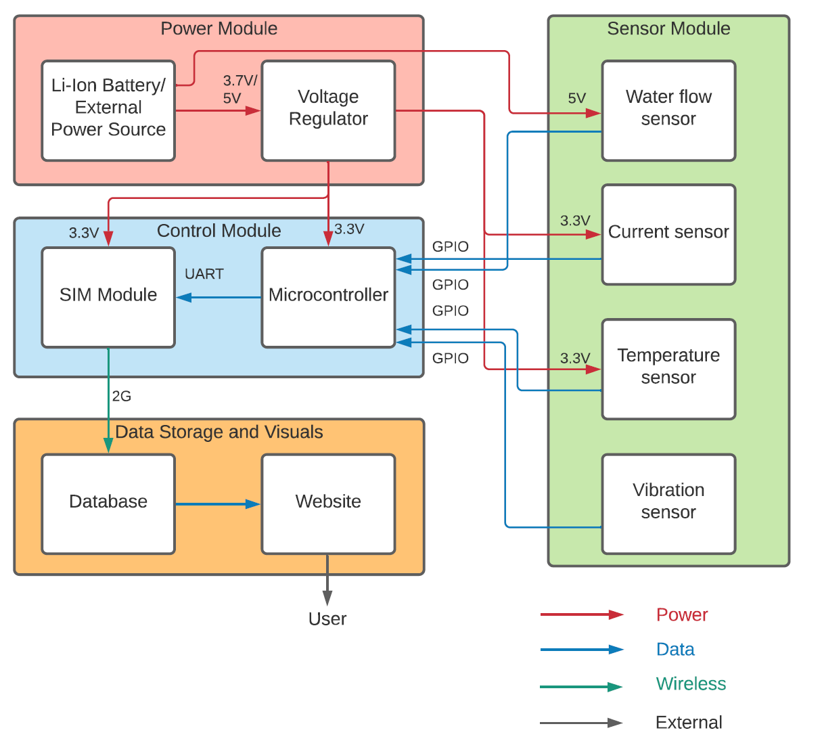
Block Diagram

Slide 6
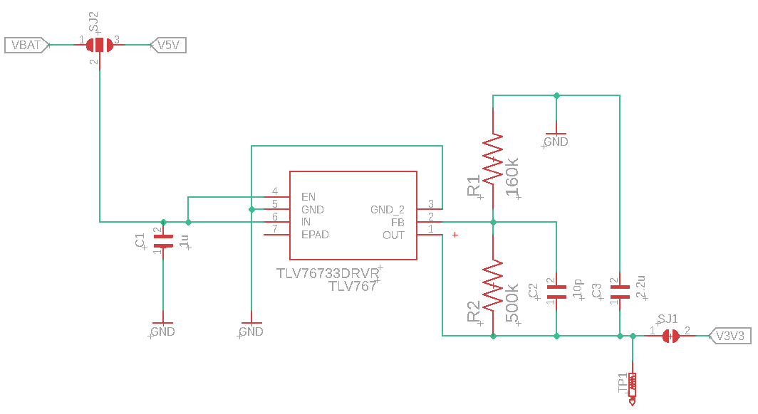
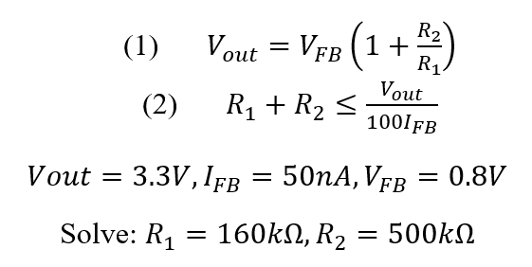
Power Module - Design

Slide 7
Power Module - Result
V_{IN} (V) | V_{OUT} (V) | V_{FB} (V)
3 | 3 | 2.27
3.3 | 3.3 | 2.56
3.5 | 3.5 | 2.76
3.8 | 3.8 | 3.05
4 | 4 | 3.3
4.3 | 4 | 3.3
4.5 | 4 | 3.3

Slide 8
Power Module - Result
V_{OUT} error possible cause: missing components
Solution: Use V_{FB} as the power signal (saturates at 3.3V)
Still able to power on components

Slide 9
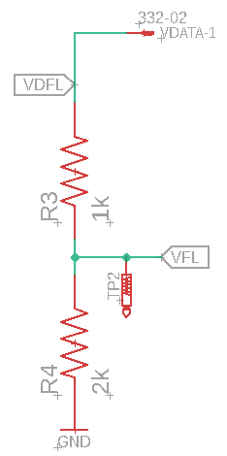
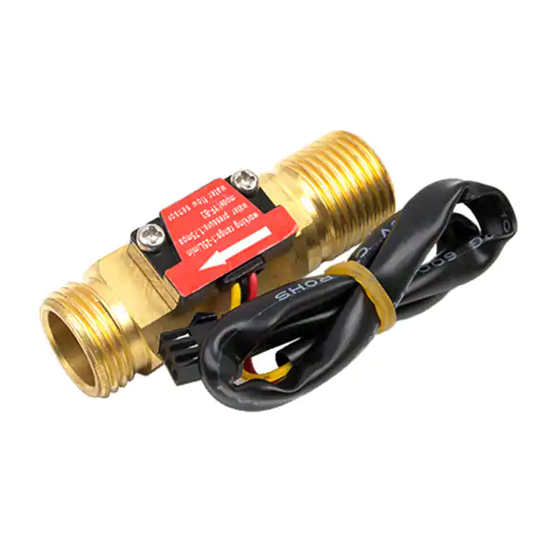
Flow Sensor - Design
5V input -> 5V amplitude square wave output (VDFL)
Voltage divider:
VFL = ⅔*VDFL
VFL = 3.3V amplitude square wave

Slide 10
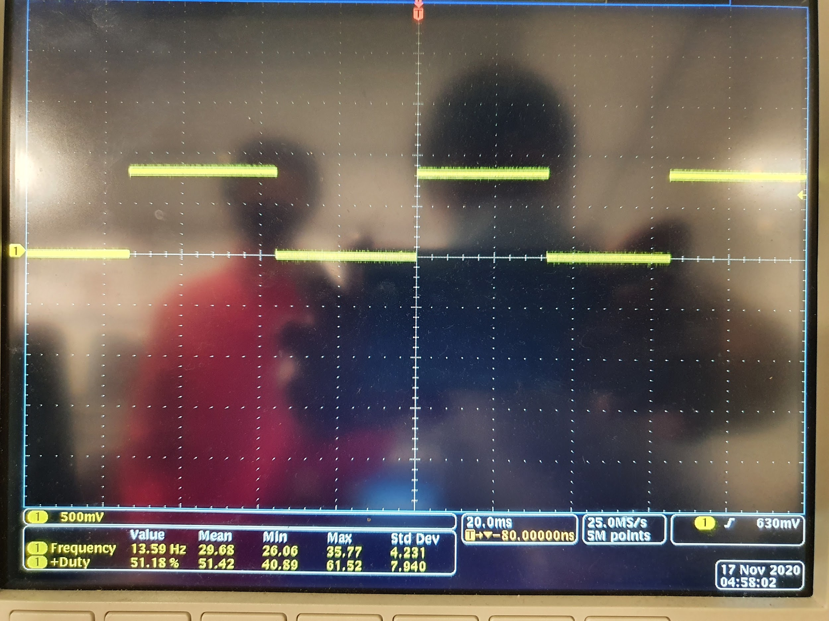
Flow Sensor - Result
0.8V amplitude square wave output (expected 3.3V)
Solution: power sensor with 3.3V, directly connect to GPIO

Slide 11
Flow Sensor - Result
float frequency(){
float period = (pulseIn(flow_pin, LOW)*2)/1000000.0;
if (period==0){
return 0;
}
return 1/period;
}
lpm = frequency()/11.0;
Use digitalRead() for new data form
pulseIn() measures the duration of a high signal (half period)
Mathematical model:
F[Hz] = 11*Q[LPM]

Slide 12
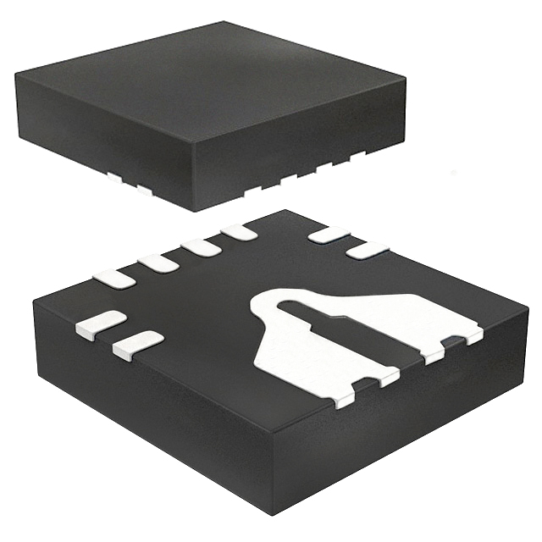
Current Sensor - Design
Power = 3.3V
Sensitivity = 45mV/A
Input range = +-31A
Output range = +-1.395V
Read by analogRead()

Slide 13
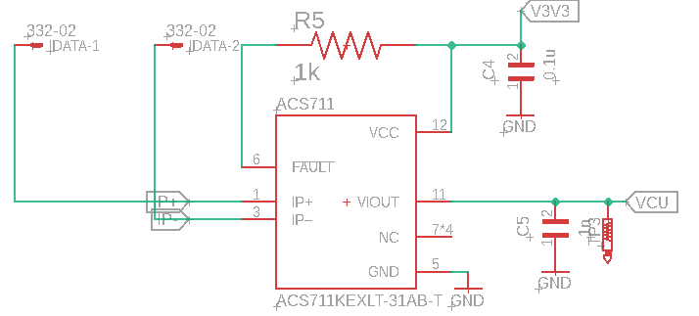

Slide 14
Current Sensor - Result
Malfunctions; output = constant 1.8V (regardless of input)
Possible cause of error:
Overheating
Flux corrosion

Slide 15
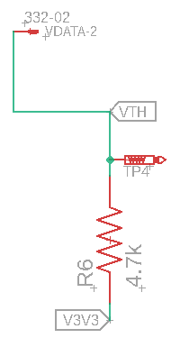
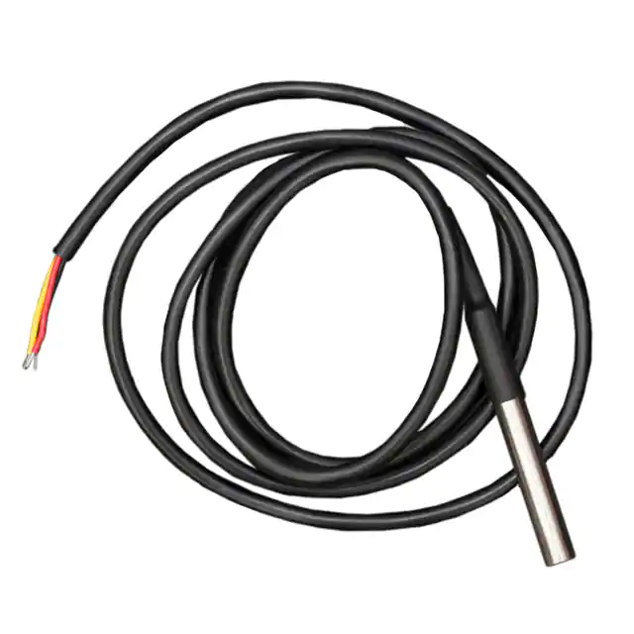
Temperature Sensor - Design
Power = 3.3V (V3V3)
Resistor bridges power - data
Output = Digital (VTH)

Slide 16
Temperature Sensor - Result
Room temperature
Digital signal -> temperature value (using sensor library)
Warmed up by hands

Slide 17
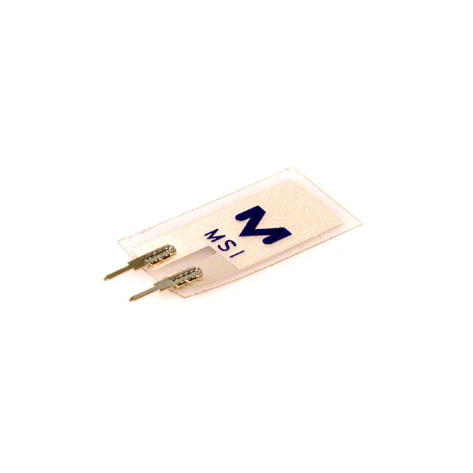
Vibration Sensor - Design
A piezoelectric device
Connect a port to MCU GPIO, another to GND
Data read using analogRead()

Slide 18
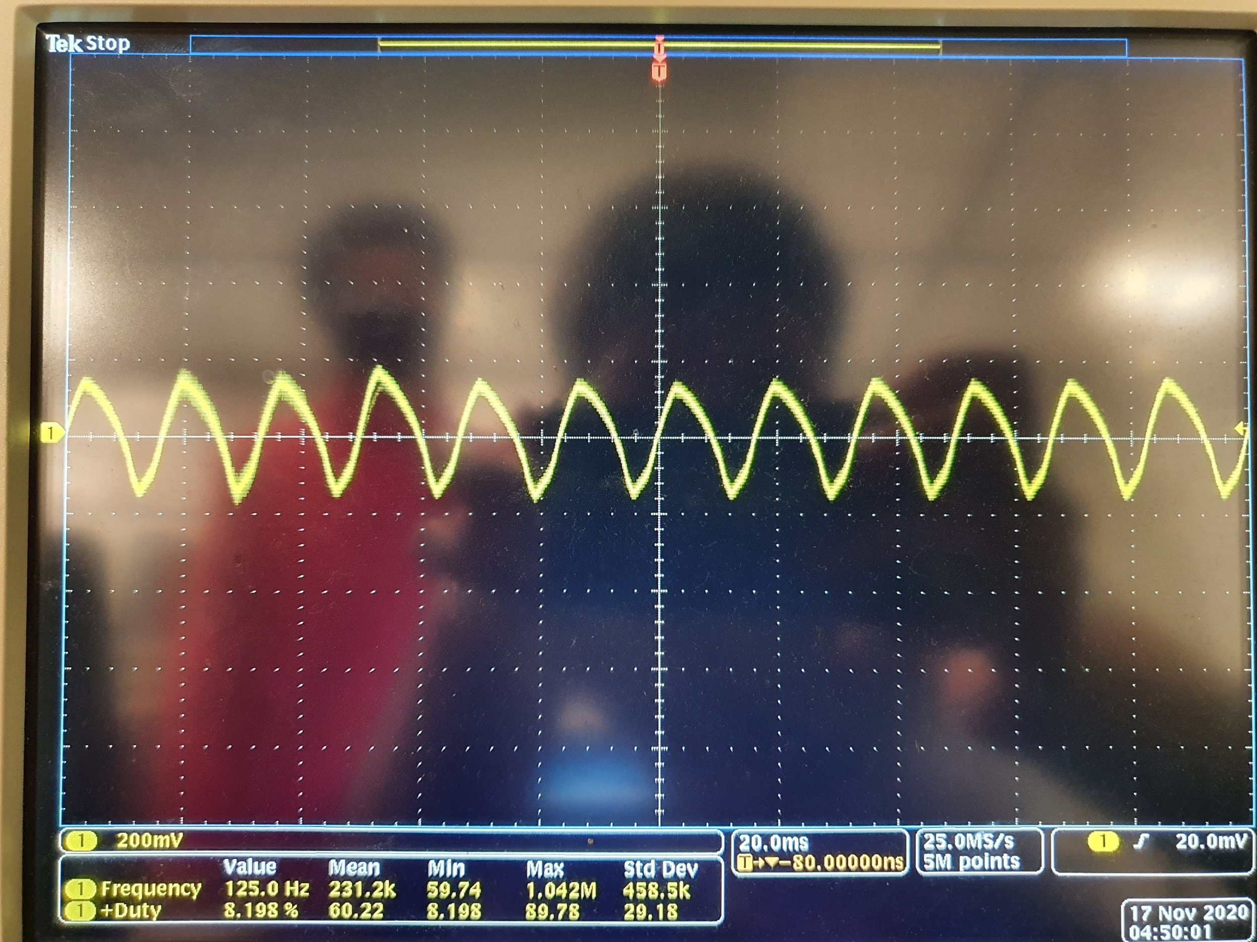
Vibration Sensor - Result
Precision Approximation
Asynchronous analogRead()’s (25ms)
Return = average of analogRead()’s (arbitrary vibration measure)

Slide 19
Vibration Sensor - Result
Idle
Distinction between different vibration sources
Arbitrary measure is good enough
Phone vibration
Tapped by finger

Slide 20
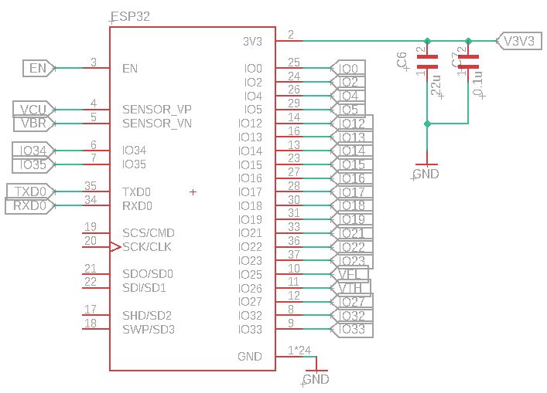
ESP32 - Design

Slide 21
ESP32 - Design cont.

Slide 22
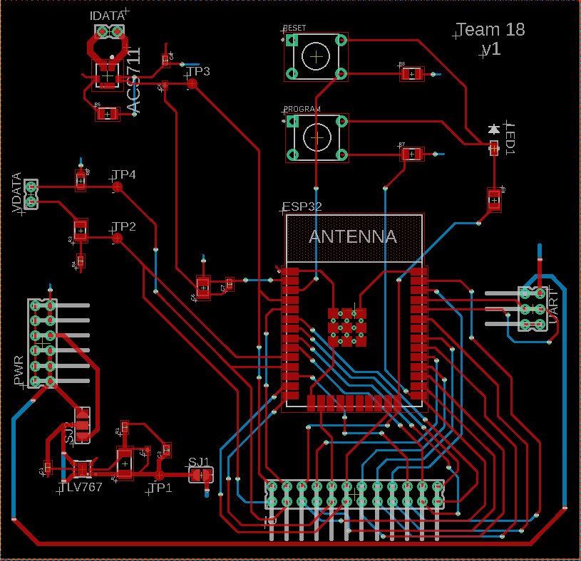
PCB
Sensor module
Control module
Power module

Slide 23
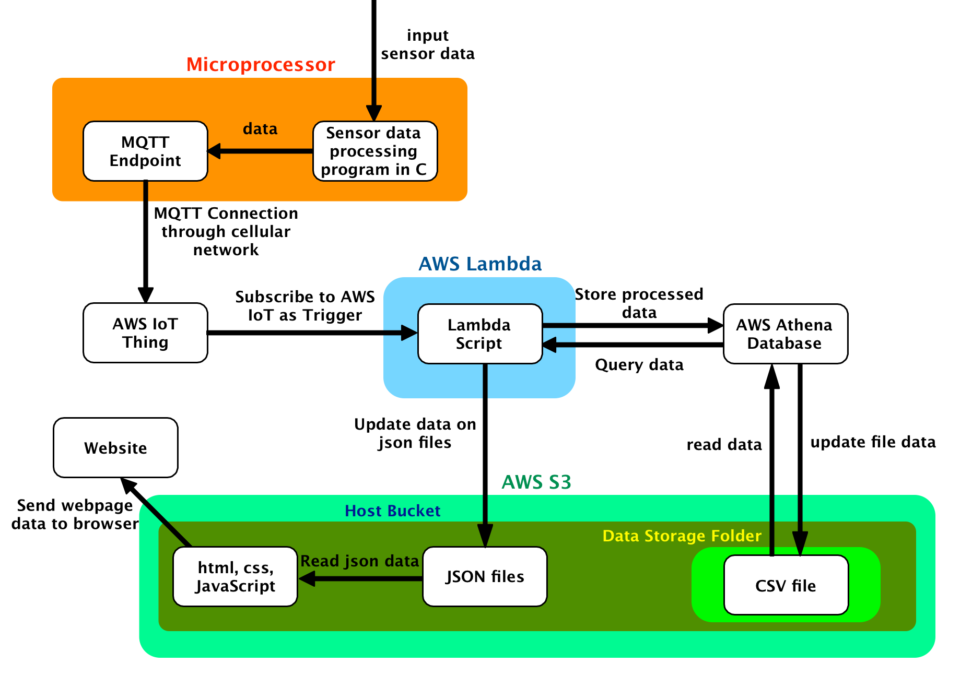
Block Diagram (Software)

Slide 24
ESP 32 to IoT
Process input data from sensors
Format data into JSON
Connected through Wi-Fi
Send JSON formatted data through MQTT protocol
Connect to AWS IoT by using credential keys

Slide 25
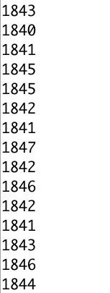
Sensor data read by ESP 32
Ammeter
Flow
Temperature
Vibration

Slide 26
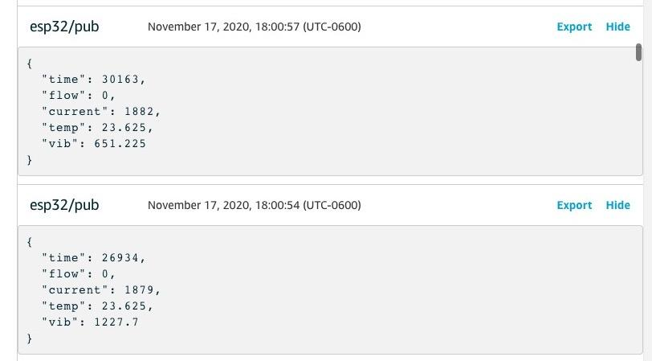
Sample of data received on AWS IoT

Slide 27
AWS Lambda Function
Executes on AWS IoT trigger
Both updates and queries the AWS Athena SQL database
Outputs queried data as a json file into S3 bucket

Slide 28
AWS Lambda Log from Mock data testing

Slide 29
AWS Athena Database
SQL Database
Stores the history of the water pump data
Data consists of: date and time, water flow, current, vibration, warning flag one, warning flag two

Slide 30
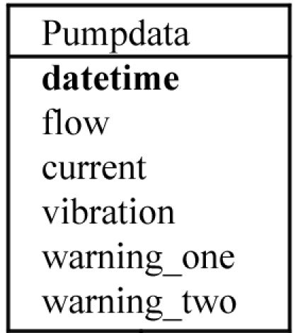
Schema of SQL data

Slide 31
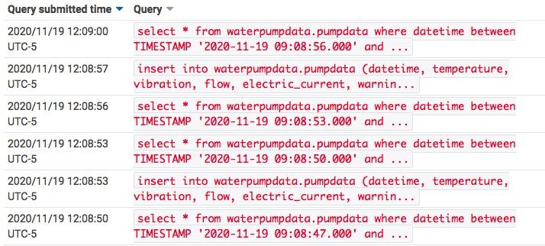
AWS Athena Query Log

Slide 32
FrontEnd - HTML
Google Charts to implement graphs
4 Graphs - Temperature, Vibration, Current Level, Water Flow
Data points are entered by dates
Points are starred to indicate maintenance is required

Slide 33
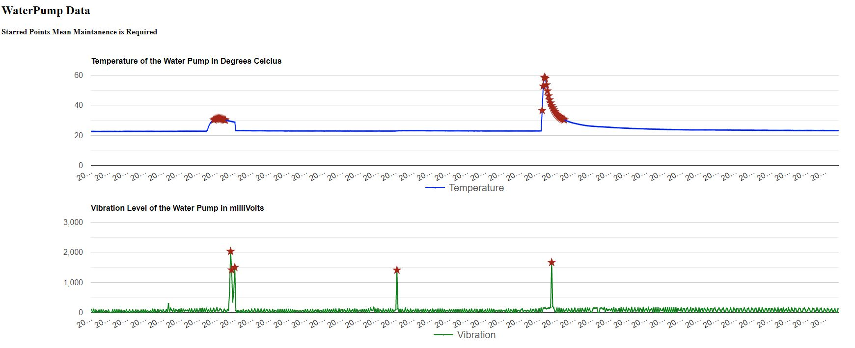
Starred points indicate maintenance is required
warmed up by hot water;
Exceeds the ideal
temperature threshold->
Shaken by hand;
Exceeds the ideal
Vibration Threshold->

Slide 34
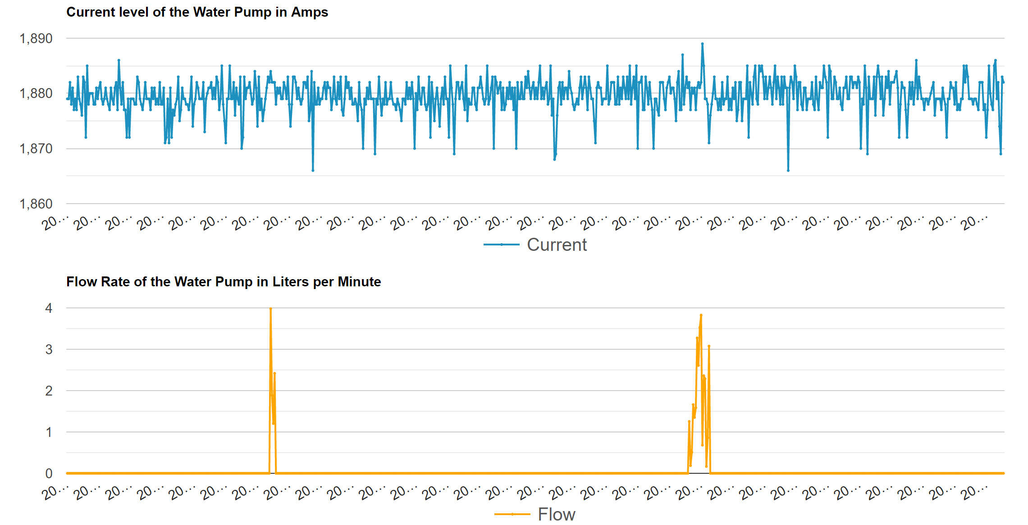

Slide 35
Conclusion
The device works as desired
Cost-effective. Can prevent large-scale failures

Slide 36
Cost of One Unit

Slide 37
Future Works
Decrease the cost of the Device
Use Cellular instead of Wi-fi
Similar process, entering credentials provider and user
Map to locate the water pumps - latitude, longitude
Multiple water pumps and locations.

Slide 38
Thank you!
Please feel free to ask any questions!

