Slide 1
Portable RF Light Socket Control
Team #9
Andrew Strauss, Grant Bonnstetter, Michael Kopera
Notes:
Person A

Slide 2
Agenda
Objectives/Motivations
Design Breakdown
High Level Requirements
Switch Box Technical Overview
Socket Insert Technical Overview
Aftermath and future work
Appendix
Notes:
Person B
Objectives/Motivations

Slide 3
Project Objectives
Budget option for college apartment lighting control
Improvements over existing options
Low latency transmission
Customizable
Portable, easy to use switches
No software required
Notes:
Person B
Objectives/Motivations

Slide 4
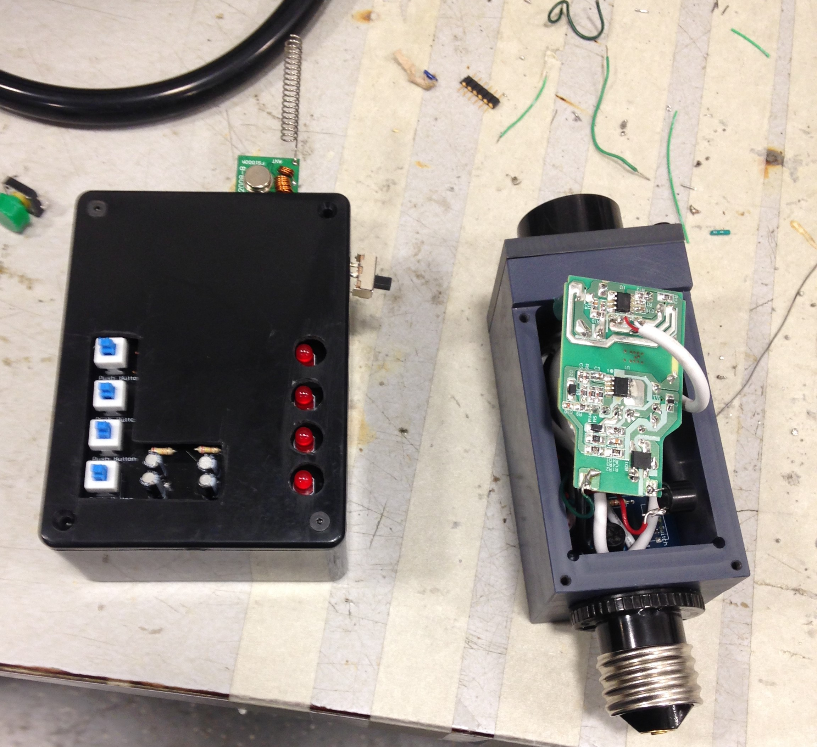
Final design
Transmitter
Light Socket Insert
Switch box
Notes:
Person C

Slide 5
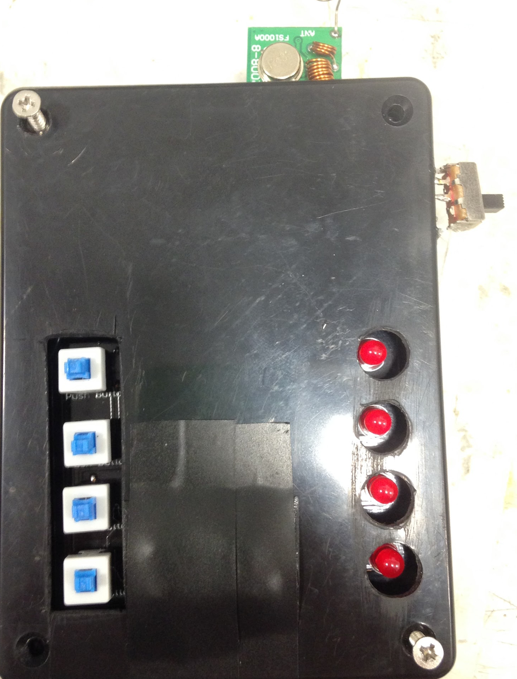
Switch Box Teardown
Notes:
Person A

Slide 6
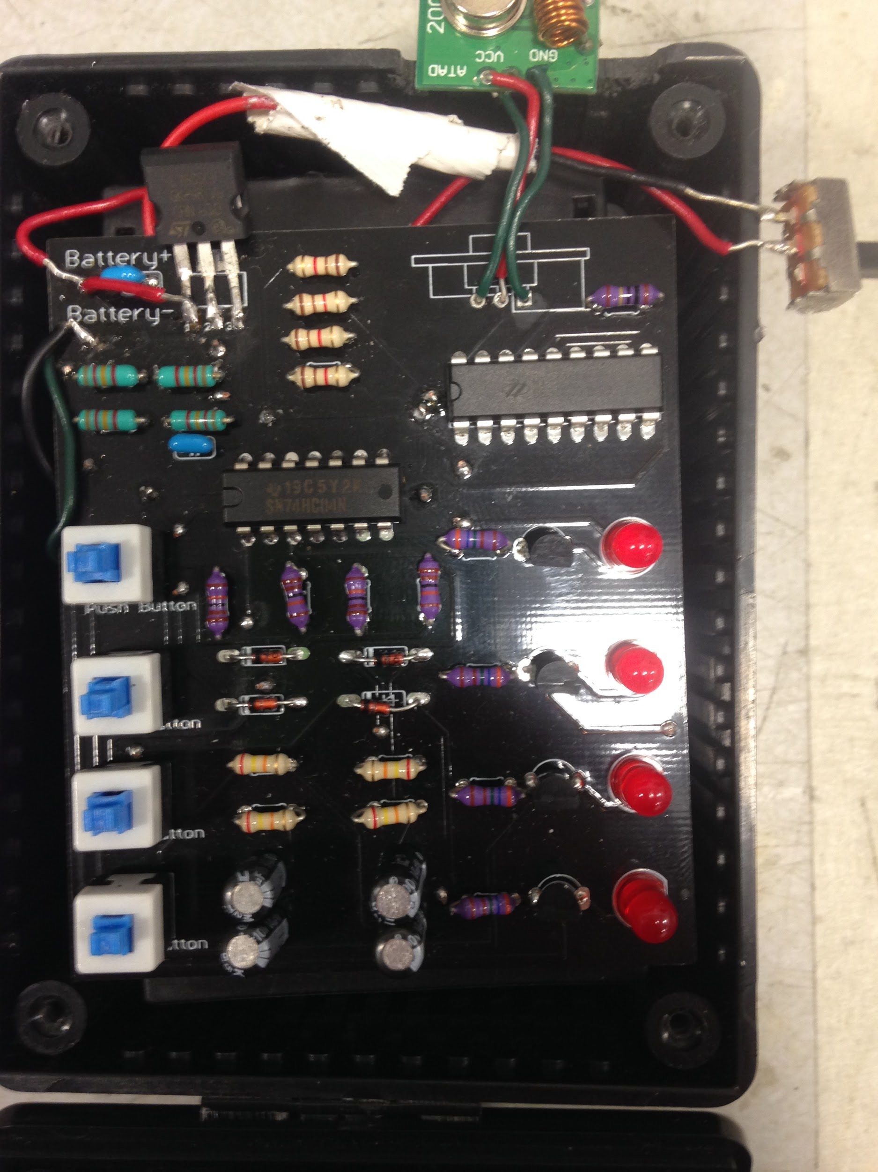
Switch Box Teardown
Notes:
Person A

Slide 7
Switch Box Teardown
Notes:
Person A

Slide 8
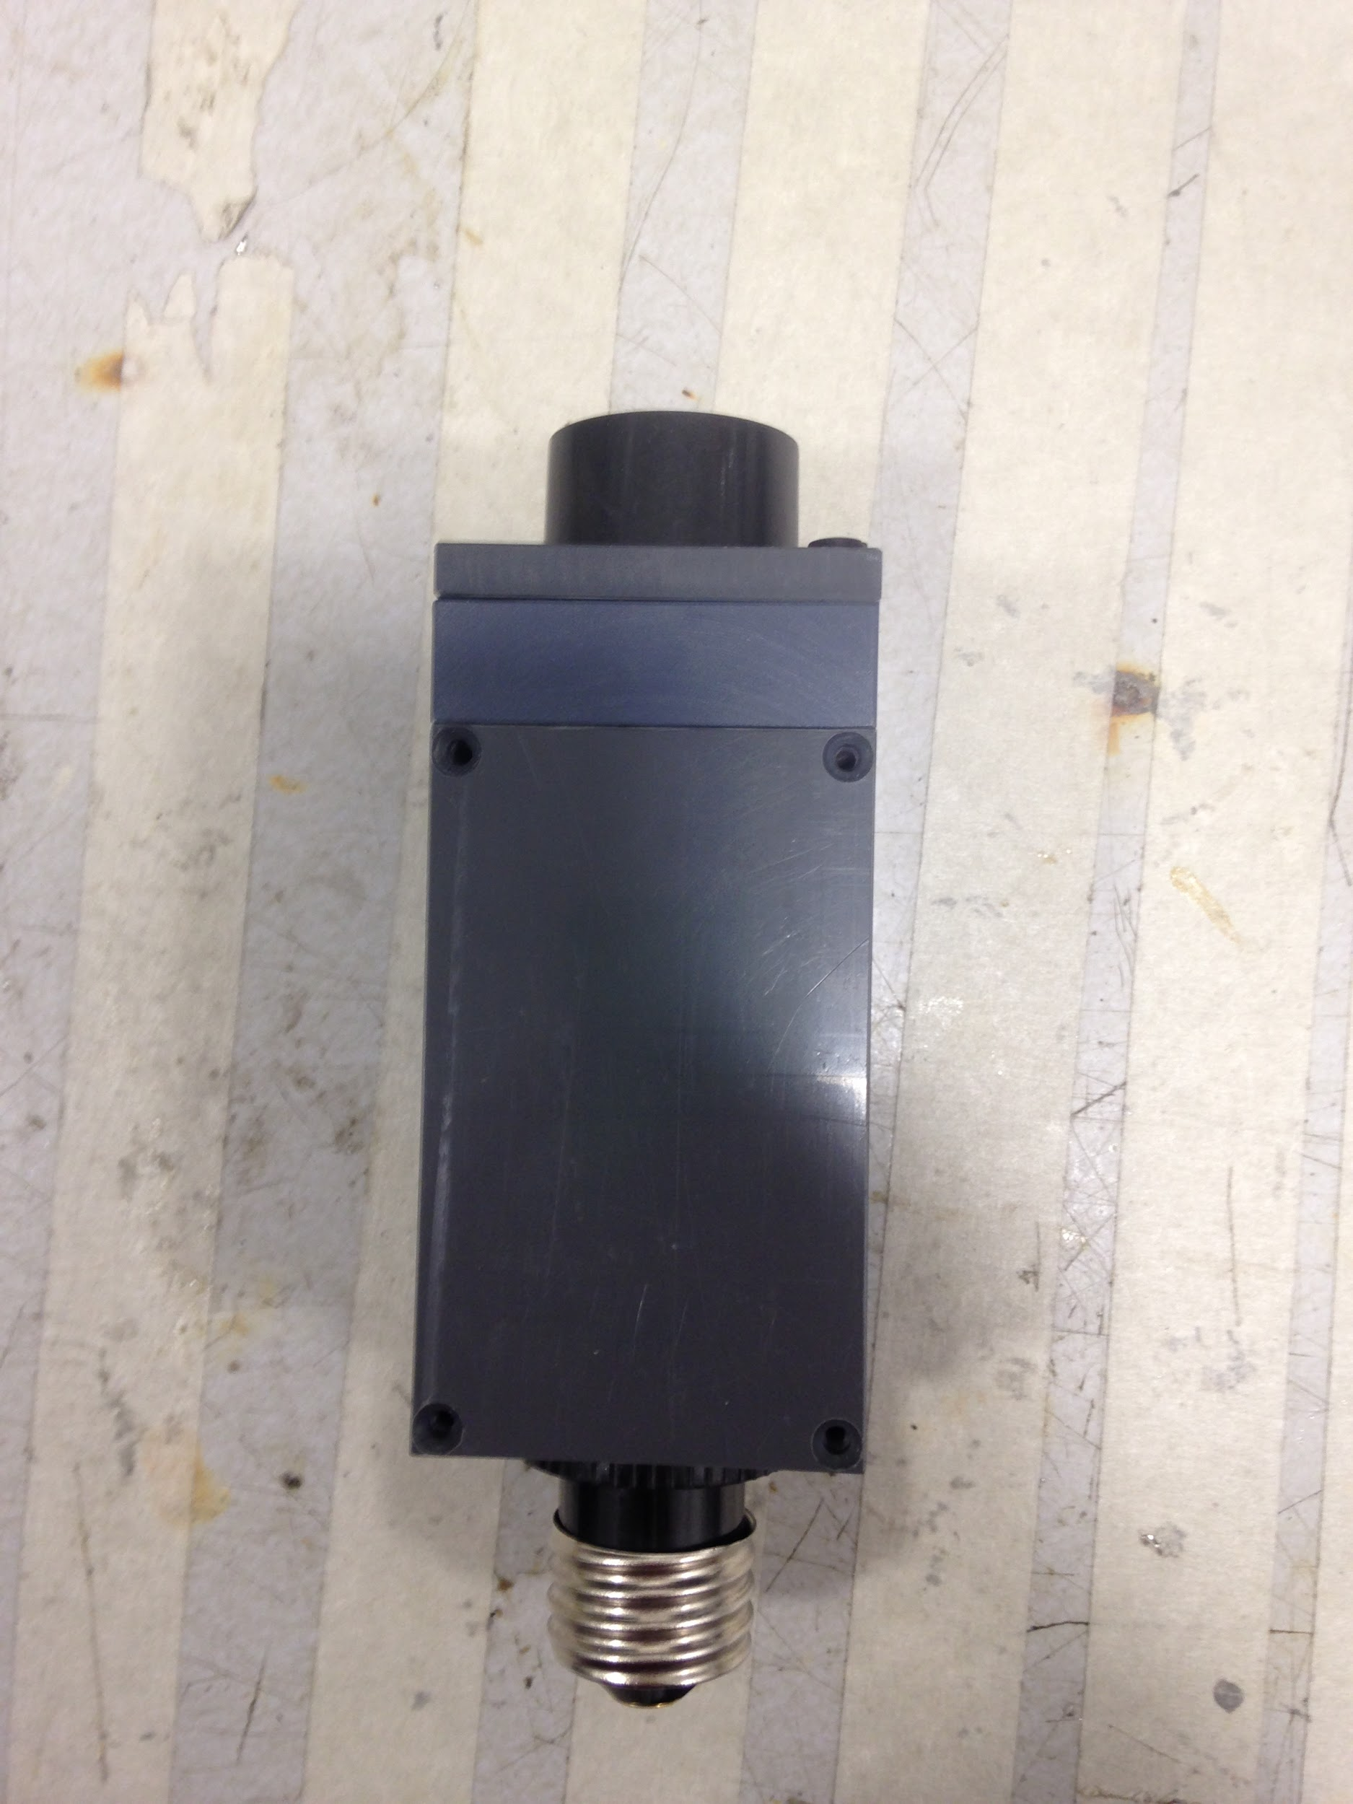
Socket Insert Teardown
Notes:
Person B

Slide 9
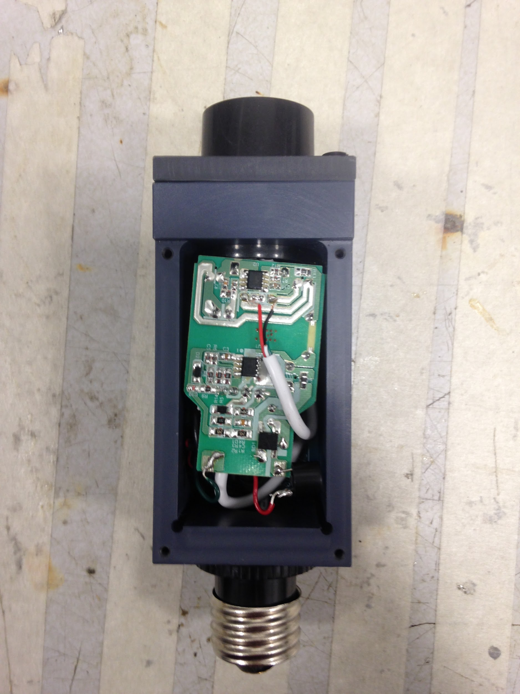
Socket Insert Teardown
Notes:
Person B

Slide 10
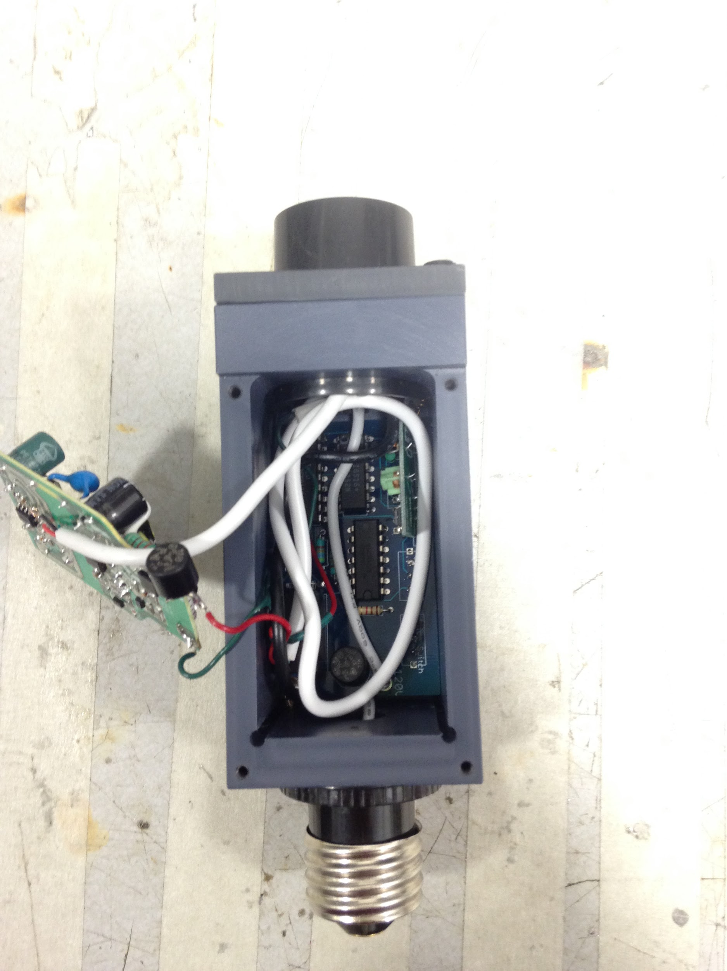
Socket Insert Teardown
Notes:
Person B

Slide 11
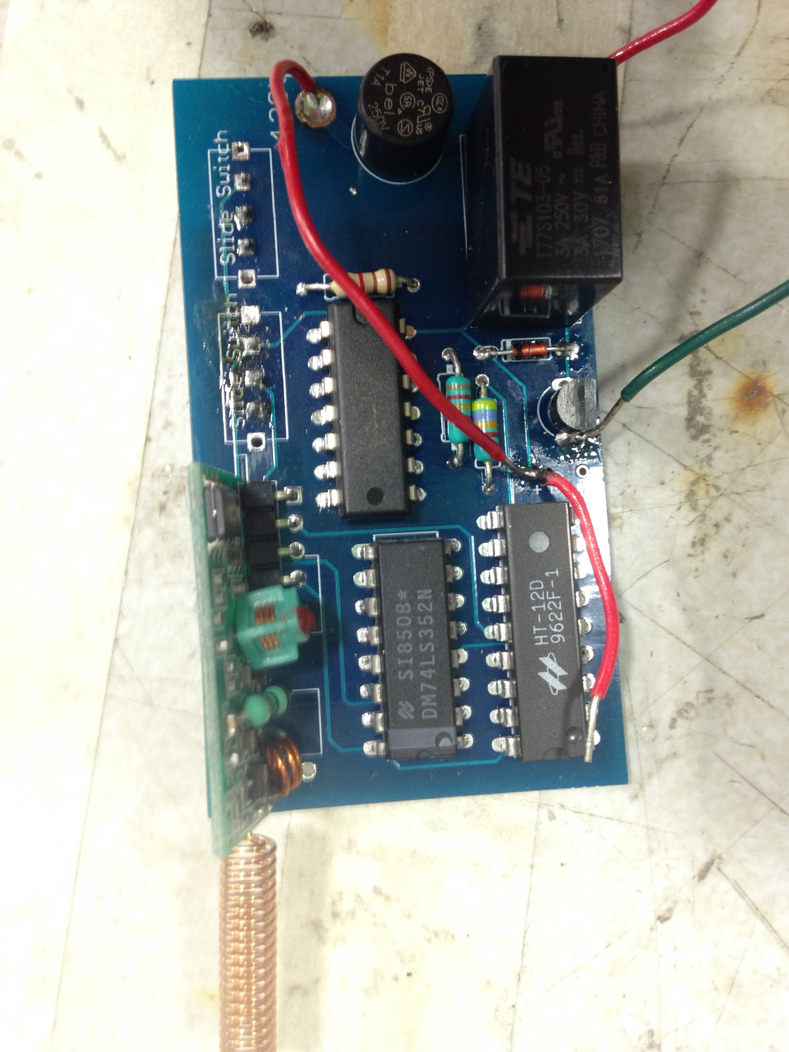
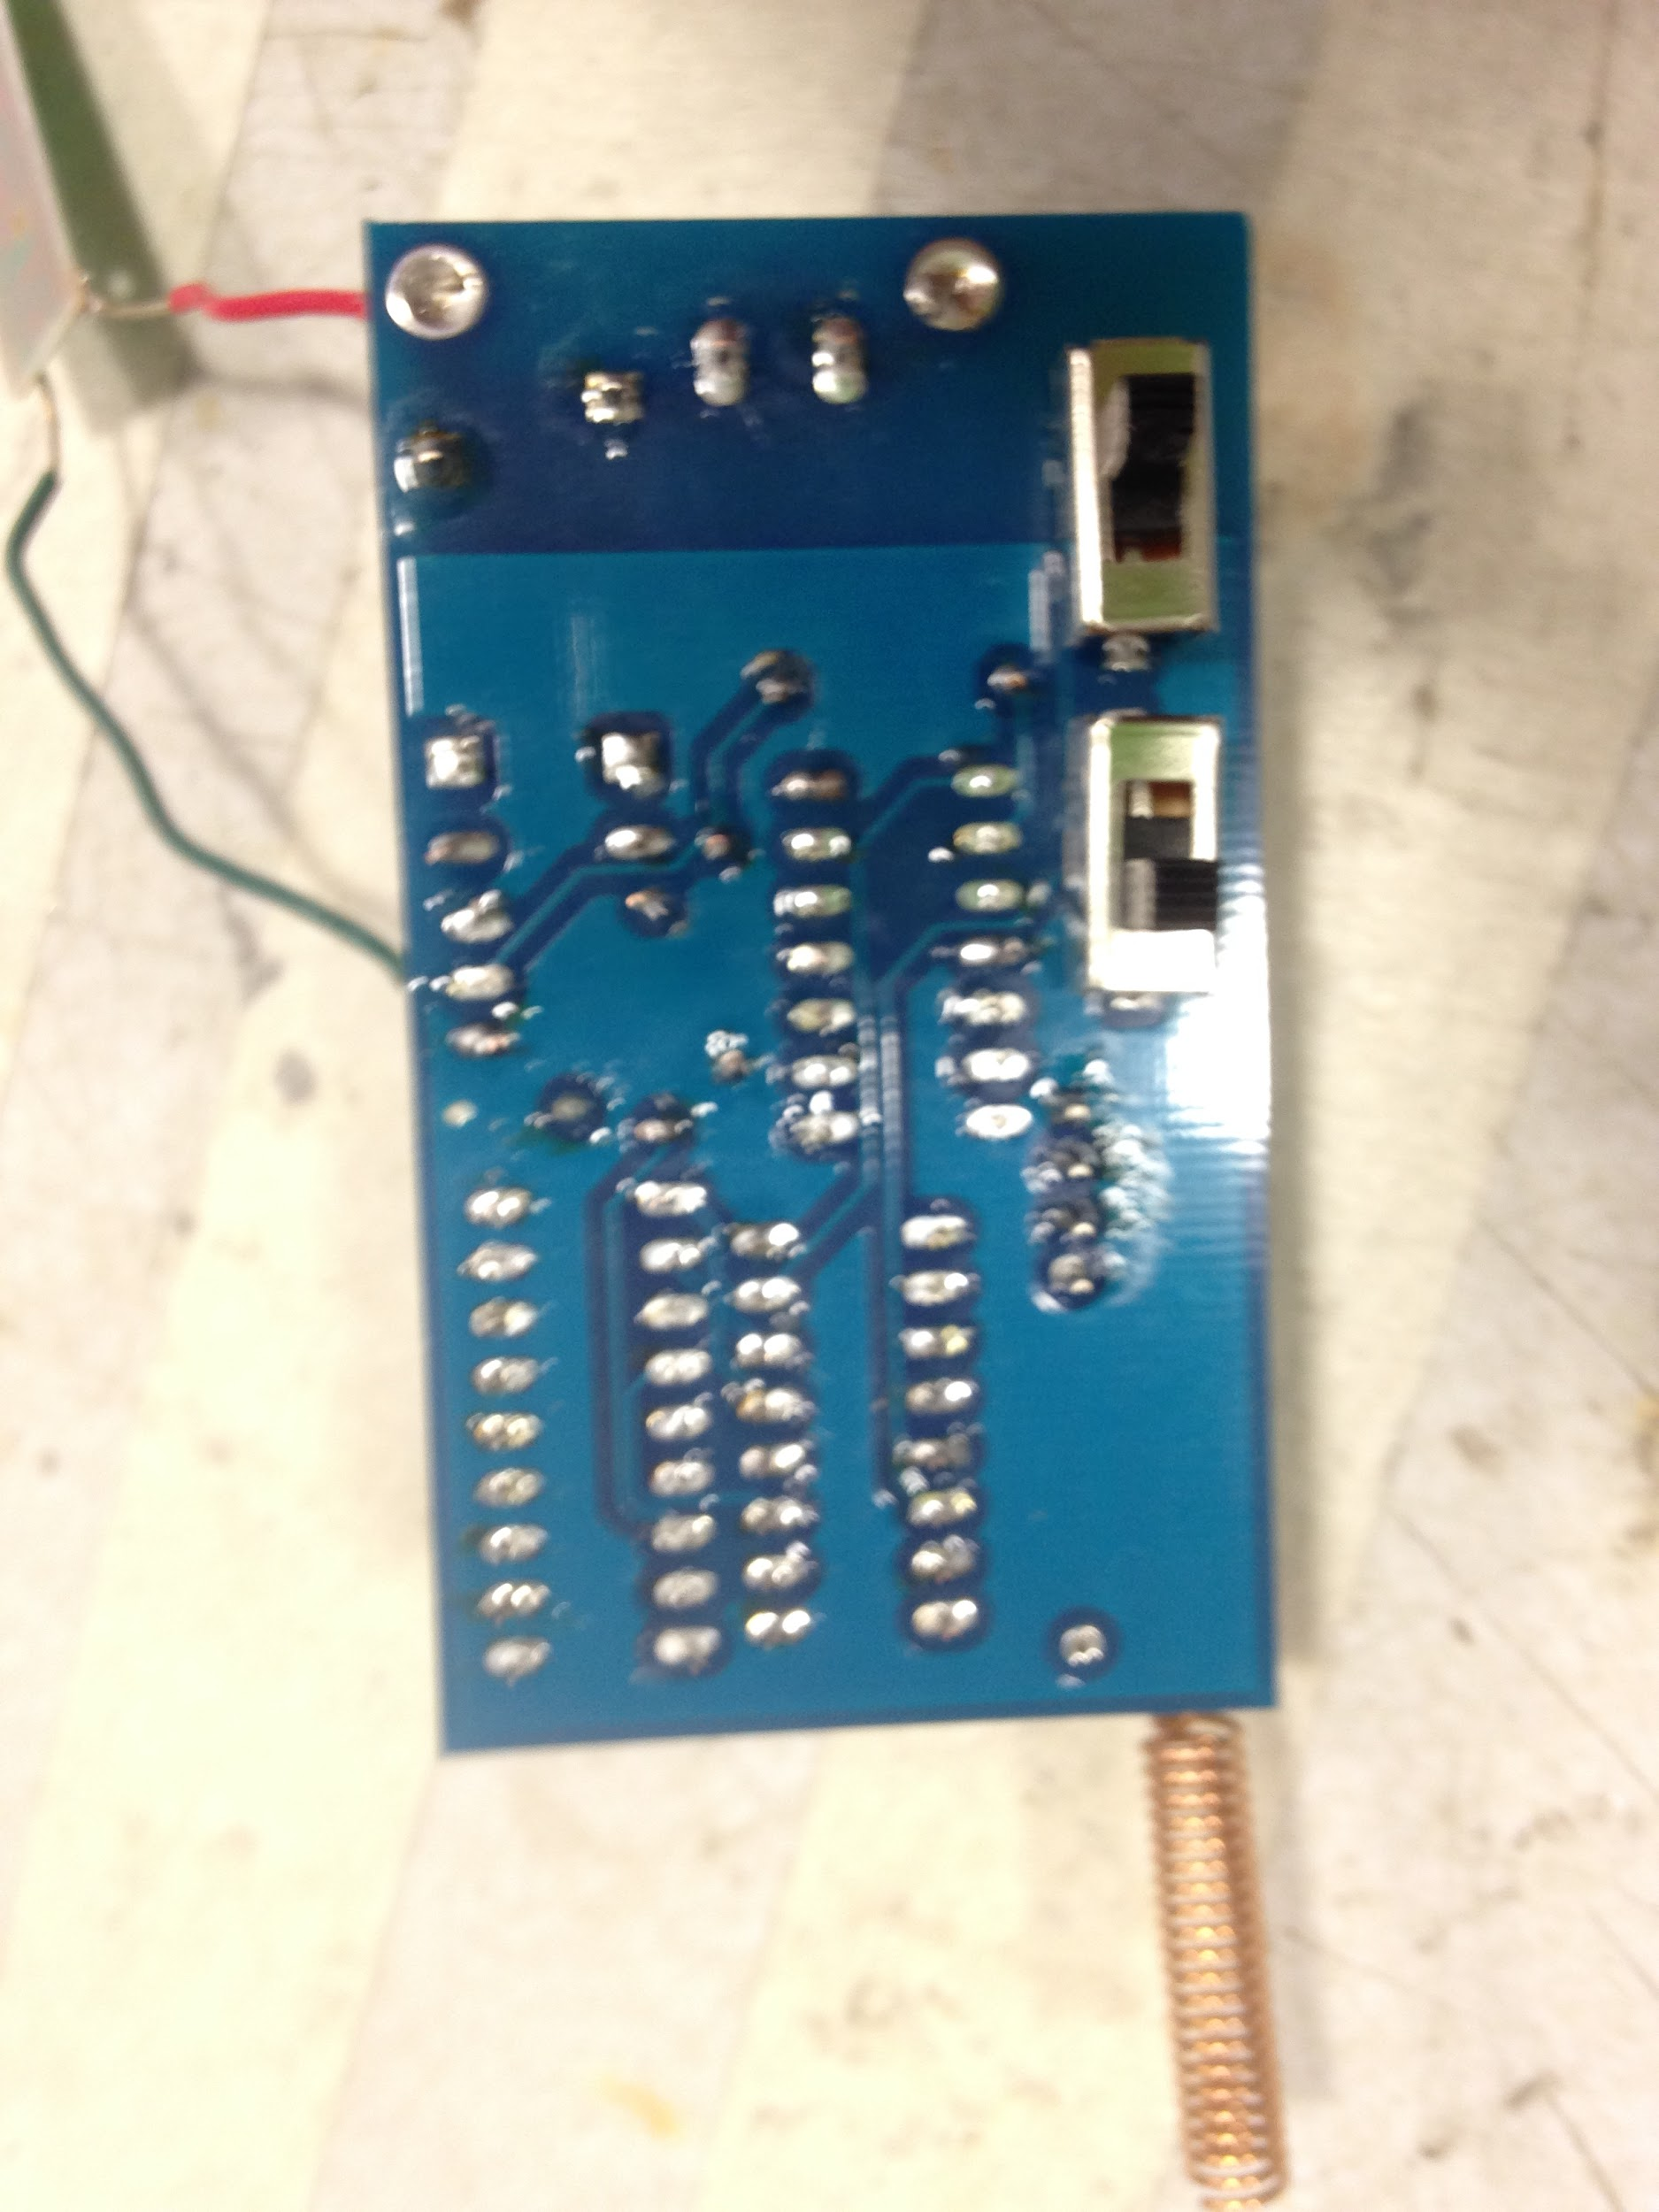
Larger view
Notes:
Person B

Slide 12
High Level Requirements
Control up to four sets of lights
Range: Socket device receives signal from switch box for distances up to 30 feet and no more than 100 feet
Size: Socket device is less than 4 inches in all dimensions for use in light fixtures
Switch box is less than 6 inches in length and width for portability and usability
Notes:
Person C

Slide 13
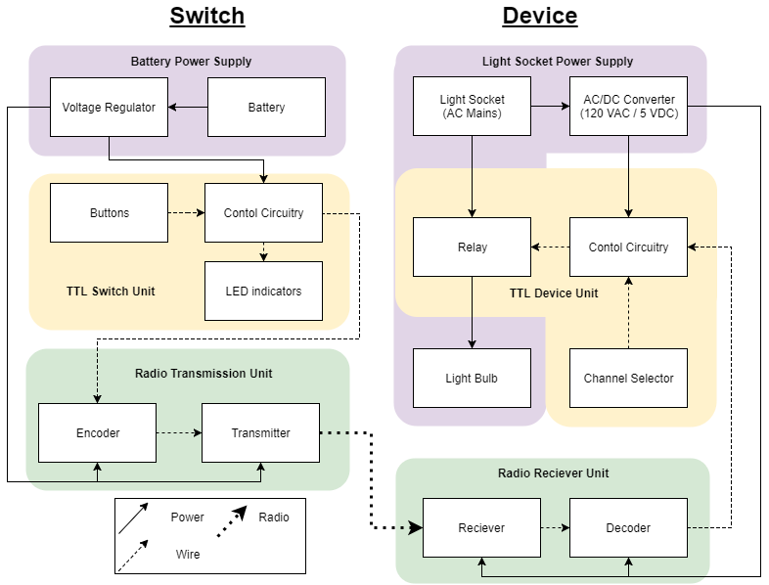
Entire Design

Slide 14
Switch Box Design

Slide 15
Power of Switch Box
9 V Battery Pack - 6 Energizer L91 AA batteries
Non-rechargeable
Battery Capacity of ~3300 mAh
All Switch Box components powered with 5 V
LM7805: 5 V Voltage Regulator
Rated for up to 1 A of current
Low power consumption
~12 mA
Over 250 hours of battery life
Notes:
Grant

Slide 16
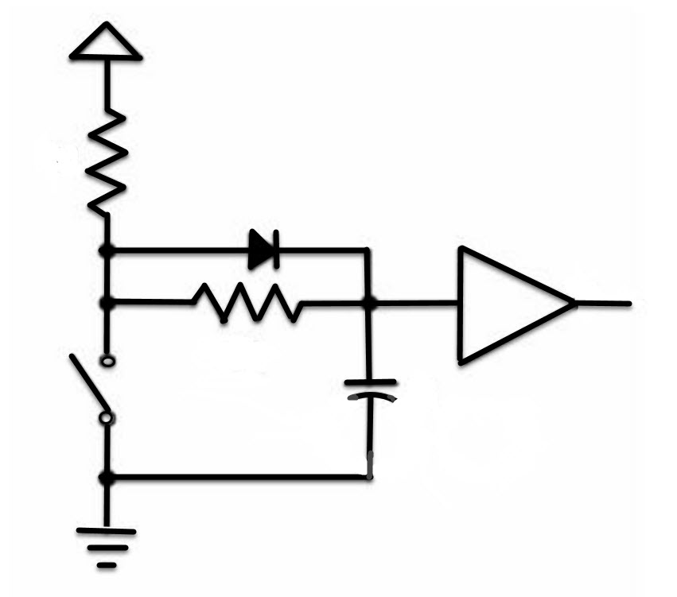
TTL of Switch Box
Buttons
Feed into debouncing circuits
Extent of debouncing dependant on resistor and capacitor quantities
Control Circuitry
Reduced to just inverters and pass transistors
LED Indicators
LEDs powered by driving circuit
Pass transistor acts like a switch for LED

Slide 17
Switch Box Transmitter Unit
FCC requirement: 11,000 µV/m at 3 meters away from radiator (Part 15.231)
Distance [ft] | Fundamental Power [dBm]
1 | -30.5 dBm
1 [weak direction] | -39.8 dBm
2 feet | -47.2 dBm
30 feet | -66.3 dBm
Notes:
Andrew
-How well did these transmitter function? That’s 2 feet away, 3 meters away will clearly be within the requirement.

Slide 18
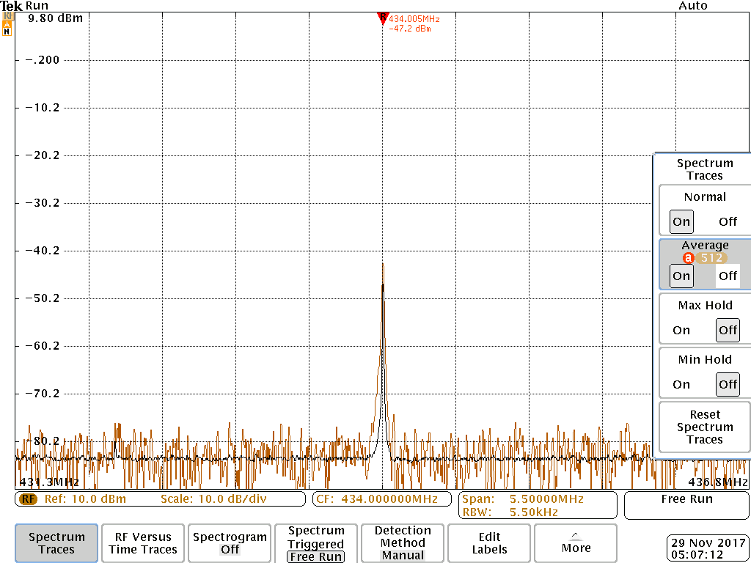
Switch Box Transmitter Unit
FYI: -35.8 dB decrease in power for 30 times increases in distance
Inverse square law: P~1/r^2
FCC requirement: 1,100 µV/m at 3 meters away from radiator for spurious Emissions
Notes:
Andrew
Well within FCC limit

Slide 19
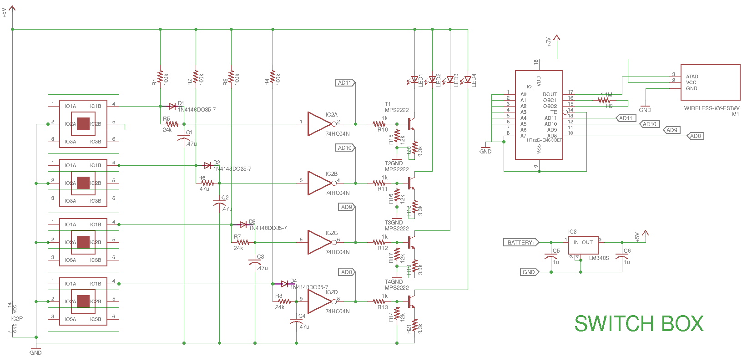
Switch Box Schematic

Slide 20
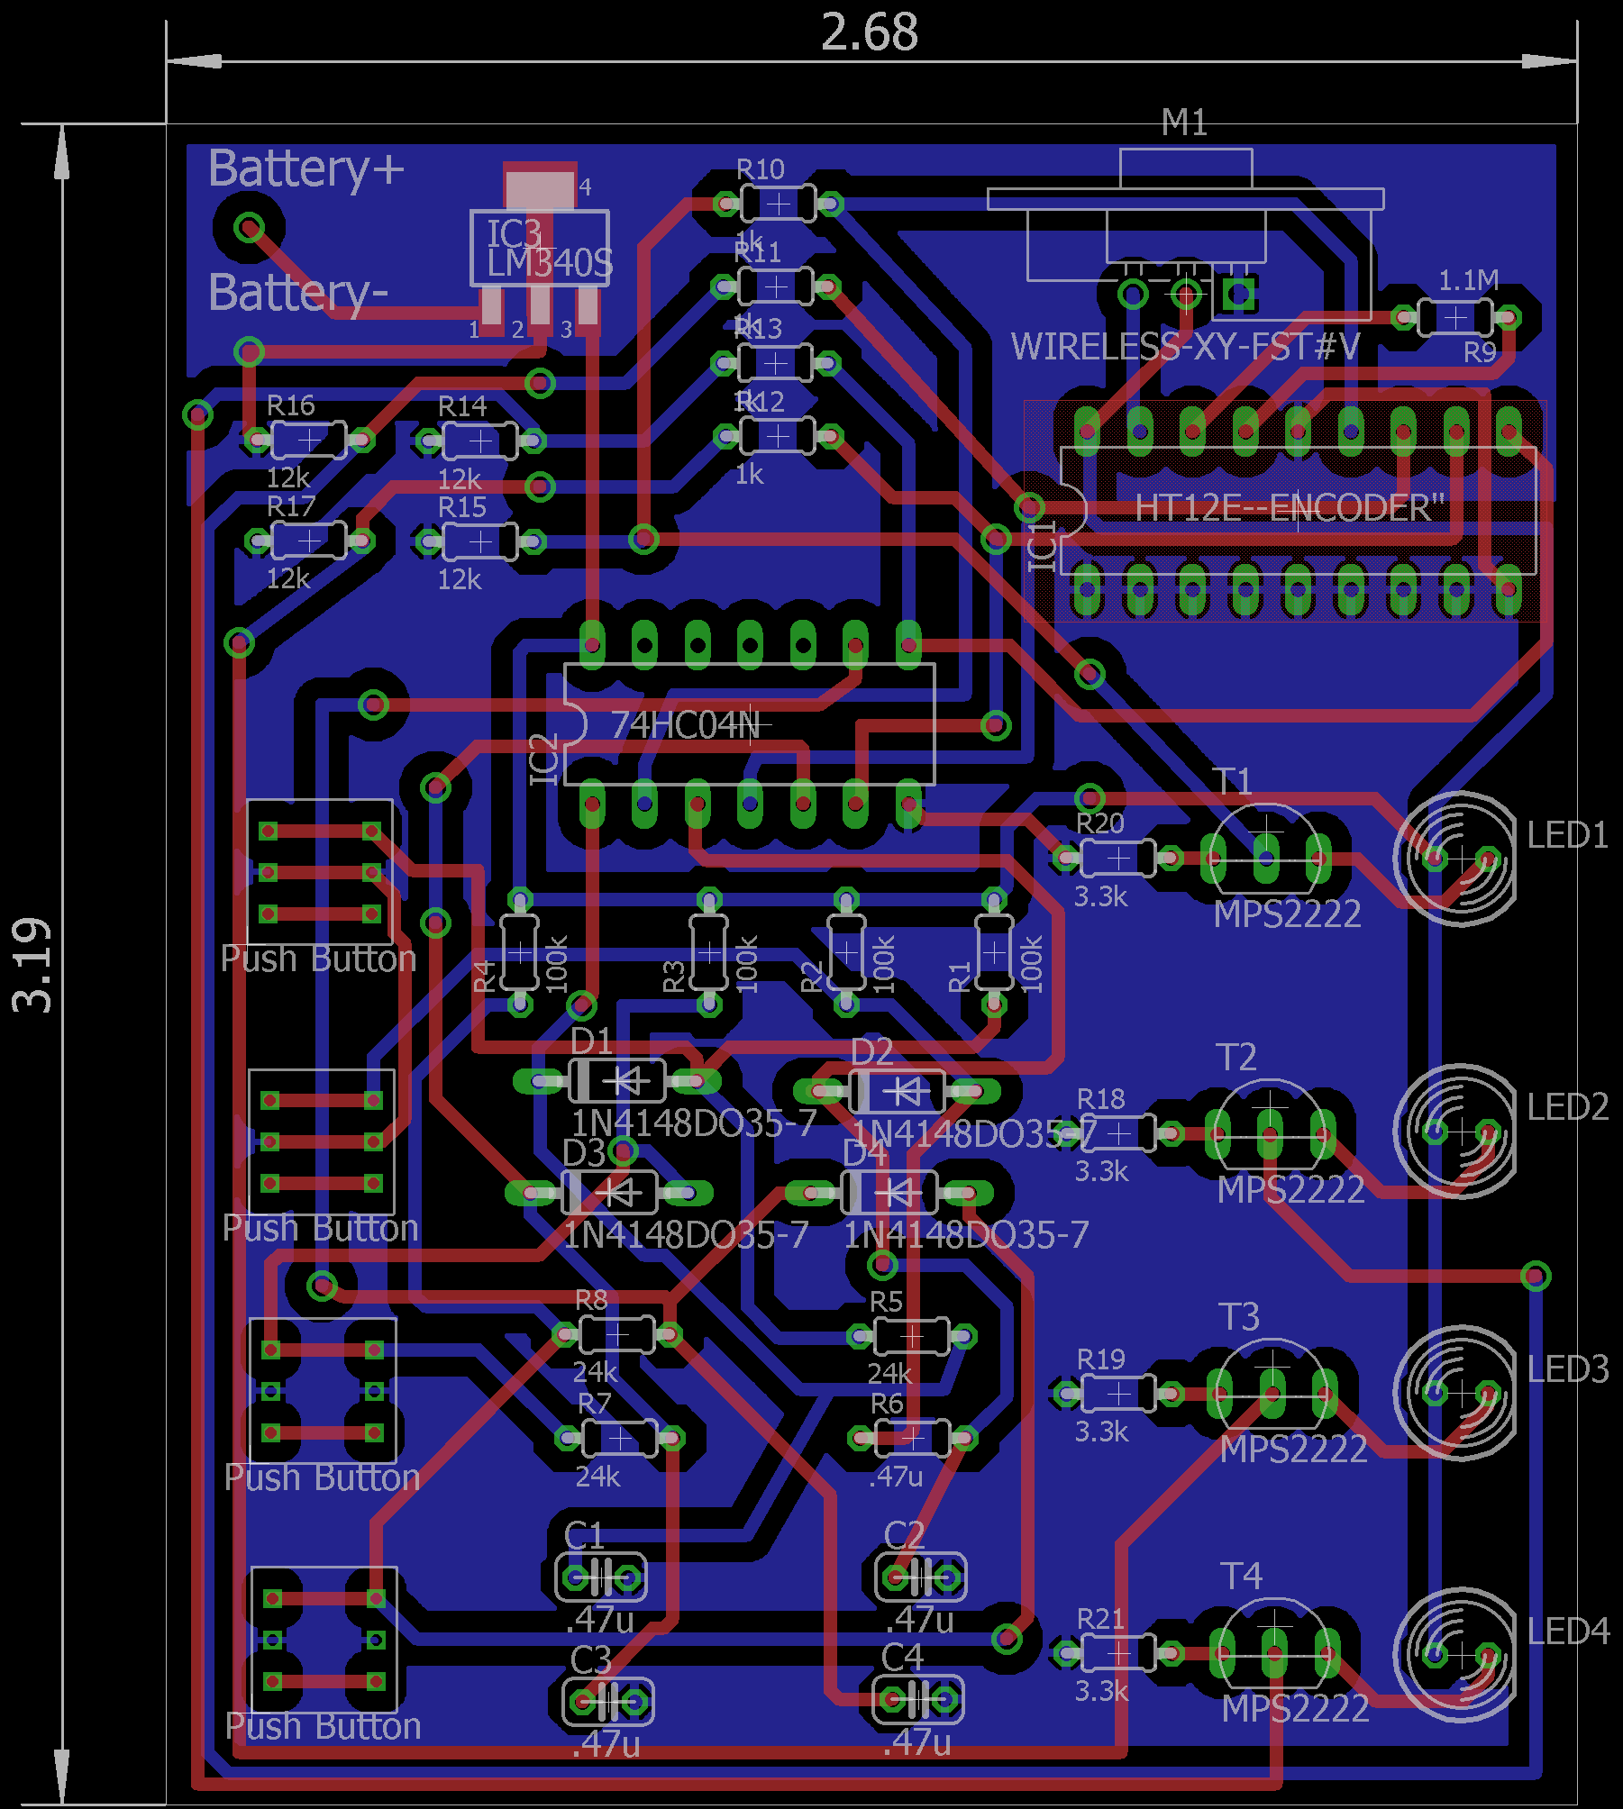
Design
Switch Box

Slide 21
Light Socket Insert Design (AKA “The Device)”
Notes:
Now that we’ve provided an overview for the switchbox we’re going to shift gears to talk about the light socket insert

Slide 22
Power of Device
All power comes from 120 VAC mains socket through edison screw adapter
120 VAC to 5 VDC supplies power for control circuitry
Deconstructed off-the-shelf usb charger
Relay switches 120 VAC for up to 40 W light bulb
Electromechanical, 40 mA across coils, rated 3 A contact current
Trace width and safety
> 1 mm trace width for high voltage, adequate isolation
Fuses for 5 V converter and light bulb

Slide 23
TTL of Device
Control Circuitry
Consist of 4:1 MUX, inverter, and pass transistor
MUX outputs the data for the device’s selected channel
Inverter inverts data before pass transistor
Pass transistor acts like a switch to the relay’s coil
Channel Selector
Two switches connected to MUX
Relay
Current flows through coil to close

Slide 24
Light Socket Insert Receiver Unit
Latency Testing
Test | Delay [ms]
Off-on (button push to decoder output) | 70
On-Off (button push to decoder output) | 115

Slide 25
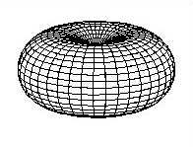
Light Socket Insert Receiver Unit
Antenna orientation testing
10 dB decrease
Did not impact performance for ~30 ft distances
strong
weak

Slide 26
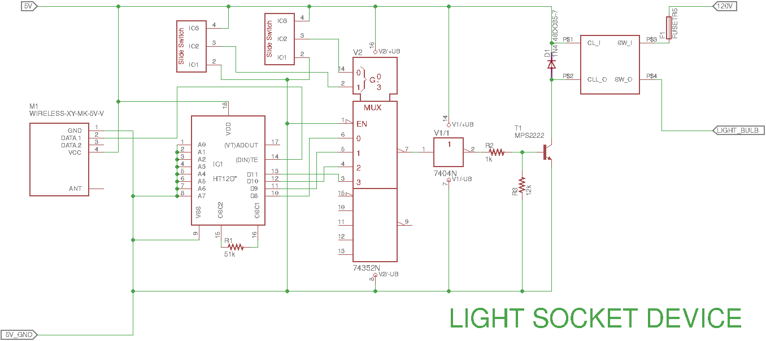
Light Socket Insert Schematic

Slide 27
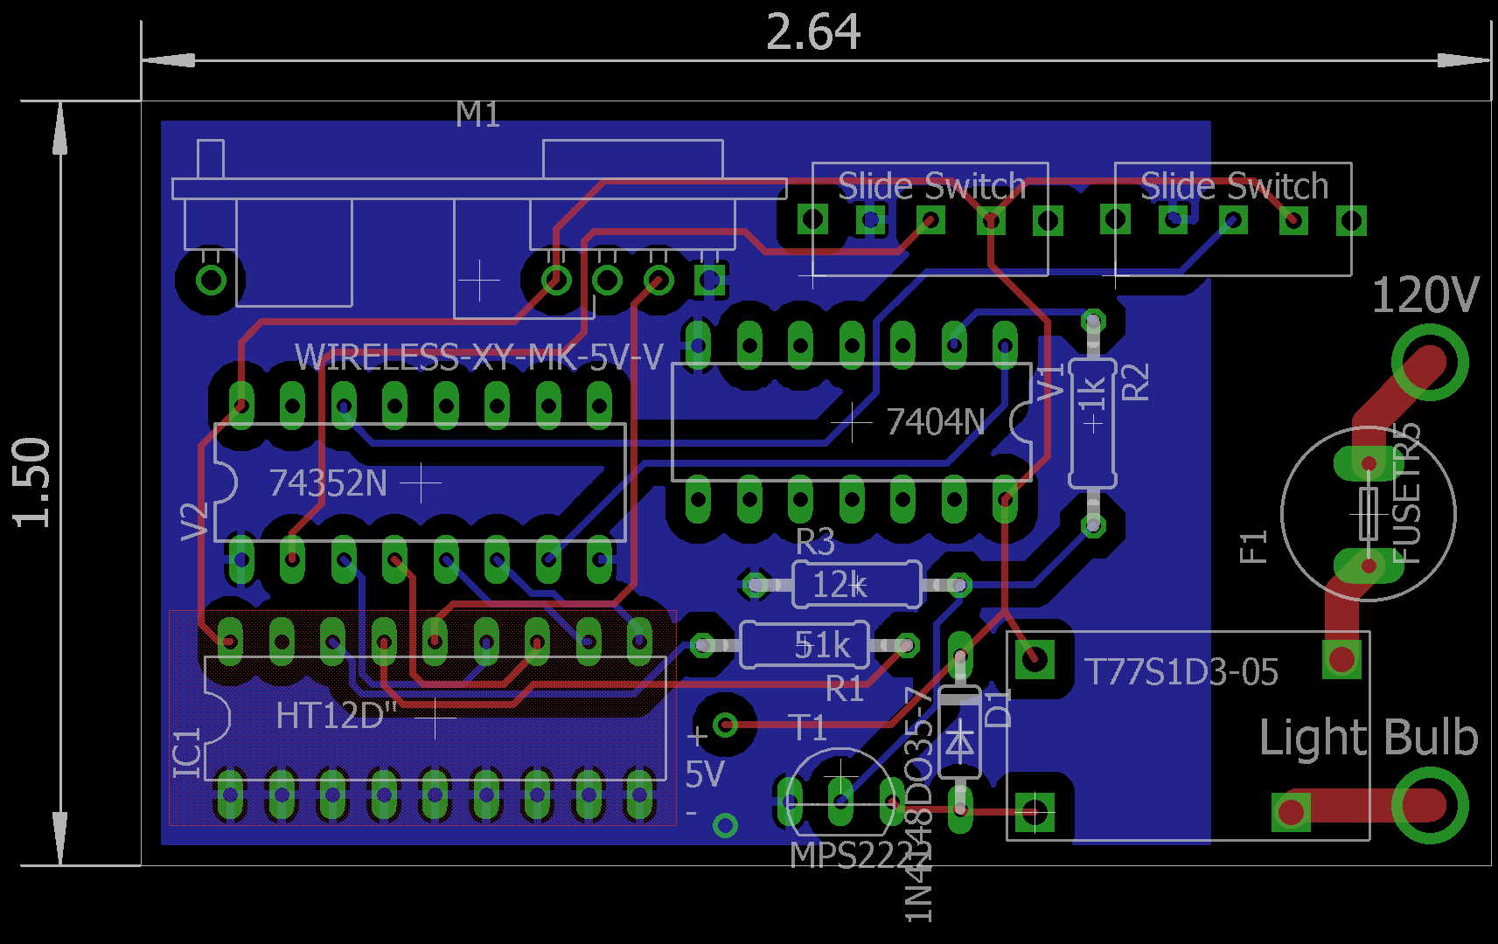
Design
Light Socket Insert

Slide 28
Design
Switch Box
Light Socket Device

Slide 29
Aftermath
System Performed in most cases
Able to control four sets of light simultaneously
Unexpected behavior like flickering of the light happened only when transmission was done near a metal object
The light socket insert that was in the box didn’t recieve the signals transmitted by the switch box well
Otherwise, the light socket inserts that were out of the box operated just as expected with little to no delay

Slide 30
Future Work / Improvements
Investigate socket device interference with 120 VAC wires
Shielding / box design
Rechargeable battery pack
Improved transmission power efficiency
More sophisticated logic controlling transmission
Car key type transmission

Slide 31
Appendix

Slide 32
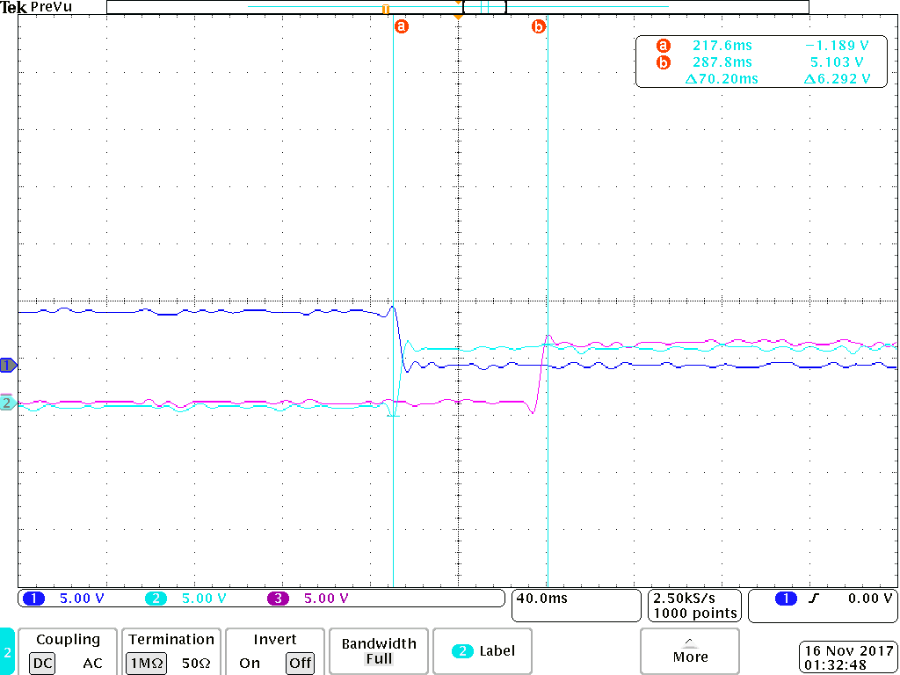
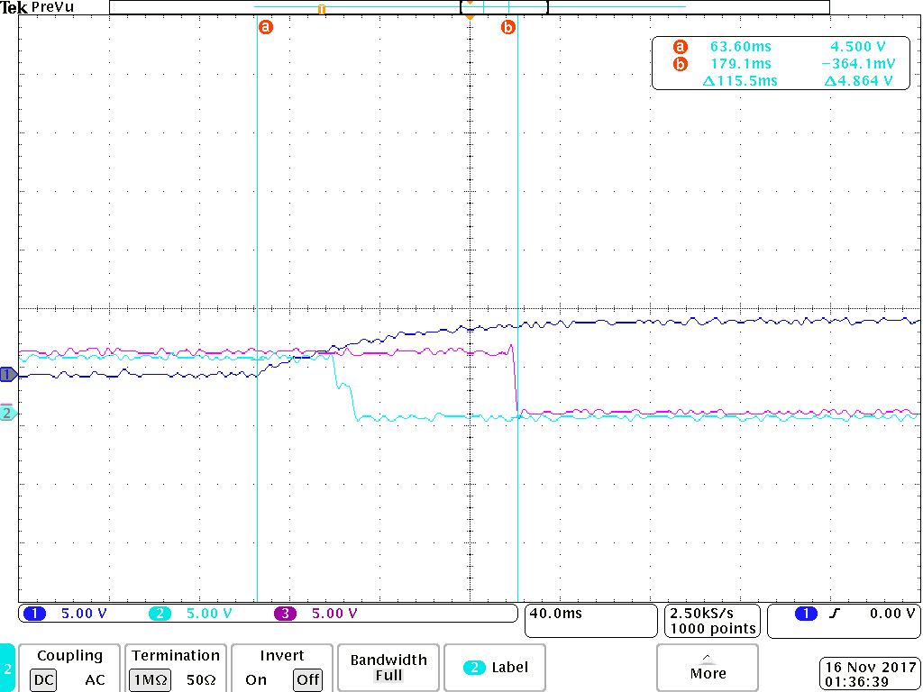
Latency Testing Using Oscilloscope
Off->on
On->off

Slide 33
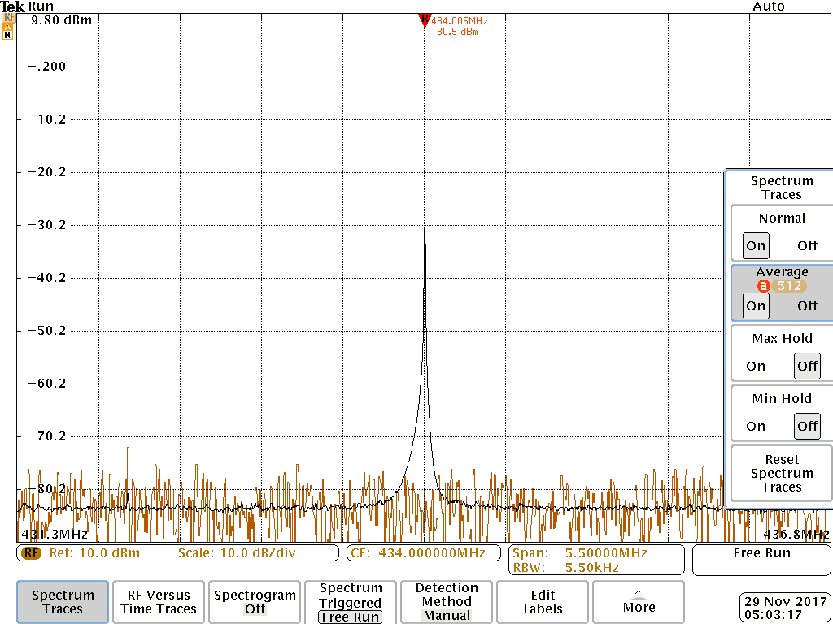
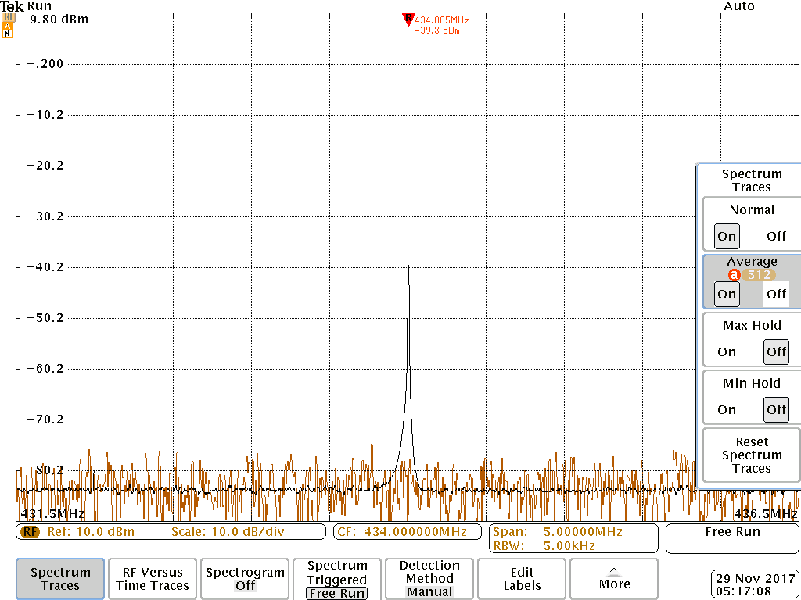
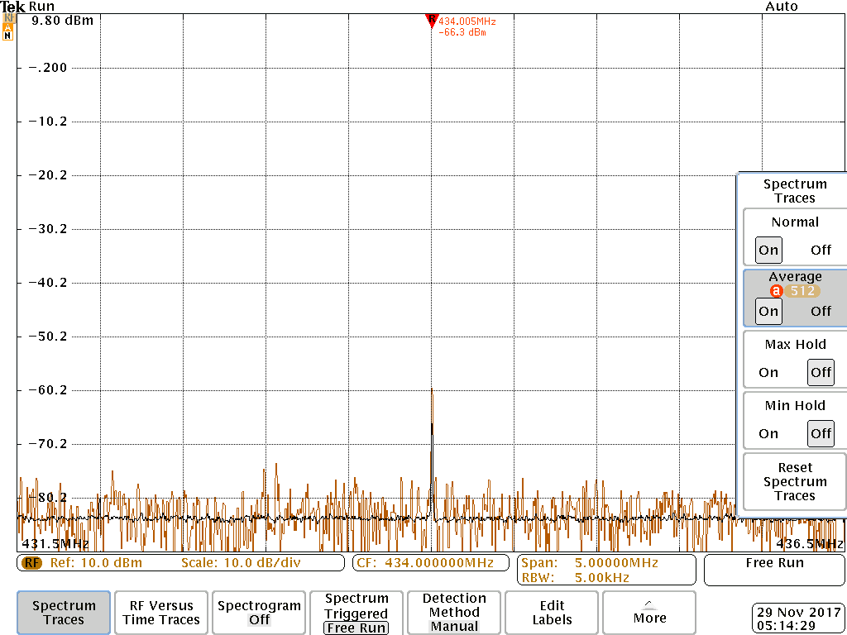
Transmit Power Using High Freq Oscilloscope
1 ft strong direction
1 ft weak direction
2 ft strong direction
30 ft strong direction

Slide 34
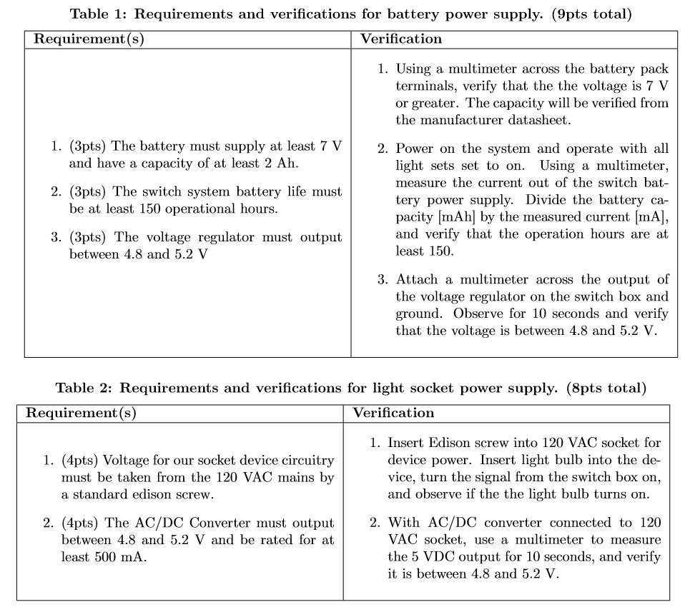

Slide 35
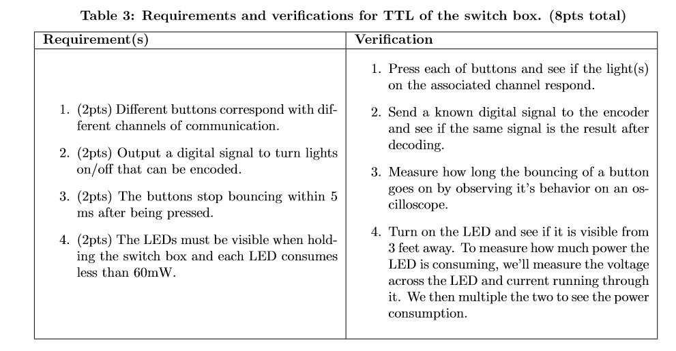

Slide 36
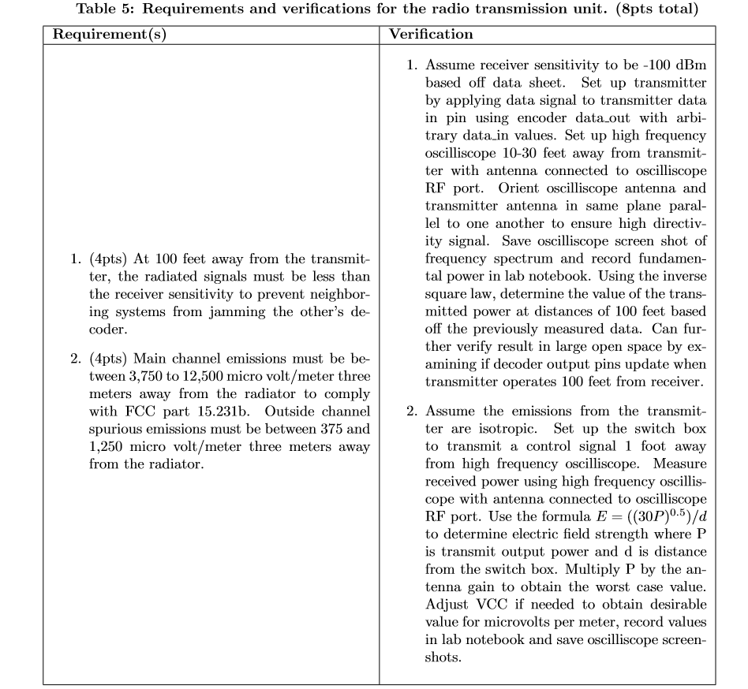

Slide 37
