Slide 1
BLUETOOTH SPEAKER WITH MOTION-BASED AUTOMATED VOLUME ADJUSTMENT
ECE 445 - Team 69
Chirag Kikkeri
Raj Pulugurtha
Dhruv Vishwanath
Notes:
Raj

Slide 2
Problem
Distracted driving is an issue for everyone using the roads
Playing music in the car while driving is a hassle
ELECTRICAL & COMPUTER ENGINEERING
GRAINGER ENGINEERING
Notes:
Raj

Slide 3
Solution
Speaker that changes volume based on change in speed
Portable with Bluetooth functionality
Fulfills needs for different types of users
Speaker system has a “stationary mode” and a “moving mode”
ELECTRICAL & COMPUTER ENGINEERING
GRAINGER ENGINEERING
Notes:
Raj

Slide 4
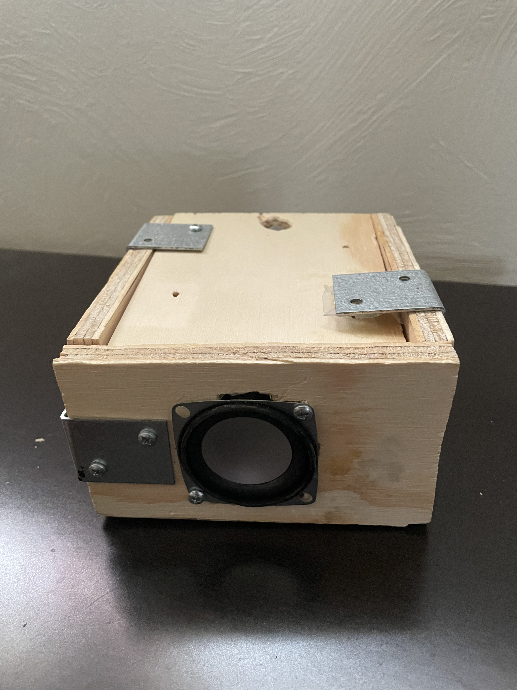
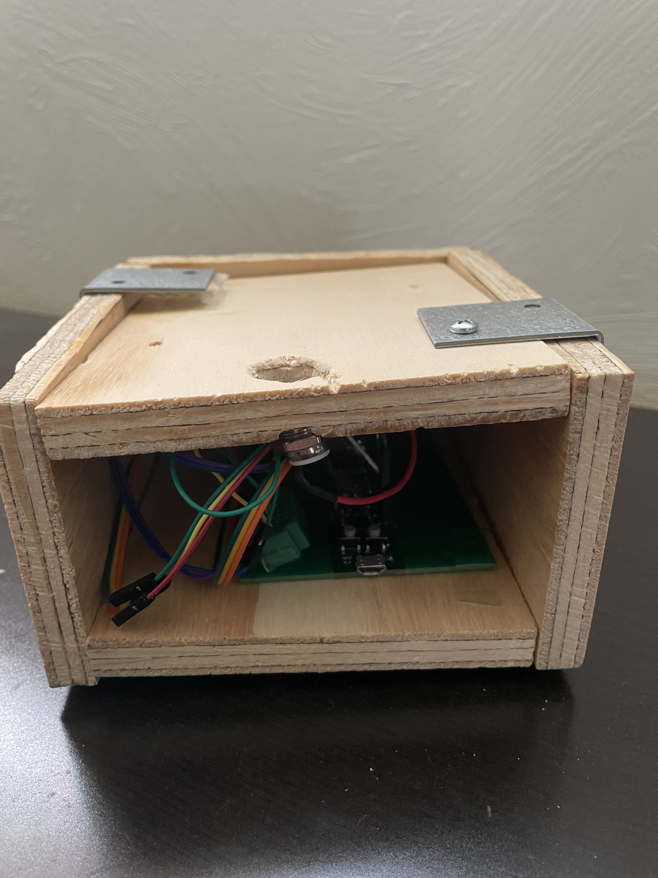
Final Product
Front and rear images of our final product showing some of the components inside
ELECTRICAL & COMPUTER ENGINEERING
GRAINGER ENGINEERING
Notes:
Raj

Slide 5
Final Product
https://drive.google.com/file/d/1nKspFGlMjxZxkiGdCIF0npBenQMTZHf0/view
Video demonstration of our speaker changing volume as speed changes in the car
ELECTRICAL & COMPUTER ENGINEERING
GRAINGER ENGINEERING
Notes:
Raj

Slide 6
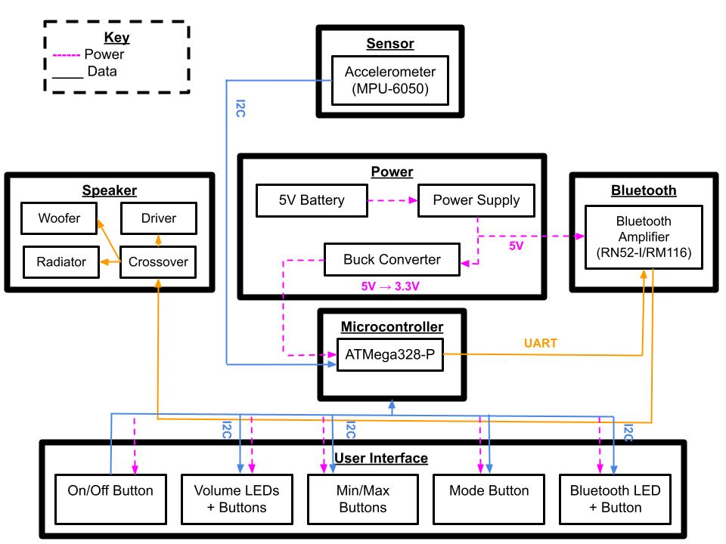
Design Review Refresher
High Level Requirements
Speaker volume changes automatically in driving mode at a fixed rate of 3 dB for a change of 15 MPH
In stationary mode the speaker should be controlled manually using buttons
Any Bluetooth device should be able to transmit media continuously to the system at 2.1 Mbps and the system will play media at an audio quality of 80 dB Signal to Noise ratio
ELECTRICAL & COMPUTER ENGINEERING
GRAINGER ENGINEERING
Notes:
Dhruv
After making adjustments from the Design Review, we thought our approach would be straightforward, as all we had to do is test our idea on a breadboard, build a PCB with that design, and then implement the same thing on the PCB. Easy, right?

Slide 7
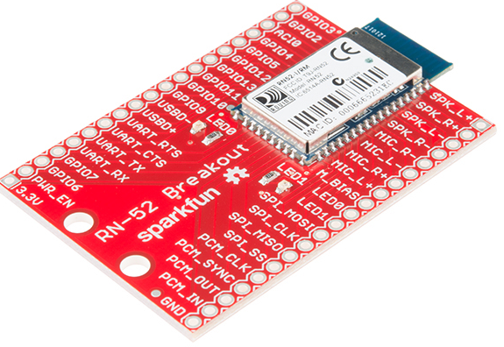
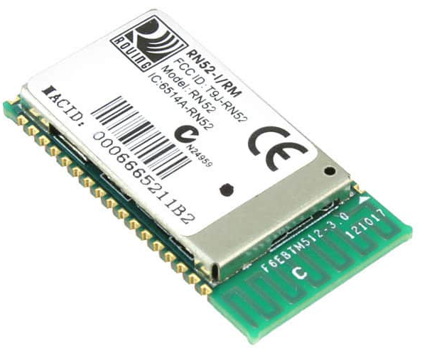
Bluetooth Subsystem Changes
RN52-I/RM116 has no breakout board
Unable to test the part without PCB
Forced us to change design
Need to change volume with microcontroller
ELECTRICAL & COMPUTER ENGINEERING
GRAINGER ENGINEERING
Notes:
Dhruv

Slide 8
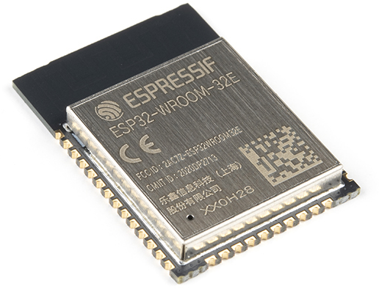
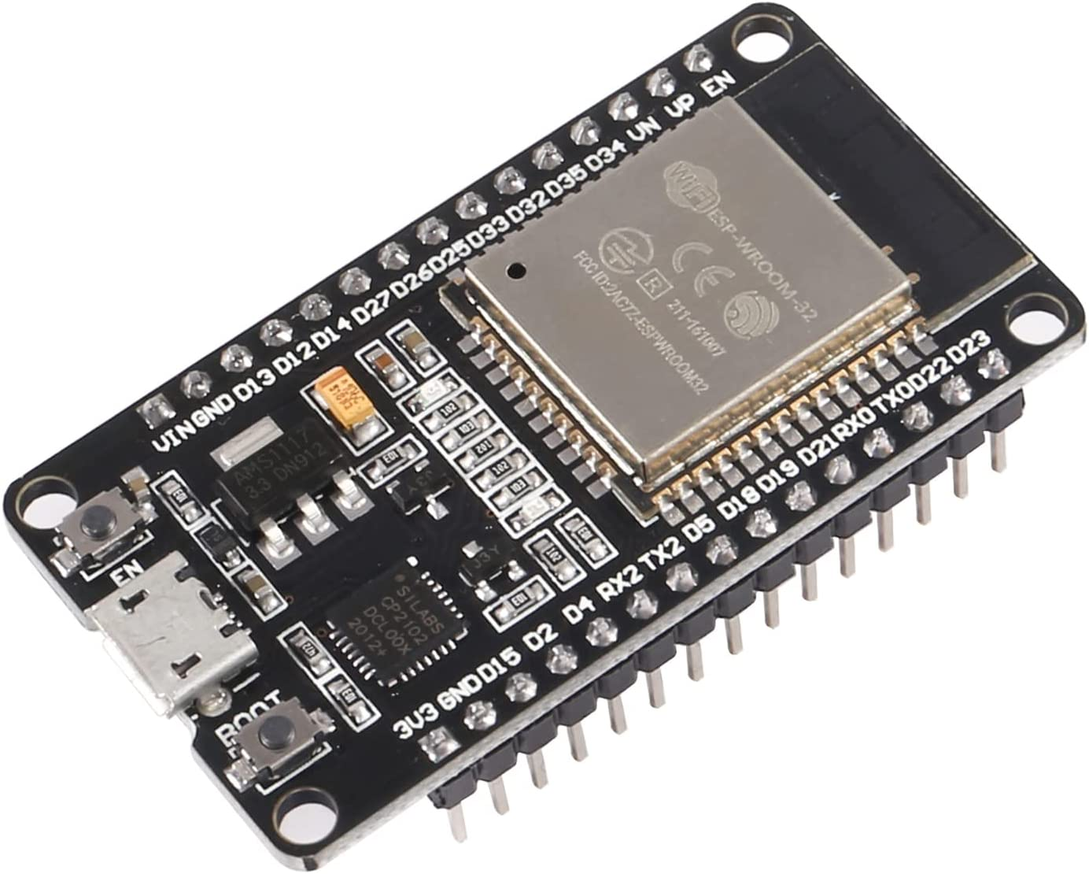
Microcontroller Changes
Changed to ESP32
Equipped with Bluetooth functionality
Simplified our design
Volume adjustment capabilities
ELECTRICAL & COMPUTER ENGINEERING
GRAINGER ENGINEERING
Notes:
Dhruv
To compensate for RN 52, we changed to ESP 32

Slide 9
Software Implementation for ESP32
Modified Bluetooth keyboard library
Wrote code to change volume through ESP32
Used accelerometer data for volume control
Accuracy of values cannot be determined before soldering
ELECTRICAL & COMPUTER ENGINEERING
GRAINGER ENGINEERING
Notes:
Chirag
End slide with how our design on breadboard worked bc it produced volume and we got values from accelerometer, but we couldn’t test validity of values without wires soldered in

Slide 10
PCB schematic design for speaker
ELECTRICAL & COMPUTER ENGINEERING
GRAINGER ENGINEERING
Notes:
Raj

Slide 11
PCB Footprint and Model
ELECTRICAL & COMPUTER ENGINEERING
GRAINGER ENGINEERING
Notes:
Raj
Followed development board datasheet
Added female connectors for design flexibility
Connected extra GPIO pins for buttons
Successfully receives accelerometer data
Unable to produce speaker output
Time is starting to become a factor

Slide 12
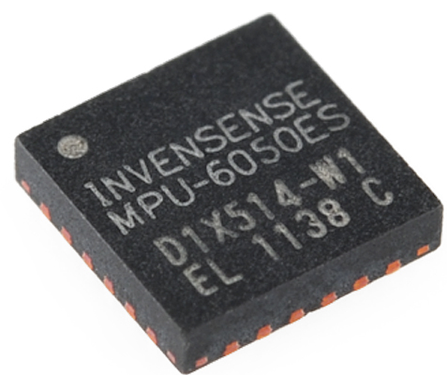
Accelerometer Subsystem
Retrieves acceleration on three axes
Converted data to velocity using V_{f} = V₀ + at
Required additional thresholds to calibrate
Tested values in the car
Struggled with sensitivity and consistency
ELECTRICAL & COMPUTER ENGINEERING
GRAINGER ENGINEERING
Notes:
Dhruv

Slide 13
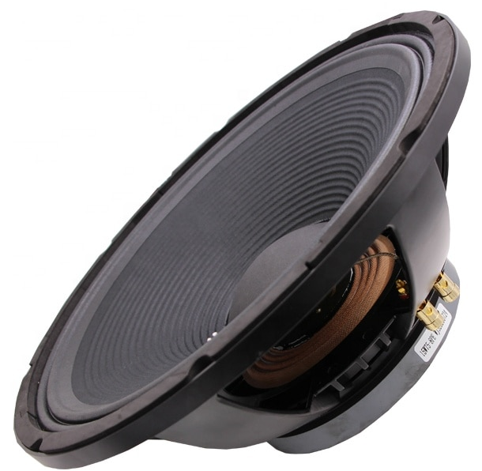
Speaker Subsystem
Put less focus on audio quality
Unable to implement stereo sound
Pins in design had been swapped
Audio amplifier has DAC capabilities
Used extra female connectors on PCB to connect to speaker
ELECTRICAL & COMPUTER ENGINEERING
GRAINGER ENGINEERING
Notes:
-Dhruv

Slide 14
User Interface Subsystem Changes
Focus on sound output reduced buttons
Unable to show volume and battery levels
Rely on Bluetooth device to adjust music
Successfully added mode button
Able to implement and test debouncing
ELECTRICAL & COMPUTER ENGINEERING
GRAINGER ENGINEERING
Notes:
Chirag

Slide 15
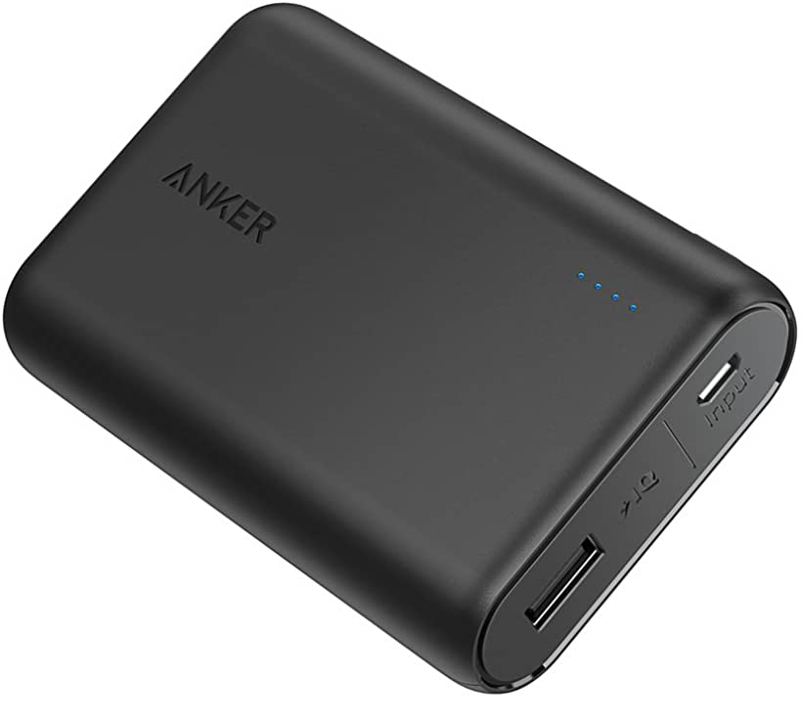
Power Subsystem
Used 5-volt battery pack
PCB has voltage regulator
Able to input 3.3 volts via Micro-USB
Checked for consistency by stress-testing
Can be recharged via USB-C
ELECTRICAL & COMPUTER ENGINEERING
GRAINGER ENGINEERING
Notes:
Chirag

Slide 16
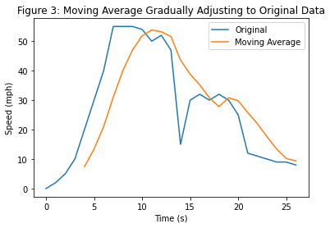
Moving Average
Sample rate: 300 milliseconds
Window size: 10 samples
ELECTRICAL & COMPUTER ENGINEERING
GRAINGER ENGINEERING
Notes:
Chirag

Slide 17
Testing and Results
Speed in MPH | Relative Volume Level on iPhone
20-25 | 95%
15-20 | 90%
10-15 | 75%
5-10 | 60%
<5 | 45%
Volume vs. speed relationship that we implemented for demonstration purposes
ELECTRICAL & COMPUTER ENGINEERING
GRAINGER ENGINEERING
Notes:
Chirag
- Add table with speeds here and discuss how this is what we got from the demo video

Slide 18
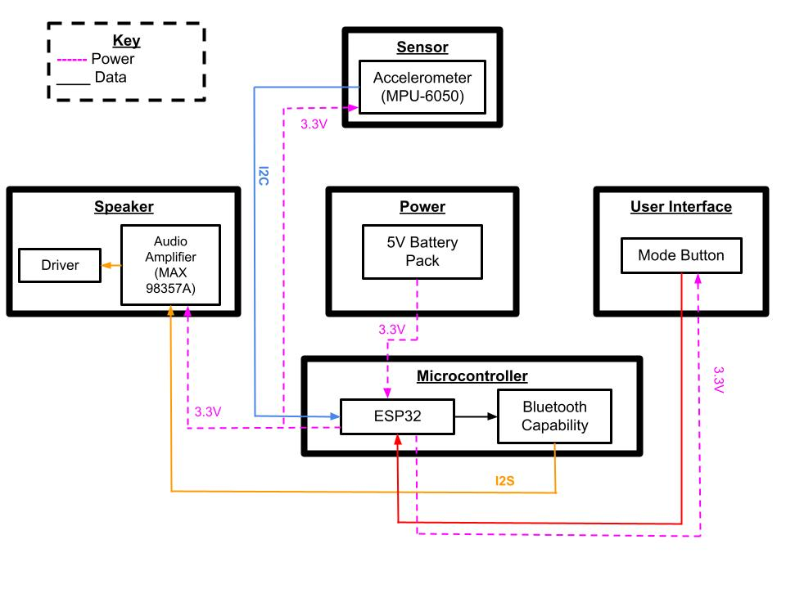
Successes
High Level Requirements
Speaker volume changes automatically in driving mode at a relative rate of 15% for a change of 5 MPH
In stationary mode the speaker is controlled manually using buttons
Bluetooth transmits media continuously, resulting in a change of volume based on a moving average
ELECTRICAL & COMPUTER ENGINEERING
GRAINGER ENGINEERING
Notes:
Raj
- Talk about how we made slight changes → Discuss why we made said changes

Slide 19
Challenges
Implementing stereo sound
Sensitivity of accelerometer for low speeds
Debugging PCB
Frying development boards for ESP32
ELECTRICAL & COMPUTER ENGINEERING
GRAINGER ENGINEERING
Notes:
Dhruv

Slide 20
Outlook and Improvements
Improve the user interface of our product
Invest in higher quality parts
Implement stereo sound
Would modify our approach earlier
ELECTRICAL & COMPUTER ENGINEERING
GRAINGER ENGINEERING
Notes:
Chirag
Want to add buttons and LEDs
Would improve accelerometer data and sound quality
Improves sound quality

Slide 21
Ethics
Volume stays at appropriate levels
Minimal interface reduces distractions
Mode button keeps user focused on task
ELECTRICAL & COMPUTER ENGINEERING
GRAINGER ENGINEERING
Notes:
Chirag

Slide 22
Notes:
Give special thanks to Abhisheka and Prof Fliflet

