Slide 1
Team 68:
Educational Smart
BreadBoard
Chinnies Chibuko, Mostafa Elkabir, Minseong Kim
TA:Kexin Hui

Slide 2
Introduction
Learning Tool for ECE undergraduates
A Circuit debugging tool
Notes:
Chinnies

Slide 3
Problem Statement
Wanted to create a user interactive breadboard that allows the user to :
Choose what mode to set the board in
Choose either to chip test or regular usage
Choose to supply voltage to a certain line
Display voltage values of certain lines
Notes:
Chinnies

Slide 4
System Hardware
Hardware:
Power Supply
Breadboard interface processing unit
Nextion screen interface
Voltage Supplying and reading unit
Software:
Processor control for chip testing
Notes:
Mostafa

Slide 5
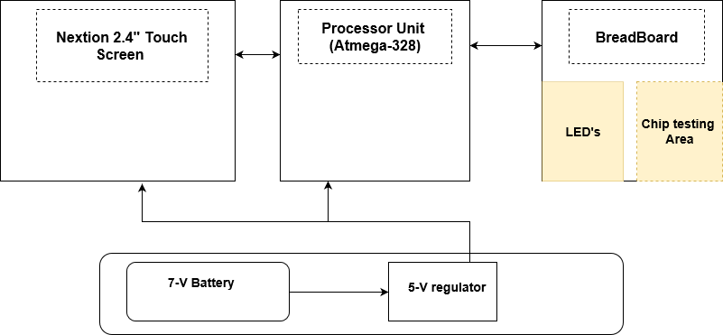
Block Diagram
Notes:
Minseong Kim

Slide 6
Hardware Overview
Power Supply
Takes 7V from a DC voltage supply and converts to 5V using a voltage regulator.
Processor Unit
Deals with I/O commands and process according to Input commands
Chip Testing Unit
Tests chips through communication with the processor module
Voltage Line Reader + Supplier
Shows active voltage lines and supply Vcc to specific lines
Notes:
Mostafa

Slide 7
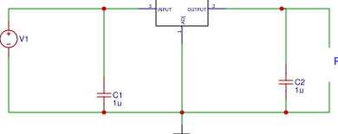
Power Supply
Supplying +5Vdc and GND to both the processor and screen
Maximum current 500mA , drop out of 1.5V, input voltage of 6.5-30 V
Notes:
Mostafa

Slide 8
Processor Unit
Atmega328P
Serial Communication with Nextion
Sends input to Chip testing Unit
Sends output to Nextion Screen
Notes:
Add connection pictures? Minseong
Yeah i guess just add a pic of the processor

Slide 9
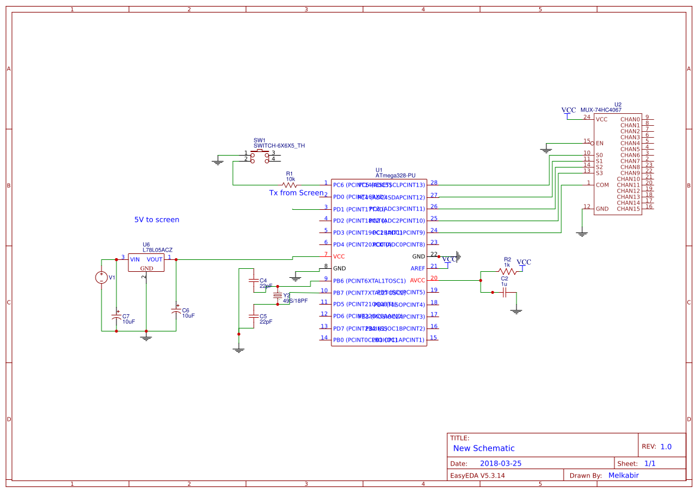
Processor Unit
Processor Unit Schematic
Notes:
Mostafa

Slide 10
Original Voltage Line reader
User chooses voltage line from screen
Processor send the select bits to muxes
The voltage line value is then passed to processor
Processor reads the value and outputs it in screen
Notes:
Mostafa

Slide 11
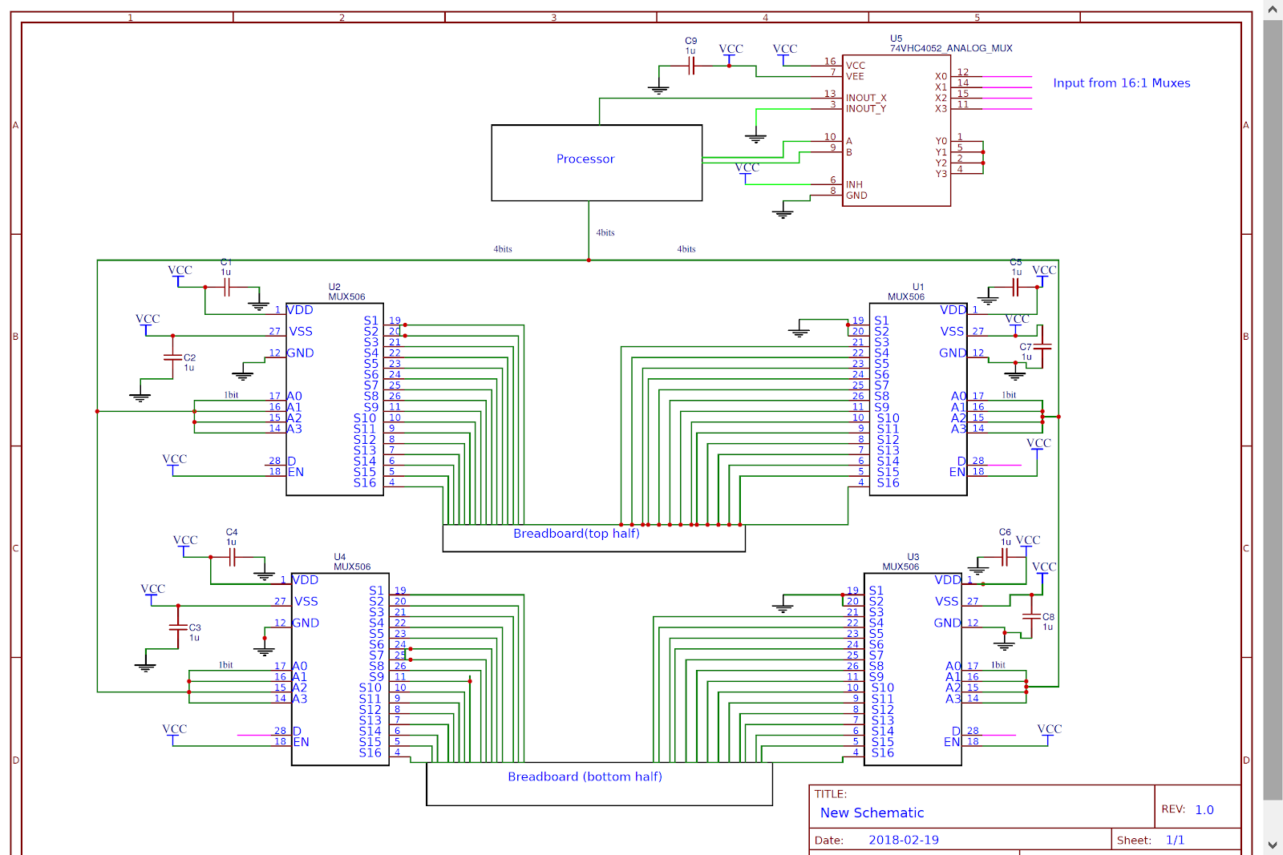
Original Voltage Line Reading Schematic
Notes:
Mostafa

Slide 12
Voltage Line Reader +Supplier
LEDs show which line is active
Tristate buffer takes input from Vcc Supply
Counters are used to select what modes to put the tristate buffer on
Processor sends last control bit to the tristate buffer
Notes:
Mostafa

Slide 13
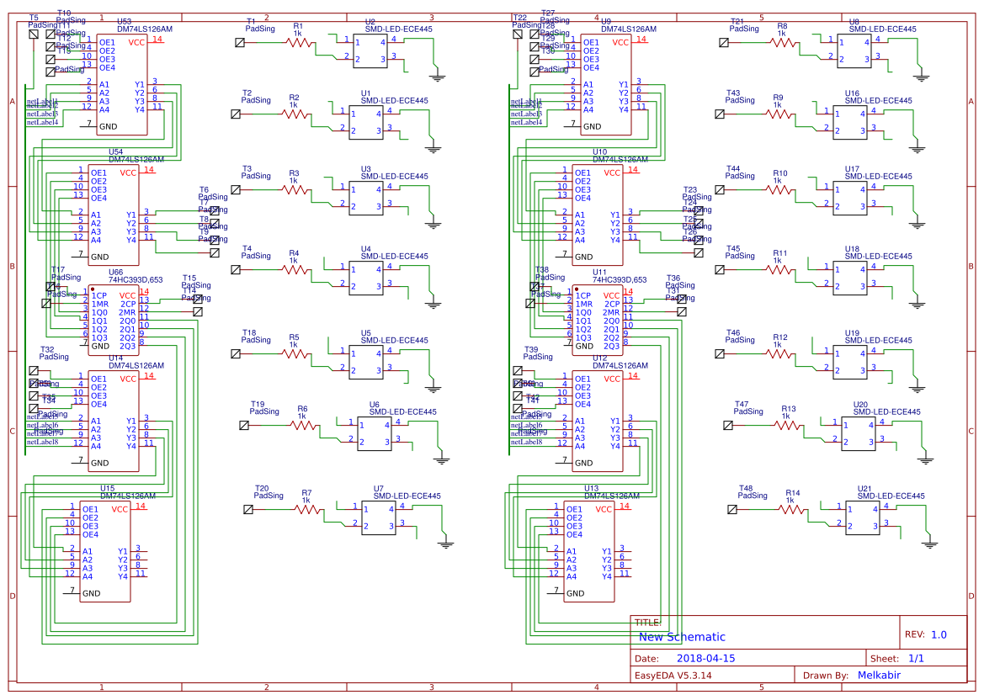
Final Voltage Lines Schematic
Notes:
Mostafa

Slide 14
Price vs Power Consumption
Original Voltage Reading Design:
5_16:1 analog muxes
Price: 5*3.34$ = 16.7$;
power(based on data sheet) 5 * 150 = 750mW
Updated Voltage Reading and Supplying design
10 LED’s, 8 tri-state buffers, 8 counters
Price: 10*0.3 + 8 *0.40 + 8*0.78= 12.44$
Power(based on Data sheet) = 10*200mw +8 * 90 mW + 8* 45 mW = 2760 mW
Notes:
chinnies

Slide 15
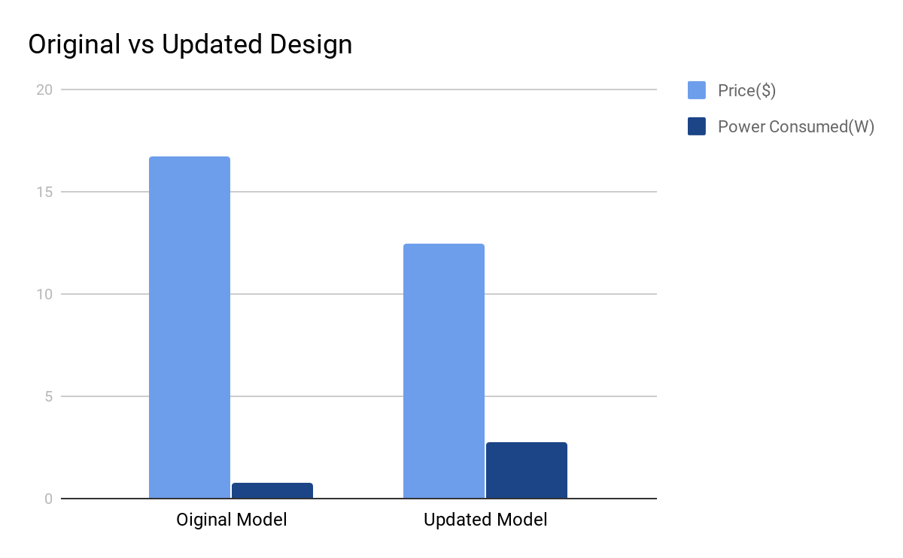
Original vs Updated Design
Notes:
chinnies

Slide 16
Chip Testing Unit
Processor module
Takes input from the Nextion screen
Runs the input through different configurations in the processor module
Sends output to Nextion screen for display
Notes:
Minseong

Slide 17
Chip Testing Feature
Testing was done using IC chips SN74LS00,SN74LS08,SN74LS02,SN74LS32,DM74LS17N,...etc
These chips are found in the library of the screen module
These are the chips that the chip tester is able to test
These are all combinational chips
Notes:
chinnies

Slide 18
Original Chip Testing
Using processor, 20 D Flip-Flops, 5 Counter chips , 5 Tri-State Buffer chips
Processor sends the select bits to counters
Counters are used to provide the input and select bits to tri-state buffers
Output of tri-state buffers go into the D Flip-Flops
Each chip to be tested, line needs 1 D Flip-Flop to hold the correct value for testing, then it’s updated by the processor
Notes:
chinnies

Slide 19
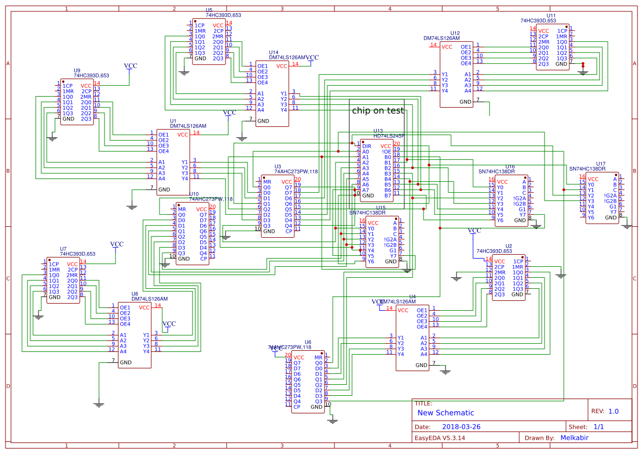
Original Chip Testing Schematic
Notes:
Mostafa

Slide 20
Final Chip Testing Unit
Used the processor to supply Vcc, GND, different configuration to chip being tested
Decrease computation time dramatically
Processed output in a parallel fashion
Limitation of 16 pin max to be tested
Notes:
Mostafa

Slide 21
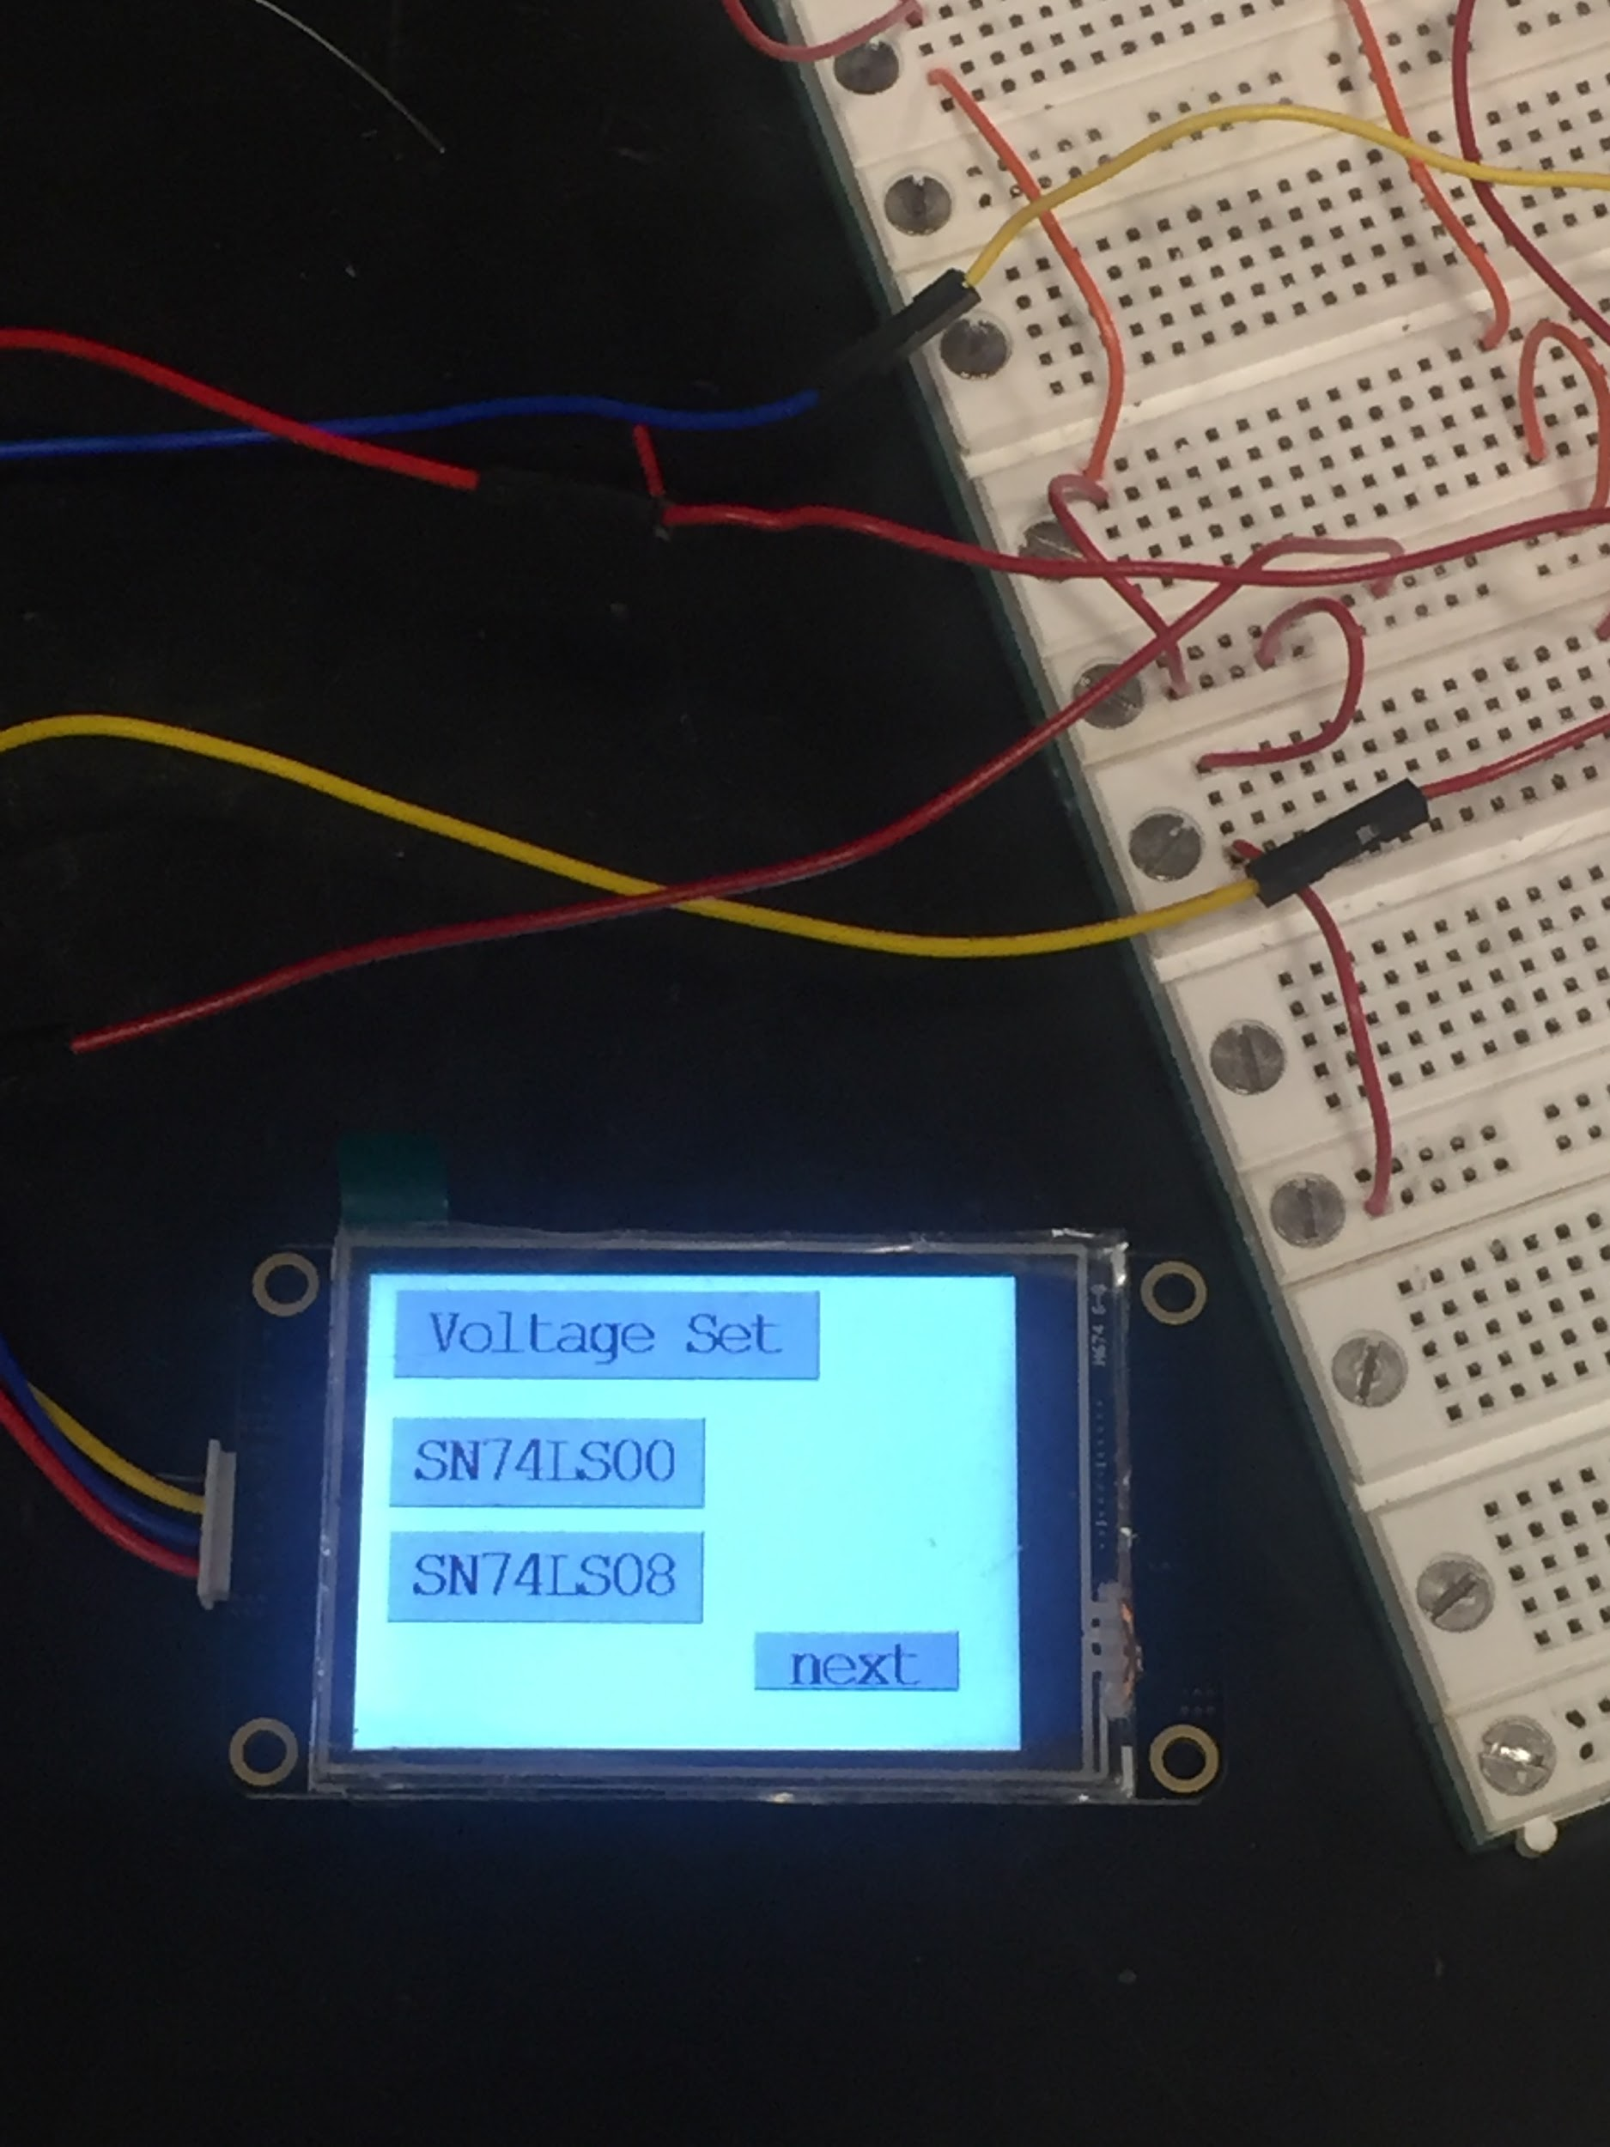
Image showing screen module
Notes:
chinnies

Slide 22
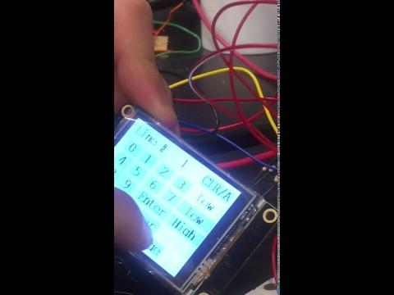
Video showing Voltage Line Reader Feature
Notes:
chinnies

Slide 23
Power Consumption(Based on Datasheet)
Voltage line Reading + Supplying : Counters + tristate buffers Processor =
2752 mW
Chip Testing : Processor+tristate buffers + counters =
232.5 mW + 4*120 mW 4*45mW = 892.5 mW
Sleep Mode:
172mW
Notes:
chinnnies

Slide 24
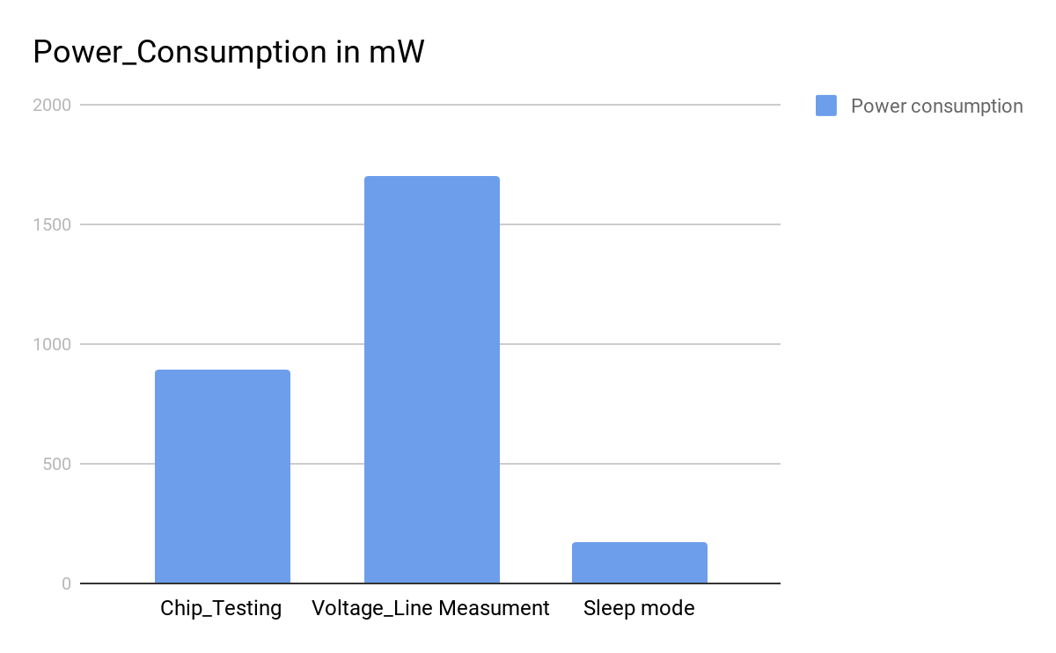
Notes:
chinnies

Slide 25
High level module requirement
CHIP TESTER: The smart breadboard should be able to test correctly whether chips that have a fixed input-output relationship work as specified by a user.There is already a library of chips and the user has the choice of which chip should be tested from the library.The user specifies which chip should be tested through the touchscreen module.Only a single chip is tested at a given time
Voltage-Line Values: The smart breadboard tests which line is active.
Notes:
chinnnies

Slide 26
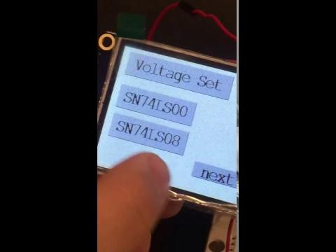
Video showing the Chip Testing Feature
Notes:
chinnies

Slide 27
Challenges
Soldiering is the main issue we had
Costs of chips
Notes:
Engineering is there to overcome cost problems, but engineering has limitations (costs of chips).

Slide 28
Future Work
The board should be able to debug if there is a shortage in a line
The board should be able to test more chips including sequential chips.
Make our whole design in one compact PCB
In general:
Users should be able to write their intention (e.g. logic function) and verify it.
Notes:
Minseong

Slide 29
Credits
TA: Kexin Hui
Professor Rakesh Kumar
Professor Arne Fliflet

