Slide 1
Pedal-Powered Smart Bike
Team 29
By Alex Sirakides, Karl Kamar and Anshul Desai

Slide 2
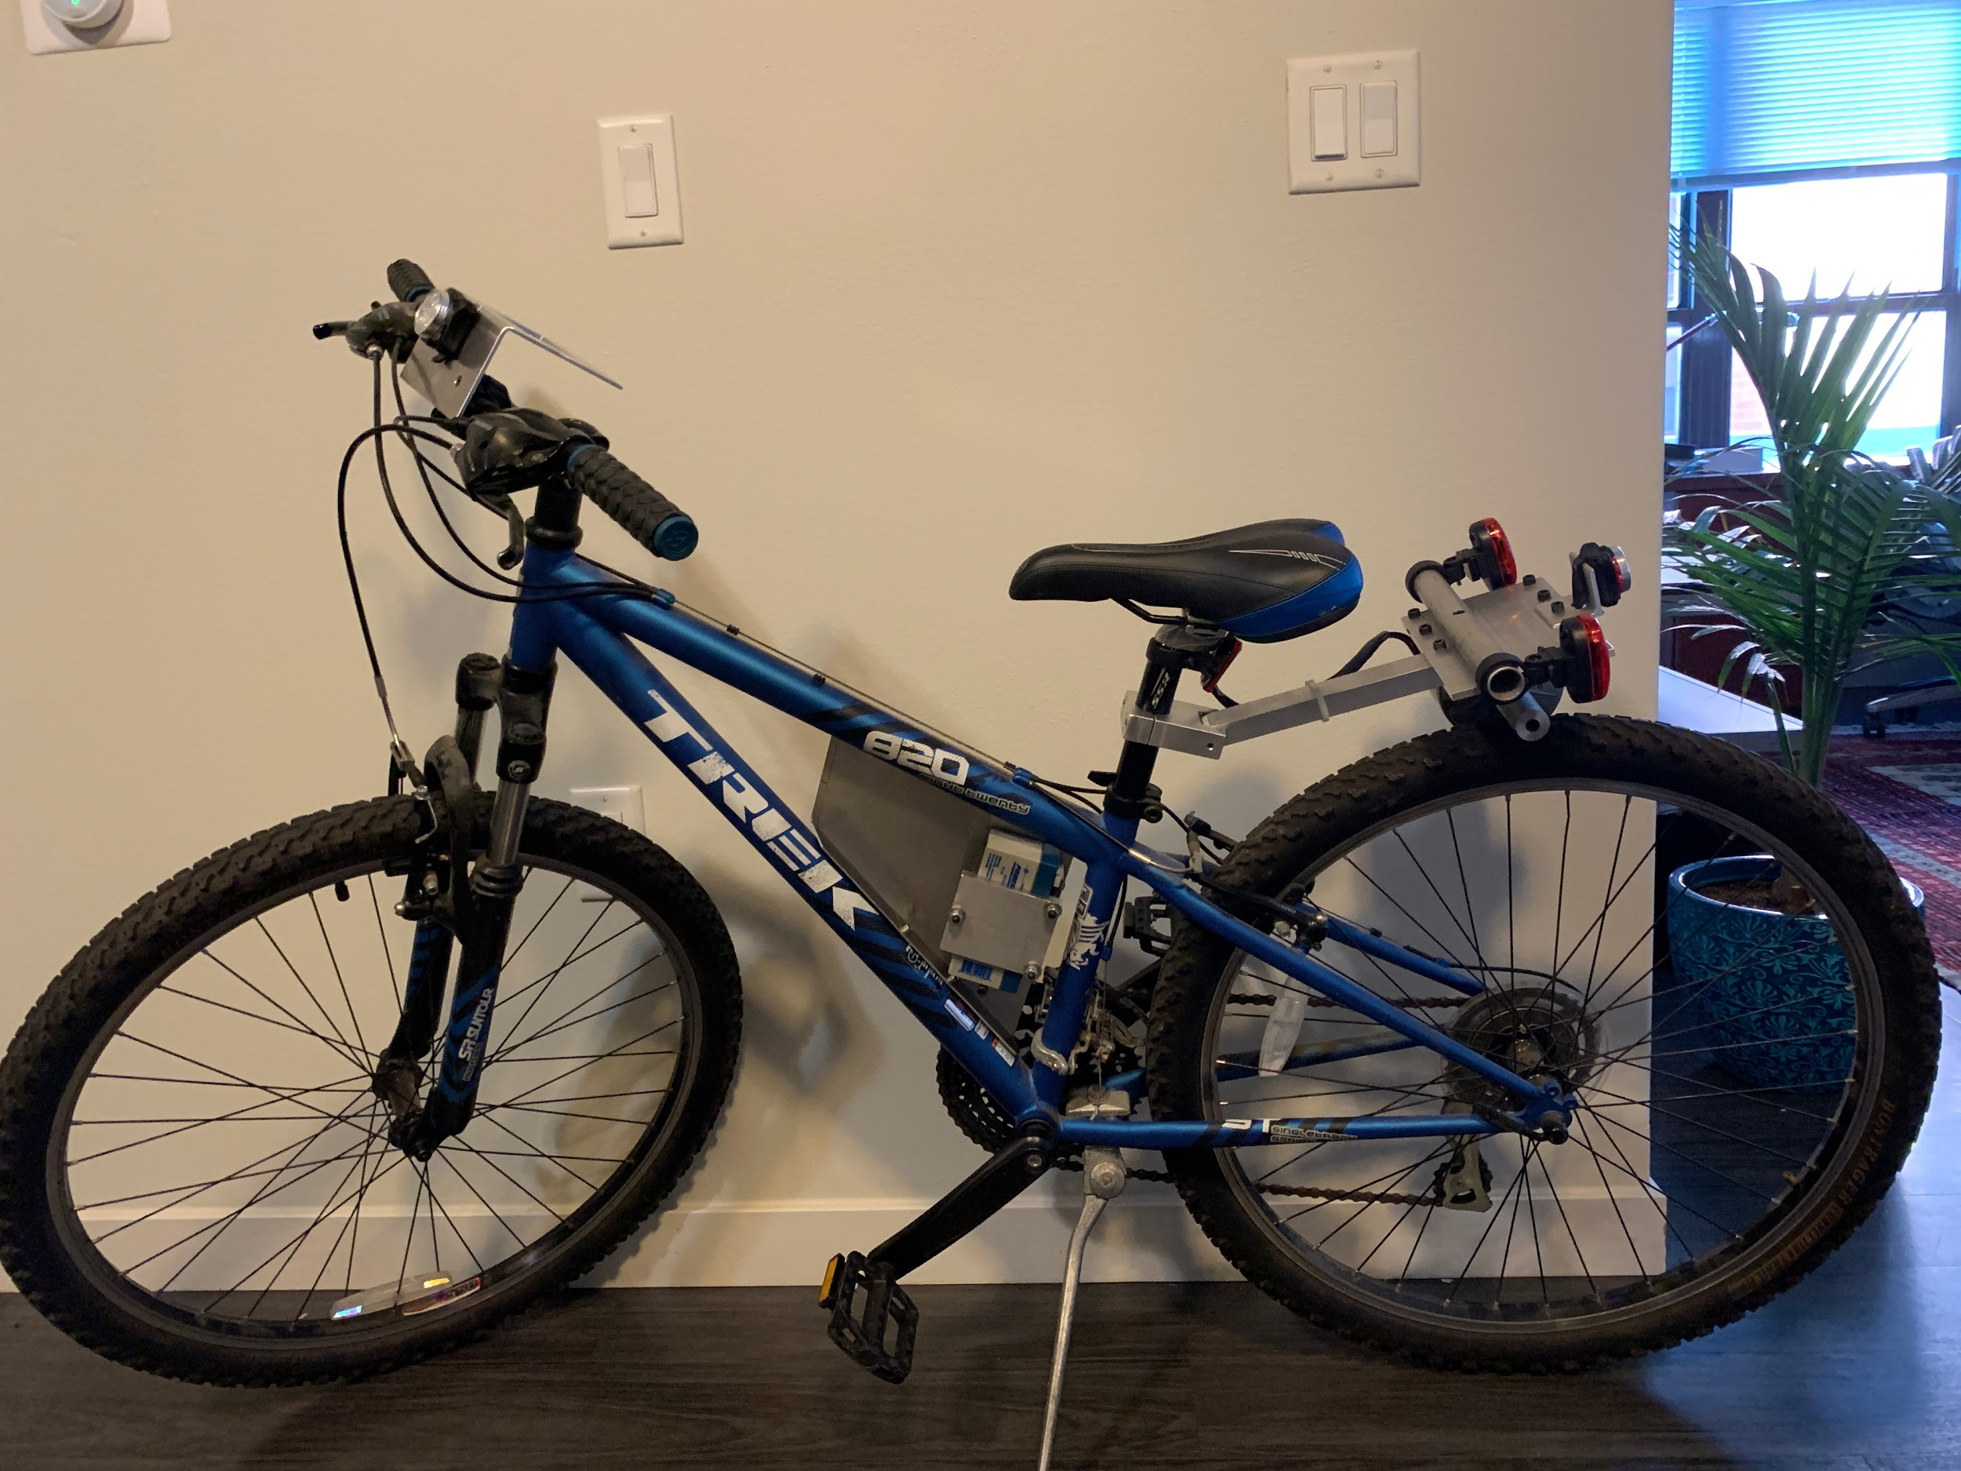
Introduction
Lack of electrical development in marketed bikes
Need for more bikers in growing cities
Need to make bike user experience comparable to modern cars
Need to make bikes more attractive to modern users

Slide 3
High Level Requirements and Objectives
Provide bikers with Safety Enhancements
Increase available information to bikers on trips
Introduce Automation to bike’s controls (ALS)
Incorporate these features in a self-contained system

Slide 4
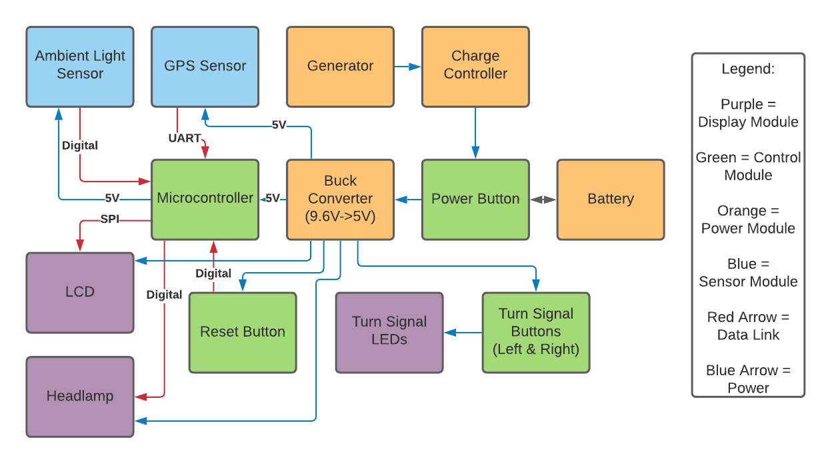

Slide 5
Calculations Behind Power Supply Design
Average torque on pedals: Biker Weight x Pedal Length x 2π = 65x9.81 x 0.17 x sin(θ) = 108.4 N-m >>>>> Drag is too big which makes it impossible to pedal. 0V output.
Torque in hinge system scenario: Normal Reaction = Motor Weight = Mass x g = 5.6lb x 0.453592kg/lb x 9.81 = 24.92 N Friction = Dynamic Friction Constant x Normal Reaction = 0.5 x 24.92 = 12.46 N Torque = Friction x sin(θ) x Motor Brush Length = 12.46 x sin(90) x 1.1in x 0.0254in/m = 0.348 N-m
0.348 N-m corresponds to 124W, 6.6A, 3320 RPM at an Efficiency of 76%: >>>>> 14.28V output

Slide 6
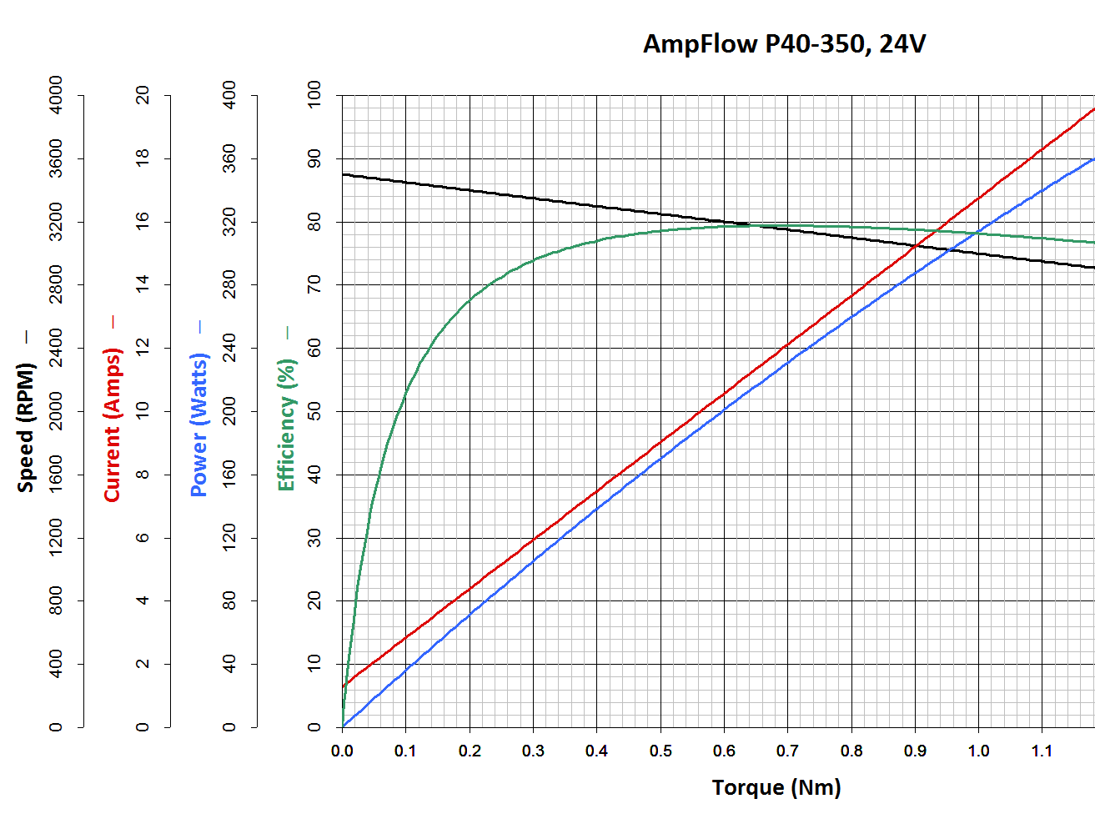
Motor Chart

Slide 7
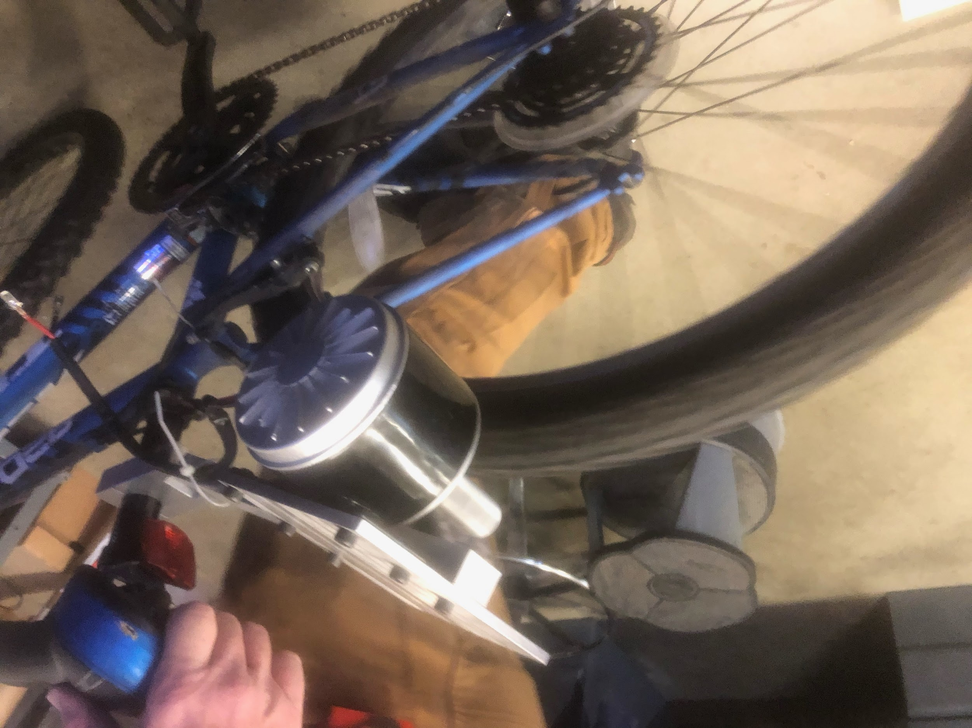
Power Supply Mechanism
24VDC Brush Motor Produces Power
Metal Cylinder Attached to the Brush
Friction of Tyre on Cylinder Drives Rotation
Hinge System Permits Motor Mobility for Safety

Slide 8
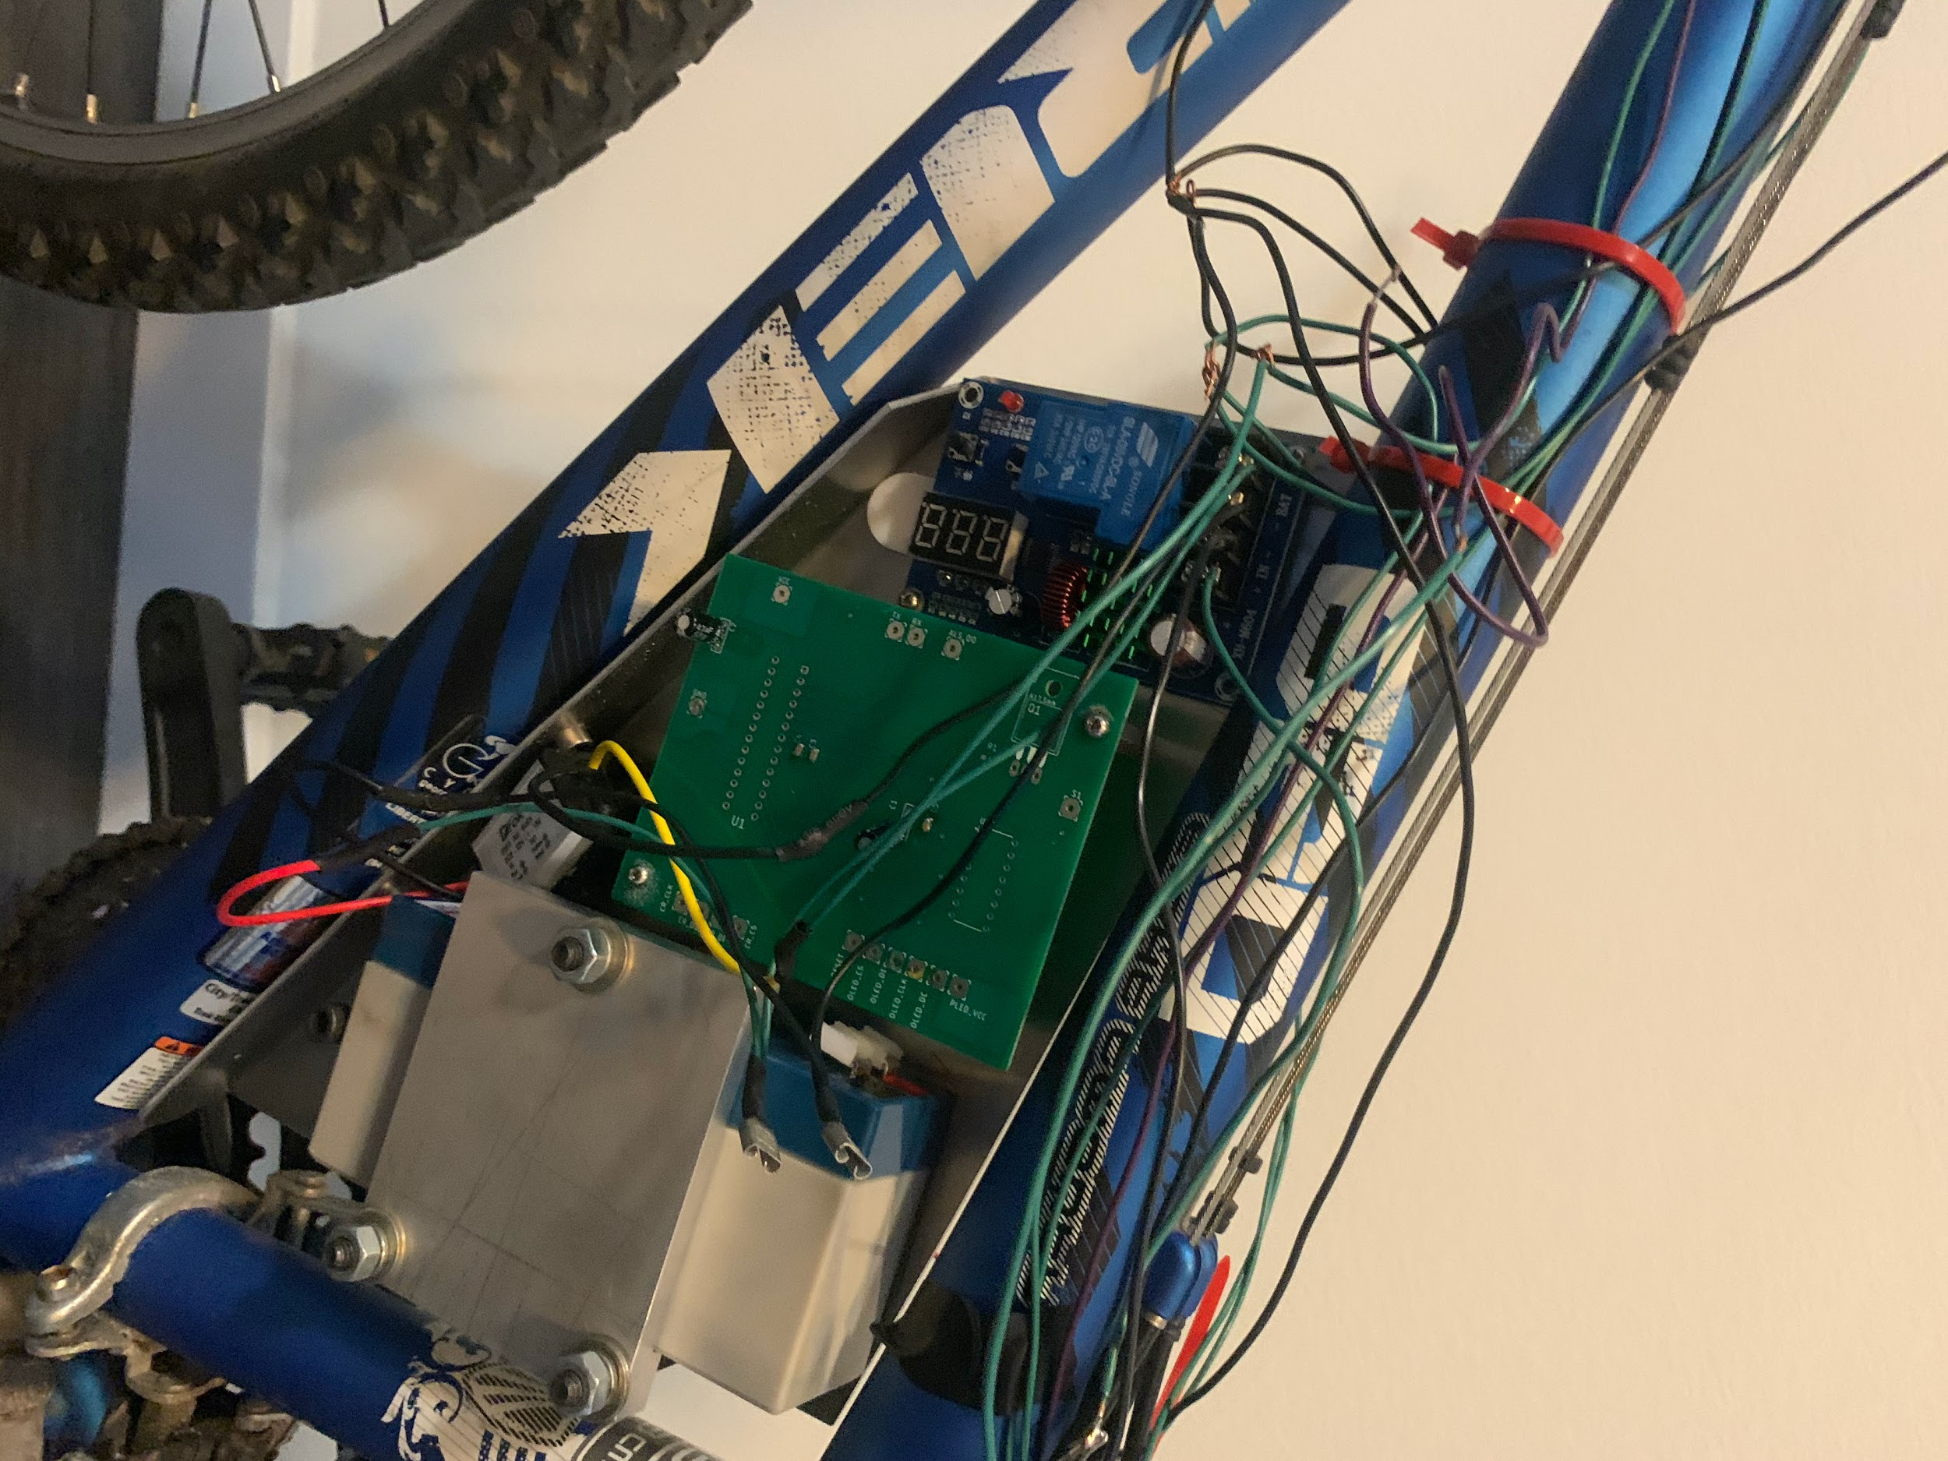
Battery
12V/2.3Ah vs 8V/3.2Ah
Power Supply for all the bike’s UI
Lead Acid Rechargeable

Slide 9
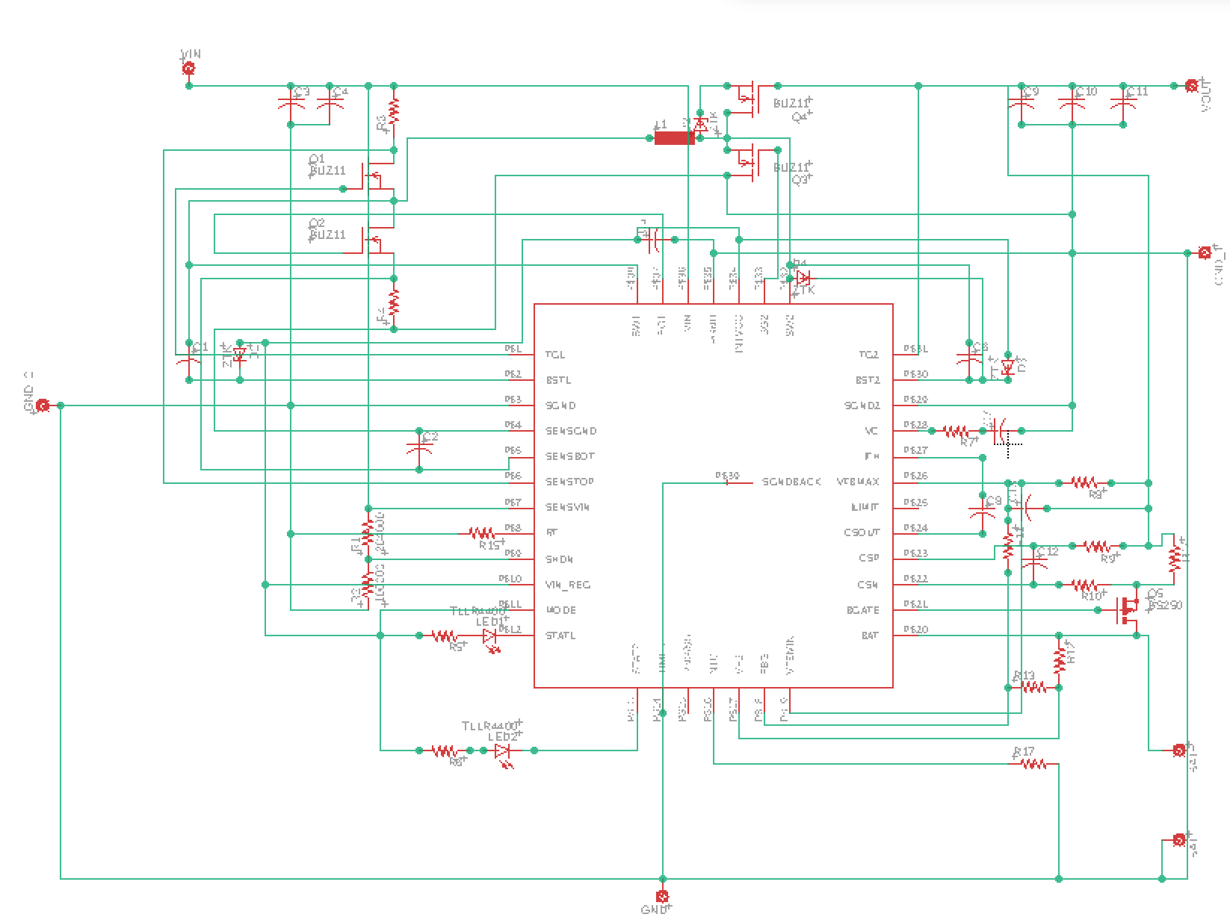
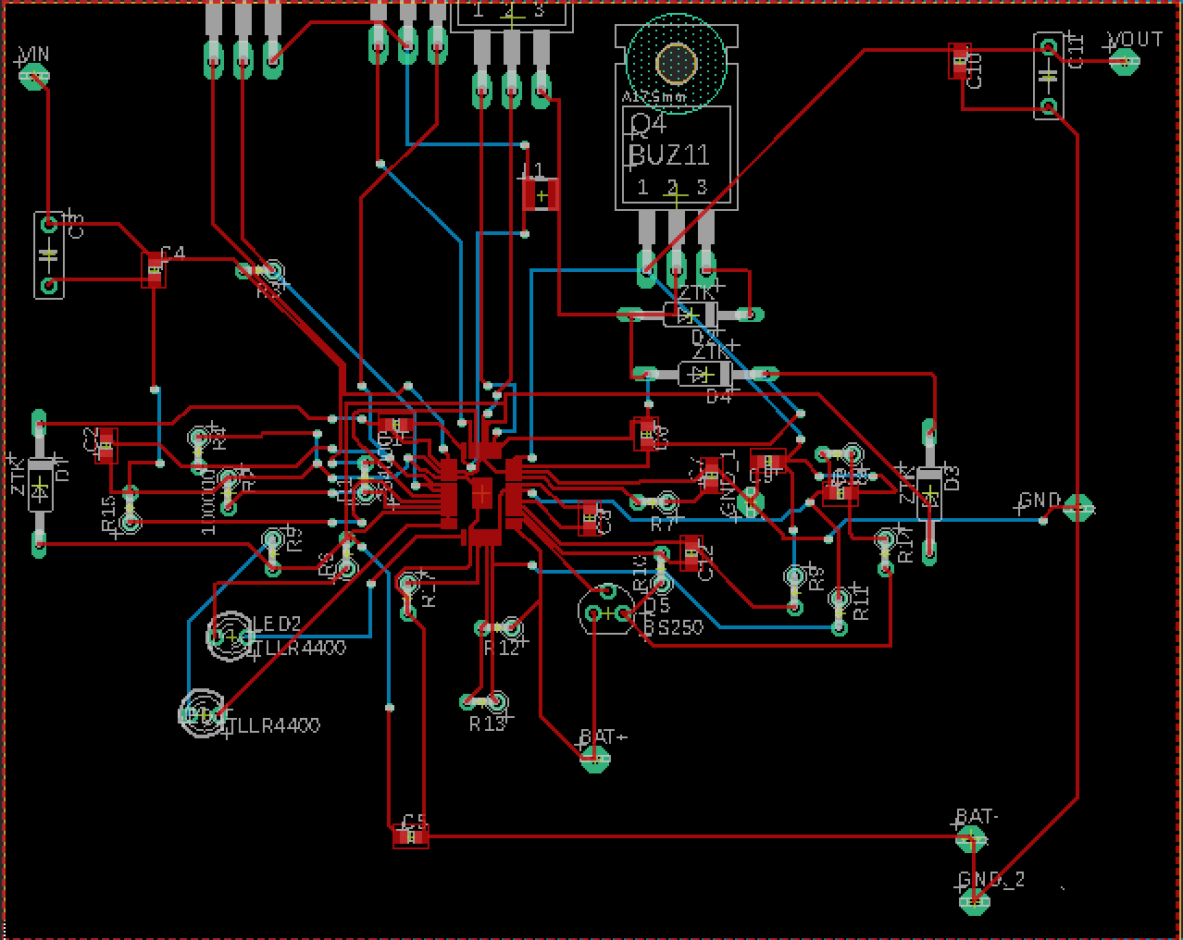
Initial Charge Controller Plan

Slide 10
Charge Controller
Controls Flow of Current from Motor to Battery (0.1 x Rated Battery Current)
Maintains Battery Voltage within a safe range (0.9 x Rated Voltage - 1.2 x Rated Voltage)
Maintains Charge Flow Direction in one direction
Based on Relay Switch system that connects/disconnects output from input
Displays voltage across battery terminals
Prefabricated vs. Soldered Ourselves
Diode Added

Slide 11
Buck Converter
5V/3A output
Chosen over Linear Voltage Regulator (Loss and Heat)
Powers MCU, Lights and Display
Ensures Constant Voltage is provided to DC components

Slide 12
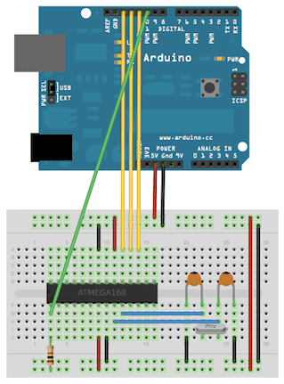
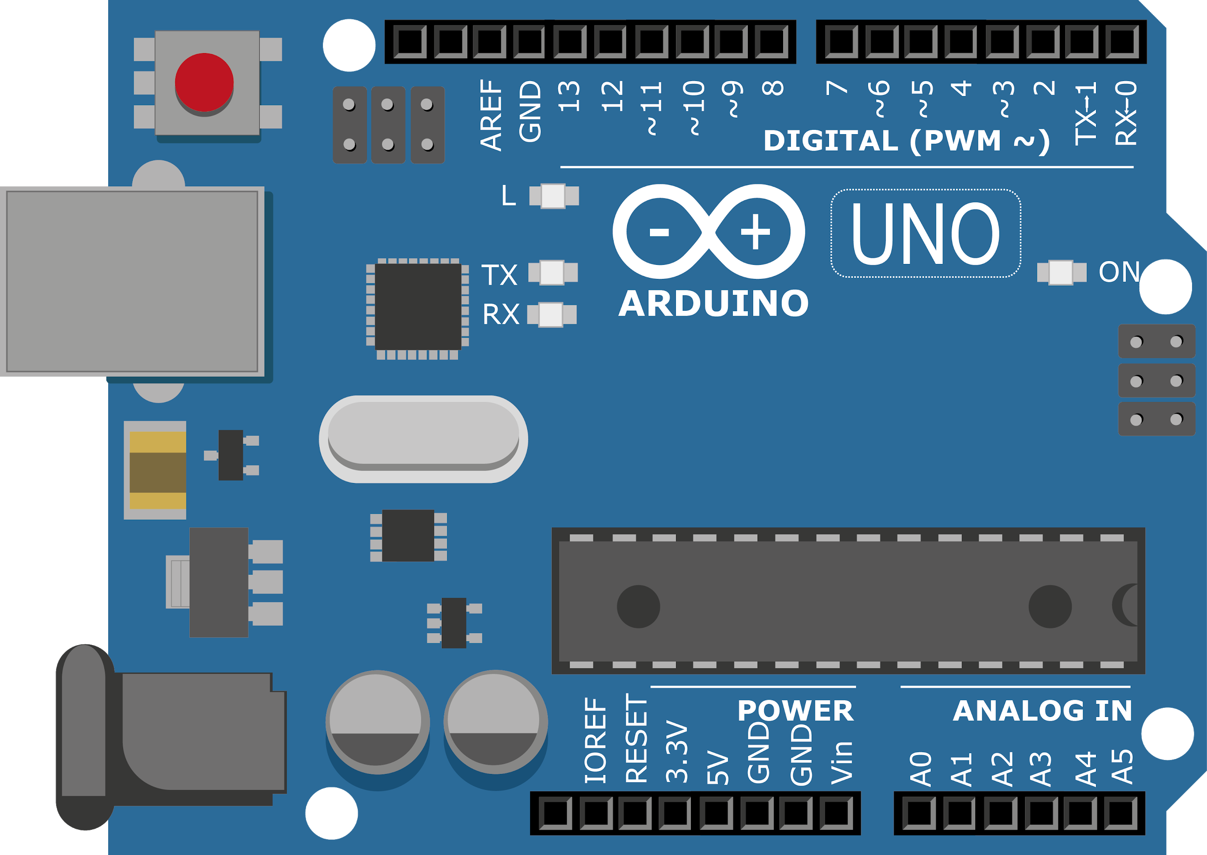
ATMEGA328P Development Process
Burn Bootloader to multiple microcontrollers
Program microcontroller directly from Arduino Uno
Verification: 2 x pF Capacitors, 1 x 16 MHz Oscillating Crystal,
1 x 5V regulated power source

Slide 13
Removing MicroSD Card Reader
Previous use cases:
Storing path data every update
Distance calculation from summed path data
Average speed calculation from stored path
Ride time from first and most recent reading
Potential for reverse geocoding
Issues:
SD card write would disrupt GPS data, feeding garbage values
MCU not fast enough to reverse geocode
Solution:
Utilize MCU EEPROM to save state data on update
Instantly retrieve saved data on init
Display relevant lat/long data
Bonus Verification:
Pins available on PCB for ALS, FET, light and reset switches, no need for redesign!

Slide 14
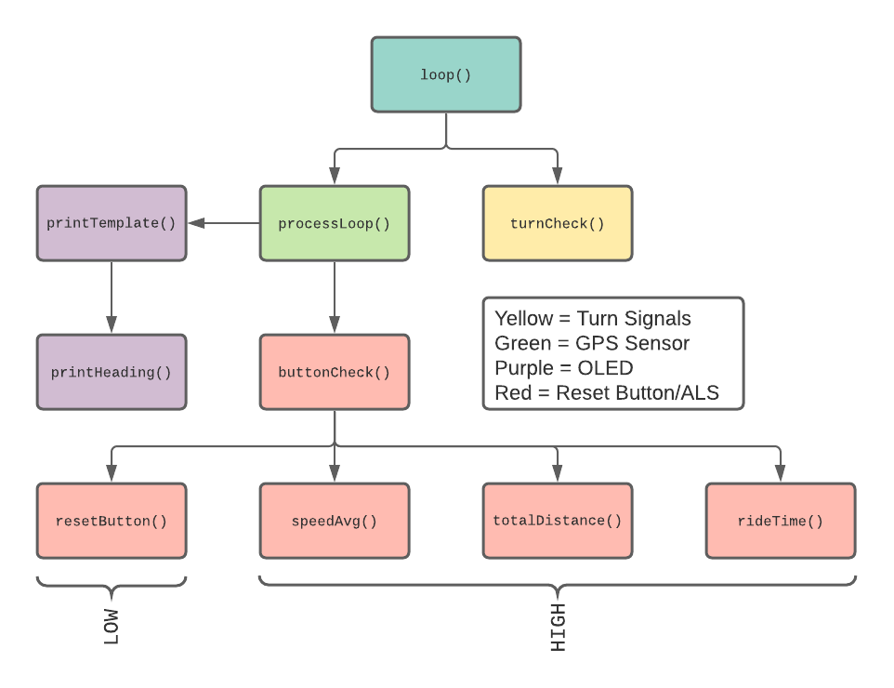
Function Tree

Slide 15
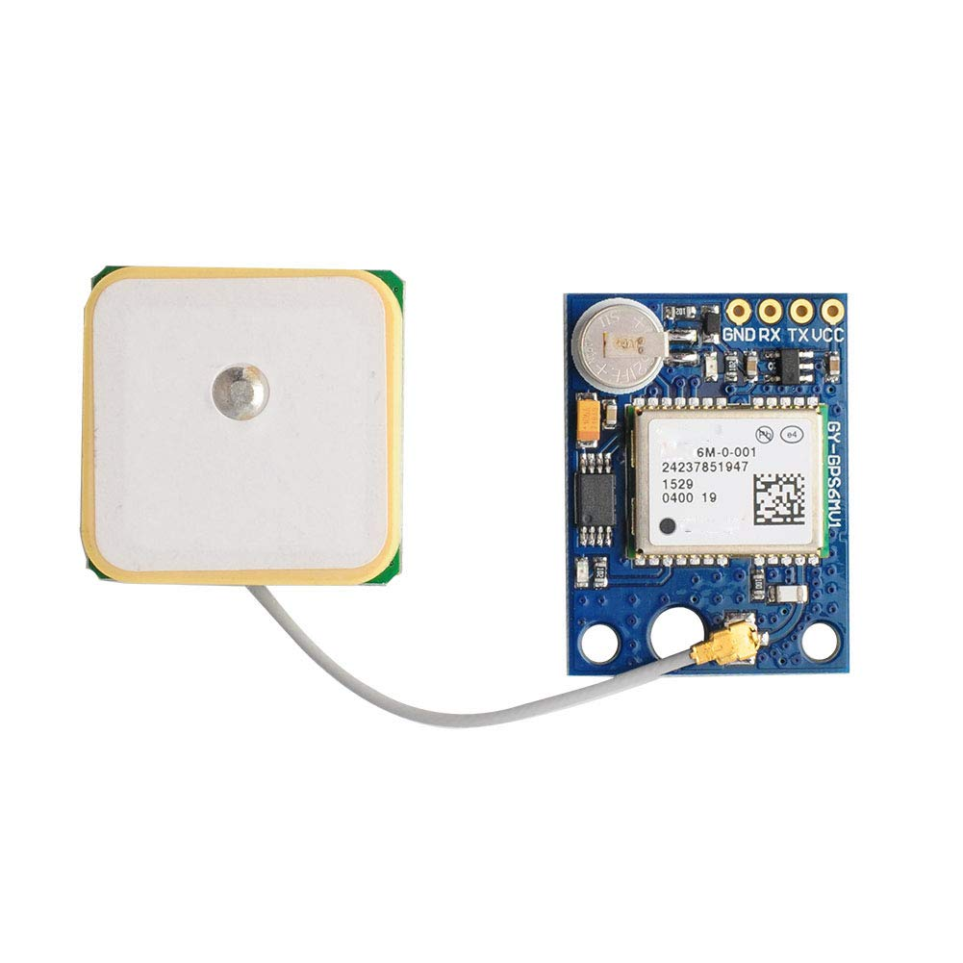
processLoop() Function
Libraries used: NeoSWSerial, NeoGPS
Called on availability of GPS Software Serial object (1 Hz)
Pseudo-algorithm:
Read ALS and RESET_BUTTON state
Save GPS data to fix
Call buttonCheck() and printTemplate()
Save exercise statistics to EEPROM
NEO-6M GPS Sensor

Slide 16
Processing NMEA GPS Data
Verification: Serial monitor of Arduino IDE outputs NMEA sentences
$GPRMC (Min. recommendation for GPS data) ex: $GPRMC,220516,A,5133.82,N,00042.24,W,173.8,231.8,130694,004.2,W*70
Timestamp Latitude/Longitude Speed (Knots) Datestamp
GPS fix updated at beginning of processLoop(): fix.speed_mph() - Speed converted from knots to miles per hour fix.latitude(), fix.longitude() - Latitude and Longitude returned as floating-point fix.heading() - Calculated heading returned in degrees clockwise from North etc… ALSO verifiable from Arduino IDE Serial monitor

Slide 17
printTemplate() Function
Libraries used: AdafruitGFX, Adafruit SSD1325 Display Driver
Updates with GPS module (1 Hz)
Pseudo-algorithm:
Clear display video buffer (prepping cursor)
Validate fix
Prints with only GPS time fix (ride time increments)
Prints with GPS time and GPS location fix (all stats increment)*
Like (a), default time “6:00:00”, no ride time
Build video buffer with variables saved to flash memory
Display video buffer *printHeading() called with fix.heading()
(a) Time Fix
(b) Time + Location Fix

Slide 18
Statistics Functions
speedAvg():
Return (reject) if speed is below 0.5 miles per hour
Redistribute average based on current speed, previous average, and previous count
Increment previous count
totalDistance():
Return (reject) if speed is below 1.0 miles per hour and location is invalid
Calculate square (or Haversine) distance between current and previous location
Update previous location to new location
rideTime():
On init (startup/record), save start time
Pull elapsed time from previous sessions via EEPROM (startup only)
Else, calculate difference between current time and start time
Include previous session time (startup only)

Slide 19
resetButton() and buttonCheck()
resetButton() simply resets all statistics and sets previous time for rideTime() to current (constant)
buttonCheck() pseudo-algorithm:
If RESET_BUTTON is LOW, call resetButton()
Else, call speedAvg(), totalDistance(), rideTime()
ALSO, verify state of ALS-FET system (a -> b -> c -> a -> …):
If ALS previous state LOW, now HIGH, pulse head and tail lights on
Else if ALS previous state HIGH, now LOW, save start time
Else if ALS previous state LOW, still LOW, and 5 seconds from start time, pulse head and tail lights off
Save previous state of ALS-FET system

Slide 20
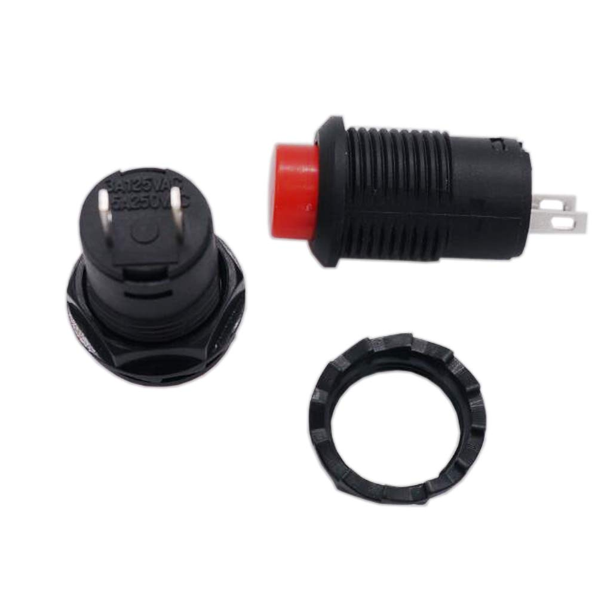
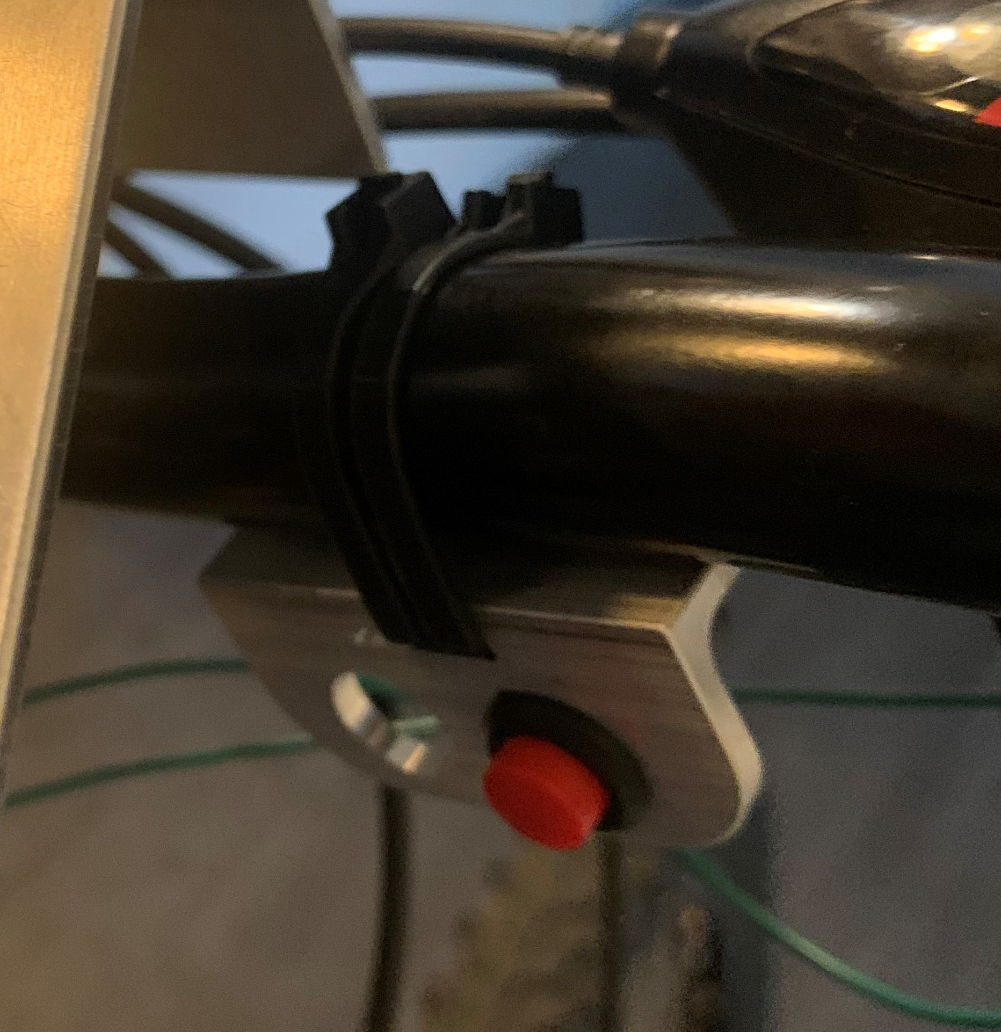
Buttons in Circuit
Power Button:
Mechanical switch disconnecting battery from CC & System
Mounted above the battery
Reset Button:
Mounted next to right turn signal
Active HIGH with pull down resistor

Slide 21
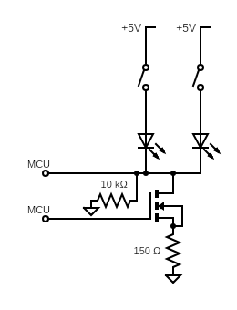
Turn Signals
Turn Signal Buttons
Active HIGH with pull down resistors
Cannot provide necessary flashing
N-Channel FET & Duty Cycle
Flashing driven via the microcontroller
Allows for any flashing speed
Allows for pin reduction

Slide 22
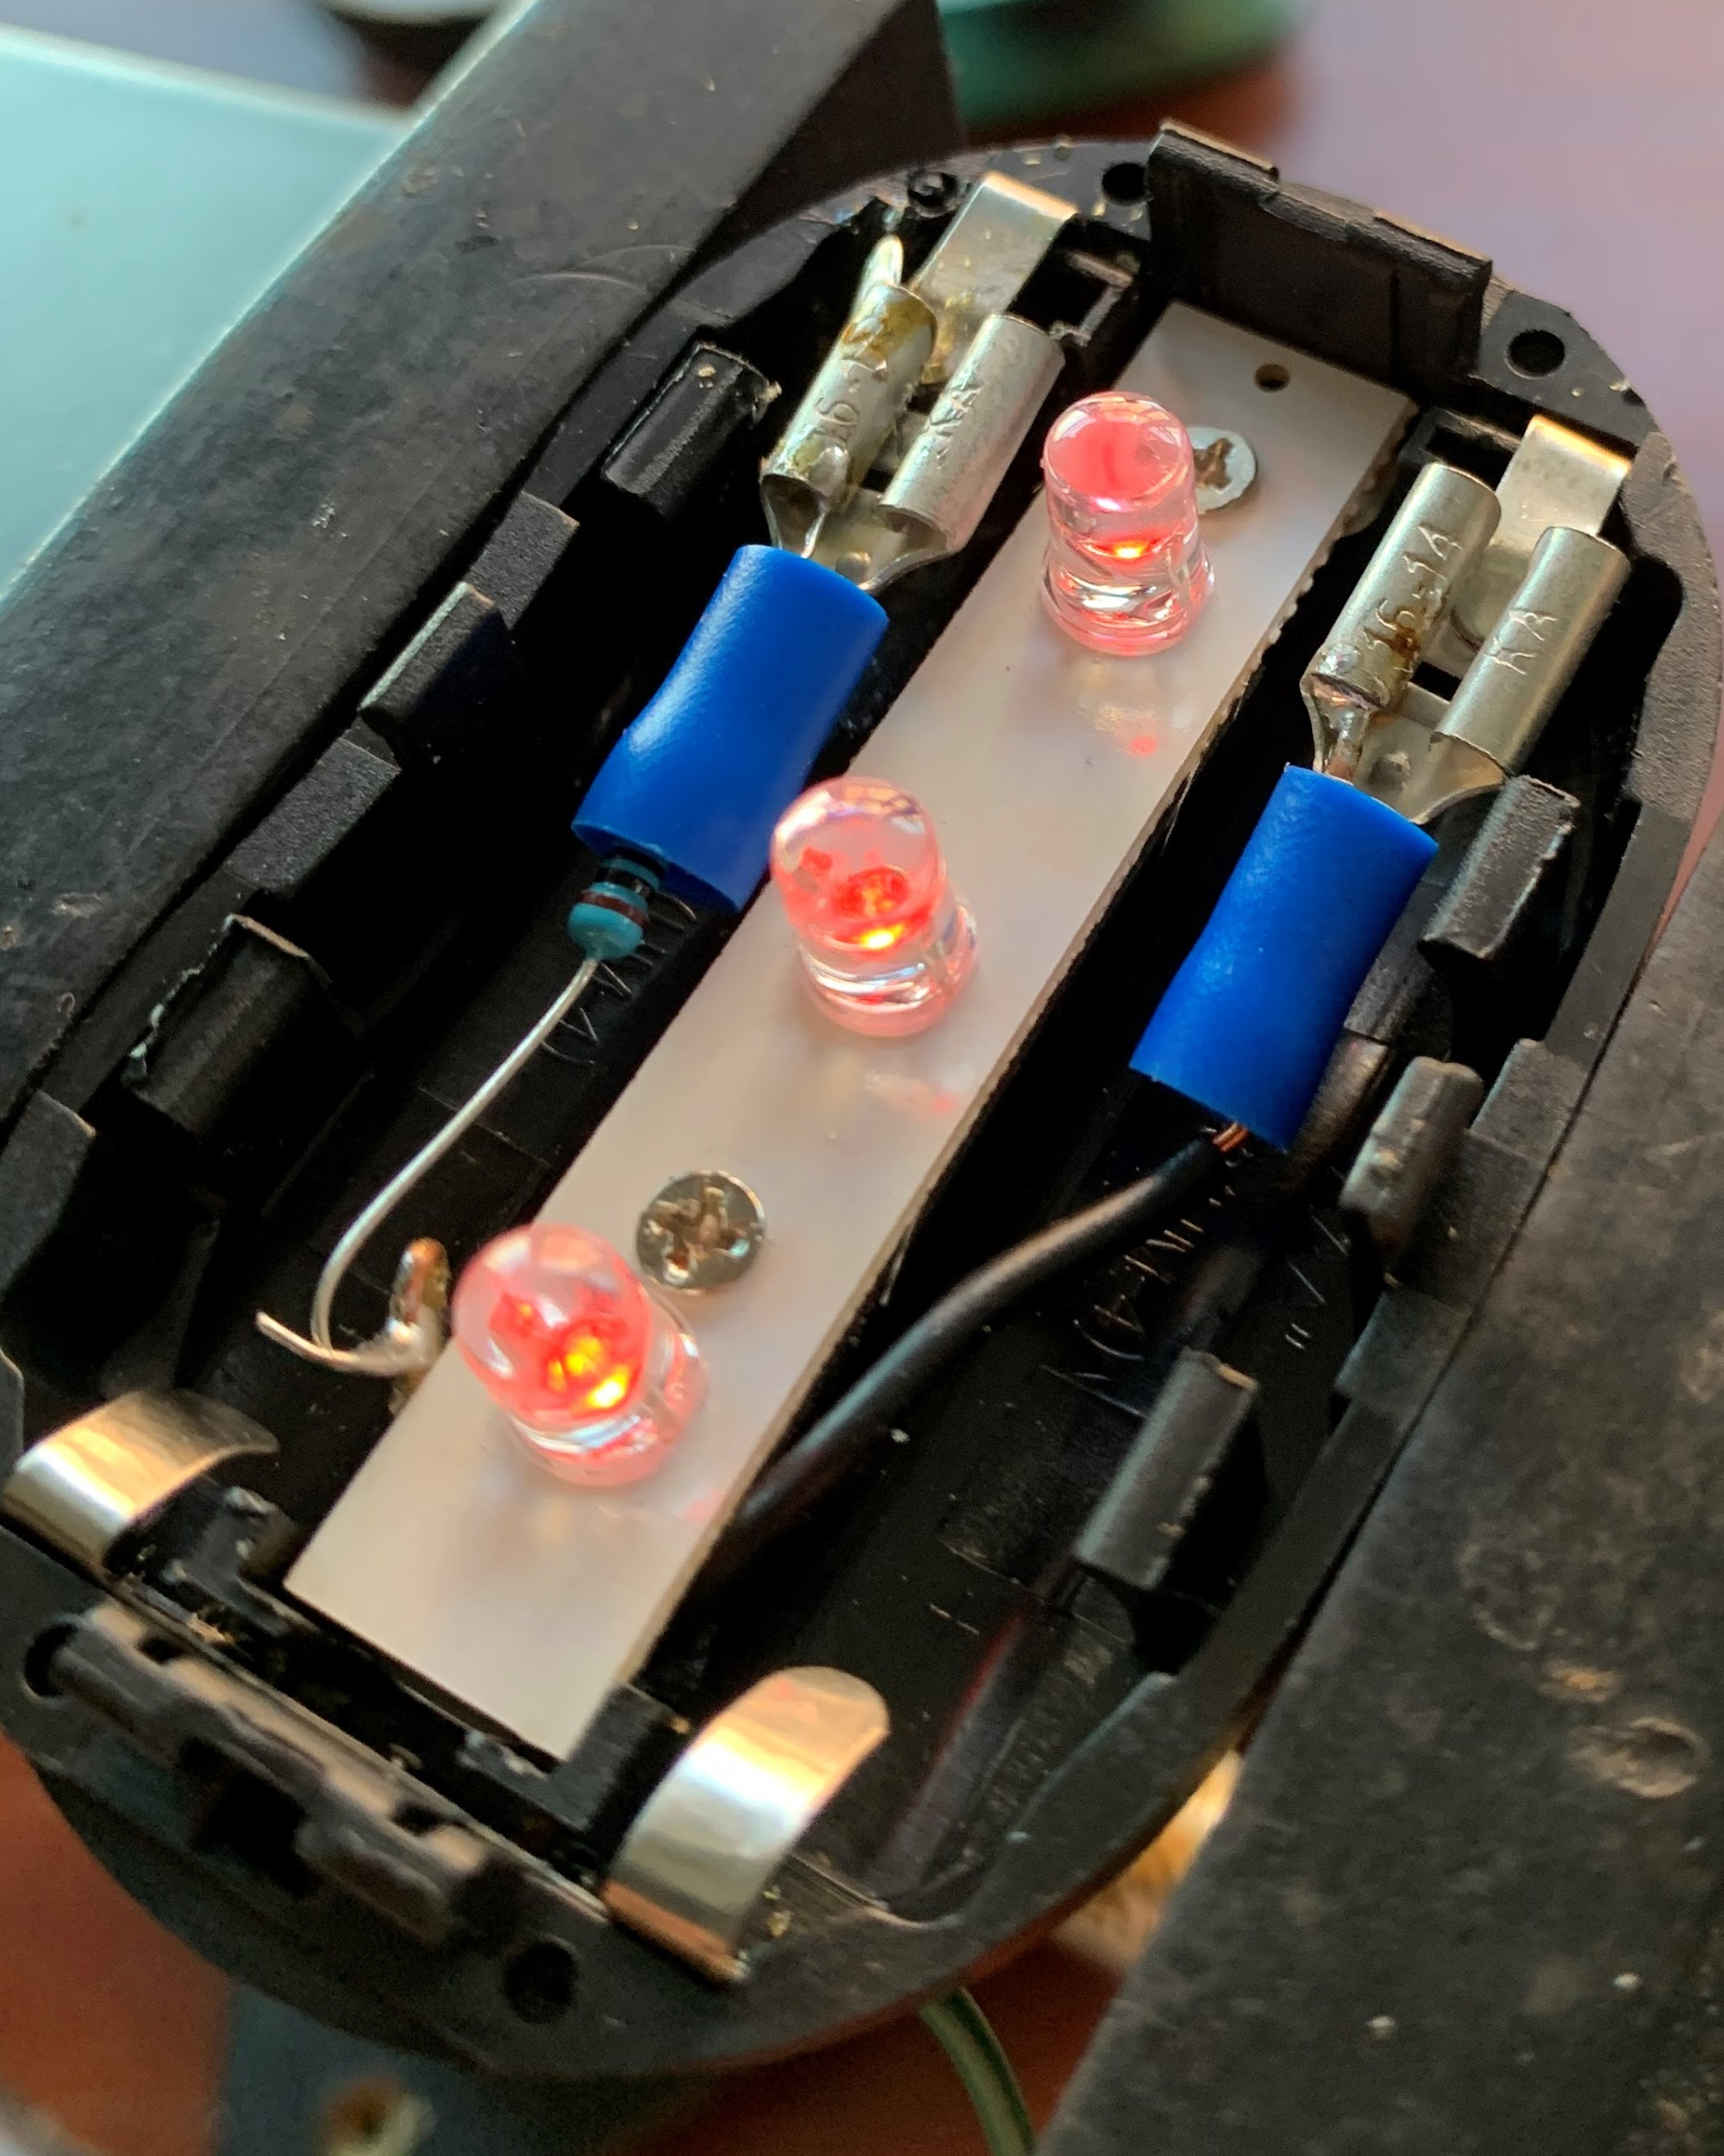
Turn Signals Continued
Turn Signal FSM
LEDs were 3-state FSMs (Off, On, Blink)
Could only be toggled mechanically
Initial State is on
Soldering
Cannot solder to aluminium
Additional resistor to offset additional voltage

Slide 23
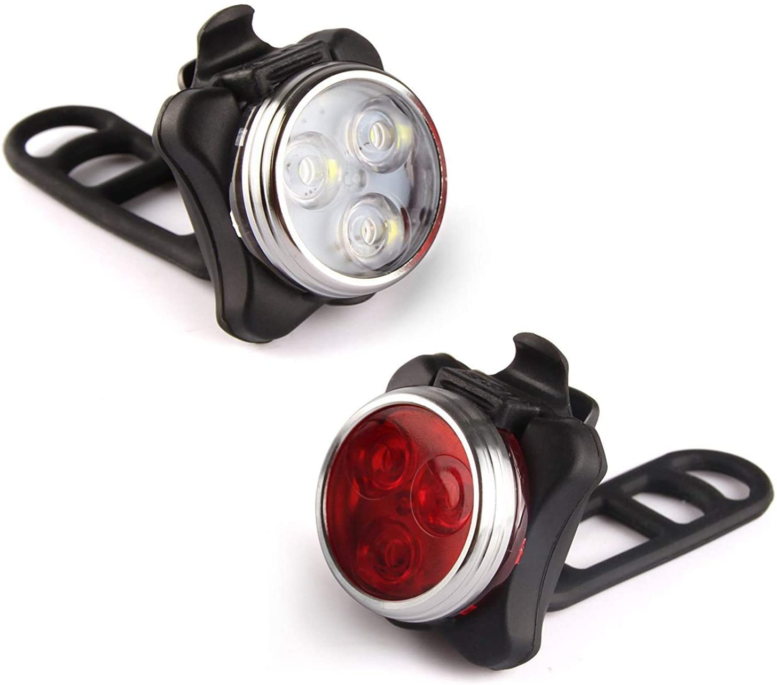
Head and Tail Lights
LED FSM
These were 5-state FSMs
Initiale State was on
Could be digitally controlled via microcontroller
Button active low, otherwise high-z
2M ohm pull-up resistor

Slide 24
Ambient Light Sensor
Controls Head & Tail Lights
Head and tail lights are on when system power is turned on
If light out -> 5 second delay -> pulse 4x to turn off
If dark out -> ALS goes HIGH -> pulse to turn on head & tail lights
When operating off Arduino board power, we had to adjust for a race condition, this went away once integrated

Slide 25
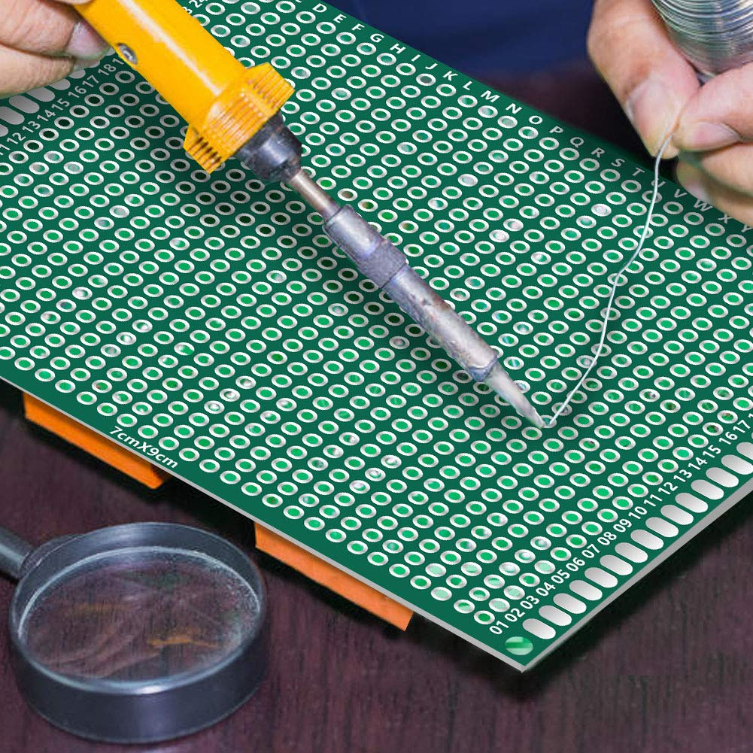
Fixing Oversights
Anything which was overlooked in development was added to a through hole board inserted behind our PCB
Pull up resistors
Pull down resistors
Crystal oscillator

Slide 26
Debugging
Most of the system was verifiable via inspection but still things did occasionally go wrong and when they did we debugged as follows:
We approached it this way once the battery, CC, and programming had been completed.
Check if everything had power Check if GPS sensor LEDs were on Check if OLED displayed anything Check if ALS was outputting properly | Check if head & tail light were working Check if reset button worked Check if turn signals work

Slide 27
Recommendations for Further Works
Adding USB charging ports to the bike
Added temperature sensors
Reverse geocoding using faster microcontroller
Simplifying the wiring of the system
Higher resolution color display with touch interface

Slide 28
Questions?

