Slide 1
Poker Chip Counting Companion
Adish Patil, David Hahn, Forrest Hare
Project 16
ECE 445

Slide 2
Agenda
Objective and Block Diagram
High Level Requirements
Physical Design
Video
App Design
Electrical Design
Conclusions and Further Improvements

Slide 3
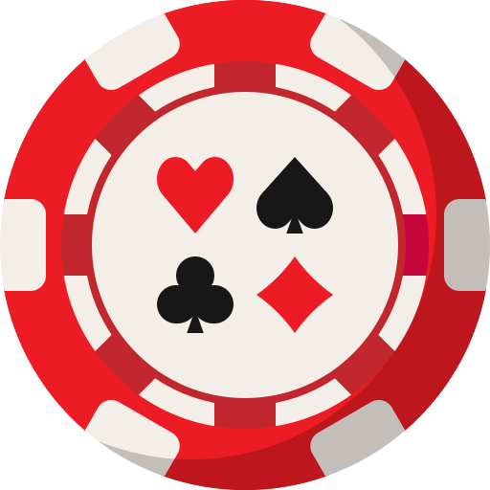
Objective
Problem: Hand counting poker chips leads to inaccuracies and is time consuming.
Solution: Create a product that accurately dispenses and counts poker chips with a paired phone application.
Benefits:
Precise chip counting
Quick game setup and collection time
Ease of use

Slide 4
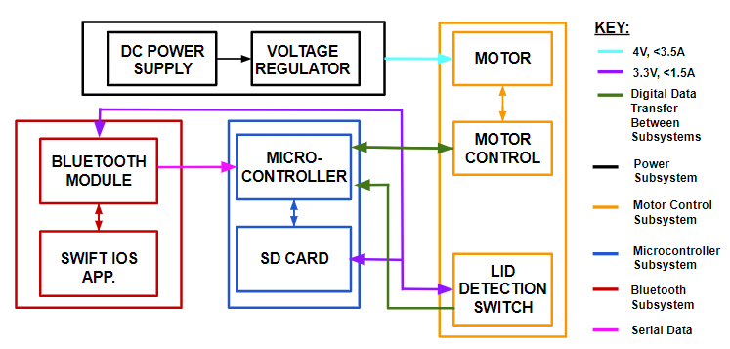
Block Diagram

Slide 5
High Level Requirements
Have a capacity of 100 poker chips
Dispense chips at a rate of 5 chips per second or faster
Receive and relay phone app information in 800ms or faster
Count player’s buy-outs in under 20 seconds

Slide 6
Project Video

Slide 7
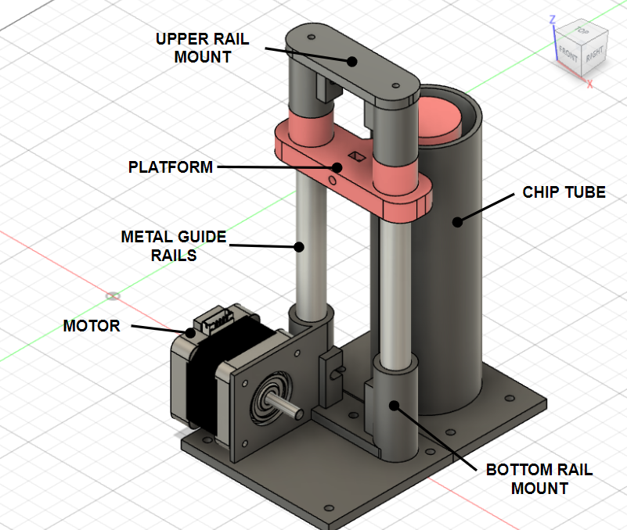
Hardware Design - Chip Elevator

Slide 8
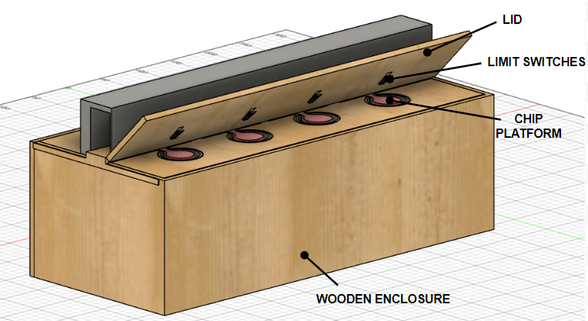
Hardware Design - Overall
Main Components:
Fiber Board Housing & Lid
3D Printed Chip Elevator
Limit switches
Stepper motors
PCB

Slide 9
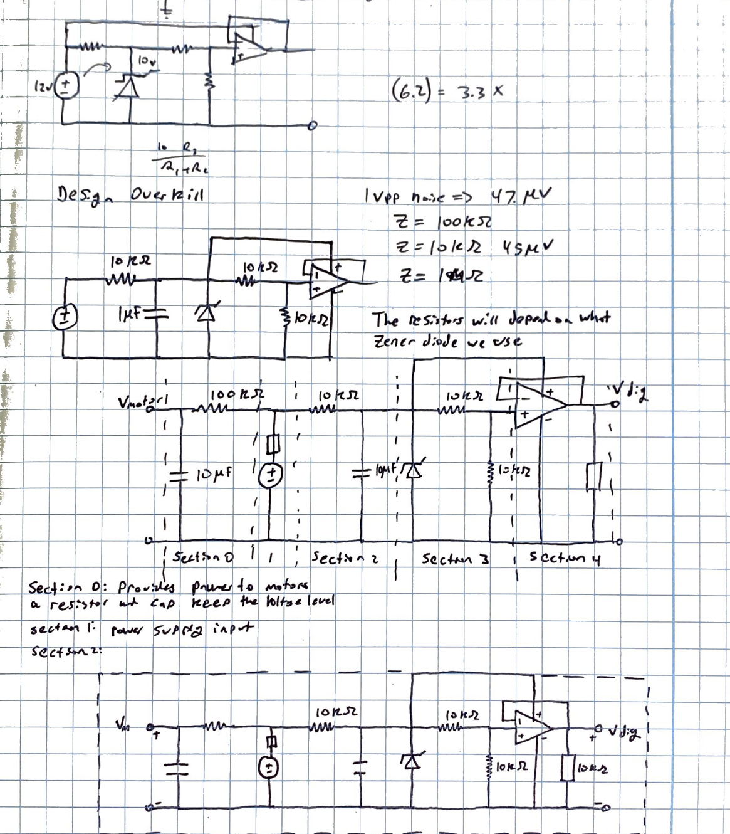
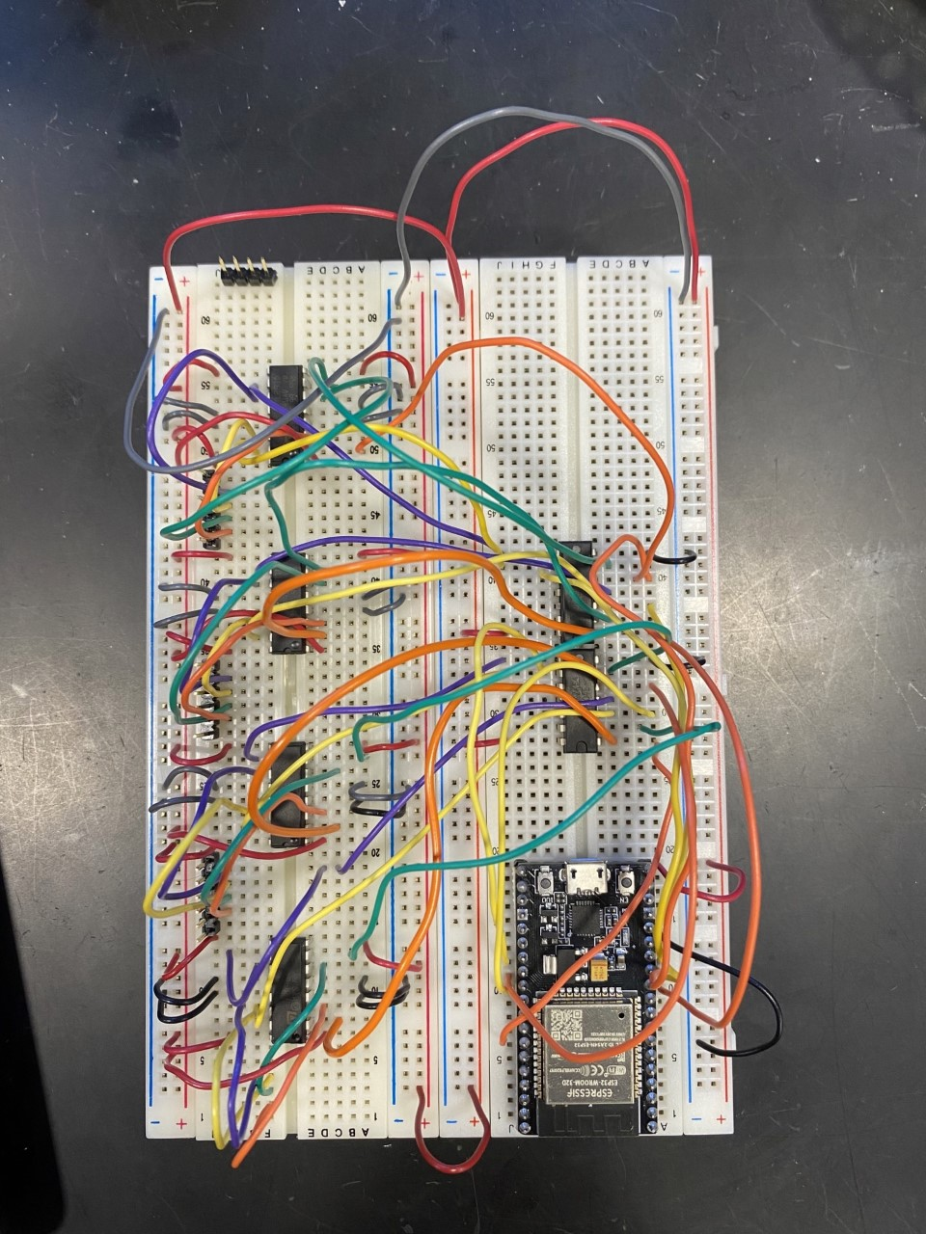
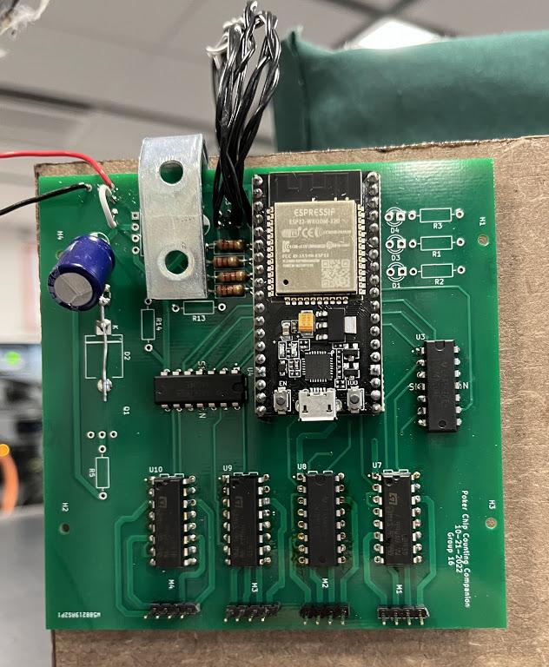
Breadboard & PCB
Schematic
Breadboard
PCB

Slide 10
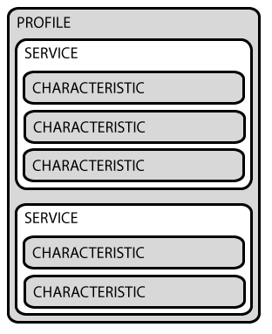
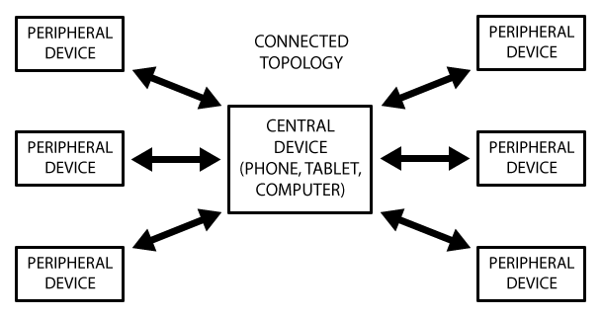
Bluetooth Low Energy GATT Communication
GATT (Generic ATTribute Profile) - The way two BLE devices transfer data back/forth using Services and Characteristics.
Needs a connection to allow two way communication.
User Mobile Application serves as a central manager.
Poker Chip Counting Companion is the peripheral with Read/Write services.

Slide 11
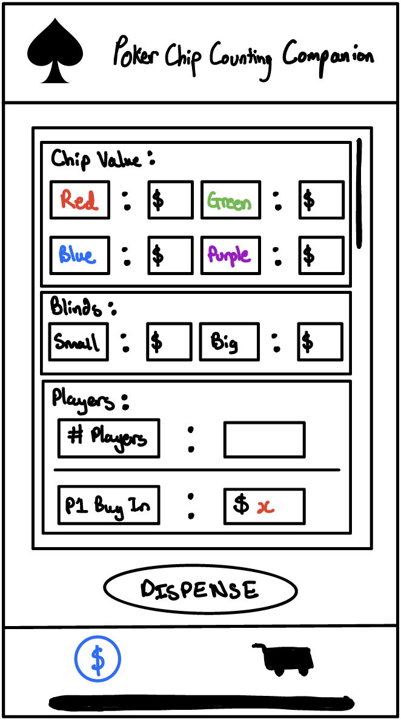
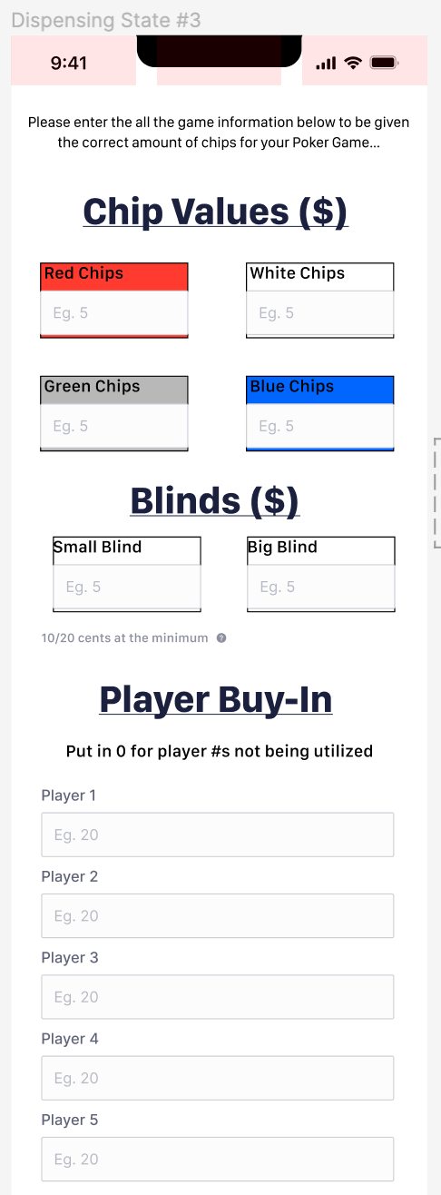
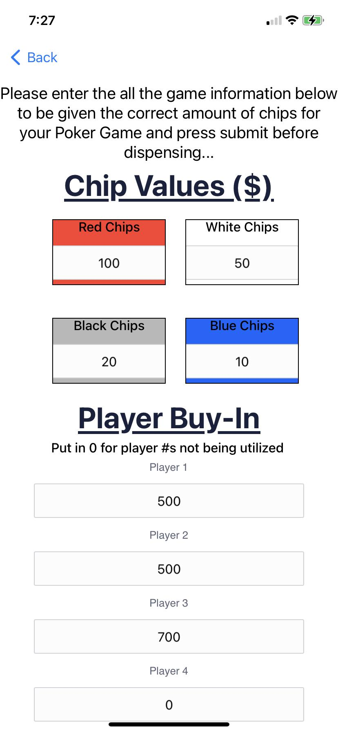
Mobile Application UI
UI underwent an iterative process from sketches to high prototypes on Figma.
Designs considered how we wanted users to interact with the application.
SwiftUI is an easy framework that uses declarative syntax to build UI.

Slide 12
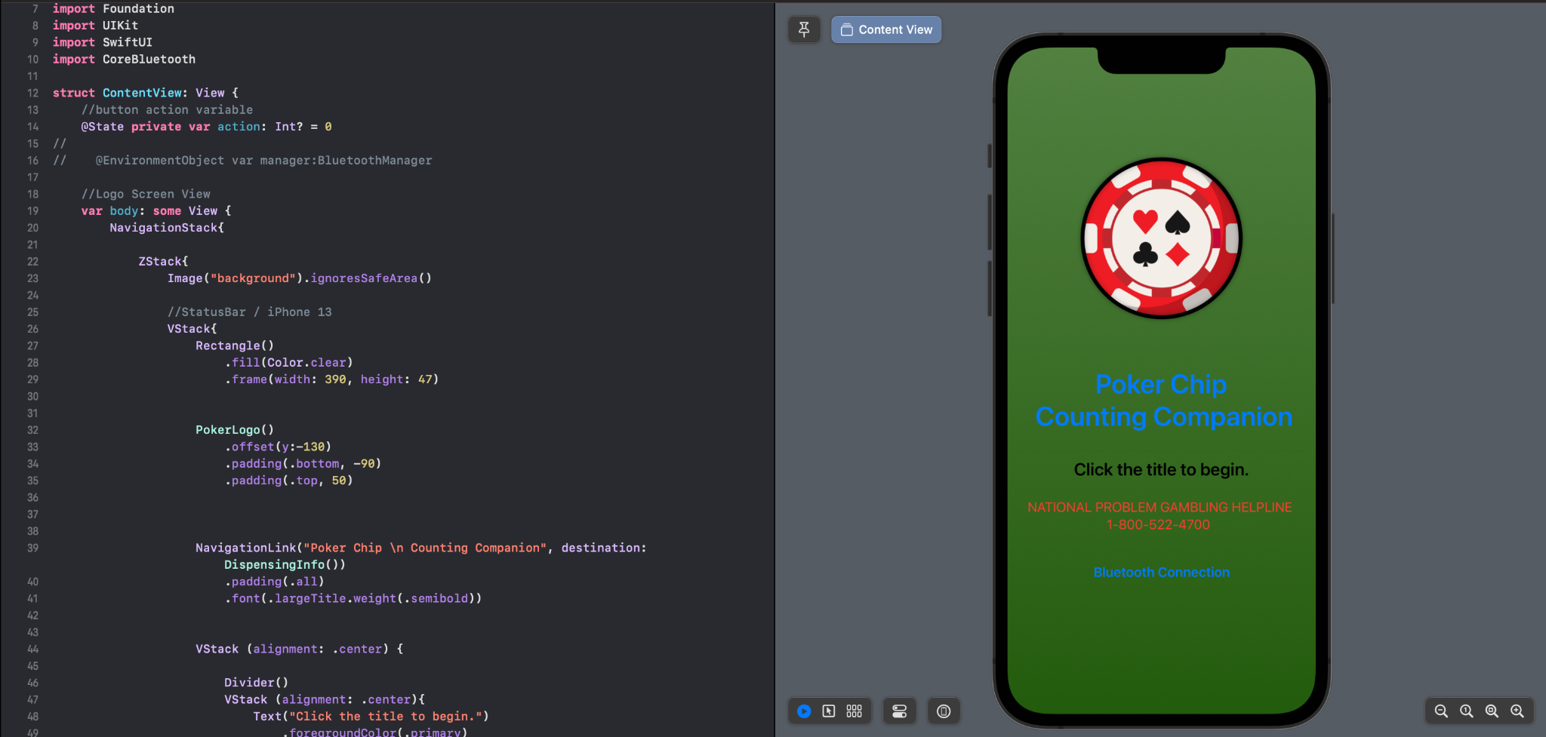
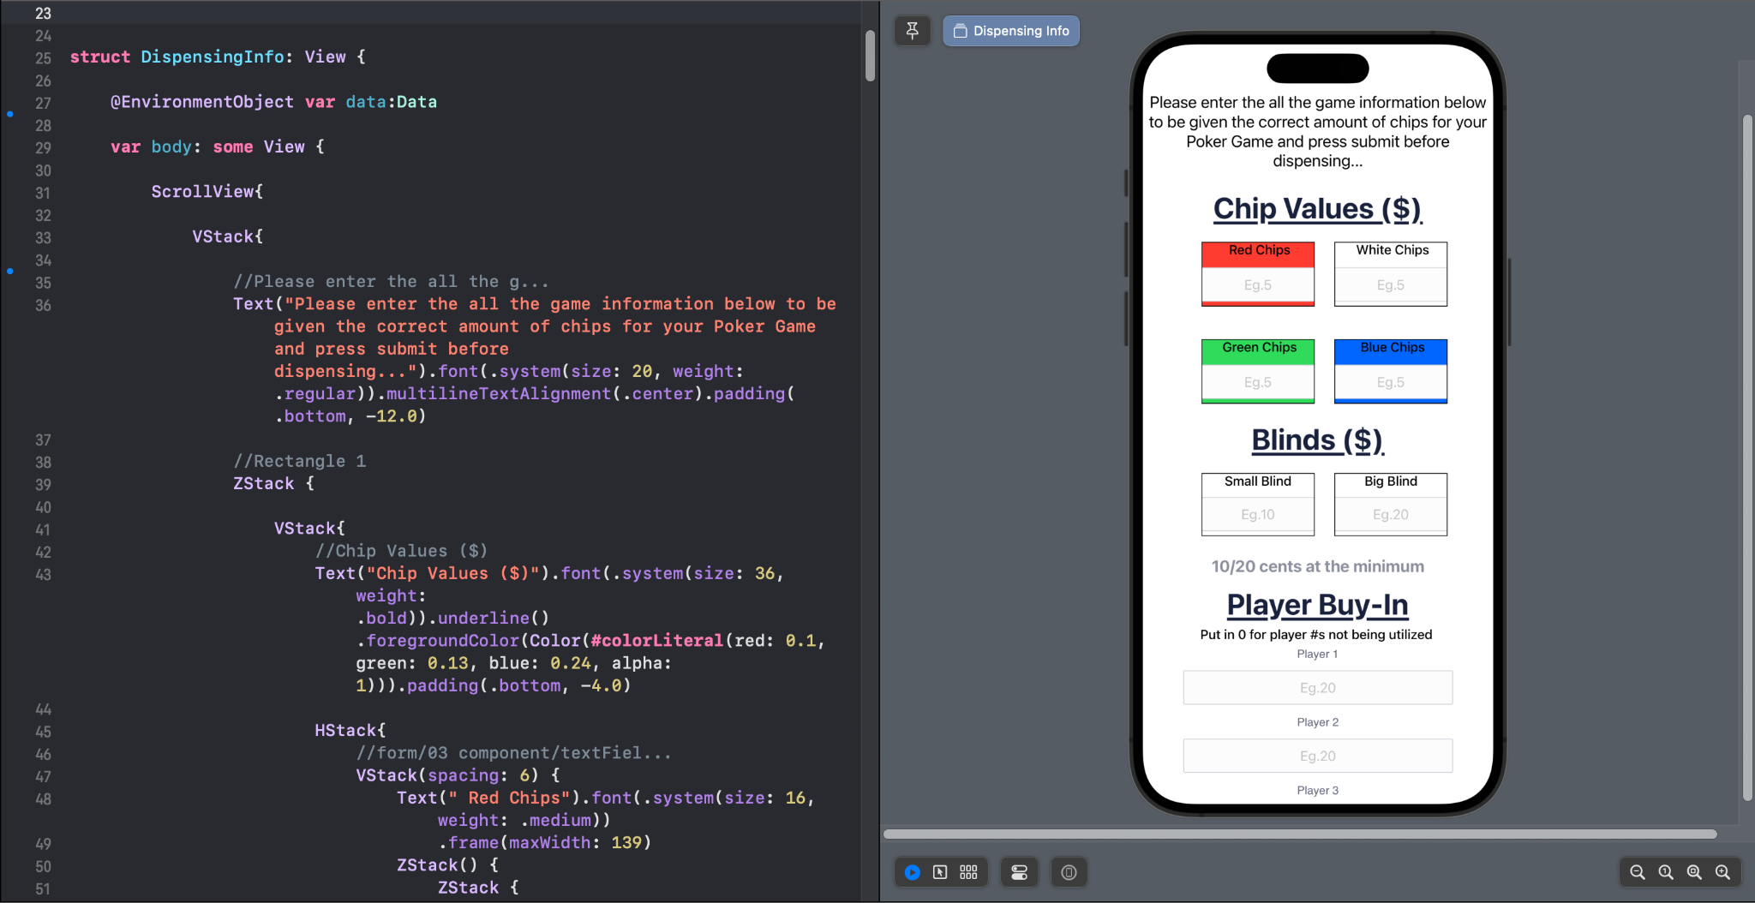
Swift Application
Swift is IOS development language.
User response via buttons and number input.
Helper classes/functions for data flow and computations.
Used Apple’s Core Bluetooth framework.

Slide 13
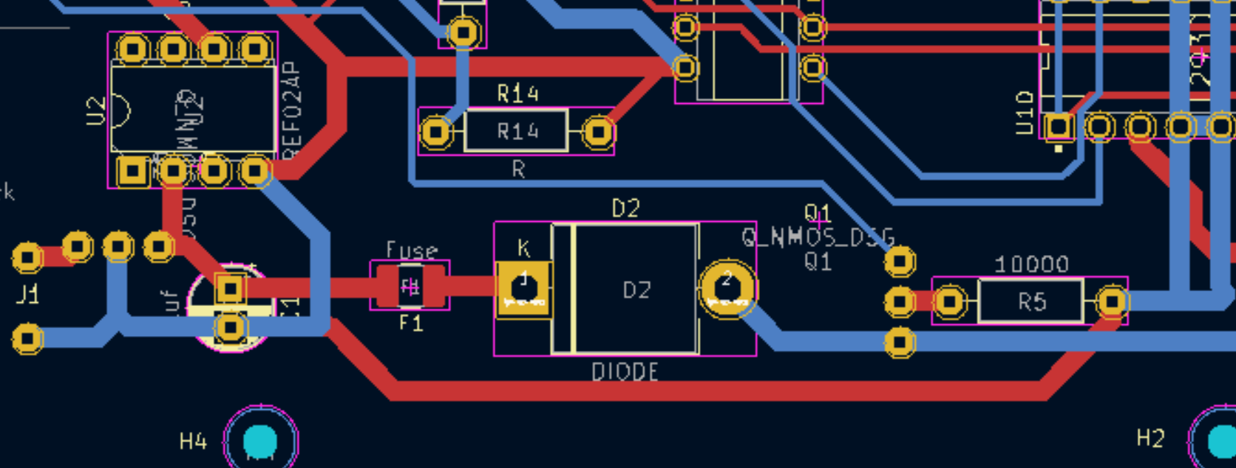
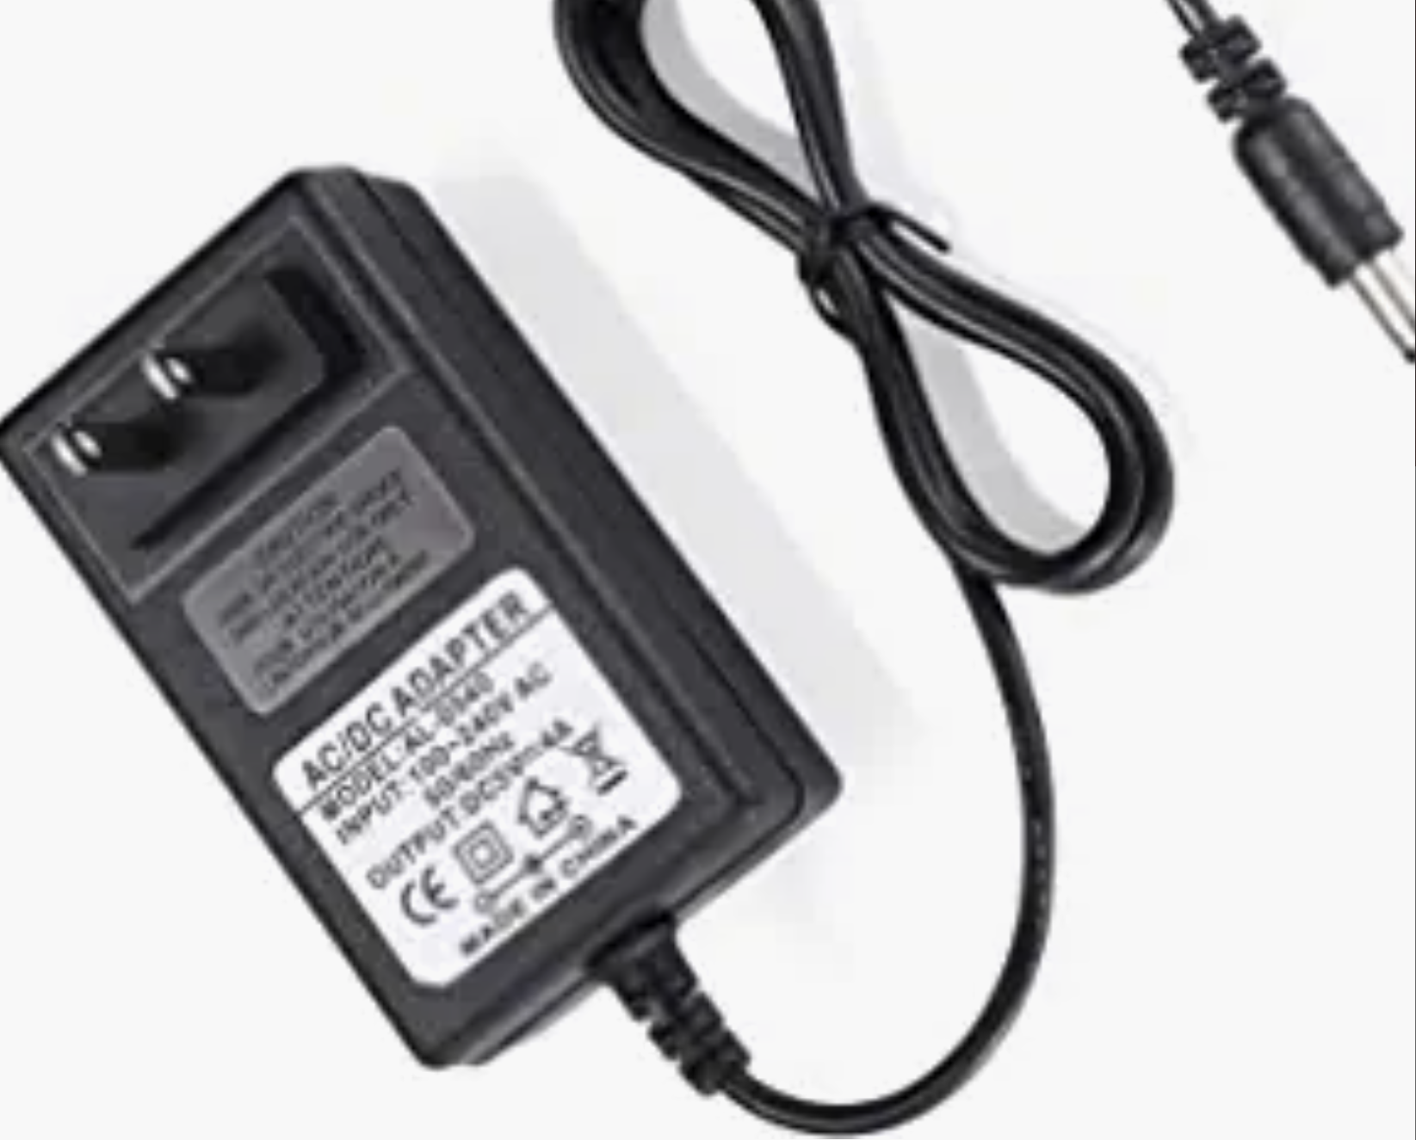
Power
Stepper Motors require more power than the control circuitry
For proper functionality and safety separate power systems were needed

Slide 14
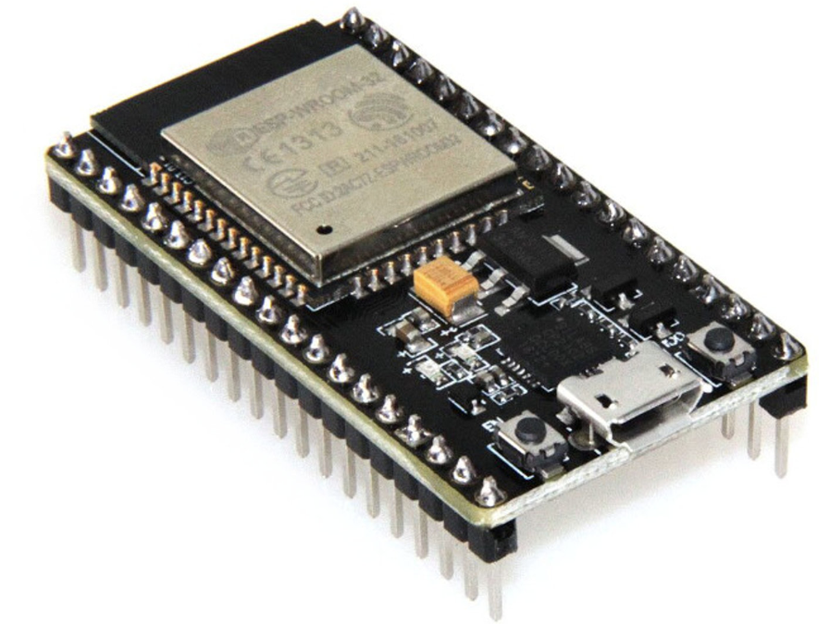
Microcontroller and Bluetooth
Bluetooth to get dispensing instructions from the app and send collection data back
Microprocessor to drive Bluetooth and give motor control signals

Slide 15
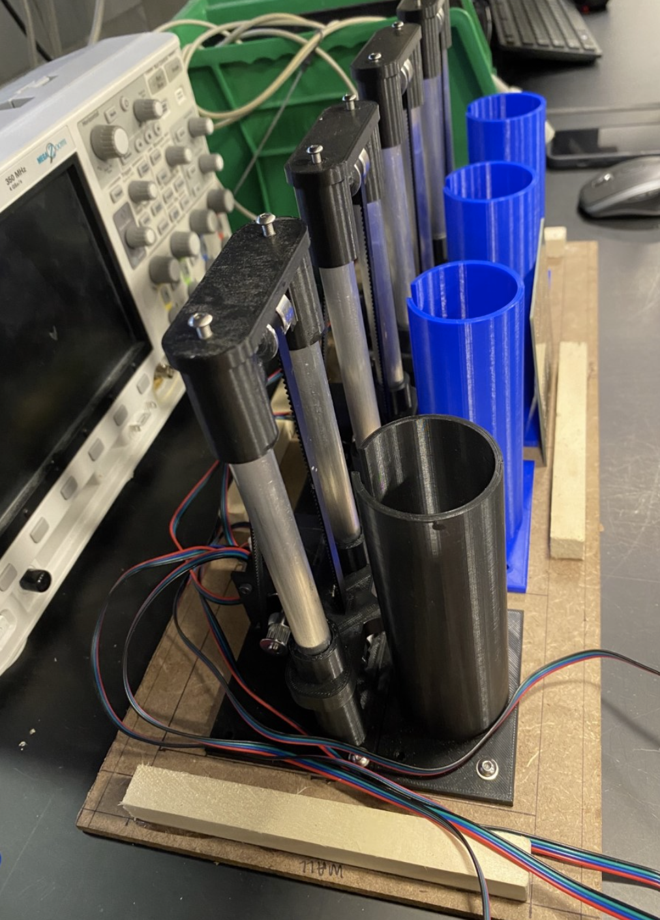
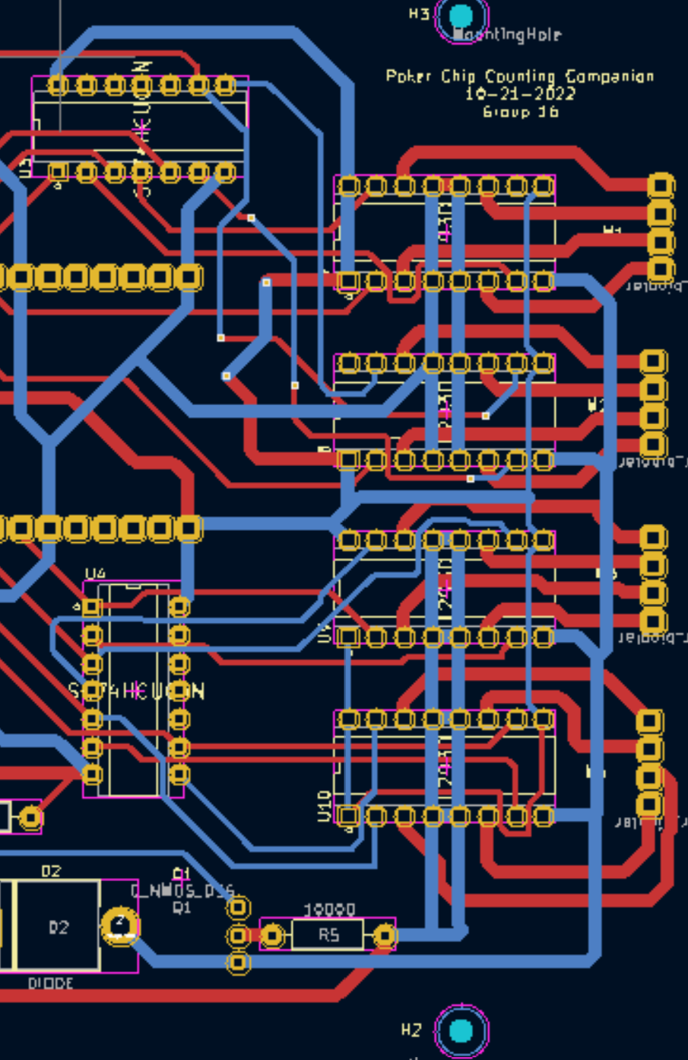
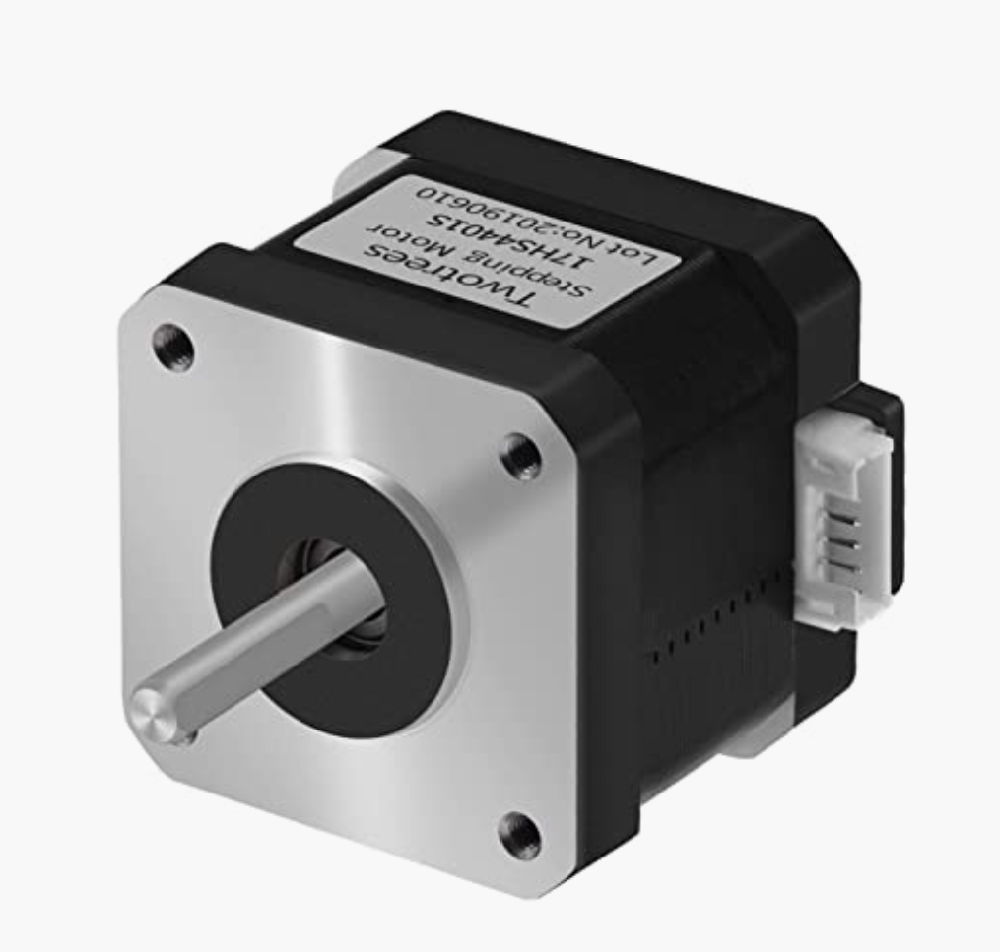
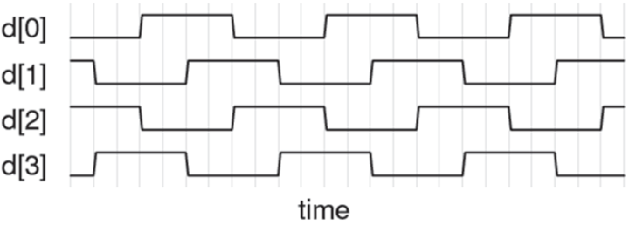
Motor Control System
H-Bridges to send control signals to the Stepper motors
Inverters to reduce the number of pins used on the microprocessor

Slide 16
Reading
Average | 9.6 ms
Writing
Average | 13.6 ms
Number of Chips Requested [Dispensing] | Time (ms) | Number of Chips given | Chips per Second
5 | 230 | 5 | 21.73
 |  | Average: | 23.692
Collection | Number of Chips Placed | Time (s) | Chips Counted
1 | 15 | 3.65 | 15

Slide 17
Conclusions
High Level Accomplishments
8,300% faster reading speed
5,882% faster writing speed
473% faster dispense speed
Collection Speed under 20s
What We Learned
Double check designs
Order components early
Test extensively
Solder carefully

Slide 18
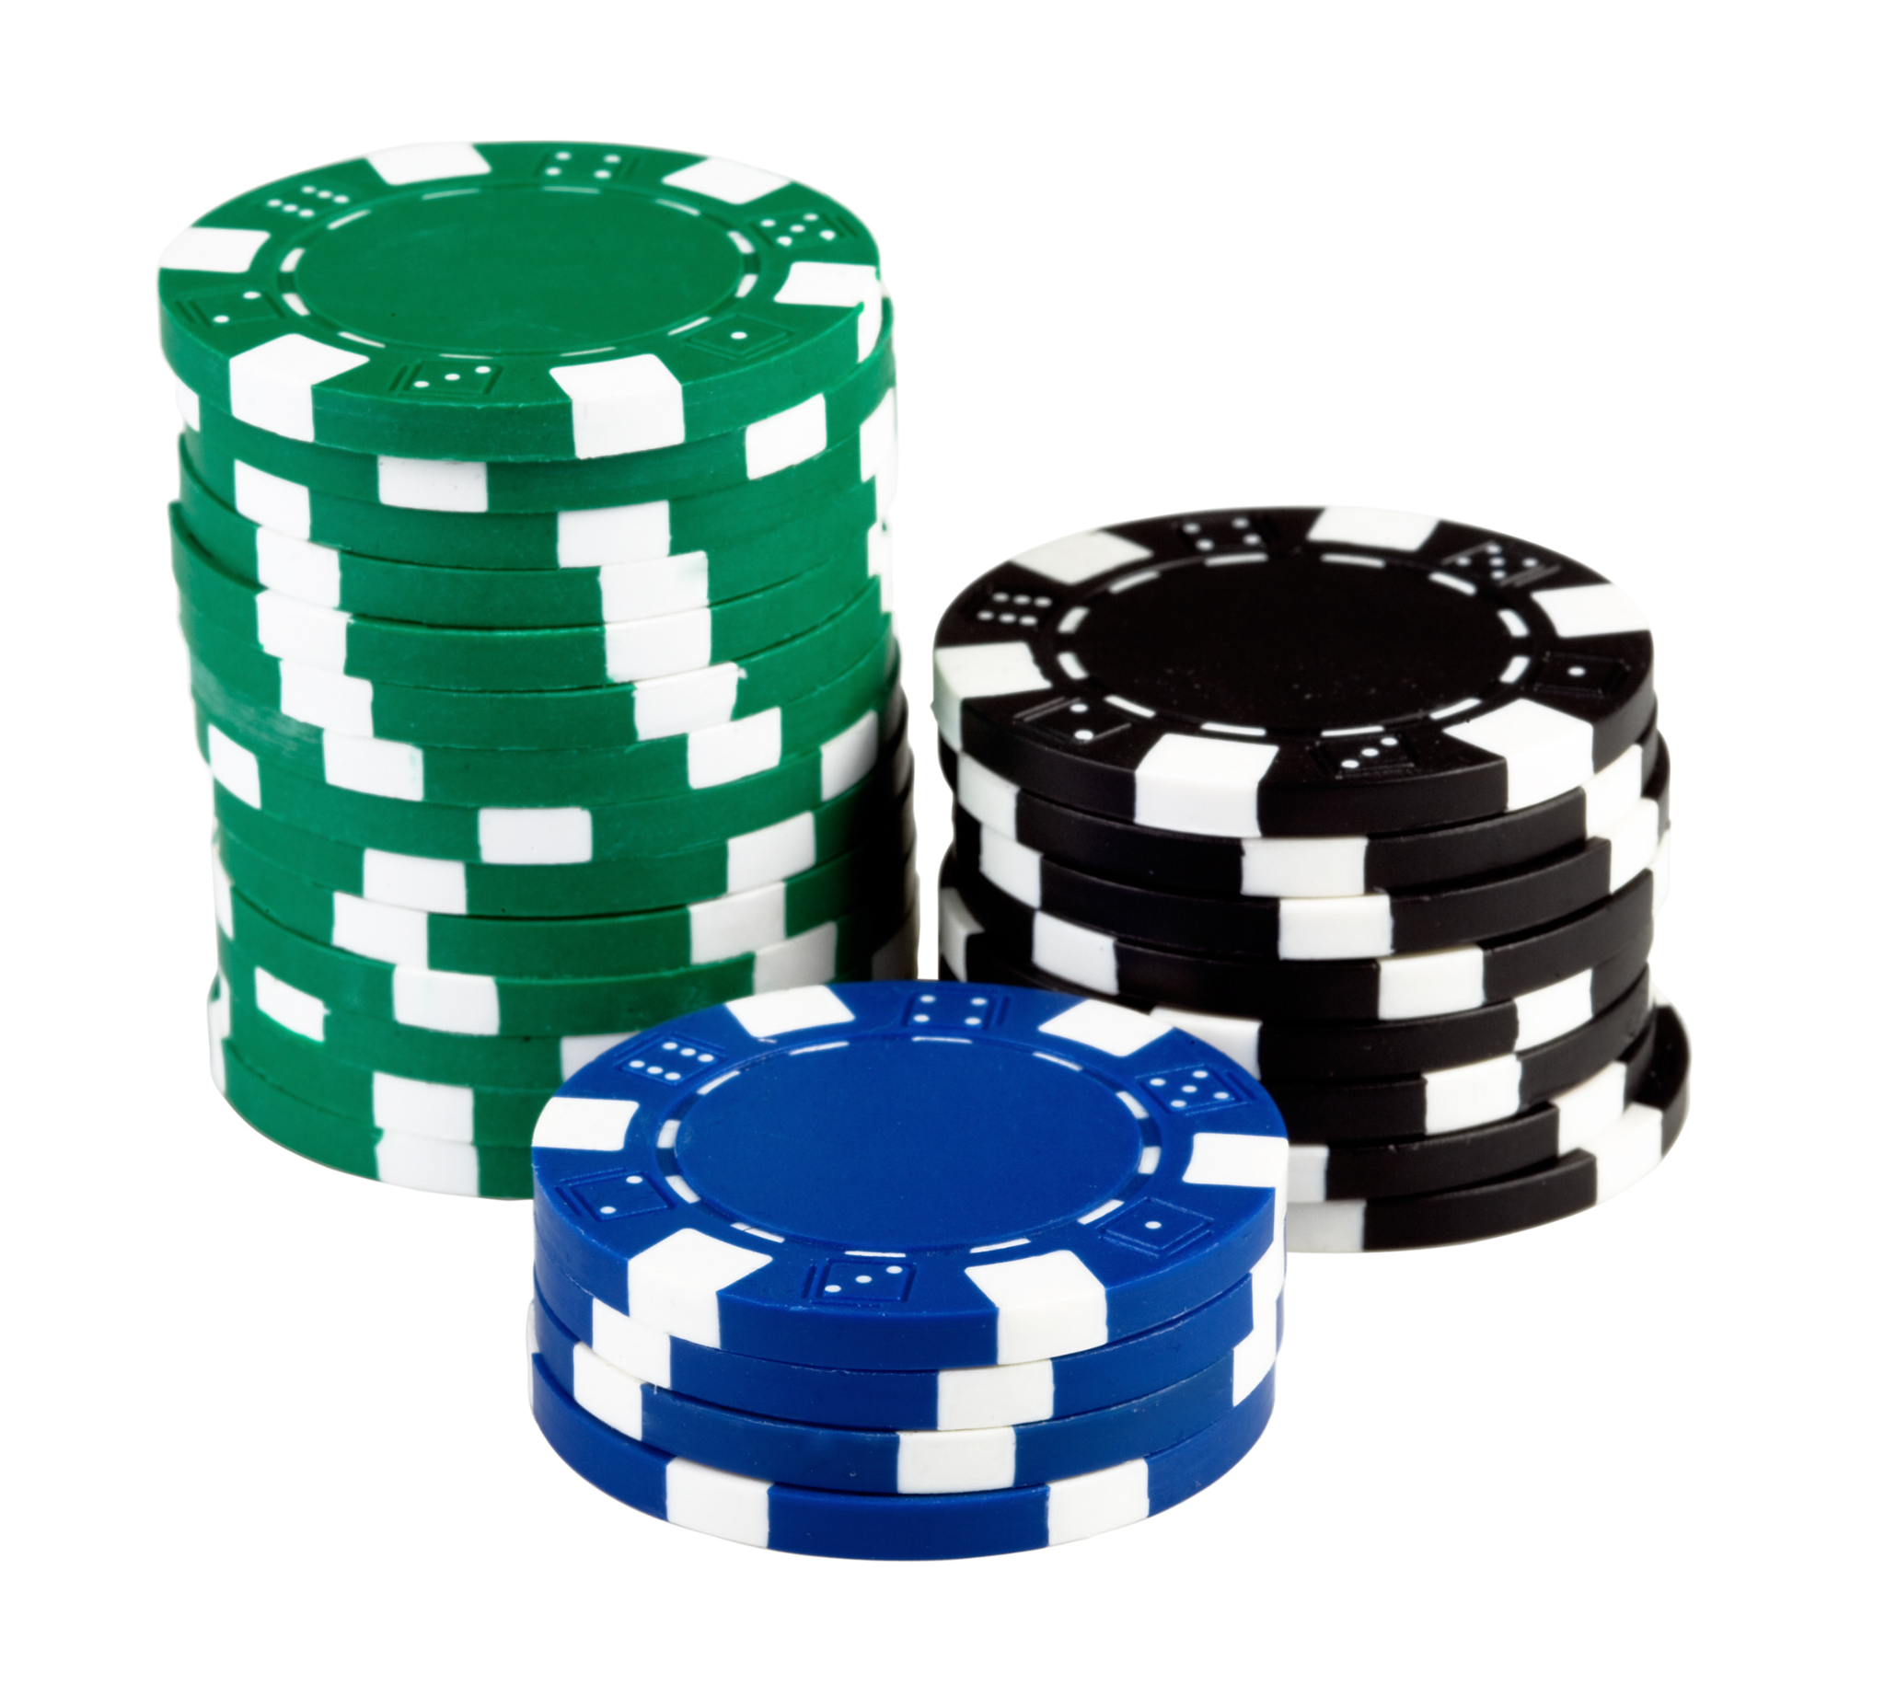
Further Improvements
More precise chips
Synchronous Motor control
Custom Power Supply
Rebuy option in App
Updated PCB

Slide 19
Thank You!

