Slide 1
Automated NBA Game Clock Stopper
ECE 445 / Team 36
Rahul Harikrishnan, Pranav Saboo, Saud Tahir
May 2, 2022
Notes:
Saud

Slide 2
Introduction and Objective
Automating the detection of a made shot.
Problem
Game clock operator manually stops the clock
Delay due to human reaction time
These delays can add up
ECE 445 / Team 36
GRAINGER ENGINEERING
Notes:
Saud

Slide 3
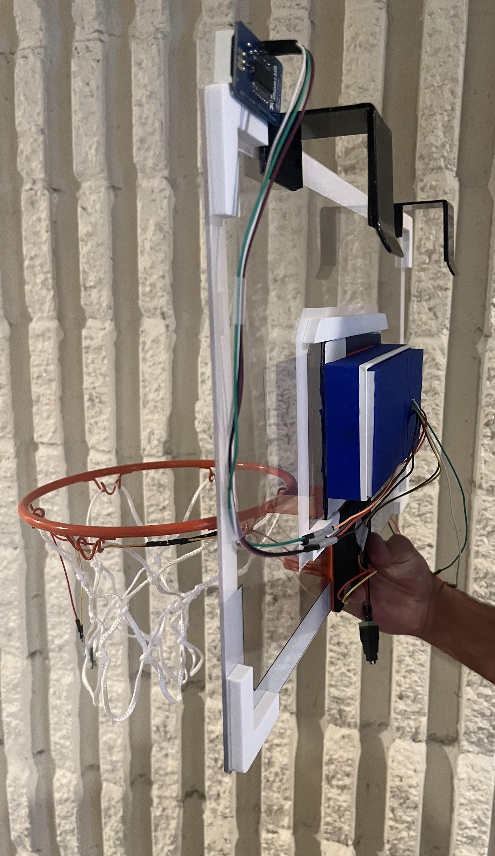
Introduction and Objective
Automating the detection of a made shot.
Solution
Light sensor to detect the ball passing through the bottom of the net
Sensor outputs data to our processing subsystem
Processing subsystem stops the clock when necessary
ECE 445 / Team 36
GRAINGER ENGINEERING
Notes:
Saud

Slide 4
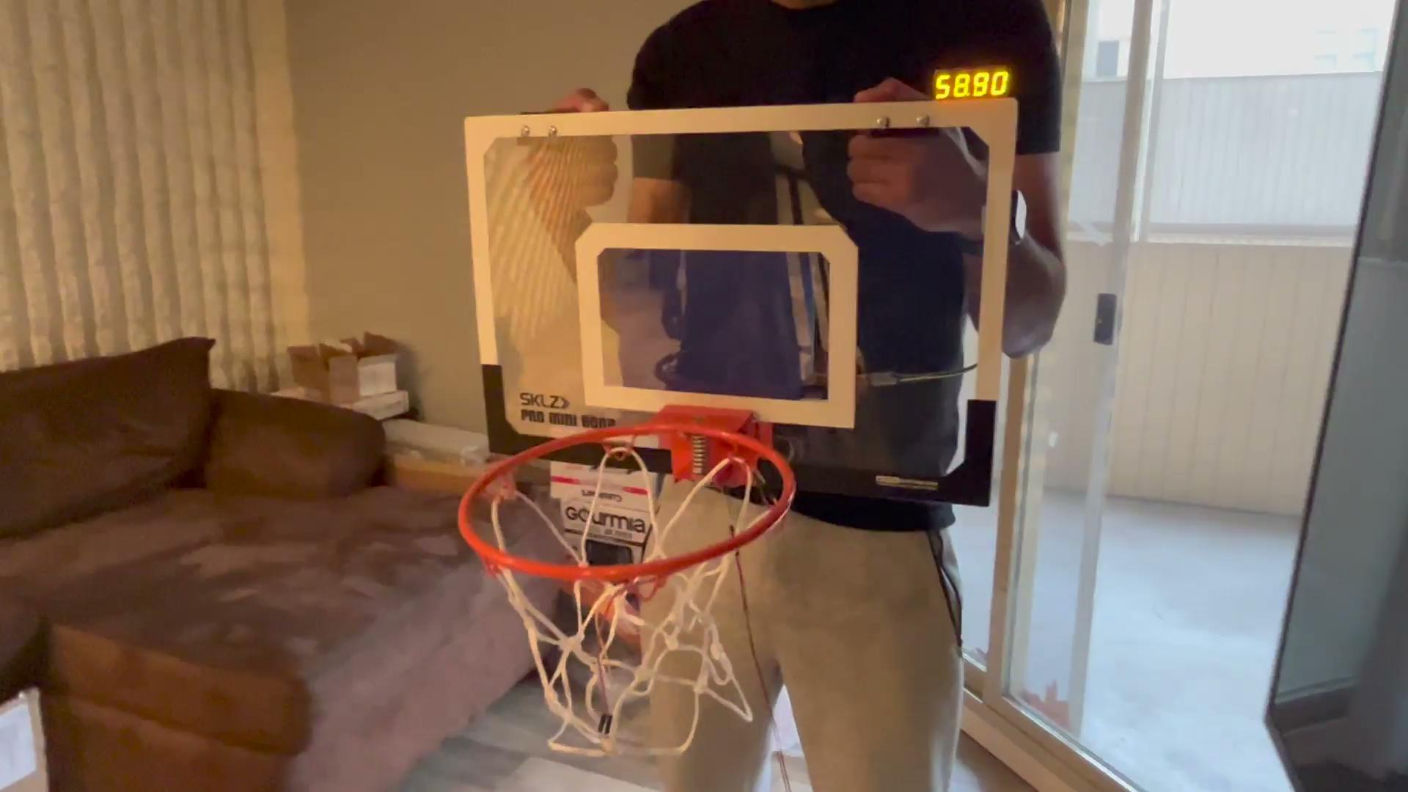
Demonstration Video
ECE 445 / Team 36
GRAINGER ENGINEERING
Notes:
Saud

Slide 5
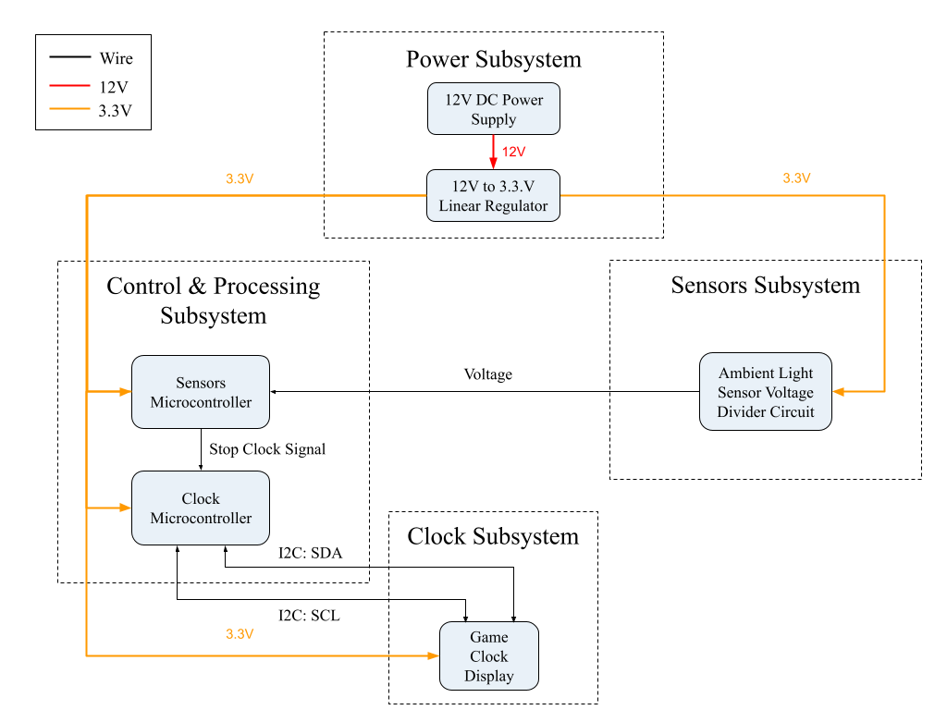
Block Diagram
ECE 445 / Team 36
GRAINGER ENGINEERING
Notes:
Pranav

Slide 6
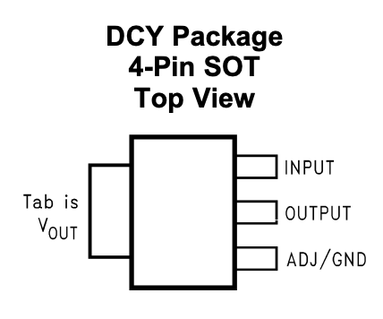
Power Subsystem
Delivers power to all components.
12V DC Power Supply
12-to-3.3V Linear Regulator
3.3V used to power all components
Why use a linear regulator over a buck converter?
Higher efficiency of buck converter was not worth the tradeoff of higher power supply noise and complexity
ECE 445 / Team 36
GRAINGER ENGINEERING
Notes:
Pranav

Slide 7
Power Subsystem Verification
Voltage Output of DC Power Supply
Theoretical Voltage (V) | Measured Voltage (V) | Verified?
12 | 11.996 | Yes
Voltage Output of Linear Regulator Over 30 Seconds
Timestamp (sec) | Theoretical Voltage (V) | Measured Voltage (V) | Verified?
0 | 3.30 | 3.296 | Yes
10 | 3.30 | 3.287 | Yes
20 | 3.30 | 3.292 | Yes
30 | 3.30 | 3.295 | Yes
ECE 445 / Team 36
GRAINGER ENGINEERING
Notes:
Pranav

Slide 8
Control & Processing Subsystem
Determines when to stop the clock.
2x ATTiny45V microcontrollers
Sensors microcontroller determines made shot
Clock microcontroller runs the game clock
Why use two microcontrollers?
ATTiny45V does not support multithreading
Need to simultaneously collect sensor data and run clock
ECE 445 / Team 36
GRAINGER ENGINEERING
Notes:
Rahul

Slide 9
Control & Processing Subsystem Images
ECE 445 / Team 36
GRAINGER ENGINEERING
Notes:
Rahul

Slide 10
Control & Processing Subsystem Verification
Sensors Microcontroller PB1 Voltage Output for Threshold of 1.65V
Input Voltage to ADC Pin (V) | Expected Voltage Output (V) | Measured Voltage Output (V) | Verified?
0 | > 2.4 | 3.265 | Yes
0.5 | > 2.4 | 3.277 | Yes
2.4 | < 0.5 | 0.122 | Yes
3.3 | < 0.5 | 0.131 | Yes
ECE 445 / Team 36
GRAINGER ENGINEERING
Notes:
Rahul

Slide 11
Clock Subsystem
Displays Game Clock.
4-digit 7-segment display
I2C Backpack Converter
Why not use a traditional 4-digit 7-segment display?
Limited number of outputs from microcontroller and increased complexity
I2C: SCL
I2C: SDA
ECE 445 / Team 36
GRAINGER ENGINEERING
Notes:
Rahul

Slide 12
Clock Subsystem Verification
Clock Output for ADC Input Threshold of 1.65V
Input Voltage to ADC Pin (V) | Expected Clock Output | Observed Clock Output | Verified?
0 | Stops within 0.3s | Stops within 0.1s | Yes
0.5 | Stops within 0.3s | Stops within 0.1s | Yes
2.4 | Running | Running | Yes
3.3 | Running | Running | Yes
ECE 445 / Team 36
GRAINGER ENGINEERING
Notes:
Rahul

Slide 13
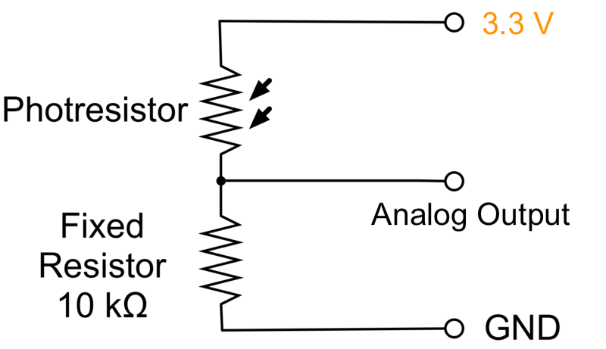
Sensors Subsystem
Detects ambient light level.
Photoresistor in a voltage divider circuit
Analog output voltage from 0 to 3.3V
Made shot → photoresistor resistance increases → output voltage decreases
Empty basket → photoresistor resistance decreases → output voltage increases
Voltage
(to control & processing)
ECE 445 / Team 36
GRAINGER ENGINEERING
Notes:
Saud

Slide 14
Sensors Subsystem Verification
Clock and Sensor Output on Made Shots from 18° Increments with Threshold of 1.65V
Position of Shot (°) | Sensor Voltage Output (V) | Clock Output | Verified?
0 | 1.243 | Stops | Yes
18 | 0.984 | Stops | Yes
36 | 0.865 | Stops | Yes
… | … | … | …
144 | 0.869 | Stops | Yes
162 | 1.042 | Stops | Yes
180 | 1.003 | Stops | Yes
ECE 445 / Team 36
GRAINGER ENGINEERING
Notes:
Saud

Slide 15
Sensors Subsystem Verification
Clock and Sensor Output on Missed Shots from 18° Increments with Threshold of 1.65V
Position of Shot (°) | Sensor Voltage Output (V) | Clock Output | Verified?
0 | 1.888 | Running | Yes
18 | 1.936 | Running | Yes
36 | 2.342 | Running | Yes
… | … | … | …
144 | 2.784 | Running | Yes
162 | 2.132 | Running | Yes
180 | 2.457 | Running | Yes
ECE 445 / Team 36
GRAINGER ENGINEERING
Notes:
Saud

Slide 16
Successes & Challenges
Successes
Every subsystem was successfully verified
Delay between made shot and clock stoppage is less than 0.1 seconds
Clock achieves over 90% accuracy on attempted shots
Challenges
I2C communication with original light sensors failed
Results are very sensitive to environment lighting fluctuations
Microcontroller doesn’t support multithreading
ECE 445 / Team 36
GRAINGER ENGINEERING
Notes:
Pranav

Slide 17
Conclusion
What we learned…
I2C Communication Protocol
Adjusting designs based on feedback
Understanding datasheets and ensuring part compatibilities
What would you do differently?
Create specialized PCBs to handle the separate programs
Add stability to the sensor location to ensure it stays in the correct orientation
Test entire system on standard indoor basketball hoop
ECE 445 / Team 36
GRAINGER ENGINEERING
Notes:
Pranav

Slide 18
Recommendations for Further Work
Improving upon our product in the future.
Ability for game clock operator to start the clock upon inbounding
Automatic detection to determine if the game is in the last two minutes
Option for game clock operator to override the displayed clock value
Creating a second system to simulate real game clock management
Testing in recreational game setting
ECE 445 / Team 36
GRAINGER ENGINEERING
Notes:
Rahul

Slide 19
Thank You
ECE 445 / Team 36
GRAINGER ENGINEERING

