Slide 1
Self-Contained Analytical Skating Form Tracker
Team 38
Jonathan Wang, Qian Ma, Charles Hu

Slide 2
Motivation
High risks of injury related to ice-skating
Learning to skate well is time intensive and/or expensive
No products available that evaluates skating form
Goal
Build a tool for quantizing and logging skating form
Meant as a teaching guide or supplementary tool
Affordable and easy to use for the public

Slide 3
System Overview
Two hardware devices that collect movement data while a user is skating
Loads data into software that runs calculation and provide visualization
Device Features
Wearable, lightweight, non-intrusive
Master and slave device communication
Push buttons for user control
Data portable to computer

Slide 4
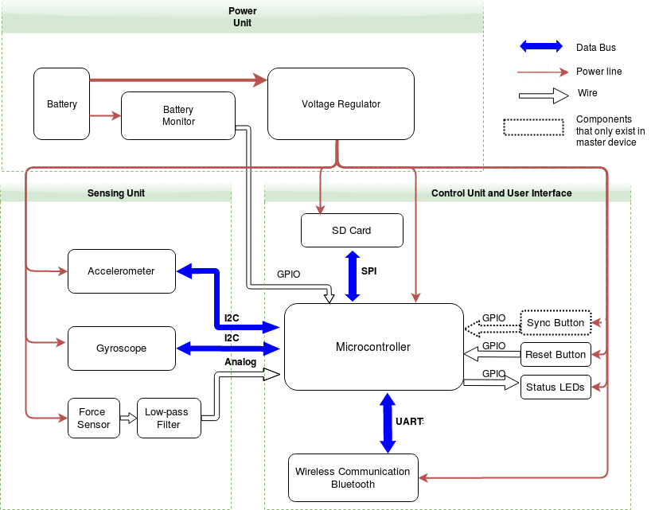
Notes:
We separate our two devices into a master and a slave unit. The two units are nearly identical, so I will focus my discussions on the master device.
Our device is split into three units, shown in this block diagram.
On the top we have the power unit, which consists of a standard 9V battery, a battery capacity monitor, and a voltage regulator that provides a steady 3.3 volt rail which is used by the rest of our device.
On the bottom left is our sensing unit, which consists of an accelerometer and gyroscope, packaged into a single inertial measurement unit, as well as two force sensors, of which only one is shown, that is connected to an analog low pass filter.
On the bottom right is our control unit, consisting of a microcontroller, a bluetooth controller, an sd card port, and two buttons

Slide 5
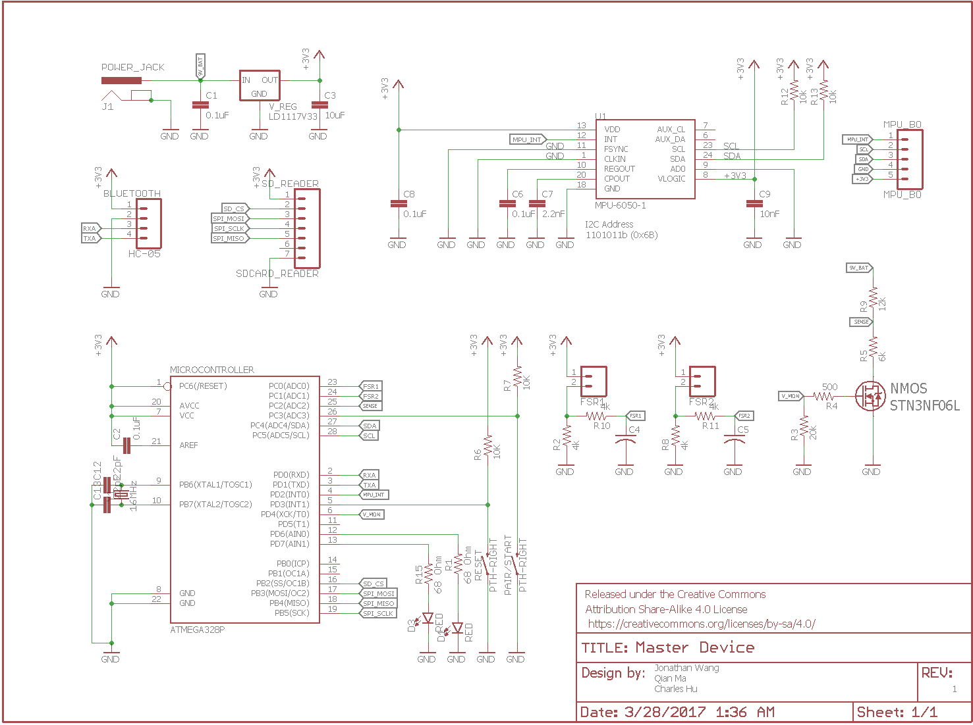

Slide 6
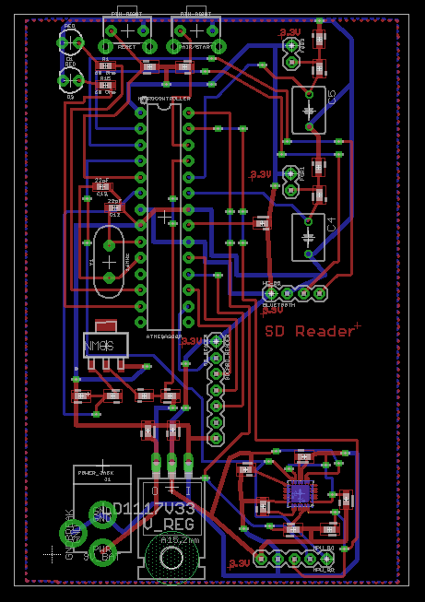
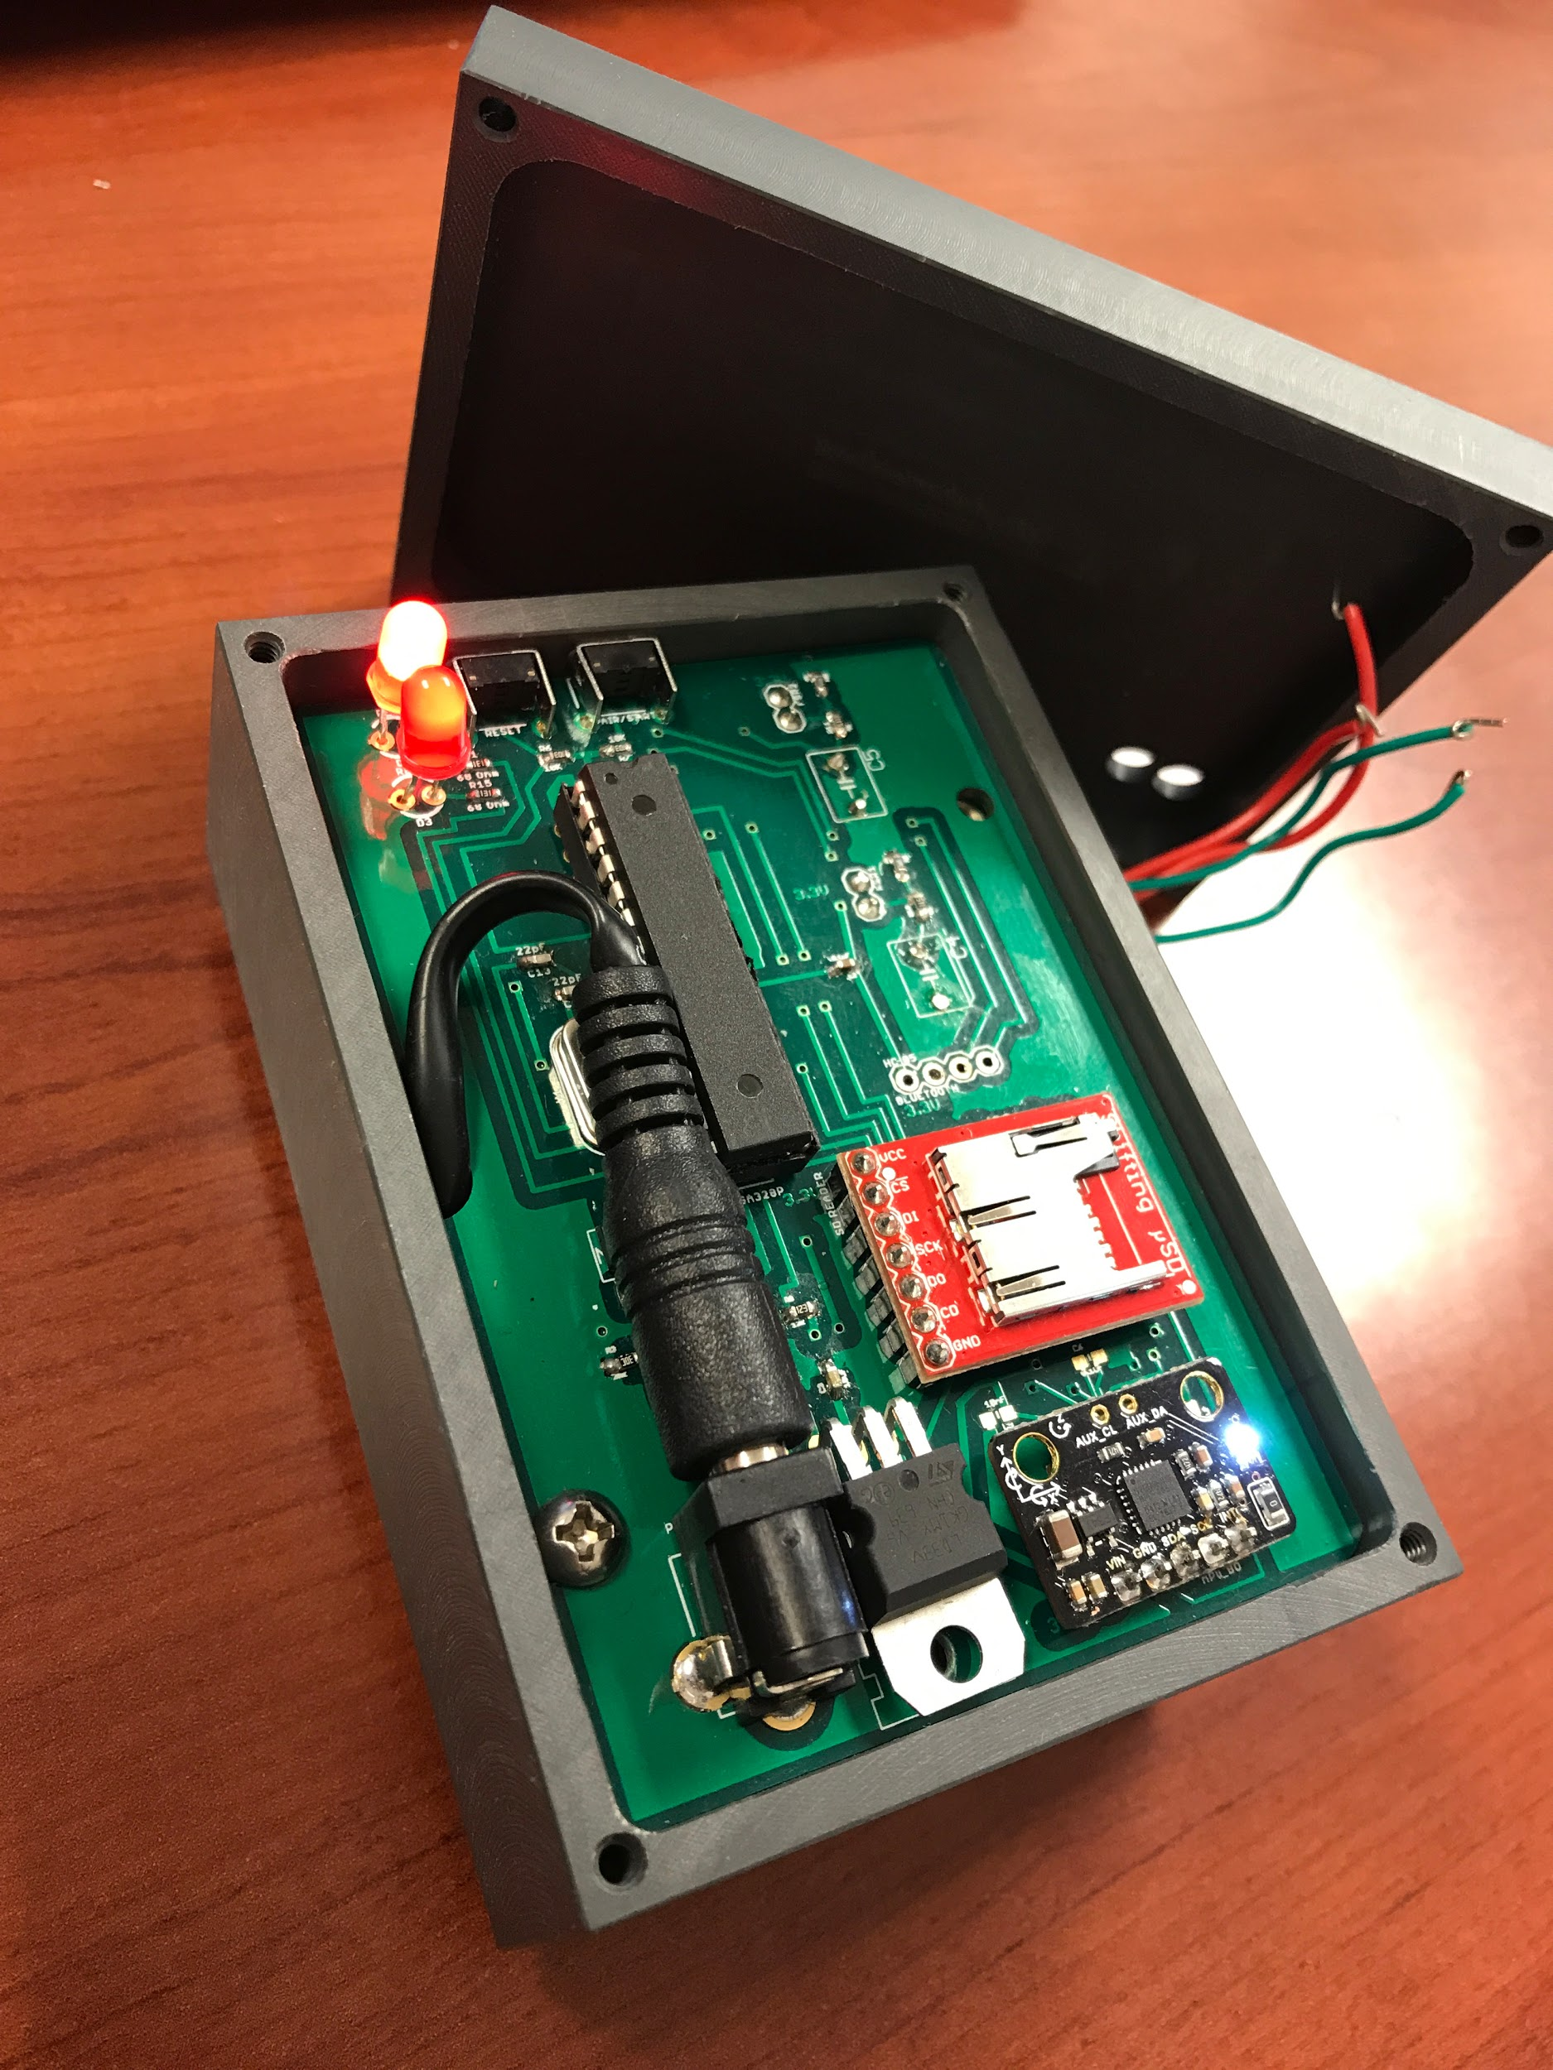
Notes:
PCB layout, prototype container with hardware integrated

Slide 7
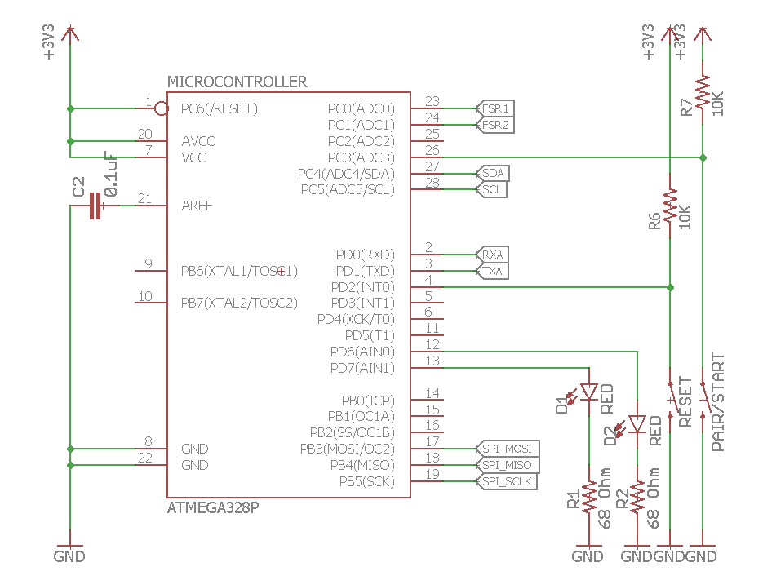
Control Unit
Microcontroller Unit (MCU)
Supports SPI, I2C, UART protocols
Reads analog voltages
FAT file format support for SD
Embedded FSM
Notes:
Now we will go into the details of our units and components.
The purpose of the MCU is to interface between the different modules. It polls data from the IMU via I2C, writes into the SD card via SPI, and talks with the other device using UART
We chose to use an ATmega328p for its versatility in supporting all the communication protocols and drivers we needed, while being powerful enough for it not to negatively affect data logging performance.he different modules.

Slide 8
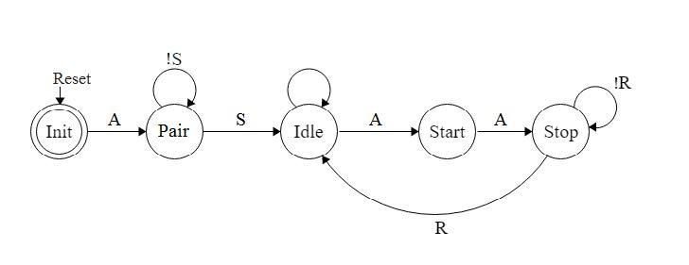
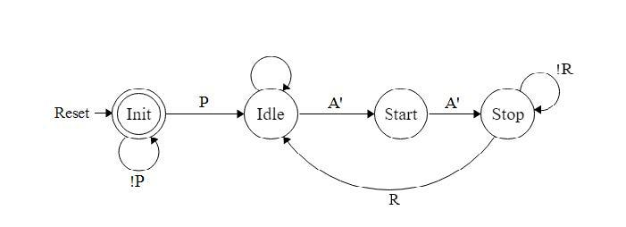
Control Unit Cont’d
Master Device
Finite State Machine
Written in C
Uses Pin-Change Interrupts
Special care taken to fully utilize 512-byte write buffer for SD
Slave Device
Notes:
Our finite state machine in the MCU is written in C, and uses pin-change interrupts which runs a special function that changes device state when the button is pressed.
The main differences between the master and slave device are the init states. The master starts in an init state and has to be put manually into the pairing state, whereas the slave starts automatically in the pairing state. Once pairing is successful, both devices automatically remain in an idle state. The master’s action button will control the state of both devices, toggling it between data collection, data transmission, and idle.
In our main data collection loop, special care is taken to optimize the 512-byte write requirements of the FAT format to ensure optimal SD writing speeds.

Slide 9
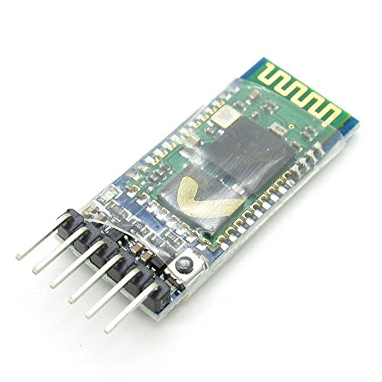
Control Unit Cont’d
Bluetooth Module (HC-05/06)
UART Baud Rate of 115200
Serial Port Profile (SPP) - bridges UART
Master device binded with slave device
Establish connection within 1 second
Notes:
We acquired the HC-05 module as it is a low-cost and robust device that supports the Serial Port Profile (SPP)

Slide 10
Control Unit Cont’d
Verification
Hardware timer was utilized to limit 31.25 polls per second
Data collection was timed, and the number of data points recorded
Bluetooth data transmission captured with a serial port connected to a laptop
Notes:
The focus of our control unit verification was on timing. As a data logger we have a strict timing requirement in that the data collection rate has to be constant for ease of analysis. To meet this requirement, a hardware timer was utilized to limit the polling rate to 31.25 per second. To verify this, data collection was timed, and the amount of data recorded was counted to see if it matched the required polling rate.
In order to verify that our bluetooth was not producing errors at 115.2k baud, we captured the data transmission through a serial port on the pc for a long period of time, and verified that the outputs were correct.

Slide 11
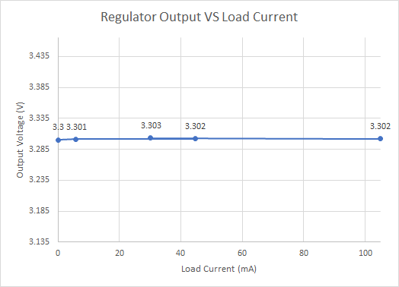
Power Unit
9V Battery and Voltage Regulator
Battery Voltage must remain above 4.3V after one hour of operation
Output voltage must be regulated to 3.3V ± 5% at different load currents

Slide 12
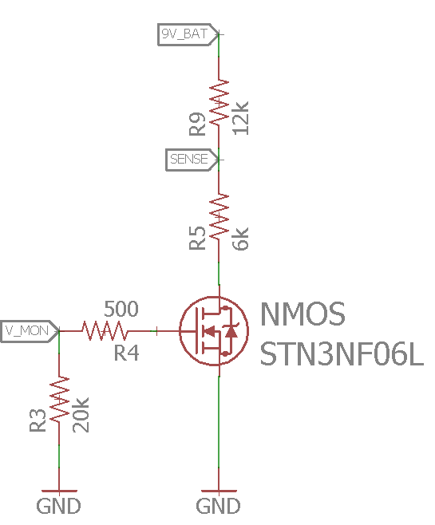
Power Unit Cont’d
Low-voltage Monitor
MCU reads analog value and converts to corresponding battery voltage
If the battery is below 4.3V, system enters error state, operations halt
Probe voltage periodically to reduce power consumption
Notes:
淼

Slide 13
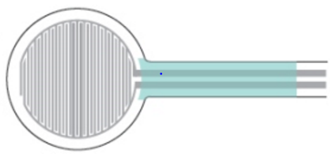
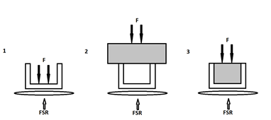
Sensing Unit
Force Sensitive Resistor (FSR) and Low-pass Filter
Two FSRs per skate
Measurement result needs to be accurate within ±10% of the theoretical value
Passive filter applied to output signal
Notes:
淼

Slide 14
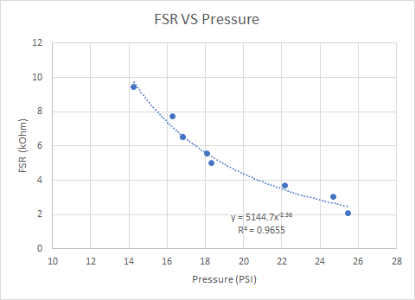
Sensing Unit Cont’d
FSR Test Results
Data displayed overall power curve
R-squared ⁤≧ 0.95
Outliers potentially due to inconsistencies in force actuation
Notes:
淼

Slide 15
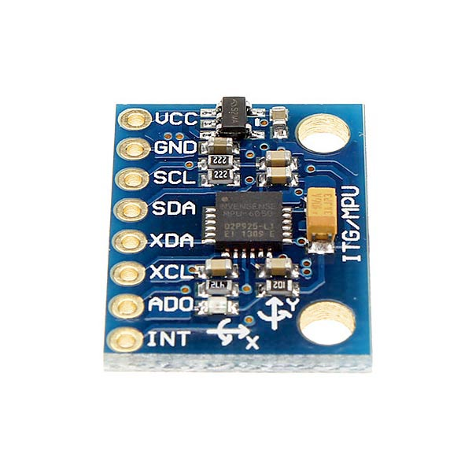
Sensing Unit Cont’d
Inertial Measurement Unit (IMU)
Accelerometer
Readings accurate to within ± 0.1 g for all axes
Sample rate of at least 180 Hz
Ensures set of 6 axis at rate of 30 Hz if transfers one axis at a time
Gyroscope
Readings accurate to within ± 7 degrees X and Y axis
Sample rate of at least 180 Hz

Slide 16
IMU Verification Methods
Accelerometer
Three tests, each isolating and targeting a single axis
Dropped IMU about 6 inches, from one hand to another while collecting data
Gyroscope
Three tests for each axis
Rotated IMU 90 degrees for each axis while collecting data
Speed requirements
Outputted time stamped file of collected data
Viewed data file to verify that we are able to receive 6 axes at a rate of at least 30 Hz

Slide 17
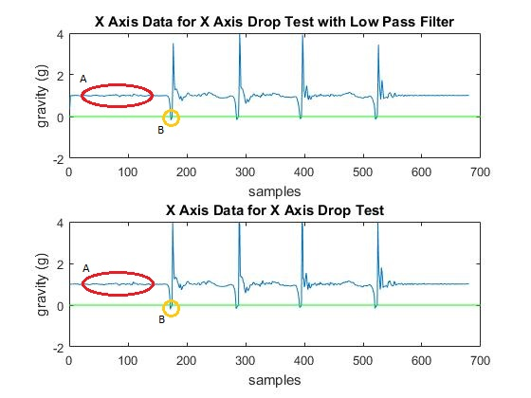
Verification: Accelerometer Results

Slide 18
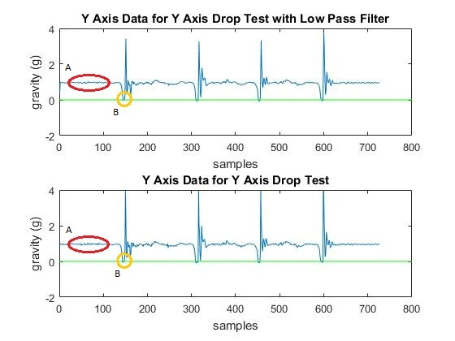
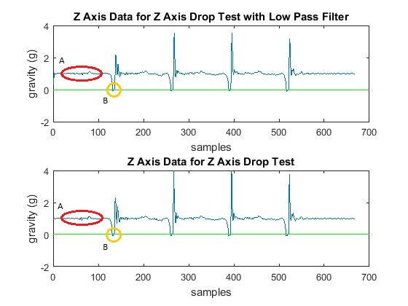
Acceleration Verification Continued

Slide 19
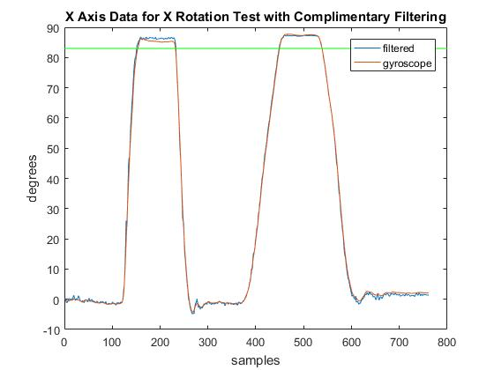
Verification: Gyroscope Results

Slide 20
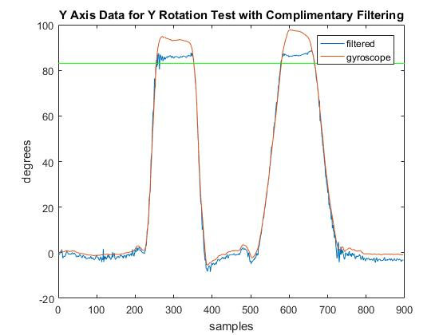
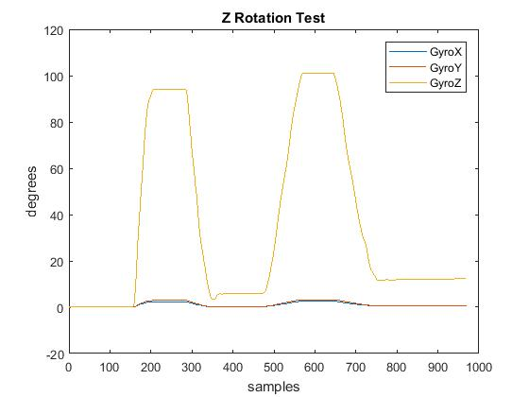
Gyroscope Verification Continued

Slide 21
Sample of Data Collected
Session ID | FSR 1 | FSR 2 | ax | ay | az | gx | gy | gz
0 | 207 | 220 | 0.03674 | -0.494 | 0.8873 | 0.4008 | 0.95934 | 0.0534
0 | 206 | 220 | 0.03015 | -0.48215 | 0.89401 | 0.33982 | 0.65446 | -0.12953
0 | 206 | 220 | 0.02905 | -0.46677 | 0.90731 | 0.27885 | 0.10568 | -0.4344
0 | 206 | 220 | 0.0238 | -0.45518 | 0.91073 | 0.21787 | -0.32115 | -0.61733

Slide 22
GUI
Prototyped with MATLAB
Loads file from SD card
Extracts data of sensors
Applies simple filters
Low pass filter
Complimentary fusion filter

Slide 23
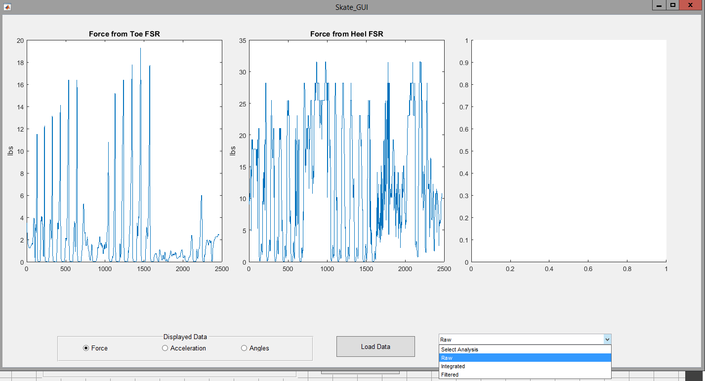

Slide 24
Results
Individual modules all verified
Majority of hardware integrated
Difficulties in fully integrating bluetooth communications
Generated a functioning GUI
Difficulties in denoising data from IMU
Notes:
At this stage, we were able to successfully verify all our individual modules, as well as integrate the majority of our hardware components.
We faced difficulties in fully integrating the bluetooth communications. Our slave device was able to correctly transmit data and signals through bluetooth, verified on the PC, but our master device often picks up garbage data that interferes with both data collection and state transitions.
We were able to create a fully functional GUI that portrayed the data collected, but interpreting the data proved to be a more daunting task, as the data we collected from the IMU were often noisy, and given the time constraints, we were unable to devise of a satisfactory method to denoise it.

Slide 25
Future Development
Integrate a magnetometer to stabilize yaw readings
Obtain signal processing parameters and implement necessary filters into microcontroller
Completely integrate master and slave interaction

Slide 26
Credits
Yuchen He
Michael Oelze
Jackson Lenz

Slide 27
Thank You

