Slide 1
ECE 445: PoV Music Display
Group #8:
Adam Belkhadir
Alex Dutrow
John Tran

Slide 2
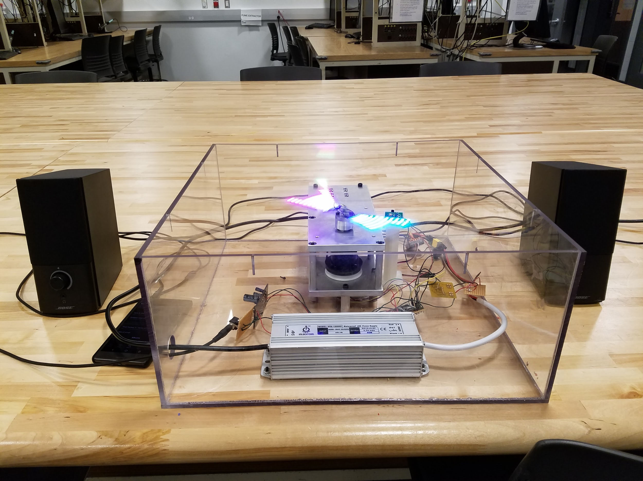
Introduction
Rotating LED display
Audio taken into mixer
Microcontroller used to process audio
Processed audio displayed
Hall Sensor used for timing and display synchronization
Figure 1. PoV Music Visualizer

Slide 3
Objective
To take in audio from any source via 3.5mm aux cable
To have plug and play accessibility
To create a fun and unique way to display audio

Slide 4
Designed Hardware
Completed:
Audio Interface Circuit
Power Converter
Hall Sensor
Unfinished:
Microcontroller Board and programmer

Slide 5
Purchased Hardware
Motor + Motor Controller
Neopixel 144 LED/m Strip
Teensy 3.2 Microcontroller
80W 12V DC power supply

Slide 6
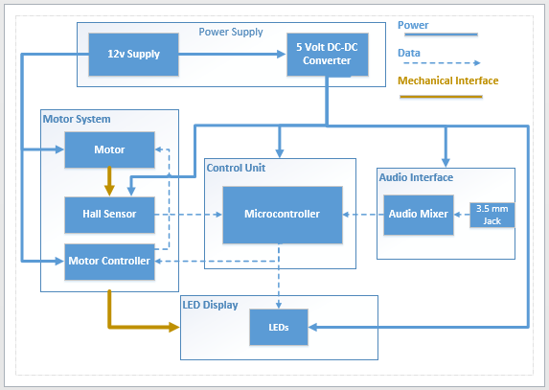
Design - Block Diagram
Figure 2. Original block diagram

Slide 7
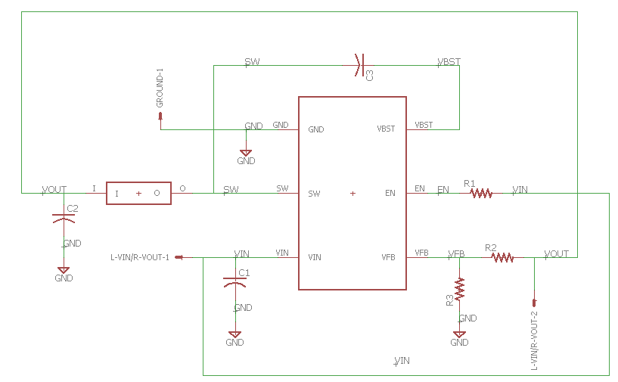
Design - DC/DC Converter
Requirements:
Convert 12V to 5V with +/- 1% ripple
Capable of outputting
1.8 - 2.0 A
Chip Used:
TPS563208
Figure 3. DC/DC converter schematic

Slide 8
Design - DC/DC Converter
Reference voltage divider
- $V_{out}=0.768 ∗(1+\frac{R1}{R2}$) [1]
R1 = 10 kΩ
R2 = 47 kΩ
Vout = 4.38V
Figure 3. DC/DC converter schematic

Slide 9
Design - DC/DC Converter
Input & Output Capacitors
C1 = 22 μF
C2 = 44 μF
Filters signal
Figure 3. DC/DC converter schematic

Slide 10
Design - DC/DC Converter
Inductor
3.3 μH
Voltage swing produces DC output with ripple
Figure 3. DC/DC converter schematic

Slide 11
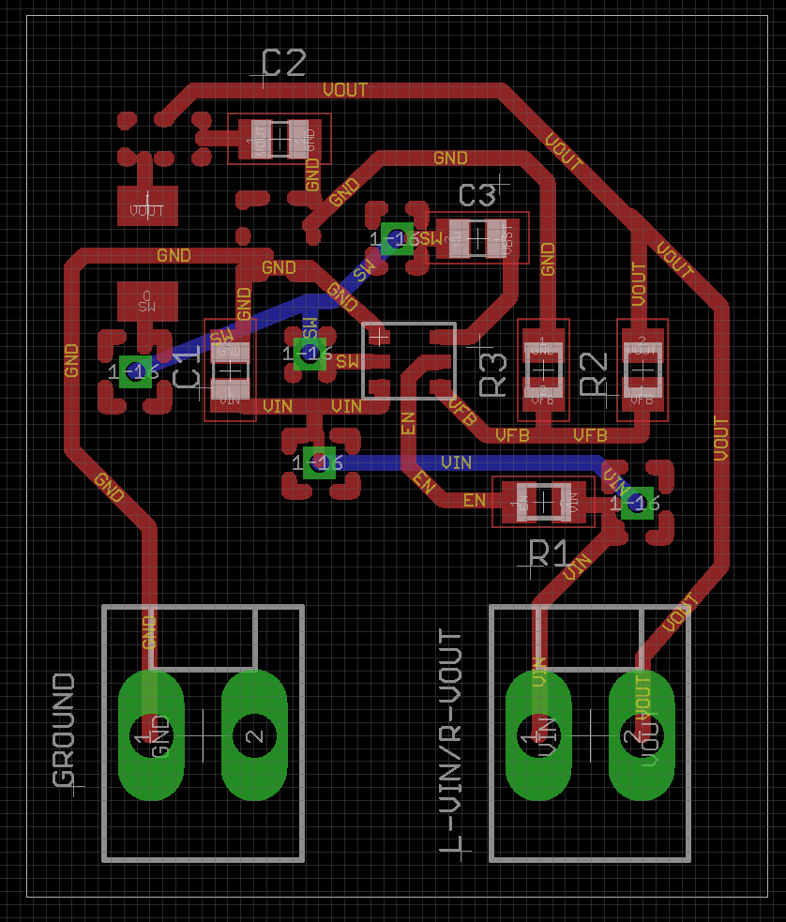
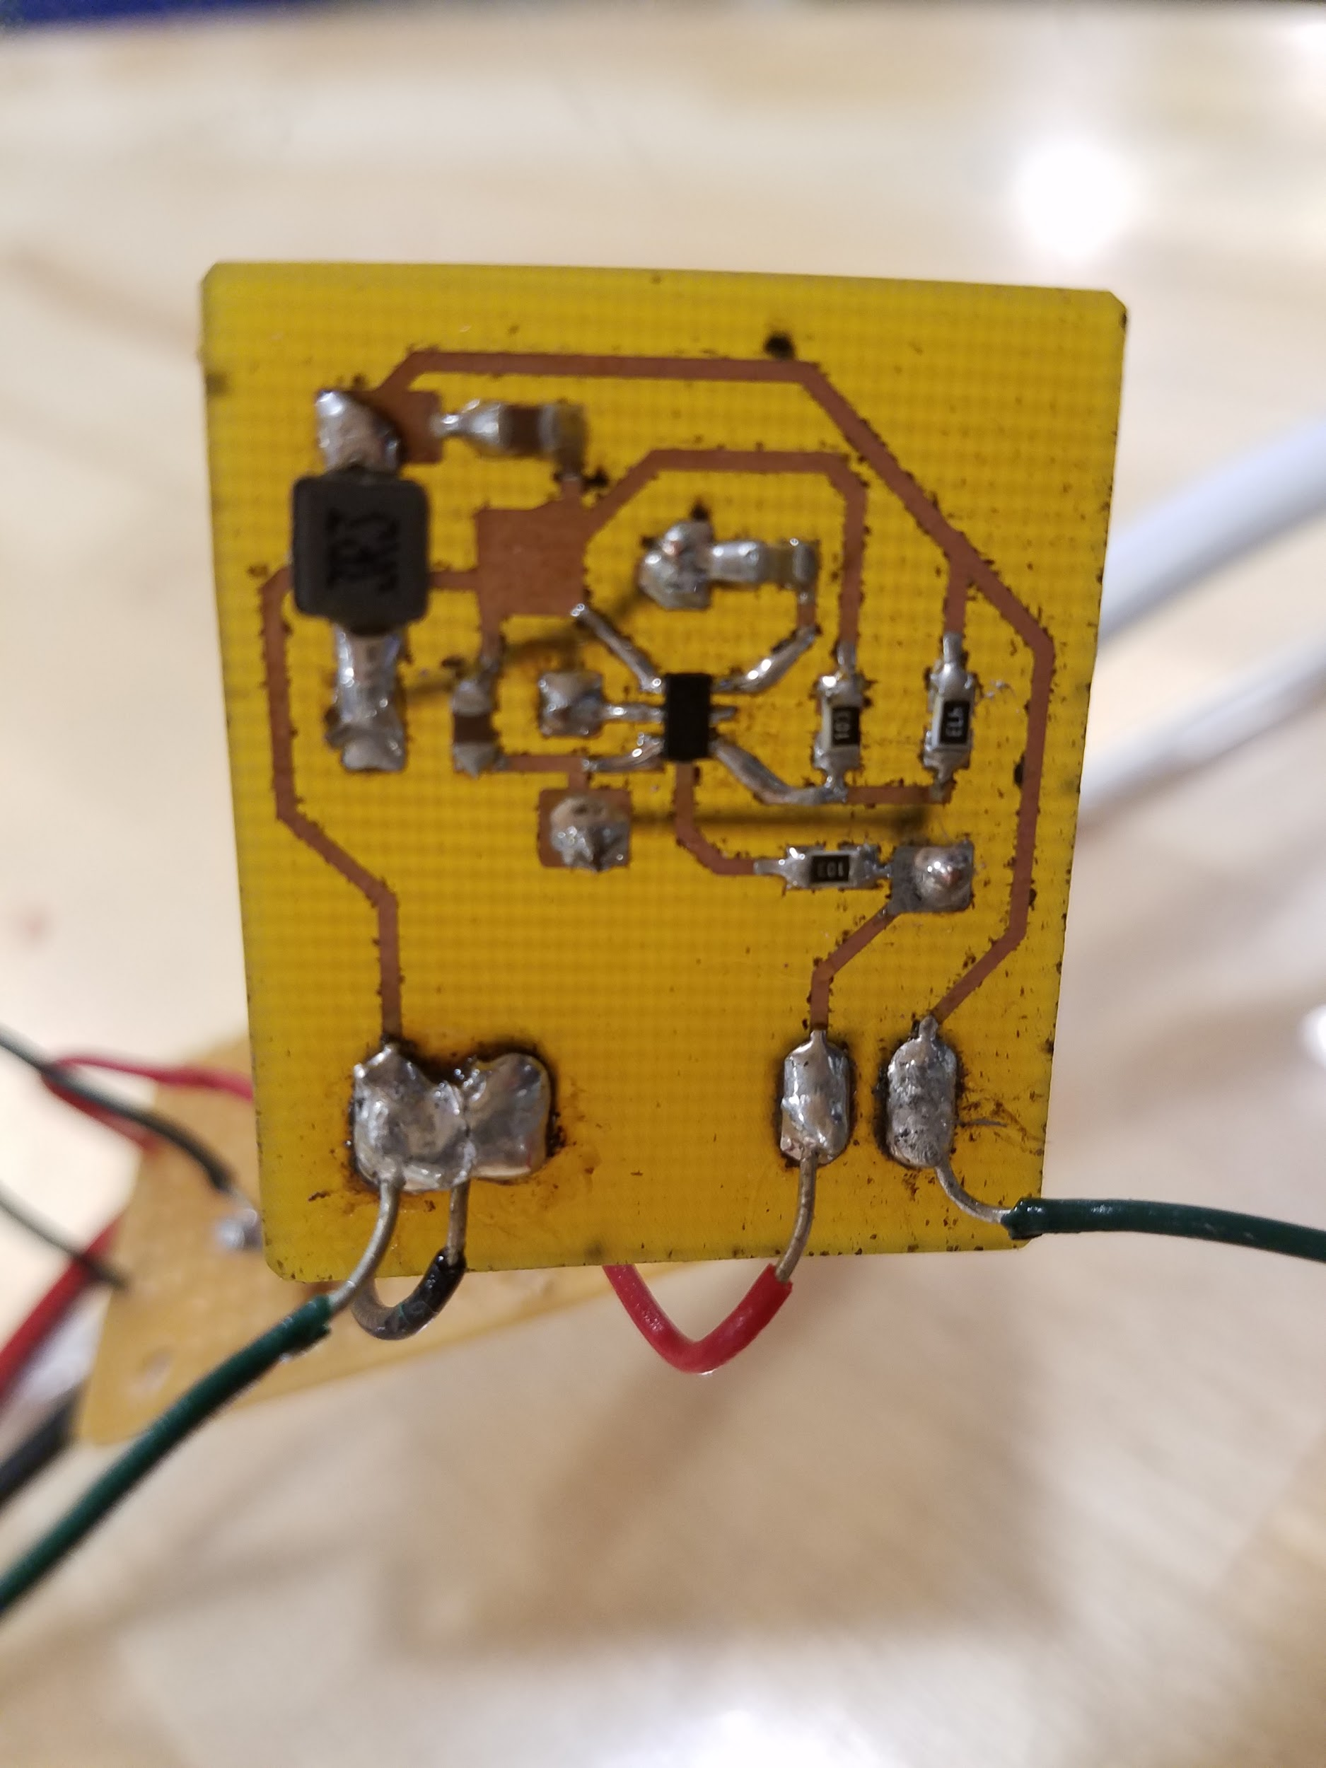
Design - DC/DC Converter
Figure 4. DC/DC converter PCB design
Figure 5. DC/DC converter product

Slide 12
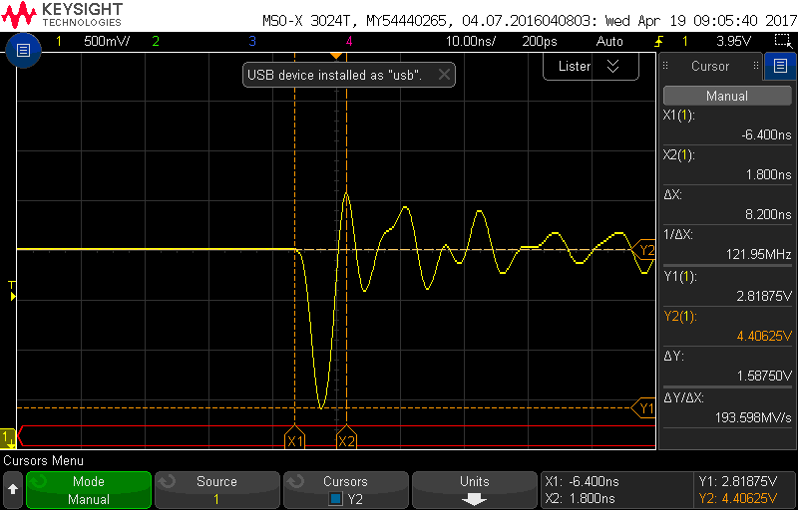
Verification - DC/DC Converter
Ringing resulted from poor filtering, components and chip itself
~500 mV
Figure 6. Output voltage ringing

Slide 13
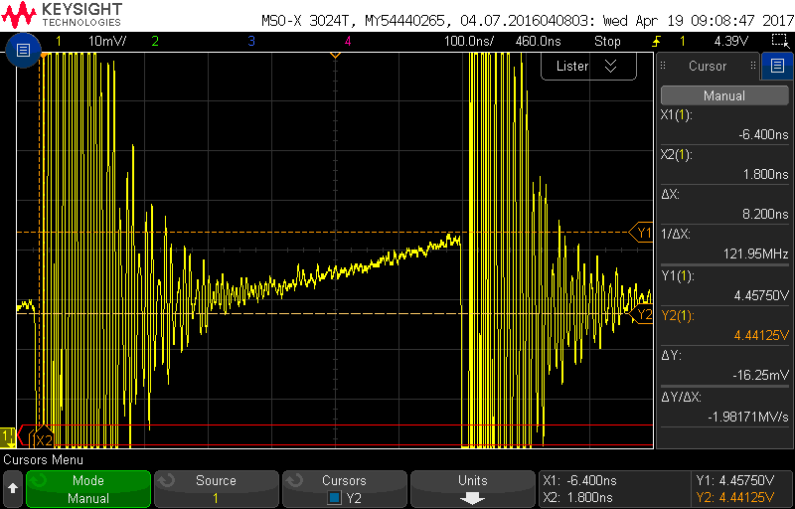
Verification - DC/DC Converter
$\text{Δ}\text{Y}\text{/(}\frac{Y1+Y2}{2}$) * 100 = %Ripple
% Ripple = .3655 %
Figure 7. Output voltage ripple

Slide 14
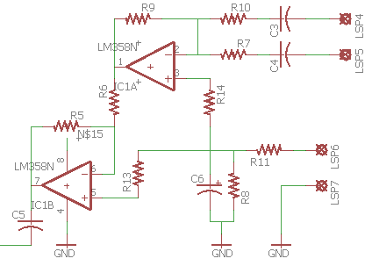
Design - Audio Mixer Circuit
Combine left and right channels
Control the signal amplitude
Figure 8. Audio mixer schematic

Slide 15
Design - Audio Mixer Circuit
Mixer Stage to combine the left and right channels
Unity gain to prevent clipping
Figure 8. Audio mixer schematic

Slide 16
Design - Audio Mixer Circuit
Phase Recovery Stage to compensate for the first stage
1.5 gain to compensate for losses
Figure 8. Audio mixer schematic

Slide 17
Design - Audio Mixer Circuit
Virtual ground generation
Needed in order to operate circuit with 0 and 5V
Figure 8. Audio mixer schematic

Slide 18
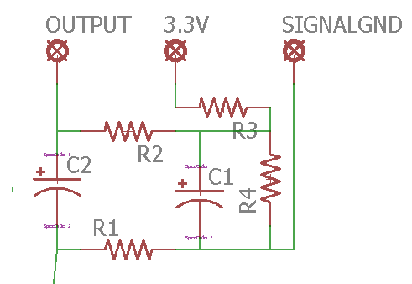
Design - Passive Bias Network
Keep DC bias within ADC range
Figure 9. Passive bias schematic

Slide 19
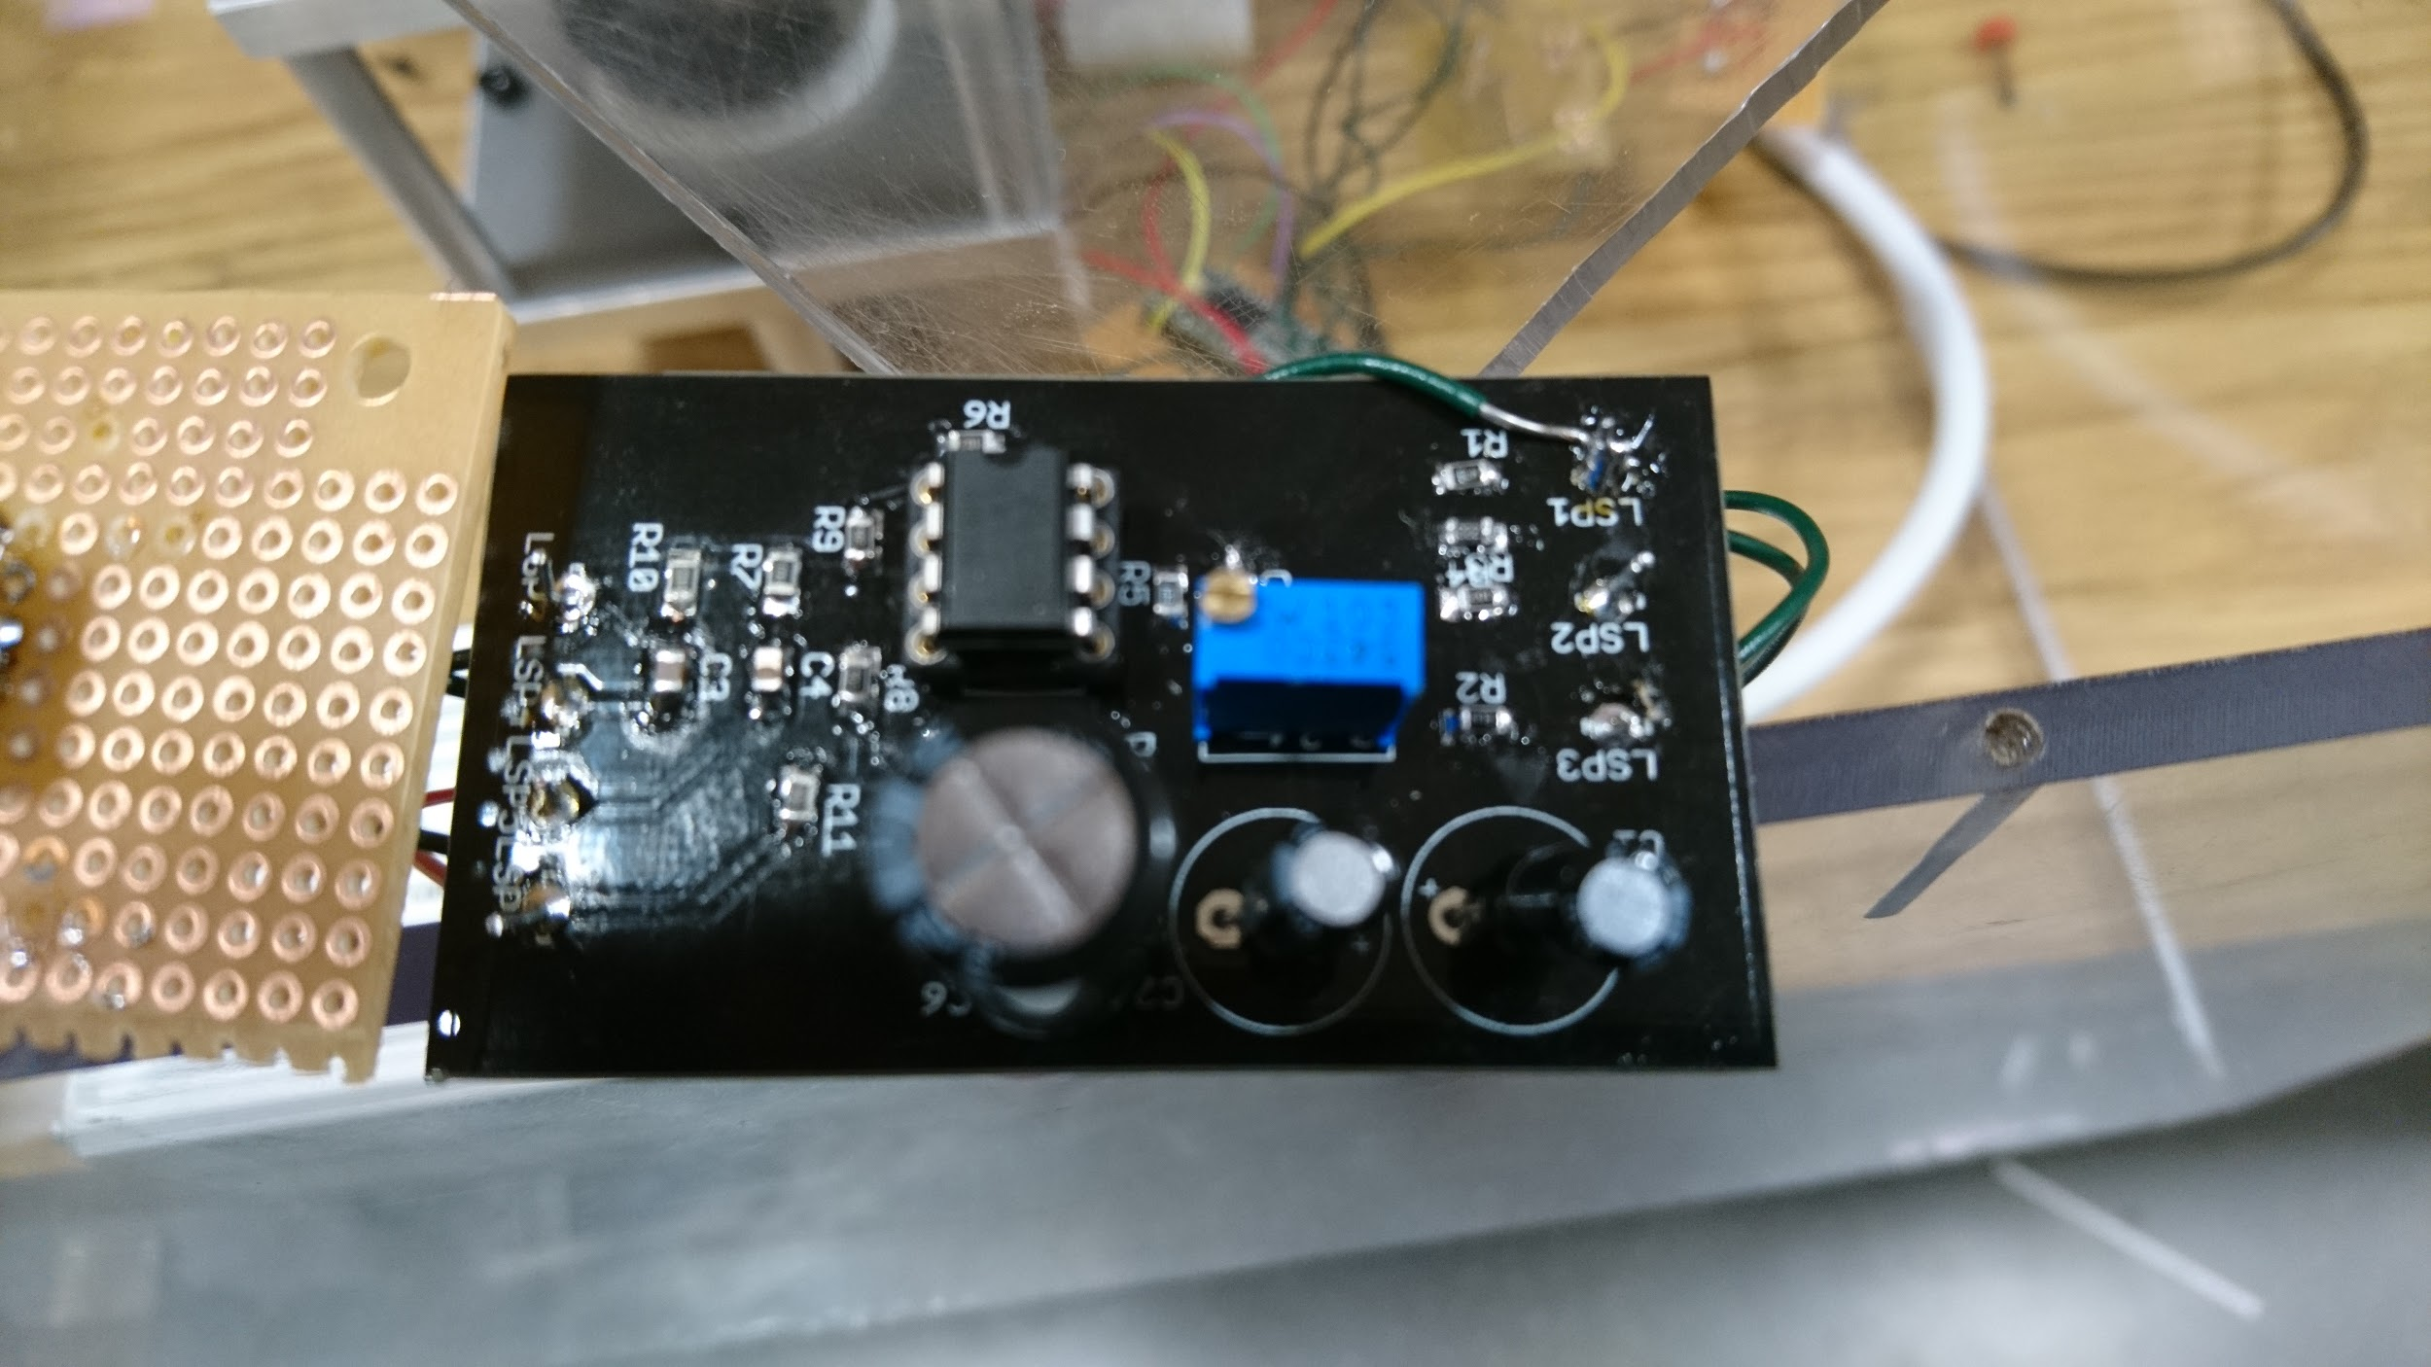
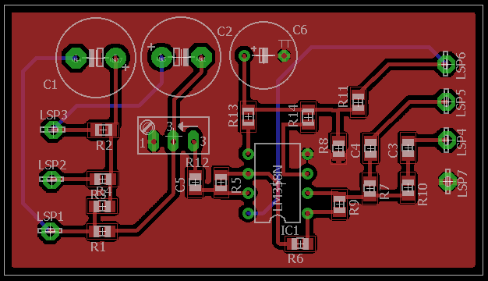
Design - Audio PCB
Figure 10. Audio mixer product
Figure 11. Audio mixer PCB

Slide 20
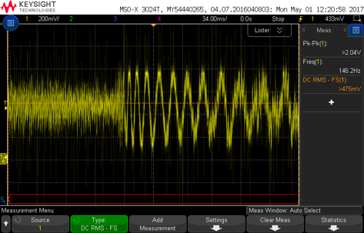
Verification - Audio Circuit
Mixed L and R channels​
​
Kept signal within ADC range​ with DC bias of 500 mV
​
Retained the original signal's P-P voltage of 1v
Figure 12. Mixed Audio Waveform

Slide 21
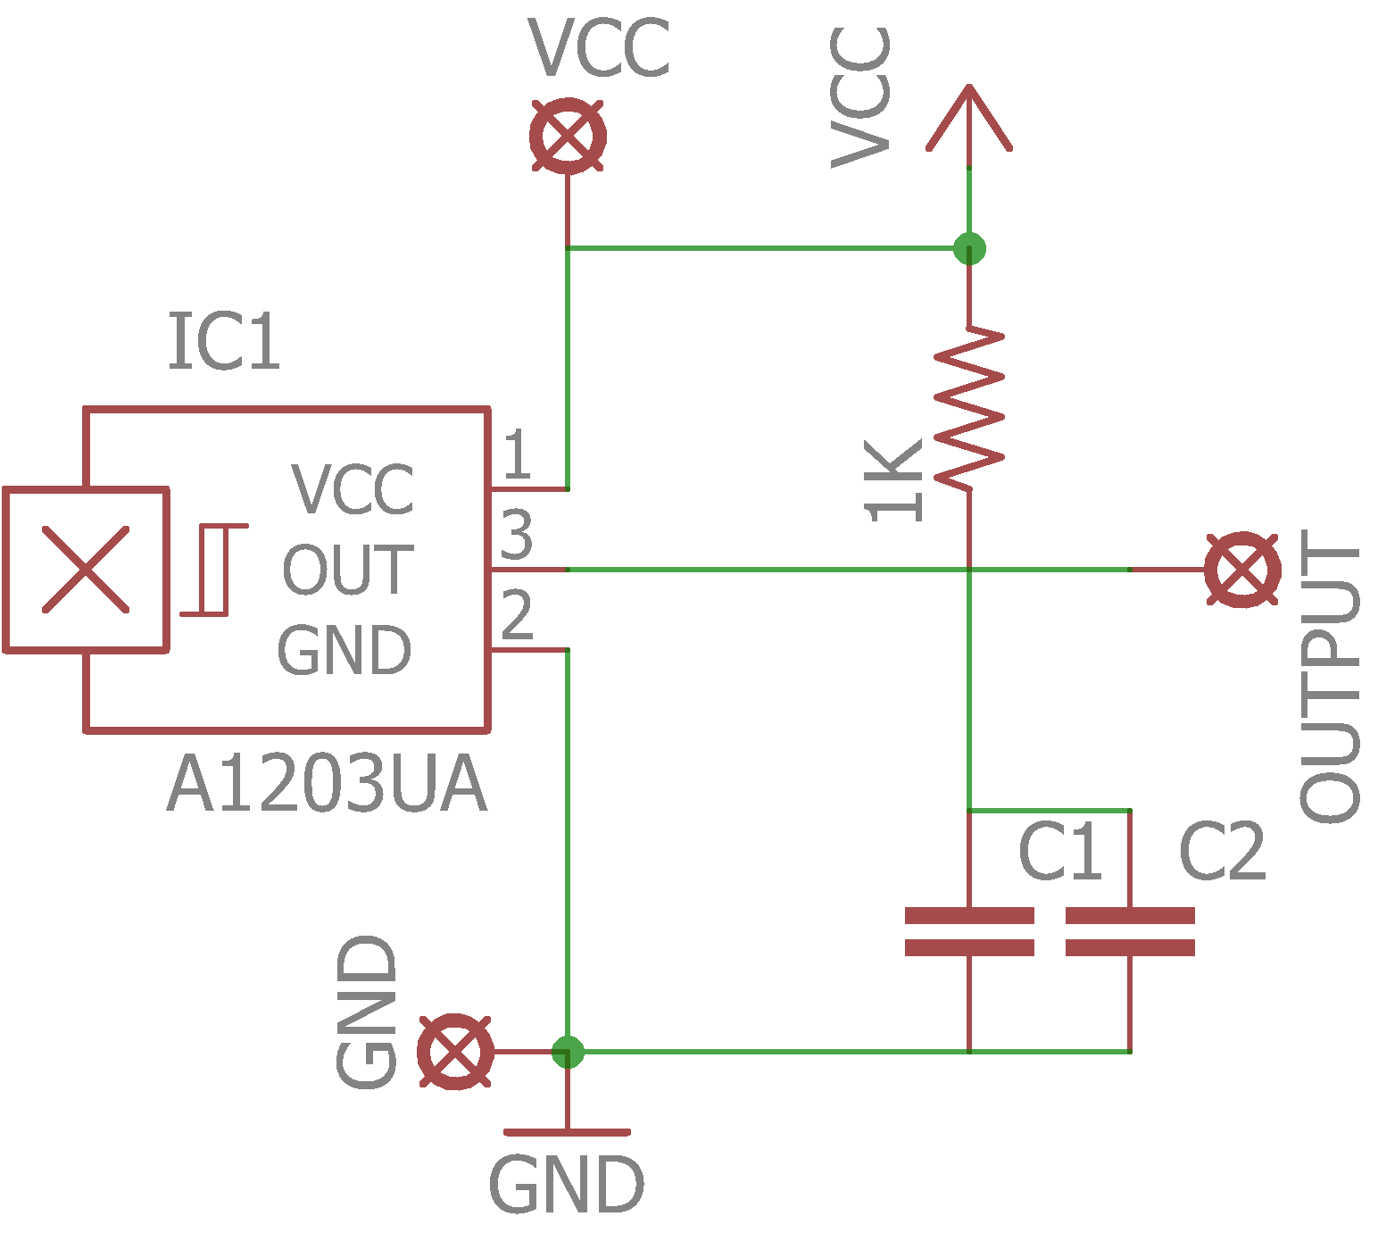
Hall Sensor Circuit
Biased to properly match Vcc
Used as a tachometer
Used for display synchronization
Resistor: 1 kΩ
C1: 10 pF
C2: 10 pF
Figure 13. Hall sensor schematic

Slide 22
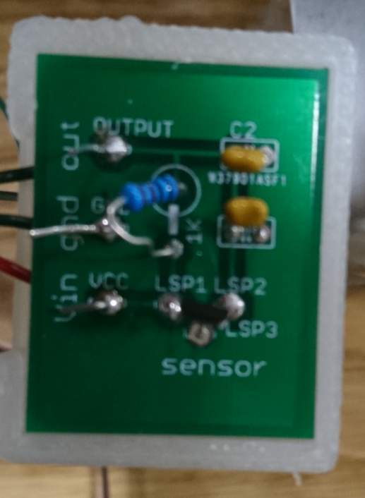
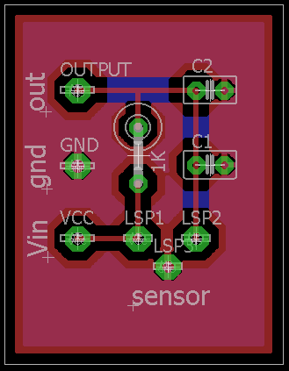
Hall Sensor PCB
Figure 14. Hall sensor product
Figure 15. Hall sensor PCB

Slide 23
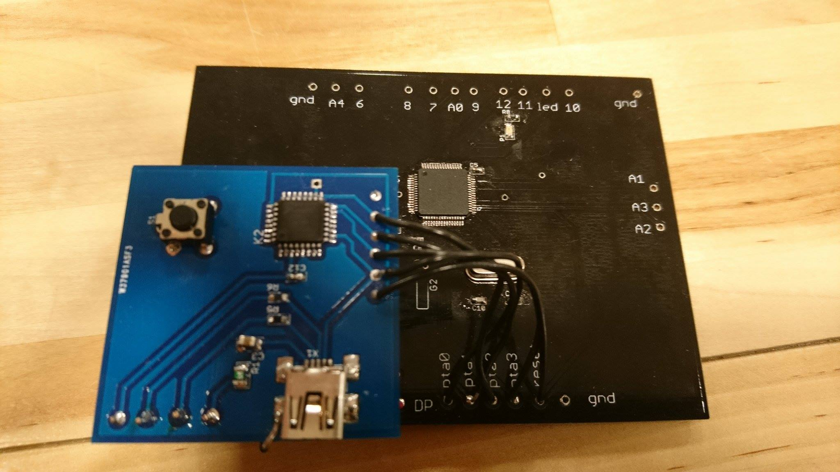
Design - MCU Board
Could not get PCB to work
Confirmed part placement and power
Broken MCU or improper design with no time or resources to change
Figure 16. Bootloader and MCU PCB

Slide 24
Hardware Within Enclosure
Figure 15. Hall sensor PCB

Slide 25
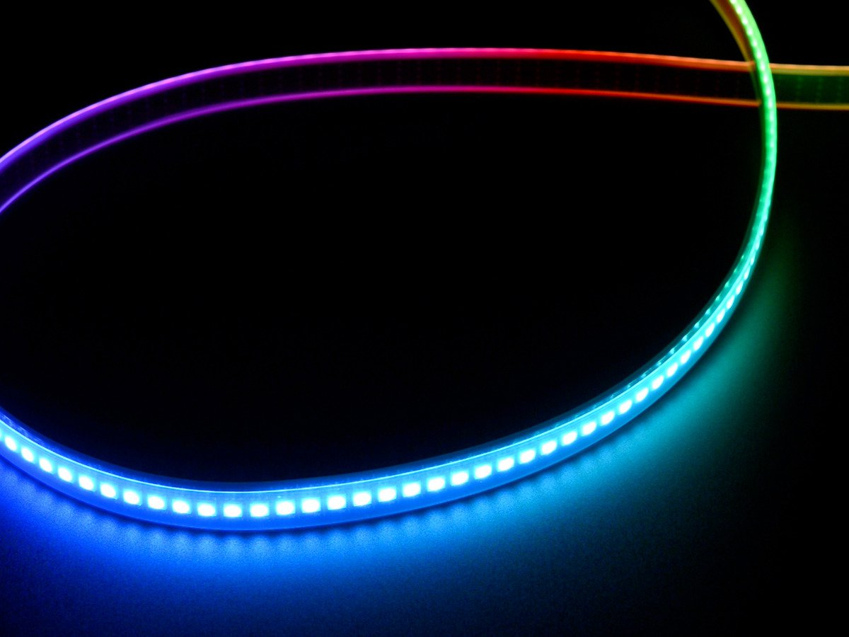
Software - SPI Communication
Clock and Data to communicate to LEDs
8 MHz protocol ideal for PoV, FastLED
Easy to manipulate an output array
Figure 18. Neopixel LED strip [2]

Slide 26
Software - PI controller
//PI Control Law
$$PWM=PWM+K_{p}\left({RPM}_{desired}−RPM\right)+K_{i}\int{\left({RPM}_{desired}−RPM\right)}$$
//Integration approximation
$$I_{k}=I_{k−1}+\frac{e_{k}+e_{k−1}}{2}∗T$$
Implemented PI controller
{
//RPMdesired-RPM
error = ideal_tar - feedback;
//PI Controller
tar = tar + Kp*error + Ki*I_error_new;
//Integration calculation (Ik)
I_error_old = I_error_new;
I_error_new = error;
I_new = I_old +
(I_error_new+I_error_old)/2*(1/Dt);
I_old = I_new;
}

Slide 27
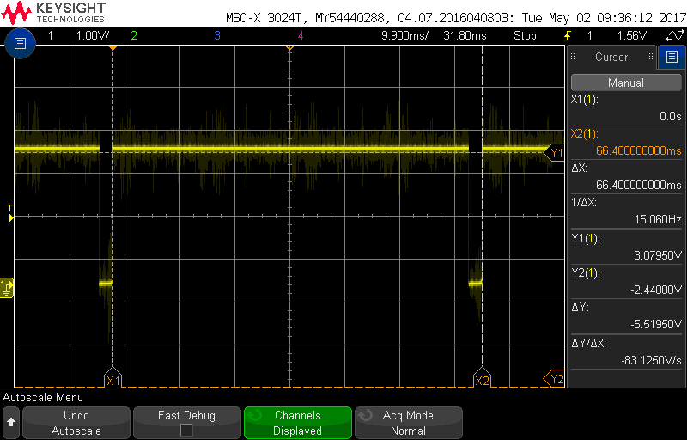
Software - PI Controller Results
Steady state error within 1%​
Variable targetcontrol due to the PI controller.​
Safe range of motor speed due to additional thresholds within the code
Figure 19. Hall sensor waveform

Slide 28
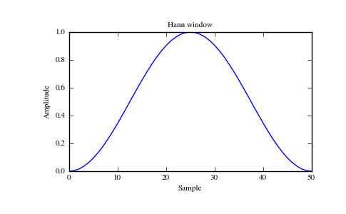
Software - Audio FFT
Used available FFT Library
Used a Hanning window to reduce spectral leakage
Figure 20. Hanning window example

Slide 29
Conclusion
Improvements / Modifications:
Dampen sound from motor
Reduce flashing by adding another magnet / Hall sensor
Implement 1024 point FFT
Design motor controller PCB
PID controller
In the end we learned quite a lot working on this project

Slide 30
Thank you for this opportunity

Slide 31
Sources Cited:
[1] TI(2015).TPS56320x 4.5-V to 17-V Input, 3-A Synchronous Step-Down Voltage Regulator in SOT-23. [Online].Available:http://www.ti.com/lit/ds/symlink/tps563208.pdf [Accessed: 23-Feb-2017].
[2] Adafruit(2017). Adafruit DotStar Digital LED Strip - Black 144 LED/m - One Meter - BLACK. [Online]. Avaliable:https://www.adafruit.com/product/2241 [Accessed: 1-Feb-2017]

