Slide 1
Self Adjusting Rear View Mirror
Adam Magier, Derek Wood, Tommy Jarosz
Fall 2018

Slide 2
Introduction
Use facial recognition and 3-axis motor control to create a hands-free self-adjusting mirror.
Notes:
Tommy

Slide 3
Objective
Devise a system to increase visibility through rear view window for a driver while simultaneously decreasing driver distraction.
Notes:
Derek

Slide 4
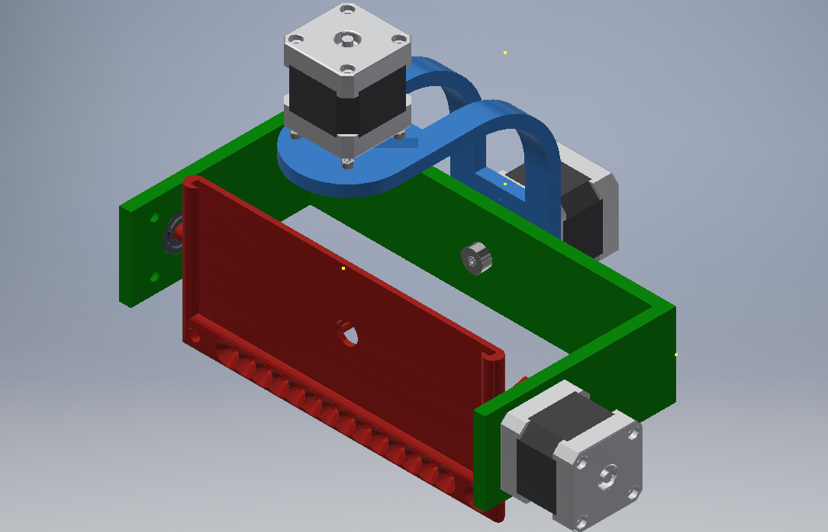
Overview
Face tracking software designed to track eyes (even with sunglasses).
Mounting mechanism capable of rotating along all three axes of rotation.
Circuit board with power regulation, stepper motor drivers, and MCU.
Notes:
Adam

Slide 5
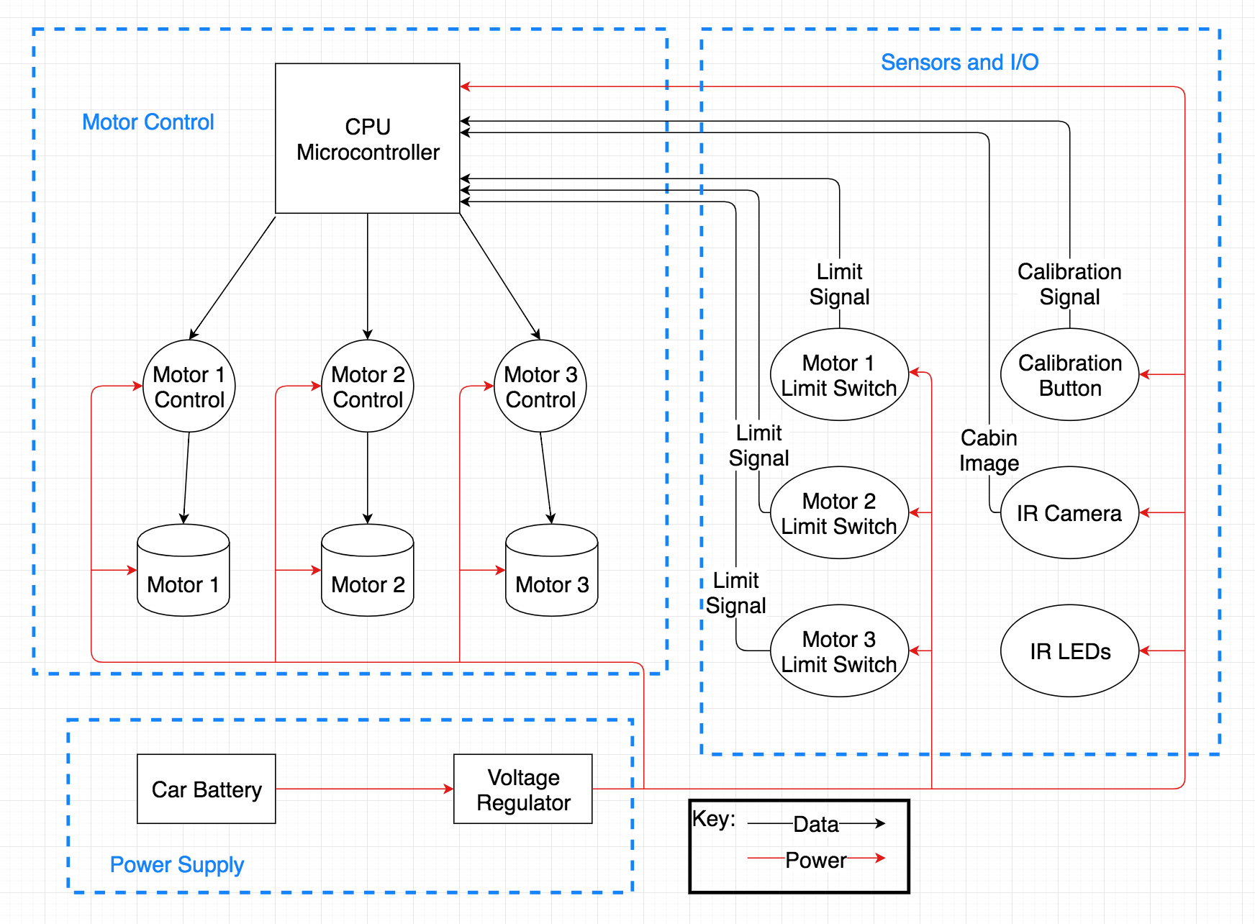
Block Diagram
Notes:
Derek

Slide 6
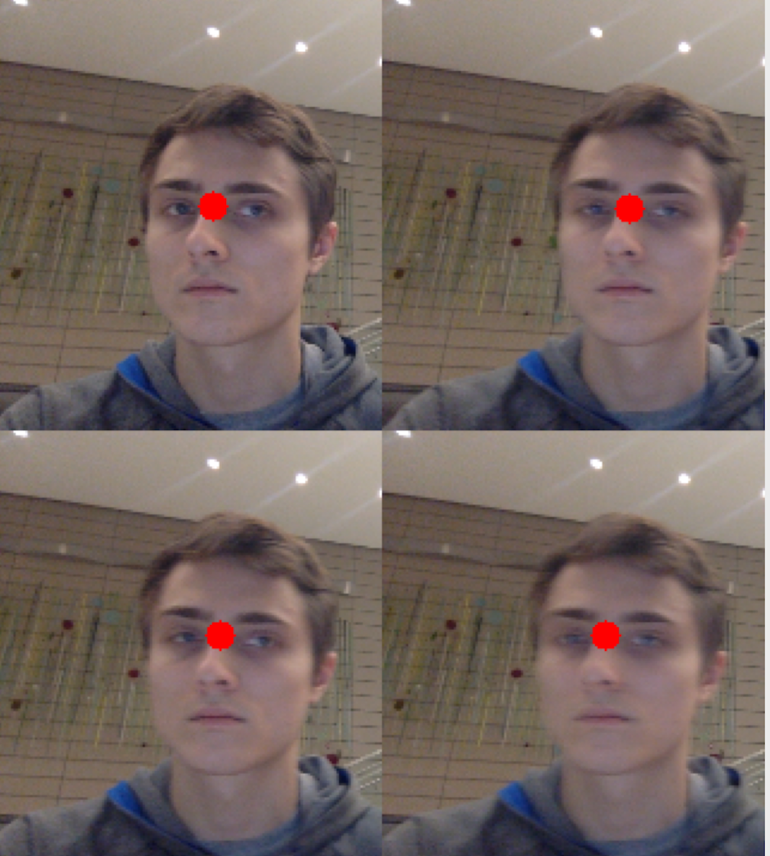
Software: Eye Detection
Eye detection is used to
determine driver eye position.
Facial recognition was
implemented in TensorFlow; Eye
detection was implemented in
OpenCV.
To meet the time requirement of
processing 1 image per second,
images were scaled down and
processed in batches.
Factors like driver head size and
Position are used to assure that
Only the driver’s eyes are being
tracked.
Notes:
Tommy

Slide 7
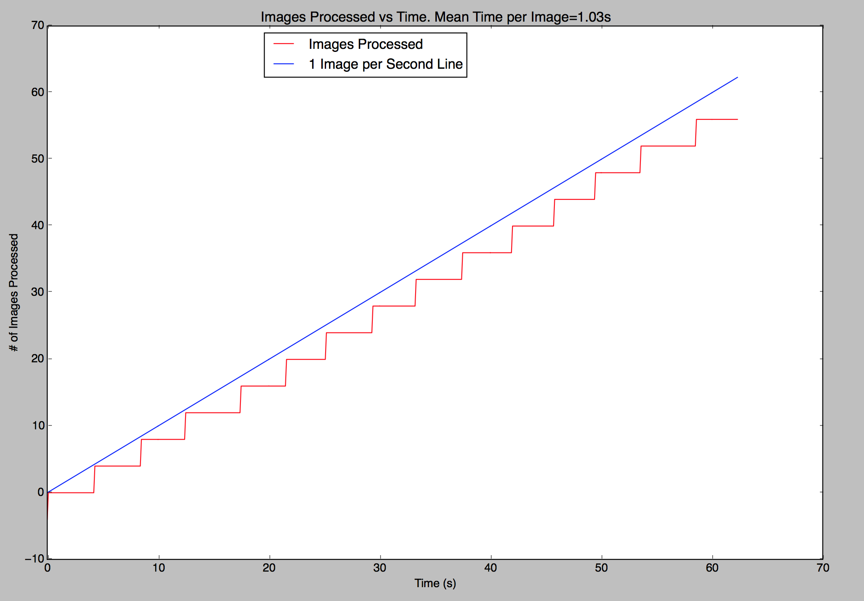
Software: Eye Detection
Notes:
Tommy

Slide 8
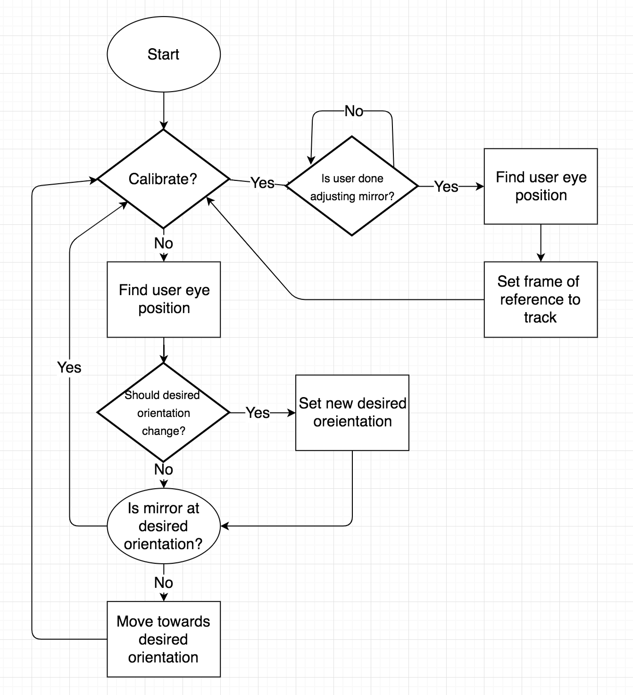
Software: Control Logic
Given the current orientation of
the mirror and the direction of
the driver’s eyes, the orientation
and position of the rear window
can be computed.
Given the orientation and
position of the rear window, and
the direction to the driver’s eyes,
a ‘desired’ mirror orientation
can be computed.
Thus, our software control logic
has 2 major processes: setting
window location and tracking
eye location.
Notes:
Tommy

Slide 9
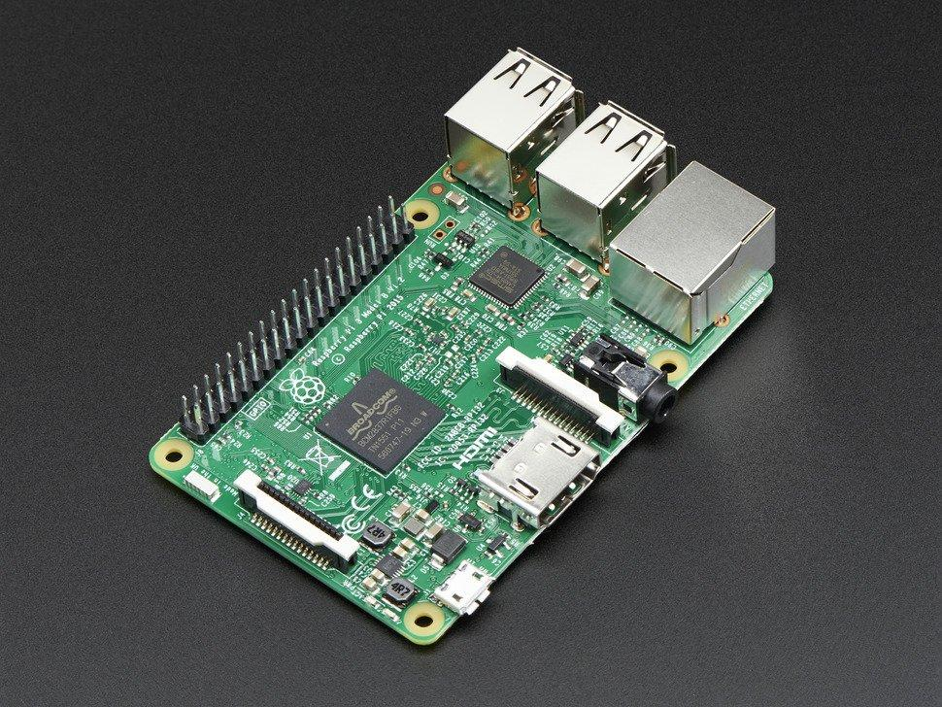
CPU
Abstraction of the central computer in a production car
Implemented as a RaspberryPi
Assumption: the central computer in a car is at least as capable as a RaspberryPi
Notes:
Adam

Slide 10
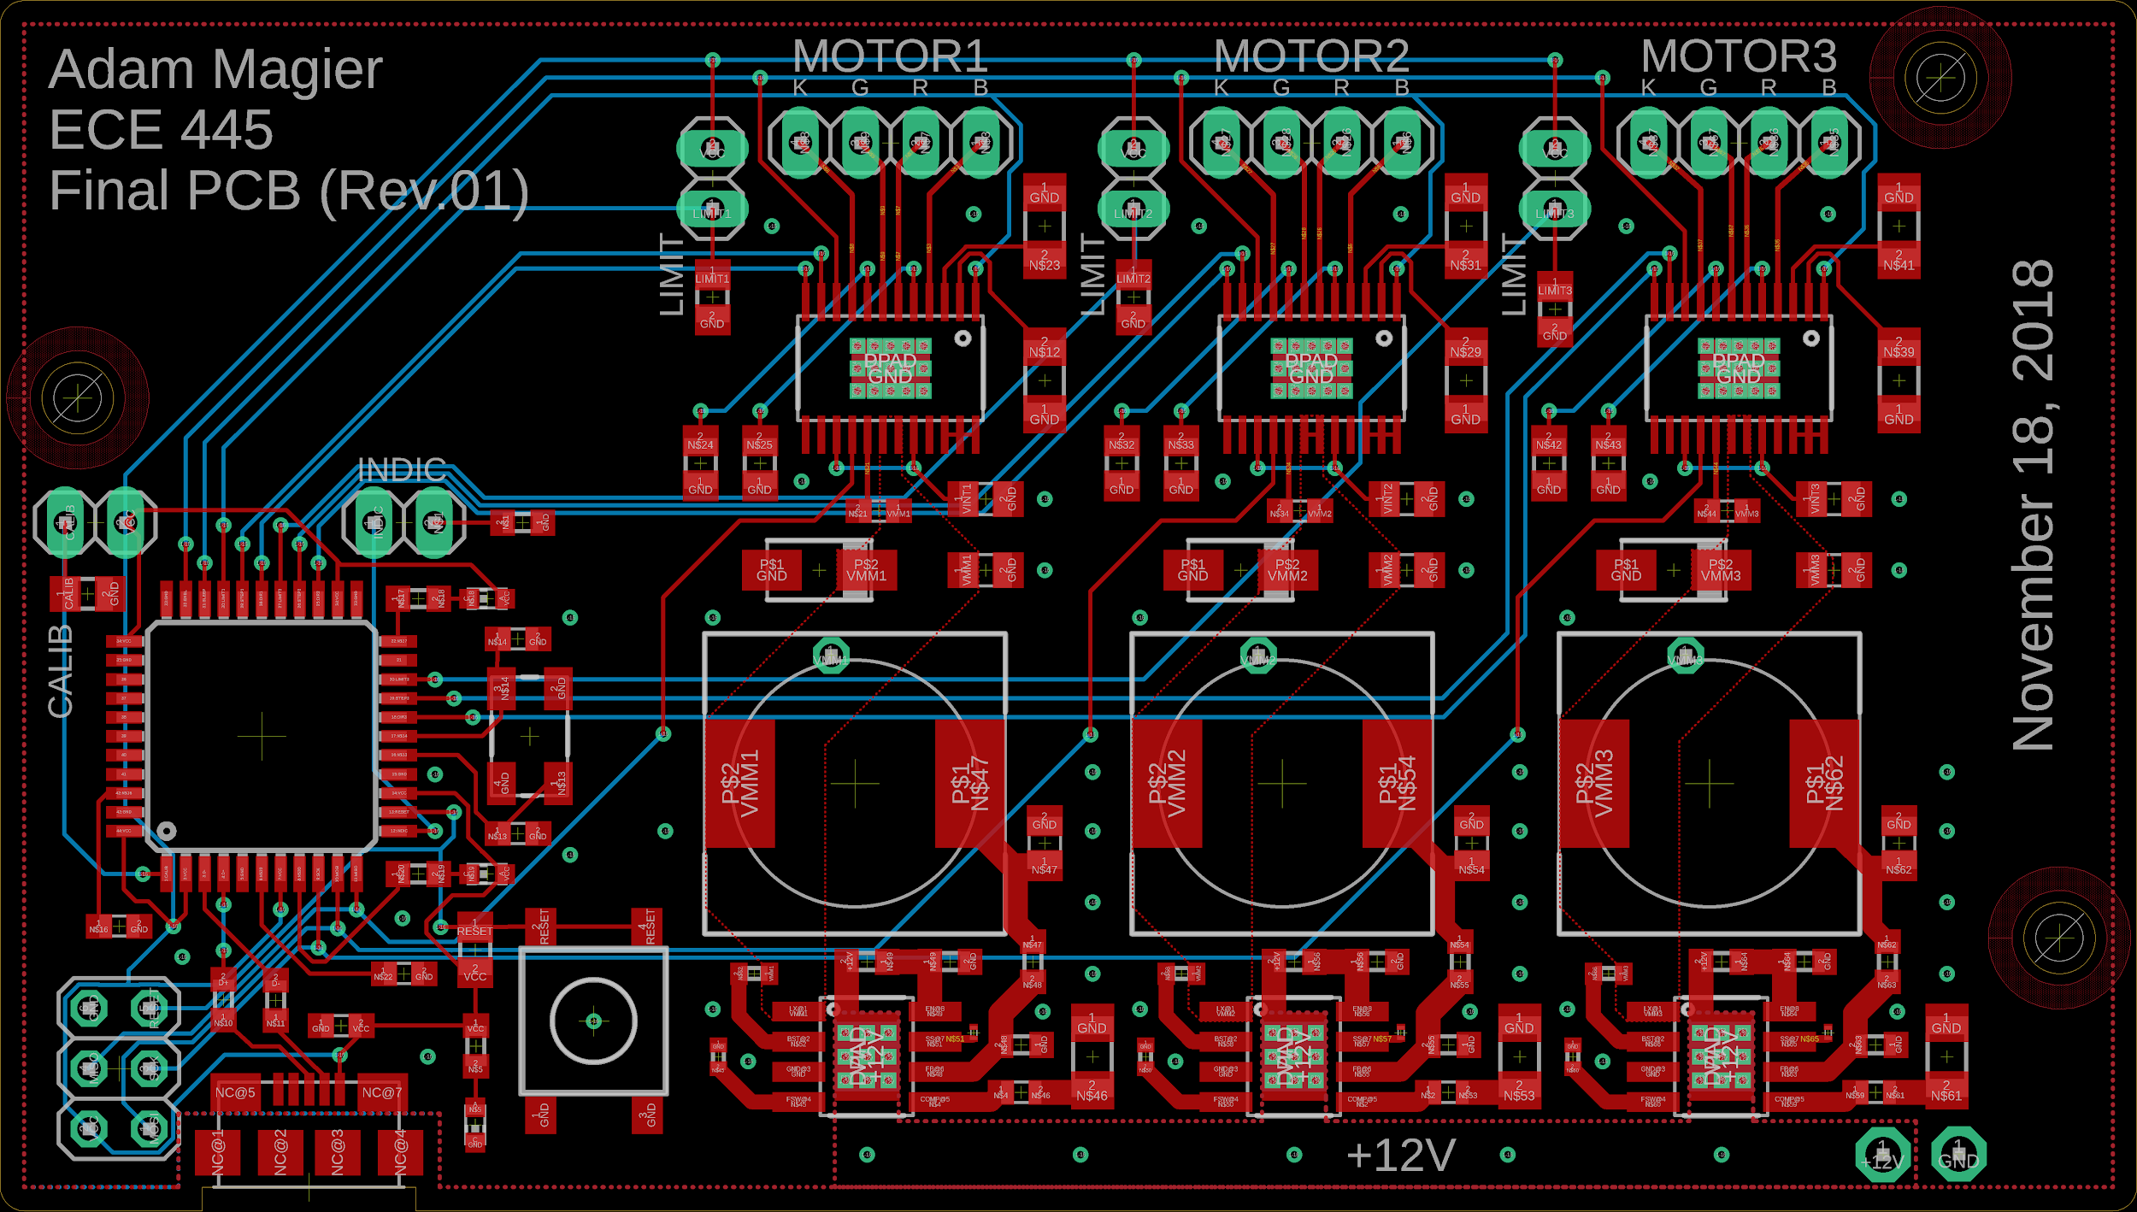
Hardware/Circuitry
Can communicate with CPU to accurately control mirror orientation
Can convert 12V to 3.3V for motors
Can appropriately step the motors as necessary
Notes:
Adam
(actual image)

Slide 11
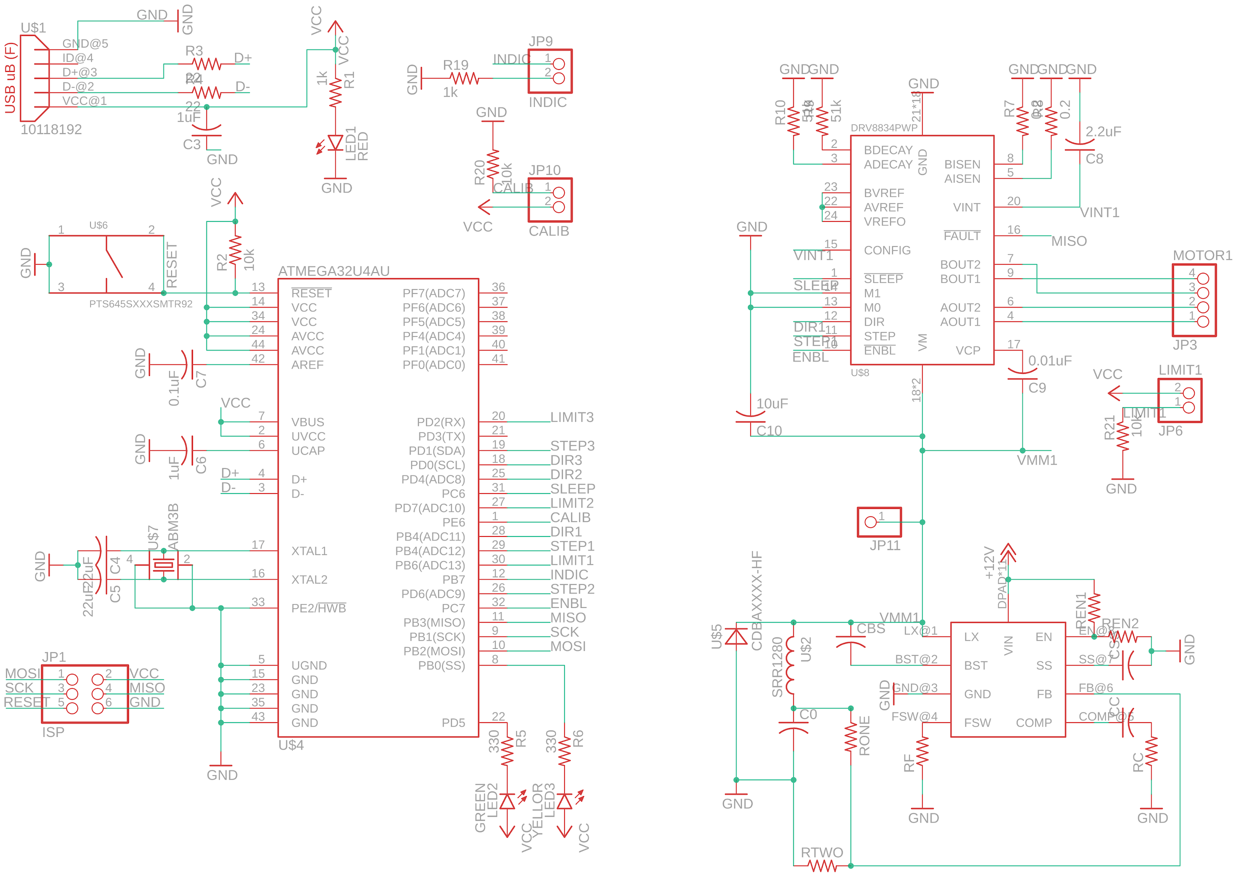
Schematic
Notes:
Adam

Slide 12
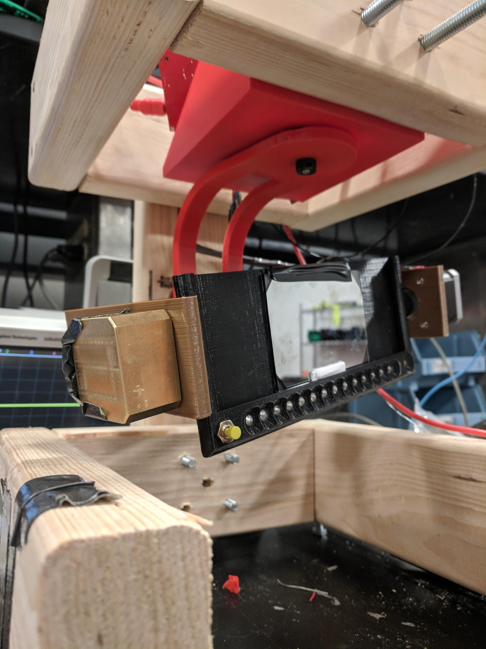
Mount
Can rotate along all three axes of rotation to adjust mirror orientation
Can hold up weight of entire mechanism
Adjustable by hand without breaking system entirely
Notes:
Adam

Slide 13
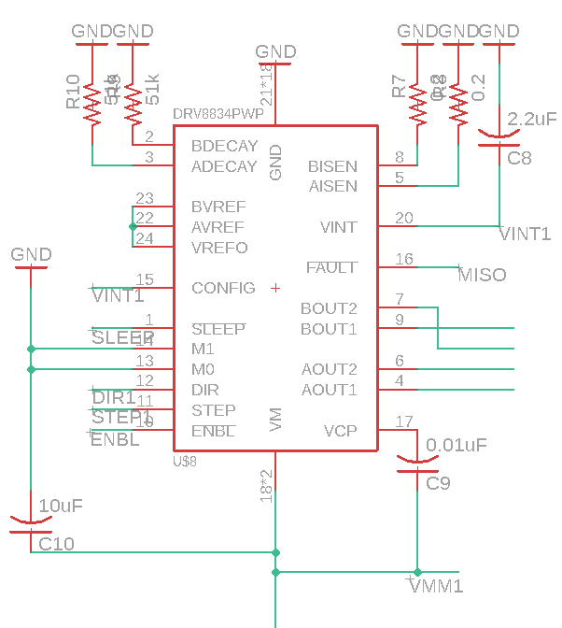
Motor Driver
Must be capable of sending out pulses according to MCU input
Must provide enough current to run motor
Must be capable of moving the motor by one step at a time
Notes:
Adam

Slide 14
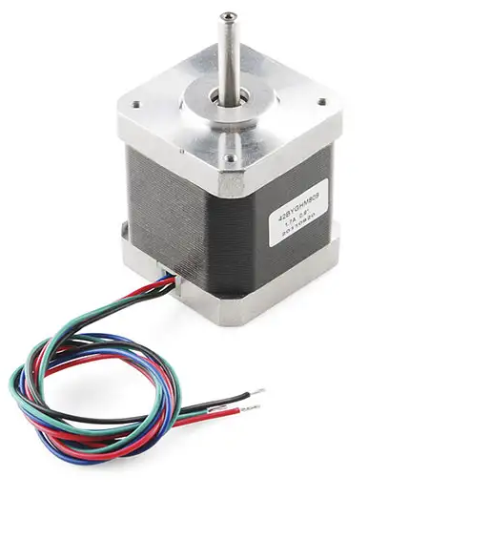
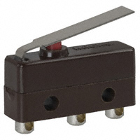
Motors/Limit Switches
Motors provide movement along all three axes of rotation
Limit switches provide an absolute point of reference for the motors
Notes:
Derek

Slide 15
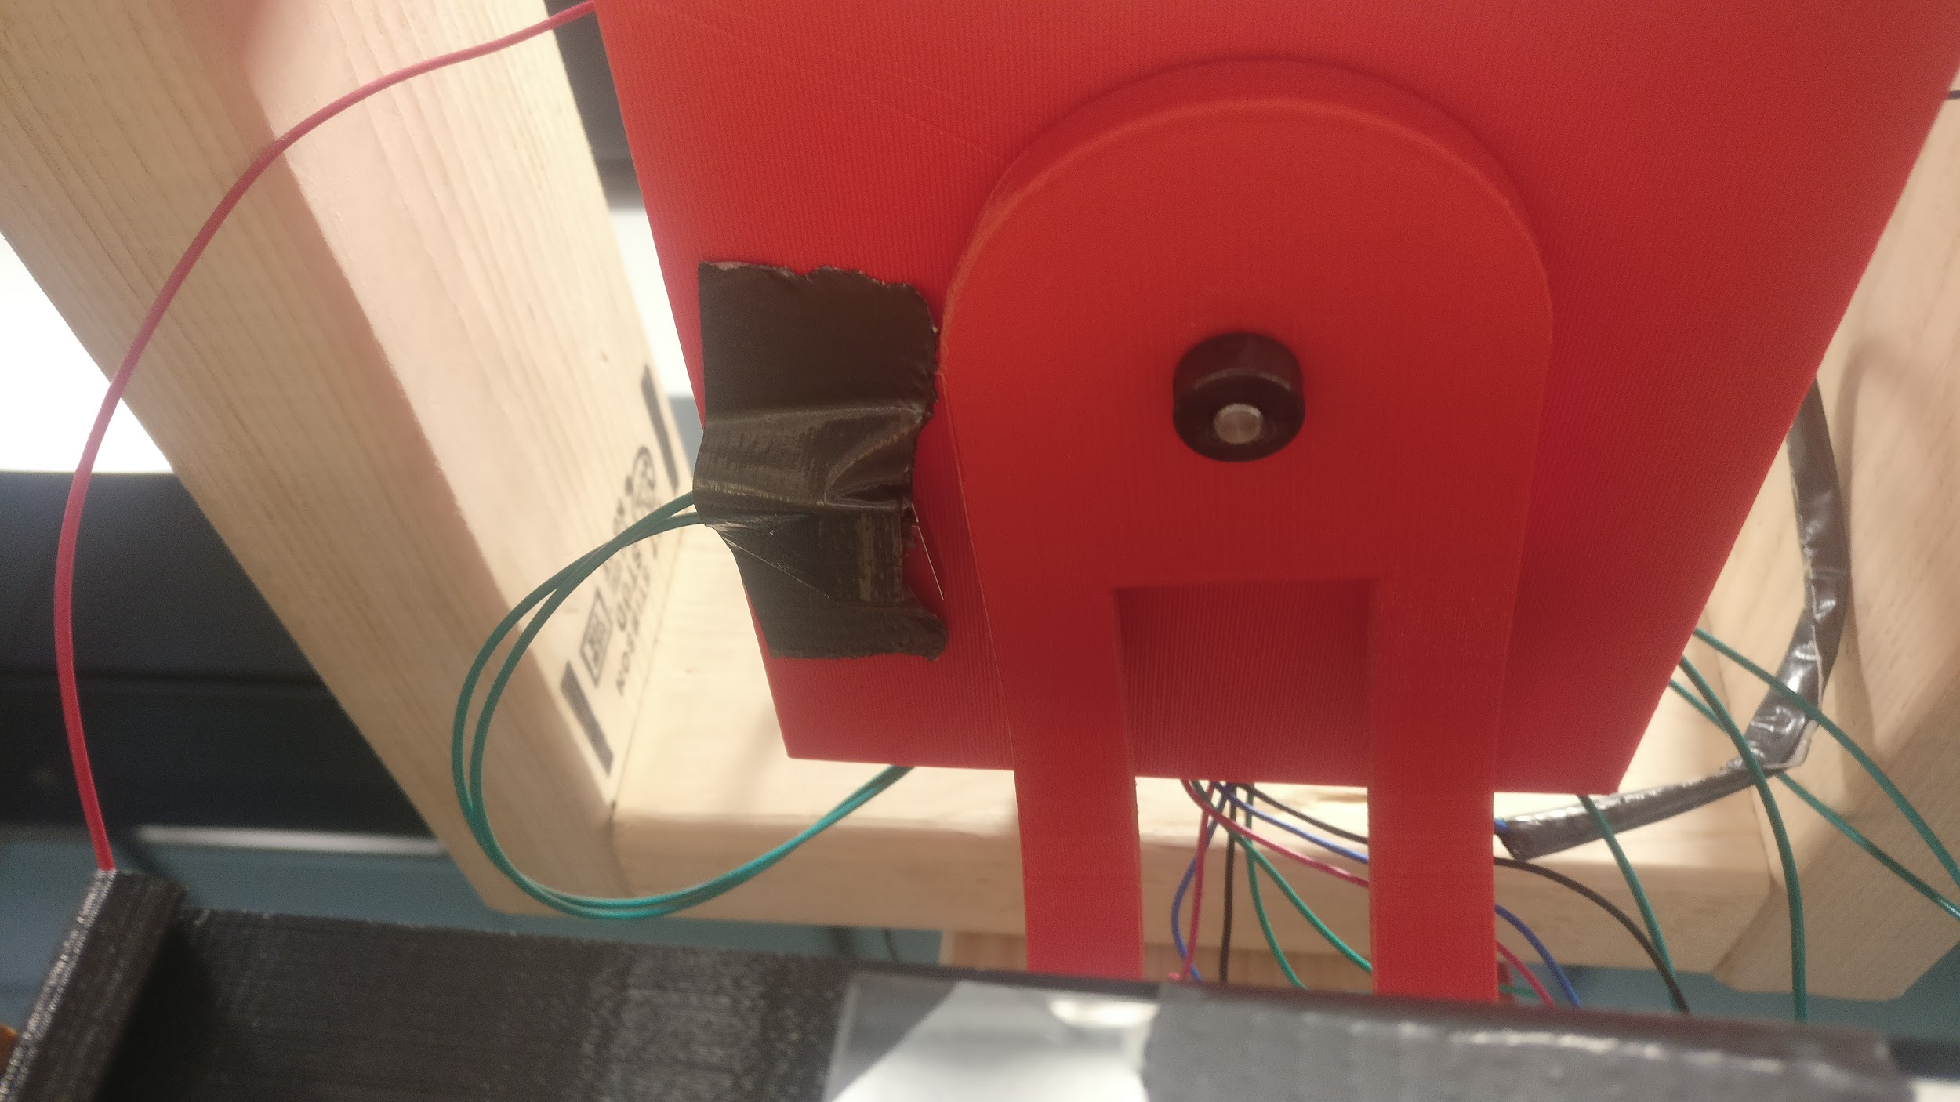
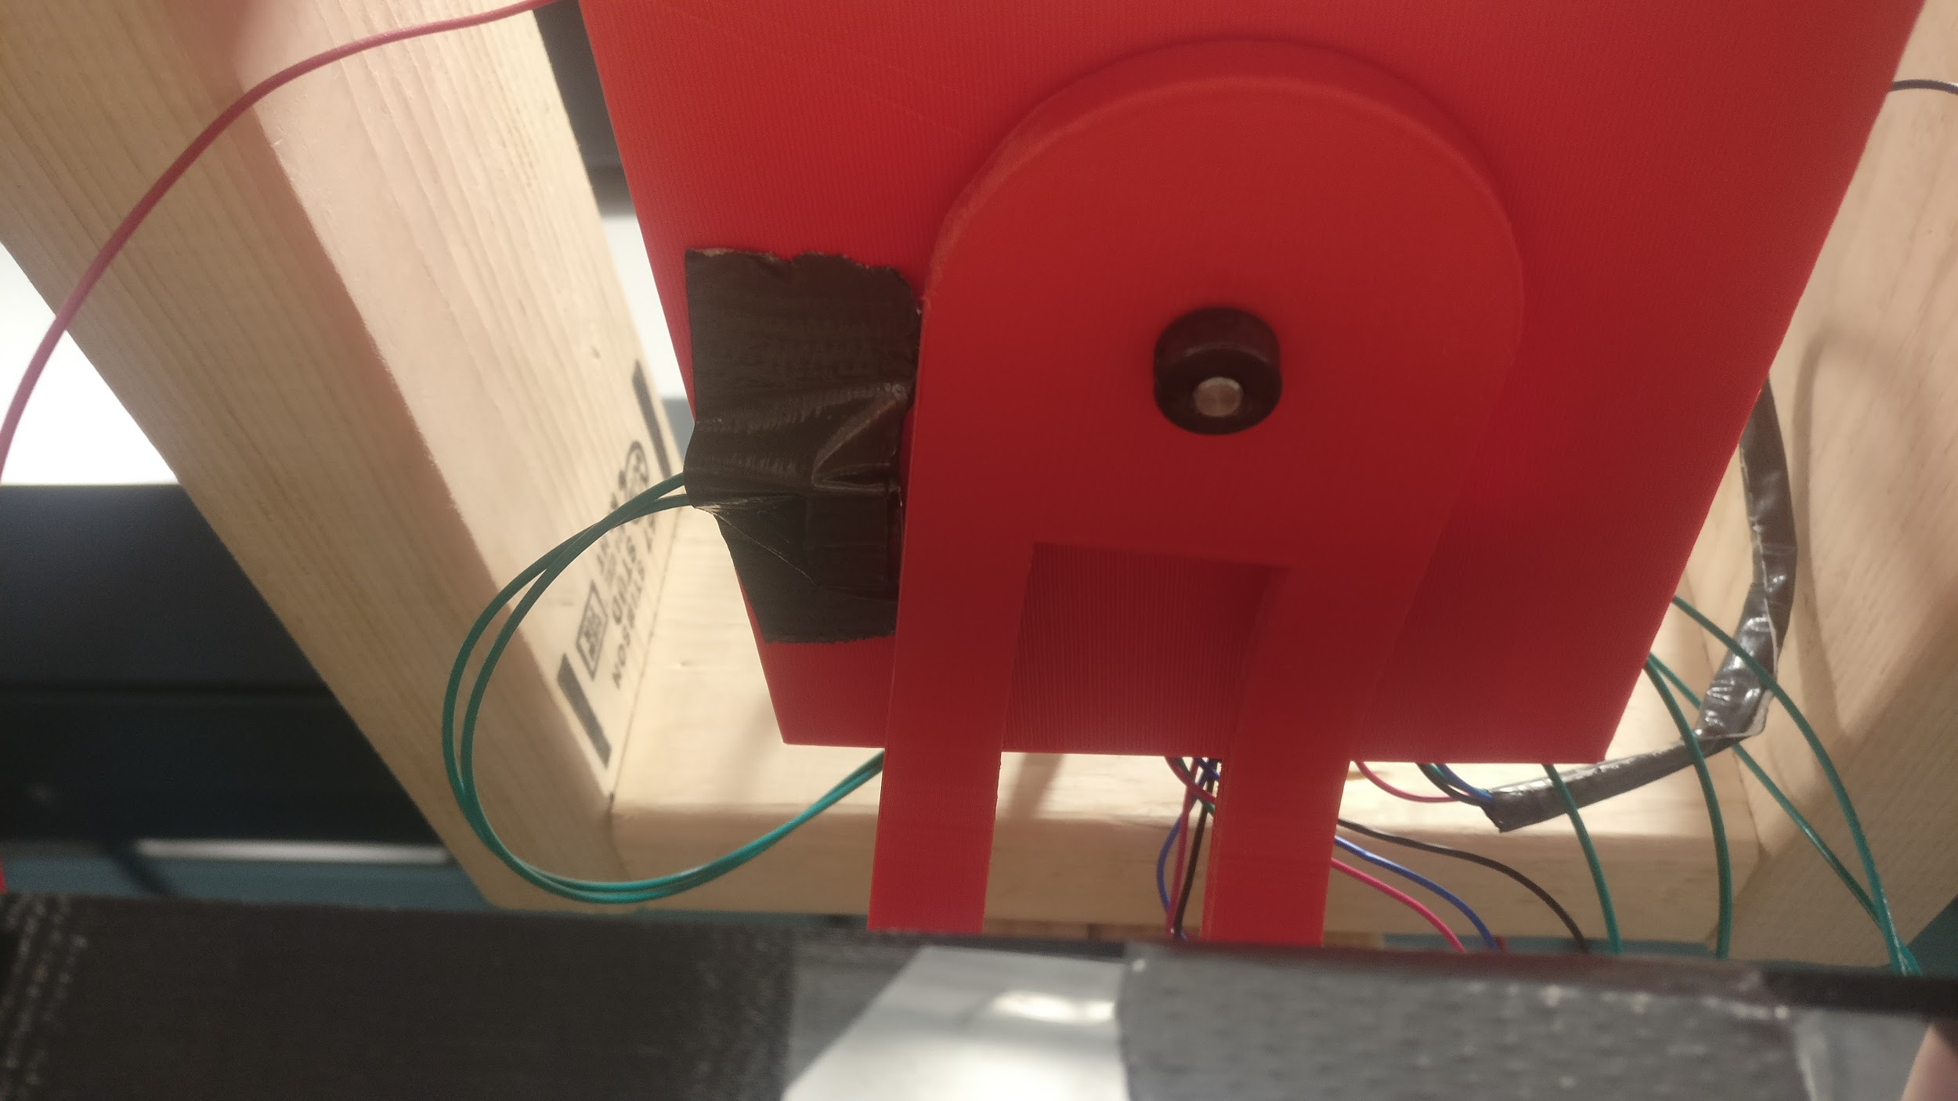
Motors/Limit Switches
Motors will rotate mount until switches come into contact with mount
Absolute point of reference for software
Notes:
Derek

Slide 16
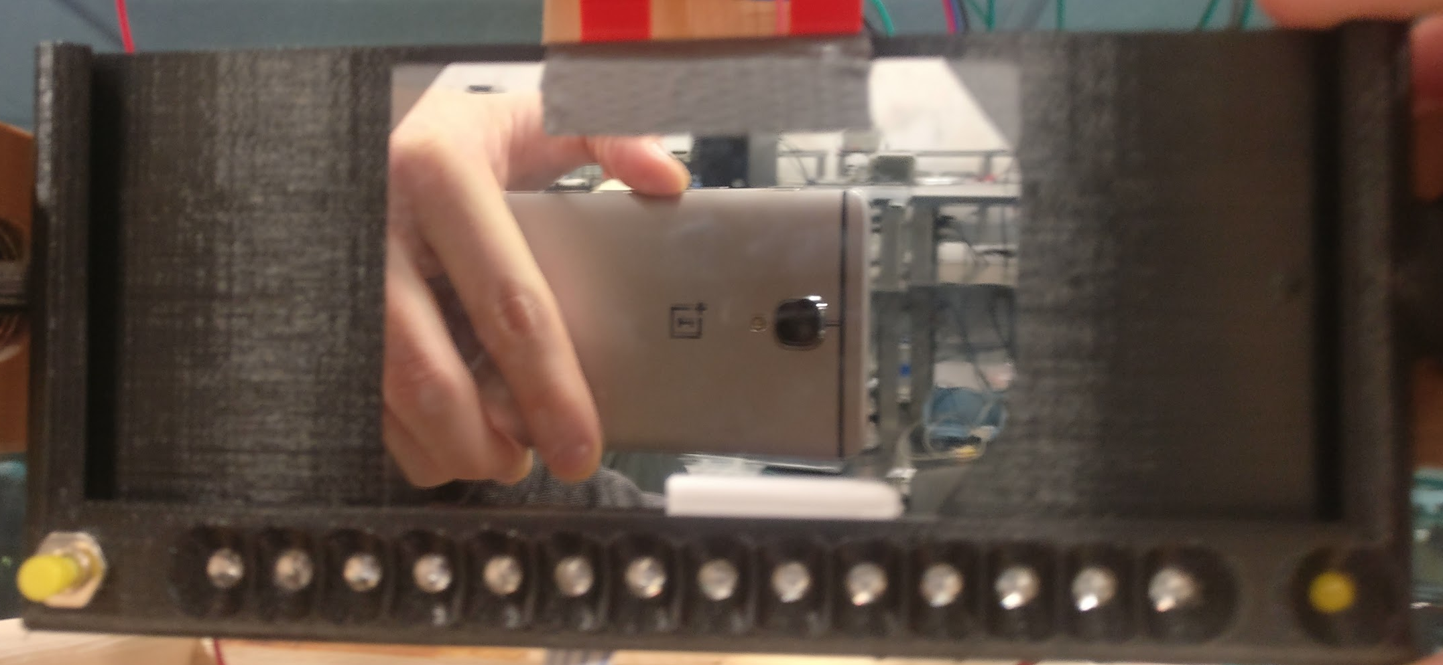
Mirror Mount
Holds mirror, status LED, IR LEDs, calibration button
Button
IR LEDs
Status LED
Notes:
Tommy

Slide 17
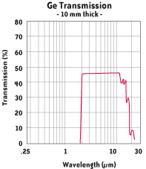
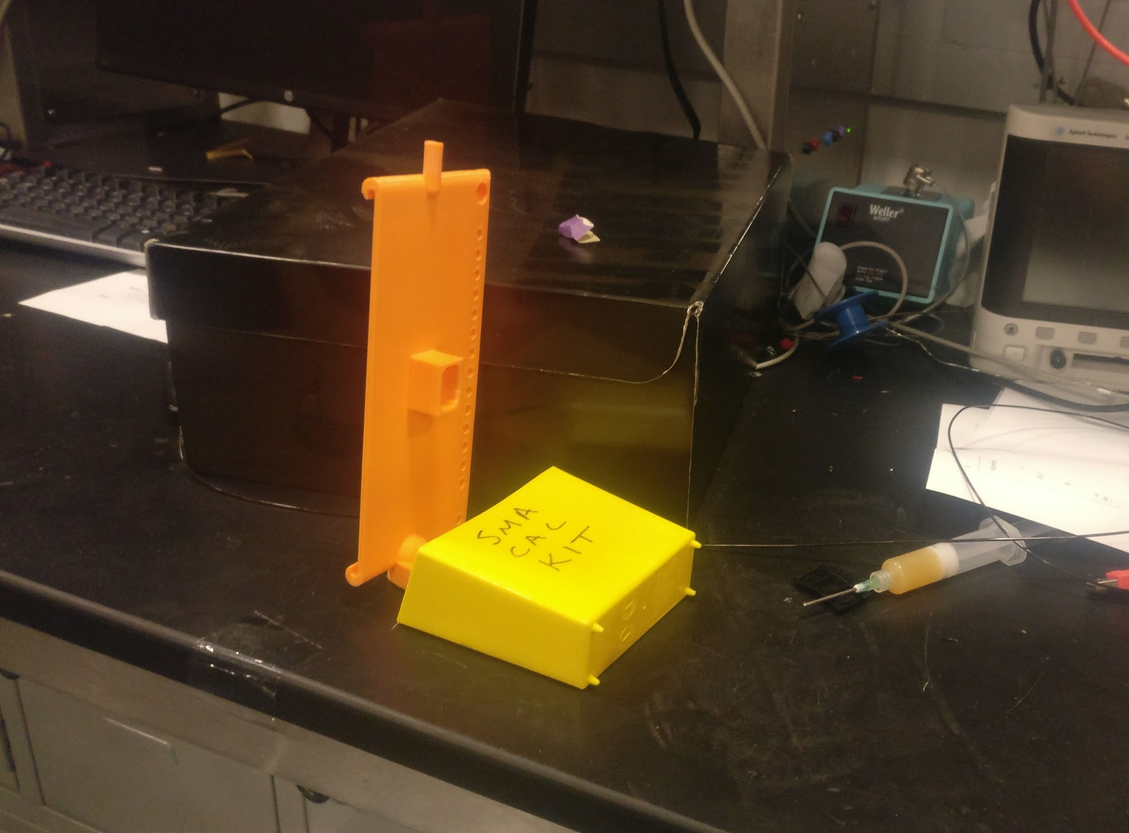
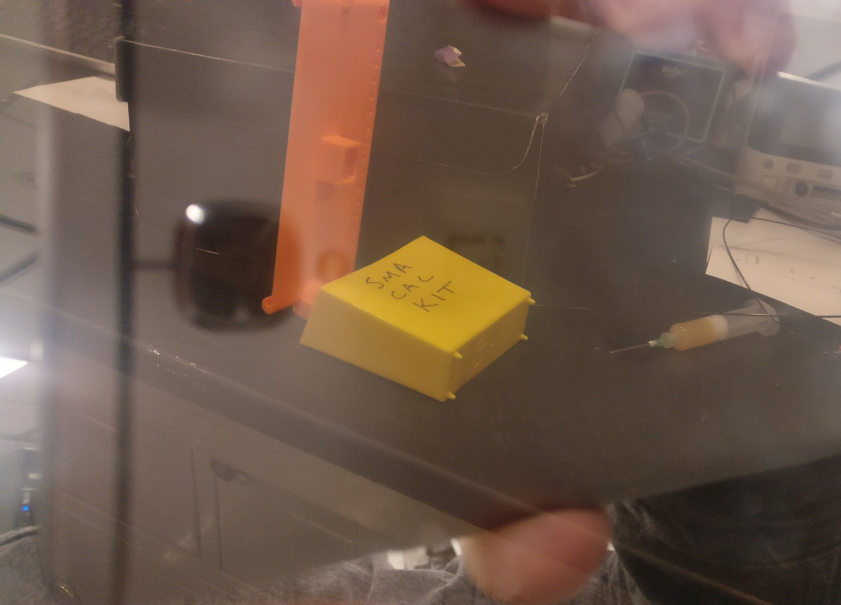
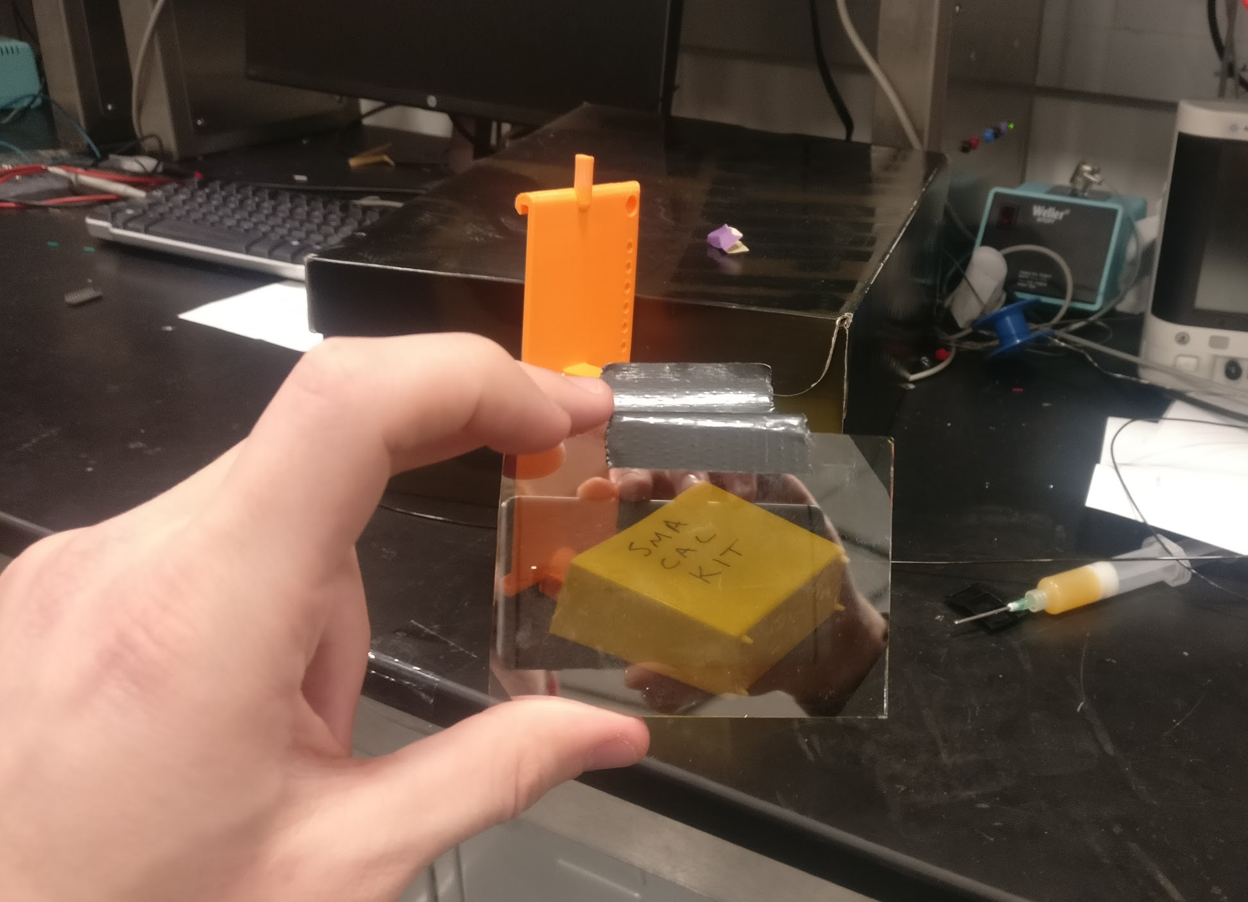
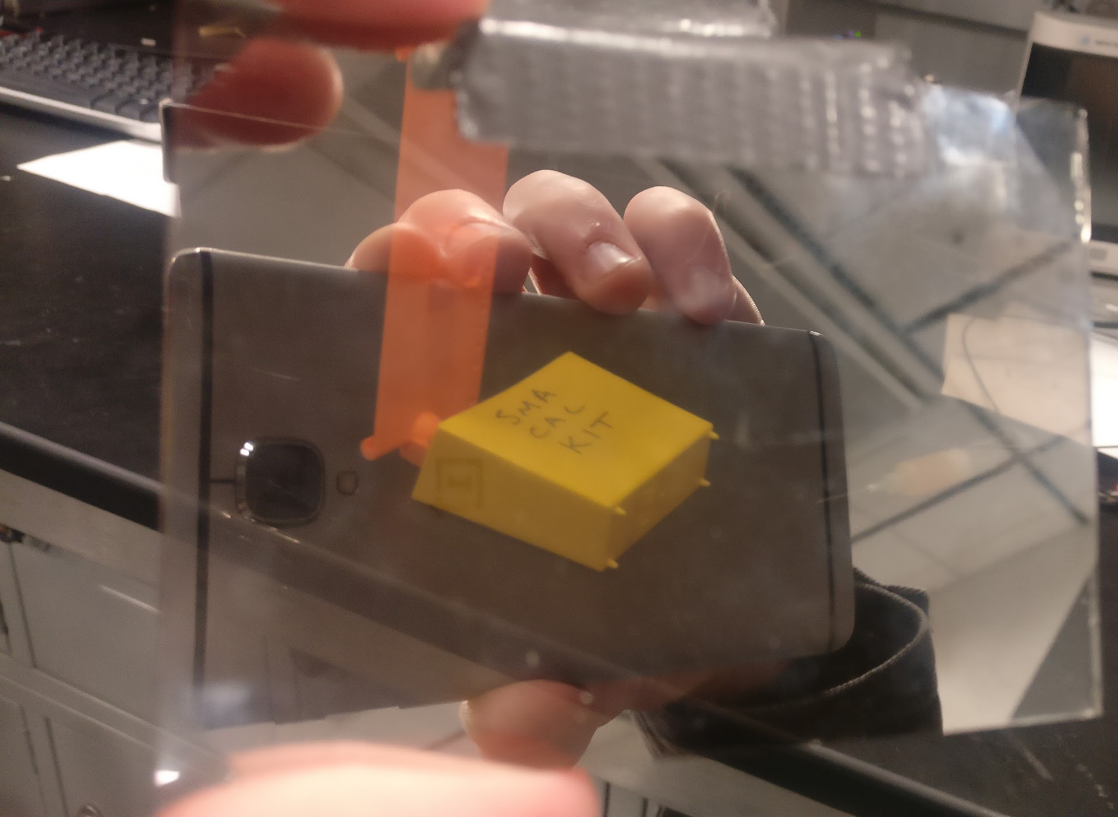
Mirror
20nm Germanium
Durable, slightly duller than Silver
Layer is reflective, with enough transmittance for IR camera functionality
Notes:
Derek

Slide 18
Successes
3D printed mounting mechanism had expected rotational behavior
Face tracking software could successfully detect faces and eyes
Driver circuits functioned as expected
Communication between CPU and MCU functioned as expected
Mirror material had acceptable visibility
Mounting mechanism can make proper adjustments
Notes:
Adam

Slide 19
Failures
MCU circuit never quite worked
Issues with stock bootloader and programming
Stepper motors not stable enough
Lack of D-shaft on motor prevented stable connections on mechanism
Power circuit couldn’t sustain load
IC couldn’t dissipate enough power despite datasheet ratings
Face tracking a tad slow
Lack of computational power on CPU
Notes:
Adam

Slide 20
Further Hardware Improvements
Acquire higher torque motors with D-shaft style shafts.
Construct mounting mechanism out of a more rigid material.
Debug onboard CPU and Voltage Regulator circuitry for full on-chip functionality.
Add rotary encoders for closed loop control of motors.
Notes:
Derek

Slide 21
Further Software Improvements
Characterize pixel-to-angle location, synching up motors to the camera.
Improve functional Arduino to RasPi communications.
Select appropriate values for determining when the mirror should and should not adjust.
Notes:
Tommy

