Slide 1
Parking Space Monitoring System
ECE 445 Fall 2017
Team 39
Alex Kapustka, Nauman Qureshi, Elias Velez

Slide 2
[1]https://blog.allstate.com/wp-content/uploads/2012/07/Parking-Lot-iStock.jpg
Notes:
Elias, Alex, Nauman

Slide 3
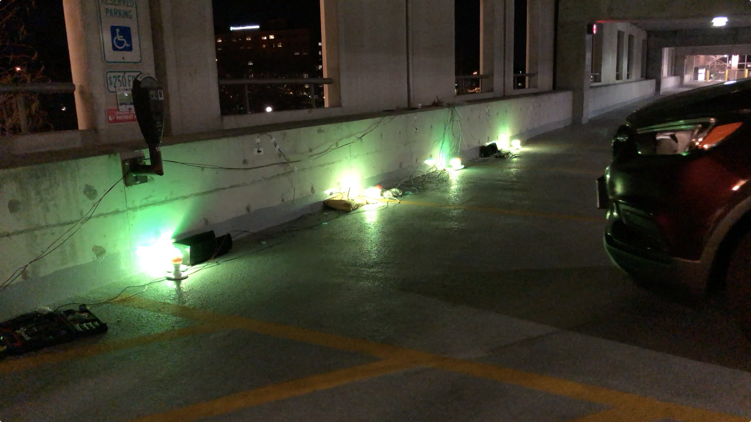
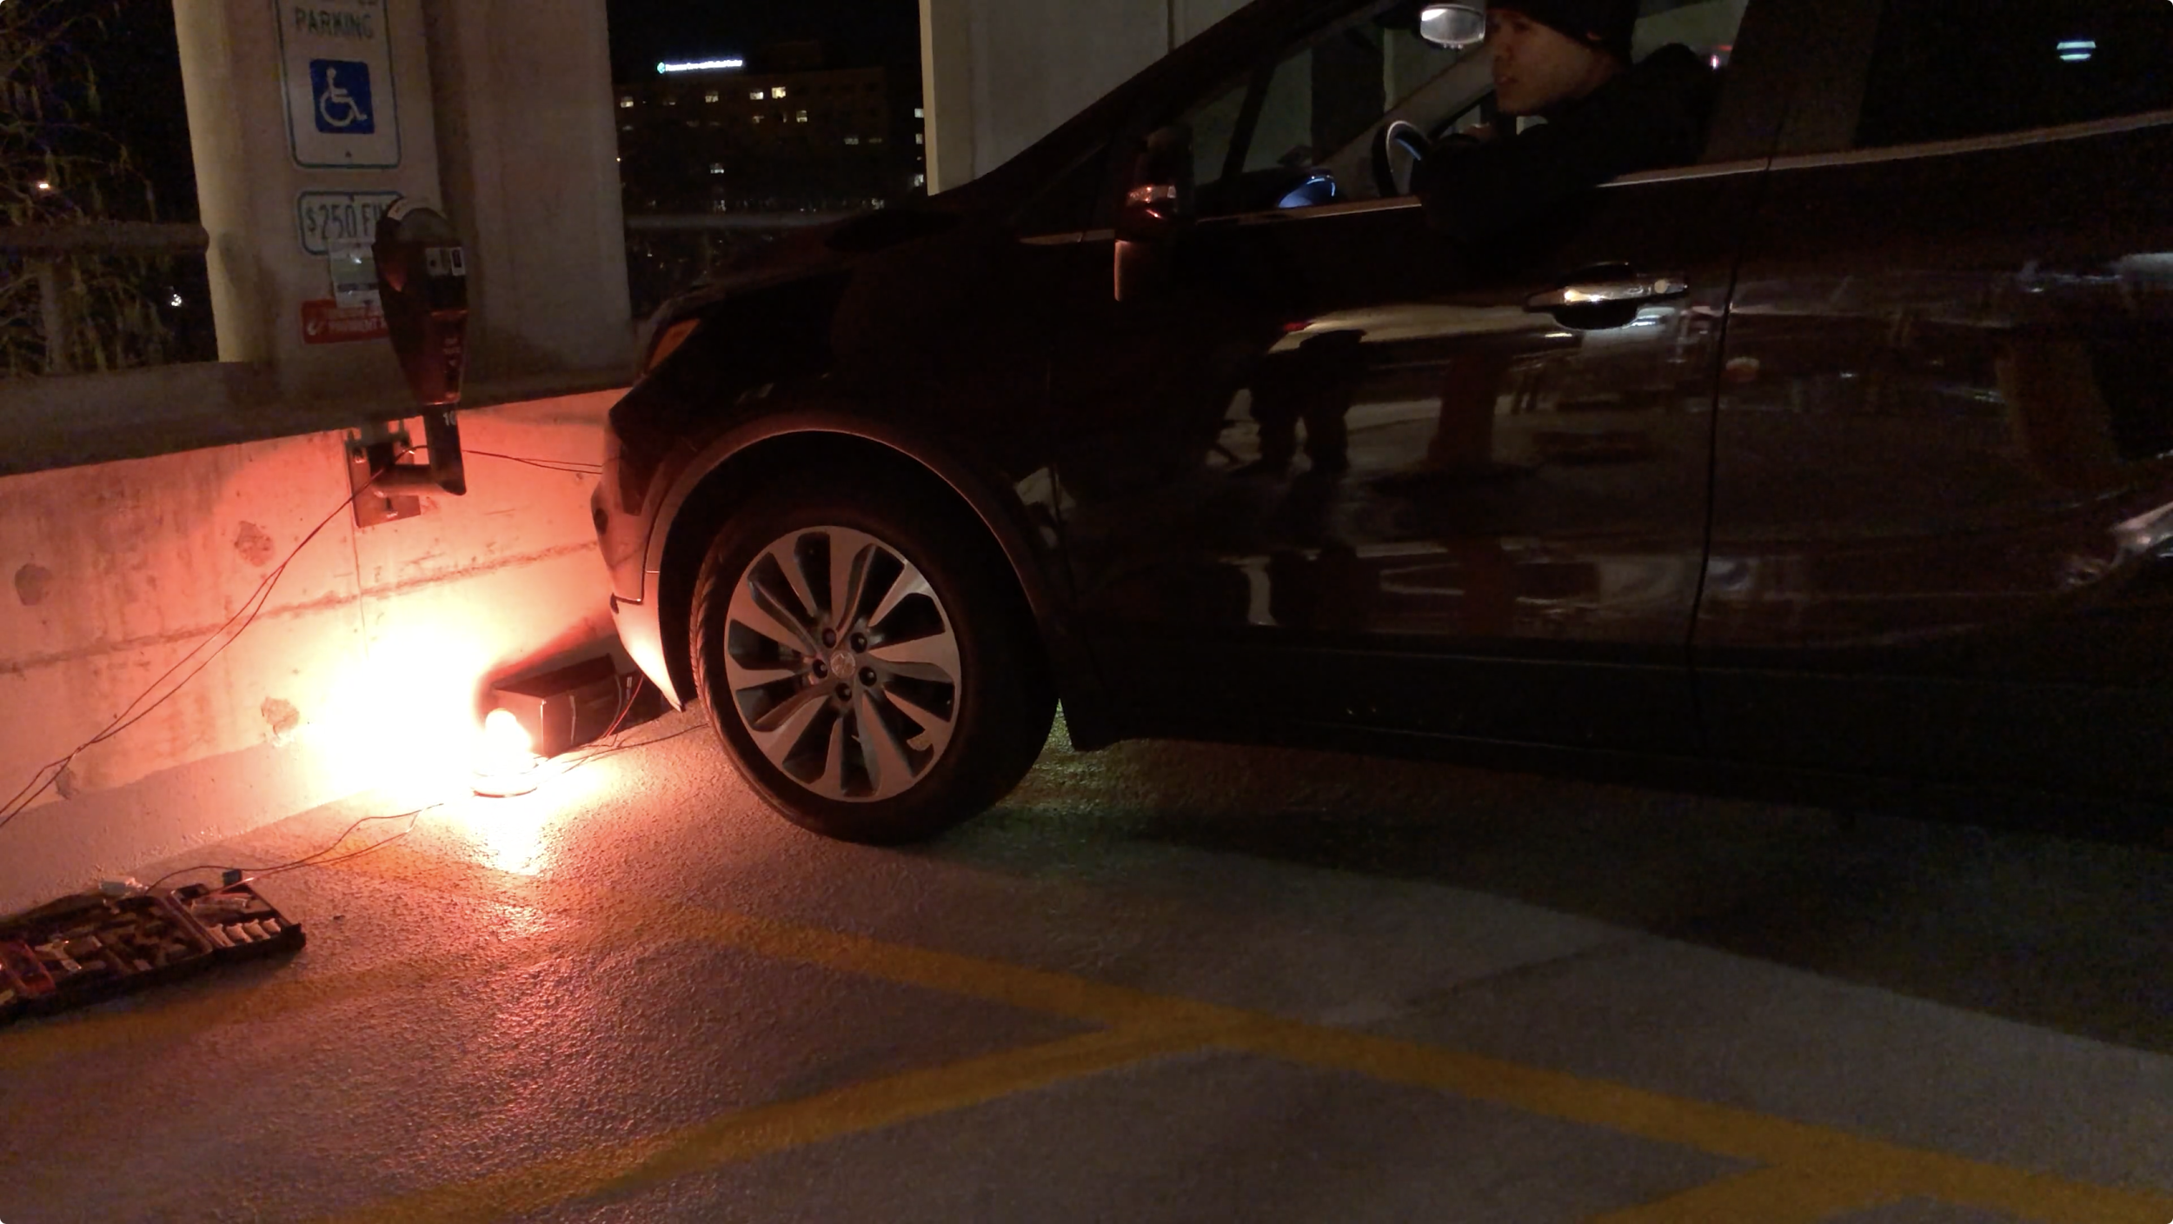
Proposed Solution
System capable of remotely monitoring the status of parking spaces
Intuitive visual interfaces for communicating to drivers
Notes:
Nauman
Elias NEXT

Slide 4
Objectives
Wireless RF transmission of parking spot status data
Visual indicator of vacancy/occupancy at individual parking spots
Aggregation of parking spot data at central hub for visual display
Notes:
Elias
Nauman NEXT

Slide 5
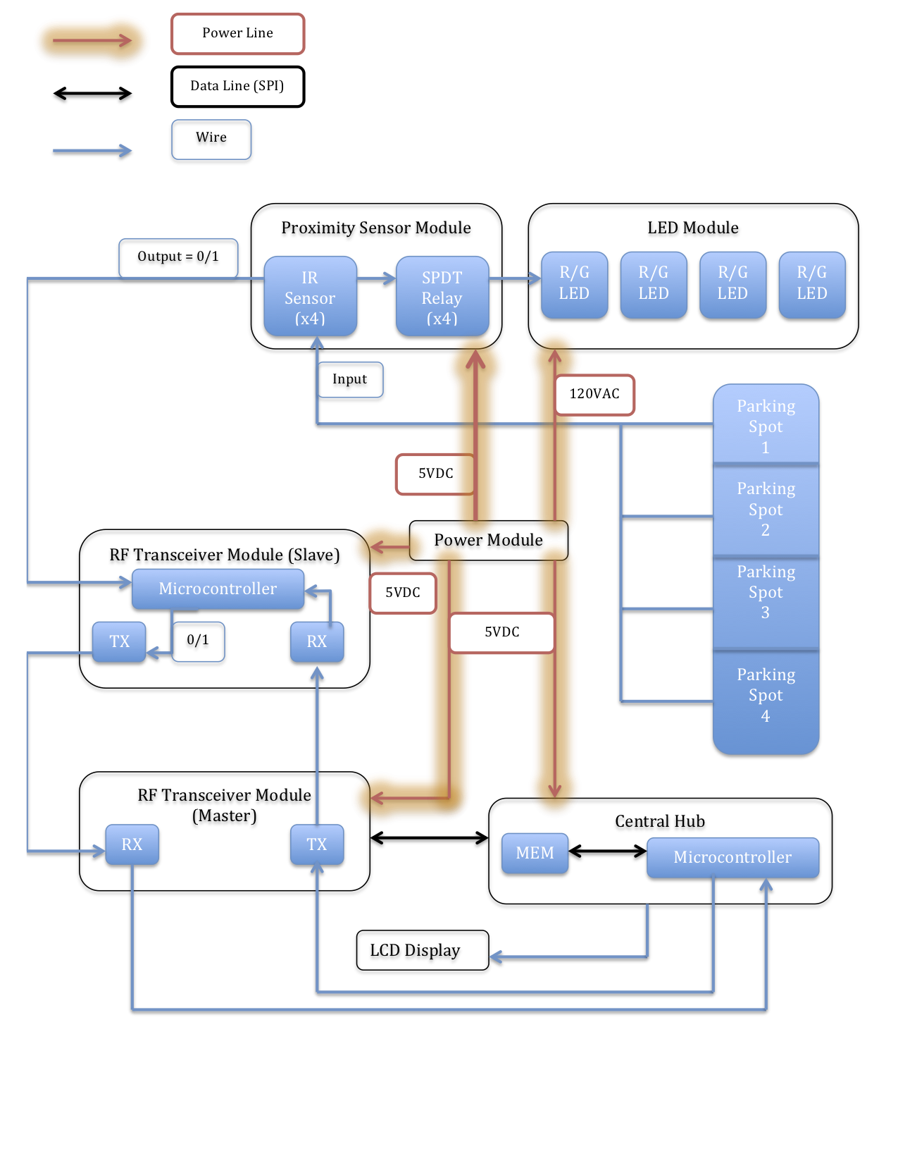
Notes:
Nauman
Alex NEXT

Slide 6
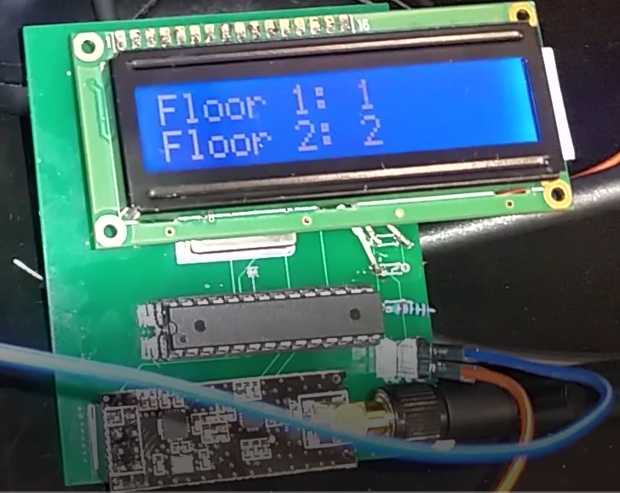
Project Overview
In-Spot Monitoring and Display
Proximity Sensor
LED
RF Transmission and Data Aggregation
Slave/Master RF
LCD
Notes:
Alex
Alex NEXT

Slide 7
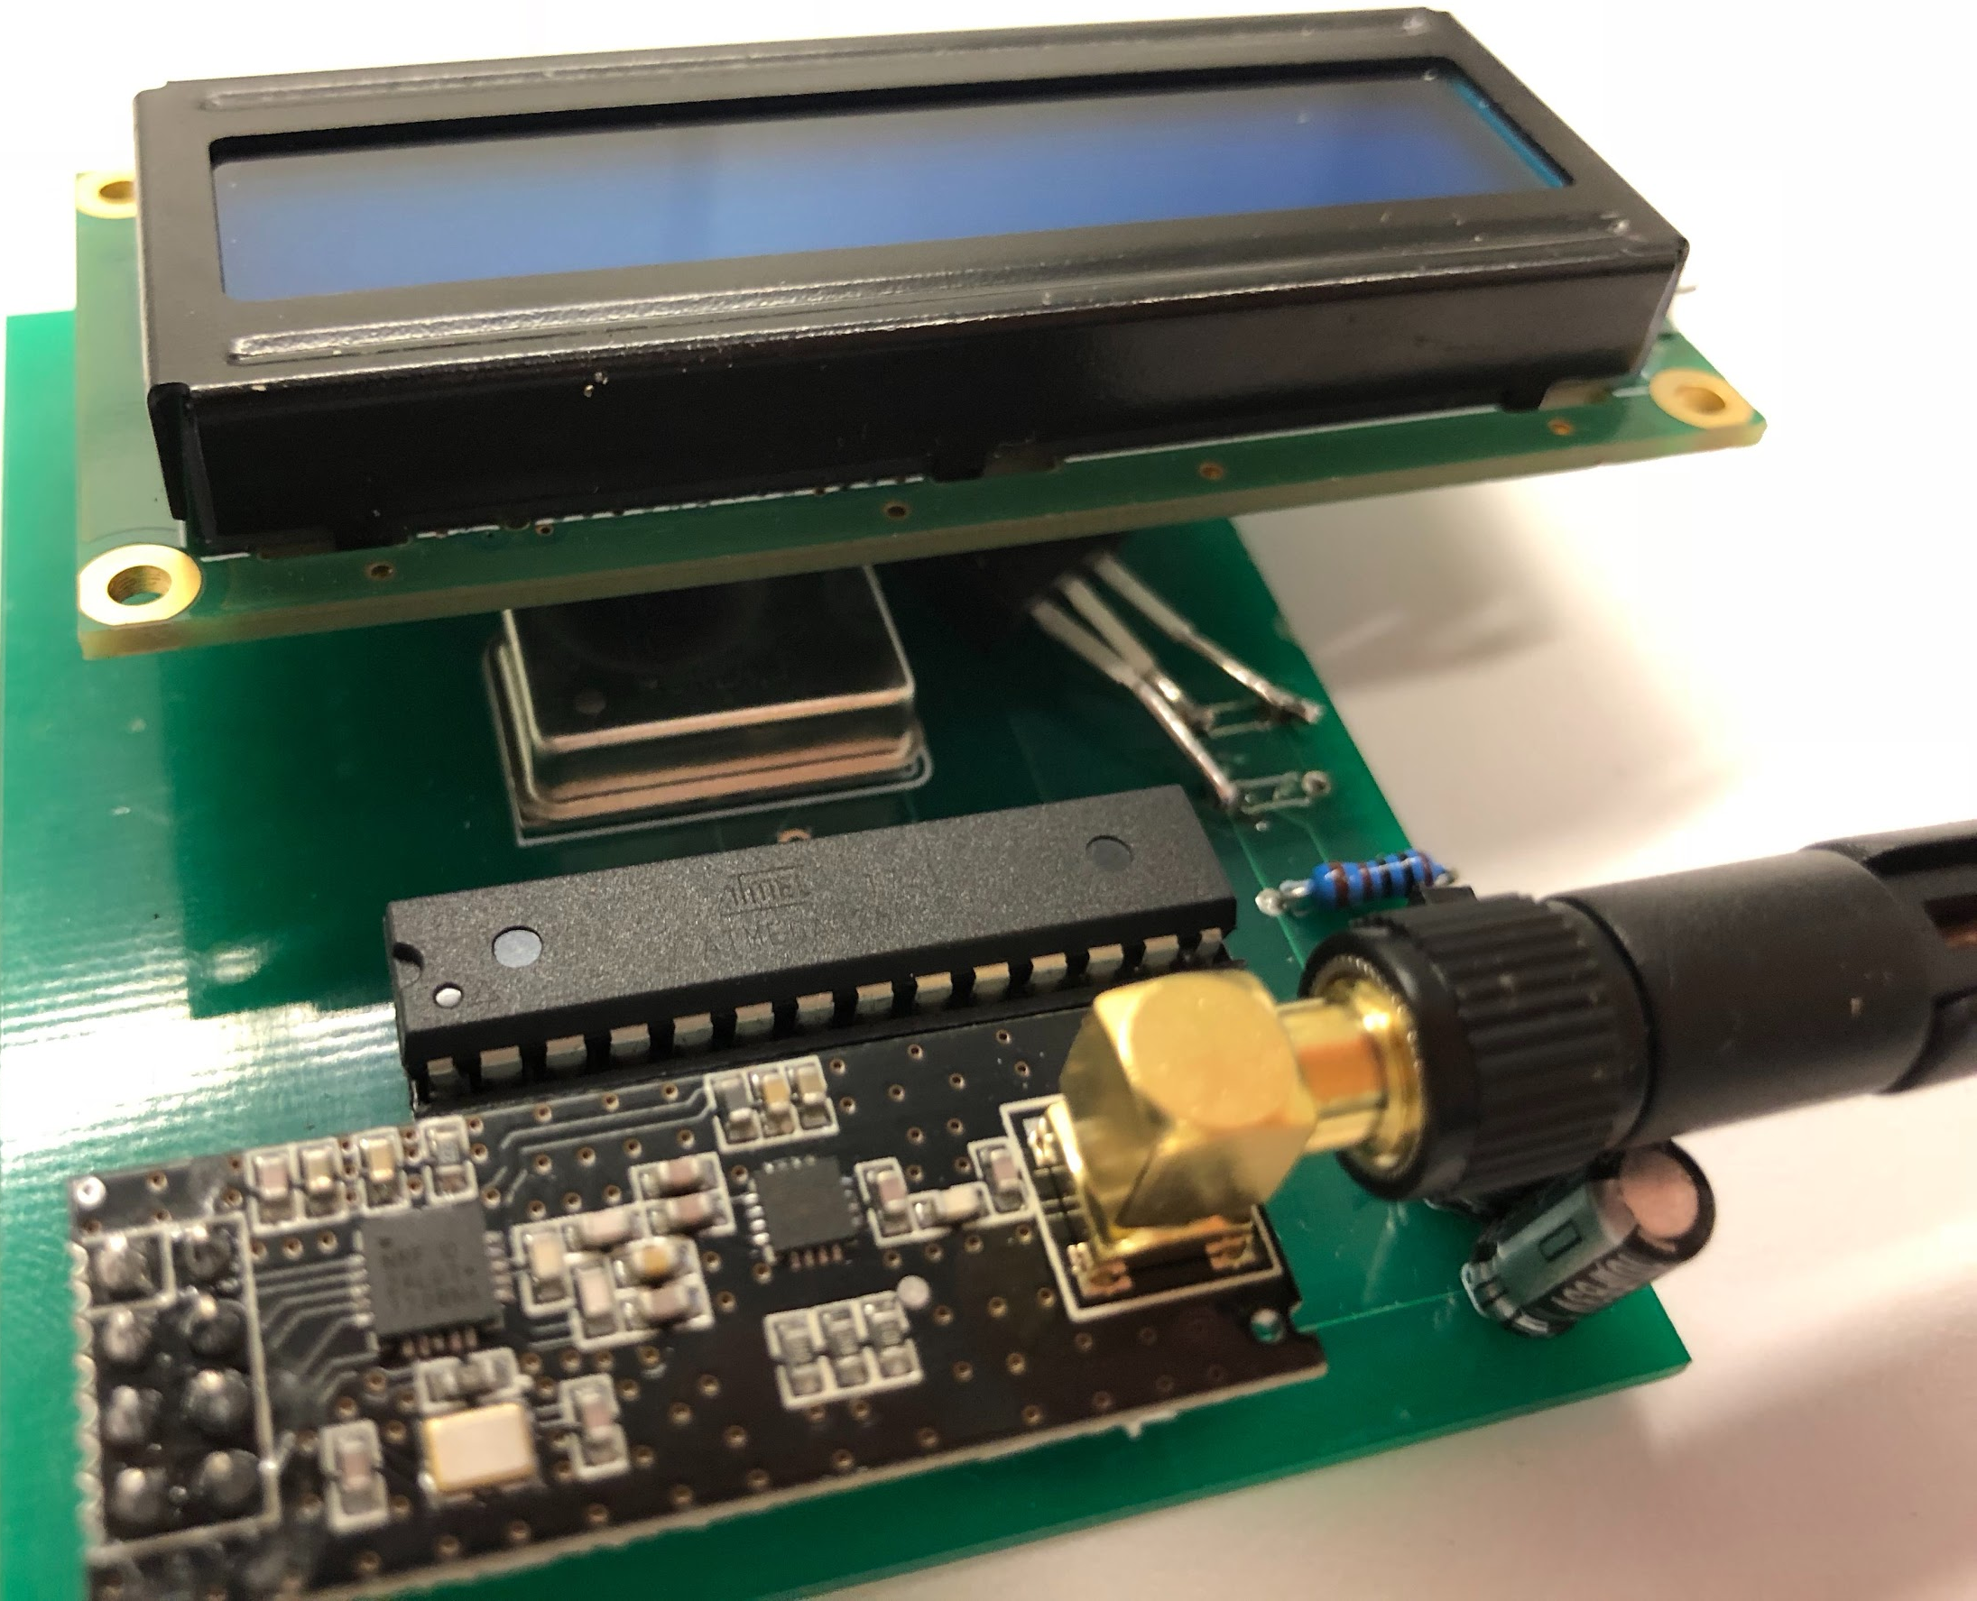
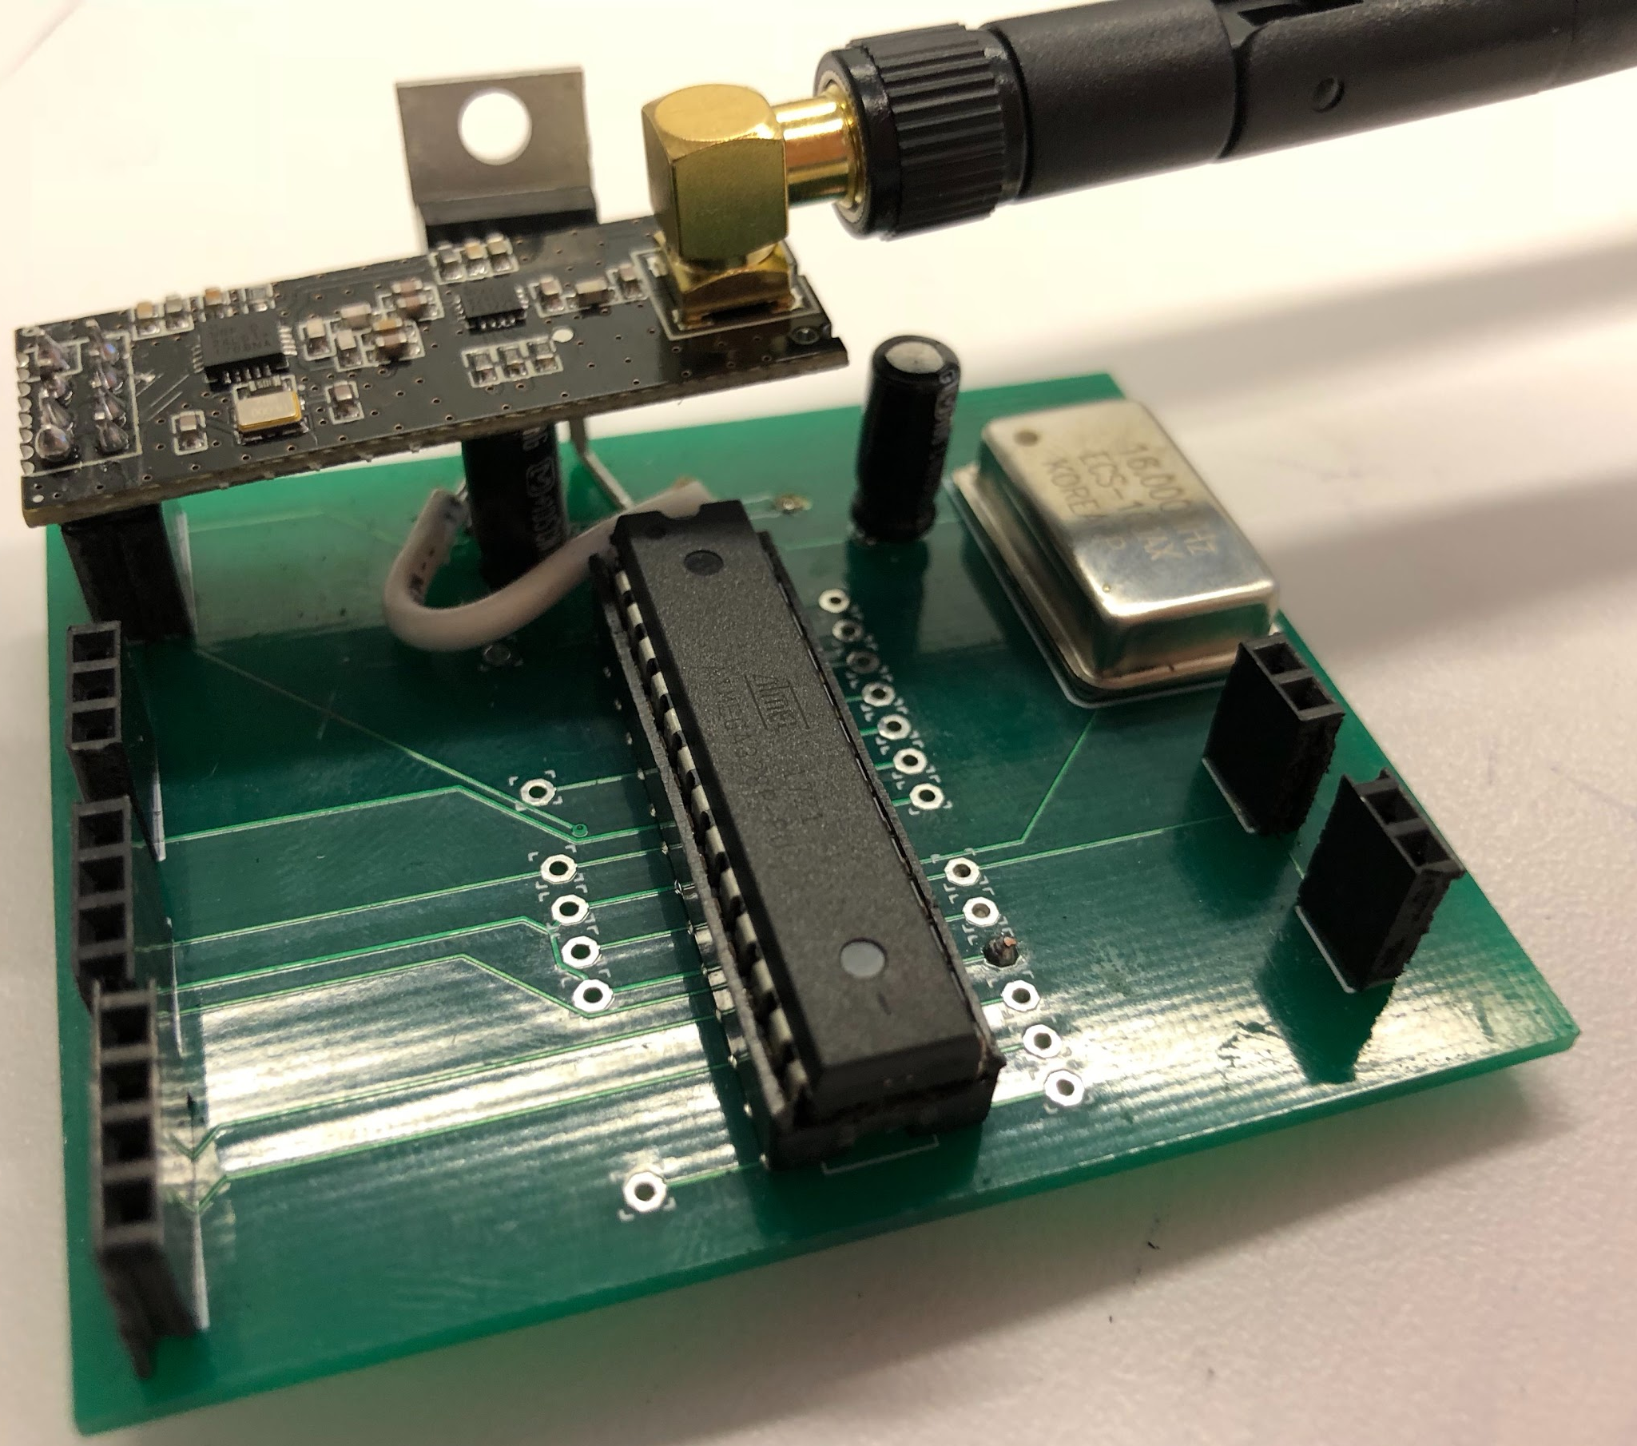
Master PCB
Slave PCB
Notes:
Alex
Nauman NEXT

Slide 8
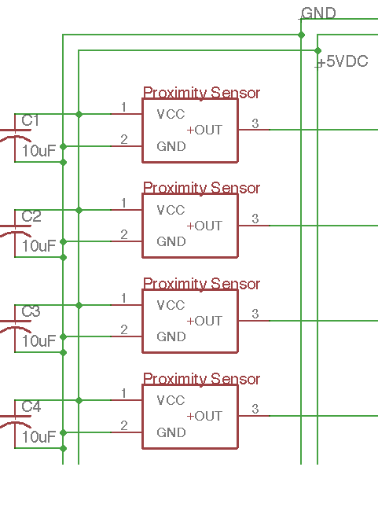
Proximity Sensor
IR Input: 5V
IR Output:
0.25V @ 80cm
3V @ ≤ 10cm
MCU Input:
Analog IR Sensor Output
MCU Output:
≤ 0.25V : Digital 1 (Vacant)
> 0.25V : Digital 0 (Occupied)
Notes:
Nauman
Elias NEXT

Slide 9
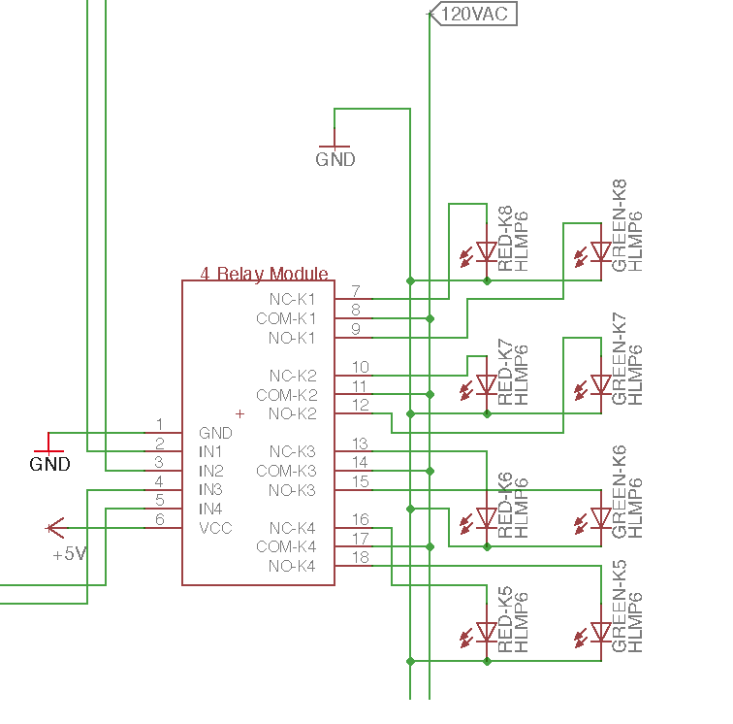
LED
Relay Input: Digital 0/1
Relay Output:
Digital 0 - Red LED
Digital 1 - Green LED
Notes:
Elias
Alex NEXT

Slide 10
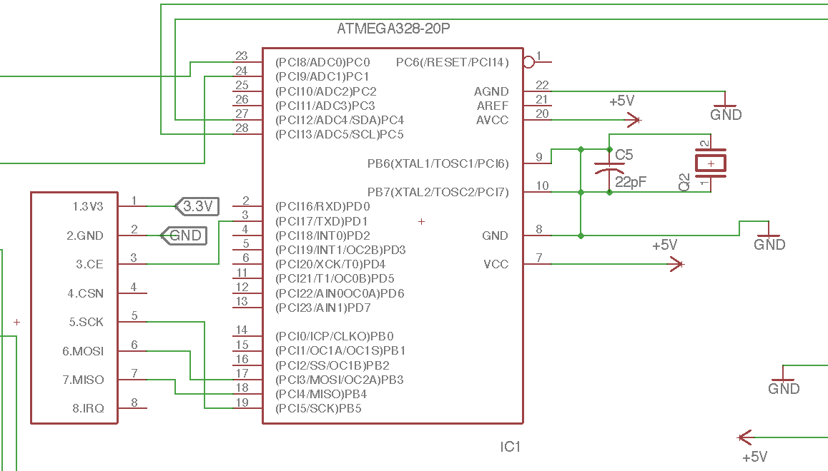
Slave/Master RF
Slave Input:
Occupancy Status
Transmission Allowed
Slave Output:
Occupancy status
Master Input:
Data from slaves
Master Output:
Occupancy status to LCD
TX allowed to slaves
Notes:
Alex
Elias NEXT

Slide 11
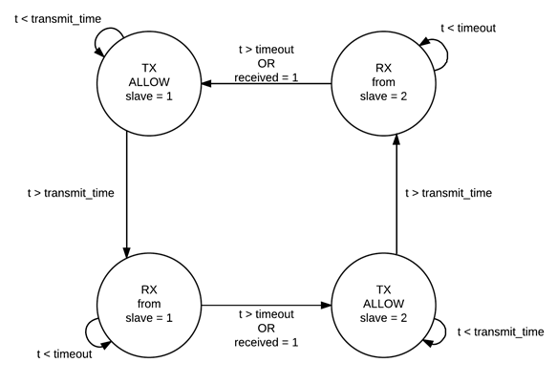
RF Polling
Notes:
Elias
Nauman NEXT

Slide 12
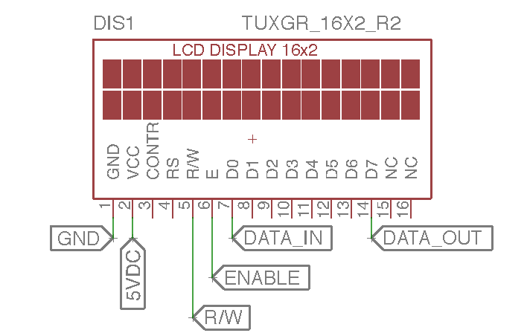
LCD Display
4-bit data mode
Required updated Arduino library
Highest current draw in system (~300 mA)
Notes:
Nauman
Nauman NEXT

Slide 13
R&V
Proximity Sensor Module
Requirement | Verification
IR output: [0.25V, 3V] | Measured voltage using multimeter at 10cm and 80cm
Relay input: digital 0/1 | Measured MCU output for digital 0/1 and verified correct relay switching
Slave/Master RF Module
Requirement | Verification
Transmit and receive data at 2.4GHz | Generate a test signal and observed it using an spectrum analyzer
Sequential polling of data from multiple slaves into a central hub | Echo Master MCU serial output to terminal and viewed periodic data from slaves.
Notes:
Nauman
Elias NEXT

Slide 14
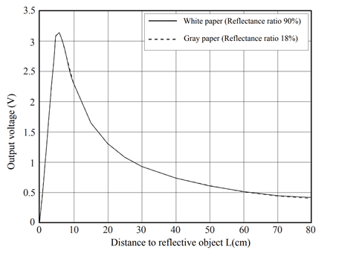
IR Sensor Characterization/Verification
Distance | Voltage Output
5 cm | 2.9 V
10 cm | 2.1 V
40 cm | ~0.5-0.6 V
80 cm | 0.35 V
No blocking | 25-45 mV
0.25 V threshold
Notes:
Elias
Alex NEXT

Slide 15
Successes
Each independent module worked as expected
Overall system worked in the lab environment
Notes:
Alex (Elias narrates over video)
Nauman NEXT

Slide 16
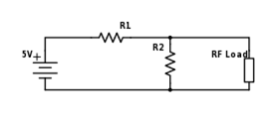
Failed Verifications
Voltage Divider Circuit
Insufficient current
~15 mA vs. ~115 mA
Replaced with voltage regulator
Notes:
Nauman
Elias NEXT

Slide 17
Lab Testing
Timing issues with RF transmission
Synchronization issues between master and slave
Solution: Repeat checking and transmits
PCB tracing issues
Auto-router (Eagle)
Solution: Re-solder wiring on PCB and cut incorrect traces
Notes:
Elias
Elias NEXT

Slide 18
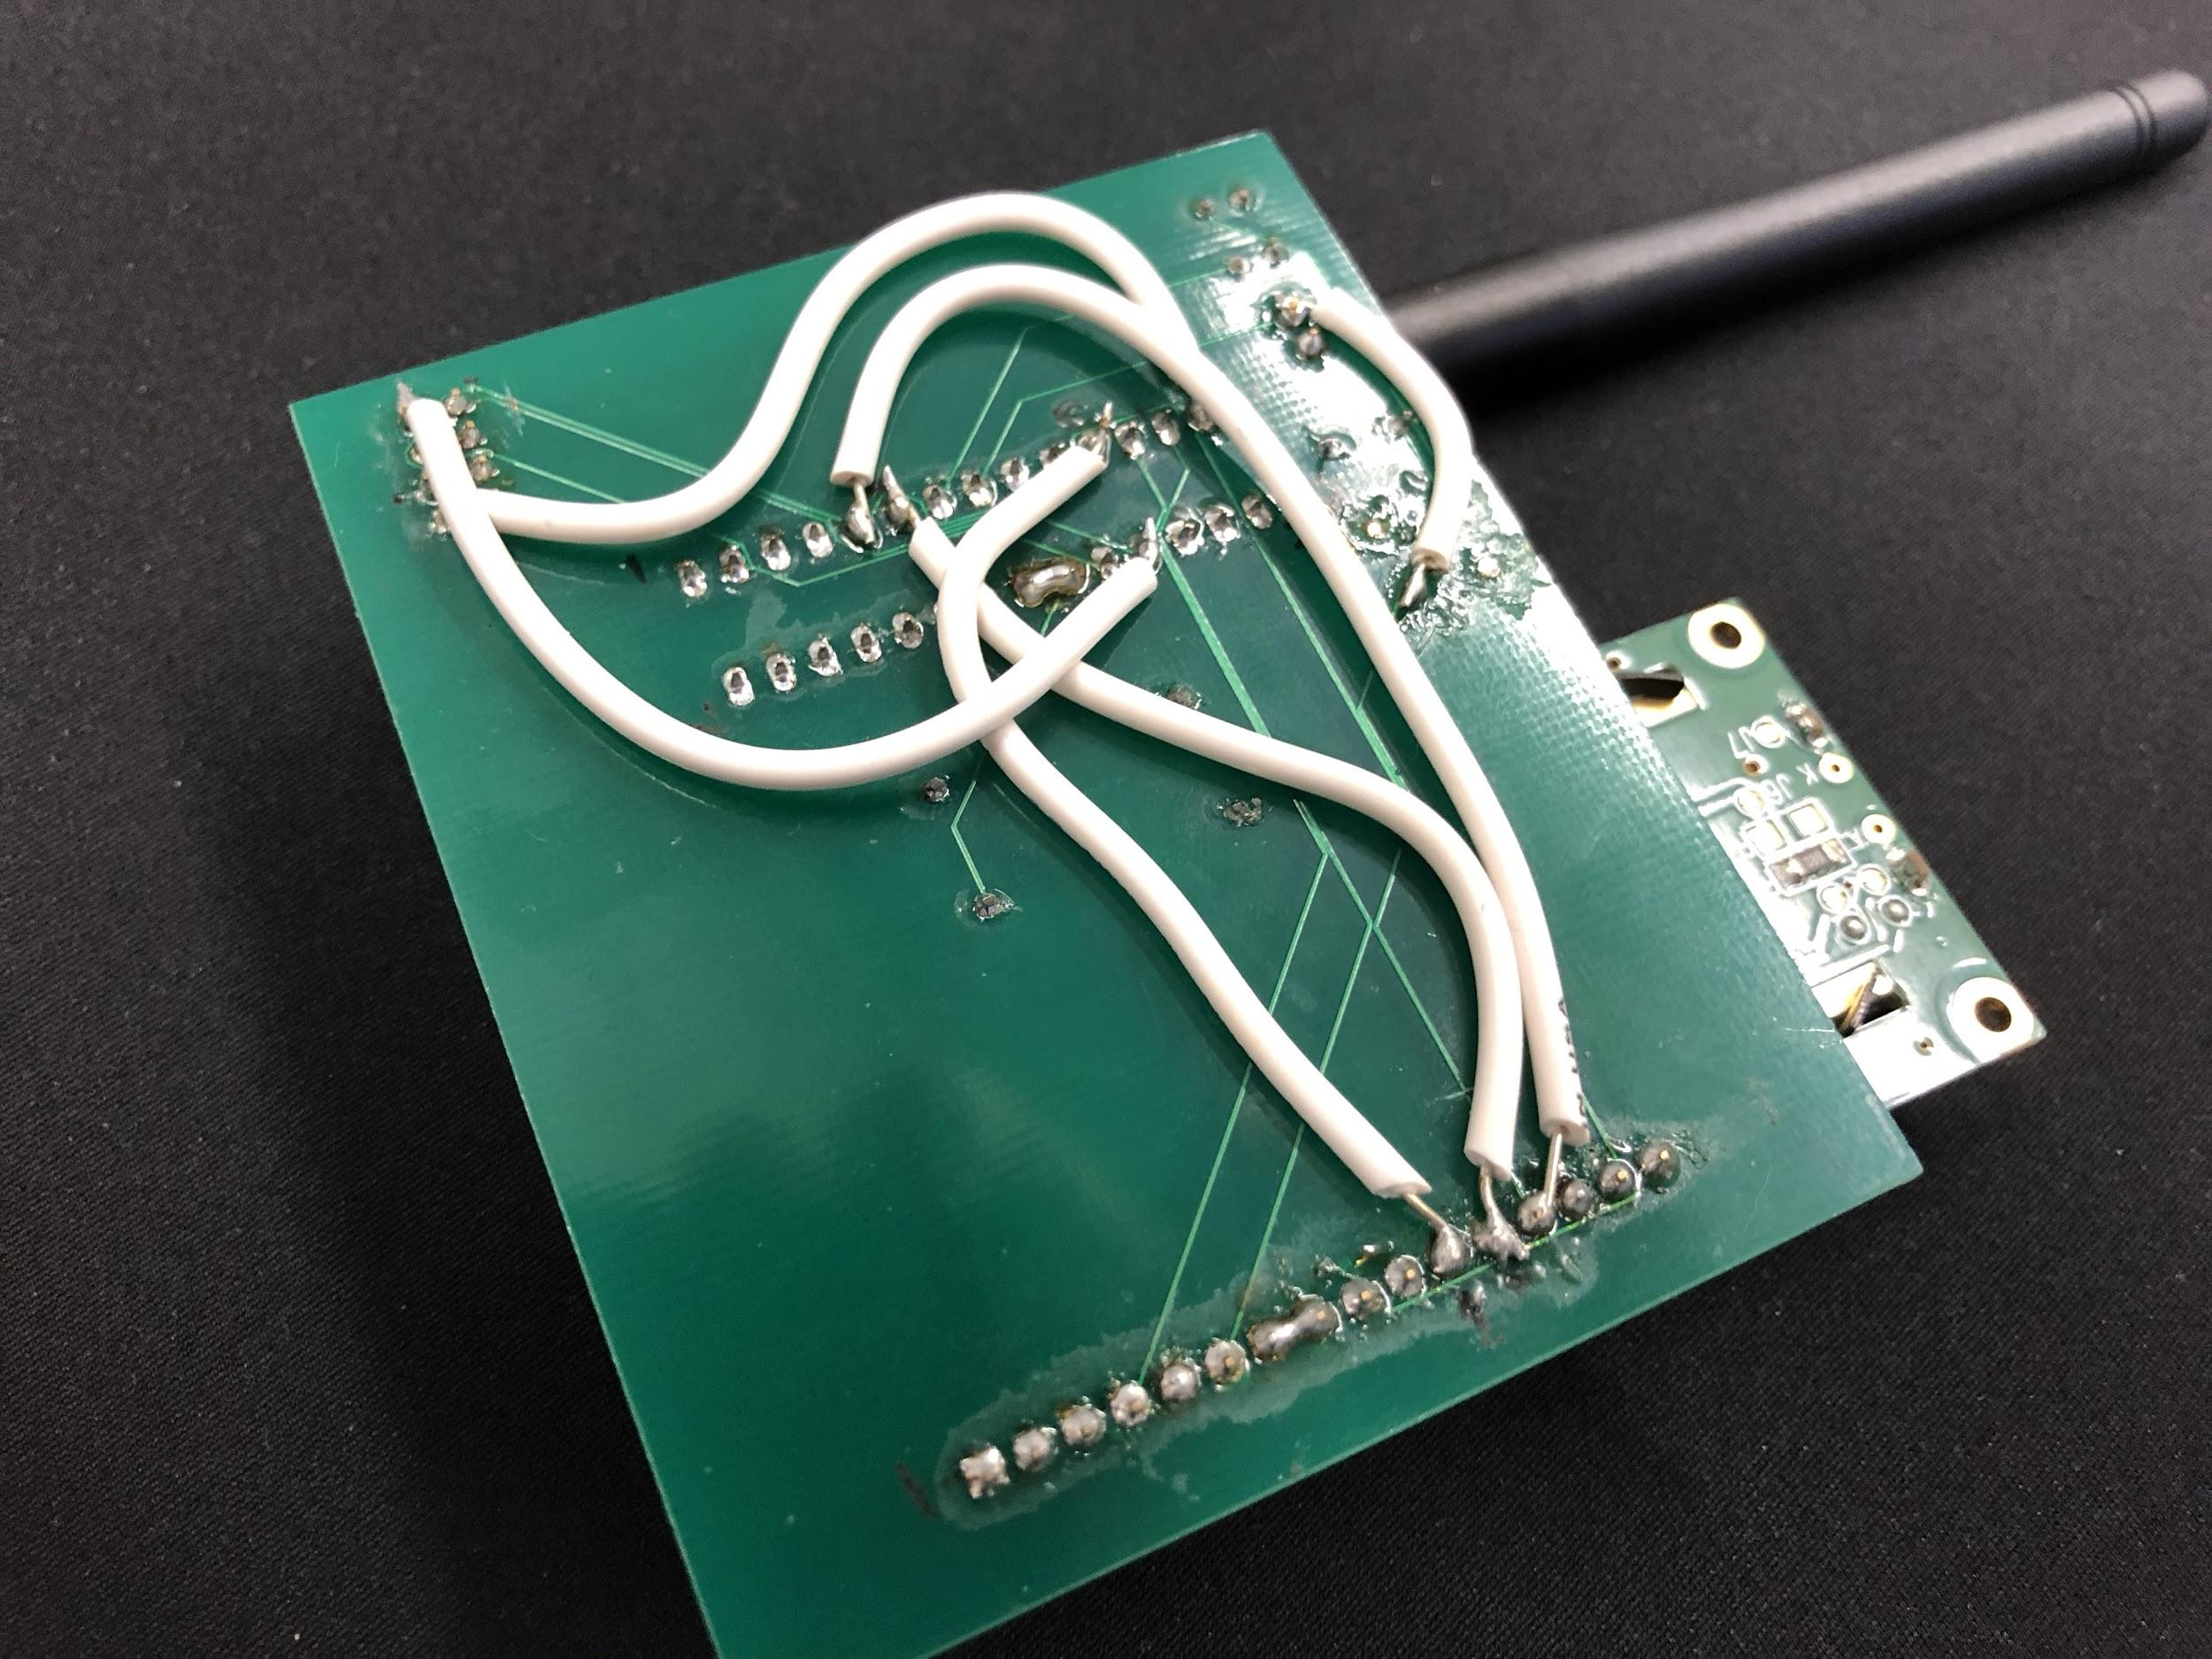
Notes:
Elias
Alex NEXT

Slide 19
Real-World Testing
IR/Relay/LEDs working
Ambient light/shadow interference
Inconsistent RF Transmission
Inconsistent Power Lines
Environment Hazards
Rain
Notes:
Alex
Nauman NEXT

Slide 20
Conclusions
Modules independently tested and verified
Successful integration in lab setting
Real-world reliability issues (testing in parking garage)
Inconsistent RF transmission
Concrete structure
Damage to PCBs
Ambient Light Interference
Notes:
Nauman
Elias NEXT

Slide 21
Future Work
Expansion of sensor network
Improving RF reliability
Optimizing data transmission protocol
IR Sensor Reliability
Shielding against ambient interference
Notes:
Elias
Elias NEXT

Slide 22
Thank You!
Credit to:
Zhen Qin (TA)
Prof. Can Bayram
Electronic Services Shop
Questions?
Notes:
Elias

