Slide 1
Solar RC Boat 49
Team #5: Nisa Chuchawat, Robert Whalen, Zhendong (Mike) Yang

Slide 2
Introduction
Innovate RC Boat
Battery life: 10-15 minutes of playtime for 1.5-2 hours of charge
Operating range: 20-100 meters
No indication if boat goes out of range

Slide 3
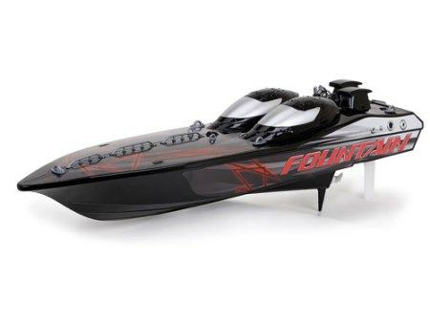
Objectives
Use solar energy to power boat
Extend battery life
Add signal strength detection and indication
https://www.walmart.com/ip/New-Bright-23-Fountain-R-C-FF-Boat/31528113

Slide 4
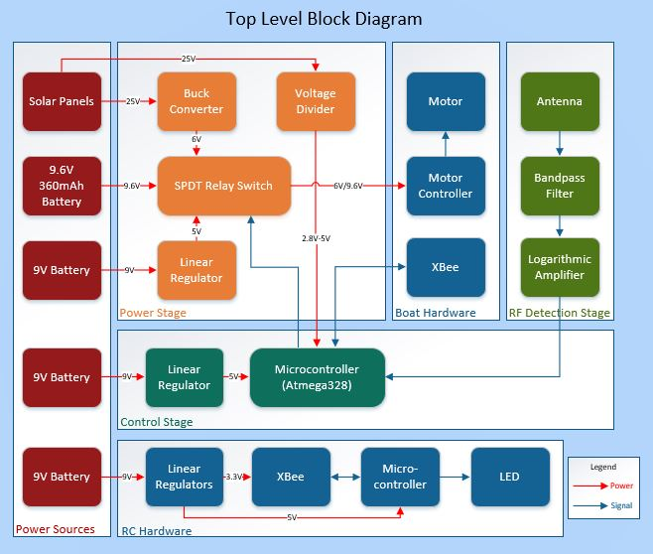
Figure 1: Top Level Block Diagram

Slide 5
Motor Requirements
Voltage (V) | Current (A) | Power (W)
3 | 0.69 | 2.07
3.5 | 0.84 | 2.94
4 | 1.00 | 4
4.5 | 1.15 | 5.175
5 | 1.34 | 6.7
5.5 | 1.50 | 8.25
6 | 1.71 | 10.26
7 | 2.10 | 14.7
Motor voltage sources:
6V regulated solar voltage
9.6V internal boat battery
Motor runs with 8.7 to 12.5 W
Table I: I-V Characteristics of Boat Motor

Slide 6
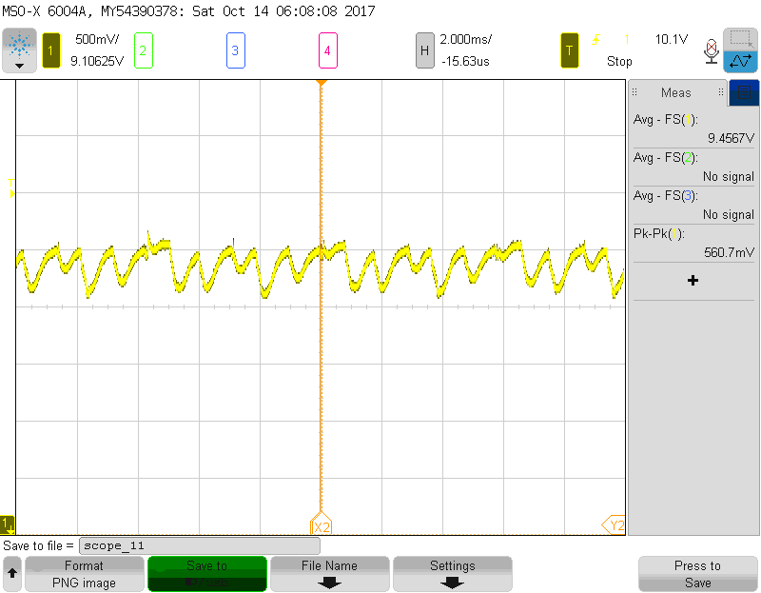
Motor Controller
Original boat hardware
Waits for RC user input
Connects power to motor
Figure 2: Motor controller output waveform with 9.5V power supply

Slide 7
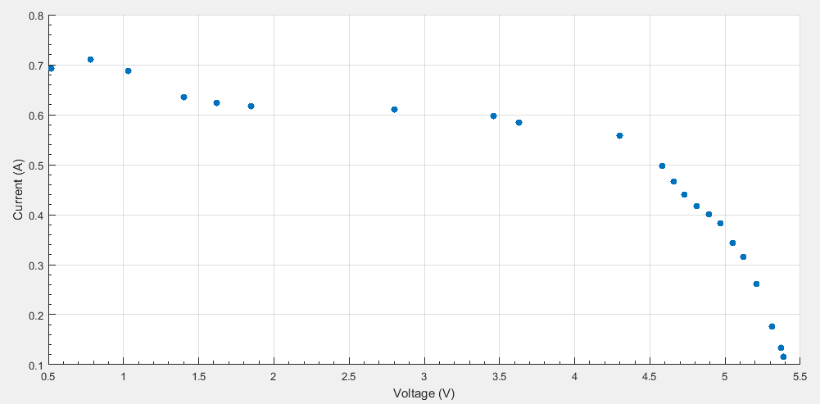
Solar Panels
Five mini encapsulated solar cells
5V, 2.5W
Voltage range: 14.35-25V
Power range: 8.7-12.5W
Figure 3: I-V Characteristic for Single Allpowers Solar Panel for Maximum Insolation

Slide 8
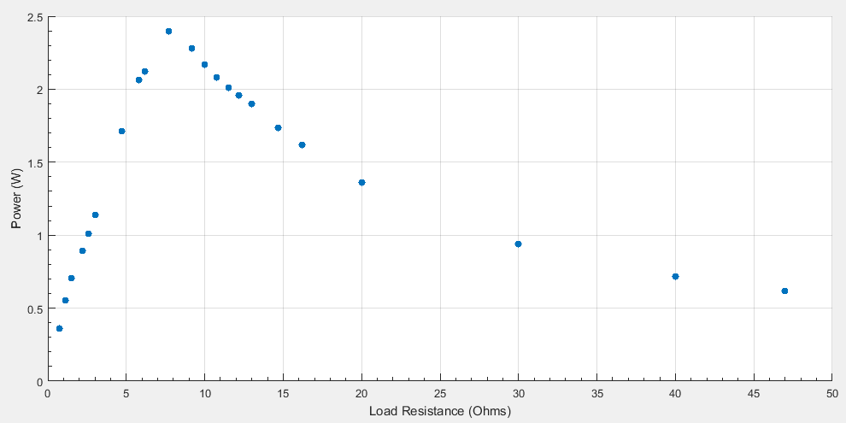
Buck Converter Design
Solar voltage input: ~14-25V
Buck converter output: 6V
Figure 4: Power (W) vs. Load Resistance for single solar cell

Slide 9
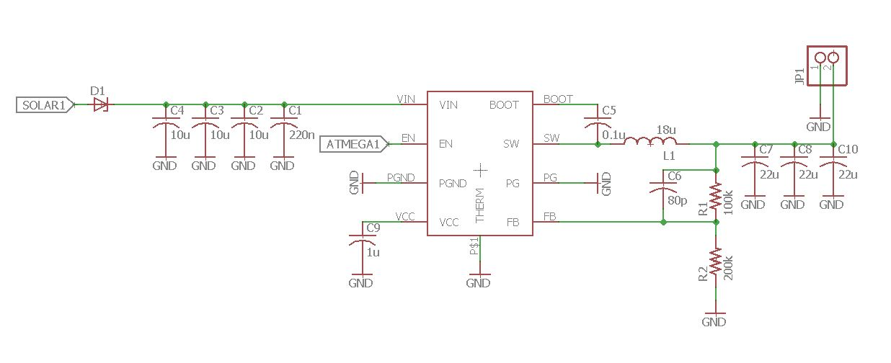
Buck Converter Schematic
Figure 5: Buck Converter Schematic

Slide 10
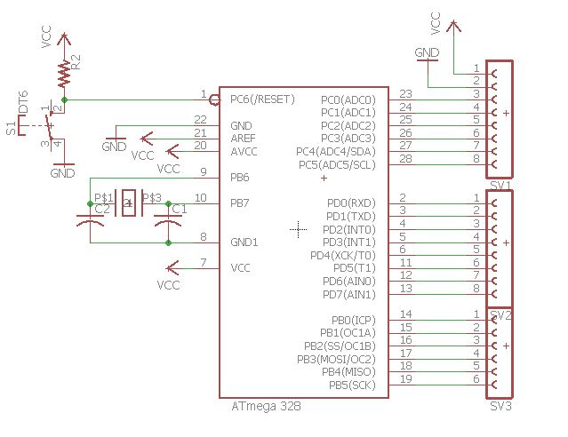
Microcontroller
ATmega328p
Controls SPDT relay
Monitor XBee communication
Figure 6: Microcontroller schematic

Slide 11
SPDT Relay
Normally connected:
6V regulated solar voltage
Energized input:
9.6V internal boat battery
Output to motor controller
Figure 7: Relay switching module

Slide 12
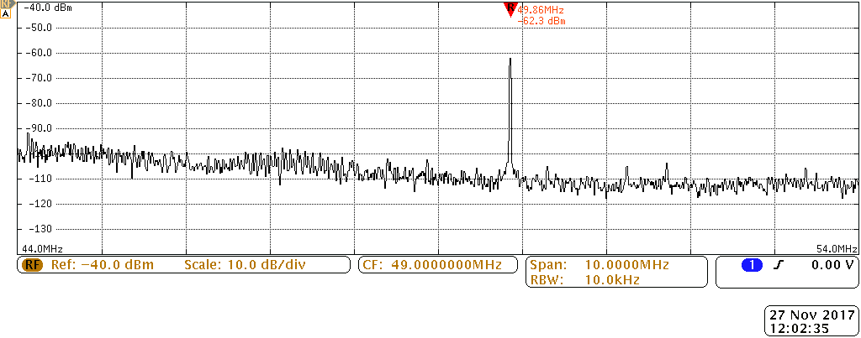
Signal Strength Detection
Logarithmic amplifier - AD8307
V_{out} = V_{slope}(P_{in} – P_{o})
V_{slope} = 25V/dB
P_{o} = -84 dBm
V_{out} ~ 0.9 to 2V
Figure 8: Frequency spectrum output using RC

Slide 13
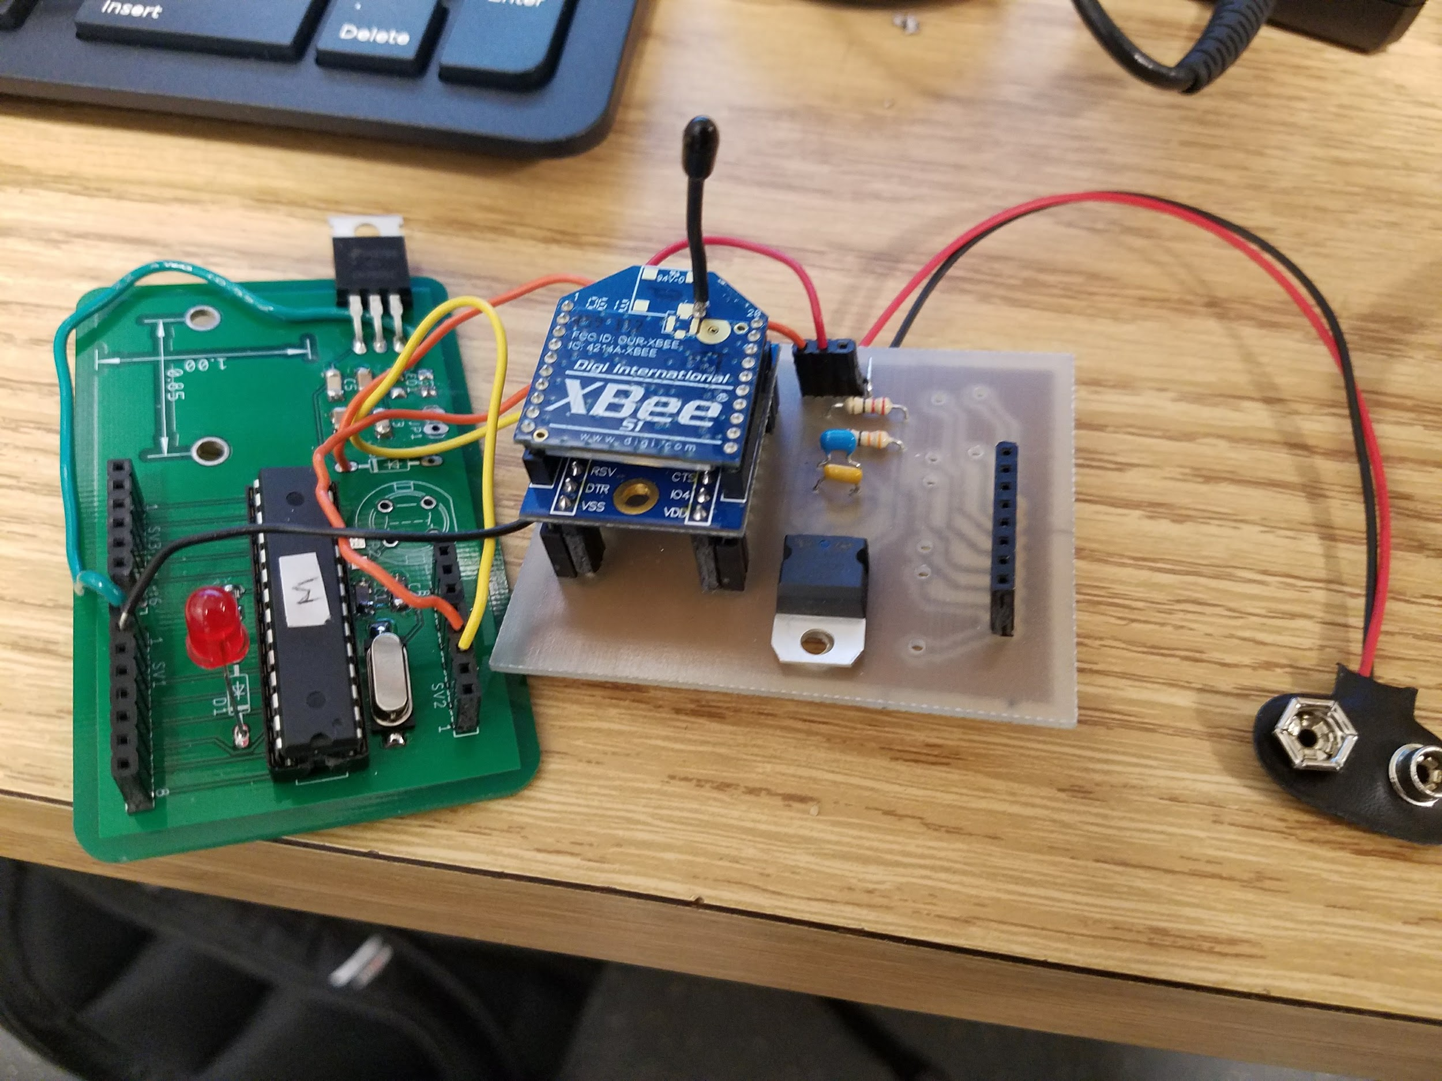
Signal Strength Detection
XBee
Radio communication module - 2.4GHz
RSSI
Threshold: -99dBm
Indicate with LED
Figure 9: RC XBee module

Slide 14
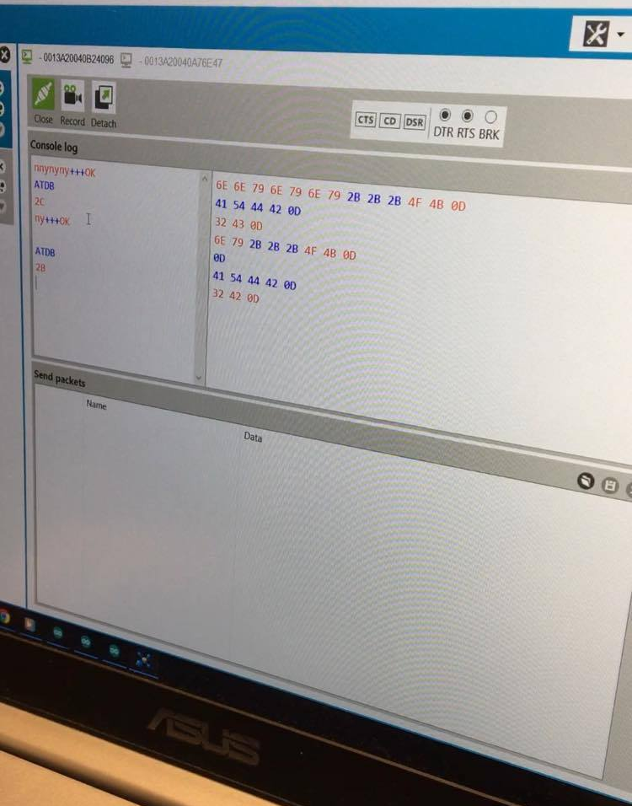
Testing XBee
Distance (m) | RSSI | Power (dBm)
0 | 0x44 | -68
3.25 | 0x56 | -86
7.05 | 0x63 | -99
11.65 | 0x77 | -119
Table II: XBee data
Figure 10: XCTU Console

Slide 15
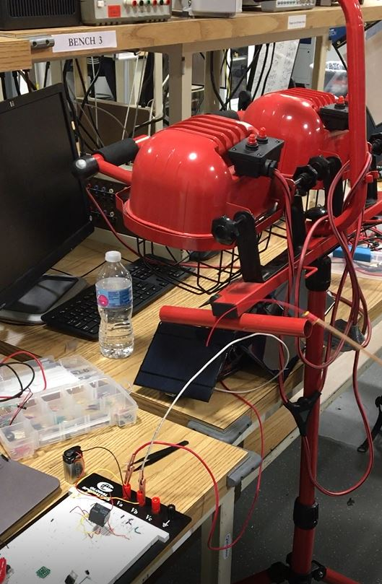
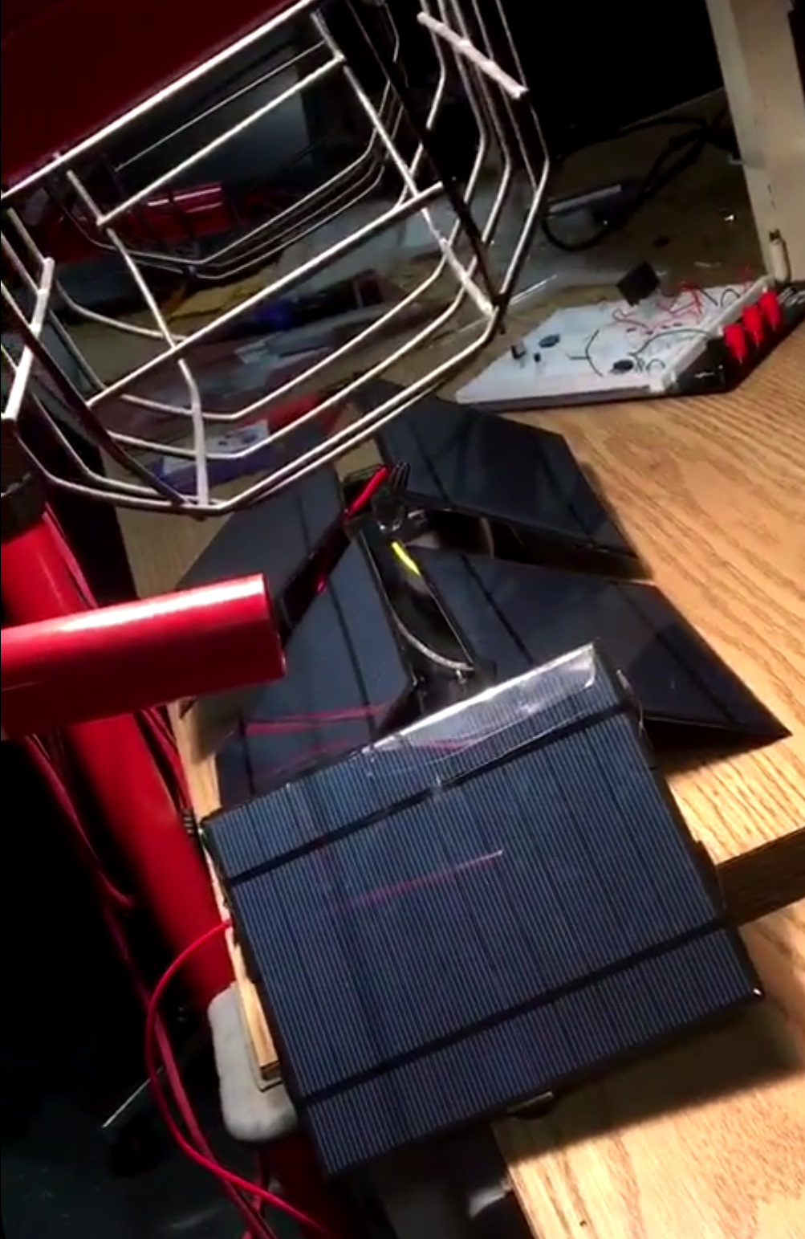
Testing Solar Cells
Solar lamps mimic sun
Arduino Uno controls switching
Figure 11: Illuminated solar cells
Figure 12: Solar cell test setup

Slide 16
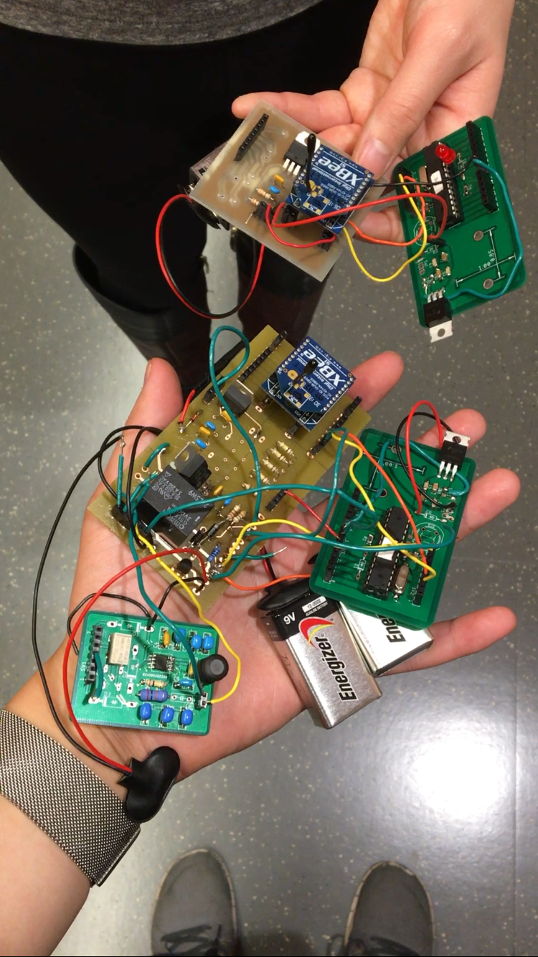
Module Integration
Buck converter, relay, and XBee modules
Figure 13: Fully integrated modules

Slide 17
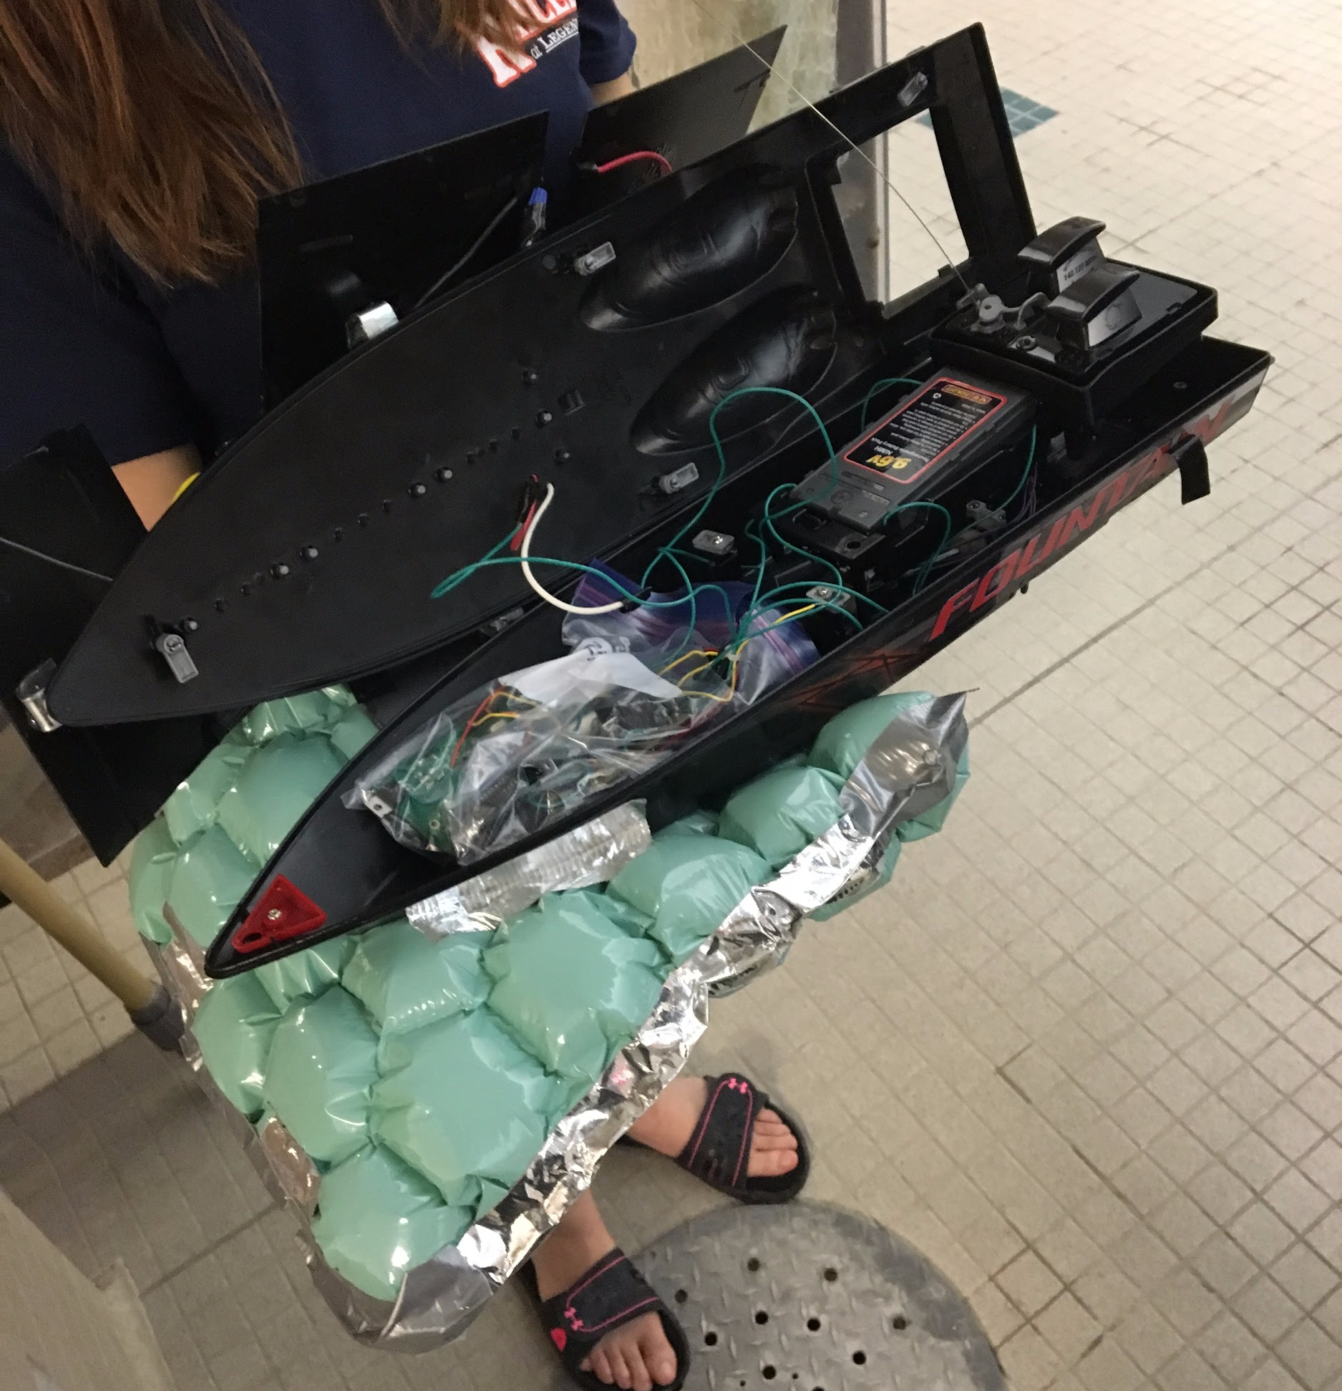
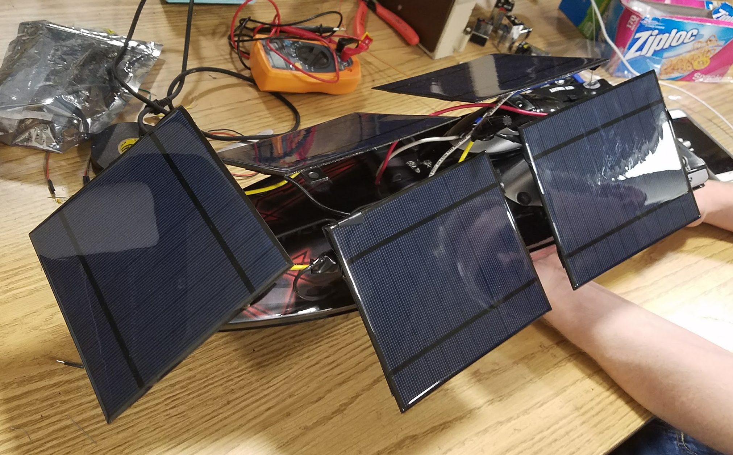
Boat Integration
Enclosure for PCBs
5 mounted solar panels
Extra floatation
Figure 14: Boat fully integrated with design

Slide 18
Figure 15: Full demo video

Slide 19
Future Improvements
Solar cells with greater current capacity
Single PCB to go inside boat
Smaller PCB and display for RC
Proper waterproof enclosure
Increase RSSI sensitivity
Better floatation

Slide 20
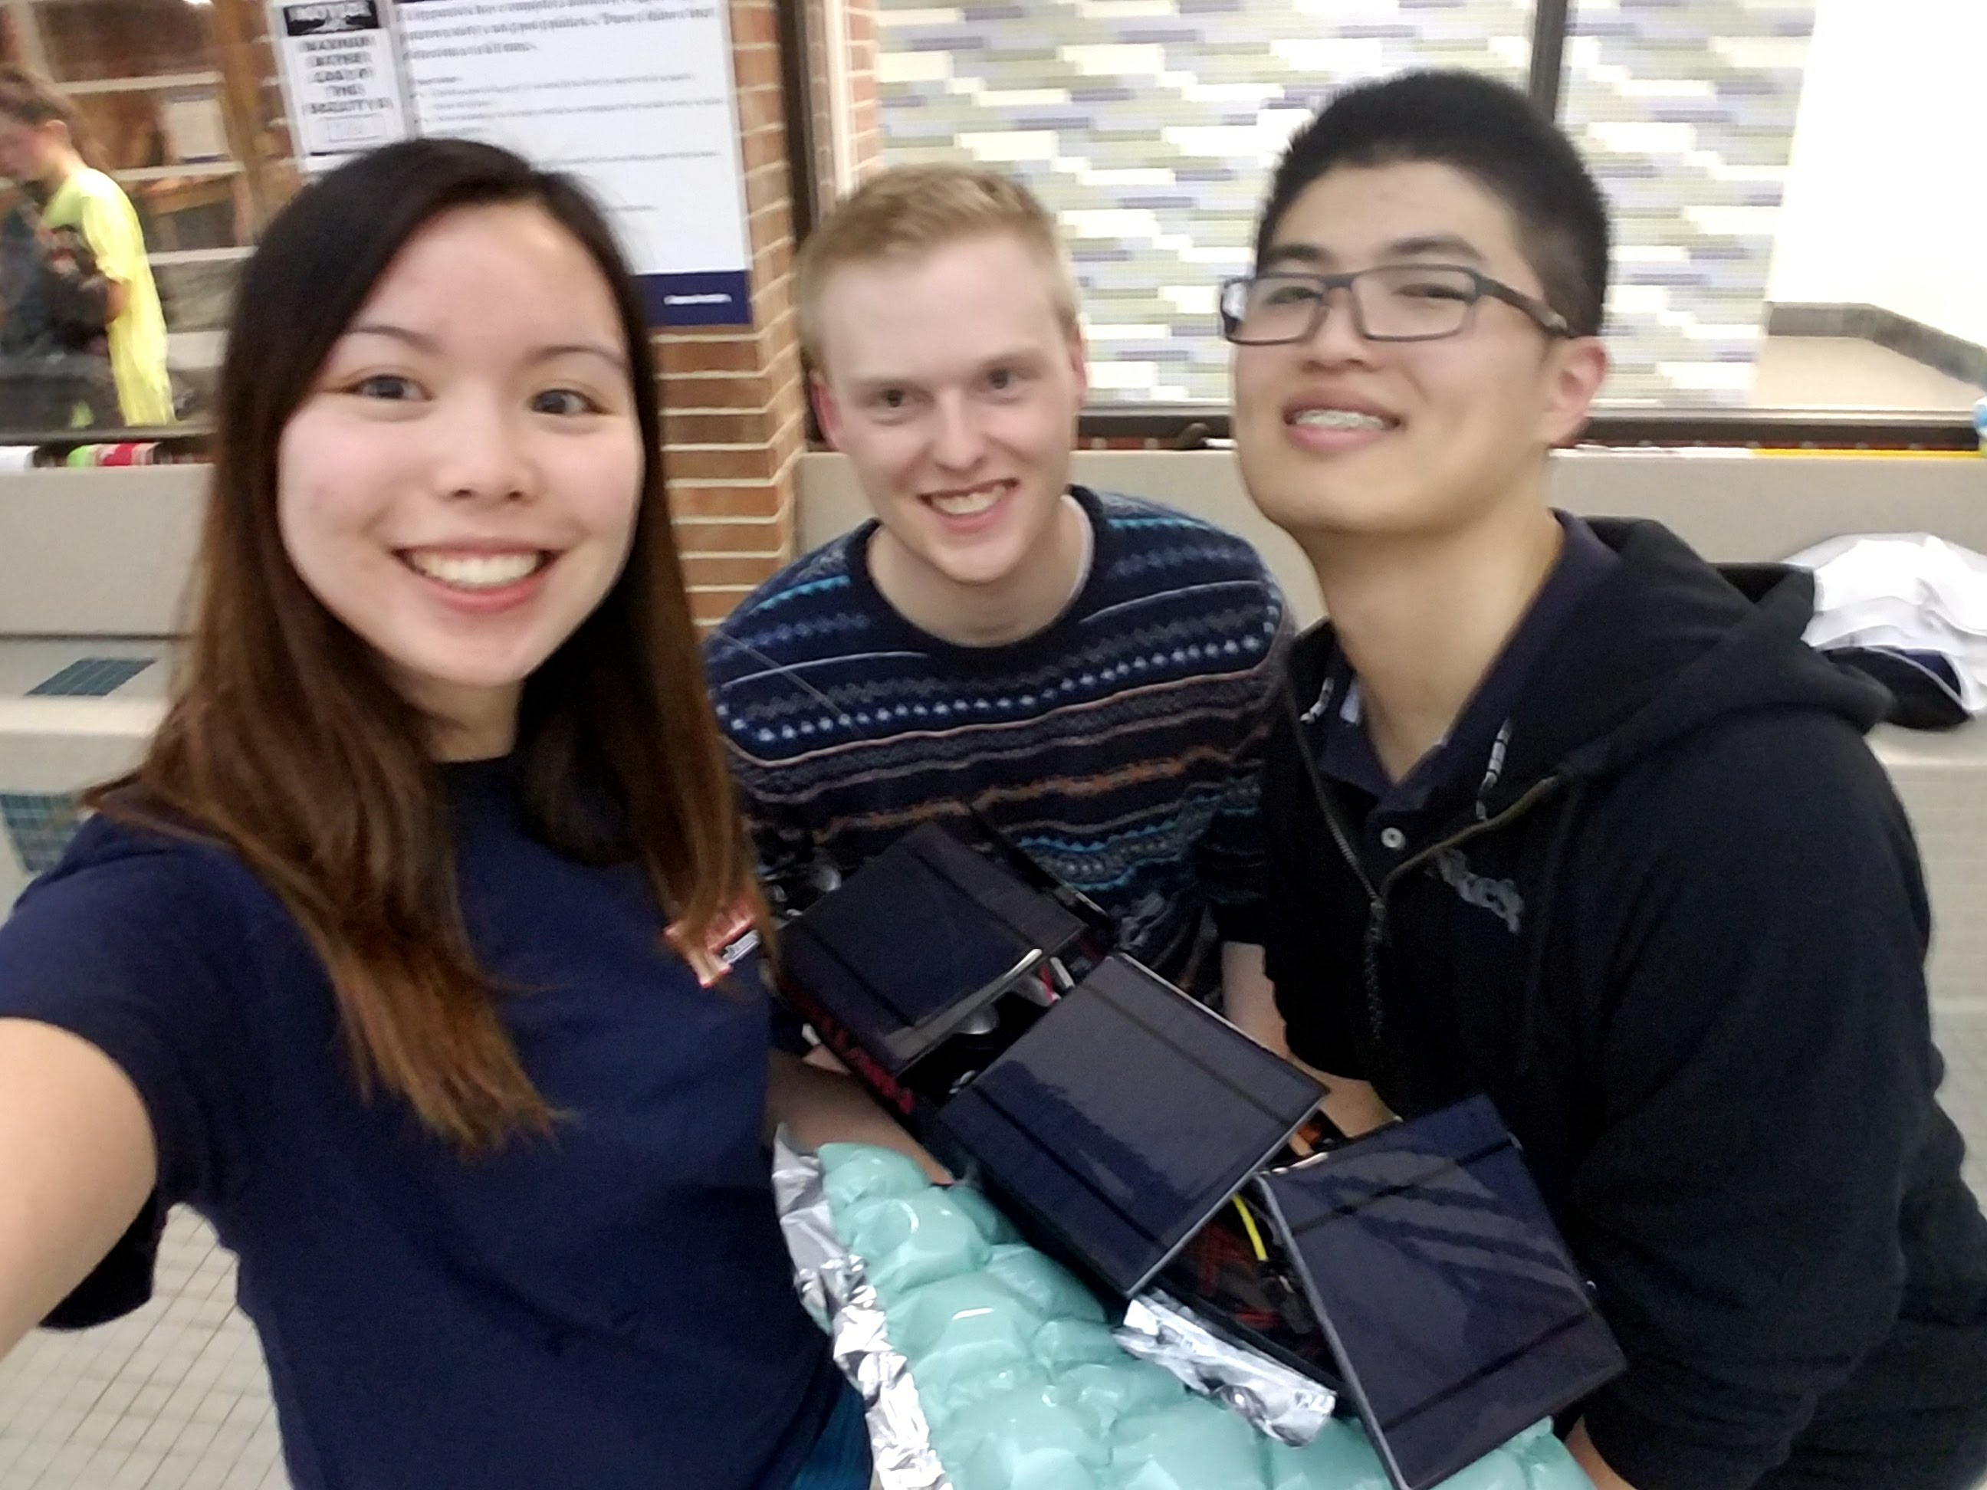
Thank you!
Yamuna Phal
Professor Xiaogang (Oliver) Chen
Professor Arne Fliflet
Professor Arijit Banerjee
Professor Michael Oelze
Figure 16: ECE 445 Team #5

