Slide 1
Human Turntable
Daniel Kalinin, Daniel Zhang, Jacob Taylor
Team 9

Slide 2
Introduction
Purpose
Human Turntable to help Ryan Corey, former TA
Binaural audio mapping
For development of better hearing aids

Slide 3
Objectives
Rotate human being up to 300 pounds
Silent when not rotating
Omnidirectional precise rotations

Slide 4
General Overview
Turntable subsystems
Controls
Motor Driver
Stepper Motor
Power Supply
Software
Physical Structure

Slide 5
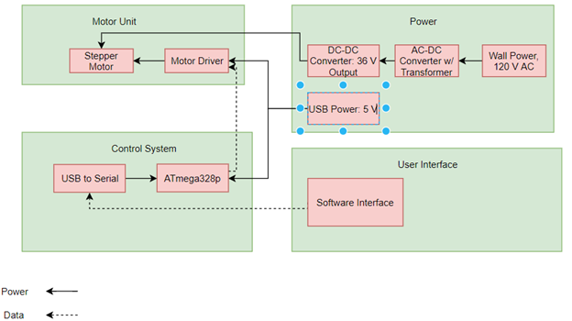
Block Diagram

Slide 6
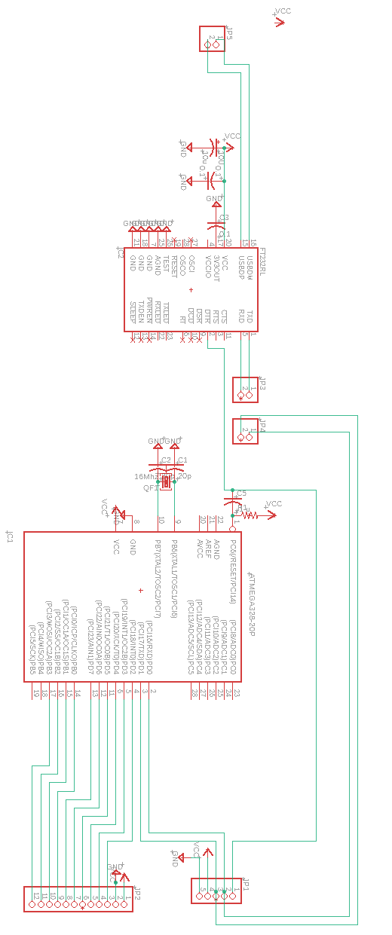
Controls
ATmega328P Microcontroller
Serial to USB via FTDI IC
Serial input from COM port

Slide 7
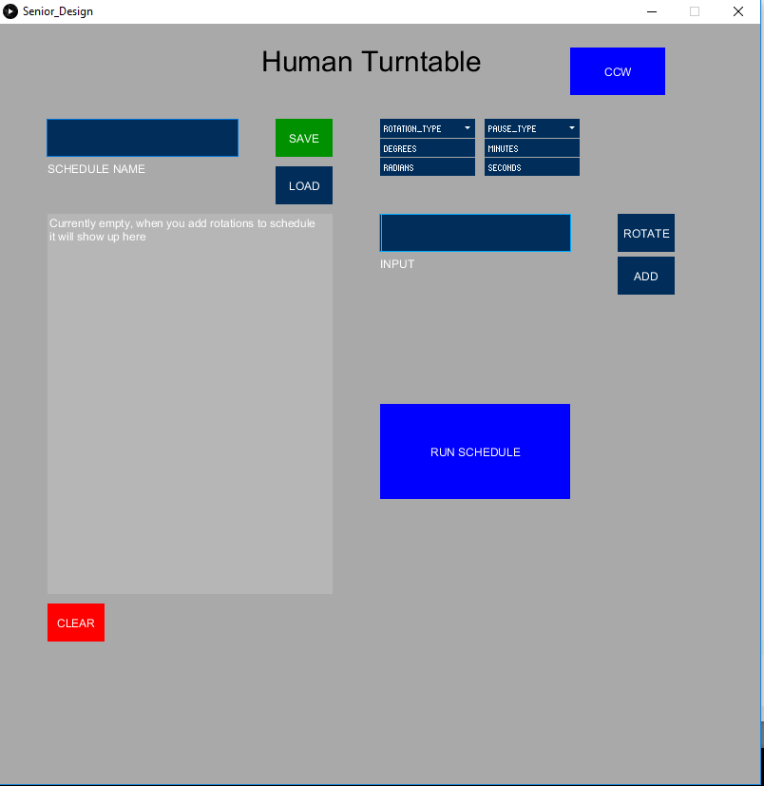
User Interface

Slide 8
Software
Processing and Arduino
https://processing.org/
Java
Serial
Always alternate between rotate and pause

Slide 9
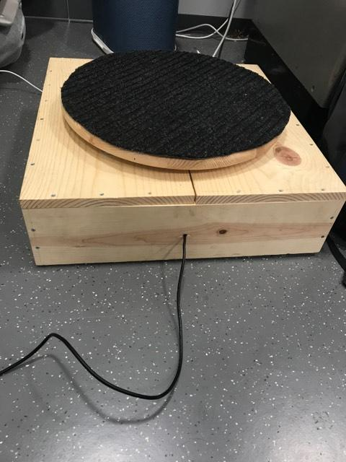
Physical Structure and Motoring
2 bearing types
Lazy Susan Bearing (~400 lbs)
Load Transfer Balls (~30 lbs ea.)
Components mounted inside, sealed
Made from metal to improve quality

Slide 10
Conclusion
All subsystems worked properly
Entire project was able to function and meet all 3 objectives
Improvements:
Machined Metal Turntable Design
Motor with less “give” between steps

Slide 11
Questions?

